Slide 1

Lecture 16
ALGORITHMS & DATA STRUCTURES
DEPARTMENT OF COMPUTING
PLEASE, DOWNLOAD WORKSHEET 16
February 25, 2019

Slide 2
Outline
Review of last week
Fixed Point, Signed Numbers, Counting Bits
Multiplication
Floating Point Representation

Slide 3
Outline
Review of last week
Fixed Point, Signed Numbers, Counting Bits
Multiplication
Floating Point Representation

Slide 4
Graphs Quiz
Final marks: 30+70*(score/10)²
124 students attempted the quiz. Average final mark equal to 67
18 (15%) students got over 90 ☺
Number of students
Mark range
This quiz closed at 4PM on Friday 15th February

Slide 5
Graphs Lab. Submission (closed)
123 submissions; average mark 60
15 (12%) students got over 90 ☺
Number of students
Mark range
This lab. submission closed at 4PM on Friday 15th February

Slide 6
First-Half Term Summary
Average marks for quizzes & lab submissions

Slide 7
Last lecture: 1-minute feedback
32 people gave written feedback at the end of last lecture

Slide 8
Last lecture: 1-minute feedback
32 people gave written feedback at the end of last lecture
These are the 5 most mentioned activities (I’ll do my best to keep on doing them)

Slide 9
Last lecture: 1-minute feedback
32 people gave written feedback at the end of last lecture
These are the 6 most mentioned activities

Slide 10
Last lecture: 1-minute feedback
32 people gave written feedback at the end of last lecture
These are the 5 most mentioned activities

Slide 11
Last lecture: 1-minute feedback
Things I can do now (second half of term) ☺
Keep on:
Not going for:
Working extra to:
making detailed/visual slides with step-by-step code
doing live demos/practical examples if possible (I am time/schedule-constrained on this)
making lectures as interactive as possible (I am time/schedule-constrained on this)
using Kahoots to detect misunderstood points to then explain them
picking students for live demos
Kahoots without explanation
giving you some extra explanations for labs
Giving you good links on the topics covered in lectures (If successful, really good and easy to understand material on A&DS is scarce at the moment in the Internet)

Slide 12
Last lecture: 1-minute feedback
Things I cannot do now (second half of term) ☹
Modifying the content of lectures (for slower pace; lectures are already setup for this term)
Changing the content/context of the labs (the system is automatized and already setup)
Prepare more material/homework (this term I am focused in producing detailed slides, next term I should have time to produce solved exercises)
Recaps (I am time-constrained on this, but it is something I should definitely consider for next term)

Slide 13
Schedule Term2 (second half)
Mon Tue Wed Thu Fri
Week 16
25-Feb 26-Feb 27-Feb 28-Feb 01-Mar
Lecture 16 Lab.16 Lab.16 Lab. Submission random numbers
YOU ARE HERE
Office hours 2-4pm
Week 17
04-Mar 05-Mar 06-Mar 07-Mar 08-Mar
Lecture 17 Lab.17 Lab.17 Numbers quiz
ESSAY, 1st submission
Office hours 2-4pm
Week 18
11-Mar 12-Mar 13-Mar 14-Mar 15-Mar
Lecture 18 Lab.18 Lab.18 Recursive functions quiz
Lab. Submission Big Integers
ESSAY, Peer assessment
Office hours 2-4pm
Week 19
18-Mar 19-Mar 20-Mar 21-Mar 22-Mar
NO LECTURE Lab.19 Lab.19 Strings quiz
On demand, Skype
Week 20
25-Mar 26-Mar 27-Mar 28-Mar 29-Mar
NO LECTURE Lab.20 Lab.20 General Knowledge quiz
Lab. Submission Lab. Exercise
ESSAY, Final submission
On demand, Skype
END OF TERM

Slide 14
Last lecture: Path Finding
Random Number Generators
Comparison Sorts
Shuffling Algorithms

Slide 15
Last lecture: Path Finding
Random Number Generators
Comparison Sorts
Shuffling Algorithms
Linear Congruential Generator
X _{i+1}=(a*X_{i}+c) mod m
seed
X₁=(aX₀+c) mod m
X₂=(aX₁+c) mod m
X₃=(aX₂+c) mod m
Xorshift Generator
function xorshift(a,b,c,seed)
y=seed
y=y xor (y<<a)
y=y xor (y>>b)
y=y xor (y<<c)
return y
end function

Slide 16
Last lecture: Path Finding
Random Number Generators
Comparison Sorts
Shuffling Algorithms
Linear Congruential Generator
X _{i+1}=(a*X_{i}+c) mod m
Bogosort (Stupid sort)
Insertion Sort
Mergesort
Quicksort
Sorting algorithms that use a comparison operator (e.g. >=, <=)
seed
X₁=(aX₀+c) mod m
X₂=(aX₁+c) mod m
X₃=(aX₂+c) mod m
Xorshift Generator
function xorshift(a,b,c,seed)
y=seed
y=y xor (y<<a)
y=y xor (y>>b)
y=y xor (y<<c)
return y
end function

Slide 17
Last lecture: Path Finding
Random Number Generators
Comparison Sorts
Shuffling Algorithms
Linear Congruential Generator
X _{i+1}=(a*X_{i}+c) mod m
Bogosort (Stupid sort)
Insertion Sort
Mergesort
Quicksort
Sorting algorithms that use a comparison operator (e.g. >=, <=)
BadShuffle 1
BadShuffle2
Fisher-Yates algorithm ✔
Algorithms that generate a collection reordered according to a uniformly distributed permutation
seed
X₁=(aX₀+c) mod m
X₂=(aX₁+c) mod m
X₃=(aX₂+c) mod m
Xorshift Generator
function xorshift(a,b,c,seed)
y=seed
y=y xor (y<<a)
y=y xor (y>>b)
y=y xor (y<<c)
return y
end function

Slide 18
Outline
Review of last week
Fixed Point Representation
Multiplication
Floating Point Representation

Slide 19
Quick recap of binary integer representation
In decimal (base 10) representation….
10²
2 x 10²+4 x 10¹+3 x 10⁰
10¹
10⁰
2 4 3

Slide 20
Quick recap of binary integer representation
In binary (base 2) representation….
1 x 2²+0 x 2¹+1 x 2⁰
2²
2¹
2⁰
1 0 1

Slide 21
Unsigned (positive) integers
b₃ | b₂ | b₁ | b₀
0 | 0 | 0 | 0
0 | 0 | 0 | 1
0 | 0 | 1 | 0
0 | 0 | 1 | 1
0 | 1 | 0 | 0
0 | 1 | 0 | 1
0 | 1 | 1 | 0
0 | 1 | 1 | 1
1 | 0 | 0 | 0
1 | 0 | 0 | 1
1 | 0 | 1 | 0
1 | 0 | 1 | 1
1 | 1 | 0 | 0
1 | 1 | 0 | 1
1 | 1 | 1 | 0
1 | 1 | 1 | 1
Decimal equivalent
2³x0 + 2²x0 + 2¹x0 + 2⁰x0 = 0
2³x0 + 2²x0 + 2¹x0 + 2⁰x1 = 1
2³x0 + 2²x0 + 2¹x1 + 2⁰x0 = 2
2³x0 + 2²x0 + 2¹x1 + 2⁰x1 = 3
2³x0 + 2²x1 + 2¹x0 + 2⁰x0 = 4
2³x0 + 2²x1 + 2¹x0 + 2⁰x1 = 5
2³x0 + 2²x01+ 2¹x1 + 2⁰x0 = 6
2³x0 + 2²x1 + 2¹x1 + 2⁰x1 = 7
2³x1 + 2²x0 + 2¹x0 + 2⁰x0 = 8
2³x1 + 2²x0 + 2¹x0 + 2⁰x1 = 9
2³x1 + 2²x0 + 2¹x1 + 2⁰x0 = 10
2³x1 + 2²x0 + 2¹x1 + 2⁰x1 = 11
2³x1 + 2²x1 + 2¹x0 + 2⁰x0 = 12
2³x1 + 2²x1 + 2¹x0 + 2⁰x1 = 13
2³x1 + 2²x1+ 2¹x1 + 2⁰x0 = 14
2³x1 + 2²x1 + 2¹x1 + 2⁰x1 = 15

Slide 22
Binary numbers
1010
We tend to think of a binary word as a positive integer
However, we can give them other interpretations to represent rational or negative numbers.

Slide 23
What about rational numbers?
143.25
Using as inspiration the representation of fractional values in the decimal world (e.g. 2.5), how could you represent fractions in binary?
(worksheet 1.1)

Slide 24
Binary representation of rationals
In decimal:
143.25
10²
10¹
10⁰
10⁻¹
10⁻²
1 x 10² + 4 x 10¹ + 3 x 10⁰ + 2 x 10⁻¹ + 5 x 10⁻²
We use a decimal point to signalise where the fractional part starts

Slide 25
Binary representation of rationals
In decimal:
143.25
10²
10¹
10⁰
10⁻¹
10⁻²
1 x 10² + 4 x 10¹ + 3 x 10⁰ + 2 x 10⁻¹ + 5 x 10⁻²
We use a decimal point to signalise where the fractional part starts
In binary:
10001111.01
2⁶
2⁴
2⁷
2⁵
2³
2²
2¹
2⁰
2⁻¹
2⁻²
1 x 2⁷ + 0 x 2⁶+ 0 x 2⁵ + 0 x 2⁴ + 1 x 2³ + 1x 2² + 1 x 2¹ + 1 x 2⁰ + 0 x 2⁻¹ + 1 x 2⁻²
We use a binary point to signalise where the fractional part starts

Slide 26
A brief note on the radix point
The radix point is the symbol used to separate the integer part from the fractional part in any base (in English speaking countries that symbol is a dot)
In base 10, the radix point is called decimal point
In base 2, the radix point is called binary point
https://en.wikipedia.org/wiki/Radix_point

Slide 27
Fixed-point binary representation
A fixed-point binary number representation has a fixed position for the binary point

Slide 28
Fixed-point binary representation
A fixed-point binary number representation has a fixed position for the binary point
For example: an unsigned rational number defined as U(6,2) has 6 integer bits and 2 fractional bits:
b₅ b₄ b₃ b₂ b₁ b₀ b₋₁ b₋₂
0 0 1 1 0 0.0 1
2⁵ 2⁴ 2³ 2² 2¹ 2⁰ 2⁻¹ 2⁻²

Slide 29
Fixed-point binary representation
A fixed-point binary number representation has a fixed position for the binary point
For example: an unsigned rational number defined as U(6,2) has 6 integer bits and 2 fractional bits:
b₅ b₄ b₃ b₂ b₁ b₀ b₋₁ b₋₂
0 0 1 1 0 0.0 1
2⁵ 2⁴ 2³ 2² 2¹ 2⁰ 2⁻¹ 2⁻²
0 x 2⁵ + 0 x 2⁴ + 1 x 2³ + 1 x 2² + 0 x 2¹ + 0 x 2⁰ + 0 x 2⁻¹ + 1 x 2⁻²
12.25 (in decimal)

Slide 30
Quick check on understanding
What is the decimal representation of the following fixed-point binary number U(4,4)?
10111010
a) 186 b) 11.625 c) 46.5 d)11.5
(worksheet 1.2)

Slide 31
Quick check on understanding
What is the decimal representation of the following fixed-point binary number U(4,4)?
b₃ b₂ b₁ b₀ b₋₁b₋₂ b₋₃b₋₄
1 0 1 1.1 0 1 0
2³ 2² 2¹ 2⁰ 2⁻¹ 2⁻² 2⁻³2⁻⁴
a) 186 b) 11.625 c) 46.5 d)11.5

Slide 32
Quick check on understanding
What is the decimal representation of the following fixed-point binary number U(4,4)?
b₃ b₂ b₁ b₀ b₋₁b₋₂ b₋₃b₋₄
1 0 1 1.1 0 1 0
2³ 2² 2¹ 2⁰ 2⁻¹ 2⁻² 2⁻³2⁻⁴
1 x 2³ + 0 x 2² + 1 x 2¹ + 1 x 2⁰ + 1 x 2⁻¹ + 0 x 2⁻² + 1 x 2⁻³ + 0 x 2⁻⁴
11.625 (in decimal)
a) 186 b) 11.625 c) 46.5 d)11.5

Slide 33
Quick check on understanding
What is the decimal representation of the following fixed-point binary number U(6,2)?
1 0 1 1 1 0 1 0
a) 186 b) 11.625 c) 46.5 d)11.5

Slide 34
Quick check on understanding
What is the decimal representation of the following fixed-point binary number U(6,2)?
b₅ b₄ b₃ b₂ b₁ b₀ b₋₁b₋₂
1 0 1 1 1 0.1 0
2⁵ 2⁴ 2³ 2² 2¹ 2⁰ 2⁻¹2⁻²
a) 186 b) 11.625 c) 46.5 d)11.5

Slide 35
Quick check on understanding
What is the decimal representation of the following fixed-point binary number U(6,2)?
b₅ b₄ b₃ b₂ b₁ b₀ b₋₁b₋₂
1 0 1 1 1 0.1 0
2⁵ 2⁴ 2³ 2² 2¹ 2⁰ 2⁻¹2⁻²
1 x 2⁵ + 0 x 2⁴ + 1 x 2³ + 1 x 2² + 1 x 2¹ + 0 x 2⁰ + 1 x 2⁻¹ + 0 x 2⁻²
46.5 (in decimal)
a) 186 b) 11.625 c) 46.5 d)11.5

Slide 36
Quick check on understanding
What is the decimal representation of the following fixed-point binary number U(8,0)?
1 0 1 1 1 0 1 0
a) 186 b) 11.625 c) 46.5 d)11.5

Slide 37
Quick check on understanding
What is the decimal representation of the following fixed-point binary number U(8,0)?
b₇ b₆ b₅ b₄ b₃ b₂ b₁ b₀
1 0 1 1 1 0 1 0
2⁷ 2⁶ 2⁵ 2⁴ 2³ 2² 2¹ 2⁰
a) 186 b) 11.625 c) 46.5 d)11.5

Slide 38
Quick check on understanding
What is the decimal representation of the following fixed-point binary number U(8,0)?
b₇ b₆ b₅ b₄ b₃ b₂ b₁ b₀
1 0 1 1 1 0 1 0
2⁷ 2⁶ 2⁵ 2⁴ 2³ 2² 2¹ 2⁰
1 x 2⁷ + 0 x 2⁶ + 1 x 2⁵ + 1 x 2⁴ + 1 x 2³ + 0 x 2² + 1 x 2¹ + 0 x 2⁰
186 (in decimal)
a) 186 b) 11.625 c) 46.5 d)11.5

Slide 39
Advantages of fixed-point
Fixed-point representation can be used to represent fractional and integer values ( U(x,0) )
The same binary word can represent different numbers:
1 0 1 1 1 0 1 0
U(0,8)
0.7265625
U(4,4)
11.625
U(8,0)
186

Slide 40
Advantages of fixed-point
No need for hardware changes:
Same number of bits (you don´t need an extra bit for the radix point, its position is pre-defined for the machine)
Same operations (you don´t need to change the circuits)

Slide 41
Advantages of fixed-point
No need for hardware changes:
Same number of bits (you don´t need an extra bit for the radix point, its position is pre-defined for the machine)
Same operations (you don´t need to change the circuits)
EXAMPLE: 4-bit words
U(4,0)
Sum of two integers: 1 and 5
U(3,1)
Sum of 0.5 and 2.5
U(2,2)
Sum of 0.25 and 1.25
0001
(1)
0001
(000.1 =>0.5)
0001
(00.01 =>0.25)
+
0101
(5)
+
0101
(010.1 =>2.5)
+
0101
(01.01 =>1.25)
0110
(6)
0110
(011.0 => 3)
0110
(01.10 => 1.5)

Slide 42
Overflow
Consider 4-bit binary words => The maximum integer number you can represent is 15.
What happens when you try to sum the integers 9 and 13?
U(4,0)
Sum of two integers: 9 and 13
1001
(9)
+
1101
(13)
1
0110
(6 instead of 22)
You get a wrong result
Overflow!
You don´t have space to store this bit ☹
By the way, this was the bug in the binary search implementation using
(lo+high)/2

Slide 43

Famous overflow bugs in games
Donkey Kong Arcade Game
8-bit registers (=> maximum number you can represent: 255)
Bonus= Level *10 +40
When you are in level 21 => Bonus= 250
1 | 1 | 1 | 1 | 1 | 0 | 1 | 0
No problem representing 250 with 8-bits words
For more examples of overflow bugs, check on https://en.wikipedia.org/wiki/Integer_overflow

Slide 44
Famous overflow bugs in games
Donkey Kong Arcade Game
8-bit registers (=> maximum number you can represent: 255)
Bonus= Level *10 +40
When you are in level 21 => Bonus= 250
1 | 1 | 1 | 1 | 1 | 0 | 1 | 0
No problem representing 250 with 8-bits words
BUT, you could not advance past level 22 due to integer overflow!
Bonus= 22*10 +40= 260: too big for a 8-bit word
(220)
1 | 1 | 0 | 1 | 1 | 1 | 0 | 0
(40)
+
0 | 0 | 1 | 0 | 1 | 0 | 0 | 0
Overflow
(1)
0 | 0 | 0 | 0 | 0 | 1 | 0 | 0
For more examples of overflow bugs, check on https://en.wikipedia.org/wiki/Integer_overflow

Slide 45
Signed Integers
How can we represent negative numbers in binary?

Slide 46
Signed Integers
Sign-magnitude
One’s complement
Two’s complement
1 bit is used for the sign
Negative number: invert very bit
Negative number: ¬x+1

Slide 47
Signed Integers
Sign-magnitude
One’s complement
Two’s complement
1 bit is used for the sign
Negative number: invert every bit
Negative number: ¬x+1
Binary number | Decimal
0000 | 0
0001 | 1
0010 | 2
0011 | 3
0100 | 4
0101 | 5
0110 | 6
0111 | 7
1000 | -0
1001 | -1
1010 | -2
1011 | -3
1100 | -4
1101 | -5
1110 | -6
1111 | -7
Magnitude bits
Sign bit

Slide 48
Signed Integers
Sign-magnitude
One’s complement
Two’s complement
1 bit is used for the sign
Negative number: invert every bit
Negative number: ¬x+1
Binary number | Decimal
0000 | 0
0001 | 1
0010 | 2
0011 | 3
0100 | 4
0101 | 5
0110 | 6
0111 | 7
1000 | -0
1001 | -1
1010 | -2
1011 | -3
1100 | -4
1101 | -5
1110 | -6
1111 | -7
Magnitude bits
Sign bit
Two zeros (not good)

Slide 49
Signed Integers
Sign-magnitude
One’s complement
Two’s complement
1 bit is used for the sign
Negative number: invert every bit
Negative number: ¬x+1
Binary number | Decimal
0000 | 0
0001 | 1
0010 | 2
0011 | 3
0100 | 4
0101 | 5
0110 | 6
0111 | 7
1000 | -0
1001 | -1
1010 | -2
1011 | -3
1100 | -4
1101 | -5
1110 | -6
1111 | -7
Magnitude bits
Sign bit
Two zeros (not good)
Not useful for arithmetic operations (not good at all):
U(4,0)
Sum of two integers: 5 and -1
0101
(5)
+
1001
(-1)
1110
(-6 instead of 4)

Slide 50
Signed Integers
Sign-magnitude
One’s complement
Two’s complement
1 bit is used for the sign
Negative number: invert every bit
Negative number: ¬x+1
Binary number | Decimal
0000 | 0
0001 | 1
0010 | 2
0011 | 3
0100 | 4
0101 | 5
0110 | 6
0111 | 7
1000 | -0
1001 | -1
1010 | -2
1011 | -3
1100 | -4
1101 | -5
1110 | -6
1111 | -7
Binary number | Decimal
0000 | 0
0001 | 1
0010 | 2
0011 | 3
0100 | 4
0101 | 5
0110 | 6
0111 | 7
1000 | -7
1001 | -6
1010 | -5
1011 | -4
1100 | -3
1101 | -2
1110 | -1
1111 | -0

Slide 51
Signed Integers
Sign-magnitude
One’s complement
Two’s complement
1 bit is used for the sign
Negative number: invert every bit
Negative number: ¬x+1
Binary number | Decimal
0000 | 0
0001 | 1
0010 | 2
0011 | 3
0100 | 4
0101 | 5
0110 | 6
0111 | 7
1000 | -0
1001 | -1
1010 | -2
1011 | -3
1100 | -4
1101 | -5
1110 | -6
1111 | -7
Binary number | Decimal
0000 | 0
0001 | 1
0010 | 2
0011 | 3
0100 | 4
0101 | 5
0110 | 6
0111 | 7
1000 | -7
1001 | -6
1010 | -5
1011 | -4
1100 | -3
1101 | -2
1110 | -1
1111 | -0
-x is obtained by ¬x
¬: Bitwise NOT operator

Slide 52
Signed Integers
Sign-magnitude
One’s complement
Two’s complement
1 bit is used for the sign
Negative number: invert every bit
Negative number: ¬x+1
Binary number | Decimal
0000 | 0
0001 | 1
0010 | 2
0011 | 3
0100 | 4
0101 | 5
0110 | 6
0111 | 7
1000 | -0
1001 | -1
1010 | -2
1011 | -3
1100 | -4
1101 | -5
1110 | -6
1111 | -7
Binary number | Decimal
0000 | 0
0001 | 1
0010 | 2
0011 | 3
0100 | 4
0101 | 5
0110 | 6
0111 | 7
1000 | -7
1001 | -6
1010 | -5
1011 | -4
1100 | -3
1101 | -2
1110 | -1
1111 | -0
-x is obtained by ¬x
¬: Bitwise NOT operator
Drawbacks:
Two zeros
Arithmetic operations still require adapting hardware.
Sum of two integers: 5 and -1
0101
(5)
+
1110
(-1)
(1) 0011
(3 instead of 4)
overflow

Slide 53
Signed Integers
Sign-magnitude
One’s complement
Two’s complement
1 bit is used for the sign
Negative number: invert every bit
Negative number: ¬x+1
Binary number | Decimal
0000 | 0
0001 | 1
0010 | 2
0011 | 3
0100 | 4
0101 | 5
0110 | 6
0111 | 7
1000 | -0
1001 | -1
1010 | -2
1011 | -3
1100 | -4
1101 | -5
1110 | -6
1111 | -7
Binary number | Decimal
0000 | 0
0001 | 1
0010 | 2
0011 | 3
0100 | 4
0101 | 5
0110 | 6
0111 | 7
1000 | -7
1001 | -6
1010 | -5
1011 | -4
1100 | -3
1101 | -2
1110 | -1
1111 | -0
Used in current systems
Only one zero
No need to modify hardware used for unsigned

Slide 54
Signed Integers: Two’s complement
To find the two’s complement of a negative number (-x):
Add 1 to ¬x
Using 3-bit binary words, calculate the two’s complement of the following numbers:
x | Two’s complement
0
1
2
3
-4
-5
-6
-7
(worksheet 1.3)

Slide 55
Signed Integers: Two’s complement
To find the two’s complement of a negative number (-x):
Add 1 to ¬x
EXAMPLE WITH A 3-BIT BINARY WORD
x | ¬x | Two’s C (¬x+1)
0 | 000 | 000
1 | 001 | 001
2 | 010 | 010
3 | 011 | 011
-4 | 011 | (011+001)= 100
-3 | 100 | (100+001)= 101
-2 | 101 | (101+001)= 110
-1 | 110 | (110+001) =111

Slide 56
Signed Integers: Two’s complement
To find the two’s complement of a negative number (-x):
Add 1 to ¬x
EXAMPLE WITH A 3-BIT BINARY WORD
x | ¬x | Two’s C (¬x+1)
0 | 000 | 000
1 | 001 | 001
2 | 010 | 010
3 | 011 | 011
-4 | 011 | (011+001)= 100
-3 | 100 | (100+001)= 101
-2 | 101 | (101+001)= 110
-1 | 110 | (110+001) =111
ADVANTAGES
Only one zero
Positive numbers start with 0
Negative numbers start with 1
Arithmetic operations do not require hardware modification

Slide 57
Signed Integers: Two’s complement
Same arithmetic's as unsigned integers
x | Two’s Complement
0 | 000
1 | 111
2 | 110
3 | 011
-4 | 100
-3 | 101
-2 | 110
-1 | 111
Sum of two integers: 3 and -1
011
(3)
+
111
(-1)
(1) 010
(2, correct)
Sum of two integers: -2 + -2
110
(-2)
+
110
(-2)
(1) 100
(-4, correct)

Slide 58
Overflow in Two’s complement
Overflow occurs when the result of an operation is out of the maximum representable number
x | Two’s Complement
0 | 000
1 | 111
2 | 110
3 | 011
-4 | 100
-3 | 101
-2 | 110
-1 | 111
Example of an operation that would return a wrong results because of overflow in a 3-bit binary word system:
x=3
y=3+1
011
(x=3)
+
001
(1)
100
(-4, incorrect)
You, as a programmer, must be very careful in avoiding operations that might result in overflow.
Take home message: Know the limits of the data types you use

Slide 59
Ranges in two’s complement
For N-bit word:
The maximum positive integer is 2^{(N-1)}-1
the maximum negative integer is -2^{(N-1)}
x | Two’s Complement
0 | 000
1 | 001
2 | 010
3 | 011
-4 | 100
-3 | 101
-2 | 110
-1 | 111
In a 3-bit word representation:
- Maximum positive number: 2²-1=3
-Maximum integer number: -2²=-4

Slide 60
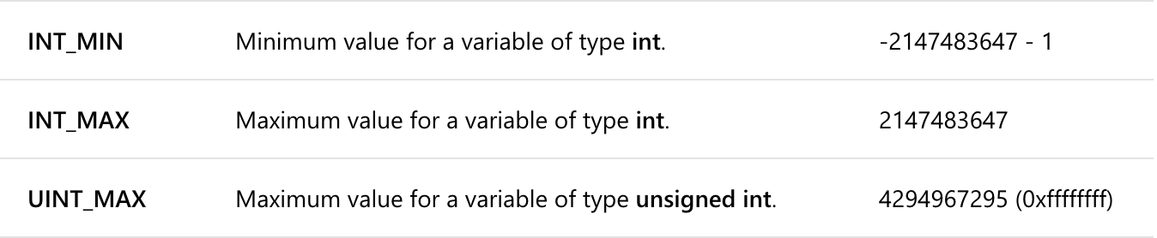
Ranges in two’s complement
For an N-bit word:
The maximum positive integer is 2^{(N-1)}-1
the maximum negative integer is -2^{(N-1)}
-2⁽³²⁻¹⁾
C++
2⁽³²⁻¹⁾-1
https://docs.microsoft.com/en-us/cpp/c-language/cpp-integer-limits?view=vs-2017
2⁽³²⁾-1
Be very careful when you are close to the limits, as you can inadvertently produce overflow

Slide 61
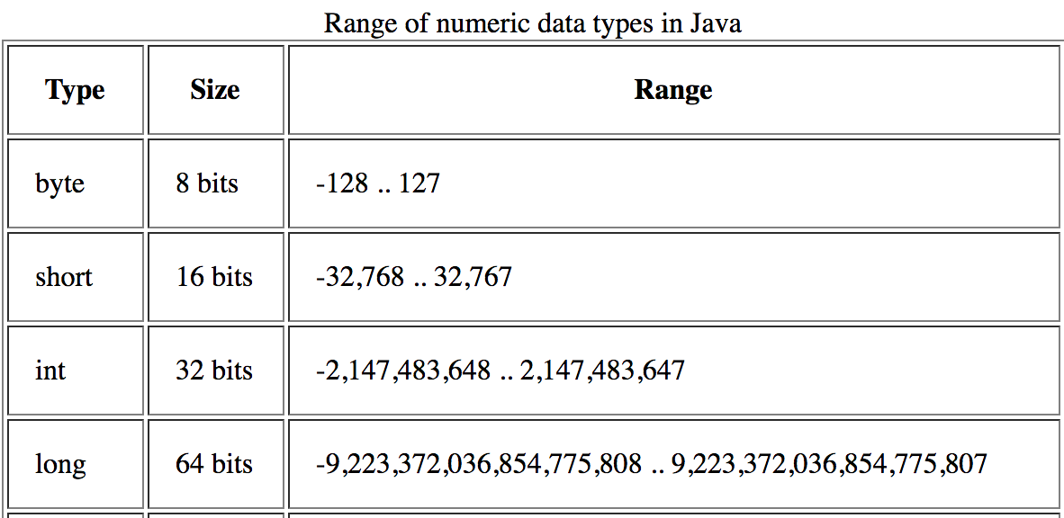
Ranges in two’s complement
For an N-bit word:
The maximum positive integer is 2^{(N-1)}-1
the maximum negative integer is -2^{(N-1)}
Java
-2⁽³²⁻¹⁾
2⁽³²⁻¹⁾-1
No unsigned int in Java

Slide 62
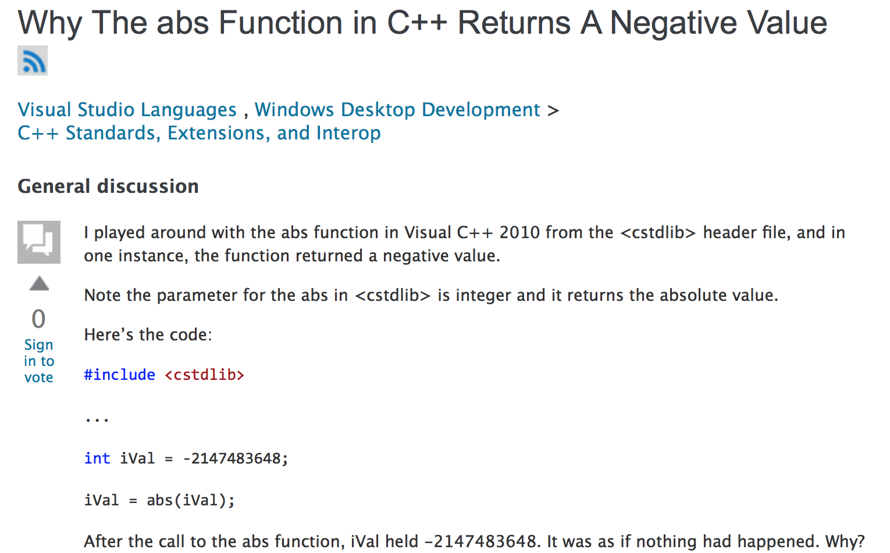
Maximum range and abs() function
https://social.msdn.microsoft.com/Forums/en-US/b2b087ad-c52c-4016-8e18-e25592b0bf8f/why-the-abs-function-in-c-returns-a-negative-value?forum=vclanguage

Slide 63
Maximum range and abs() function
https://social.msdn.microsoft.com/Forums/en-US/b2b087ad-c52c-4016-8e18-e25592b0bf8f/why-the-abs-function-in-c-returns-a-negative-value?forum=vclanguage

Slide 64
Maximum range and abs() function
Execute, step-by-step, the function abs (that returns the absolute value of x) to see what happens when the maximum negative integer is given as an input
function neg(x)
r ← ¬x
return r + 1
end function
function abs(x)
if x < 0 then
return neg(x)
else
return x
end if
end function

Slide 65
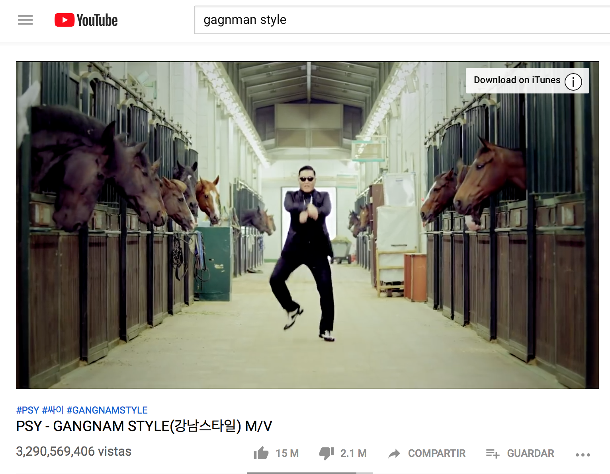
Youtube Overflow in 2014
Gangnam Style Hit: Who would think that a video will reach more than 2 billion views?
Youtube used signed 32-bit integer to count the number of visits => max. number for signed integer: 2,147,483,647 (2³¹-1)
In May 2014, this register had to be updated to 64 bits to avoid overflow
(Picture taken on Friday 15th Feb. 2019)
https://arstechnica.com/information-technology/2014/12/gangnam-style-overflows-int_max-forces-youtube-to-go-64-bit/

Slide 66
Converting to/from two’s complement
From decimal to two’s complement
if number is positive then
use classic conversion from decimal to binary
else
use classic conversion from decimal to binary
invert every bit (bitwise NOT operator)
add 1

Slide 67
Converting to/from two’s complement
From decimal to two’s complement
if number is positive then
use classic conversion from decimal to binary
else
use classic conversion from decimal to binary
invert every bit (bitwise NOT operator)
add 1
(worksheet 1.4)
To decimal from two’s complement
if number starts wih 0 then
use classic conversion from binary to decimal
else
invert every bit (bitwise NOT operator)
add 1
use classic conversion from binary to decimal
multiply the decimal number by -1

Slide 68
Converting to/from two’s complement
From decimal to two’s complement
18 => 8-bit binary word
if number is positive then
use classic conversion from decimal to binary
else
use classic conversion from decimal to binary
invert every bit (bitwise NOT operator)
add 1
To decimal from two’s complement
if number starts wih 0 then
use classic conversion from binary to decimal
else
invert every bit (bitwise NOT operator)
add 1
use classic conversion from binary to decimal
multiply the decimal number by -1

Slide 69
Converting to/from two’s complement
From decimal to two’s complement
18 => 8-bit binary word
if number is positive then
use classic conversion from decimal to binary
else
use classic conversion from decimal to binary
invert every bit (bitwise NOT operator)
add 1
To decimal from two’s complement
if number starts wih 0 then
use classic conversion from binary to decimal
else
invert every bit (bitwise NOT operator)
add 1
use classic conversion from binary to decimal
multiply the decimal number by -1

Slide 70
Converting to/from two’s complement
From decimal to two’s complement
18 => 8-bit binary word
if number is positive then
use classic conversion from decimal to binary
else
use classic conversion from decimal to binary
invert every bit (bitwise NOT operator)
add 1
00010010
To decimal from two’s complement
if number starts wih 0 then
use classic conversion from binary to decimal
else
invert every bit (bitwise NOT operator)
add 1
use classic conversion from binary to decimal
multiply the decimal number by -1

Slide 71
Converting to/from two’s complement
From decimal to two’s complement
-27 => 8-bit binary word
if number is positive then
use classic conversion from decimal to binary
else
use classic conversion from decimal to binary
invert every bit (bitwise NOT operator)
add 1
To decimal from two’s complement
if number starts wih 0 then
use classic conversion from binary to decimal
else
invert every bit (bitwise NOT operator)
add 1
use classic conversion from binary to decimal
multiply the decimal number by -1

Slide 72
Converting to/from two’s complement
From decimal to two’s complement
-27 => 8-bit binary word
if number is positive then
use classic conversion from decimal to binary
else
use classic conversion from decimal to binary
invert every bit (bitwise NOT operator)
add 1
To decimal from two’s complement
if number starts wih 0 then
use classic conversion from binary to decimal
else
invert every bit (bitwise NOT operator)
add 1
use classic conversion from binary to decimal
multiply the decimal number by -1

Slide 73
Converting to/from two’s complement
From decimal to two’s complement
-27 => 8-bit binary word
if number is positive then
use classic conversion from decimal to binary
else
use classic conversion from decimal to binary
invert every bit (bitwise NOT operator)
add 1
To decimal from two’s complement
if number starts wih 0 then
use classic conversion from binary to decimal
else
invert every bit (bitwise NOT operator)
add 1
use classic conversion from binary to decimal
multiply the decimal number by -1

Slide 74
Converting to/from two’s complement
From decimal to two’s complement
-27 => 8-bit binary word
if number is positive then
use classic conversion from decimal to binary
else
use classic conversion from decimal to binary
invert every bit (bitwise NOT operator)
add 1
00011011
To decimal from two’s complement
if number starts wih 0 then
use classic conversion from binary to decimal
else
invert every bit (bitwise NOT operator)
add 1
use classic conversion from binary to decimal
multiply the decimal number by -1

Slide 75
Converting to/from two’s complement
From decimal to two’s complement
-27 => 8-bit binary word
if number is positive then
use classic conversion from decimal to binary
else
use classic conversion from decimal to binary
invert every bit (bitwise NOT operator)
add 1
00011011
11100100
To decimal from two’s complement
if number starts wih 0 then
use classic conversion from binary to decimal
else
invert every bit (bitwise NOT operator)
add 1
use classic conversion from binary to decimal
multiply the decimal number by -1

Slide 76
Converting to/from two’s complement
From decimal to two’s complement
-27 => 8-bit binary word
if number is positive then
use classic conversion from decimal to binary
else
use classic conversion from decimal to binary
invert every bit (bitwise NOT operator)
add 1
11100100
+
00000001
11100101
To decimal from two’s complement
if number starts wih 0 then
use classic conversion from binary to decimal
else
invert every bit (bitwise NOT operator)
add 1
use classic conversion from binary to decimal
multiply the decimal number by -1

Slide 77
Converting to/from two’s complement
From decimal to two’s complement
if number is positive then
use classic conversion from decimal to binary
else
use classic conversion from decimal to binary
invert every bit (bitwise NOT operator)
add 1
To decimal from two’s complement
01010101=> decimal
if number starts wih 0 then
use classic conversion from binary to decimal
else
invert every bit (bitwise NOT operator)
add 1
use classic conversion from binary to decimal
multiply the decimal number by -1

Slide 78
Converting to/from two’s complement
From decimal to two’s complement
if number is positive then
use classic conversion from decimal to binary
else
use classic conversion from decimal to binary
invert every bit (bitwise NOT operator)
add 1
To decimal from two’s complement
01010101=> decimal
if number starts wih 0 then
use classic conversion from binary to decimal
else
invert every bit (bitwise NOT operator)
add 1
use classic conversion from binary to decimal
multiply the decimal number by -1

Slide 79
Converting to/from two’s complement
From decimal to two’s complement
if number is positive then
use classic conversion from decimal to binary
else
use classic conversion from decimal to binary
invert every bit (bitwise NOT operator)
add 1
To decimal from two’s complement
01010101=> decimal
if number starts wih 0 then
use classic conversion from binary to decimal
else
invert every bit (bitwise NOT operator)
add 1
use classic conversion from binary to decimal
multiply the decimal number by -1
2⁶+2⁴+2²+2⁰=85

Slide 80
Converting to/from two’s complement
From decimal to two’s complement
if number is positive then
use classic conversion from decimal to binary
else
use classic conversion from decimal to binary
invert every bit (bitwise NOT operator)
add 1
To decimal from two’s complement
11010101=> decimal
if number starts wih 0 then
use classic conversion from binary to decimal
else
invert every bit (bitwise NOT operator)
add 1
use classic conversion from binary to decimal
multiply the decimal number by -1

Slide 81
Converting to/from two’s complement
From decimal to two’s complement
if number is positive then
use classic conversion from decimal to binary
else
use classic conversion from decimal to binary
invert every bit (bitwise NOT operator)
add 1
To decimal from two’s complement
11010101=> decimal
if number starts wih 0 then
use classic conversion from binary to decimal
else
invert every bit (bitwise NOT operator)
add 1
use classic conversion from binary to decimal
multiply the decimal number by -1

Slide 82
Converting to/from two’s complement
From decimal to two’s complement
if number is positive then
use classic conversion from decimal to binary
else
use classic conversion from decimal to binary
invert every bit (bitwise NOT operator)
add 1
To decimal from two’s complement
11010101=> decimal
if number starts wih 0 then
use classic conversion from binary to decimal
else
invert every bit (bitwise NOT operator)
add 1
use classic conversion from binary to decimal
multiply the decimal number by -1

Slide 83
Converting to/from two’s complement
From decimal to two’s complement
if number is positive then
use classic conversion from decimal to binary
else
use classic conversion from decimal to binary
invert every bit (bitwise NOT operator)
add 1
To decimal from two’s complement
11010101=> decimal
if number starts wih 0 then
use classic conversion from binary to decimal
else
invert every bit (bitwise NOT operator)
add 1
use classic conversion from binary to decimal
multiply the decimal number by -1
00101010

Slide 84
Converting to/from two’s complement
From decimal to two’s complement
if number is positive then
use classic conversion from decimal to binary
else
use classic conversion from decimal to binary
invert every bit (bitwise NOT operator)
add 1
To decimal from two’s complement
11010101=> decimal
if number starts wih 0 then
use classic conversion from binary to decimal
else
invert every bit (bitwise NOT operator)
add 1
use classic conversion from binary to decimal
multiply the decimal number by -1
00101010
+
00000001
00101011

Slide 85
Converting to/from two’s complement
From decimal to two’s complement
if number is positive then
use classic conversion from decimal to binary
else
use classic conversion from decimal to binary
invert every bit (bitwise NOT operator)
add 1
To decimal from two’s complement
11010101=> decimal
if number starts wih 0 then
use classic conversion from binary to decimal
else
invert every bit (bitwise NOT operator)
add 1
use classic conversion from binary to decimal
multiply the decimal number by -1
00101011
2⁵+2³+2¹+2⁰=43

Slide 86
Converting to/from two’s complement
From decimal to two’s complement
if number is positive then
use classic conversion from decimal to binary
else
use classic conversion from decimal to binary
invert every bit (bitwise NOT operator)
add 1
To decimal from two’s complement
11010101=> decimal
if number starts wih 0 then
use classic conversion from binary to decimal
else
invert every bit (bitwise NOT operator)
add 1
use classic conversion from binary to decimal
multiply the decimal number by -1
2⁵+2³+2¹+2⁰=43
-43

Slide 87
Counting set bits in a binary number
Why should I care about counting bits?
One example of application:
Error detection in digital communications
Assume you receive this string of bits from the data source:
0 | 1 | 1 | 1 | 0 | 1 | 1 | 0
You interpret this string as the letter “v” (ASCII code 118).
However, the data source intended to send the string 01111110, which is the symbol ~.
How do you know whether there is an error?

Slide 88
Counting set bits in a binary number
Why should I care about counting bits?
One example of application:
Error detection in digital communications
You add a “even parity check” bit (1 if the bit count –including the parity bit- is odd, 0 if even):
0 | 0 | 1 | 1 | 1 | 0 | 1 | 1 | 0
Now you know there is an error here (parity bit tells you the total number of bits should be even, but you count an odd number of bits) => you ask for retransmission
This is also a type of job interview question for developers

Slide 89
Counting set bits in a binary number: Population Count
Function that returns the number of bits set in an unsigned integer (popcount)
Divide-and-conquer recursive implementation
function popcnt(x)
return popcntw(x,W) ▷ W is the integer width
end function
function popcntw(x,w)
if w = 1 then
return x
else
nw ← 𝑤/2 ▷ w assumed to be a power of 2
lo ← popcntw(x & 2^{nw} − 1, nw)
hi ← popcntw(floor(𝑥/2^{nw}), nw)
return lo + hi
end if
end function
If you are curious about other ways of solving the same problem, watch:
https://www.youtube.com/watch?v=Hzuzo9NJrlc

Slide 90
Counting set bits in a binary number: Population Count
Function that returns the number of bits set in an unsigned integer (popcount)
Divide-and-conquer recursive implementation
function popcnt(x)
return popcntw(x,W) ▷ W is the integer width
end function
function popcntw(x,w)
if w = 1 then
return x
else
nw ← 𝑤/2 ▷ w assumed to be a power of 2
lo ← popcntw(x & 2^{nw} − 1, nw)
hi ← popcntw(floor(𝑥/2^{nw}), nw)
return lo + hi
end if
end function
If you get to a single bit,
return its value
If you are curious about other ways of solving the same problem, watch:
https://www.youtube.com/watch?v=Hzuzo9NJrlc

Slide 91
Counting set bits in a binary number: Population Count
Function that returns the number of bits set in an unsigned integer (popcount)
Divide-and-conquer recursive implementation
function popcnt(x)
return popcntw(x,W) ▷ W is the integer width
end function
function popcntw(x,w)
if w = 1 then
return x
else
nw ← 𝑤/2 ▷ w assumed to be a power of 2
lo ← popcntw(x & 2^{nw} − 1, nw)
hi ← popcntw(floor(𝑥/2^{nw}), nw)
return lo + hi
end if
end function
“Separate” the left/right halves of the word, until you get a single bit (like you do in mergesort)
If you are curious about other ways of solving the same problem, watch:
https://www.youtube.com/watch?v=Hzuzo9NJrlc

Slide 92
Recursive Population Count
function popcntw(x,w)
if w = 1 then
return x
else
nw ← 𝑤/2
lo ← popcntw(x & 2^{nw} − 1, nw)
hi ← popcntw(floor(𝑥/2^{nw}), nw)
return lo + hi
end if
end function
Popcntw(21,8)
0 | 0 | 0 | 1 | 0 | 1 | 0 | 1
hi
lo
Popcntw(1,4)
Popcntw(5,4)
0 | 0 | 0 | 0 | 0 | 0 | 0 | 1
0 | 0 | 0 | 0 | 0 | 1 | 0 | 1
hi
lo
hi
lo
Popcntw(0,2)
Popcntw(1,2)
Popcntw(1,2)
Popcntw(1,2)
0 | 0 | 0 | 0 | 0 | 0 | 0 | 0
0 | 0 | 0 | 0 | 0 | 0 | 0 | 1
0 | 0 | 0 | 0 | 0 | 0 | 0 | 1
0 | 0 | 0 | 0 | 0 | 0 | 0 | 1
hi
lo
hi
lo
hi
lo
hi
lo
Popcntw(0,1)
Popcntw(0,1)
Popcntw(0,1)
Popcntw(1,1)
Popcntw(0,1)
Popcntw(1,1)
Popcntw(0,1)
Popcntw(1,1)
0 | 0 | 0 | 0 | 0 | 0 | 0 | 0
0 | 0 | 0 | 0 | 0 | 0 | 0 | 0
0 | 0 | 0 | 0 | 0 | 0 | 0 | 0
0 | 0 | 0 | 0 | 0 | 0 | 0 | 1
0 | 0 | 0 | 0 | 0 | 0 | 0 | 0
0 | 0 | 0 | 0 | 0 | 0 | 0 | 1
0 | 0 | 0 | 0 | 0 | 0 | 0 | 0
0 | 0 | 0 | 0 | 0 | 0 | 0 | 1

Slide 93
Recursive Population Count
function popcntw(x,w)
if w = 1 then
return x
else
nw ← 𝑤/2
lo ← popcntw(x & 2^{nw} − 1, nw)
hi ← popcntw(floor(𝑥/2^{nw}), nw)
return lo + hi
end if
end function
3
Popcntw(21,8)
1
2
0 | 0 | 0 | 1 | 0 | 1 | 0 | 1
hi
lo
0
Popcntw(1,4)
1
1
Popcntw(5,4)
1
0 | 0 | 0 | 0 | 0 | 0 | 0 | 1
0 | 0 | 0 | 0 | 0 | 1 | 0 | 1
hi
lo
hi
lo
0
Popcntw(0,2)
0
0
Popcntw(1,2)
1
0
Popcntw(1,2)
1
0
Popcntw(1,2)
1
0 | 0 | 0 | 0 | 0 | 0 | 0 | 0
0 | 0 | 0 | 0 | 0 | 0 | 0 | 1
0 | 0 | 0 | 0 | 0 | 0 | 0 | 1
0 | 0 | 0 | 0 | 0 | 0 | 0 | 1
hi
lo
hi
lo
hi
lo
hi
lo
Popcntw(0,1)
Popcntw(0,1)
Popcntw(0,1)
Popcntw(1,1)
Popcntw(0,1)
Popcntw(1,1)
Popcntw(0,1)
Popcntw(1,1)
0 | 0 | 0 | 0 | 0 | 0 | 0 | 0
0 | 0 | 0 | 0 | 0 | 0 | 0 | 0
0 | 0 | 0 | 0 | 0 | 0 | 0 | 0
0 | 0 | 0 | 0 | 0 | 0 | 0 | 1
0 | 0 | 0 | 0 | 0 | 0 | 0 | 0
0 | 0 | 0 | 0 | 0 | 0 | 0 | 1
0 | 0 | 0 | 0 | 0 | 0 | 0 | 0
0 | 0 | 0 | 0 | 0 | 0 | 0 | 1

Slide 94
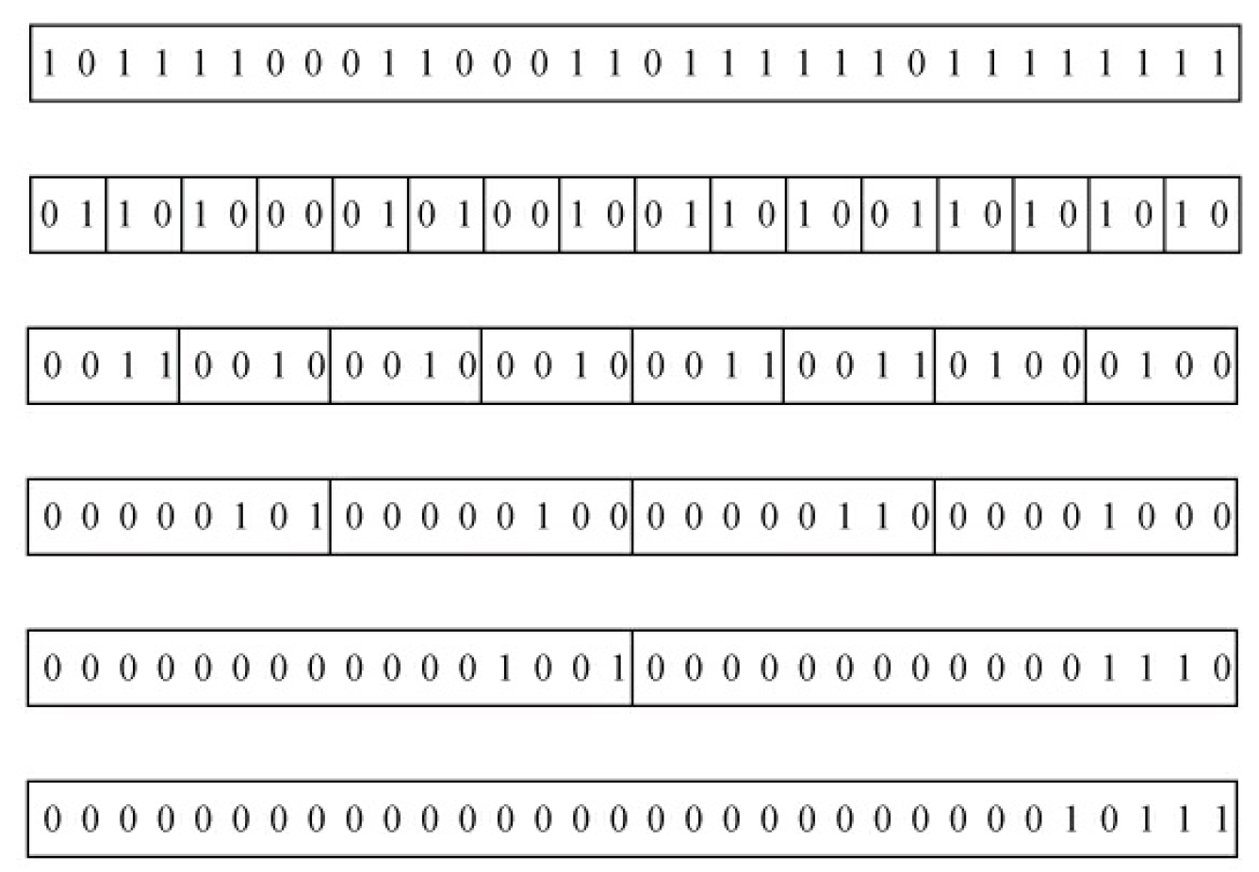
“Parallel” Population Count
The main idea: “set each 2-bit field equal to the sum of the two single bits that were originally in the field, and then sum adjacent 2-bit fields, putting the results in each 4-bit field, and so on.” (Hacker’s Delight, Addison Wesley 2003).
1
0
2
3
2
4
5
8
9
14
23

Slide 95
“Parallel” Population Count
Parallel divide-and-conquer implementation:
function popcnt(x) ▷ Assume W = 8
x ← (x & 0x55 ) + (x>>1 & 0x55)
x ← (x & 0x33 ) + (x>>2 & 0x33 )
x ← (x & 0x0f ) + (x>>4 & 0x0f )
return x
end function
0x55 | 01010101
0x33 | 00110011
0x0f | 00001111

Slide 96
“Parallel” Population Count
Parallel divide-and-conquer implementation:
function popcnt(x) ▷ Assume W = 8
x ← (x & 0x55 ) + (x>>1 & 0x55)
x ← (x & 0x33 ) + (x>>2 & 0x33 )
x ← (x & 0x0f ) + (x>>4 & 0x0f )
return x
end function
0x55 | 01010101
0x33 | 00110011
0x0f | 00001111
x=46 (00101110)

Slide 97
“Parallel” Population Count
Parallel divide-and-conquer implementation:
function popcnt(x) ▷ Assume W = 8
x ← (x & 0x55 ) + (x>>1 & 0x55)
x ← (x & 0x33 ) + (x>>2 & 0x33 )
x ← (x & 0x0f ) + (x>>4 & 0x0f )
return x
end function
0x55 | 01010101
0x33 | 00110011
0x0f | 00001111
x=46 (00101110)
(x & 0x55 ) + (x>>1 & 0x55)
0 0 1 0 1 1 1 0
(46)
0 0 0 1 0 1 1 1
(x>>1: 23)
&
0 1 0 1 0 1 0 1
(0x55)
&
0 1 0 1 0 1 0 1
(0x55)
0 0 0 0 0 1 0 0
0 0 0 1 0 1 0 1
The right bit of every pair in the original word is stored in bits
b6, b4, b2 and b0
The left bit of every pair in the original word is stored in bits b6, b4, b2 and b0

Slide 98
“Parallel” Population Count
Parallel divide-and-conquer implementation:
function popcnt(x) ▷ Assume W = 8
x ← (x & 0x55 ) + (x>>1 & 0x55)
x ← (x & 0x33 ) + (x>>2 & 0x33 )
x ← (x & 0x0f ) + (x>>4 & 0x0f )
return x
end function
0x55 | 01010101
0x33 | 00110011
0x0f | 00001111
x=46 (00101110)
(x & 0x55 ) + (x>>1 & 0x55)
0 0 1 0 1 1 1 0
(46)
0 0 0 1 0 1 1 1
(x>>1: 23)
0 0 0 0 0 1 0 0
&
0 1 0 1 0 1 0 1
(0x55)
&
0 1 0 1 0 1 0 1
(0x55)
+
0 0 0 1 0 1 0 1
0 0 0 0 0 1 0 0
0 0 0 1 0 1 0 1
0 0 0 1 1 0 0 1
The right bit of every pair in the original word is stored in bits
b6, b4, b2 and b0
The left bit of every pair in the original word is stored in bits b6, b4, b2 and b0

Slide 99
“Parallel” Population Count
Parallel divide-and-conquer implementation:
function popcnt(x) ▷ Assume W = 8
x ← (x & 0x55 ) + (x>>1 & 0x55)
x ← (x & 0x33 ) + (x>>2 & 0x33 )
x ← (x & 0x0f ) + (x>>4 & 0x0f )
return x
end function
0x55 | 01010101
0x33 | 00110011
0x0f | 00001111
46 (0 0 1 0 1 1 1 0)
x
0 0 0 1 1 0 0 1

Slide 100
“Parallel” Population Count
Parallel divide-and-conquer implementation:
function popcnt(x) ▷ Assume W = 8
x ← (x & 0x55 ) + (x>>1 & 0x55)
x ← (x & 0x33 ) + (x>>2 & 0x33 )
x ← (x & 0x0f ) + (x>>4 & 0x0f )
return x
end function
0x55 | 01010101
0x33 | 00110011
0x0f | 00001111
46 (0 0 1 0 1 1 1 0)
x
0 0 0 1 1 0 0 1
(x & 0x33 ) + (x>>2 & 0x33)
0 0 0 1 1 0 0 1
0 0 0 0 0 1 1 0
0 0 0 1 0 0 0 1
&
0 0 1 1 0 0 1 1
&
0 0 1 1 0 0 1 1
+
0 0 0 0 0 0 1 0
0 0 0 1 0 0 0 1
0 0 0 0 0 0 1 0
0 0 0 1 0 0 1 1
We get the right pair of every 4-bit set
We get the left pair of every 4-bit set
We sum them

Slide 101
“Parallel” Population Count
Parallel divide-and-conquer implementation:
function popcnt(x) ▷ Assume W = 8
x ← (x & 0x55 ) + (x>>1 & 0x55)
x ← (x & 0x33 ) + (x>>2 & 0x33 )
x ← (x & 0x0f ) + (x>>4 & 0x0f )
return x
end function
0x55 | 01010101
0x33 | 00110011
0x0f | 00001111
46 (0 0 1 0 1 1 1 0)
0 0 0 1 1 0 0 1
x
0 0 0 1 0 0 1 1

Slide 102
“Parallel” Population Count
Parallel divide-and-conquer implementation:
function popcnt(x) ▷ Assume W = 8
x ← (x & 0x55 ) + (x>>1 & 0x55)
x ← (x & 0x33 ) + (x>>2 & 0x33 )
x ← (x & 0x0f ) + (x>>4 & 0x0f )
return x
end function
0x55 | 01010101
0x33 | 00110011
0x0f | 00001111
46 (0 0 1 0 1 1 1 0)
0 0 0 1 1 0 0 1
x
0 0 0 1 0 0 1 1
(x & 0x0f ) + (x>>4 & 0x0f )
0 0 0 1 0 0 1 1
0 0 0 0 0 0 0 1
0 0 0 0 0 0 1 1
&
0 0 0 0 1 1 1 1
&
0 0 0 0 1 1 1 1
+
0 0 0 0 0 0 0 1
0 0 0 0 0 0 1 1
0 0 0 0 0 0 0 1
0 0 0 0 0 1 0 0

Slide 103
“Parallel” Population Count
Parallel divide-and-conquer implementation:
function popcnt(x) ▷ Assume W = 8
x ← (x & 0x55 ) + (x>>1 & 0x55)
x ← (x & 0x33 ) + (x>>2 & 0x33 )
x ← (x & 0x0f ) + (x>>4 & 0x0f )
return x
end function
0x55 | 01010101
0x33 | 00110011
0x0f | 00001111
46 (0 0 1 0 1 1 1 0)
0 0 0 1 1 0 0 1
0 0 0 1 0 0 1 1
x
0 0 0 0 0 1 0 0

Slide 104
“Parallel” Population Count
Parallel divide-and-conquer implementation:
function popcnt(x) ▷ Assume W = 8
x ← (x & 0x55 ) + (x>>1 & 0x55)
x ← (x & 0x33 ) + (x>>2 & 0x33 )
x ← (x & 0x0f ) + (x>>4 & 0x0f )
return x
end function
0x55 | 01010101
0x33 | 00110011
0x0f | 00001111
46 (0 0 1 0 1 1 1 0)
0 0 0 1 1 0 0 1
0 0 0 1 0 0 1 1
x
0 0 0 0 0 1 0 0
(4, the correct number of set bits)

Slide 105
“Parallel” Population Count for 32 bits
Parallel divide-and-conquer implementation for width equal to 32:
function popcnt(x) ▷ Assume W = 32
x ← (x & 0x55555555 ) + (x>>1 & 0x55555555 )
x ← (x & 0x33333333 ) + (x>>2 & 0x33333333 )
x ← (x & 0x0f0f0f0f ) + (x>>4 & 0x0f0f0f0f )
x ← (x & 0x00ff00ff ) + (x>>8 & 0x00ff00ff )
x ← (x & 0x0000ffff ) + (x>>16 & 0x0000ffff )
return x
end function
This algorithm (for 32 bits) is explained in:
Henry S. Warren, Jr. Hacker’s Delight, Addison-Wesley (2003), Section 5-1

Slide 106
Outline
Review of last week
Fixed Point, Signed Numbers, Counting Bits
Multiplication
Floating Point Representation

Slide 107
School Multiplication
123 x 135
You might have learned any of the following methods:
123
x 135
123 x 135
x
100 20 3
615
100
30
5
10000 2000 300
615
369
3000 600 90
3690
+
123
500 100 15
+
12300
16605
16605
w² multiplications and
w² sums
w² single-digit multipli-cations and w sums
w² single-digit multi-
plications and w sums
Every method it involves w² multiplications (w: number of digits) => Θ(w²)
Can we do better?

Slide 108
1st attempt: Divide-and-Conquer Multiplication
1. Divide each integer (made of w digits each) in two halves:
x
1438
y
2576
x_{hi}
14
x_{lo}
38
X_{hi}
25
X_{lo}
76
Note that we can reconstruct the number by making: x_{hi} * 10^{(w/2)} + x_{lo}
Thus, x * y = (x_{hi} * 10^{(w/2)} + x_{lo}) * (y_{hi} * 10^{(w/2)} + y_{lo})
= x_{hi} * 10^{(w/2)*} y_{hi} * 10^{(w/2)} + x_{hi} * 10^{(w/2)} *y_{lo} + x_{lo} * y_{hi} * 10^{(w/2)} + x_{lo} *y_{lo}
= x_{hi} * y_{hi} * 10^{w} + (x_{hi} *y_{lo} + x_{lo} * y_{hi} )* 10^{(w/2)} + x_{lo} *y_{lo}
2. Calculate x_{hi} * y_{hi} * 10^{w} + (x_{hi} *y_{lo} + x_{lo} * y_{hi} )* 10^{floor(w/2)} + x_{lo} *y_{lo}
The procedure is called recursively until you get only single-digit multiplications

Slide 109
Recursive Implementation
x_{hi} * y_{hi} * 10^{w} + (x_{hi} *y_{lo} + x_{lo} * y_{hi} )* 10^{(w/2)} + x_{lo}*y_{lo}
function Div-Conq-Mult(x,y):
if x or y has one digit then
return x * y
else
w <- number of digits
x_hi <- left half of x
x_lo <- right half of x
y_hi <- left half of y
y_lo <- right half of y
x1 <- Div-Conq-Mult(x_hi,y_hi)
x2 <- Div-Conq-Mult(x_hi, y_lo)
x3 <- Div-Conq-Mult(x_lo,y_hi)
x₄ <- Div-Conq-Mult(x_lo, y_lo)
return x₁*10^{w} + (x₂ + x₃)*10^{w/2} + x₄
end of if
Four multiplications of half the size of the original numbers

Slide 110
Recursive Implementation
x_{hi} * y_{hi} * 10^{w} + (x_{hi} *y_{lo} + x_{lo} * y_{hi} )* 10^{(w/2)} + x_{lo}*y_{lo}
function Div-Conq-Mult(x,y):
if x or y has one digit then
return x * y
else
w <- number of digits
x_hi <- left half of x
x_lo <- right half of x
y_hi <- left half of y
y_lo <- right half of y
x1 <- Div-Conq-Mult(x_hi,y_hi)
x2 <- Div-Conq-Mult(x_hi, y_lo)
x3 <- Div-Conq-Mult(x_lo,y_hi)
x₄ <- Div-Conq-Mult(x_lo, y_lo)
return x₁*10^{w} + (x₂ + x₃)*10^{w/2} + x₄
end of if
1438 x 2576

Slide 111
Recursive Implementation
x_{hi} * y_{hi} * 10^{w} + (x_{hi} *y_{lo} + x_{lo} * y_{hi} )* 10^{(w/2)} + x_{lo}*y_{lo}
function Div-Conq-Mult(x,y):
if x or y has one digit then
return x * y
else
w <- number of digits
x_hi <- left half of x
x_lo <- right half of x
y_hi <- left half of y
y_lo <- right half of y
x1 <- Div-Conq-Mult(x_hi,y_hi)
x2 <- Div-Conq-Mult(x_hi, y_lo)
x3 <- Div-Conq-Mult(x_lo,y_hi)
x₄ <- Div-Conq-Mult(x_lo, y_lo)
return x₁*10^{w} + (x₂ + x₃)*10^{w/2} + x₄
end of if
1438 x 2576

Slide 112
Recursive Implementation
x_{hi} * y_{hi} * 10^{w} + (x_{hi} *y_{lo} + x_{lo} * y_{hi} )* 10^{(w/2)} + x_{lo}*y_{lo}
function Div-Conq-Mult(x,y):
if x or y has one digit then
return x * y
else
w <- number of digits
x_hi <- left half of x
x_lo <- right half of x
y_hi <- left half of y
y_lo <- right half of y
x1 <- Div-Conq-Mult(x_hi,y_hi)
x2 <- Div-Conq-Mult(x_hi, y_lo)
x3 <- Div-Conq-Mult(x_lo,y_hi)
x₄ <- Div-Conq-Mult(x_lo, y_lo)
return x₁*10^{w} + (x₂ + x₃)*10^{w/2} + x₄
end of if
1438 x 2576
w
4

Slide 113
Recursive Implementation
x_{hi} * y_{hi} * 10^{w} + (x_{hi} *y_{lo} + x_{lo} * y_{hi} )* 10^{(w/2)} + x_{lo}*y_{lo}
function Div-Conq-Mult(x,y):
if x or y has one digit then
return x * y
else
w <- number of digits
x_hi <- left half of x
x_lo <- right half of x
y_hi <- left half of y
y_lo <- right half of y
x1 <- Div-Conq-Mult(x_hi,y_hi)
x2 <- Div-Conq-Mult(x_hi, y_lo)
x3 <- Div-Conq-Mult(x_lo,y_hi)
x₄ <- Div-Conq-Mult(x_lo, y_lo)
return x₁*10^{w} + (x₂ + x₃)*10^{w/2} + x₄
end of if
1438 x 2576
w
4
x_hi
14
x_lo
38
y_hi
25
y_lo
76

Slide 114
Recursive Implementation
x_{hi} * y_{hi} * 10^{w} + (x_{hi} *y_{lo} + x_{lo} * y_{hi} )* 10^{(w/2)} + x_{lo}*y_{lo}
function Div-Conq-Mult(x,y):
if x or y has one digit then
return x * y
else
w <- number of digits
x_hi <- left half of x
x_lo <- right half of x
y_hi <- left half of y
y_lo <- right half of y
x1 <- Div-Conq-Mult(x_hi,y_hi)
x2 <- Div-Conq-Mult(x_hi, y_lo)
x3 <- Div-Conq-Mult(x_lo,y_hi)
x₄ <- Div-Conq-Mult(x_lo, y_lo)
return x₁*10^{w} + (x₂ + x₃)*10^{w/2} + x₄
end of if
1438 x 2576
w
4
x_hi
14
x_lo
38
y_hi
25
y_lo
76
1438 x 2576
x1
x2
x3
x4
14x25
14x76
38x25
38x76

Slide 115
Recursive Implementation
x_{hi} * y_{hi} * 10^{w} + (x_{hi} *y_{lo} + x_{lo} * y_{hi} )* 10^{(w/2)} + x_{lo}*y_{lo}
function Div-Conq-Mult(x,y):
if x or y has one digit then
return x * y
else
w <- number of digits
x_hi <- left half of x
x_lo <- right half of x
y_hi <- left half of y
y_lo <- right half of y
x1 <- Div-Conq-Mult(x_hi,y_hi)
x2 <- Div-Conq-Mult(x_hi, y_lo)
x3 <- Div-Conq-Mult(x_lo,y_hi)
x₄ <- Div-Conq-Mult(x_lo, y_lo)
return x₁*10^{w} + (x₂ + x₃)*10^{w/2} + x₄
end of if
1438 x 2576
w
4
x_hi
14
x_lo
38
y_hi
25
y_lo
76
1438 x 2576
x1
x2
x3
x4
14x25
14x76
38x25
38x76
1x7
1x6
4x7
4x6
x1
x2
x3
x4
3x2
3x5
8x2
8x5
x1
x2
x3
x4
1x2
1x5
4x2
4x5
3x7
3x6
8x7
8x6
x1
x2
x3
x4
x1
x2
x3
x4

Slide 116
Recursive Implementation
function Div-Conq-Mult(x,y):
if x or y has one digit then
return x * y
else
return x₁*10^{w} + (x₂ + x₃)*10^{w/2} + x₄
end of if
1438 x 2576
x1
x2
x3
x4
14x25
14x76
38x25
38x76
1x2
1x5
4x2
4x5
1x7
1x6
4x7
4x6
3x2
3x5
8x2
8x5
3x7
3x6
8x7
8x6
x1
x2
x3
x4
x1
x2
x3
x4
x1
x2
x3
x4
x1
x2
x3
x4

Slide 117
Recursive Implementation
function Div-Conq-Mult(x,y):
if x or y has one digit then
return x * y
else
return x₁*10^{w} + (x₂ + x₃)*10^{w/2} + x₄
end of if
1438 x 2576
2
x1
x2
x3
x4
14x25
20
14x76
38x25
38x76
48
2
8
7
6
24
40
28
6
21
16
18
56
15
1x2
1x5
4x2
4x5
1x7
1x6
4x7
4x6
3x2
3x5
8x2
8x5
3x7
3x6
8x7
8x6
x1
x2
x3
x4
x1
x2
x3
x4
x1
x2
x3
x4
x1
x2
x3
x4

Slide 118
Recursive Implementation
function Div-Conq-Mult(x,y):
if x or y has one digit then
return x * y
else
return x₁*10^{w} + (x₂ + x₃)*10^{w/2} + x₄
end of if
350x10⁴ + 2014x10² + 2888
= 3704288
21x10² + 74x10¹ + 48
= 2888
2x10² + 13x10¹ + 20
= 350
1438 x 2576
1064
950
2
x1
x2
x3
x4
14x25
20
14x76
38x25
38x76
48
5
8
7
6
24
40
28
6
21
16
18
56
15
1x2
1x5
4x2
4x5
1x7
1x6
4x7
4x6
3x2
3x5
8x2
8x5
3x7
3x6
8x7
8x6
x1
x2
x3
x4
x1
x2
x3
x4
x1
x2
x3
x4
x1
x2
x3
x4

Slide 119
Time Complexity
x_{hi} * y_{hi} * 10^{w} + (x_{hi} *y_{lo} + x_{lo} * y_{hi} )* 10^{(w/2)} + x_{lo}*y_{lo}
function Div-Conq-Mult(x,y):
if x or y has one digit then
return x * y
else
w <- number of digits
x_hi <- left half of x
x_lo <- right half of x
y_hi <- left half of y
y_lo <- right half of y
x1 <- Div-Conq-Mult(x_hi,y_hi)
x2 <- Div-Conq-Mult(x_hi, y_lo)
x3 <- Div-Conq-Mult(x_lo,y_hi)
x₄ <- Div-Conq-Mult(x_lo, y_lo)
return x₁*10^{w} + (x₂ + x₃)*10^{w/2} + x₄
end of if
T(w) = 4 T(w/2) + O(w)
Four multiplications of half the size of the original numbers
3 sums => O(1)
Multiply by 10^{w} =>O(w)

Slide 120
Time Complexity
T(w) = 4 T(w/2) + O(w)
Using the Master Theorem:
a = 4, b = 2, c = 1 ⇒ case 1
• log_{𝑏}𝑎 = log₂(4) = 2
⇒ 𝑇 (𝑤) ∈ Θ(𝑤²)
More complicated than school multiplication and still the same time complexity ☹

Slide 121
Karatsuba Multiplication (1962)
Divide-and-Conquer Multiplication
X_{hi}*y_{hi}*10^{w} + (x_{hi} *y_{lo} + x_{lo} * y_{hi} )* 10^{(w/2)} + x_{lo}*y_{lo}
This term remains the same
This term remains the same
Divide-and-Conquer Karatsuba Multiplication
X_{hi}*y_{hi}*10^{w} + [(x_{hi} +x_{lo})*(y_{hi}+y_{lo})-x_{hi}*y_{hi}-x_{lo}*y_{lo}]* 10^{(w/2)} + x_{lo}*y_{lo}
This term is re-written, but it is still the same term:
[(x_{hi} +x_{lo})*(y_{hi}+y_{lo})-x_{hi}*y_{hi}-x_{lo}*y_{lo}]=
[x_{hi}*y_{hi} + x_{hi}*y_{lo} + x_{lo}*y_{hi} + x_{lo}*y_{lo} -x_{hi}*y_{hi}-x_{lo}*y_{lo}]=
[x_{hi}*y_{lo} + x_{lo}*y_{hi} ]

Slide 122
Karatsuba Multiplication (1962)
X_{hi}*y_{hi}*10^{w} + [(x_{hi} +x_{lo})*(y_{hi}+y_{lo})-x_{hi}*y_{hi}-x_{lo}*y_{lo}]* 10^{(w/2)} + x_{lo}*y_{lo}
z_{hi}
z_{c}
z_{hi}
z_{lo}
z_{lo}
function Karatsuba(x,y):
if x or y has one digit then
return x * y
else
w <- number of digits
x_hi <- left half of x
x_lo <- right half of x
y_hi <- left half of y
y_lo <- right half of y
z_hi <- Karatsuba(x_hi,y_hi)
z_c <- Karatsuba(x_hi+x_lo, y_hi+y_lo)
z_lo <- Karatsuba(x_lo, y_lo)
return z_hi*10^{w} + (z_c - z_hi - z_lo)*10^{w/2} + z_lo
end of if
Three multiplications of half the size of the original numbers
Instead of 4, we can just do 3 single-digit multiplications

Slide 123
Karatsuba Recursive Calls
function Karatsuba(x,y):
if x or y has one digit then
return x * y
else
z_hi <- Karatsuba(x_hi,y_hi)
z_c <- Karatsuba(x_hi+x_lo, y_hi+y_lo)
z_lo <- Karatsuba(x_lo, y_lo)
end of if
1438 x 2574
z_hi
z_c
z_lo
14x25
52x99
38x74
z_hi
z_c
z_lo
z_hi
z_c
z_lo
1x2
5x7
4x5
5x9
7x18
2x9
3x7
11x11
8x4
z_hi
z_c
z_lo
1x1
2x2
1x1
z_hi
z_c
z_lo

Slide 124
Karatsuba Recursive Calls
function Karatsuba(x,y):
if x or y has one digit then
return x * y
else
return z_hi*10^{w} + (z_c - z_hi - z_lo)*10^{w/2} + z_lo
end of if
1438 x 2574
z_hi
z_c
z_lo
2
14x25
52x99
38x74
32
20
2
2
21
35
126
z_hi
z_c
z_lo
z_hi
z_c
z_lo
1x2
5x7
4x5
5x9
7x18
2x9
3x7
11x11
8x4
z_hi
z_c
z_lo
1
1
4
1x1
2x2
1x1
z_hi
z_c
z_lo

Slide 125
Karatsuba Recursive Calls
function Karatsuba(x,y):
if x or y has one digit then
return x * y
else
return z_hi*10^{w} + (z_c - z_hi - z_lo)*10^{w/2} + z_lo
end of if
3500000+198600+2812=3701412
200+130+20=350
1438 x 2574
2100+680+32=2812
4500+630+18=5148
z_c
2
z_hi
z_lo
14x25
52x99
38x74
32
20
45
18
21
35
126
100+20+1=121
z_hi
z_c
z_lo
z_hi
z_c
z_lo
1x2
5x7
4x5
5x9
7x18
2x9
3x7
11x11
8x4
z_hi
z_c
z_lo
1
1
4
1x1
2x2
1x1
z_hi
z_c
z_lo

Slide 126
Karatsuba Time Complexity
function Karatsuba(x,y):
if x or y has one digit then
return x * y
else
w <- number of digits
x_hi <- left half of x
x_lo <- right half of x
y_hi <- left half of y
y_lo <- right half of y
z_hi <- Karatsuba(x_hi,y_hi)
z_c <- Karatsuba(x_hi+x_lo, y_hi+y_lo)
z_lo <- Karatsuba(x_lo, y_lo)
return z_hi*10^{w} + (z_c - z_hi - z_lo)*10^{w/2} + z_lo
end of if
Three multiplications of half the size of the original numbers
4 sums/substractions => O(1)
Multiply by 10^{w} =>O(w)
T(w) = 3 T(w/2) + O(w)
Using the Master Theorem:
• a = 3, b = 2, c = 1 ⇒ case 1
• log_{𝑏} 𝑎 = log₂(3) = 1.58
⇒ 𝑇 (𝑤) ∈ Θ(𝑤^{1.58})

Slide 127
Multiplication Exercise (worksheet 2.1)
_______+______+ 40=________
38 x 85
24
100+___+3=____
z_hi
z_c
z_lo
3x8
11x13
1
3
z_hi
1x1
z_c
z_lo
1x3

Slide 128
Karatsuba
2400+790+40=3230
38 x 85
40
24
100+40+3=143
z_hi
z_c
z_lo
3x8
11x13
8x5
1
3
8
z_hi
1x1
z_c
z_lo
2x4
1x3

Slide 129
Additional Links
These links might be useful to remember the details of multiplication algorithms:
http://www.cs.cmu.edu/~cburch/pgss99/lecture/0721-divide.html
http://www.cburch.com/csbsju/cs/160/notes/31/1.html

Slide 130
Outline
Review of last week
Fixed Point, Signed Numbers, Counting Bits
Multiplication
Floating Point Representation

Slide 131
The problem with fixed point…
What if you need to operate numbers in very different ranges?
e.g. the distance travelled by light in 12 nanoseconds
Speed of light: 299 792458 m/s (we need 29 bits for this U(32,0) )
0001 0001 1101 1110 0111 1000 0100 1010
(using a 32-bit word)
2³¹2³⁰2²⁹2²⁸ 2²⁷2²⁶2²⁵2²⁴ 2²³2²²2²¹2²⁰ 2¹⁹2¹⁸2¹⁷2¹⁶ 2¹⁵2¹⁴2¹³2¹² 2¹¹2¹⁰2⁹2⁸ 2⁷ 2⁶ 2⁵ 2⁴ 2³ 2² 2¹ 2⁰
12 nanoseconds: 0.000000012 s (we need 29 bits for this U(1,31))
0.000 0000 0000 0000 0000 0000 0001 1010
(using a 32-bit word)
1.21072 x10⁻⁸
2⁰ 2⁻¹2-²2⁻³ 2⁻⁴2⁻⁵2⁻⁶2⁻⁷ 2⁻⁸2⁻⁹2⁻¹⁰2⁻¹¹ 2⁻¹²2⁻¹³2⁻¹⁴2⁻¹⁵ 2⁻¹⁶2⁻¹⁷2⁻¹⁸2⁻¹⁹ 2⁻²⁰2⁻²¹2⁻²²2⁻²³ 2⁻²⁴ 2⁻²⁵ 2⁻²⁶ 2⁻²⁷ 2⁻²⁸ 2⁻²⁹ 2⁻³⁰ 2⁻³¹
You cannot represent such different numbers with the same fixed point representation

Slide 132
Floating point representation
The scientific notation in base 2
Let’s see a simple example first with the number 12.75
STEP 1: Represent the integer and fractional part of the number in binary (Worksheet 3.1)
12.75
1100.11
2³2²2¹2⁰ 2⁻¹2-²
STEP 2: Transform the binary number into scientific notation: 1.mantissa x 2^{exponent}
(notice we are moving the point, that’s why it is called “floating point”) (Worksheet 3.2)
1.10011 x 2³
STEP 3: Write the number in the IEEE 754 format (standard format for floating point numbers)

Slide 133
IEEE 754 standard for floating point representation
STEP 3: Write the number in the IEEE 754 format (standard format for floating point numbers)
1.10011 x 2³
32 bits
(single precision)

Slide 134
IEEE 754 standard for floating point representation
STEP 3: Write the number in the IEEE 754 format (standard format for floating point numbers)
1.10011 x 2³
Sign bit (1 bit)
0 for positive numbers
1 for negative numbers
(Worksheet 3.1)

Slide 135
IEEE 754 standard for floating point representation
STEP 3: Write the number in the IEEE 754 format (standard format for floating point numbers)
1.10011 x 2³
Exponent bits (8 bits)
The binary number equivalent to (127 + exponent)
The number 127 is called bias
The bias allows you to represent exponents between -126 and 127
Historical note: the bias was introduced in 1954. Two’s complement was first implemented in a computer in 1964
(Worksheet 3.1)

Slide 136
IEEE 754 standard for floating point representation
STEP 3: Write the number in the IEEE 754 format (standard format for floating point numbers)
Significand
This bit is implicit
(it is not stored in the 32-bit word)
1.10011 x 2³
Mantissa
Mantissa bits (23 bits)
The fractional part of the significand
(Worksheet 3.1)

Slide 137
IEEE 754 standard for floating point representation
STEP 3: Write the number in the IEEE 754 format (standard format for floating point numbers)
1.10011 x 2³
0
1 | 0 | 0 | 0 | 0 | 0 | 1 | 0
1 | 0 | 0 | 1 | 1 | 0 | 0 | 0 | 0 | 0 | 0 | 0 | 0 | 0 | 0 | 0 | 0 | 0 | 0 | 0 | 0 | 0 | 0
Sign bit
Exponent bits (8 bits)
Mantissa bits (23 bits)
Sign bit: 0 (it is a positive number)
Exponent bits: 1000 0010 (equivalent to 127+3=130)
Mantissa bits: 1001 1000 0000 0000 0000 000
Haxadecimal notation: 0x 414c0000
(Worksheet 3.1)

Slide 138
IEEE 754 standard
Single-precision (32-bit word)
• 1 sign bit
• 8 exponent bits (bias is 127, range is -126 to 127)
• 23 mantissa bits (plus “hidden bit” gives 24 binary (~7 decimal) digits of precision)
Double-precision (64-bit word)
• 1 sign bit
• 11 exponent bits (bias is 1023, range is -1022 to 1023)
• 52 mantissa bits (plus “hidden bit” gives 53 binary (~16 decimal) digits of precision)
Representation of number zero (due to the implicit 1, a special representations is needed)
• sign bit can be 0 or 1
• exponent field equal to 0
• mantissa field equal to 0

Slide 139
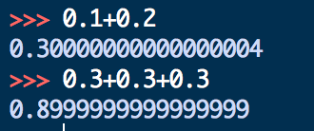
The problem with floating point…
It has a larger range at the expense of precision, which means:
calculations with floating points will usually not give an exactly
representable answer, even if the input numbers were exact
EXAMPLE (Python Shell):
We can only represent precisely numbers that can be expressed as sums of 1/2^{x} . The rest of numbers can only be approximated with the numbers of available bits

Slide 140
Additional links
A complete explanation of floating numbers (mathematical proofs included):
David Goldberg, What every computer scientist should know about
floating point arithmetic, Computing (1991)
How to transform a decimal number into its floating point representation
https://www.youtube.com/watch?v=8afbTaA-gOQ
(if you are not interested in how to transform the integer and fractional part to binary, after
the introduction just skip to 4:04 min)

