Slide 1



Hardware
Fellowship

Slide 2

Overview
Avoiding use of delay()
Voltage Regulator (7805)
Servo Motor
DHT-11: Using external libraries
Interrupts

Slide 3
Writing Code without delay()
Use of delay() for timing purposes is not preferred
delay() halts all the operation of the microcontroller until the duration ends
We could be doing something more useful during that time!

Slide 4
Avoiding the use of delay()
Measure time!
By keeping track of how much time has passed, we can time our events
Arduino has the millis() function which provides us with timing functionality
millis()
Returns the number of milliseconds passed since the Arduino board began running the current program.
Syntax:
millis()
Example:
unsigned long time = millis();

Slide 5
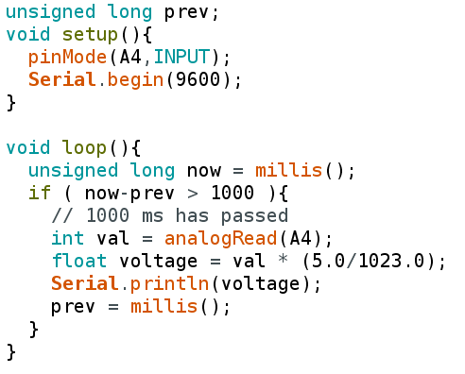
void setup()
{
pinMode(A4, INPUT);
Serial.begin(9600);
}
void loop()
{
int val = analogRead(A4);
float voltage = val * (5.0/1023.0);
Serial.println(voltage);
delay(1000);
}

Slide 6
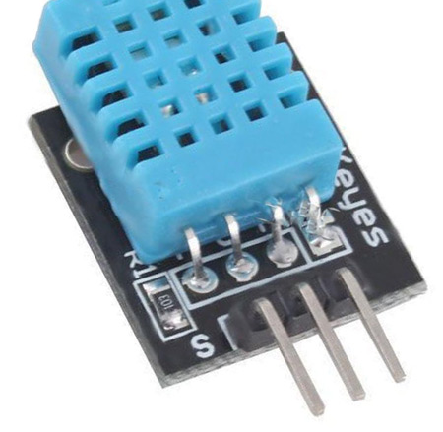
DHT11

Slide 7
DHT 11
Commonly used temperature and humidity sensor
Uses a capacitive humidity sensor and a thermistor
Returns a digital signal with the temperature and humidity
We use the DHT library to interface with DHT11
Data from DHT11 can be read only once every second

Slide 8
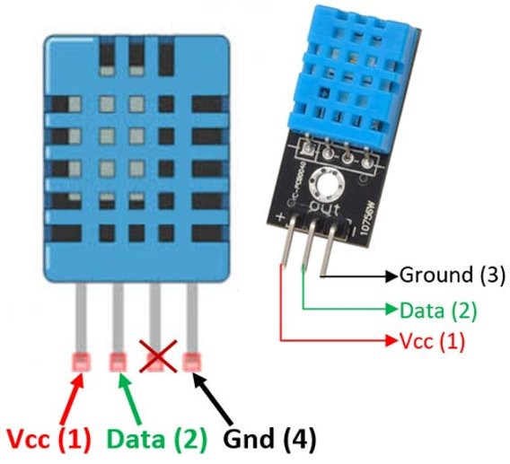
Pin Configuration
The first pin of the DHT11 is Vcc pin.
The second pin of the DHT is Data pin.
The third pin is not used.
The fourth pin of the DHT sensor is ground.

Slide 9
IMPORTING LIBRARIES IN ARDUINO IDE
Open the Arduino IDE and Navigate to the menu bar.
From there go to Sketch>Include Library.
If you haven't installed the library yet, go to "Manage Libraries" or "Add .ZIP Library" and install the library.
The library now appears in the Menu.
You will notice that this also adds a folder in your hard drive's file tree.

Slide 10
Install the DHT Library!
You need to add two libraries:
DHT-sensor-library-1.4.3.zip
Adafruit_Sensor-1.1.4.zip

Slide 11
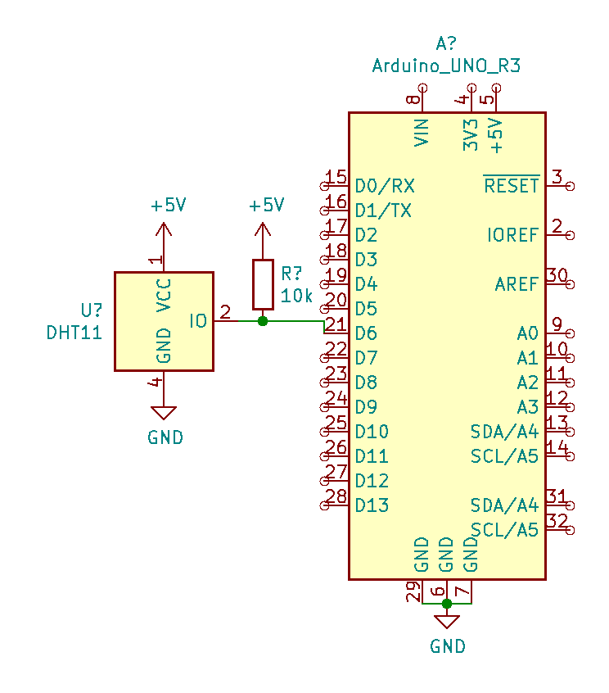
Interfacing DHT11 with Arduino

Slide 12
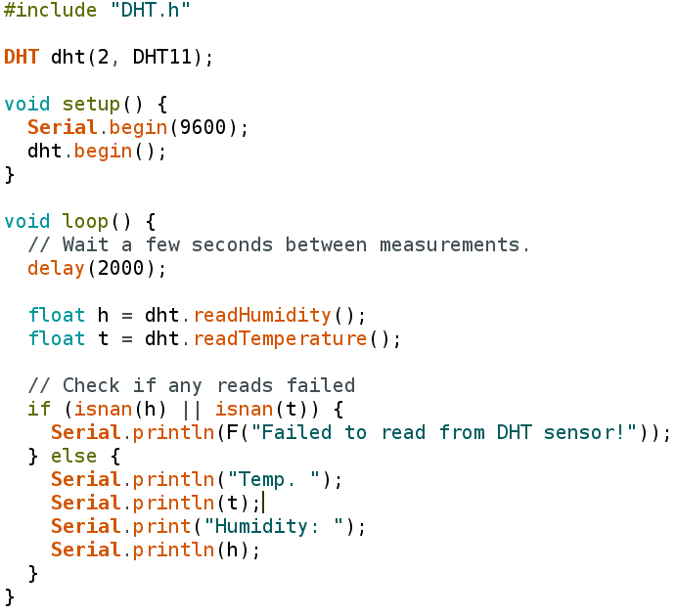
Do it without delay() !

Slide 13
Voltage Regulators

Slide 14
What is a voltage regulator?
A voltage regulator is an integrated circuit (IC) that provides a constant fixed output voltage regardless of a change in the load or input voltage.
Electronic circuits requires voltages of different levels, e.g. 5V , 3.3V, 9V etc.
Voltage regulators convert one voltage level to another level
Why use voltage regulators over voltage dividers?

Slide 15
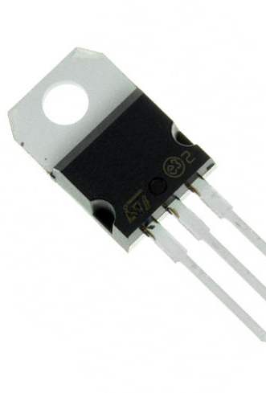
LM78XX Series
3-terminal Linear regulators.
Used extensively in the device that needs the regulated power supplies such as microcontroller.
'XX' indicates the voltage that each regulator outputs, e.g. 7805 outputs 5V, 7809 outputs 9V etc.

Slide 16
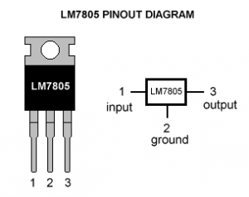
Pin 1 (Input Pin): The Input pin is the pin that accepts the incoming DC voltage, which the voltage regulator will eventually regulate down to 5 volts.
Pin 2 (Ground): Ground pin establishes the ground for the regulator.
Pin 3 (Output Pin): The Output pin is the regulated 5 volts DC.

Slide 17
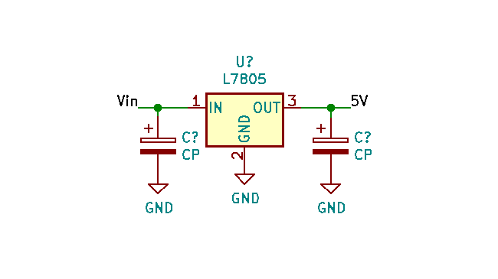

Slide 18
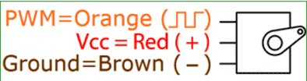
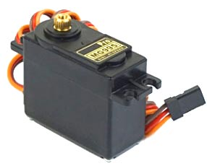
Servo Motor
A servomotor is a rotatory actuator or linear actuator that allows for precise control of angular or linear position, velocity and acceleration.

Slide 19
Interfacing Servo with Arduino
Connect signal pin (Orange) to Arduino pin 9
Connect Vcc to 5v (from the regulator)
Connect the Grounds together

Slide 20
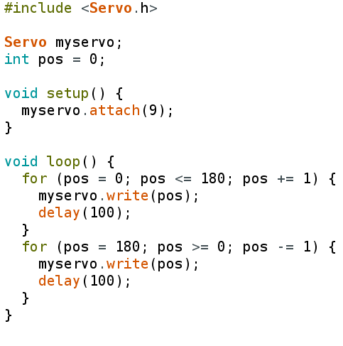

Slide 21
Interrupts in Arduino

Slide 22
What is an Interrupt?
Interrupt is a signal emitted by hardware or software when a process or an event needs immediate attention.
Alerts the processor to a high-priority process requiring interruption of the current working process.

Slide 23
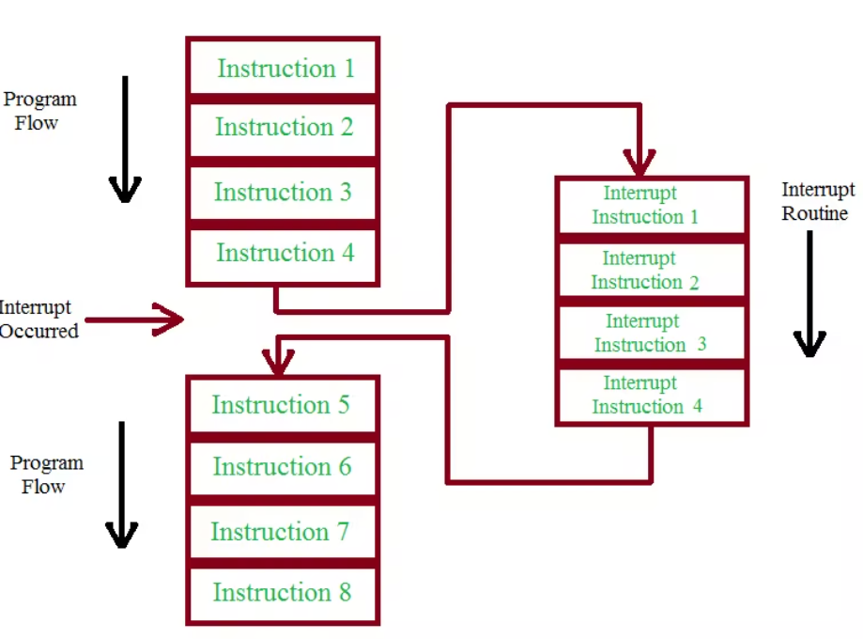

Slide 24
Interrupts in Arduino
Pin change interrupts
Timer based interrupts
External Interrupts
External interrupts are available on digital pins 2 and 3 only!

Slide 25
Interrupt Service Routing (ISR)
Code that is run when an interrupt occurs
Arduino uses attachInterrupt() to define interrupts and their ISRs.
ISR has the following Syntax in Arduino:
attachInterrupt(digitalPinToInterrupt(pin), ISR, mode);

Slide 26
Interrupt Modes
Mode argument of attachInterrupt defines which kind of signal will generate an interrupt
Available types are:
LOW to trigger the interrupt whenever the pin is low,
CHANGE to trigger the interrupt whenever the pin changes value
RISING to trigger when the pin goes from low to high,
FALLING for when the pin goes from high to low
e.g.
attachInterrupt( digitalPinToInterrupt(3), ISR, RISING );

Slide 27
Recall: The button Circuit!
Remember to debounce your circuit!
Also, connect an LED to one of the digital pins.

Slide 28
