Slide 1

E-Voting

Slide 2
Team Members
Ibrahim Jawed (k15-2131)
M. Shahiq Qureshi (k15-2822)
Taha Asif Siddiqui (k15-2855)

Slide 3
Introduction
Online Mobile Application
Online Admin Controller Web-based
Find Voting Event
Vote Favourite Candidate
Email Notification
Android Notification
SMS Notification
Fair Elections
No more Rigging

Slide 4
Literature Review
Another project called E-VOX at MIT implemented a simplified, user-friendly version of the FOO framework using Java, Netscape and JDBC (Java Database Connectivity).
In India first election using electronic voting was held from April 20 to May 10, 2004.
In Pakistan, no such project is being developed yet.

Slide 5
Methodology Used
Process Model:
In process model we used incremental approach
Website:
We used php and javascript
Android:
We used java(android)
Other Platforms:
Firebase notification
MySql Database
Lifetime Sms

Slide 6
Features
Single Platform for Multiple Voting Events
No More Creating Rush and Chaos at Polling stations
Vote Your Favourite Candidate
Get Notified by email
Get Notified by Android notifications
No more manual paper work
No more manual vote counting

Slide 7
Admin-Side Features
Automatic Android Notifications to all users
Automatic Email Notifications to all users
Can Add Voting Events
Can Start and Stop Particular Event
Can Add any number of candidates to Voting Event

Slide 8
Future Goals
Source of Advertisements for Election Campaign.
Political Parties would invest to provide advertisements for their parties.
Could Also Enable it and restrict it for a particular educational institutes.

Slide 9
Android Screen Shots

Slide 10
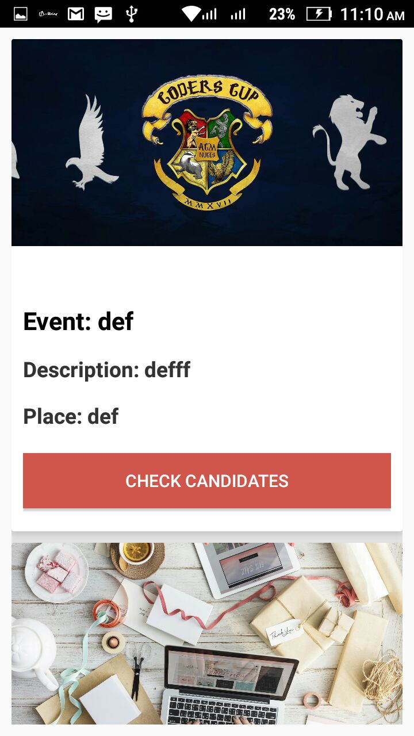
Android Screenshots

Slide 11
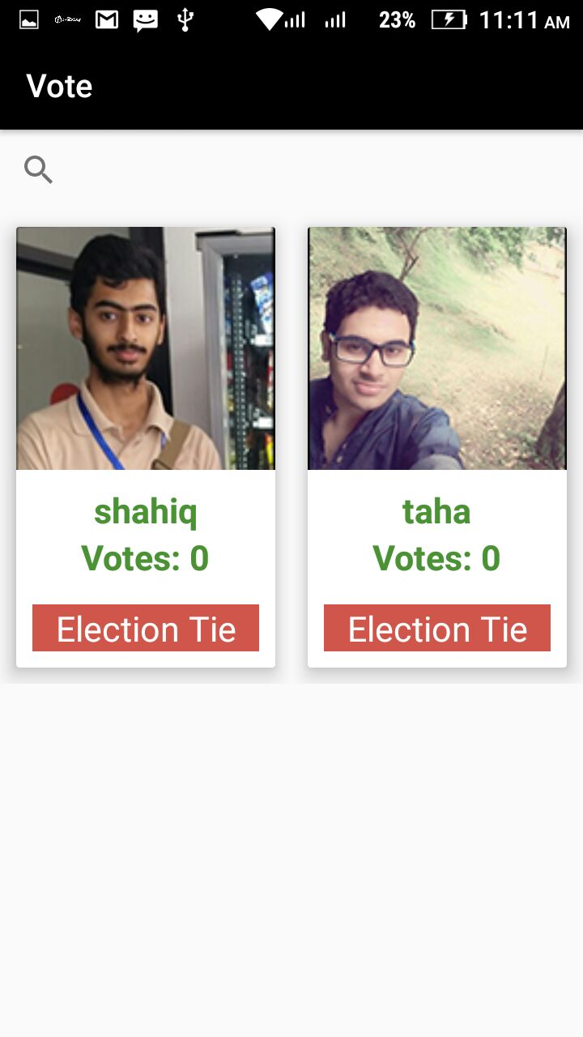

Slide 12
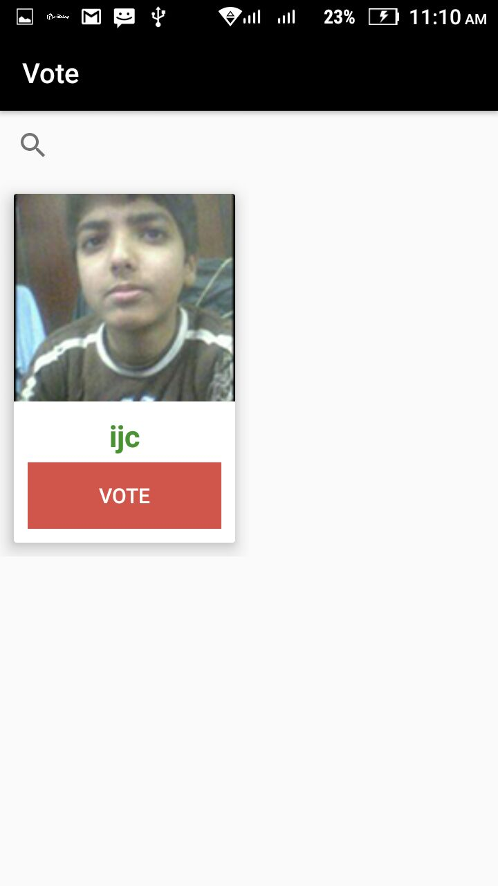

Slide 13
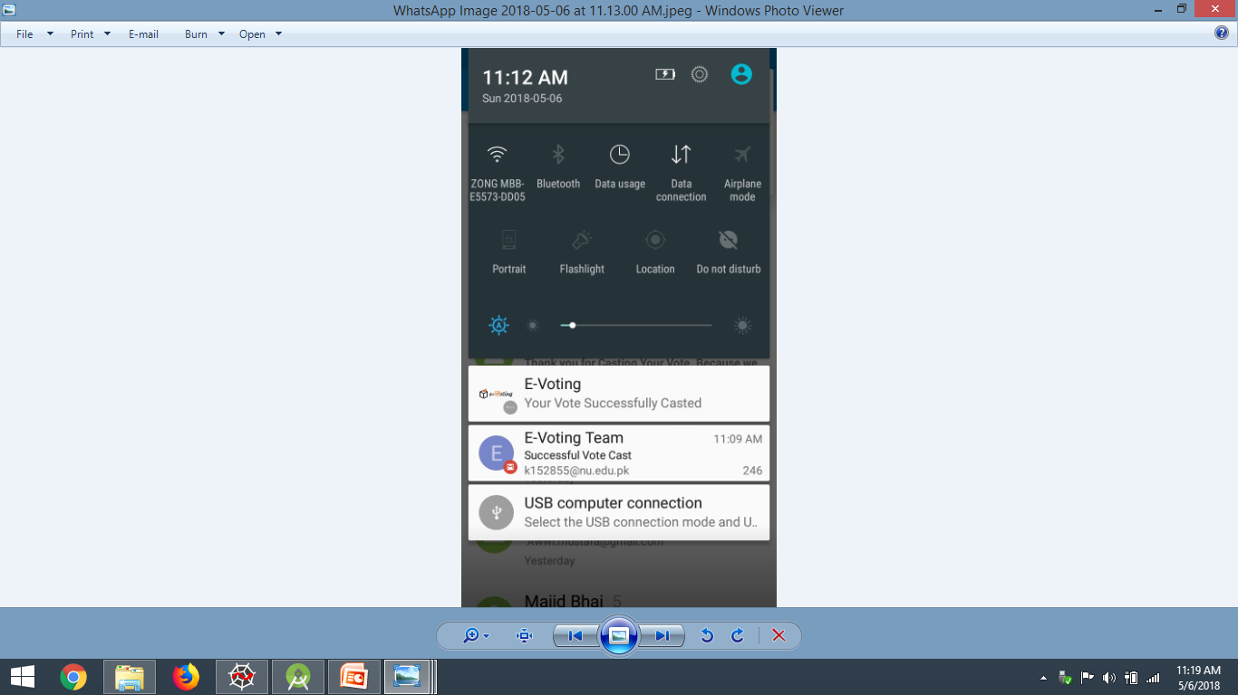

Slide 14
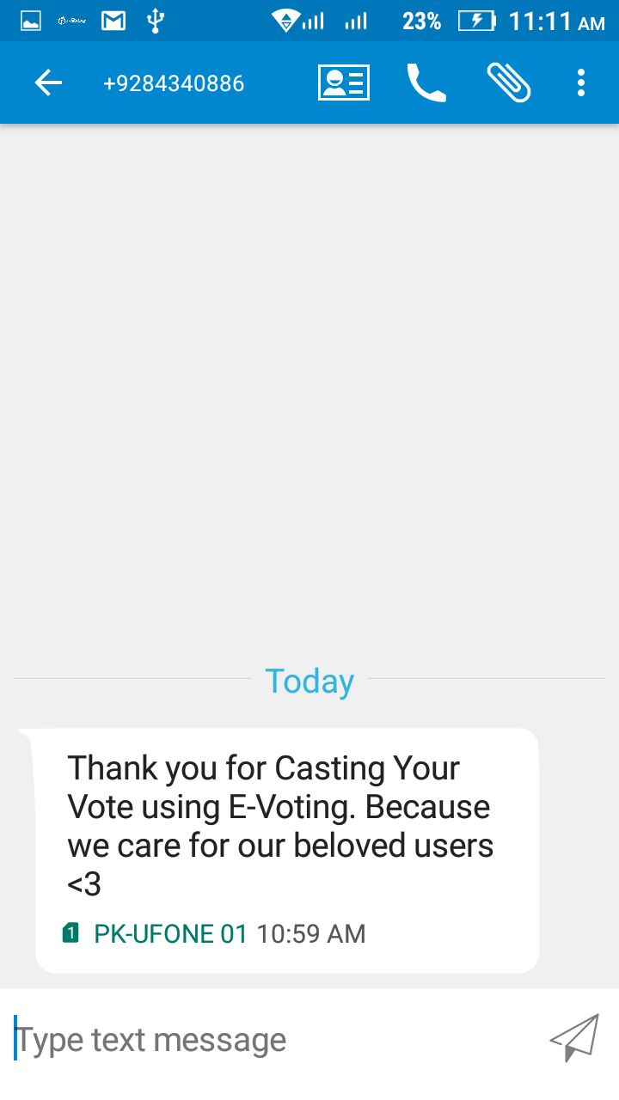

Slide 15

Admin Panel

Slide 16
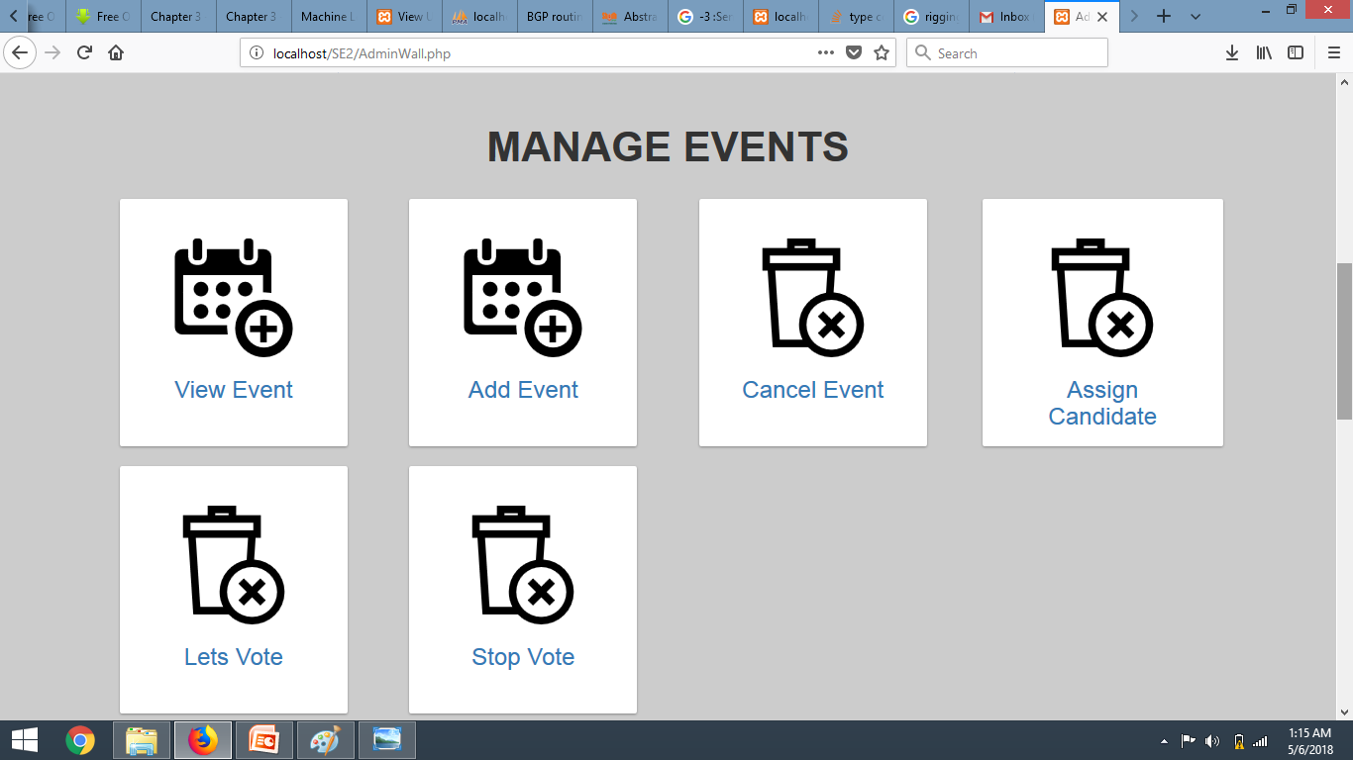
Admin Panel

Slide 17
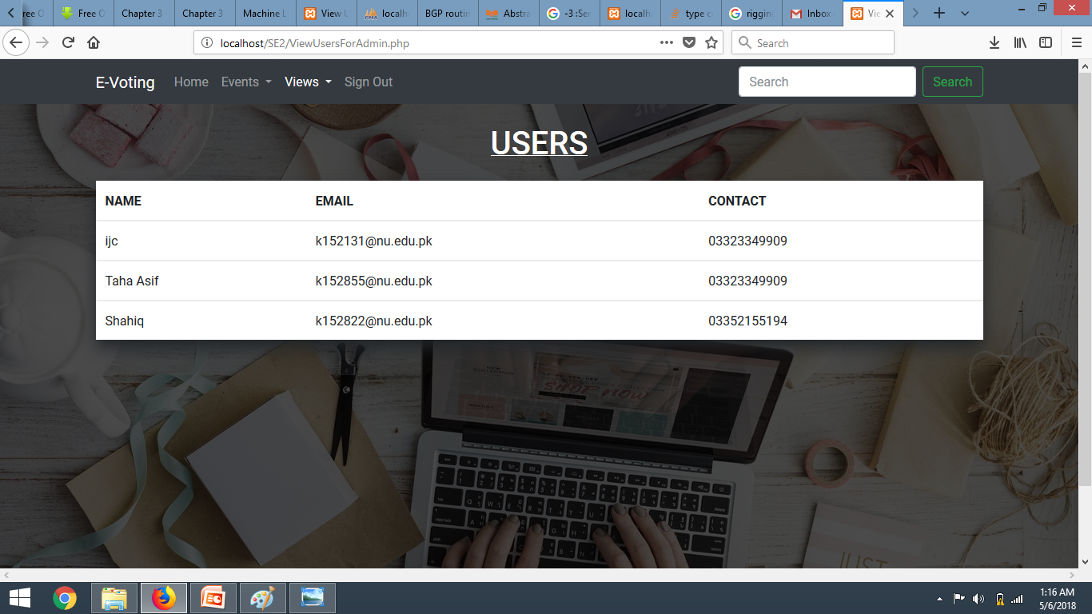
Admin Panel

Slide 18
Work Distribution (in terms of phases)
Name | Analyse | Design | Implementation | Testing
Ibrahim | 40% | 30% | 30% | 34%
Shahiq Qureshi | 30% | 40% | 30% | 33%
Taha Asif | 30% | 30% | 40% | 33%

Slide 19
Work Distribution (in terms of Implementation)
Name | Database | Android | Website | Testing
Ibrahim | 80% | 10% | 10% | 40%
Shahiq Qureshi | 10% | 10% | 80% | 40%
Taha Asif | 10% | 80% | 10% | 20%

