Slide 1
Singapore Travel Guide Project Milestone #2

Slide 2
Outline
Overview
UI Design Diagram
...
Cloud Architecture
...
Image Processing
...
Implementation Plan
Elasticity and Scalability

Slide 3
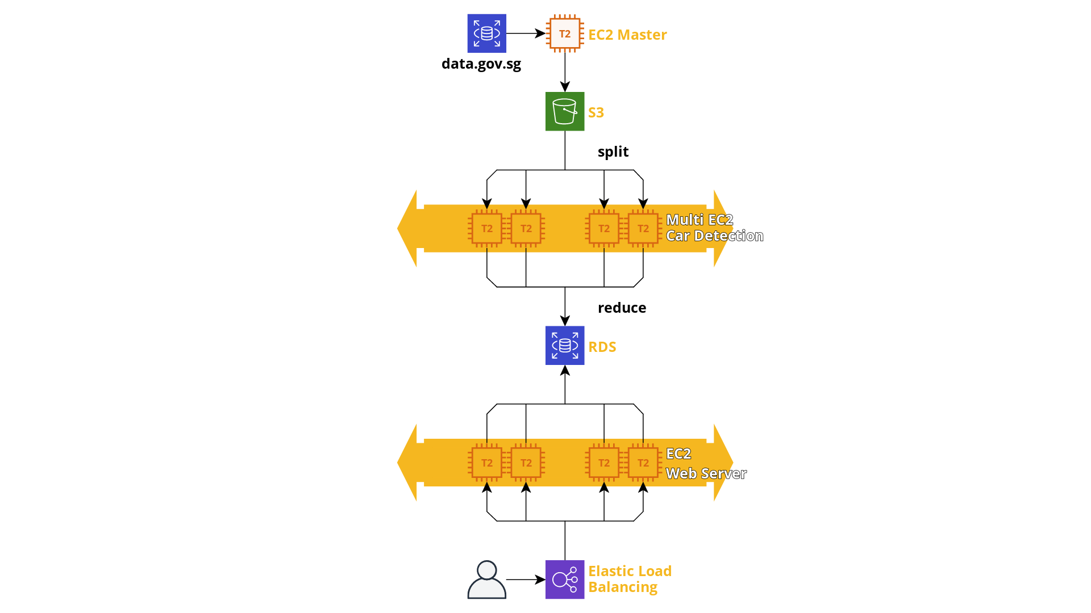
Overview

Slide 4
Outline
Overview
UI Design Diagram
...
Cloud Architecture
...
Image Processing
...
Implementation Plan
Elasticity and Scalability

Slide 5
UI Design Diagram

Slide 6
Outline
Overview
UI Design Diagram
...
Cloud Architecture
...
Image Processing
...
Implementation Plan
Elasticity & Scalability

Slide 7
Cloud Architecture

Slide 8
Outline
Overview
UI Design Diagram
...
Cloud Architecture
...
Image Processing
...
Implementation Plan
Elasticity & Scalability

Slide 9
Image Processing

Slide 10
Outline
Overview
UI Design Diagram
...
Cloud Architecture
...
Image Processing
...
Implementation Plan
Elasticity & Scalability

Slide 11
Implementation Plan

Slide 12
Outline
UI Design Diagram
...
Cloud Architecture
...
Image Processing
...
Implementation Plan
Elasticity & Scalability

Slide 13
Elasticity & Scalability

