Slide 1
Notes on Integrate and Fire Neurons
May 2009

Slide 2
IF Neuron
Properties
  Vt threshold pot.
  Vr reset pot.
  V0 (resting pot.
  Tm membrane (leak) constant
  Tr refractory (inactive after firing) period
State variables
  V membrane potential
  Active or recovering for time Tm after firing

Slide 3
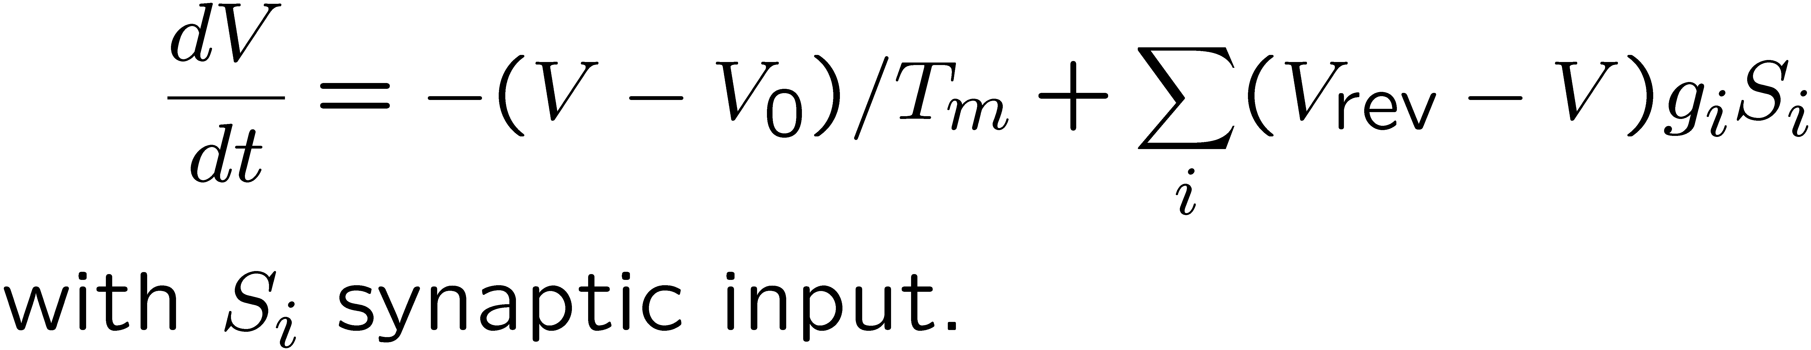
IF Neuron
Conductance Synapses
  Vrev reversal potential
    Vrev > Vt for excitatory
    Vrev < Vr for inhibitory
  g (>0) synaptic weight (conductance)
Dynamics

