Slide 1
Introduction
SURP 2025 Python Bootcamp
Ohio State Astronomy
Slides by: James W. Johnson and Liam Dubay

Slide 2
Hello!
We’d like to introduce ourselves
Liam Dubay (5th year grad)
Tawny Sit (4th year grad)
Jack Roberts (6th year grad)
Kaz Gary (4th year grad)
Devisree Tallapaneni (2nd year grad)
Sai Vidyud Senthil Nathan (senior undergrad)
Amber Malpas (postdoc)

Slide 3
Format
Emphasis on hands-on experience and group coding
There will be some slides, but not many
Slides from previous years are available as a reference
Start by going through a guided Jupyter notebook
Exercises are included, but won’t be graded – this isn’t a course
Ask us if you have questions at any time!
Each day will end with a group coding challenge (tiny prize for completion!)

Slide 4
Format
Material is very condensed to fit into five sessions – mastery of these skills will come over time, even beyond this summer
In the long run, what you get out of this will reflect what you put into it
Notes:
In the past, students have started to notice the usefulness of the concepts covered in the later sessions around July – mind them and you’ll be thanking yourself later.

Slide 5
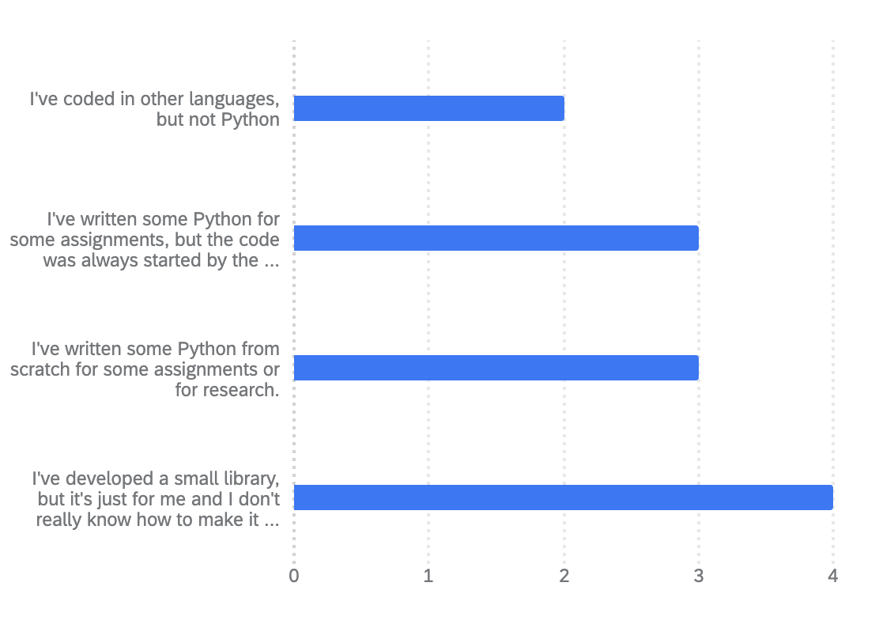
Survey Responses
Q1: How would you describe your skill level in Python?
A wide range of skills, but most have experience in Python
We’re aiming to get you up to the last option
Notes:
About current capabilities in Python, general census is most, if not all of you, have coded before. You’ve written code for class or research.

Slide 6
Survey Responses
Most have used libraries like matplotlib and numpy
Mostly solo coding experience
Range of comfort levels on basic Python syntax (if/else, loops, functions)
~Half have written a class before (!), and most know how to import their own code
Most use Jupyter notebooks and are not super comfortable with the terminal
Lots of experience with other languages, especially C (yes I made one of them up)
Most have not opened a FITS file
Notes:
We will provide some notebooks to learn and review material, but many of the exercises and group challenges are best done in text files. I encourage everyone to practice using text files in this bootcamp, since most of you are less familiar with that way of coding

Slide 7
Survey Responses
New material:
For many of you: the terminal, object-oriented programming, FITS files
For about half of you:
How to import your own code from elsewhere in your computer (packaging may be new to some)
Some of the material is either impossible or quite difficult when coding in a notebook. I advise all of you to use this bootcamp as practice for working in text files.
Notes:
I’ll show them how to download the course material after we talk about terminal commands.

Slide 8
Additional Learning Material
Those of you new to Python – we strongly advise going through some of this ahead of tomorrow’s session, which will be a crash course
Python Foundation’s Beginner’s Guide: https://www.python.org/about/gettingstarted/
https://www.learnpython.org/ - There is also an iOS app for this
Codecademy: https://www.codecademy.com/learn/learn-python-3
Notes:
1) Developed Python and a good start for a refresher or new to Python, 2) LearnPython is an app and website and a good way to learn syntax and get it running, 3) CodeAcademy is a great tool too, plenty of resources

Slide 9
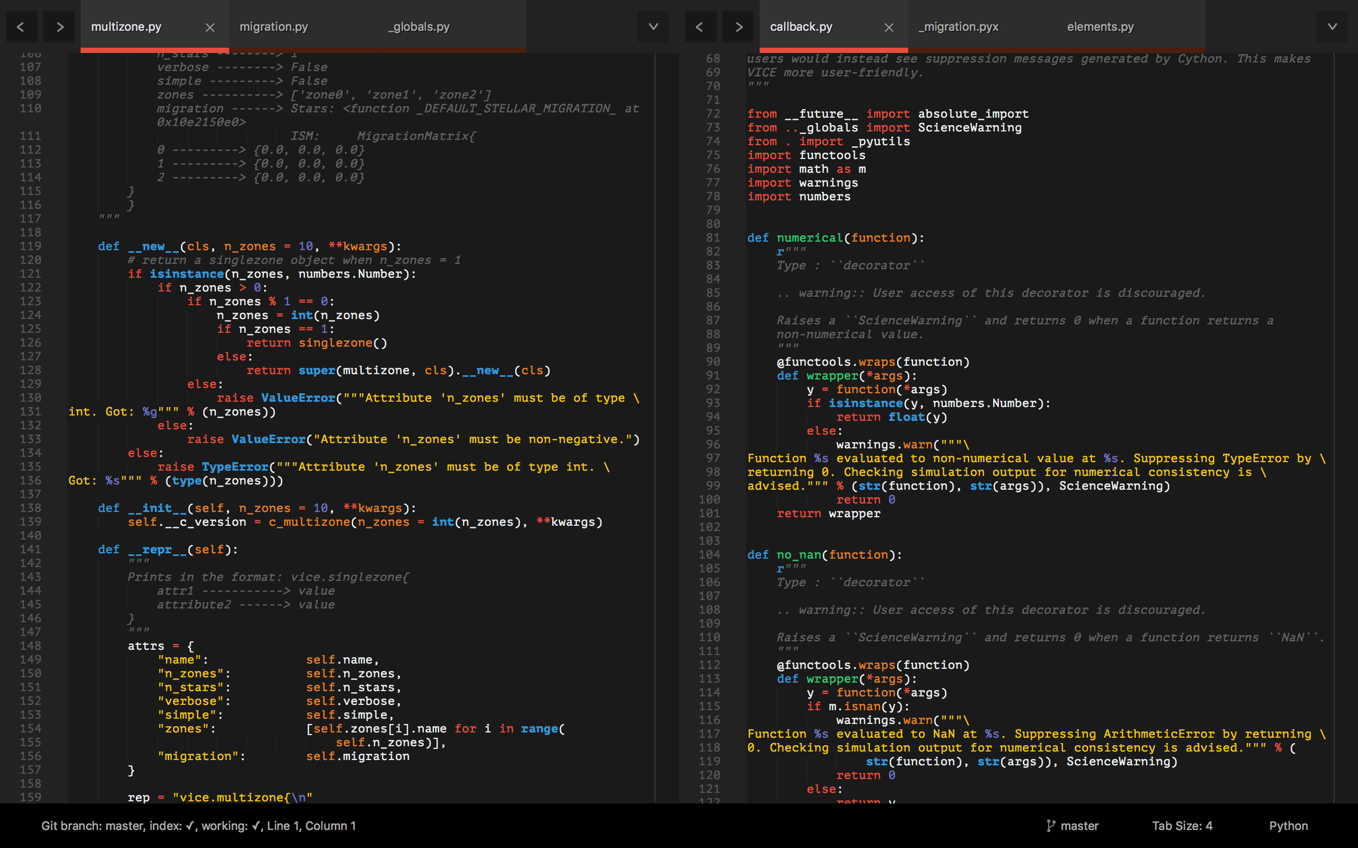
Tools: An IDE
Integrated Development Environment (IDE) – can edit & run code, organize projects
Examples: PyCharm, Spyder, VSCode
I recommend VSCode
https://code.visualstudio.com/
Free, lots of plugins, supports Jupyter notebooks too!

Slide 10
Tools: A Text Editor
Differs from an IDE – all they do is open, create, edit, etc. plain text files
Lots of options – some run right in the terminal (Emacs, VIM)
I recommend Sublime Text
https://www.sublimetext.com/
Notes:
As mentioned before, a text editor is a useful tool when coding with Python as not everything can be done in notebooks. If you’ve ever written a file that ends in .py, that’s a python text file while notebooks typically end in .ipynb. IDE’s differ from notebooks in that they will run your code for you while notebooks are applications that use the internet to run your code for you. IDE’s are a type of text editor, but are also only dedicated to one language, meaning you can only code in Python in a Python IDE, such as PyCharm or Spyder. Whereas with other text editors, you can use multiple languages. Sublime Text is a great text editor that’s not an IDE, meaning you can code in many different languages. Ultimately, it’s up to you and what you feel like is the best fit for your needs as a researcher/programmer.

Slide 11
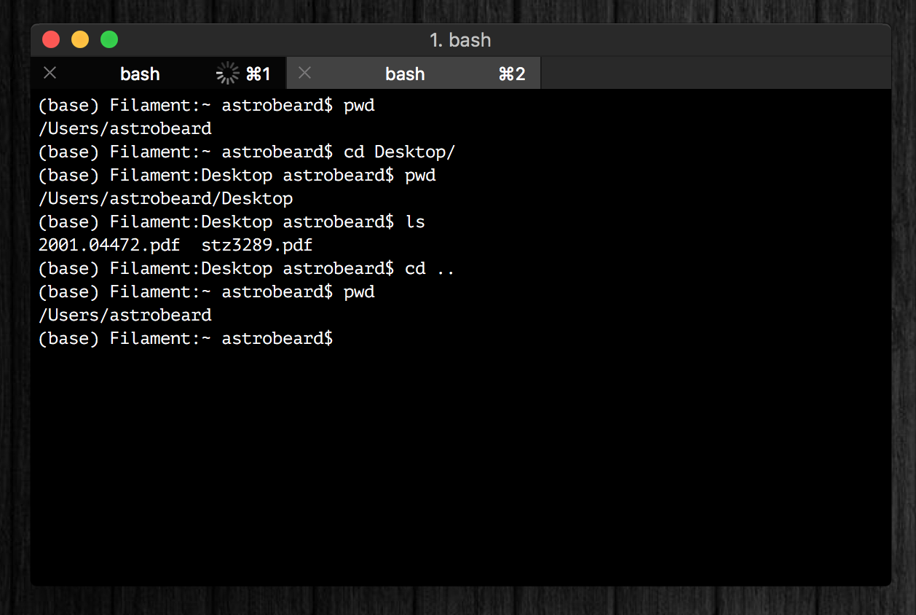
Tools: A Terminal
I recommand iTerm2
Terminal replacement
https://www.iterm2.com/
You should think of a terminal as just a different interface on a Finder window with some extra programs built-in
Tip: you can run python line-by-line in a terminal (python or ipython)
Notes:
Works the same as a Finder window basically, if you have a Mac you have a built in terminal application. iTerm2 is an application that can replace your terminal and functions just the same. Terminals are also cool because you run python code line by line in them, so if you wanted to import or update already installed Python packages or libraries, you can do it right there instead of in your notebook or text editor.

Slide 12
Tools: A Terminal
If you’re running Windows, your terminal will be different than some of the notes and exercises here, unless you take some extra steps at the beginning to set up a bash interpreter (e.g. WSL).
Talk to me if you need help with this!
Notes:
We’ll sit down at the end of this session with anyone running windows and help them set up the Windows Subsystem for Linux (WSL)
For Windows users, those who don’t have a Mac or Linux machine, terminal can be a bit more difficult to find and use but it is possible. There’s a couple extra steps that you have to do get it so be sure to come and talk to us if you want/need help with getting that set up on your Windows machine.

Slide 13
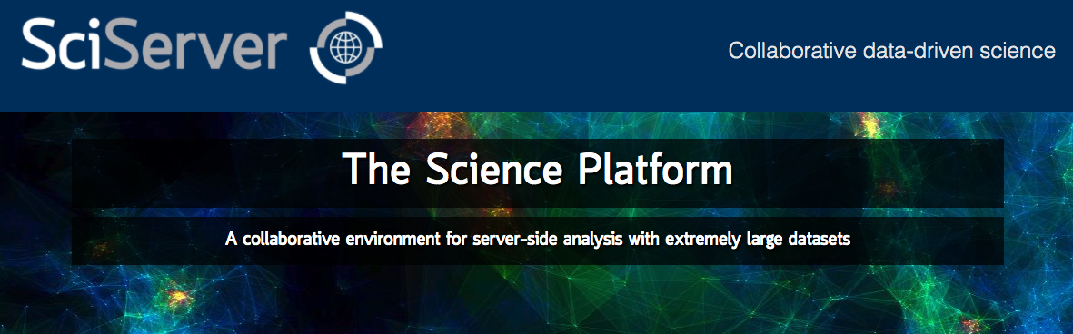
Tools: Cloud Computing
Allows you to run python on a remote server
SciServer is a popular platform across many STEM fields:
https://www.sciserver.org/
In the long run you should choose the tools that you’re most comfortable with
Notes:
We won’t be using this in the bootcamp but is a good tool to use. It’s an example of a cloud-computing server, meaning that when you run a notebook on SciServer, instead of it being ran by your computer, it’s being ran by their own server. Basically, your computer is not doing the work and running the code, it’s the website (in this case SciServer’s) own remote server that is executing the code and then sending the results of that code back to you to look at. Again, use the application that you are most comfortable with!

Slide 14

If You Haven’t Already
https://www.anaconda.com/products/individual
This will install Python, Anaconda, and Jupyter Notebooks
Latest version of python: 3.13.3
Most libraries now require >= 3.8
Python 3.9 will be deprecated October 2025
Python 2.7 is deprecated
Talk to us if you need to use it, for now just don’t install that version
Notes:
Emphasize that python 2.7 is deprecated (no longer supported) because the number of stubborn researchers still using it is surprisingly high. If given code that runs on 2.7, they should come talk to us.
If you haven’t already, you’ll need to get Python. We won’t be going over Python itself today, but this is just so you guys have some time to get familiar with the tools around programming and have time to download and install your platform of choice. If you don’t know if you have Python, go to this link and it will install Python, Anaconda and Jupyter Notebooks for you. I use Anaconda to get to Jupyter Notebooks and Spyder, so it’s kind of like a main menu of all the different ways you can run Python. We will talk more in depth about Anaconda and things you can do with it later in the bootcamp course. Python 2.7 and below are deprecated, which means the programmers who run Python do not offer support or code for any versions older than Python 2.7. So, again, this website will let you download Python if it’s not already installed and update it if your machine has it pre-installed with the latest version of Python which is 3.11.

Slide 15
Goals
What we’ll aim to cover:
How to use a terminal
Review of the basics: control structures, data types, functions, import, etc.
How to read documentation
Third-party libraries: NumPy, AstroPy and matplotlib
How to import your own code, and how to set up a directory tree to organize it
Classes: how to make new objects
Inheritance and Composition
Some basic software engineering principles (i.e. good habits)
Notes:
Today, Wednesday, Friday (Anaconda too, documentation is important throughout different packages or libraries, going over exercises), Monday (second week is going more into detail about object-oriented programming, something we’ll talk a little bit about today), Wednesday (inheritance and composition are powerful tools), Thursday (not coding more, but coding better) Less is more!

Slide 16
Resources
Do use:
The reference notebooks and slides
Your groupmates and peers
The bootcamp facilitators
Coding forums, e.g. Stack Overflow
Your research advisor(s)
Don’t use:
ChatGPT, Copilot, or other AI code generators
Notes:
This bootcamp is for YOU – there are no grades, no penalty if you don’t get through all the material. We want to start developing good habits that you will rely on the rest of your career.

Slide 17
Monday Motivation
Every expert coder was once a novice.
You can’t improve your coding practices without first criticizing what you once thought was great code.
Since we’re not professional developers, scientists have to actively create and foster good coding habits if they want them. Being early career researchers, you have the option to make this decision now. It will only become more difficult to do this.

Slide 18
Today’s Plan
Get into groups – all experience levels in each group
Slides: context of Python
Install Anaconda
Make sure you have a way to edit text files and Jupyter notebooks
Either an IDE or combination text editor and web browser
Windows users: install WSL
or find a friend with a UNIX terminal
Download course material
git clone https://github.com/lodubay/PythonBootcamp2025
Group challenge: terminal quest!

