Slide 1
LOFAR FIELD CABLING
An internship by Thomas tijsma

Slide 2
introduction
Thomas Tijsma
NHL/Stenden Leeuwarden
September 2018 – January 2019

Slide 3
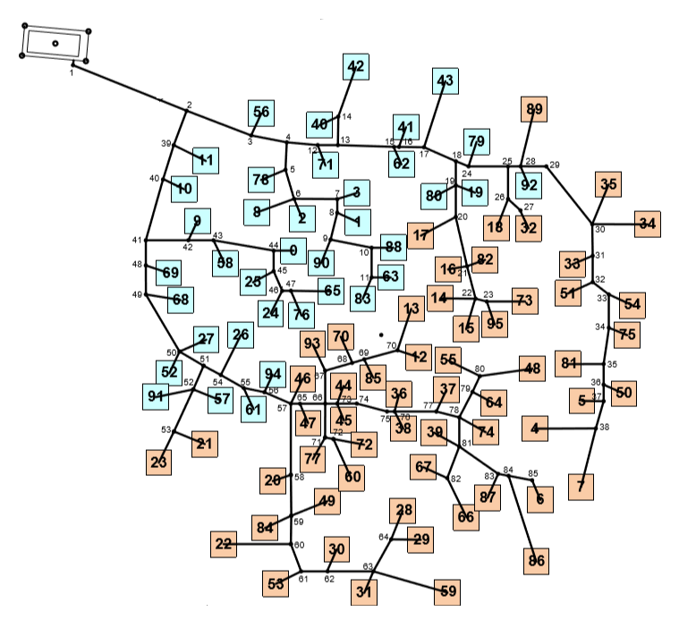
The issue

Slide 4
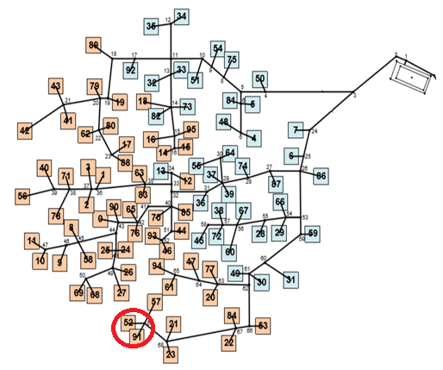
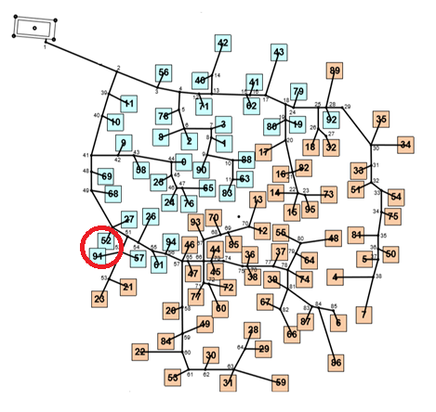
A closer look at the issue
Same 96 antenna’s
Cable house
85m or 115m
Can’t go under antenna’s

Slide 5
Researching similar problems
Steiner tree

