Slide 1
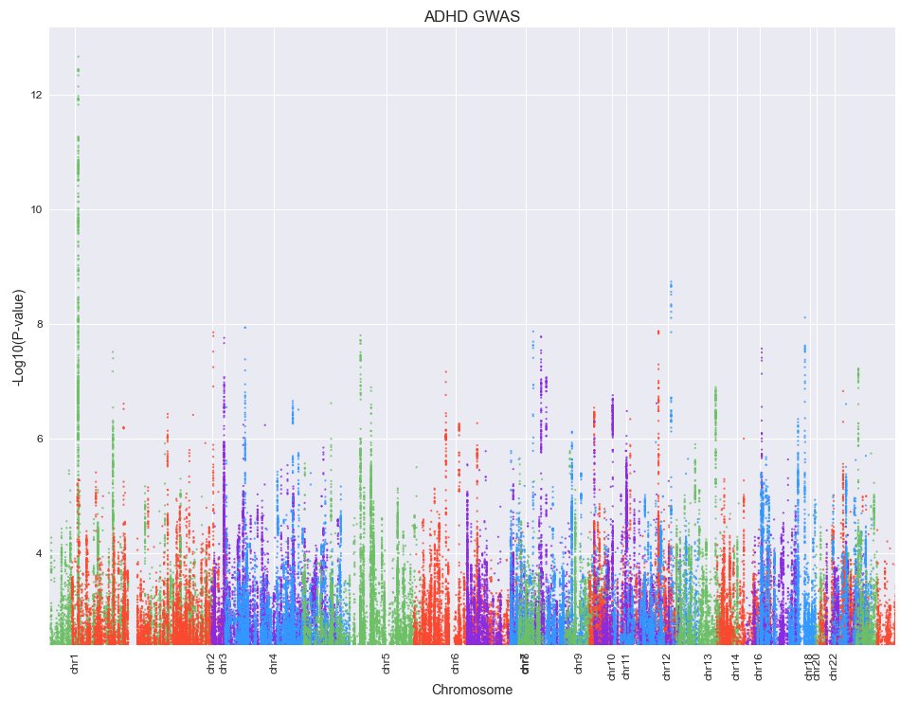
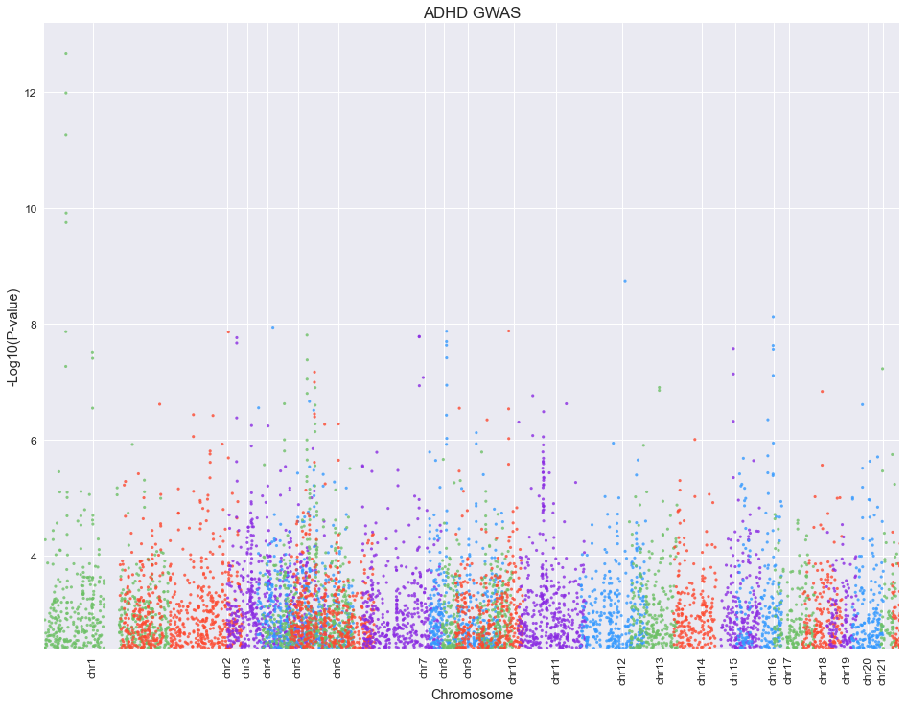
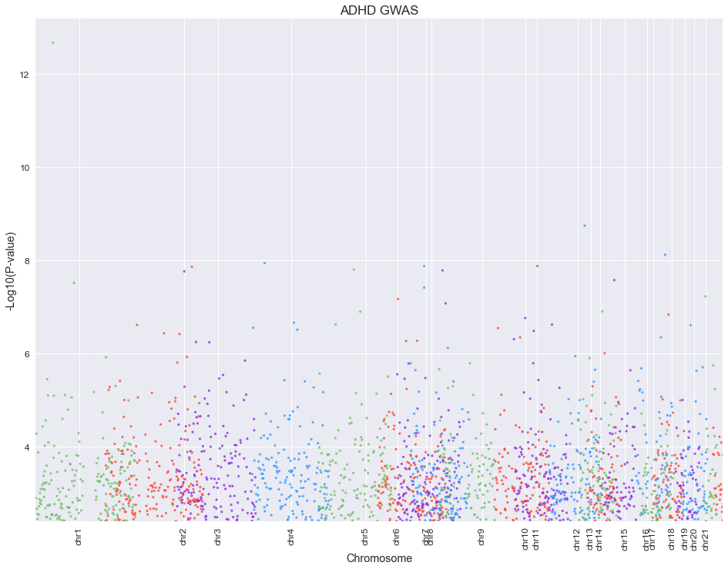
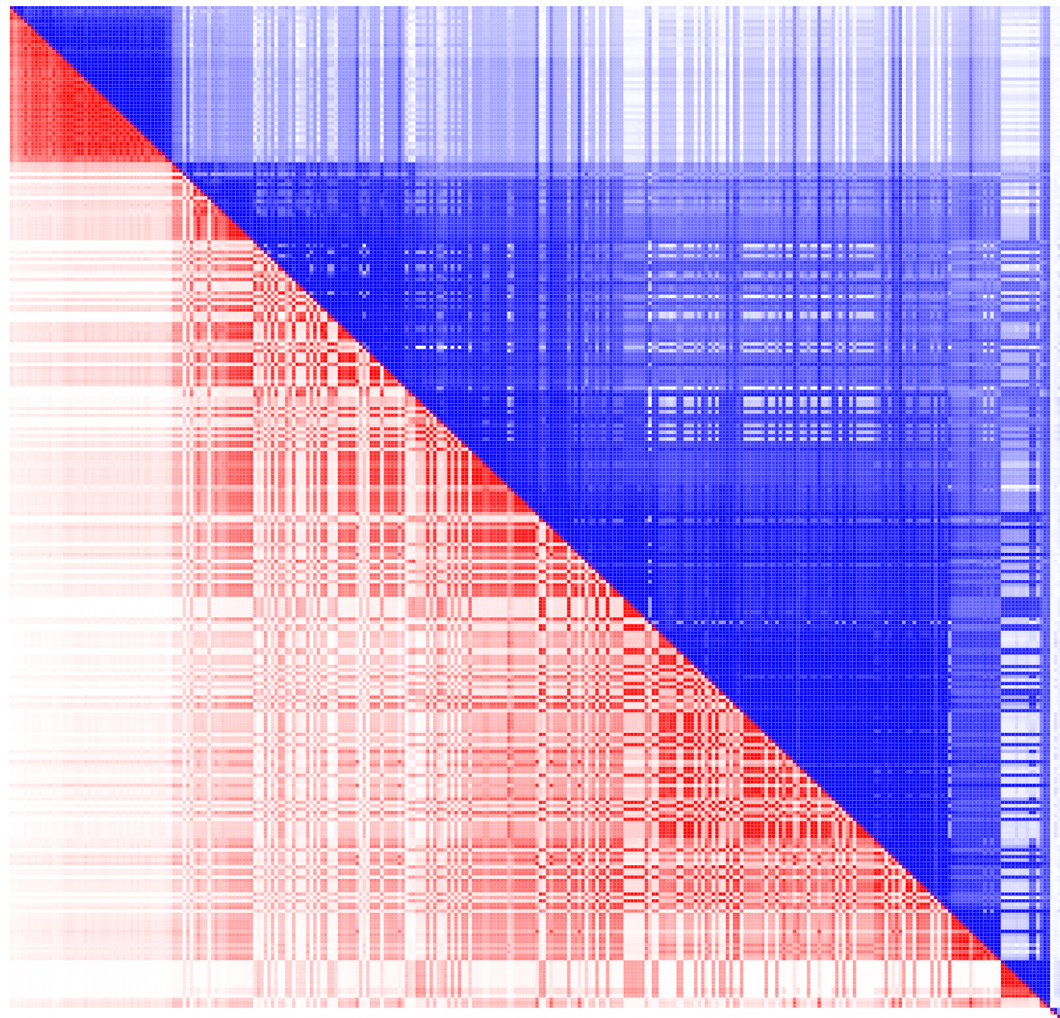
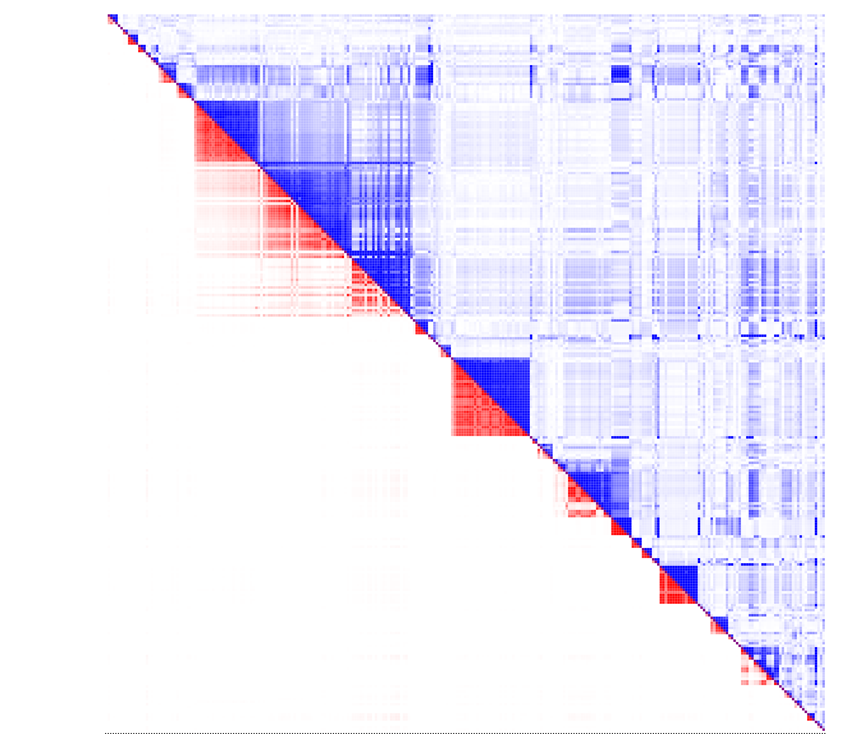
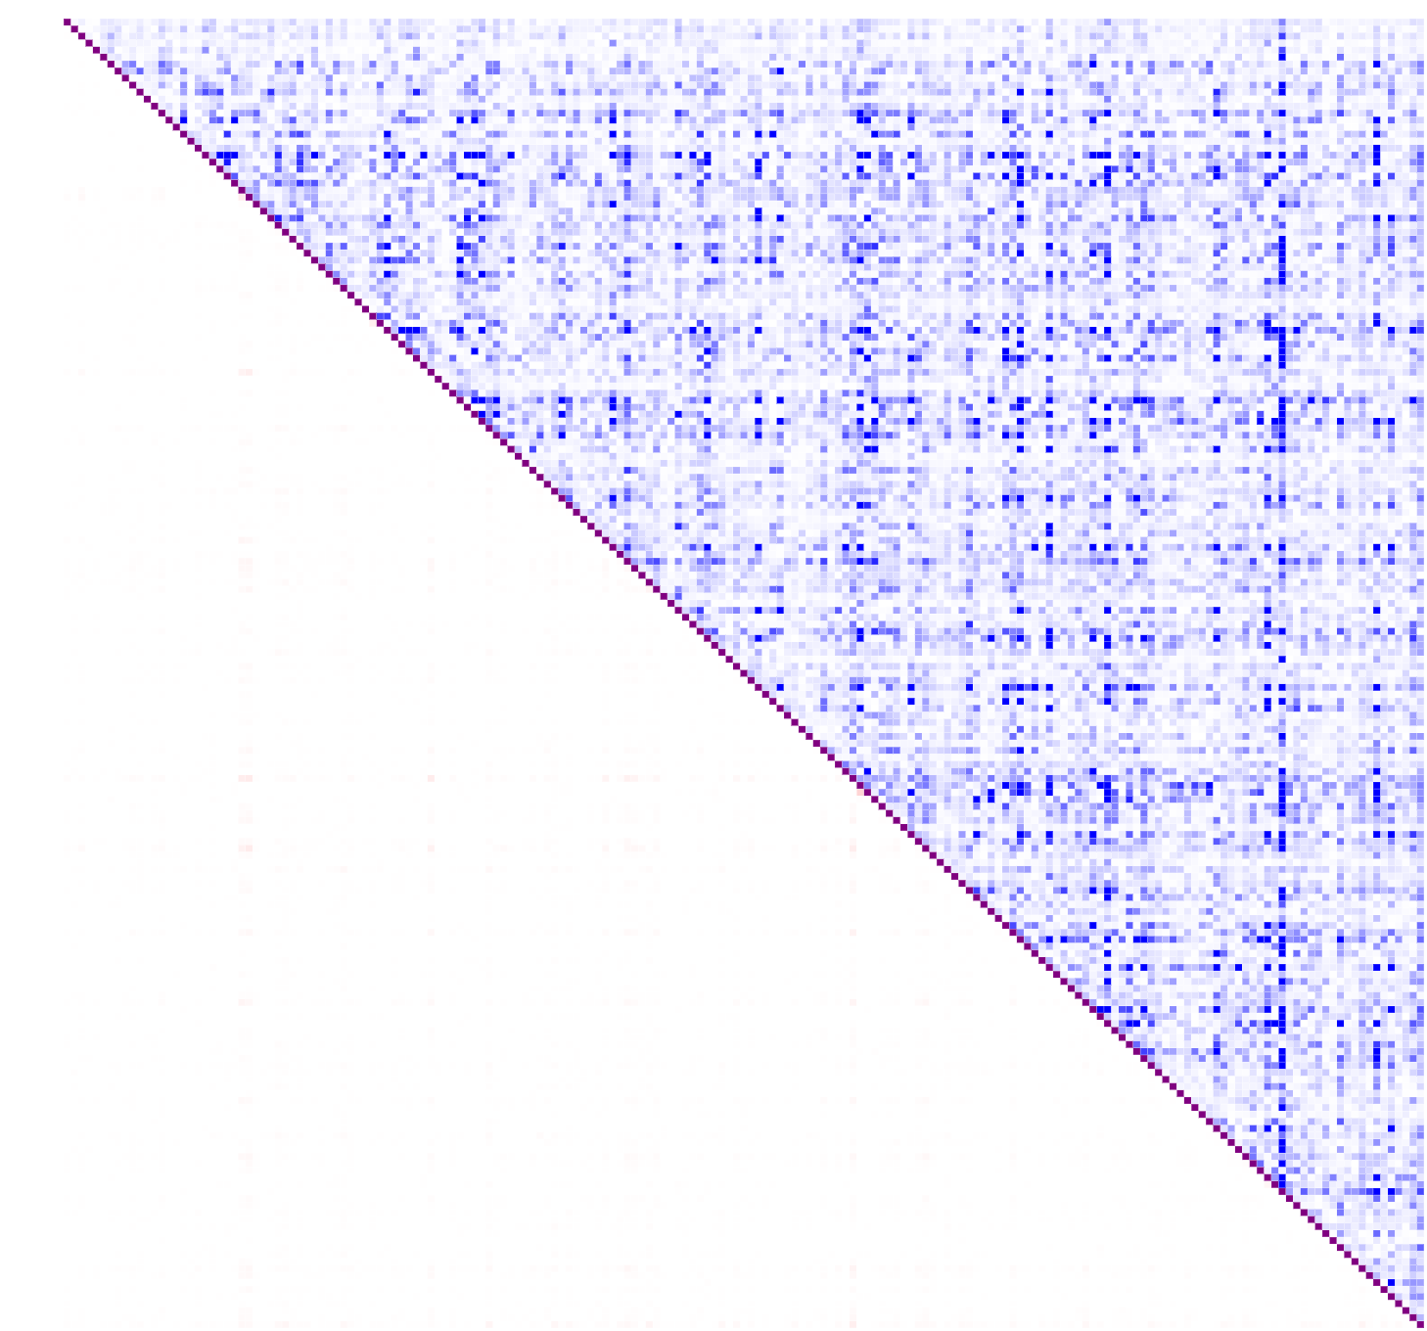
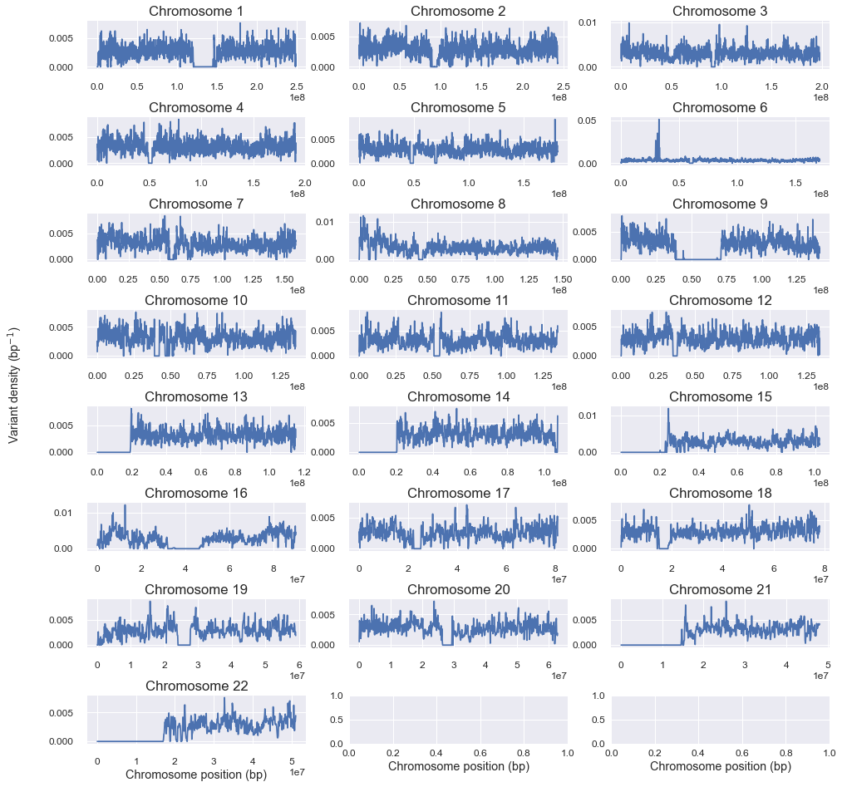
Genetic Correlates of ADHD
Alexander Russell Loftus
The Johns Hopkins University
Foundations of Computational Biology and Bioinformatics Spring 2020
Summary
Results
Discussion and implications
No Adjustment
BW=40,000
BW=400,000
Background
ADHD is a neurodevelopmental disorder with a population prevalence of 2-5%.
High association with negative life outcomes
Lower education, underachievement, impaired relationships, health issues, and many more
ADHD is highly heritable – twin and adoption studies consistently report 50-70% heritability.
Massively polygenic, so it is difficult to pinpoint specific genetic causes of the disorder.
Early candidate genes were dopamine-focused due to the psychopharmacodynamic effects of amphetamines like Adderall and Ritalin
2017 GWAS study with large enough sample size to achieve genome-wide significance found little significance from DA-related genes, but found other highly-conserved regions
Also found genetic correlation with many negative life outcomes and other neurodevelopmental disorders
Methods
Above: Results of mean-shift clustering within chromosome.
Top row: Manhattan plots at each bandwidth. 100,000 highest p-values were used, and then colored by chromosome. Left: Manhattan plot prior to clustering. Middle: Manhattan plot post-clustering with bandwidth of 40,000. Right: Manhattan plot post-clustering with bandwidth of 400,000.
Bottom row: linkage disequilibrium matrices for chromosome 1, 300 highest p-values. Red is correlation (Pearson’s R), blue is normalized linkage disequilibrium coefficient. (I, J)th position of each matrix corresponds to the linkage disequilibrium between variant I and variant J. Left: pre-clustering linkage disequilibrium. Middle: post-clustering linkage disequilibrium with a bandwidth of 40,000. Right: post-clustering linkage disequilibrium with a bandwidth of 400,000.
References
Faraone, S., Asherson, P., Banaschewski, T. et al. Attention-deficit/hyperactivity disorder. Nat Rev Dis Primers 1, 15020 (2015). https://doi.org/10.1038/nrdp.2015.20
Demontis, D., Walters, R. K., Martin, J., Mattheisen, M., Als, T. D., Agerbo, E., ... & Cerrato, F. (2019). Discovery of the first genome-wide significant risk loci for attention deficit/hyperactivity disorder. Nature genetics, 51(1), 63-75.
Heal, D. J., Smith, S. L., Gosden, J., & Nutt, D. J. (2013). Amphetamine, past and present–a pharmacological and clinical perspective. Journal of Psychopharmacology, 27(6), 479-496.
Franke, B., Faraone, S. V., Asherson, P., Buitelaar, J., Bau, C. H. D., Ramos-Quiroga, J. A., ... & Lesch, K. P. (2012). The genetics of attention deficit/hyperactivity disorder in adults, a review. Molecular psychiatry, 17(10), 960-987.
Alberts-Corush J, Firestone P, Goodman JT. Attention and impulsivity characteristics of the biological and adoptive parents of hyperactive and normal control children. Am J Orthopsychiatry 1986; 56: 413–423.
Sprich S, Biederman J, Crawford MH, Mundy E, Faraone SV. Adoptive and biological families of children and adolescents with ADHD. J Am Acad Child Adolesc Psychiatry 2000; 39: 1432–1437.
Bulik-Sullivan, B. K., Loh, P. R., Finucane, H. K., Ripke, S., Yang, J., Patterson, N., ... & Schizophrenia Working Group of the Psychiatric Genomics Consortium. (2015). LD Score regression distinguishes confounding from polygenicity in genome-wide association studies. Nature genetics, 47(3), 291.
Vilhjálmsson, B. J.; et al. (2015). "Modeling linkage disequilibrium increases accuracy of polygenic risk scores". American Journal of Human Genetics.
Comaniciu, D., & Meer, P. (2002). Mean shift: A robust approach toward feature space analysis. IEEE Transactions on pattern analysis and machine intelligence, 24(5), 603-619.
Left: per-chromosome variant density. For each chromosome, windows of 100,000 base pairs were generated, and the average variant density as a proportion of base pairs that had GWAS variants was calculated. Windows roll forward and density was plotted on the y-axis.

