Slide 1
Android Hardware Abtraction Layer Part 2
Luu An Phu

Slide 2
Agenda
Service HAL (Proxy)
Init service .rc
Device manifest

Slide 3
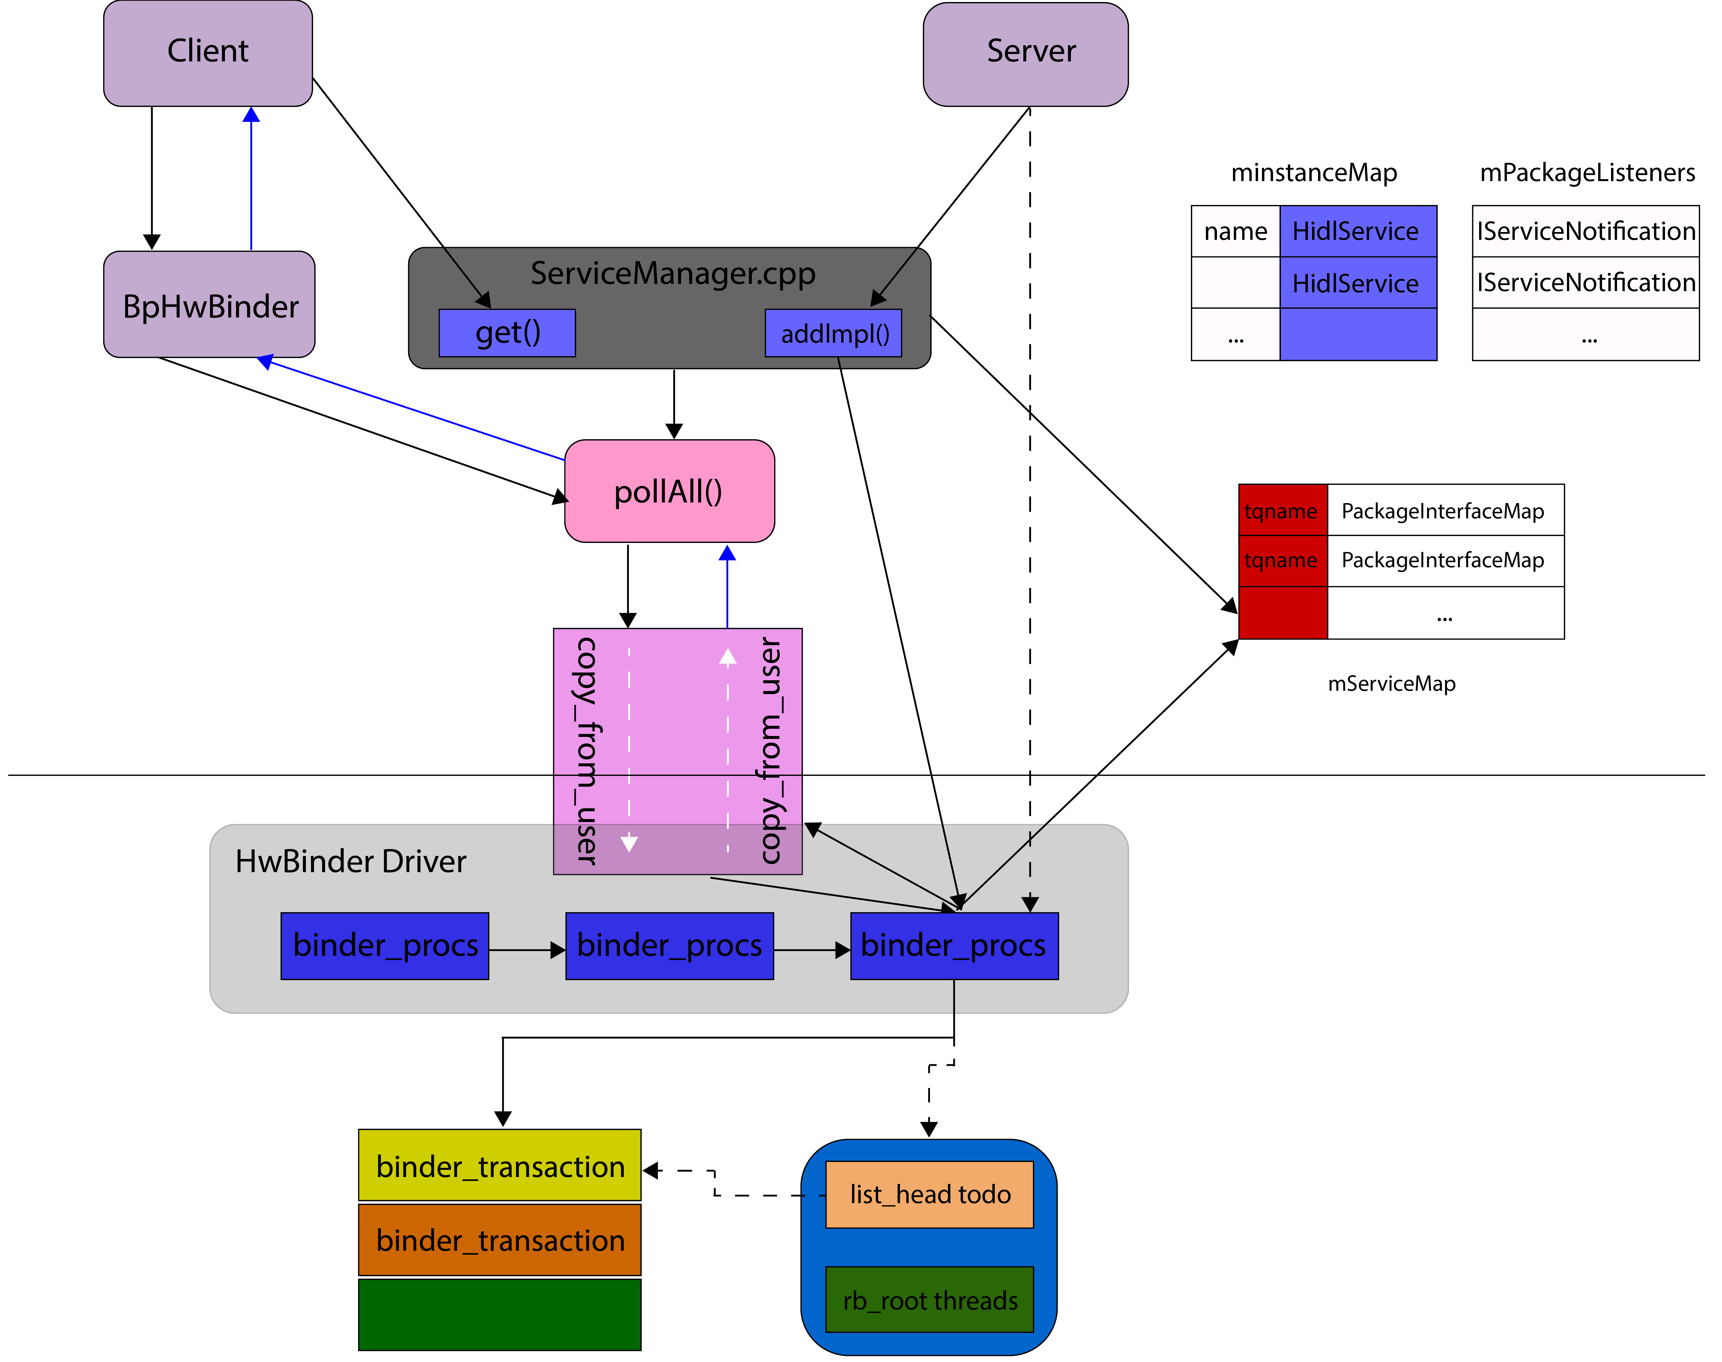
Service HAL (Proxy)

Slide 4
THANK YOU

