Slide 1
Model
Star
Teff = 3000
M = 0.16
R = 0.2
Logg = 5.0
[M/H] = 1
Teff = 3500
M = 0.44
R = 0.45
Logg = 4.8
[M/H] = 1
Teff = 4000
M = 0.64
R = 0.63
Logg = 4.6
[M/H] = 1
Teff = 5000
M = 0.8
R = 0.8
Logg = 4.5
[M/H] = 1
Teff = 7000
M = 1.5
R = 1.7
Logg = 4.2
[M/H] = 1
Planet
Neptune
M = 0.05
R = 0.35
[M/H] = 100
SuperNeptune
M = 0.09
R = 0.54
[M/H] = 50
Saturn
M = 0.3
R = 0.8
[M/H] = 10
Jupiter
M = 1
R = 1
[M/H] = 3
SuperJupiter
M = 5
R = 0.9
[M/H] = 1
C/O
0.5 Solar
1.0 Solar
1.5 Solar
Each Model contains
Equil temp -> sets separation
75 K
100 K
150 K
180 K
200 K
250 K
300 K
500 K
Pressure/Temperature profile for each Teq
Each Teq has
Phase
0 deg
45 deg
90 deg
120 deg
140 deg
For each phase:
Stellar Spectrum and cloud-free Albedo, Planet/Star Flux Ratio, and Planet Spectrum from 0.3-2 um at R = 60,000
And cloudy models:
Sedimentation efficiency f_sed
0.1
0.5
1
3
6
10
Vertical mixing k_zz
1x10⁹
1x10¹¹
75 Models
36,375 total spectra
485 spectra

Slide 2
Climate calculation step
Spectrum calculation step
Final outputs
inputs
Star Spectrum
star
Phoenix
RCE, chemical equilibrium, iterative solution
Calculation of cloud-free and cloudy albedo and planet-star flux contrast
Star spectrum
Planet
Initial P(T) guess
albedo spectrum
Calculation setup
picaso
picaso
cloud
Cloud postprocessing step
Flux contrast spectrum
outputs
P(T) Profile
outputs
Calculation of cloud profile
Planet spectrum
Molecular abundances
cloud Profile
Energy transport in atm
virga
Base model
Base model has:
Star
Planet
C/O
Eq Temp
Phase
M5V
Neptune
75 K
M2V
superneptune
0.5
100 K
0
K8V
saturn
1.0
150 K
K2V
jupiter
1.5
45
180 K
F1V
superjupiter
90
200 K
120
75 base models
250 K
140
300 K
Each cloudy model has:
500 K
F_sed
Log(K_ZZ)
75x40 Climate models
0.1
0.5
39,000 total spectra
1
9
3
11
6
10
12 cloudy spectra + 1 cloud-free

Slide 3
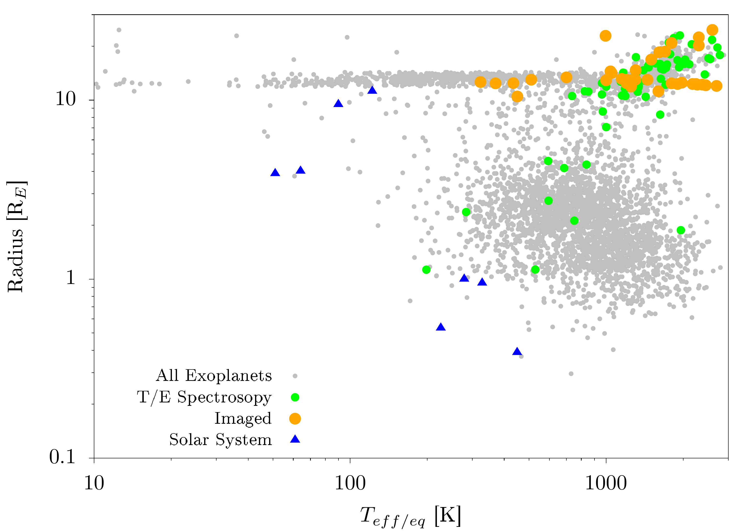
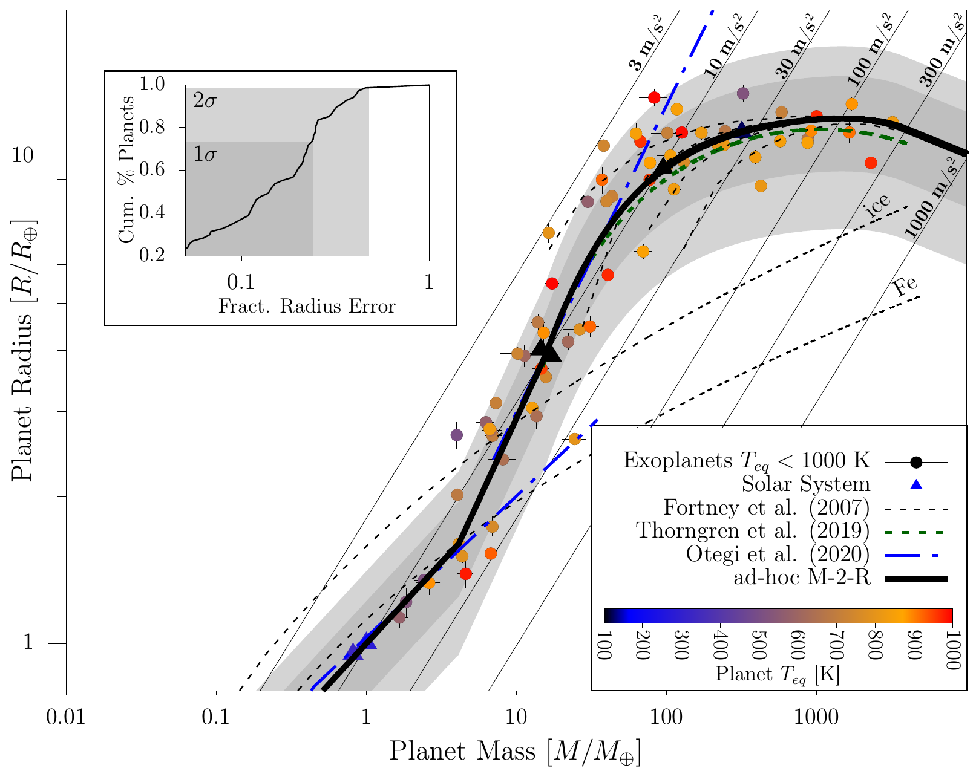
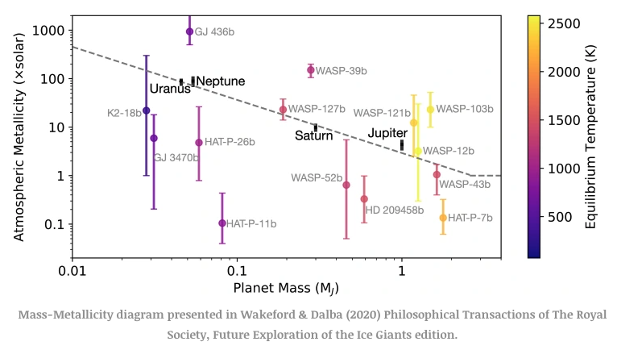
Planet Parameter Selection Justification
Neptune-Saturn Intermediate
Neptune
Saturn
Jupiter
Super Jupiter
Radius = 4 Rearth = 0.35Rjup
Mass = 17Mearth = 0.05Mjup
Metallicity = 100
Radius = 6 Rearth = 0.54Rjup
Mass = 30Mearth = 0.09Mjup
Metallicity = 50
Radius = 9 Rearth = 0.8Rjup
Mass = 95Mearth = 0.3Mjup
Metallicity = 10
Radius = 11Rearth = 1Rjup
Mass = 317Mearth = 1Mjup
Metallicity = 3
Radius = 10 Rearth = 0.9Rjup
Mass = 1560Mearth = 5Mjup
Metallicity = 1

