Slide 1
Object-Oriented
JavaScript
Stoyan Stefanov, Yahoo! Inc.
Beijing, Dec 6th, 2008

Slide 2

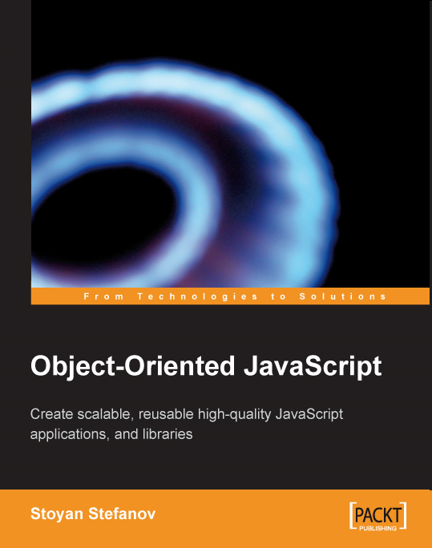


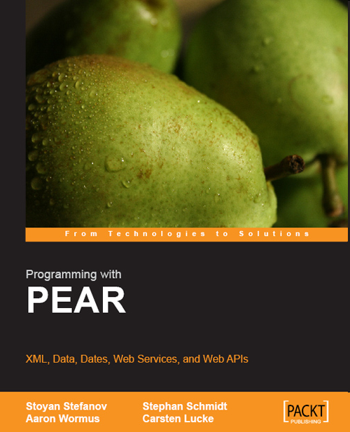
About the presenter
Yahoo! Performance
YSlow 2.0
smush.it tool
phpied.com blog

Slide 3
First off…
the Firebug console

Slide 4
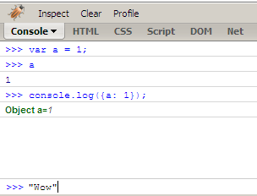
Firebug console as a learning tool

Slide 5
Console features
Inspect the contents of objects by clicking on them
Tab auto-complete, a.k.a cheatsheet
Arrows ↑ and ↓
Fiddle with any page

Slide 6
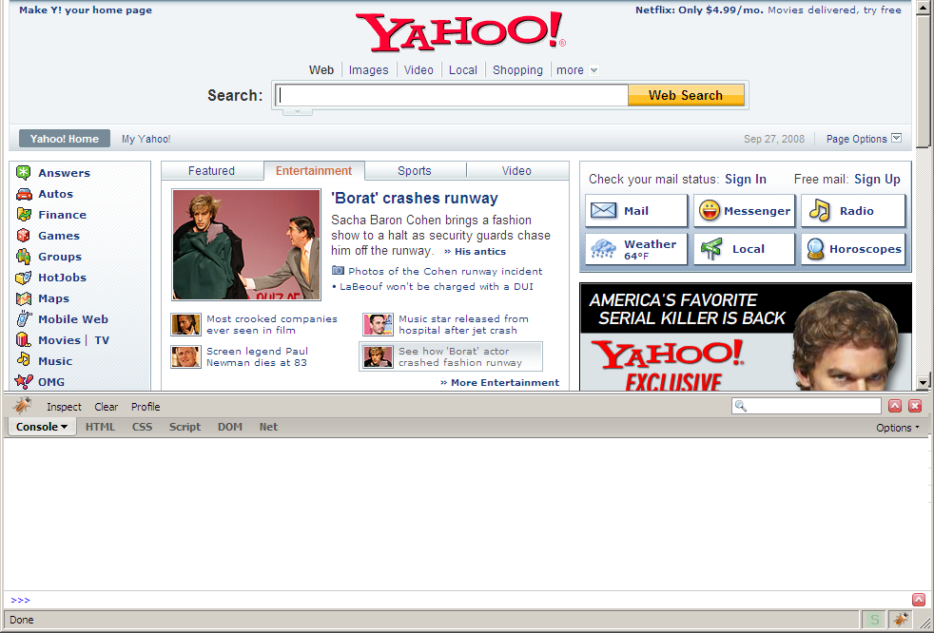
Any page

Slide 7
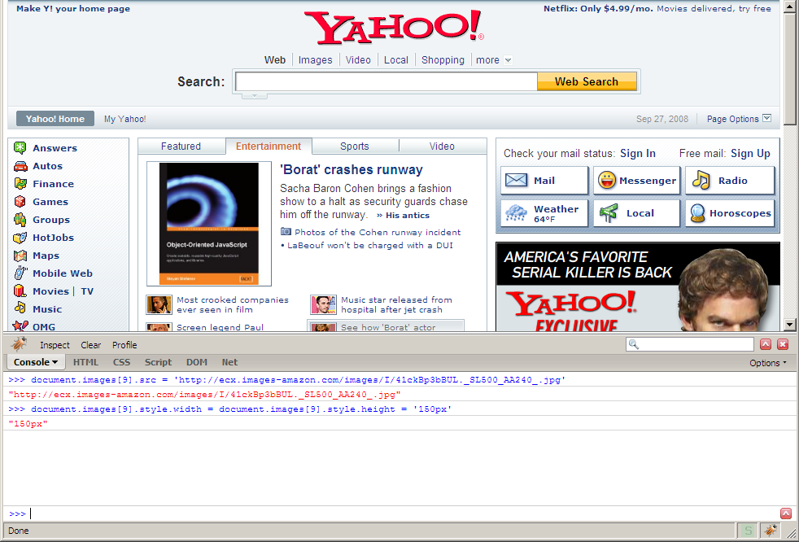
Fiddle

Slide 8
Objects

Slide 9
JavaScript !== Java
C-like syntax 
Classes 

Slide 10
Data types
A. Primitive:
  number – 1, 3, 1001, 11.12, 2e+3
  string – "a", "stoyan", "0"
  boolean – true | false
  null
  undefined
B. Objects
  everything else…

Slide 11
Objects
hash tables
key: value

Slide 12
A simple object
var obj = {};
obj.name = 'my object';
obj.shiny = true;

Slide 13
A simple object
var obj = {
shiny: true,
isShiny: function() {
return this.shiny;
}
};
obj.isShiny(); // true

Slide 14
Methods
When a property is a function
we can call it a method

Slide 15
Object literal notation
Key-value pairs
Comma-delimited
Wrapped in curly braces
{a: 1, b: "test"}

Slide 16
Arrays
Arrays are objects too
Auto-increment properties
Some useful methods

Slide 17
Arrays
>>> var a = [1,3,2];
>>> a[0]
1
>>> typeof a
"object"

Slide 18
Array literal notation
var array = [
"Square",
"brackets",
"wrap",
"the",
"comma-delimited",
"elements"
];

Slide 19
JSON
Object literals + array literals
JavaScript Object Notation
{"num": 1, "str": "abc",
"arr": [1,2,3]}

Slide 20
Constructors

Slide 21
Functions
functions are objects
they have properties
they have methods
can be copied, deleted, augmented...
special feature: invokable

Slide 22
Function
function say(what) {
return what;
}

Slide 23
Function
var say = function(what) {
return what;
};

Slide 24
Function
var say = function say(what) {
return what;
};

Slide 25
Functions are objects
>>> say.length
1
>>> say.name
"boo"

Slide 26
Functions are objects
>>> var tell = say;
>>> tell("doodles")
"doodles"
>>> tell.call(null, "moo!");
"moo!"

Slide 27
Return values
All functions always return a value

Slide 28
Return values
If a function doesn’t return a value explicitly, it returns undefined

Slide 29
Return values
Functions can return objects, including other functions

Slide 30
Constructors

Slide 31
Constructor functions
when invoked with new, functions return an object known as this
you can modify this before it’s returned

Slide 32
Constructor functions
var Person = function(name) {
this.name = name;
this.getName = function() {
return this.name;
};
};

Slide 33
Using the constructor
var me = new Person("Stoyan");
me.getName(); // "Stoyan"

Slide 34
Constructors…
… are just functions

Slide 35
A naming convention
MyConstructor
myFunction

Slide 36
constructor property
>>> function Person(){};
>>> var jo = new Person();
>>> jo.constructor === Person
true

Slide 37
constructor property
>>> var o = {};
>>> o.constructor === Object
true
>>> [1,2].constructor === Array
true

Slide 38
Built-in constructors
Object
Array
Function
RegExp
Number
String
Boolean
Date
Error, SyntaxError, ReferenceError…

Slide 39
Use this | Not that
var o = {}; | var o = new Object();
var a = []; | var a = new Array();
var re = /[a-z]/gmi; | var re = new RegExp( '[a-z]', 'gmi');
var fn = function(a, b){ return a + b; } | var fn = new Function( 'a, b','return a+b');

Slide 40
Prototype

Slide 41
Prototype…
… is a property of the function objects

Slide 42
Prototype
>>> var boo = function(){};
>>> typeof boo.prototype
"object"

Slide 43
Augmenting prototype
>>> boo.prototype.a = 1;
>>> boo.prototype.sayAh = function(){};

Slide 44
Overwriting the prototype
>>> boo.prototype =
{a: 1, b: 2};

Slide 45
Use of the prototype
The prototype is used when a function is called as a constructor

Slide 46
Prototype usage
var Person = function(name) {
this.name = name;
};
Person.prototype.say = function(){
return this.name;
};

Slide 47
Prototype usage
>>> var dude = new Person('dude');
>>> dude.name;
"dude"
>>> dude.say();
"dude"

Slide 48
Prototype usage
say() is a property of the prototype object
but it behaves as if it's a property of the dude object
can we tell the difference?

Slide 49
Own properties vs. prototype’s
>>> dude.hasOwnProperty('name');
true
>>> dude.hasOwnProperty('say');
false

Slide 50
isPrototypeOf()
>>> Person.prototype.isPrototypeOf(dude);
true
>>> Object.prototype.isPrototypeOf(dude);
true

Slide 51
__proto__
The objects have a secret link to the prototype of the constructor that created them
__proto__ is not directly exposed in all browsers

Slide 52
__proto__
>>> dude.__proto__.hasOwnProperty('say')
true
>>> dude.prototype
??? // Trick question
>>> dude.__proto__.__proto__.
hasOwnProperty('toString')
true

Slide 53
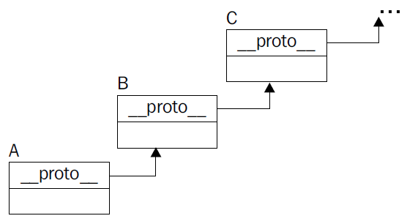
Prototype chain

Slide 54
It’s a live chain
>>> typeof dude.numlegs
"undefined"
>>> Person.prototype.numlegs = 2;
>>> dude.numlegs
2

Slide 55
Inheritance

Slide 56
Parent constructor
function NormalObject() {
this.name = 'normal';
this.getName = function() {
return this.name;
};
}

Slide 57
Child constructor
function PreciousObject(){
this.shiny = true;
this.round = true;
}

Slide 58
The inheritance
PreciousObject.prototype =
new NormalObject();

Slide 59
A child object
var crystal_ball = new PreciousObject();
crystal_ball.name = 'Crystal Ball.';
crystal_ball.round; // true
crystal_ball.getName(); // "Crystal Ball."

Slide 60
Inheritance by copying

Slide 61
Two objects
var shiny = {
shiny: true,
round: true
};
var normal = {
name: 'name me',
getName: function() {
return this.name;
}
};

Slide 62
extend()
function extend(parent, child) {
for (var i in parent) {
child[i] = parent[i];
}
}

Slide 63
Inheritance
extend(normal, shiny);
shiny.getName(); // "name me"

Slide 64
Prototypal inheritance

Slide 65
Beget object
function object(o) {
function F(){}
F.prototype = o;
return new F();
}

Slide 66
Beget object
>>> var parent = {a: 1};
>>> var child = object(parent);
>>> child.a;
1
>>> child.hasOwnProperty(a);
false

Slide 67
Wrapping up…

Slide 68
Objects
Everything is an object (except a few primitive types)
Objects are hashes
Arrays are objects

Slide 69
Functions
Functions are objects
Only invokable
Methods: call(), apply()
Properties: length, name, prototype

Slide 70
Prototype
Property of the function objects
It’s an object
Useful with Constructor functions

Slide 71
Constructor
A function meant to be called with new
Returns an object

Slide 72
Class
No such thing in JavaScript

Slide 73
Inheritance
Classical
Prototypal
By copying
… and many other variants

Slide 74

Stoyan Stefanov, http://phpied.com
stoyan@yahoo-inc.com

