Slide 1
面向对象的JavaScript

Slide 2
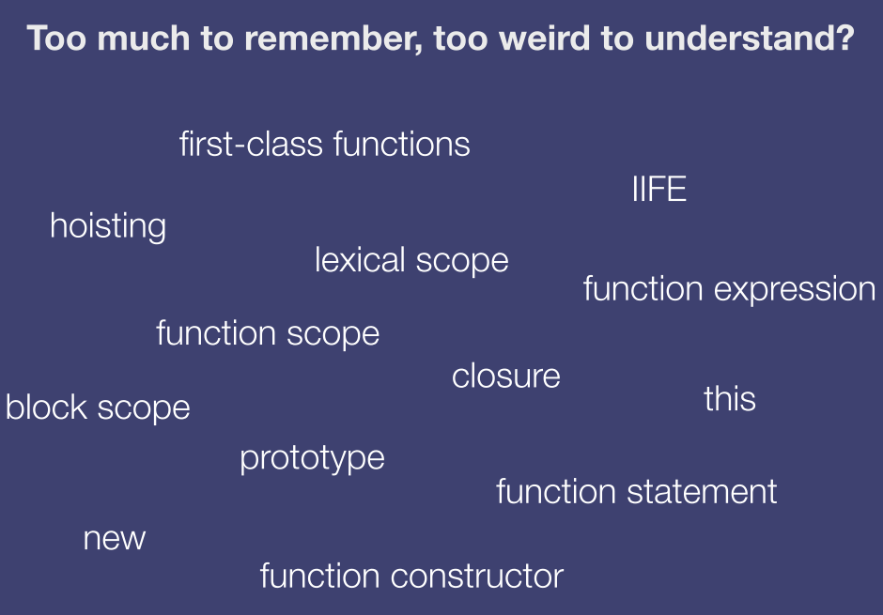

Slide 3
JavaScript Types
Primitive types
Undefined (undefined)
Null (null)
Boolean (true, false)
String (“a”, ‘a’)
Number (1, 1.23)
Object
Everything else

Slide 4
JavaScript objects
Object is nothing but key/value pair
Properties can be added and removed on the fly
var o = {}; // Empty
object.o.x = 42; // Adding property.
o.x; // Accessing property (result: 42).
o.y; // Accessing non-existing property // (result: undefined).
delete o.x; // Removing property.
o.x; // Accessing non-existing property.

Slide 5
JavaScript objects
No classes in JavaScript
All JavaScript objects are constructed from functions
function Point(x, y) {
this.x = x;
this.y = y;
}
var p = new Point(1, 2);
var q = Object.create(p);
var o = {}; // Basically shorthand for "new Object()"

Slide 6
JavaScript function
Functions are objects
Have properties
Have methods
Assigned to variables
Passed as arguments to other functions
Return from functions
Special feature: invokable

Slide 7
Function overload

Slide 8
call && apply
function foo() {
this.bar();
};
foo.call(scope, arg1, arg2, ... );
foo.apply(scope, [arg1, arg2, ...] );

Slide 9
JavaScript prototype
All objects have a __proto__ property which can be either another object or null
When accessing a property on an object the entire [[prototype]] chain is searched

Slide 10
JavaScript prototype
function C(x) { this.x = x; }
C.prototype.f = function() {
return this.x;
}
var o = new C(42);
o.f(); // Result: 42
var p = new C(1);
p.f(); // Result: 1

Slide 11
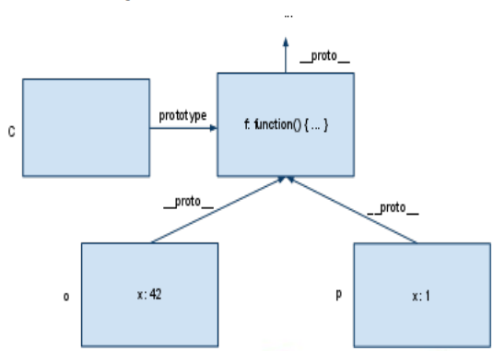
JavaScript prototype

Slide 12
JavaScript prototype
Array.prototype.remove = Array.prototype.remove || function(member){
var index = this.indexOf(member);
if (index > -1) {this.splice(index, 1);};
return this;
}

Slide 13
JavaScript prototype
Object.prototype.isArray || Object.prototype.isArray = function(obj) {
return ({}).toString.call(obj).match(/\s([a-zA-Z])+/)[1].toLowerCase() === ‘array’;
}

Slide 14
JavaScript prototype
All functions has a prototype property
prototype, which is itself an object, inherits from its parent’s prototype, which inherits from its parent’s prototype, and and so on. This is often referred to as the [[prototype]] chain.
Object.prototype, which is always at the end of the [[prototype]] chain (i.e., at the top of the prototypal inheritance tree)

Slide 15
JavaScript prototype
Object.getPrototypeOf()
Object.hasOwnProperty()
Object.getOwnPropertyNames()
instanceof
The instanceof operator actually checks if the [[prototype]] chain of the first argument contains the prototype property of the second argument (a function)

Slide 16
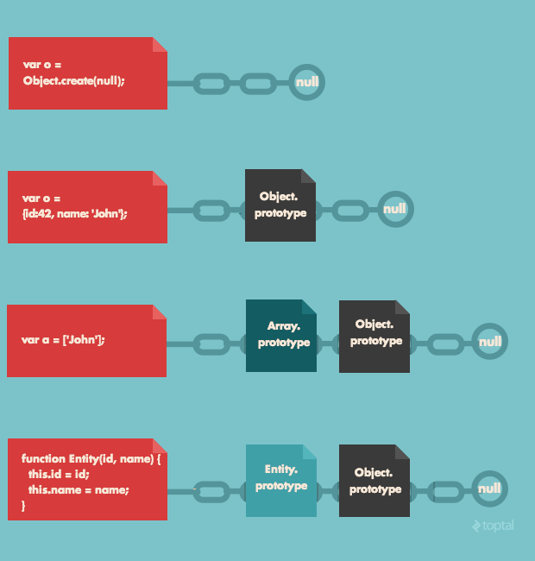
JavaScript prototype

Slide 17
Change function’s prototype
function Parent() {
this.someVar = 'someValue';
};
Parent.prototype.sayHello = function(){
console.log('Hello');
};
function Child(){
Parent.call(this);
};
Child.prototype.otherVar = 'otherValue';
Child.prototype = Object.create(Parent.prototype); --prototype changed
var p2 = new Child();
p2.sayHello();
console.log(p2.someVar);
console.log(p2.otherVar);

Slide 18
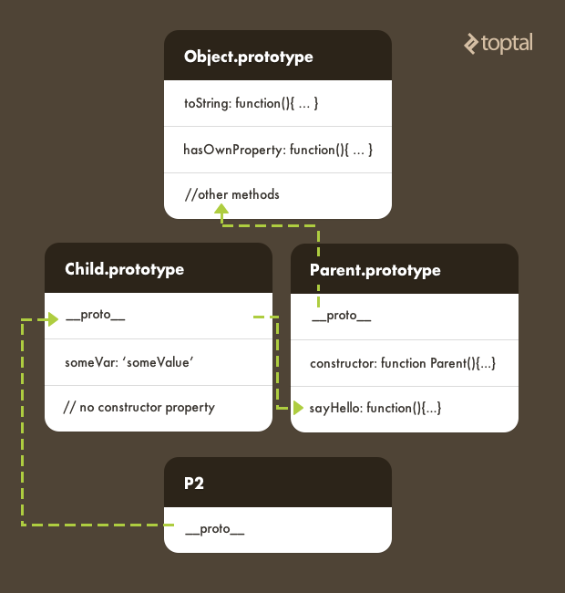
Change function’s prototype

Slide 19
JavaScript encapsulation
function Person(name, age) {
this.name = name;
this.age = age;
this.talk = function() {
return “hello!”;
}
}

Slide 20
Calling the superclass' constructor

Slide 21
JavaScript polymorphism
function Person(name) {
this.name = name;
this.toString = function() {
return name;
}
}
function f1(obj) {
console.log(obj.toString());
}
f1(new Object());
f1(new Person());

Slide 22
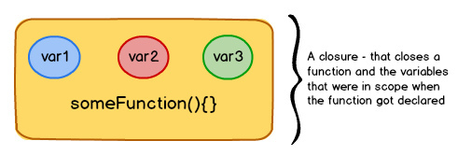
JavaScript closure
A closure (like a box) contains a function and all the variables that were in scope when the function got declared.
As long as the function exists, the variables inside closure will not get garbage collected, letting the function access them whenever it pleases do so.

Slide 23
JavaScript closure
function sayHello() {
var message = “hello”;
return function() {
console.log(message);
};
}

Slide 24
Curry
Function.prototype.curry = function() {
var args = Array.prototype.slice.apply(arguments);
var __method = this;
return function() {
return __method.apply(this, args.concat(Array.prototype.slice.apply(arguments)));
}
}

Slide 25
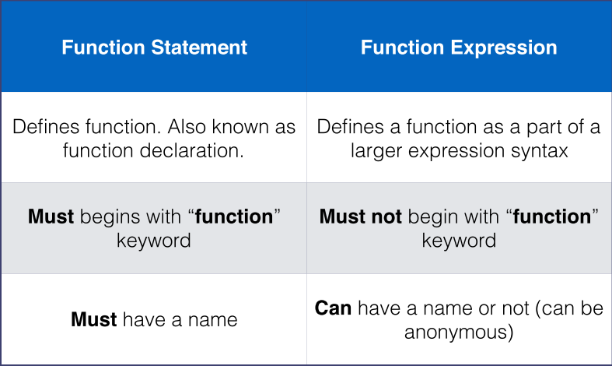
Function hoisting

Slide 26
Function hoisting
function foo(){
function bar() {
return 3;
}
return bar();
function bar() {
return 8;
}
}
alert(foo());

Slide 27
Function hoisting
function foo(){
var bar = function() {
return 3;
};
return bar();
var bar = function() {
return 8;
};
}
alert(foo());

Slide 28
Function hoisting
alert(foo());
function foo(){
var bar = function() {
return 3;
};
return bar();
var bar = function() {
return 8;
};
}

Slide 29
Function hoisting
function foo(){
return bar();
var bar = function() {
return 3;
};
var bar = function() {
return 8;
};
}
alert(foo());

Slide 30
this keyword
Execution Context | Syntax of function call | Value of this
Global | n/a | global object (e.g. window)
Function | Method call: myObject.foo(); | myObject
Function | Baseless function call: foo(); | global object (e.g. window) (undefined in strict mode)
Function | Using call: foo.call(context, myArg); | context
Function | Using apply: foo.apply(context, [myArgs]); | context
Function | Constructor with new: var newFoo = new Foo(); | the new instance (e.g. newFoo)
Evaluation | n/a | value of this in parent context

Slide 31
Truth, Equality
The following values are falsy
false
0 (zero)
“” (empty string”)
null
undefined
NaN (not a number)
Everything else is truthy

Slide 32
Truth, Equality
if ([0]) {
console.log([0] == true);
}
if (“potato”) {
console.log(“potato” == false);
console.log(“potato” == true);
}

Slide 33
toNumber
ToNumber
Argument Type | Result
Undefined | NaN
Null | +0
Boolean | The result is 1 if the argument is true. The result is +0 if the argument is false.
Number | The result equals the input argument (no conversion).
String | In effect evaluates Number(string) “abc” -> NaN “123” -> 123
Object | Apply the following steps: 1. Let primValue be ToPrimitive(input argument, hint Number). 2. Return ToNumber(primValue).

Slide 34
ToPrimitive
Argument Type | Result
Object | (in the case of equality operator coercion) if valueOf returns a primitive, return it. Otherwise if toString returns a primitive return it. Otherwise throw an error
otherwise… | The result equals the input argument (no conversion).

