Slide 1
面向对象的JavaScript

Slide 2
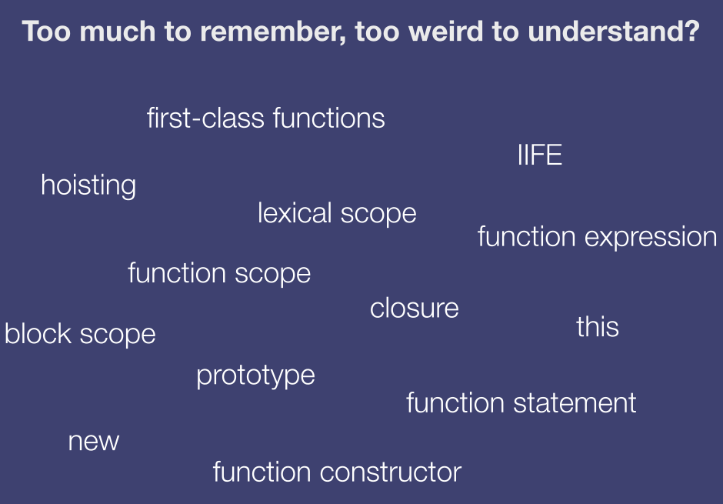

Slide 3
Data types(数据类型)
Primitive types
Undefined (undefined)
Null (null)
Boolean (true, false)
String (“a”, ‘a’)
Number (1, 1.23)
Object
Everything else

Slide 4
Data types(数据类型)
Object.prototype.isArray || Object.prototype.isArray = function(obj) {
return ({}).toString.call(obj).match(/\s([a-zA-Z]+)/[1].toLowerCase() === ‘array’;
}

Slide 5
Objects(对象)
Object is nothing but key/value pair
Properties can be added and removed on the fly
var o = {};
o.x = 42;
o.x;
o.y;
delete o.x;
o.x;

Slide 6
Function(函数)
Functions are objects(??)
Have properties, methods
Passed as arguments to other functions
Return from functions
All JavaScript objects are constructed from functions(??)
Special feature: invokable

Slide 7
Function(函数)
new | shorthand
var o = new Object(); | var o = {};
var a = new Array(); | var a = [];
var re = new RegExp('[a-z]', 'gmi'); | var re = /[a-z]/gmi;
var fn = new Function( 'a, b','return a+b'); | var fn = function(a, b){ return a + b; }

Slide 8
Overload(方法重载)
function add(num1) {
return 10 + num1;
}
function add(num1, num2) {
return 20 + num1;
}

Slide 9
Function hoisting(提升机制)
function foo(){
function bar() {
return 3;
}
return bar();
function bar() {
return 8;
}
}
alert(foo());

Slide 10
Function hoisting(提升机制)
function foo(){
var bar = function() {
return 3;
};
return bar();
var bar = function() {
return 8;
};
}
alert(foo());

Slide 11
Function hoisting(提升机制)
alert(foo());
function foo(){
var bar = function() {
return 3;
};
return bar();
var bar = function() {
return 8;
};
}

Slide 12
Function hoisting(提升机制)
function foo(){
return bar();
var bar = function() {
return 3;
};
var bar = function() {
return 8;
};
}
alert(foo());

Slide 13
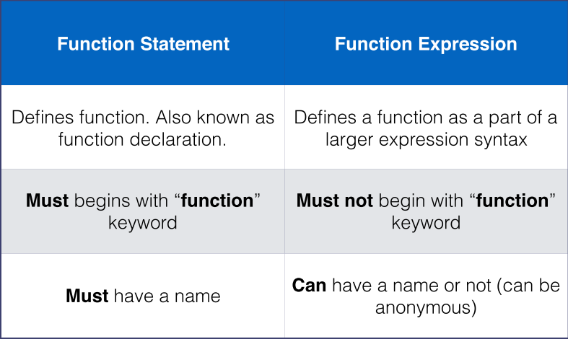
Function hoisting(提升机制)

Slide 14
定义对象的方式
扩展原有对象
工厂方法
构造方法
原型
构造方法+原型
动态原型

Slide 15
扩展原有对象
var obj = new Object();
obj.name = “zhangsan”;
obj.sayName = function() {
return this.name;
}

Slide 16
工厂方法
function createObject() {
var obj = new Object();
obj.name = “zhangsan”;
obj.sayName = function() {
return this.name;
}
return obj;
}

Slide 17
构造方法
function Person() {
// new Object();
this.username = “zhangsan”;
this.password = “123”;
this.getInfo = function() {return this.username + this.password};
// this.__proto__ = Person.prototype;
// return this;
}

Slide 18
原型
function Person() {};
Person.prototype.username = “zhangsan”;
Person.prototype.password = “123”;
Person.prototype.addresses = [];
Person.getInfo = function() {return this.username + this.addresses};

Slide 19
Prototype(原型)
All functions has a prototype property
prototype, which is itself an object, inherits from its parent’s prototype, which inherits from its parent’s prototype, and and so on. This is often referred to as the [[prototype]] chain.
Object.prototype is the top of the [[prototype]] chain

Slide 20
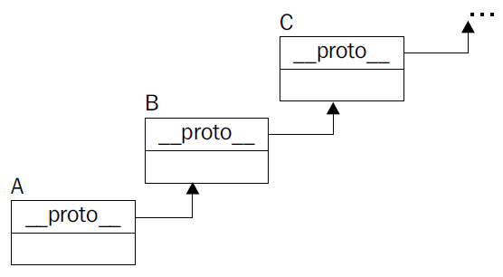
Prototype(原型)

Slide 21
Prototype(原型)
All objects have a __proto__ property
When accessing a property on an object the entire [[prototype]] chain is searched

Slide 22
Prototype(原型)
function C(x) { this.x = x; }
C.prototype.f = function() {
return this.x;
}
var o = new C(42);
o.f();
var p = new C(1);
p.f();

Slide 23
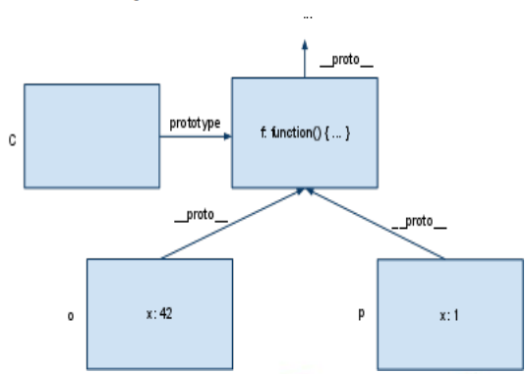
Prototype(原型)

Slide 24
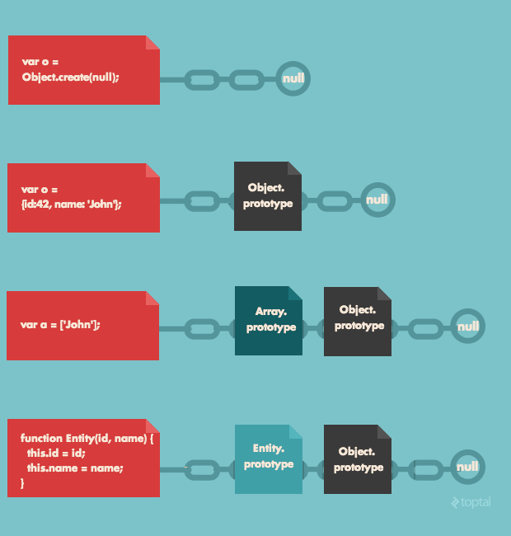
Prototype(原型)

Slide 25
Prototype(原型)
Array.prototype.remove = Array.prototype.remove || function(member){
var index = this.indexOf(member);
if (index > -1) {this.splice(index, 1);};
return this;
}

Slide 26
Prototype(原型)
Object.getPrototypeOf()
Object.hasOwnProperty()
Object.getOwnPropertyNames()
instanceof
The instanceof operator actually checks if the [[prototype]] chain of the first argument contains the prototype property of the second argument (a function)
Object.create

Slide 27
原型+构造方法

Slide 28
动态原型
function Person() {
this.username = “zhangsan”;
this.password = “123”;
if (!Person.flag) {
this.getInfo = function() {return this.username + this.password};
Person.flag = true;
}
}

Slide 29
Encapsulation (封装)
function Person(name, age) {
this.name = name;
this.age = age;
this.talk = function() {
return “hello!”;
}
}

Slide 30
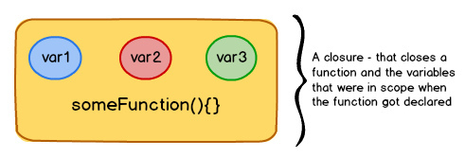
Closure(闭包)
A closure (like a box) contains a function and all the variables that were in scope when the function got declared.
As long as the function exists, the variables inside closure will not get garbage collected, letting the function access them whenever it pleases do so.

Slide 31
Closure(闭包)
function sayHello() {
var message = “hello”;
return function() {
console.log(message);
};
}

Slide 32
timer
setTimeout(fn, ms);

Slide 33
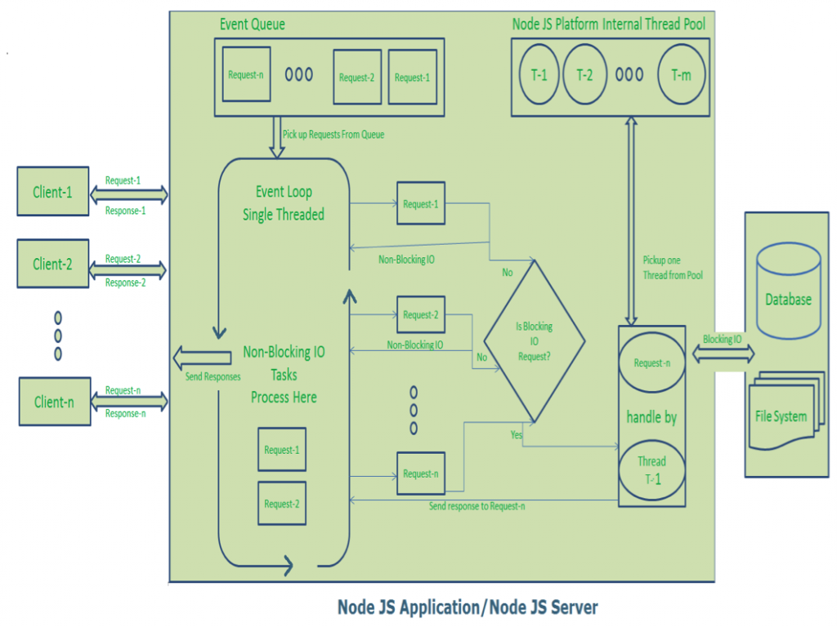
Event loop

Slide 34
Curry
Function.prototype.curry = function() {
var args = Array.prototype.slice.apply(arguments);
var __method = this;
return function() {
return __method.apply(this, args.concat(Array.prototype.slice.apply(arguments)));
}
}

Slide 35
Encapsulation(封装)

Slide 36
Inheritance(继承)
对象拷贝
对象冒充
Call方法
Apply方法
原型链
混合方式

Slide 37
对象拷贝
function Parent(username) {
this.username = username;
this.sayHello = function() {return this.username;};
}
function extend(parent, child) {
for (var i in parent) {child[i] = parent[i]};
}
function Child() {};
var child = new Child(); extend(parent, child);

Slide 38
对象冒充
function Parent(username) {
this.username = username;
this.sayHello = function() {return this.username;};
}
function Child(username, password) {
this.method = Parent;
this.method(username);
delete this.method;
this.password = password;
};

Slide 39
Call方法
function Parent(username) {
this.username = username;
this.sayHello = function() {return this.username;};
}
function Child(username, password) {
Parent.call(this, username);
this.password = password;
};

Slide 40
Call/Apply
function foo() {
this.bar();
};
foo.call(scope, arg1, arg2, ... );
foo.apply(scope, [arg1, arg2, ...] );

Slide 41
Apply方法
function Parent(username) {
this.username = username;
this.sayHello = function() {return this.username;};
}
function Child(username, password) {
Parent.apply(this, [username]);
this.password = password;
};

Slide 42
原型链
function Parent(username) {};
Parent.prototype.username = “zhangsan”;
Parent.prototype.sayHello = function() {return this.username;};
function Child(username, password) {};
Child.protype = new Parent();
Parent.prototype.password = “zhangsan”;
Parent.prototype.sayWord = function() {return this.password;};

Slide 43
混合方式

Slide 44
this
Execution Context | Syntax of function call | Value of this
Global | n/a | global object (e.g. window)
Function | Method call: myObject.foo(); | myObject
Function | Baseless function call: foo(); | global object (e.g. window) (undefined in strict mode)
Function | Using call: foo.call(context, myArg); | context
Function | Using apply: foo.apply(context, [myArgs]); | context
Function | Constructor with new: var newFoo = new Foo(); | the new instance (e.g. newFoo)
Evaluation | n/a | value of this in parent context

Slide 45
Polymorphism(多态)

Slide 46
Truth, Equality
The following values are falsy
false
0 (zero)
“” (empty string”)
null
undefined
NaN (not a number)
Everything else is truthy

Slide 47
Truth, Equality
if ([0]) {
console.log([0] == true);
}
if (“potato”) {
console.log(“potato” == false);
console.log(“potato” == true);
}

Slide 48
toNumber
ToNumber
Argument Type | Result
Undefined | NaN
Null | +0
Boolean | The result is 1 if the argument is true. The result is +0 if the argument is false.
Number | The result equals the input argument (no conversion).
String | In effect evaluates Number(string) “abc” -> NaN “123” -> 123
Object | Apply the following steps: 1. Let primValue be ToPrimitive(input argument, hint Number). 2. Return ToNumber(primValue).

Slide 49
ToPrimitive
Argument Type | Result
Object | (in the case of equality operator coercion) if valueOf returns a primitive, return it. Otherwise if toString returns a primitive return it. Otherwise throw an error
otherwise… | The result equals the input argument (no conversion).

