Slide 1
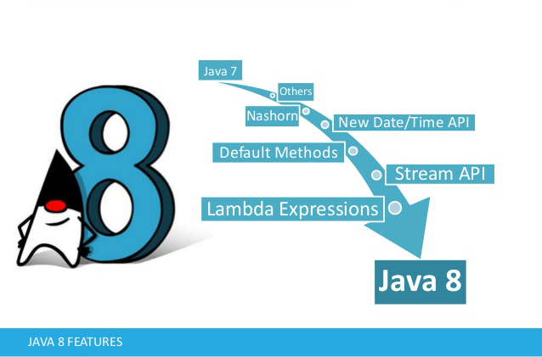

Slide 2
Agenda
Lambda
Streams API
Date and Time API
Map
Optional & Interface Default and Static Methods

Slide 3

Lambda
What is lambda
The @FunctionalInterface Annotation
Method References
Types of method references

Slide 4
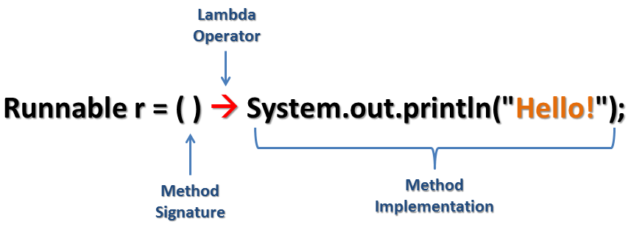
What is lambda
“In computer science terminology: A Lambda is an anonymous function. That is, a function without a name”
“In Java: All functions are members of classes, and are referred to as methods. To create a method, you need to define the class of which it’s a member.”

Slide 5

The @FunctionalInterface Annotation
Example

Slide 6
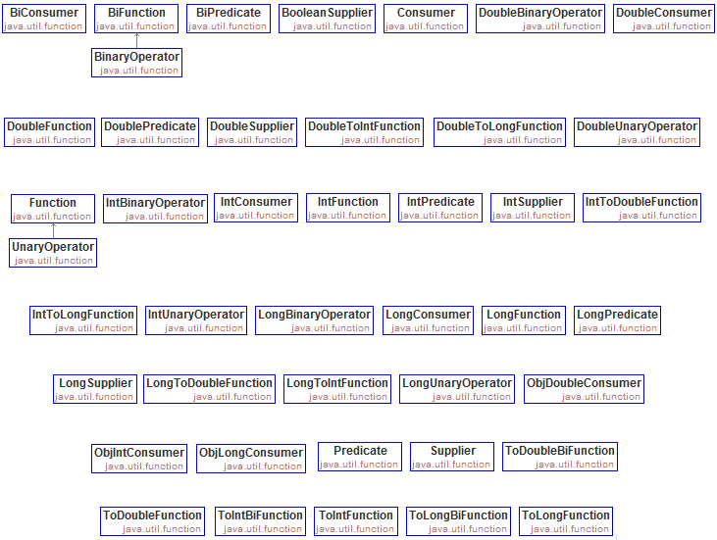
Java 8 Functional Interfaces

Slide 7
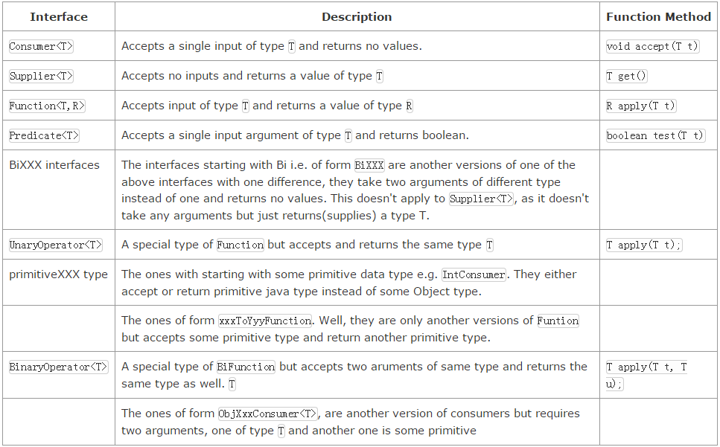
Java 8 Functional Interfaces

Slide 8
Method References
We can possibly simplify that further in the situations where lambda expression body just call another existing method. Or more appropriately and generally speaking: if lambda's functional interface's abstract method matches another existing method signature. That applies to all kind of method, doesn't matter they are static method or instance methods. That applies to constructors as well.

Slide 9
Reference to a Static Method
syntax: ContainingClass::methodName

Slide 10
Reference to an Instance Method
syntax:ContainingInstance::methodName

Slide 11
Reference to an Instance Method of an Object of a Particular Type
syntax: ContainingType::methodName

Slide 12
Reference to a Constructor
syntax: ClassName::new
Create an Array: ClassName[]::new

Slide 13
Reference to A this/super Method
syntax: this/super:: methodName

Slide 14
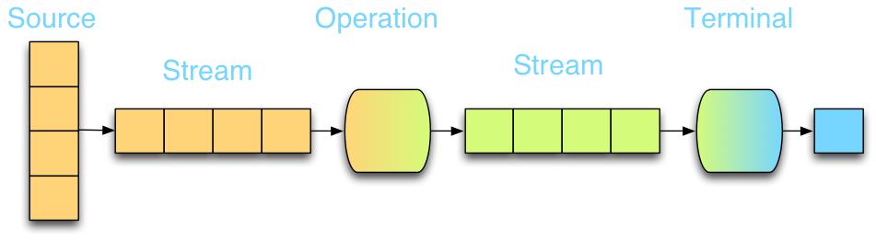
Streams API
What are streams
Stream vs Collection
Stream Pipeline
Lazy Invocation
StringJoiner

Slide 15
What are Streams
A short definition is “a sequence of elements from a source that supports aggregate operations”
Sequence of elements: A stream provides an interface to a sequenced set of values of a specific element type. However, streams don’t actually store elements; they are computed on demand.
Source: Streams operate a data-providing source such as collections, arrays, or I/O resources.
Aggregate operations: Streams support SQL-like operations and common operations from functional programing languages, such as filter, map, reduce, find, match, sorted, and so on.

Slide 16
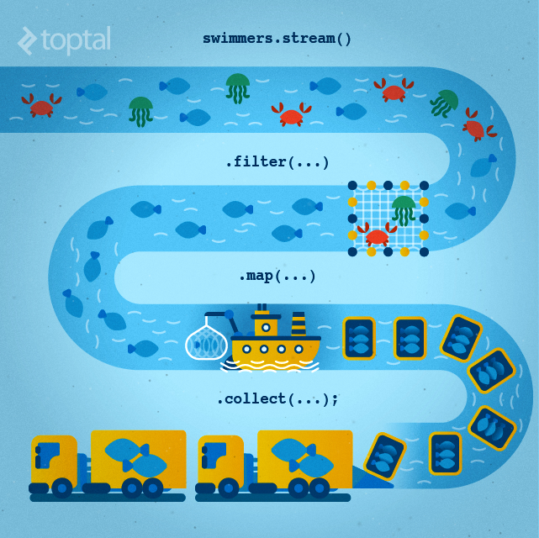
What are Streams

Slide 17
Stream vs. Collection
A collection is an in-memory data structure to hold values and before we start using collection, all the values should have been populated. Whereas a Stream is a data structure that is computed on-demand.
Stream doesn’t store data, it operates on the source data structure (collection and array) and produce pipelined data that we can use and perform specific operations. Such as we can create a stream from the list and filter it based on a condition.

Slide 18
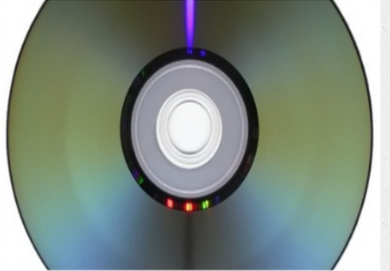

Stream vs. Collection
Consider a movie stored on a DVD. This is a collection (perhaps of bytes or perhaps of frames—we don’t care which here) because it contains the whole data structure. Now consider watching the same video when it is being streamed over the internet. It is now a stream (of bytes or frames). The streaming video player needs to have downloaded only a few frames in advance of where the user is watching, so you can start displaying values from the beginning of the stream before most of the values in the stream have even been computed (consider streaming a live football game).

Slide 19
Stream Pipeline
Obtaining the instance of Stream from a source. A source might be an array, a collection, a generator function, an I/O channel, etc
Zero or more intermediate operations which transform a stream into another stream, such as filter()
A terminal operation which produces a result, such as count, sum or a collection.

Slide 20
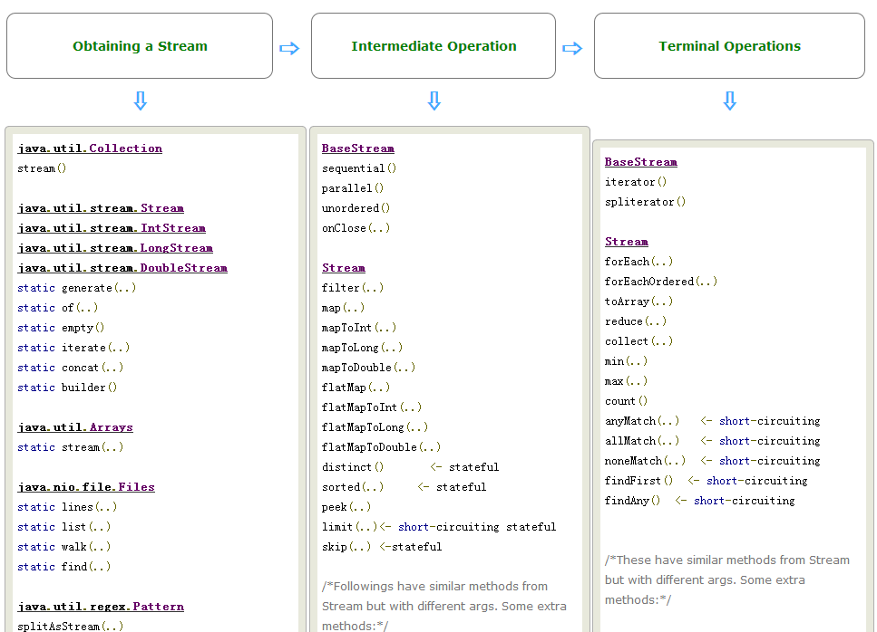
Stream Pipeline

Slide 21
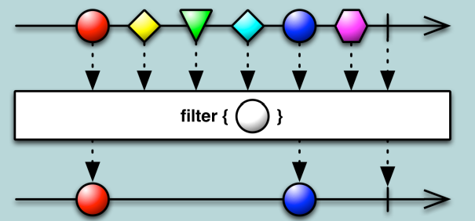
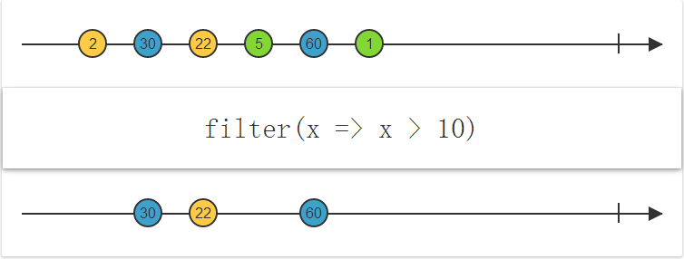
filter

Slide 22
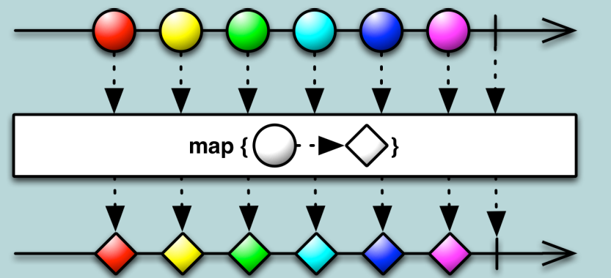
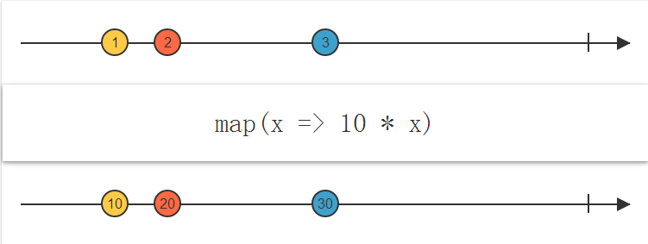
map

Slide 23
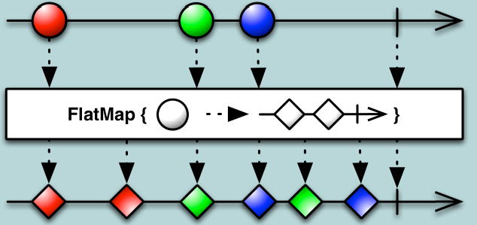
flatMap

Slide 24
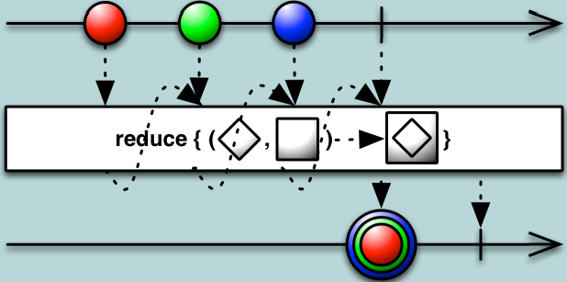
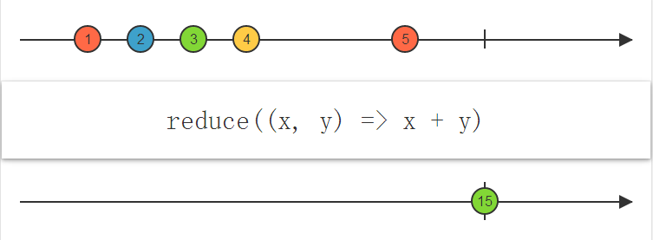
reduce

Slide 25
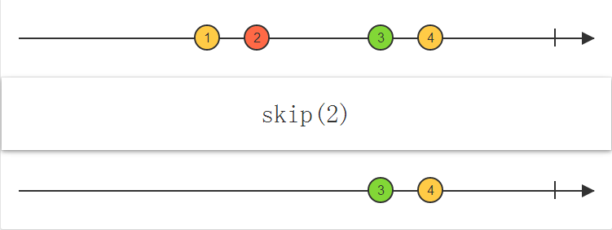
skip

Slide 26
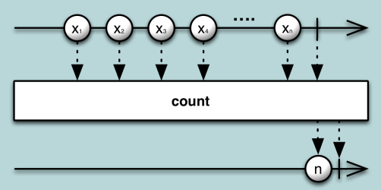
count

Slide 27
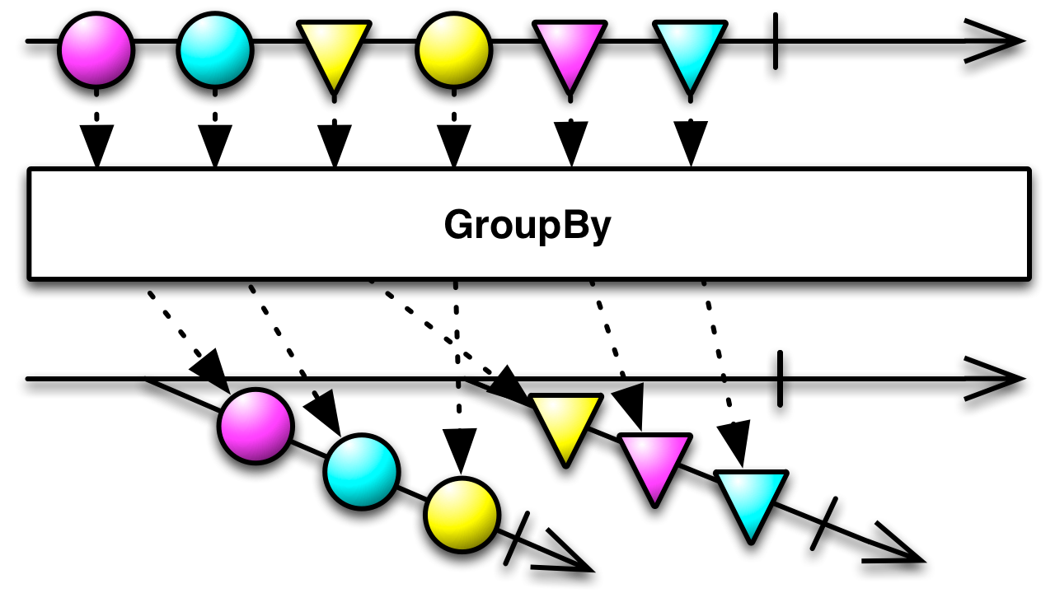
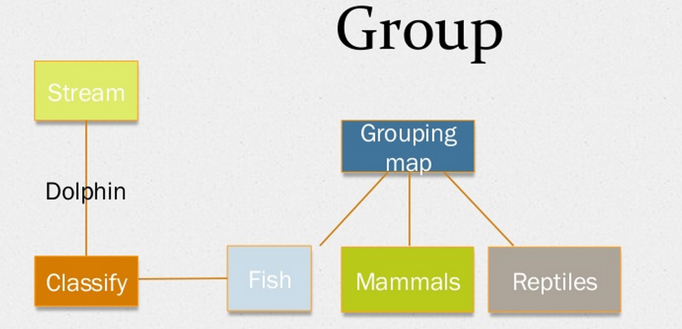
groupBy

Slide 28
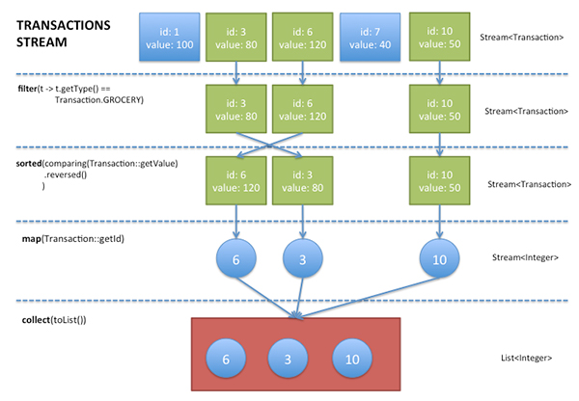
examples

Slide 29
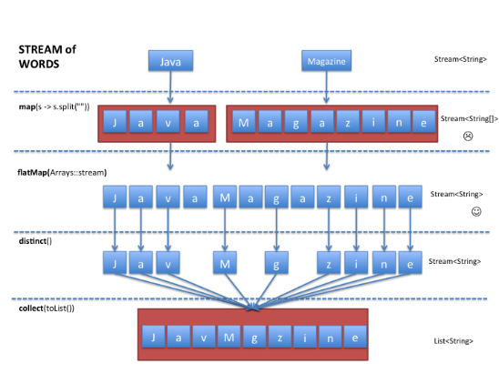
examples

Slide 30
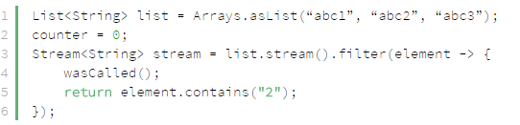
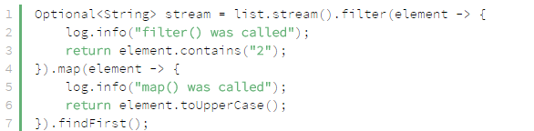


Lazy Invocation
Streams are lazy: intermediate operations are not evaluated unless terminal operation is invoked.

Slide 31
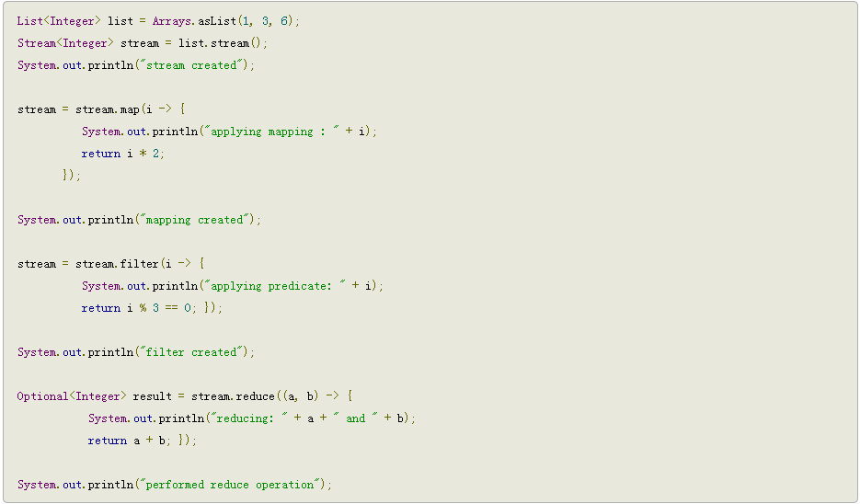
Lazy Invocation

Slide 32
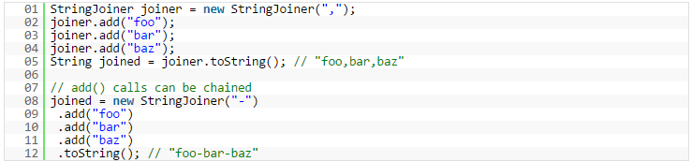

StringJoiner

Slide 33
Date and Time API
LocalDate LocalTime LocalDateTime
Formatting and parsing
Timestamps
Conversion

Slide 34
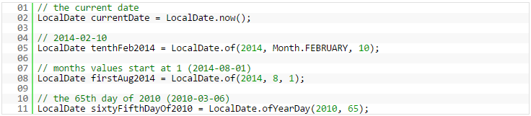
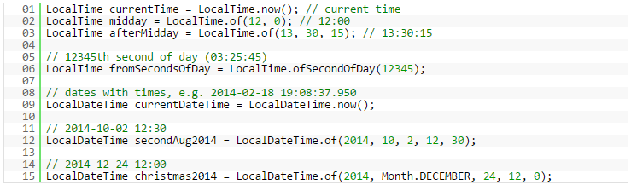
LocalDate & LocalTime & LocalDateTime
A LocalDate represents a year-month-day date without time
A LocalTime works with time without dates
LocalDateTime combines date and time

Slide 35
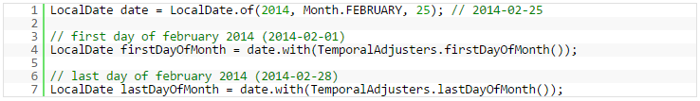
LocalDate & LocalTime & LocalDateTime
Compare: isBefore isEqual isAfter
Manipulate: plus minus TemporalAdjusters

Slide 36
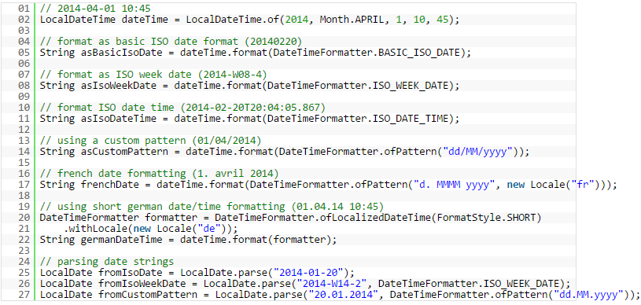
Formatting and parsing

Slide 37
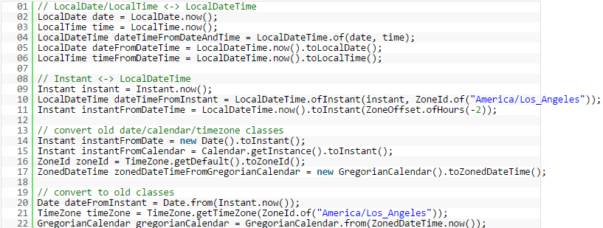
Conversion

Slide 38
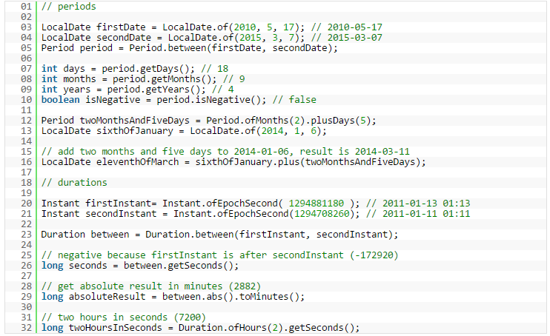
Periods and Durations

Slide 39

Map
Map.getOrDefault(Object, V)
Map.putIfAbsent(K, V)
Map.remove(Object, Object)
Map.replace(K, V) Map.replace(K, V, V)

Slide 40


