Slide 2
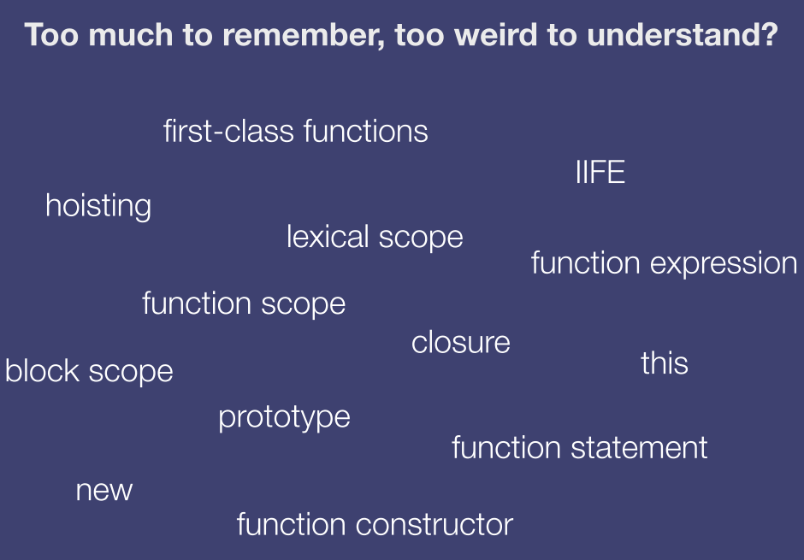

Slide 3
JavaScript Types
Primitive types
Undefined (undefined)
Null (null)
Boolean (true, false)
String (“a”, ‘a’)
Number (1, 1.23)
Object
Everything else

Slide 4
JavaScript objects
An object is a collection of properties
A property has a name and a value
Properties can be added and removed on the fly
var o = {}; // Empty
object.o.x = 42; // Adding property.
o.x; // Accessing property (result: 42).
o.y; // Accessing non-existing property // (result: undefined).
delete o.x; // Removing property.
o.x; // Accessing non-existing property.

Slide 5
JavaScript objects
No classes in JavaScript
All JavaScript objects are constructed from functions
function Point(x, y) {
this.x = x;
this.y = y;
}
var p = new Point(1, 2);
var q = Object.create(p);
var o = {}; // Basically shorthand for "new Object()"

Slide 6
JavaScript function
Functions are objects
Have properties
Have methods
Assigned to variables
Passed as arguments to other functions
Return from functions
Special feature: invokable

Slide 7
Return values
All functions always return a value
If a function doesn’t return a value explicitly, it returns undefined (except for new)

Slide 8
call && apply
function foo() {
this.bar();
};
foo.call(scope, arg1, arg2, ... );
foo.apply(scope, [arg1, arg2, ...] );

Slide 9
JavaScript prototype
All objects have a __proto__ property which can be either another object or null
When accessing a property on an object the entire [[prototype]] chain is searched

Slide 10
JavaScript prototype
function C(x) { this.x = x; }
C.prototype.f = function() {
return this.x;
}
var o = new C(42);
o.f(); // Result: 42
var p = new C(1);
p.f(); // Result: 1

Slide 11
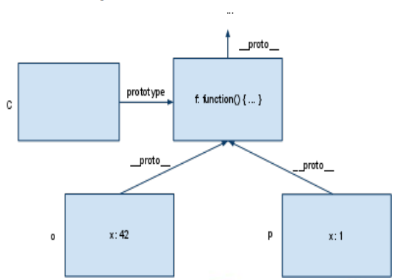
JavaScript prototype

Slide 12
JavaScript prototype
Array.prototype.remove = Array.prototype.remove || function(member){
var index = this.indexOf(member);
if (index > -1) {this.splice(index, 1);};
return this;
}

Slide 13
JavaScript prototype
Object.prototype.isArray || Object.prototype.isArray = function(obj) {
return ({}).toString.call(obj).match(/\s([a-zA-Z])+/)[1].toLowerCase() === ‘array’;
}

Slide 14
JavaScript prototype
All functions has a prototype property
prototype, which is itself an object, inherits from its parent’s prototype, which inherits from its parent’s prototype, and and so on. This is often referred to as the [[prototype]] chain.
Object.prototype, which is always at the end of the [[prototype]] chain (i.e., at the top of the prototypal inheritance tree)

Slide 15
JavaScript prototype
Object.getPrototypeOf()
Object.hasOwnProperty()
Object.getOwnPropertyNames()
instanceof
The instanceof operator actually checks if the [[prototype]] chain of the first argument contains the prototype property of the second argument (a function)

Slide 16
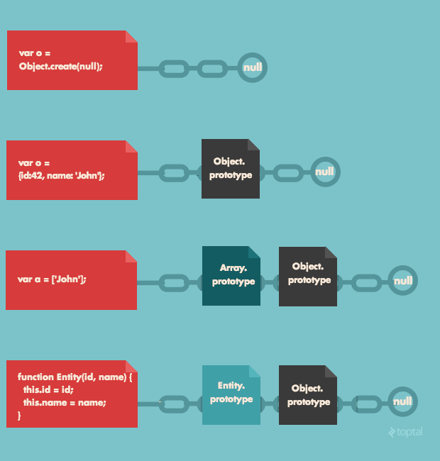
JavaScript prototype

Slide 17
Change function’s prototype
function Parent() {
this.someVar = 'someValue';
};
Parent.prototype.sayHello = function(){
console.log('Hello');
};
function Child(){
Parent.call(this);
};
Child.prototype.otherVar = 'otherValue';
Child.prototype = Object.create(Parent.prototype); --prototype changed
var p2 = new Child();
p2.sayHello();
console.log(p2.someVar);
console.log(p2.otherVar);

Slide 18
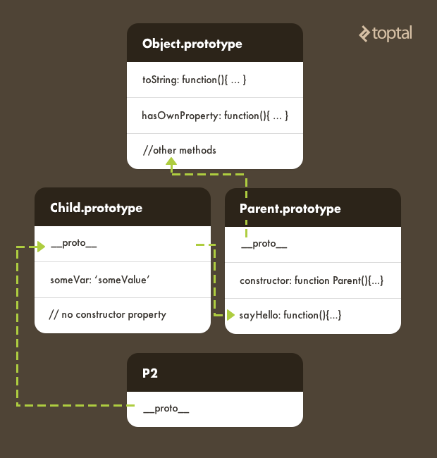
Change function’s prototype

Slide 19
JavaScript encapsulation
function Person(name, age) {
this.name = name;
this.age = age;
this.talk = function() {
return “hello!”;
}
}

Slide 20
Calling the superclass' constructor

Slide 21
JavaScript polymorphism
function Person(name) {
this.name = name;
this.toString = function() {
return name;
}
}
function f1(obj) {
console.log(obj.toString());
}
f1(new Object());
f1(new Person());

Slide 22
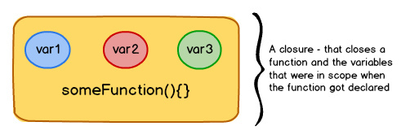
JavaScript closure
A closure (like a box) contains a function and all the variables that were in scope when the function got declared.
As long as the function exists, the variables inside closure will not get garbage collected, letting the function access them whenever it pleases do so.

Slide 23
JavaScript closure
function sayHello() {
var message = “hello”;
return function() {
console.log(message);
};
}

Slide 24
Curry

Slide 25
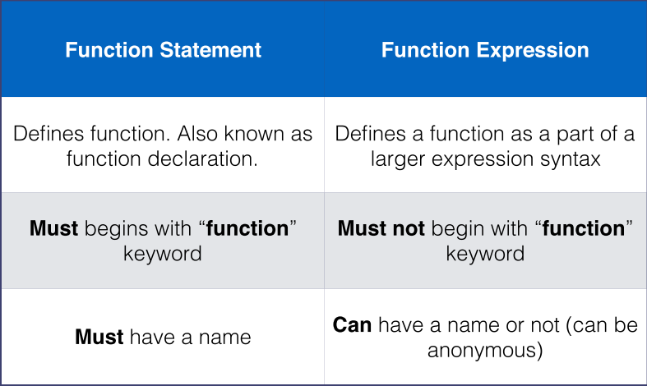
Function hoisting

Slide 26
this keyword

Slide 27
If and “==”
The following values are falsy
false
0 (zero)
“” (empty string”)
null
undefined
NaN (not a number)
Everything else is truthy

