Slide 1

Don’t Dump Thread Dumps
Ram Lakshmanan
Founder – GCEasy.io & FastThread.io

Slide 2
Agenda
How to take Thread Dumps?
Anatomy of Thread Dump
Troubleshooting – Real world problems through Patterns
Sudden CPU spikes
Out Of Memory Error
Unresponsive DB
Unresponsive NoSQL
Unresponsive Application

Slide 3

How to take thread dumps? – 8 options
1
2
3
1.
2.
3.
Jstack (since Java 5)
kill -3
jVisualVM
jstack -l <pid> > /tmp/threadDump.txt
4
5
6
4.
5.
6.
JMC
Windows (Ctrl + Break)
ThreadMXBean
7
8
7.
8.
APM Tools
jcmd <pid> Thread.print > /tmp/threadDump.txt
Jcmd (since Java 7)

Slide 4

How to take thread dumps? – 8 options
1.
2.
3.
Jstack (since Java 5)
kill -3
jVisualVM
jstack -l <pid> > /tmp/threadDump.txt
4.
5.
6.
JMC
Windows (Ctrl + Break)
ThreadMXBean
7.
8.
APM Tools
JCMD (since Java 7)
jcmd <pid> Thread.print > /tmp/threadDump.txt
How to take thread dumps? Click here for read the full blog

Slide 5

Best Practice
3 thread dumps in a gap of 10 seconds

Slide 6
Agenda
How to take Thread Dumps?
Anatomy of a Thread Dump
Troubleshooting – Real world problems through Patterns
Sudden CPU spikes
Out Of Memory Error
Unresponsive DB
Unresponsive NoSQL
Unresponsive Application

Slide 7
Anatomy of Thread Dump
2016-06-26 17:13:23
Full thread dump Java HotSpot(TM) 64-Bit Server VM (23.7-b01 mixed mode):
"Hashed wheel timer #9261" prio=10 tid=0x00007f0442e17800 nid=0x112b waiting on condition
[0x00007f042e709000]
java.lang.Thread.State: TIMED_WAITING (sleeping)
at java.lang.Thread.sleep(Native Method)
at org.jboss.netty.util.HashedWheelTimer$Worker.waitForNextTick(HashedWheelTimer.java:483)
at org.jboss.netty.util.HashedWheelTimer$Worker.run(HashedWheelTimer.java:392)
at org.jboss.netty.util.ThreadRenamingRunnable.run(ThreadRenamingRunnable.java:108)
at java.lang.Thread.run(Thread.java:722)
"Reconnection-1" prio=10 tid=0x00007f0442e10800 nid=0x112a waiting on condition [0x00007f042f719000]
java.lang.Thread.State: WAITING (parking)
at sun.misc.Unsafe.park(Native Method)
- parking to wait for <0x007b3953a98> (a java.util.concurrent.locks.AbstractQueuedSynchr)
at java.util.concurrent.locks.LockSupport.park(LockSupport.java:186)
at java.lang.Thread.run(Thread.java:722)
:
:
1
2
3
1
Timestamp at which thread dump was triggered - 2016-06-26 17:13:23
2
JVM Version info
3
Thread Details - <<details in following slides>>

Slide 8
Found one Java-level deadlock:
=============================
"Thread-1":
waiting to lock monitor 0x0000000007252140 (object 0x00000007ac3b1970, a java.lang.Object),
which is held by "Thread-0"
"Thread-0":
waiting to lock monitor 0x0000000007250d90 (object 0x00000007ac3b1980, a java.lang.Object),
which is held by "Thread-1"
Java stack information for the threads listed above:
===================================================
"Thread-1":
at com.tier1app.DeadLockSimulator$SecondThread.run(DeadLockSimulator.java:29)
- waiting to lock <0x00000007ac3b1970> (a java.lang.Object)
- locked <0x00000007ac3b1980> (a java.lang.Object)
"Thread-0":
at com.tier1app.DeadLockSimulator$FirstThread.run(DeadLockSimulator.java:16)
- waiting to lock <0x00000007ac3b1980> (a java.lang.Object)
- locked <0x00000007ac3b1970> (a java.lang.Object)
Found 1 deadlock.
4
4
Optional – if deadlock is detected

Slide 9
5
Heap
def new generation total 458752K, used 292671K [0x62c00000, 0x82c00000, 0x82c00000)
eden space 393216K, 57% used [0x62c00000, 0x709cfe50, 0x7ac00000)
from space 65536K, 100% used [0x7ec00000, 0x82c00000, 0x82c00000)
to space 65536K, 0% used [0x7ac00000, 0x7ac00000, 0x7ec00000)
tenured generation total 1523712K, used 743702K [0x82c00000, 0xdfc00000, 0xdfc00000)
the space 1523712K, 48% used [0x82c00000, 0xb0245a40, 0xb0245b00, 0xdfc00000)
compacting perm gen total 262144K, used 70366K [0xdfc00000, 0xefc00000, 0xefc00000)
the space 262144K, 26% used [0xdfc00000, 0xe40b7a60, 0xe40b7b00, 0xefc00000)
5
Optional - Java Heap usage statistics

Slide 10
Thread Details
1
2
3
4
5
"InvoiceThread-A996" prio=10 tid=0x00002b7cfc6fb000 nid=0x4479 runnable [0x00002b7d17ab8000]
java.lang.Thread.State: RUNNABLE
at com.buggycompany.rt.util.ItinerarySegmentProcessor.setConnectingFlight(ItinerarySegmentProcessor.java:380)
at com.buggycompany.rt.util.ItinerarySegmentProcessor.processTripType0(ItinerarySegmentProcessor.java:366)
at com.buggycompany.rt.util.ItinerarySegmentProcessor.processItineraryByTripType(ItinerarySegmentProcessor.java:254)
at com.buggycompany.rt.util.ItinerarySegmentProcessor.templateMethod(ItinerarySegmentProcessor.java:399)
at com.buggycompany.qc.gds.InvoiceGeneratedFacade.readTicketImage(InvoiceGeneratedFacade.java:252)
at com.buggycompany.qc.gds.InvoiceGeneratedFacade.doOrchestrate(InvoiceGeneratedFacade.java:151)
at com.buggycompany.framework.gdstask.BaseGDSFacade.orchestrate(BaseGDSFacade.java:32)
at com.buggycompany.framework.gdstask.BaseGDSFacade.doWork(BaseGDSFacade.java:22)
at com.buggycompany.framework.concurrent.BuggycompanyCallable.call(buggycompanyCallable.java:80)
at java.util.concurrent.FutureTask$Sync.innerRun(FutureTask.java:334)
at java.util.concurrent.FutureTask.run(FutureTask.java:166)
at java.util.concurrent.ThreadPoolExecutor.runWorker(ThreadPoolExecutor.java:1145)
at java.util.concurrent.ThreadPoolExecutor$Worker.run(ThreadPoolExecutor.java:615)
at java.lang.Thread.run(Thread.java:722)
6
7
1
Thread Name - InvoiceThread-A996
2
Priority - Can have values from 1 to 10
3
Thread Id - 0x00002b7cfc6fb000 - In Oracle/Sun's JDK implementation, this ID is simply a auto-incrementing long, starting from 1. The thread ID is unique
during its lifetime. When a thread is terminated, this thread ID may be reused. It's platform independent. It's returned by calling the Thread.getId() method.
4
Native Id - 0x4479 - This ID is highly platform dependent. On Linux, it's the pid of the thread. On Windows, it's simply the OS-level thread ID within
a process. On Mac OS X, it is said to be the native pthread_t value.
5
Address space - 0x00002b7d17ab8000 -
6
Thread State - RUNNABLE
7
Stack trace -
Notes:
public Thread(Runnable target, String name);
public Thread(ThreadGroup group, String name);
public Thread(ThreadGroup group, Runnable target, String name);
public Thread(ThreadGroup group, Runnable target, String name, long stackSize);
OR
java.util.concurrent.ThreadFactory

Slide 11
Agenda
How to take Thread Dumps?
Anatomy of Thread Dump
Troubleshooting – Real world problems through Patterns
Sudden CPU spikes
Out Of Memory Error
Unresponsive DB
Unresponsive NoSQL
Unresponsive Application

Slide 12


Special Thanks
Buggy Company

Slide 13
Diagnose sudden CPU spikes
1. Infinite looping
while (aCondition()) {
doSomething();
}
2. Consecutive Full GCs

Slide 14

Thread Mill Pattern
Thread dump analysis pattern thread mill
Read the full blog
Notes:
C:\workspace\javaOne\dontDumpThreadDumps\threadDumps\demo-1-thread-mill\

Slide 15
Diagnose OutOfMemoryError: Java Heap Space
My Object
public class MyObject {
@Override
public void finalize() {
}
}
Finalizer Thread
public class MyObject {
@Override
public void finalize() {
SomeObject.doSomething();
}
}
public class SomeObject {
@Override
public static synchronized void doSomething() {
}
}
java.lang.ref.Finalizer#ReferenceQueue
MyObject
Finalizer Thread
java.lang.ref.Finalizer#ReferenceQueue

Slide 16


Leprechaun Trap Pattern
THREAD DUMP ANALYSIS PATTERN – LEPRECHAUN TRAP
Read the full blog

Slide 17

Diagnose Unresponsive DB
RSI Pattern
Notes:
https://www.youtube.com/watch?v=nnpHLxlj3fQ

Slide 18

Diagnose OutOfMemoryError: Unable to Create Native Threads
RSI – Repetitive Strain Injury
THREAD DUMP ANALYSIS PATTERN – REPETITIVE STRAIN INJURY (RSI)

Slide 19


Diagnose unresponsive App
Traffic Jam Pattern
THREAD DUMP ANALYSIS PATTERN – TRAFFIC JAM

Slide 20

More Patterns
For more blogs on Thread Dump Patterns , please

Slide 21

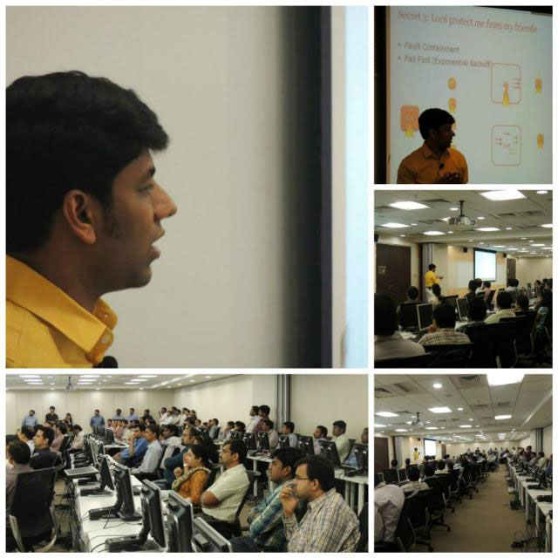


Services Offered
SPA – Scalability, Performance,
Availability Consulting
On-site Training
ram@tier1app.com

Slide 22





Thank you
Follow Us:

