Slide 1

Pick Diamonds from Garbage
Ram Lakshmanan
Founder – GCEasy.io & FastThread.io

Slide 2
Agenda
KPI
Anatomy of GC Log
Tools
Analyze real world GC Logs

Slide 3



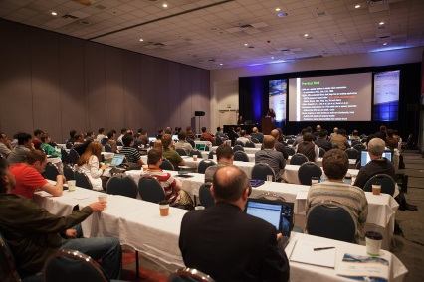
Lets go to vacation ☺
F-16 Falcon
Hawaii
2,392 miles
Boeing

Slide 4
KPI
Enemy attacking
Leisure/Business
1320 mph
570 mph
Time to transport 1 passenger
108 mins
(i.e. 2392 / 1320)
251 mins
(i.e. 2392/570)
Latency
GC Pause time
# of passengers transported in 24 hrs
13
No. of trips in 24 hrs: 13
No. of passengers/trip: 1
3300
No. of trips: in 24 hrs: 5
No. of Passengers/trip: 660
Throughput
# of passengers transported in 24 hrs
(fueling, wind, breaks….)
12
No. of trips in 24 hr: 12
No. of passengers/trip: 1
2640
No. of trips in 24 hrs: 4
No. of Passengers/trip: 660
Useful Work
Cost
??
Should be expensive
600$/passengers
Footprint
CPU, Memory
Notes:
2.3x
220x

Slide 5
Example Requirements
Latency:
No API call can run beyond 500 ms.
Search pages response time should be under 1 second
Throughput:
Application should be able to process 1000 API calls/second
Batch process should complete with in 6 hours. (Every night 6:00pm - 12:00pm)
Foot print:
Application must run on JVMs with less than 2 GB of memory
AWS bill shouldn't exceed 20,000$

Slide 6
Agenda
KPI
Anatomy of GC Log
Tools
Analyze real world GC Logs

Slide 7
GC Log
1
2
3
4
2016-03-21T13:46:58.371+0000: 500.203: [Full GC [PSYoungGen: 1047584K->0K(1048064K)] [ParOldGen: 2097151K->865378K(2097152K)] 3144735K->865378K(3145216K) [PSPermGen: 29674K->29634K(262144K)], 1.8485590 secs] [Times: user=3.17 sys=0.21, real=1.84 secs]
5
7
6
8
1
2016-03-21T13:46:58.371 – Timestamp at which GC event ran
2
500.203 – Number of seconds since application started
Full GC – Type of GC
3
PSYoungGen: 1047584K->0K(1048064K) – Young Gen size dropped from 1047584K
(i.e.1gb) to 0k. Total allocated Young Gen size is 1048064K
4
5
ParOldGen: 2097151K->865378K(2097152K) – Old Gen size dropped from 2097151K
(i.e.1.99gb) to 865378K(i.e.845mb). Total allocated Old Gen size is 2097152k (i.e.2gb)
6
3144735K->865378K(3145216K) – overall heap size dropped from 3144735K
(i.e.2.99gb) to 865378K (i.e.845mb)
7
PSPermGen: 29674K->29634K(262144K) – Perm Gen Size dropped from 29674K to
29634K. Overall Perm Gen Size is 262144K (i.e.256mb)
8
[Times: user=3.17 sys=0.21, real=1.84 secs]

Slide 8
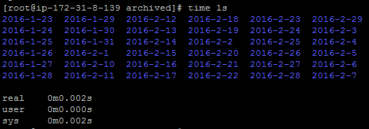
Unix command – “time”

Slide 9
GC Time
Real is wall clock time – time from start to finish of the call. This is all elapsed time including time slices used by other processes and time the process spends blocked (for example if it is waiting for I/O to complete).
Sys is the amount of CPU time spent in the kernel within the process. This means executing CPU time spent in system calls within the kernel, as opposed to library code, which is still running in user-space. Like ‘user’, this is only CPU time used by the process.
User is the amount of CPU time spent in user-mode code (outside the kernel) within the process. This is only actual CPU time used in executing the process. Other processes and time the process spends blocked do not count towards this figure.
User+Sys will tell you how much actual CPU time your process used. Note that this is across all CPUs, so if the process has multiple threads it could potentially exceed the wall clock time reported by Real.
[Times: user=3.09 sys=0.00, real=3.10 secs]
Typical for Serial GC
[Times: user=11.53 sys=1.38, real=1.03 secs]

Slide 10
G1 GC Log Format
1
2
3
2015-09-14T12:32:24.398-0700: 0.356: [GC pause (G1 Evacuation Pause) (young), 0.0215287 secs]
[Parallel Time: 20.0 ms, GC Workers: 8]
[GC Worker Start (ms): Min: 355.9, Avg: 356.3, Max: 358.4, Diff: 2.4]
[Processed Buffers: Min: 0, Avg: 1.1, Max: 5, Diff: 5, Sum: 9]
:
:
[Free CSet: 0.0 ms]
[Eden: 12.0M(12.0M)->0.0B(14.0M) Survivors: 0.0B->2048.0K Heap: 12.6M(252.0M)->7848.3K(252.0M)]
[Times: user=0.08 sys=0.00, real=0.02 secs]
4
5
6
1
2015-09-14T12:32:24.398-0700: 0.356 – indicates the time at which this GC event fired. Here 0.356 indicates that 356 milliseconds after the Java process was started this GC event was fired.
2
GC pause (G1 Evacuation Pause) — Evacuation Pause is a phase where live objects are copied from one region (young or young + old) to another region.
3
(young) – indicates that this is a Young GC event.
4
GC Workers: 8 – indicates the number of GC worker threads.
5
[Eden: 12.0M(12.0M)->0.0B(14.0M) Survivors: 0.0B->2048.0K Heap: 12.6M(252.0M)->7848.3K(252.0M)] – This line indicates the heap size changes:
Eden: 12.0M(12.0M)->0.0B(14.0M) - indicates that Eden generation’s capacity was 12mb and all of the 12mb was occupied. After this GC event, young generation occupied size came down to 0. Target Capacity of Eden generation has been increased to 14mb, but not yet committed. Additional regions are added to Eden generation, as demands are made.
Survivors: 0.0B->2048.0K - indicates that Survivor space was 0 bytes before this GC event. But after the event Survivor size increased to 2048kb. It indicates that objects are promoted from Young Generation to Survivor space.
Heap: 12.6M(252.0M)->7848.3K(252.0M) – indicates that capacity of heap size was 252mb, in that 12.6mb was utilized. After this GC event, heap utilization dropped to 7848.3kb (i.e. 5mb (i.e. 12.6mb – 7848.3kb) of objects has been garbage collected in this event). And heap capacity remained at 252mb.
6
Times: user=0.08, sys=0.00, real=0.02 secs
Notes:
Doubtful on #3.

Slide 11
G1 GC Log - another format
53957.956: [GC pause (G1 Evacuation Pause) (young) 104M->49M(118M), 0.0020080 secs]

Slide 12
CMS Log format
Before GC:
Statistics for BinaryTreeDictionary:
------------------------------------
Total Free Space: 2524251
Max Chunk Size: 2519552
Number of Blocks: 13
Av. Block Size: 194173
Tree Height: 8
2016-05-03T04:27:37.503+0000: 30282.678: [ParNew
Desired survivor size 214728704 bytes, new threshold 1 (max 1)
- age 1: 85782640 bytes, 85782640 total
: 3510063K->100856K(3774912K), 0.0516290 secs] 9371816K->6022161K(14260672K)After GC:
Statistics for BinaryTreeDictionary:
------------------------------------
Total Free Space: 530579346
Max Chunk Size: 332576815
Number of Blocks: 7178
Av. Block Size: 73917
Tree Height: 44
After GC:
Statistics for BinaryTreeDictionary:
------------------------------------
Total Free Space: 2524251
Max Chunk Size: 2519552
Number of Blocks: 13
Av. Block Size: 194173
Tree Height: 8
, 0.0552970 secs] [Times: user=0.67 sys=0.00, real=0.06 secs]
Heap after GC invocations=5898 (full 77):
par new generation total 3774912K, used 100856K [0x000000047ae00000, 0x000000057ae00000, 0x000000057ae00000)
eden space 3355520K, 0% used [0x000000047ae00000, 0x000000047ae00000, 0x0000000547ae0000)
from space 419392K, 24% used [0x0000000547ae0000, 0x000000054dd5e328, 0x0000000561470000)
to space 419392K, 0% used [0x0000000561470000, 0x0000000561470000, 0x000000057ae00000)
concurrent mark-sweep generation total 10485760K, used 5921305K [0x000000057ae00000, 0x00000007fae00000, 0x00000007fae00000)
concurrent-mark-sweep perm gen total 49380K, used 29537K [0x00000007fae00000, 0x00000007fde39000, 0x0000000800000000)
}

Slide 13
IBM GC Log format
<af type="tenured" id="4" timestamp="Jun 16 11:28:22 2016" intervalms="5633.039">
<minimum requested_bytes="56" />
<time exclusiveaccessms="0.010" meanexclusiveaccessms="0.010" threads="0" lastthreadtid="0xF6B1C400" />
<refs soft="7232" weak="3502" phantom="9" dynamicSoftReferenceThreshold="30" maxSoftReferenceThreshold="32" />
<tenured freebytes="42949632" totalbytes="1073741824" percent="3" >
<soa freebytes="0" totalbytes="1030792192" percent="0" />
<loa freebytes="42949632" totalbytes="42949632" percent="100" />
</tenured>
<pending-finalizers finalizable="0" reference="0" classloader="0" />
<gc type="global" id="6" totalid="6" intervalms="3342.687">
<classunloading classloaders="0" classes="0" timevmquiescems="0.000" timetakenms="1.200" />
<finalization objectsqueued="75" />
<timesms mark="28.886" sweep="1.414" compact="0.000" total="31.571" />
<tenured freebytes="1014673616" totalbytes="1073741824" percent="94" >
<soa freebytes="982461648" totalbytes="1041529856" percent="94" />
<loa freebytes="32211968" totalbytes="32211968" percent="100" />
</tenured>
</gc>
<tenured freebytes="1014608080" totalbytes="1073741824" percent="94" >
<soa freebytes="982396112" totalbytes="1041529856" percent="94" />
<loa freebytes="32211968" totalbytes="32211968" percent="100" />
</tenured>
<refs soft="7020" weak="2886" phantom="9" dynamicSoftReferenceThreshold="30" maxSoftReferenceThreshold="32" />
<pending-finalizers finalizable="75" reference="15" classloader="0" />
<time totalms="33.852" />
</af>

Slide 14
IBM GC Log – another format
<gc-op id="139" type="scavenge" timems="335.610" contextid="136" timestamp="2016-06-15T15:51:10.128">
<scavenger-info tenureage="4" tenuremask="7ff0" tiltratio="58" />
<memory-copied type="nursery" objects="11071048" bytes="448013400" bytesdiscarded="88016" />
<memory-copied type="tenure" objects="286673" bytes="9771936" bytesdiscarded="320608" />
<copy-failed type="nursery" objects="286673" bytes="9771936" />
<finalization candidates="112" enqueued="16" />
<ownableSynchronizers candidates="8111" cleared="11" />
<references type="soft" candidates="1256" cleared="0" enqueued="0" dynamicThreshold="32" maxThreshold="32" />
<references type="weak" candidates="2953" cleared="0" enqueued="0" />
<references type="phantom" candidates="142406" cleared="142335" enqueued="142335" />
</gc-op>

Slide 15
GC Log format varies
Java Vendor
JVM Version
GC Algorithm
Arguments

Slide 16

Reminds of…
https://www.youtube.com/watch?v=QNJL6nfu__Q
Notes:
https://www.youtube.com/watch?v=QNJL6nfu__Q

Slide 17
Agenda
KPI
Anatomy of GC Log
Tools
Analyze real world GC Logs

Slide 18
gceasy.io
Universal GC log analyzer – http://gceasy.io

Slide 19

gceasy.io – REST API
https://blog.gceasy.io/2016/06/18/garbage-collection-log-analysis-api/

Slide 20
Agenda
KPI
Anatomy of GC Log
Tools
Analyze real world GC Logs

Slide 21

Diamond 1: Long GC Pause

Slide 22
Diamond 2: Poor Throughput

Slide 23
Diamond 3: Memory Leak

Slide 24
Diamond 4: Memory Leak 2

Slide 25
Diamond 5: Consecutive Full GCs

Slide 26
Diamond 6: G1 GC – advanced info

Slide 27

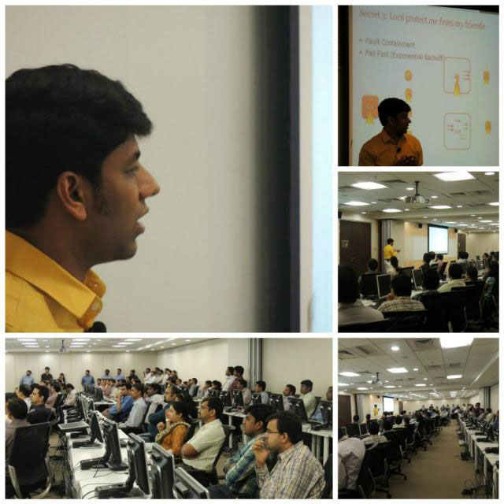


Services Offered
Consulting
1. SPA (Scalability, Performance, Availability)
2. Cloud
On-site Training
ram@tier1app.com
https://www.linkedin.com/in/ramlakshman

Slide 28





Thank you
Follow Us:

