Slide 1
Driessen’s Model
A successful Git branching model
Target Audience: Project Mangers/Leads/Developers/Testing Team, SCM Administrators with experience in Git/Mercurial and use Distributed Version control system in their Projects.

Slide 2
GITFLOW
GitFlow is a branching model for Git, created by Vincent Driessen. It has attracted a lot of attention because it is very well suited to collaboration and scaling the development team.
One of the great things about GitFlow is that it makes parallel development very easy, by isolating new development from finished work. New development (such as features and non-emergency bug fixes) is done in feature branches, and is only merged back into main body of code when the developer(s) is happy that the code is ready for release.

Slide 3
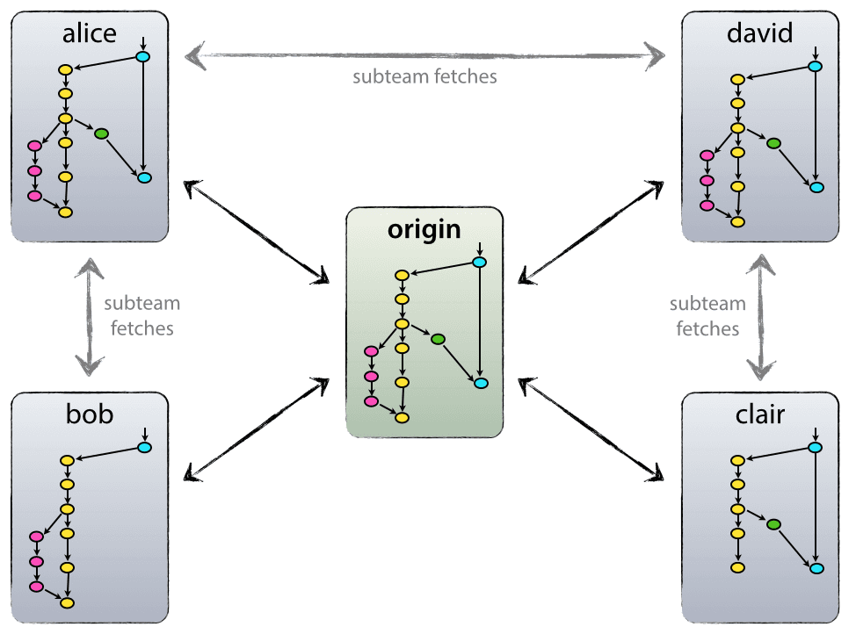
Decentralized but Centralized:
As Git is DVCS, there is no such thing as a central repo at a technical level. We will refer to main repo as origin, since this name is familiar to all Git users

Slide 4
Gitflow /Driessen Model
In Detail

Slide 5
Main branches
At the core, the development model is greatly inspired by existing models out there. The central repo (origin) holds two main branches with an infinite lifetime:
origin: master
origin: develop
Ideally develop branch is owned by development manager and master branch by SCM Leads.
The master branch at origin should be familiar to every Git user. Parallel to the master branch, another branch exists called develop.
We consider origin/master to be the main branch where the source code of HEAD always reflects a production-ready state.

Slide 6
Main branches
We consider origin/develop to be the main branch where the source code of HEAD always reflects a state with the latest delivered development changes for the next release. Some would call this the “integration branch”. This is where any automatic nightly builds are built from.
When the source code in the develop branch reaches a stable point and is ready to be released, all of the changes should be merged back into master somehow and then tagged with a release number. How this is done in detail will be discussed further on.
Therefore, each time when changes are merged back into master, this is a new production release by definition.

Slide 7
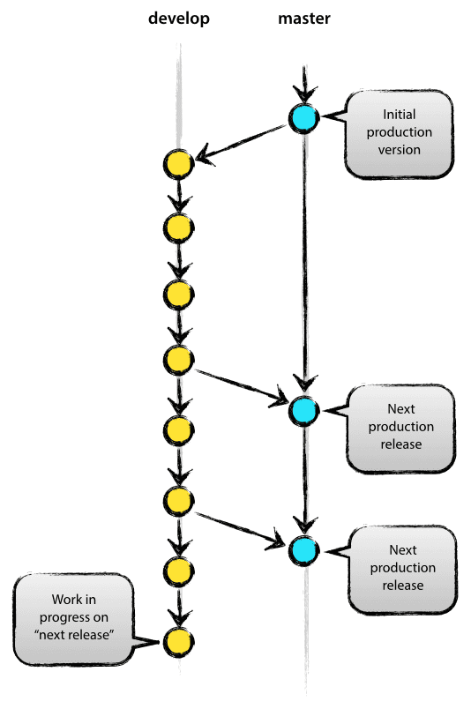

Slide 8
Supporting branches
Next to the main branches master and develop, our development model uses a variety of supporting branches to aid parallel development between team members, ease tracking of features, prepare for production releases and to assist in quickly fixing live production problems. Unlike the main branches, these branches always have a limited life time, since they will be removed eventually.

Slide 9
Supporting branches
The different types of branches we may use are:
Feature branches
Release branches
Hotfix branches
Each of these branches have a specific purpose and are bound to strict rules as to which branches may be their originating branch and which branches must be their merge targets. We will walk through them in a minute.

Slide 10
Supporting branches : Feature branch
May branch off from:
develop
Must merge back into:
Develop
Branch naming convention:
anything except master, develop, release-*, or hotfix-*

Slide 11
Supporting branches : Feature branch
Feature branches (or sometimes called topic branches) are used to develop new features for the upcoming or a distant future release. When starting development of a feature, the target release in which this feature will be incorporated may well be unknown at that point. The essence of a feature branch is that it exists as long as the feature is in development, but will eventually be merged back into develop (to definitely add the new feature to the upcoming release) or discarded (in case of a disappointing experiment).
Feature branches typically exist in developer repos only, not in origin.

Slide 12
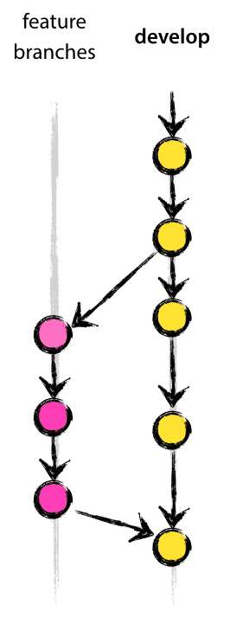

Slide 13
Supporting branches : Release branch
May branch off from:
Develop
Must merge back into:
develop and master
Branch naming convention:
release-*

Slide 14
Supporting branches : Release branch
Release branches support preparation of a new production release. They allow for last-minute dotting of i’s and crossing t’s. Furthermore, they allow for minor bug fixes and preparing meta-data for a release (version number, build dates, etc.). By doing all of this work on a release branch, the develop branch is cleared to receive features for the next big release.

Slide 15
Supporting branches : Hotfix branch
May branch off from:
master
Must merge back into:
develop and master
Branch naming convention:
hotfix-*

Slide 16
Supporting branches : Hotfix branch
Hotfix branches are very much like release branches in that they are also meant to prepare for a new production release, albeit unplanned. They arise from the necessity to act immediately upon an undesired state of a live production version. When a critical bug in a production version must be resolved immediately, a hotfix branch may be branched off from the corresponding tag on the master branch that marks the production version.

Slide 17
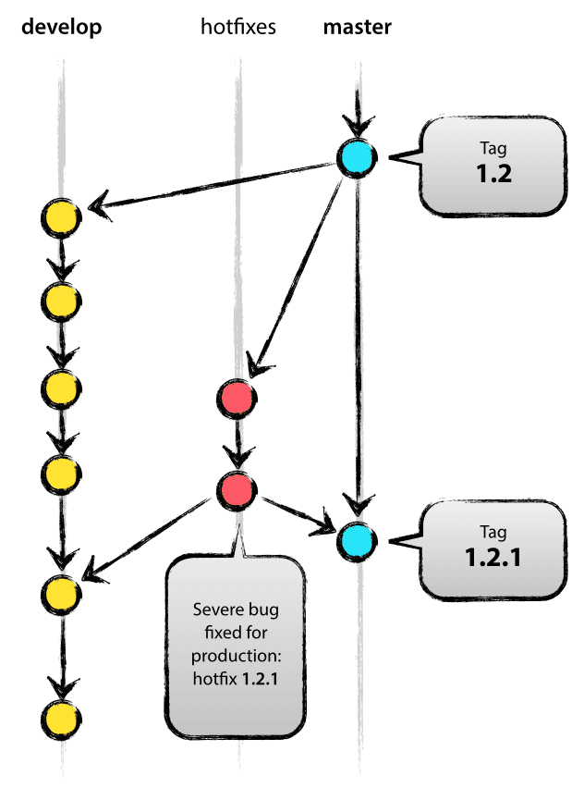

Slide 18
Gitflow /Driessen Model
How it Works

Slide 19
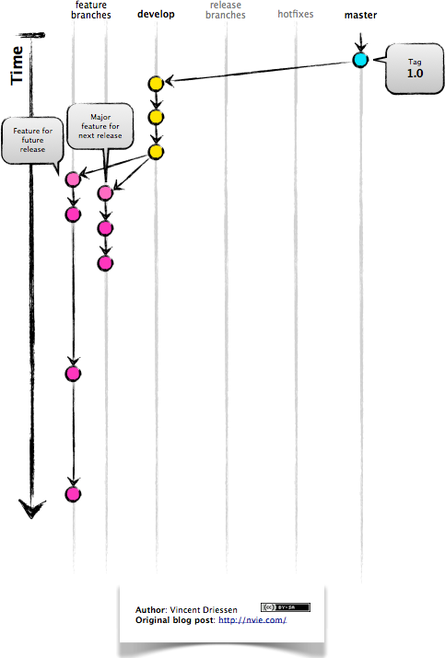
GITFLOW: How it works
New development (new features, non-emergency bug fixes) are built in feature branches:

Slide 20
GITFLOW: How it works
Feature branches are branched off of the develop branch, and finished features and fixes are merged back into the develop branch when they’re ready for release:

Slide 21
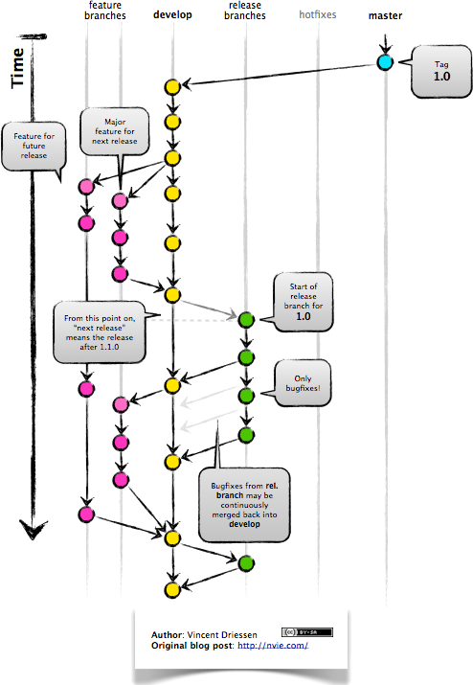
GITFLOW: How it works
When it is time to make a release, a release branch is created off of develop:

Slide 22
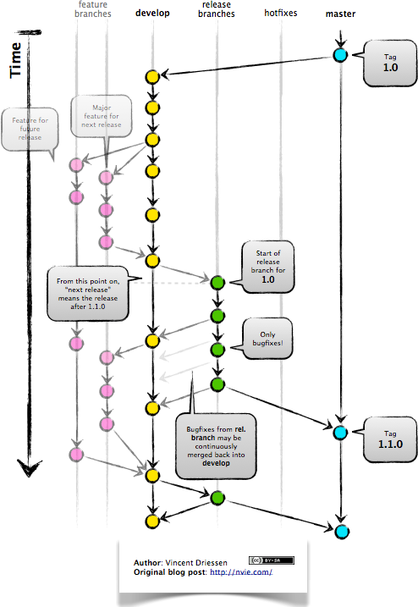
GITFLOW: How it works
The code in the release branch is deployed onto a suitable test environment, tested, and any problems are fixed directly in the release branch. This deploy -> test -> fix -> redeploy -> retest cycle continues until you’re happy that the release is good enough to release to customers.
When the release is finished, the release branch is merged into master and into develop too, to make sure that any changes made in the release branch aren’t accidentally lost by new development.

Slide 23
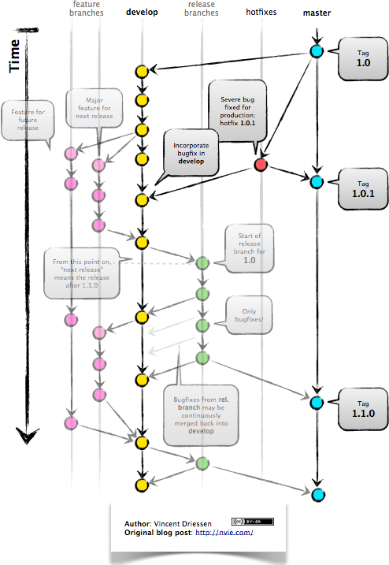
GITFLOW: How it works
The master branch tracks released code only. The only commits to master are merges from release branches and hotfix branches.
Hotfix branches are used to create emergency fixes:

Slide 24
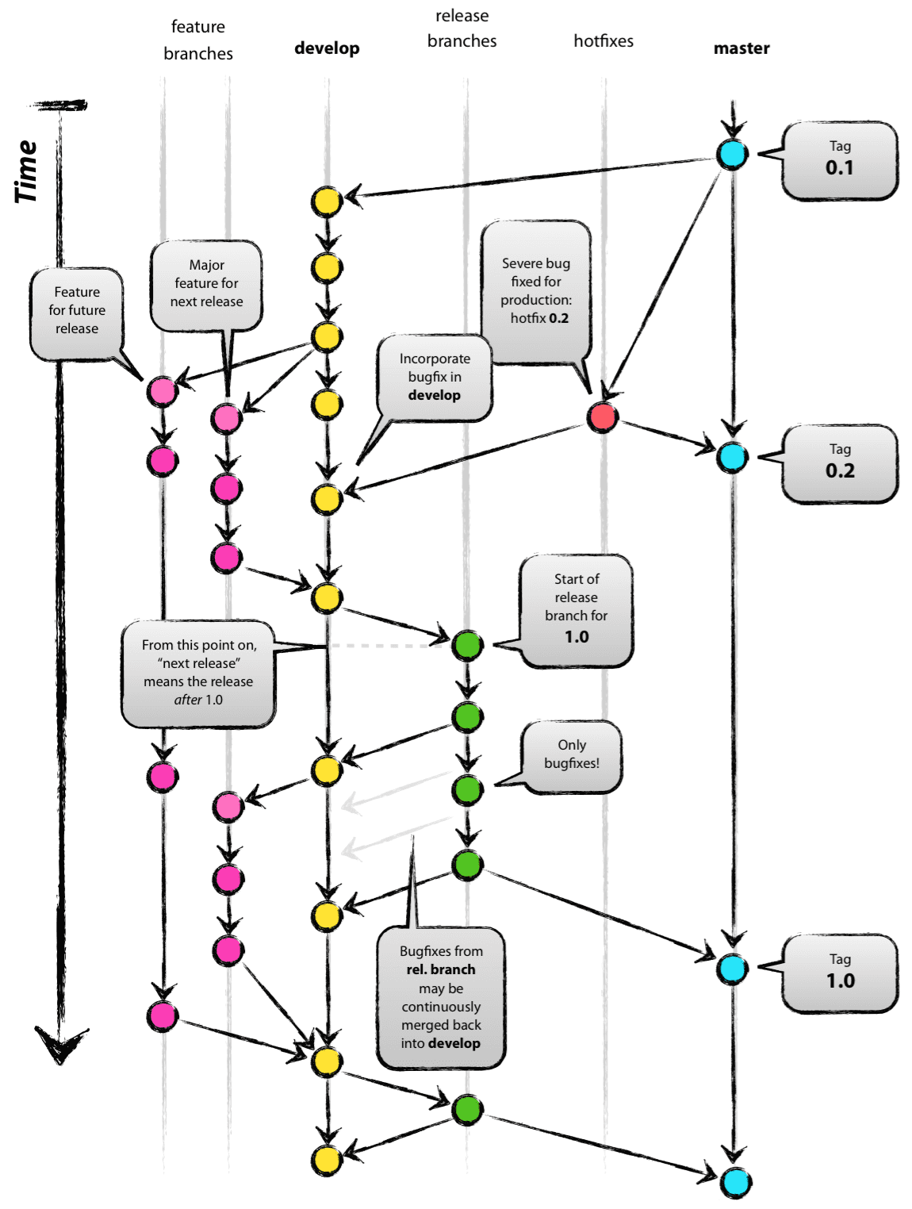
GITFLOW: Complete MODEL DIAGRAM

Slide 25
Software Requirements
Bitbucket is used for hosting Mercurial and Git Repositories.
An account in Bitbucket repository with required access is needed to access the repository.
Following Tools has built in support for GitFlow. Remote repository can be cloned using these tools. Built in Gitflow is used to implement Gitflow Branching Model.
SourceTree : For Windows
SmartGit : For Linux
HG, Git command line utilities may be useful too.

Slide 26
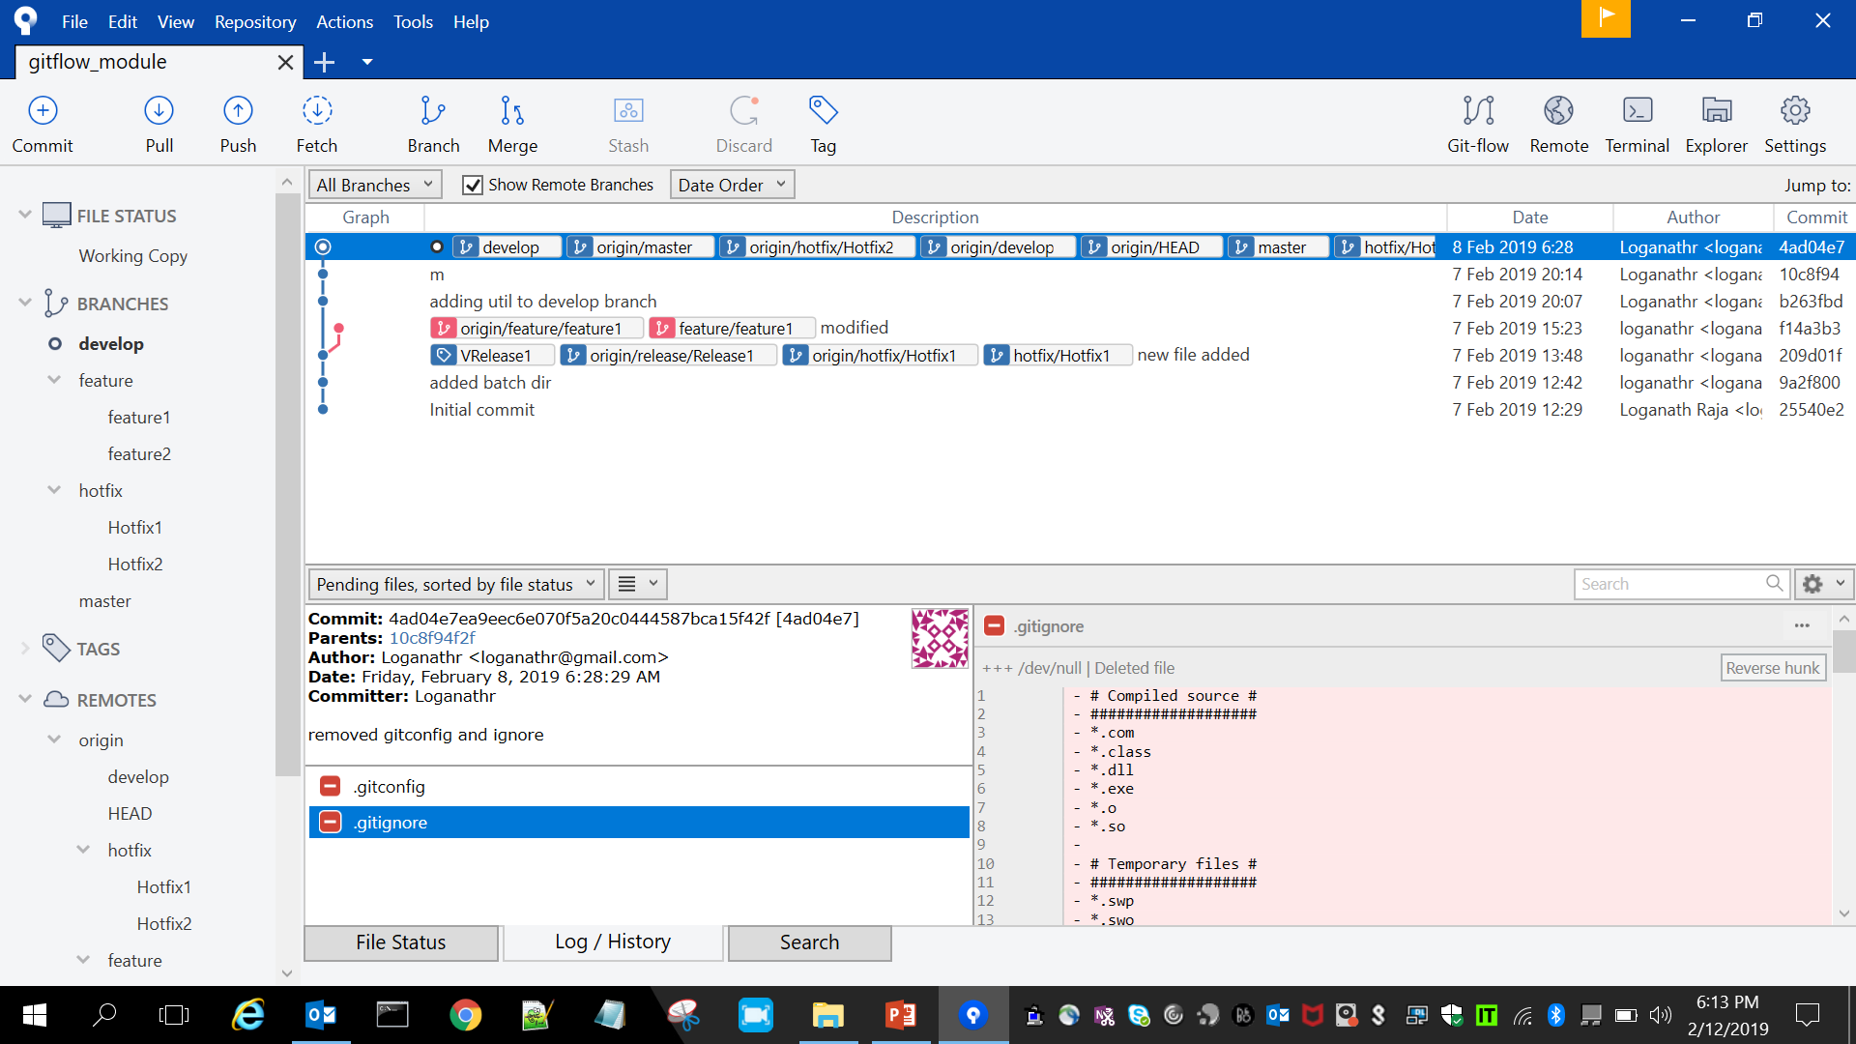
Source Tree

Slide 27
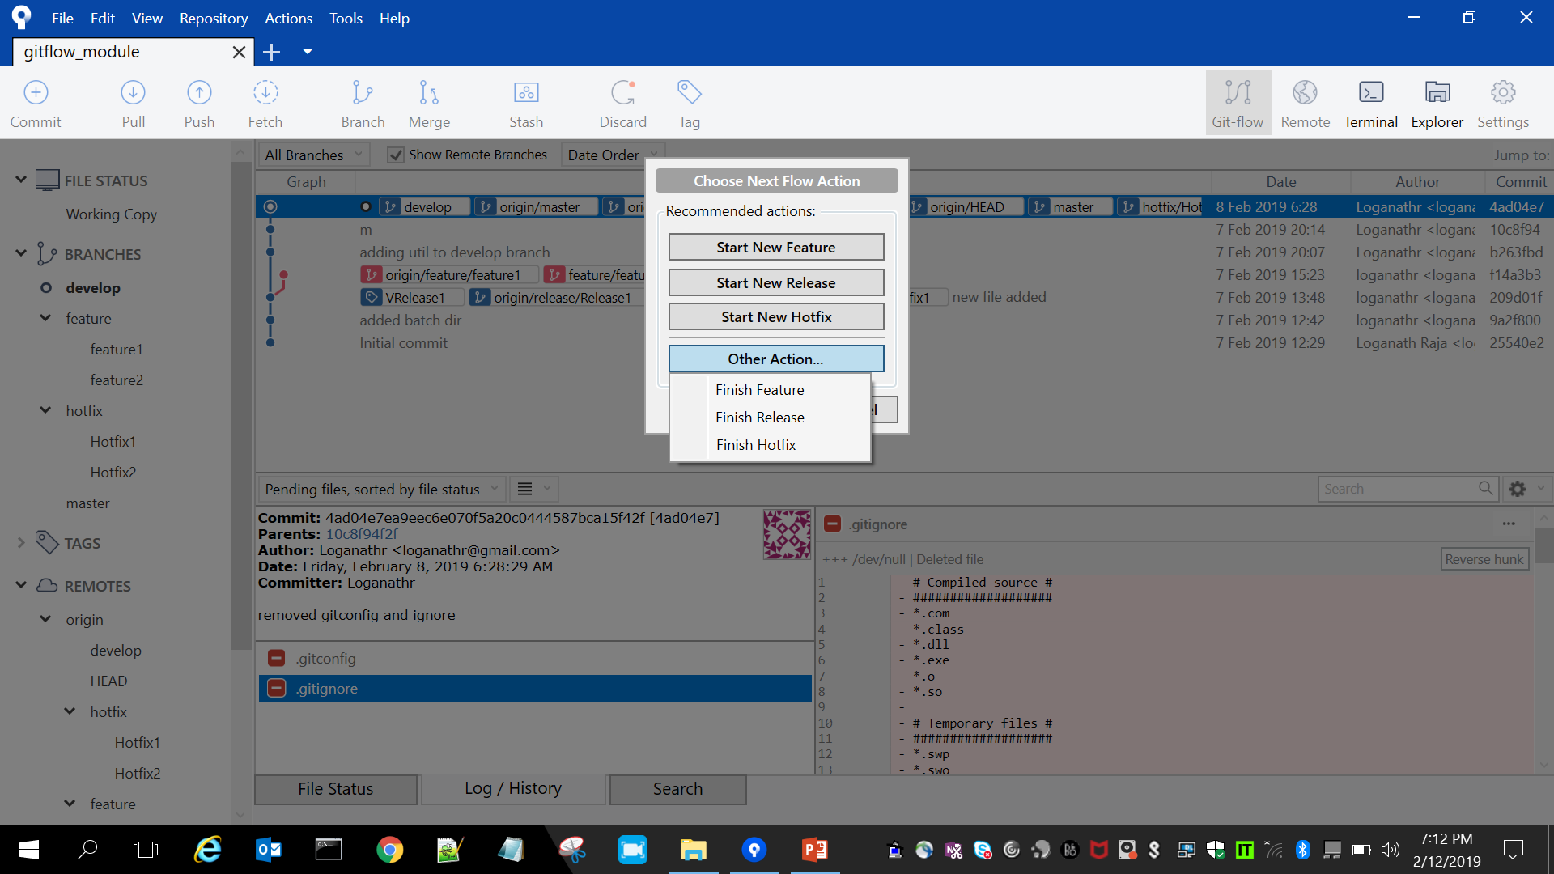
Source Tree
GitFlow Icon

Slide 28
Git Tips – basic operations from command line
Goto your project folder from command line:
Example :
cd C:\AirCanada
Clone:
git clone https://repo.ca-intranet.aimia.com/scm/ac/xrez-aeroplan-com.git
List branches:
$ git branch -a
$ git branch –vv

Slide 29
Git Tips – basic operations from command line
List status:
$ git status
List Log:
git log --oneline --decorate
Switching to a branch
$ git checkout develop

Slide 30
Git Tips – basic operations from command line
Сreate Git Branch and Checkout - Syntax
Create a new Git branch and checkout:
$ git branch <branch_name>
$ git checkout <branch_name>
Create a Git branch and checkout in one command:
$ git checkout -b <branch_name>
Example:
$ git checkout -b bugfix/BWKB-1187-popup-misaligned
Switched to a new branch " bugfix/BWKB-1187-popup-misaligned“
This is shorthand for:
$ git branch bugfix/BWKB-1187-popup-misaligned
$ git checkout bugfix/BWKB-1187-popup-misaligned

Slide 31
Git Tips – basic operations from command line
(or)
git checkout -b bugfix/BWKB-1187-popup-misaligned develop
Add and commit:
add files and commit
git add <filename>
git commit -a -m "Updated POM version to SNAPSHOT"
Set Upstream for push and pull : (one time activity while branch creation)
git push --set-upstream origin bugfix/BWKB-1187-pop-alignment

Slide 32
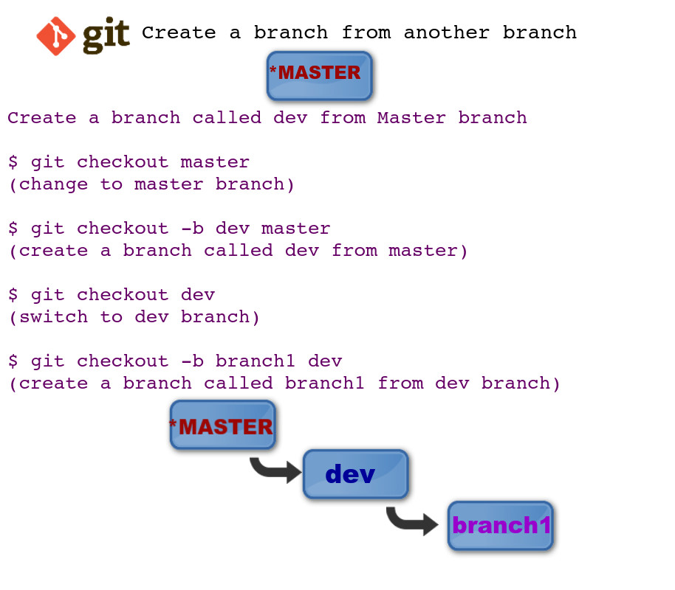
Git Tips – basic operations from command line

Slide 33
Git Tips – command line
Renaming a Branch
$ git branch -m branch1 newbranchname
Delete a Branch
$ git branch -d branch-to-delete
$ git branch -D branch-to-delete ( force deletion without checking the merged status )

Slide 34
Git Tips – Merging
I generally like to merge master (parent branch) into the development (child branch) first so that if there are any conflicts, I can resolve in the development branch (child branch) itself and my master(parent branch) remains clean.
$ git checkout development
(on branch development)$ git merge master
(resolve any merge conflicts if there are any)
git checkout master
git merge development (there won't be any conflicts now)
there is still more work to be done before these can be merged, so I tend to leave master untouched until final stuff.

Slide 35
Git Tips – command line operations
echo " Local branches "
echo " *************** "
git branch
git branch -vv
echo " Remote branches "
echo " *************** "
git remote -vv
echo " All remote branches"
echo " *************** "
git branch –a
echo " Status"
echo " *************** "
git status
Extract and copy the attached id.bat in your path. Then type id from your working dir.

Slide 36
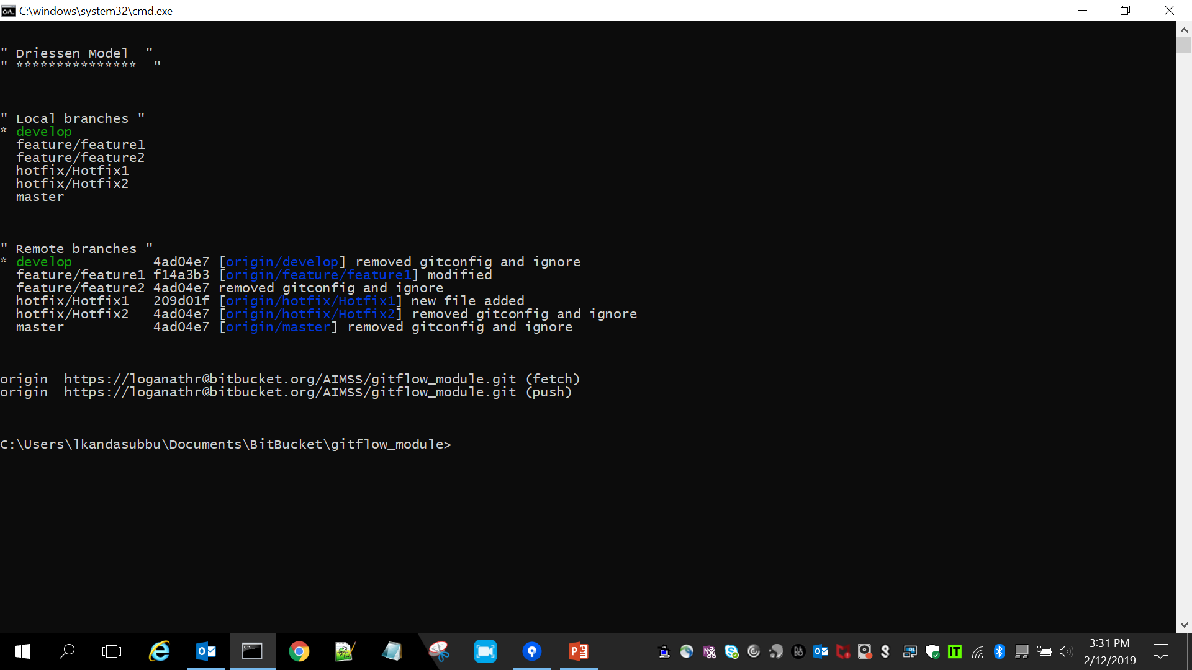
Source Tree

Slide 37
Best practices
There is no restrcitions the number/name of branch you will have in local. It is better you will have same set of Branches as in Remote into your local.
Ideally you should be having the same branch name in local as well remote to clearly identify for self and other Team members.

Slide 38
Thank you

