Slide 1
DAO
Design pattern

Slide 2
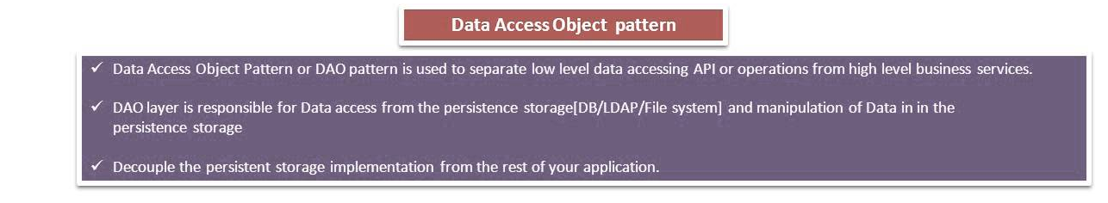
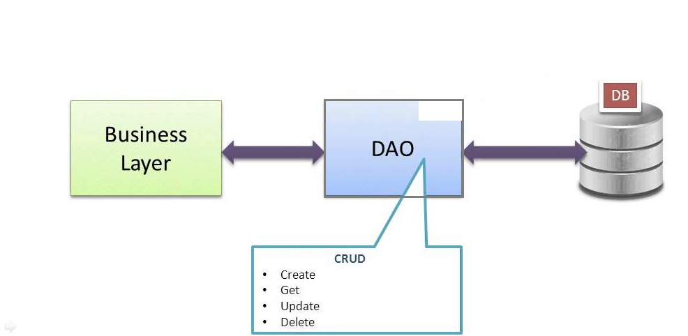

Slide 3
Participants in Data Access Object Pattern.
Data Access Object Interface -
Data Access Object concrete class -
Model Object or Value Object -
The model objects are Simple POJO representing real world data, such as Person, Product, Order, etcetera.
model class which represents a single row of the 'User' table of the 'javabase' database.
containing get/set methods to store data retrieved using DAO class.

Slide 4
DAO interface
This interface defines all actions(standard operations) which needs to be performed on the User model class.
All DAO implementations should adhere the contract as specified by this interface.
new methods, should be specified in the interface first.

Slide 5
DAO Implementation
This is a concrete class
Implements the User DAO interface.
This class is responsible to get data from a data source which can be database / xml or any other storage mechanism.

Slide 6
Model Object or Value Object -
The model objects are Simple POJO* representing real world data, such as Person, Product, Order, etcetera.
model class which represents a single row of the “AddressBook” table of the database.
containing get/set methods to store data retrieved using DAO class.
*Pojo means plain old java object

Slide 7
Benefit of POJO
Decoupling:
It decouples the application components
that lets you construct an application from loosely coupled components.
Notes:
In object oriented design, the amount of coupling refers to how much the design of one class depends on the design of another class. In other words, how often do changes in class A force related changes in class B? Tight coupling means the two classes often change together, loose coupling means they are mostly independent. In general, loose coupling is recommended because it's easier to test and maintain.

Slide 8
Benefit of POJO
By using plain old Java objects, your code can be much simpler.
This lends itself to better testing, flexibility, and ability to make new decisions in the future.
Notes:
Understand one class without reading others
Change one class without affecting others
Thus improves maintainability

