Slide 1
Improving Hospital Service for Americans and Russians
Group 4
Logan Wu Andrew Jackson Scott Sung

Slide 2






Meet the Registrars
Meredith
Cristina
Izzie
George
Alex
Jay P
Heavy workloads lead to tremendously stressed registrars
Trump Hospital wants to balance workloads between wards
Objective: Minimise the expected range of ward occupancies

Slide 3
Assumptions
Patients and wards are independent and identical
Expected stay of 2.1 days – every patient has a 45% chance of leaving each day (Poisson)
Admissions on each weekday (e.g. Tuesdays) have a constant mean
The long-term expected ward occupancies are periodic

Slide 4
Formulation
Complete Enumeration of Starting Weeks
15 unique registrar combinations
Mixed-Integer Program
Feasibility
Daily Patient Numbers
Time-discounted network
Exponential discharge distribution
Tracks patient numbers in each ward
Admit [X]
1-p
2
1-p
1
1-p
42
Infinite Horizon Cycle LP
1-p
41
Assignment problem
Admit [Y]
1-p
40
1-p

Slide 5
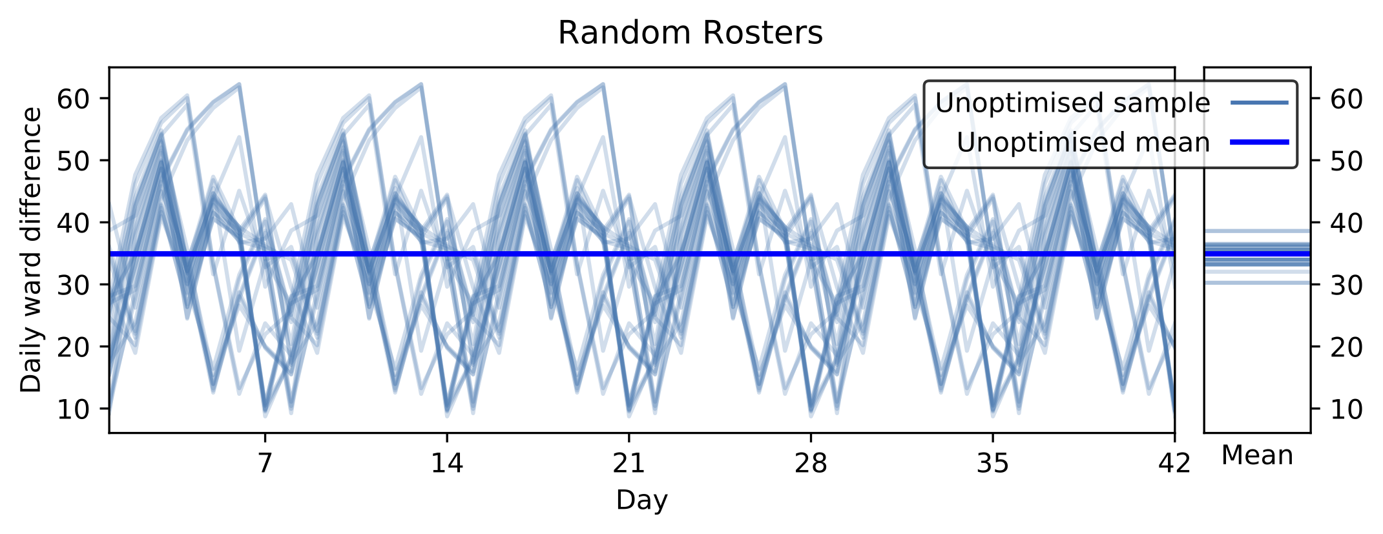
Roster Random
Mean daily ward imbalance between 34 and 36 patients (n=30)

Slide 6
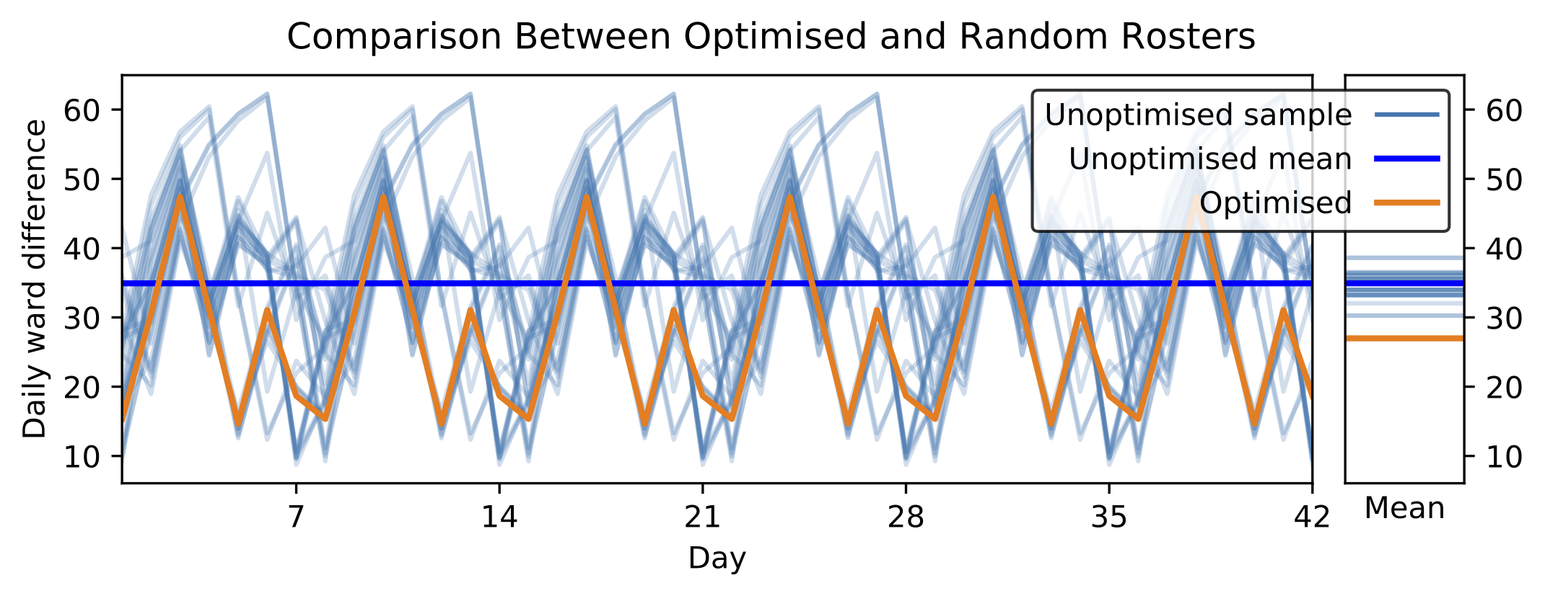
Roster Optimised
Mean daily ward imbalance between 34 and 36 patients (n=30)
Optimal roster decreases mean imbalance to 27 patients

Slide 7
Optimal Roster
Decreases occupancy differences between the busiest and quietest wards by 8 people (23%)
Each ward’s registrars start 3 weeks apart
Night shift is always on the last week of the roster

Slide 8

Conclusions
Our roster decreases expected occupancy differences between the busiest and quietest wards by 8 people each day (23%)
Registrars are happier and patients like Penny feel bigly covfefe

