Slide 1
Trumping Trump Hospital
Group 4
Logan Wu Andrew Jackson Scott Sung

Slide 2
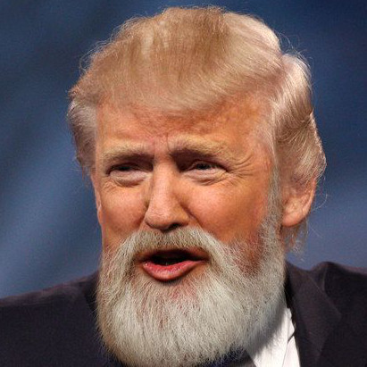

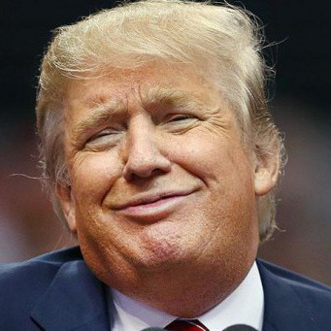



Meet the Registrars
Meredith
Cristina
Izzie
George
Alex
Jay P
Heavy workloads lead to tremendously stressed registrars
Trump Hospital wants to balance workloads between wards
Objective: Minimise the range of ward occupancies

