Slide 1
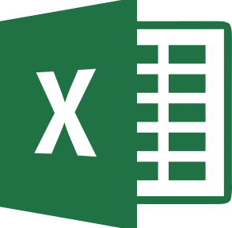



Excel
Python
R

