Slide 1
Is Cholesterol Overrated? Examining Its Independent Effect on Heart Disease Risk
Logan Calder, Chase Mayer, Anirudh Ramesh

Slide 2
Research Question
In this project, we are investigating...
What is the relationship between serum cholesterol (mg/dL) and the presence of coronary heart disease, and how does that relationship change after adjusting for age and resting blood pressure?
Why it matters
Cholesterol drives decades of dietary guidelines and pharmaceutical development
Recent evidence suggests its independent signal weakens once age and BP are controlled for
This is a purely descriptive question — not causal inference

Slide 3
Operationalization and Variables
Outcome (Y): Binary heart disease indicator — 1 if vessel narrowing present, 0 otherwise
Primary predictor (X): Serum cholesterol (mg/dL) from fasting blood draw
Covariates: Age (years), Resting blood pressure (mmHg)
Slippage to consider
Binary outcome discards disease severity (original scale: 0–4)
Cholesterol is a single snapshot — does not capture trends over time
Statin use not recorded — could suppress measured cholesterol in high-risk patients

Slide 4
Population
Dataset: UCI Heart Disease dataset (Janosi et al., 1988) — 4 clinical sites
Unit of observation: Individual patient visit with angiographic examination
Sample construction
Primary: Cleveland Clinic (n = 304 before cleaning, 303 after); pooled four-site (n = 675) for replication
Cleveland split 70/30: 70% confirmation set (n = 213), 30% exploration set
Clinical convenience sample — higher-risk patients referred for angiography
Base rate of heart disease ~47% — far higher than general population; do not extrapolate

Slide 5
Regression Results
4 Linear Probability Models: Cleveland + all-sites × unadjusted + adjusted. HC3 robust SEs throughout.
Key findings
Cholesterol not significant in Cleveland alone (p ≈ 0.26 unadjusted; p ≈ 0.72 adjusted)
Cholesterol reaches significance in all-sites (larger n = 675), but effect size identical: +100 mg/dL → ~10 pp increase
Age is the dominant predictor: each additional decade → ~9 pp (p < 0.05)
Model fit: adjusted R² = 0.055 (Cleveland), 0.093 (all sites) — low in absolute terms
Practical significance (Model 2, sample medians: chol=243, age=56, BP=130)
A 100 mg/dL increase in Cholesterol shifts predicted probability by ~10pp
Age 56→66 (same cholesterol) shifts predicted probability by ~9 pp

Slide 6
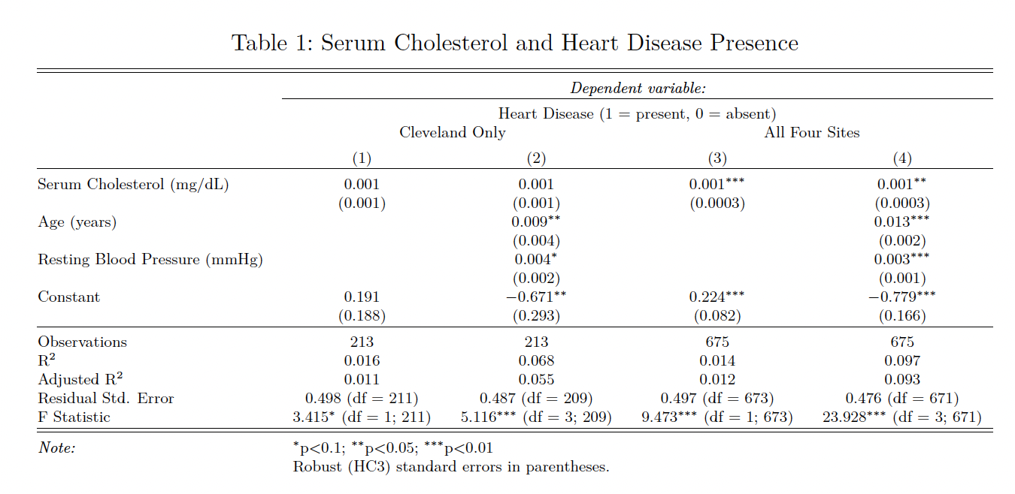
Regression Results

Slide 7
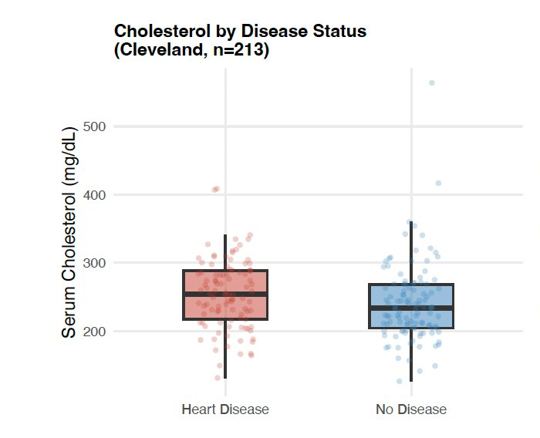
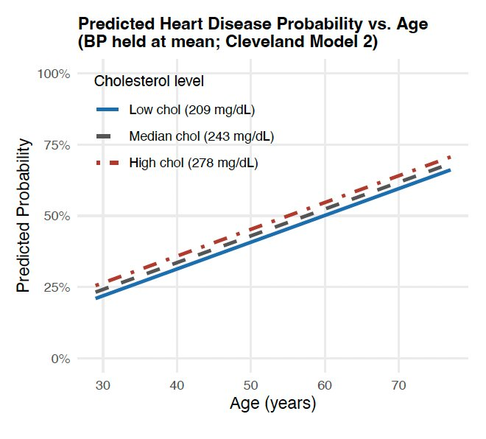
Data Visualization: What the Data Shows
Left: Cholesterol IQRs overlap almost entirely — no visual separation between disease and no-disease groups
Right: Three cholesterol lines (low/median/high) track nearly on top of each other; age 30→70 drives ~40pp increase in predicted risk

Slide 8
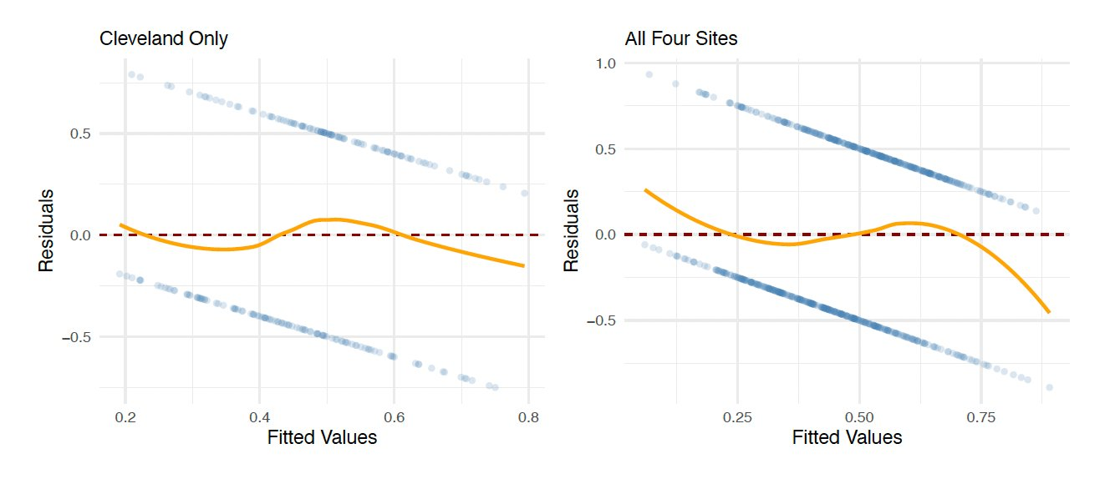
Residuals vs. Fitted: Assumption Checks
Loess smoother tracks near zero — no systematic curvature, linear CEF supported
Pairwise correlations |r| < 0.35; VIF < 1.15 — no multicollinearity concern
Heteroskedasticity expected with binary outcome — addressed throughout with HC3 robust SEs

Slide 9
Conclusion
Cholesterol shows a statistically fragile and practically small association with heart disease
Its descriptive signal is largely absorbed by age and, to a lesser extent, blood pressure
Key limitation: Statin use not recorded — could suppress cholesterol in highest-risk patients, potentially understating its relevance
Questions for the audience:
"We used a linear probability model rather than logistic regression for interpretability — is that the right tradeoff here?”
"Are there other confounders beyond age and BP we should have included?”
"We excluded observations where cholesterol was recorded as zero, treating them as physiologically implausible rather than true zero values. Could this exclusion have introduced selection bias — and if so, in which direction?”
"Our sample consists entirely of patients already referred for angiography, meaning they were already flagged as higher-risk. How do you think this referral bias affects the generalizability of our cholesterol finding to the broader population?"

Slide 10
References
Janosi, A., Steinbrunn, W., Pfisterer, M., & Detrano, R. (1988). Heart Disease [Dataset]. UCI Machine Learning Repository. https://archive.ics.uci.edu/dataset/45/heart+disease
Wilson, P. W., et al. (1998). Prediction of coronary heart disease using risk factor categories. Circulation. https://www.ahajournals.org/doi/epub/10.1161/01.CIR.97.18.1837
Detrano, R., et al. (1989). Bayesian analysis of hygienic and noninvasive test data in the diagnosis of coronary artery disease. American Journal of Cardiology. https://www.sciencedirect.com/science/article/pii/0002914989905249

