Slide 1
ProTech
Professional Services Marketplace Platform
End-of-Year Master's Project
IT Innovation in Business — Master's Degree
Web Technology in Business · Web Application Development
Manye Patrice
June 09, 2026
github.com/logandescapo-eng/protech1
Notes:
Welcome. Introduce yourself, the programme, and the project title. Mention this is an 8–10 minute defence of a full-stack marketplace platform.

Slide 2
Presentation Outline
1. Introduction, problem & goals
2. Business model & growth projections
3. System design & architecture
4. Implementation & security
5. Live demo (screenshots)
6. Testing, deployment & rubric alignment
7. Conclusion & Q&A
Manye Patrice | IT Innovation in Business — Master's Degree | Slide 2 of 31
Notes:
~8–10 minute defence. Backup slides follow for Q&A.

Slide 3
1
Introduction & Business Case
Manye Patrice | IT Innovation in Business — Master's Degree | Slide 3 of 31

Slide 4
Introduction & Problem Statement
ProTech — a marketplace connecting clients with skilled service workers.
End-of-year master's project: IT Innovation in Business.
Problems: poor discovery, payment risk, fragmented coordination, no admin oversight.
Solution: one Django platform with booking, escrow, reviews, and RBAC.
Clone-and-run via Docker for academic evaluation.
Manye Patrice | IT Innovation in Business — Master's Degree | Slide 4 of 31
Notes:
Keep to 60 seconds. Make the problem relatable.

Slide 5
Goals & Business Use Case
Technical goals
Stakeholders
Project goals:
• Working client + worker marketplace
• Django, Docker, Redis, tests, logging
• Escrow with platform commission
• Django Admin CMS
Who benefits:
• Clients — search, book, pay safely
• Workers — profile, jobs, wallet payouts
• Platform — commission + subscriptions
Manye Patrice | IT Innovation in Business — Master's Degree | Slide 5 of 31

Slide 6
2
Business Model & Growth
Manye Patrice | IT Innovation in Business — Master's Degree | Slide 6 of 31

Slide 7
Business Model Overview
Hybrid revenue: transaction commission + worker subscriptions.
Clients pay no membership — job price held in escrow until completion.
Commission implemented in escrow/services.py (default 5%).
Subscriptions (Starter / Professional / Premium) specified for production.
Charts below are illustrative projections, not audited forecasts.
Manye Patrice | IT Innovation in Business — Master's Degree | Slide 7 of 31

Slide 8
Revenue Model
Per transaction
Monthly plans
Commission (on job completion):
• Micro (<$50): 8% or min $3
• Standard: 5%
• Commercial (>$500): 3.5%
Worker subscriptions:
• Starter — free, basic listing
• Professional — $29/mo, −1% commission
• Premium — $59/mo, featured placement
Manye Patrice | IT Innovation in Business — Master's Degree | Slide 8 of 31

Slide 9
Break-Even Analysis
Per worker
Platform operator
Worker plans (commission savings):
Jobs = Subscription ÷ (Avg job × Discount %)
• Professional ($29): 14 jobs/mo @ $200
• Premium ($59): 15 jobs/mo @ $200
Before ranking / featured-placement uplift.
Platform operating break-even:
• Fixed costs: Bootstrap scenario — Months 1–6: $3,200 · 7–12: $3,800 · 13–24: $4,500
• Variable: 2% of GMV
• Break-even: Month 25 (illustrative)
• Month 24 margin: $-27
Manye Patrice | IT Innovation in Business — Master's Degree | Slide 9 of 31
Notes:
Walk through formulas. Charts on next slides show worker job thresholds and platform crossover.

Slide 10
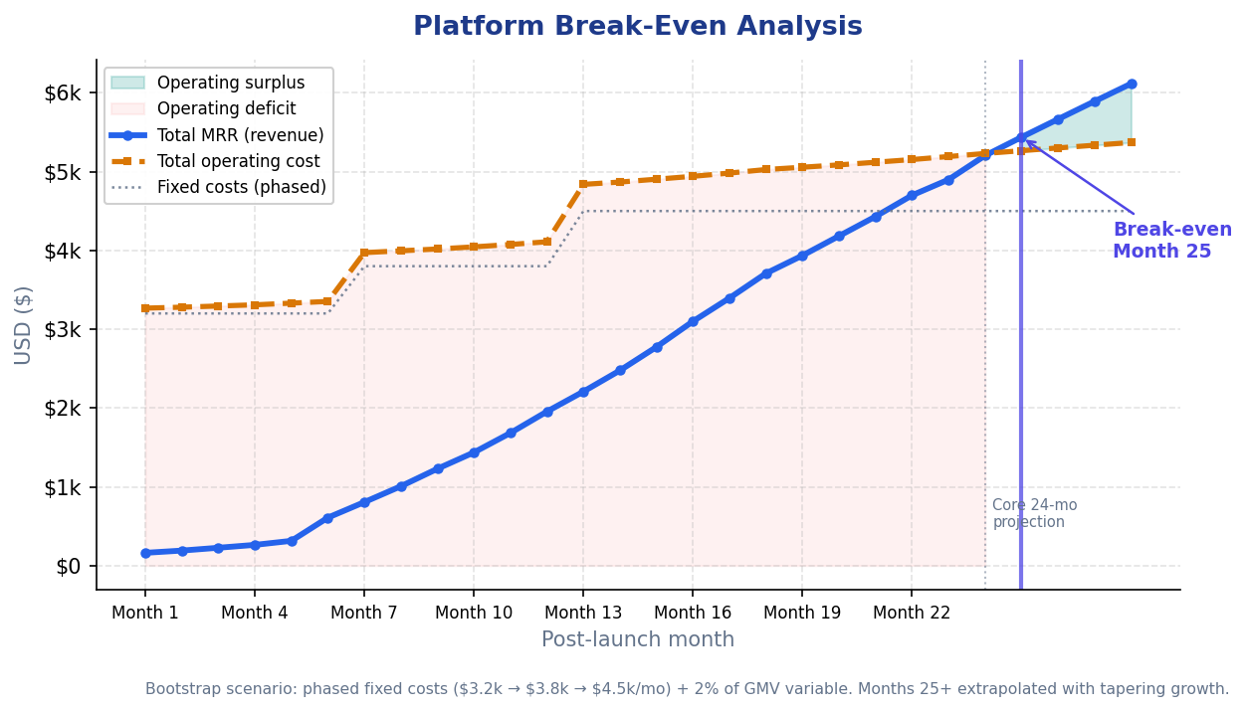
Platform Break-Even
Revenue vs operating cost — break-even at Month 25 (illustrative)
Manye Patrice | IT Innovation in Business — Master's Degree | Slide 10 of 31
Notes:
Shaded red = deficit, green = surplus. Dotted line = phased fixed-cost baseline.

Slide 11
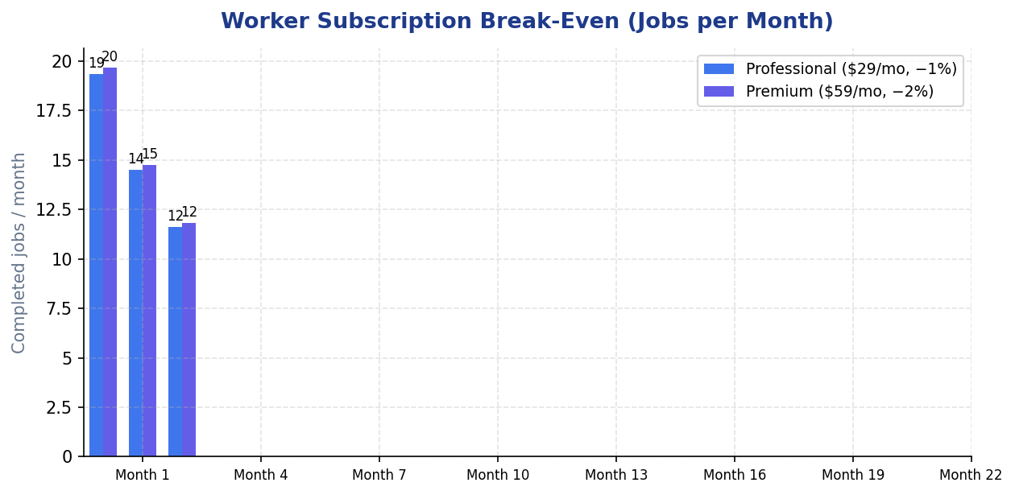
Worker Subscription Break-Even
Jobs per month to offset plan cost via commission savings only
Manye Patrice | IT Innovation in Business — Master's Degree | Slide 11 of 31
Notes:
At $200 avg job: Pro ≈15 jobs, Premium ≈15 jobs. Featured placement adds upside.

Slide 12
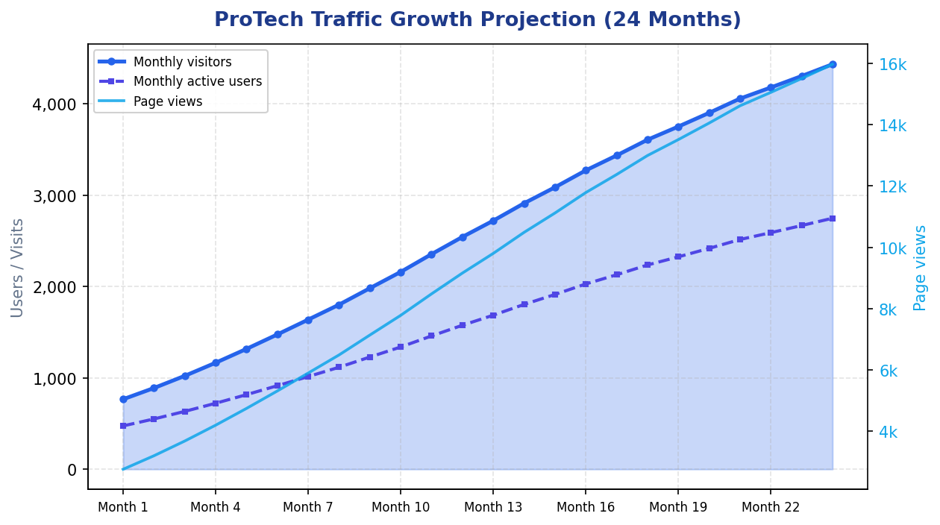
Traffic Growth Projection
Month 24: ~9,500 visitors/mo (illustrative)
Manye Patrice | IT Innovation in Business — Master's Degree | Slide 12 of 31

Slide 13
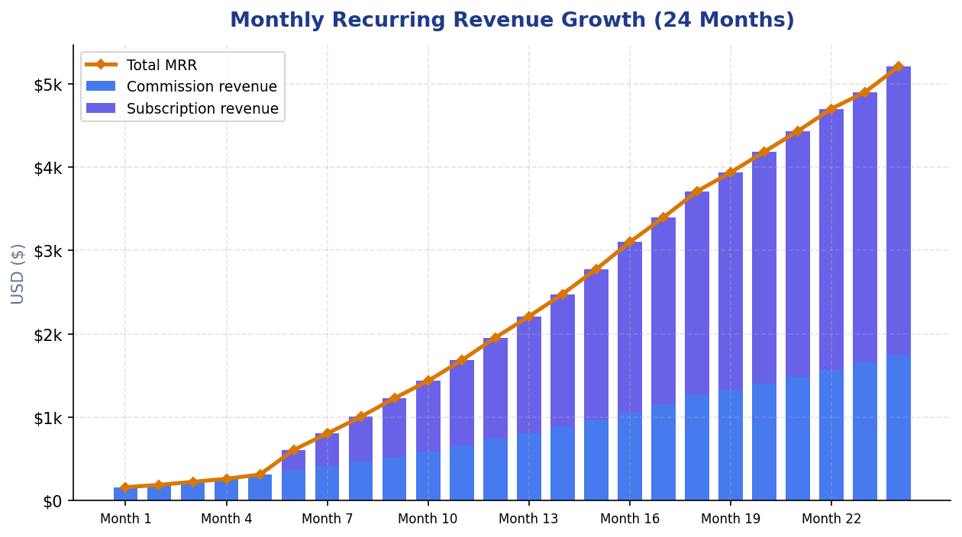
Revenue Growth (MRR)
Month 24: ~$50k MRR — commission + subscriptions
Manye Patrice | IT Innovation in Business — Master's Degree | Slide 13 of 31

Slide 14
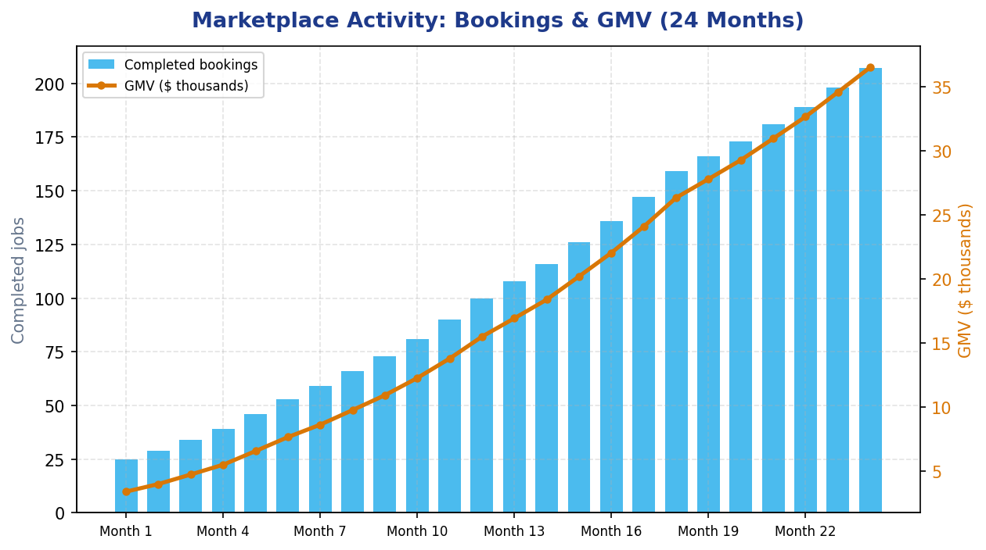
Bookings & GMV
Completed jobs and gross merchandise volume
Manye Patrice | IT Innovation in Business — Master's Degree | Slide 14 of 31

Slide 15
3
System Design & Architecture
Manye Patrice | IT Innovation in Business — Master's Degree | Slide 15 of 31

Slide 16
System Architecture
Three-tier design — Docker Compose deployment
Presentation
Browser → Nginx (port 80) → static files & reverse proxy
▼
Application
Gunicorn → Django 5.2 | users · bookings · reviews · escrow
▼
Data & Cache
PostgreSQL 15 + Redis 7 (sessions & cache)
▼
Cross-cutting
RBAC · Escrow ledger · Logging · Django Admin
Manye Patrice | IT Innovation in Business — Master's Degree | Slide 16 of 31
Notes:
Walk through each tier. Emphasise Nginx offloads static files, Django handles business logic, PostgreSQL is source of truth, Redis speeds up sessions and worker search.

Slide 17
Technology Stack
Layer | Technology | Role
Back-end | Django 5.2.15 | ORM, auth, admin, security
Front-end | Jinja2 templates | Server-rendered UI
Database | PostgreSQL 15 | Relational data + escrow ledger
Cache | Redis 7 | Sessions and worker search
Deploy | Docker Compose + Nginx | Four-service stack
Manye Patrice | IT Innovation in Business — Master's Degree | Slide 17 of 31

Slide 18
Escrow Payment Flow
1. Client deposits demo funds → UserWallet.
2. Client books worker → Booking (pending).
3. Client funds escrow → EscrowHold created.
4. Worker completes job → release_escrow() runs.
5. Worker paid net of platform fee; transactions logged.
6. Cancel → refund_escrow() returns funds to client.
Manye Patrice | IT Innovation in Business — Master's Degree | Slide 18 of 31
Notes:
Key differentiator. Mention Decimal + atomic DB transactions.

Slide 19
4
Implementation & Security
Manye Patrice | IT Innovation in Business — Master's Degree | Slide 19 of 31

Slide 20
Security & Implementation
Controls
Django apps
Security:
• Email login, PBKDF2 hashing
• CSRF, ORM, XSS escaping
• RBAC (@user_type_required)
• Secrets in .env only
Code structure:
• users/ bookings/ reviews/ escrow/
• escrow/services.py — all money logic
• Redis cache (300s worker search)
• Logging → stdout + django.log
Manye Patrice | IT Innovation in Business — Master's Degree | Slide 20 of 31

Slide 21
5
Application Demo
Manye Patrice | IT Innovation in Business — Master's Degree | Slide 21 of 31

Slide 22
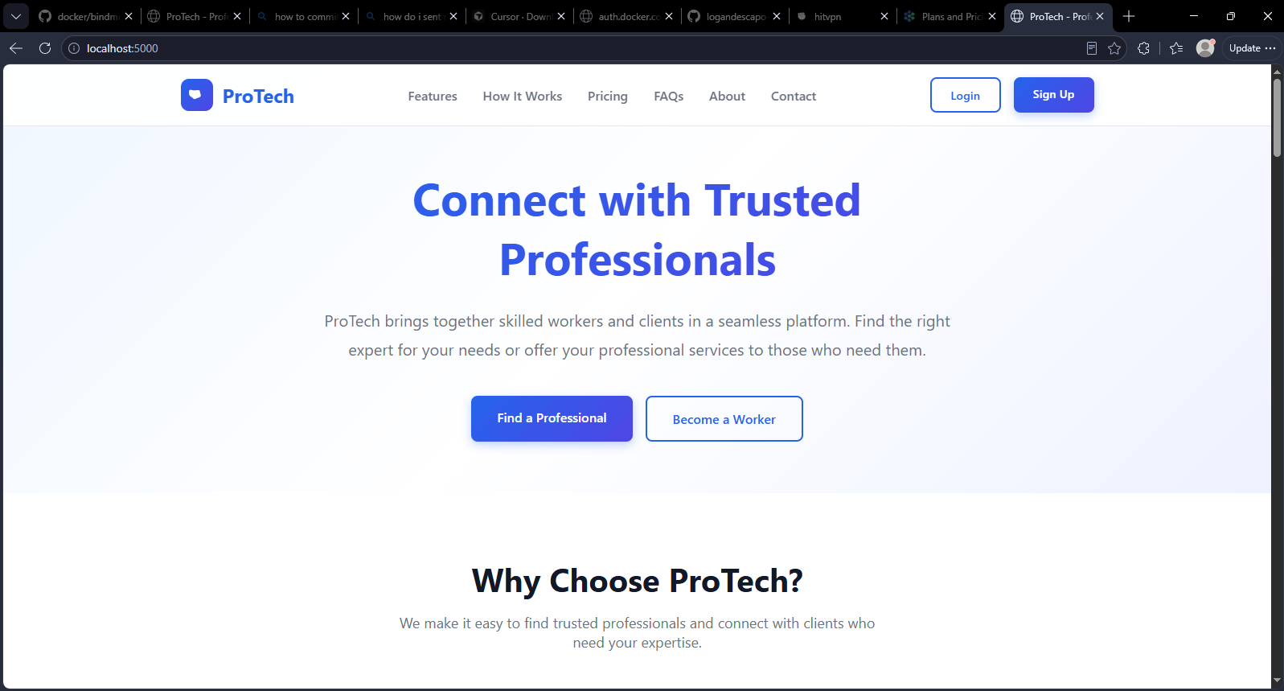
Figure 1 — Landing Page (Home)
[ INSERT SCREENSHOT HERE ]
URL: http://localhost/
PowerPoint: Insert → Pictures, or drag image into the dashed frame
Manye Patrice | IT Innovation in Business — Master's Degree | Slide 22 of 31

Slide 23
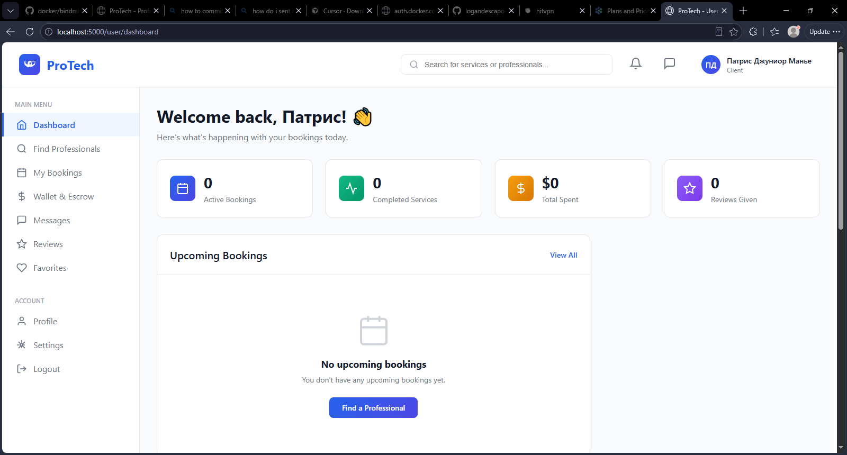
Figure 2 — Client Dashboard
[ INSERT SCREENSHOT HERE ]
URL: http://localhost/user/dashboard/ | Login: john@example.com / password123
PowerPoint: Insert → Pictures, or drag image into the dashed frame
Manye Patrice | IT Innovation in Business — Master's Degree | Slide 23 of 31

Slide 24
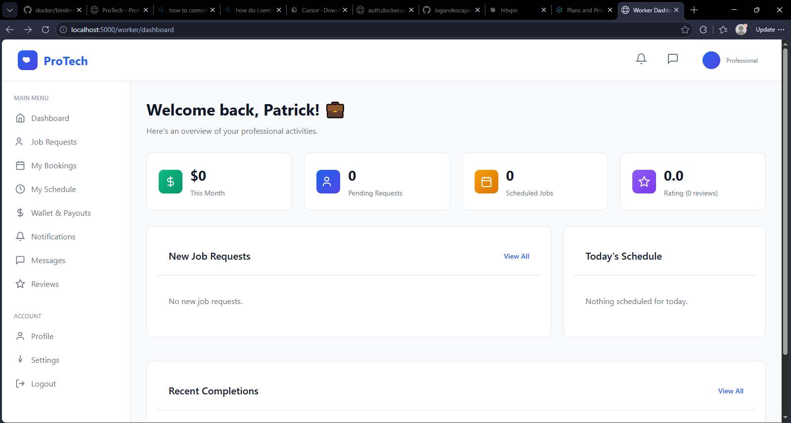
Figure 3 — Worker Dashboard
[ INSERT SCREENSHOT HERE ]
URL: http://localhost/worker/dashboard/ | Login: mike@example.com / password123
PowerPoint: Insert → Pictures, or drag image into the dashed frame
Manye Patrice | IT Innovation in Business — Master's Degree | Slide 24 of 31

Slide 25
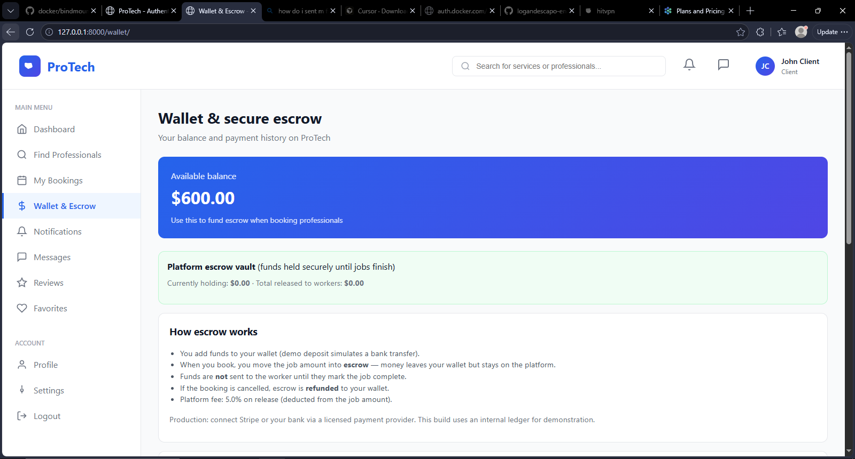
Figure 4 — Escrow Payment
[ INSERT SCREENSHOT HERE ]
URL: http://localhost/booking/<id>/escrow/ | Login: john@example.com / password123
PowerPoint: Insert → Pictures, or drag image into the dashed frame
Manye Patrice | IT Innovation in Business — Master's Degree | Slide 25 of 31

Slide 26
6
Testing & Deployment
Manye Patrice | IT Innovation in Business — Master's Degree | Slide 26 of 31

Slide 27
Testing, Deployment & Demo
17 automated tests pass (python manage.py test).
GitHub Actions: flake8, migrate, test, /health/ on every push.
Docker: db · redis · backend · nginx — docker compose up --build.
Demo: john@example.com / mike@example.com — password123.
Health: http://localhost/health/ → {"status": "ok"}
Manye Patrice | IT Innovation in Business — Master's Degree | Slide 27 of 31

Slide 28
Rubric Alignment (Summary)
Requirement | Status | Evidence
Django + templates | ✓ | templates/, Jinja2 env
Auth & RBAC | ✓ | users/decorators.py
Docker + Redis | ✓ | docker-compose.yml
Tests + CI | ✓ | 17 tests, ci.yml
Logging + security | ✓ | settings.py, CSRF
Manye Patrice | IT Innovation in Business — Master's Degree | Slide 28 of 31
Notes:
Full rubric table is in the technical report Appendix D.

Slide 29
7
Conclusion
Manye Patrice | IT Innovation in Business — Master's Degree | Slide 29 of 31

Slide 30
Lessons, Future Work & Conclusion
Reflection
Outcome
Lessons learned:
• Domain-split Django apps scale well
• Flask→Django needed Jinja2 shim
• Escrow needs Decimal + TXNs
• Docker entrypoint seeds demo data
Conclusion:
• Full-stack brief met
• Working escrow marketplace
• Clear business model + growth path
• Ready for live demo & Q&A
Manye Patrice | IT Innovation in Business — Master's Degree | Slide 30 of 31
Notes:
Thank the panel. Offer live demo if time allows.

Slide 31
Thank You
Questions & Discussion
Manye Patrice · IT Innovation in Business — Master's Degree
github.com/logandescapo-eng/protech1
Notes:
Pause for questions. Have demo ready at http://localhost.

Slide 32
BACKUP SLIDES
Additional material for Q&A
Hidden from main slideshow — use during Q&A if needed
Manye Patrice | BACKUP SLIDE | Slide 32

Slide 33
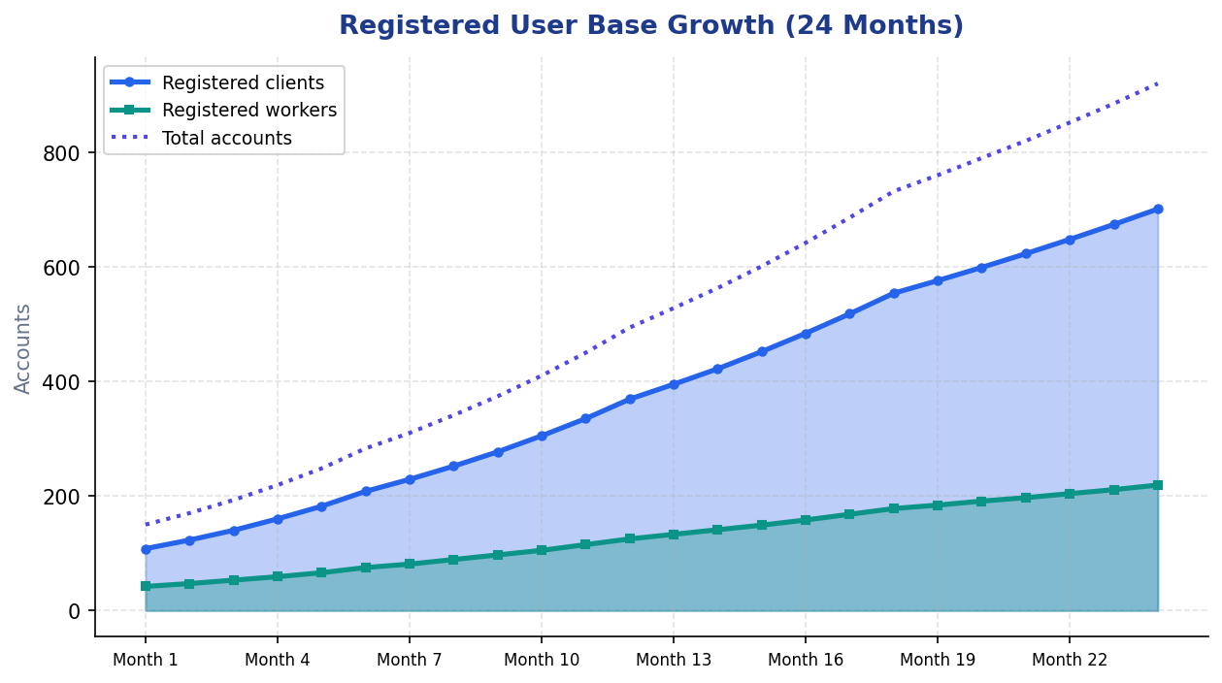
BACKUP — User Growth
Registered client and worker accounts (24 months)
Manye Patrice | BACKUP SLIDE | Slide 33

Slide 34
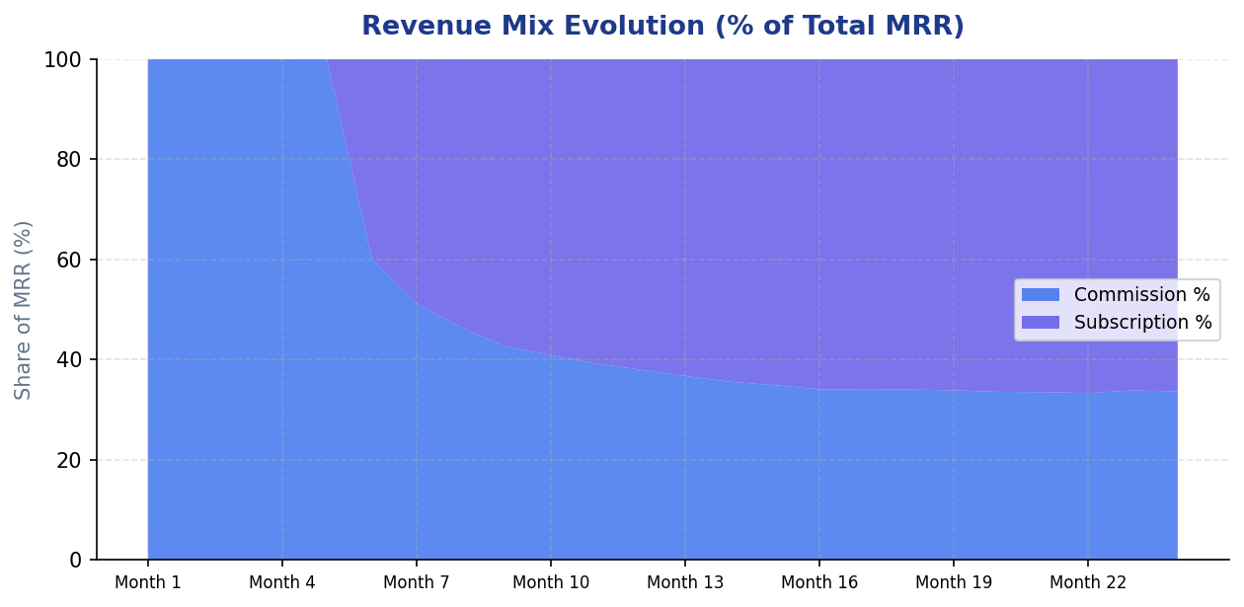
BACKUP — Revenue Mix
Subscription share of MRR after Month 7
Manye Patrice | BACKUP SLIDE | Slide 34

Slide 35
BACKUP — Full Use Case List
ID | Use case | Actor
UC-01 | Register & login | Visitor
UC-04 | Reset password | User
UC-05 | Browse workers | Client
UC-06 | Create booking | Client
UC-07 | Manage booking status | Client / Worker
UC-08 | Fund escrow | Client
UC-09 | Release / refund escrow | System
UC-10 | Leave review | Client
UC-11 | Admin CRUD | Staff
Manye Patrice | BACKUP SLIDE | Slide 35

Slide 36
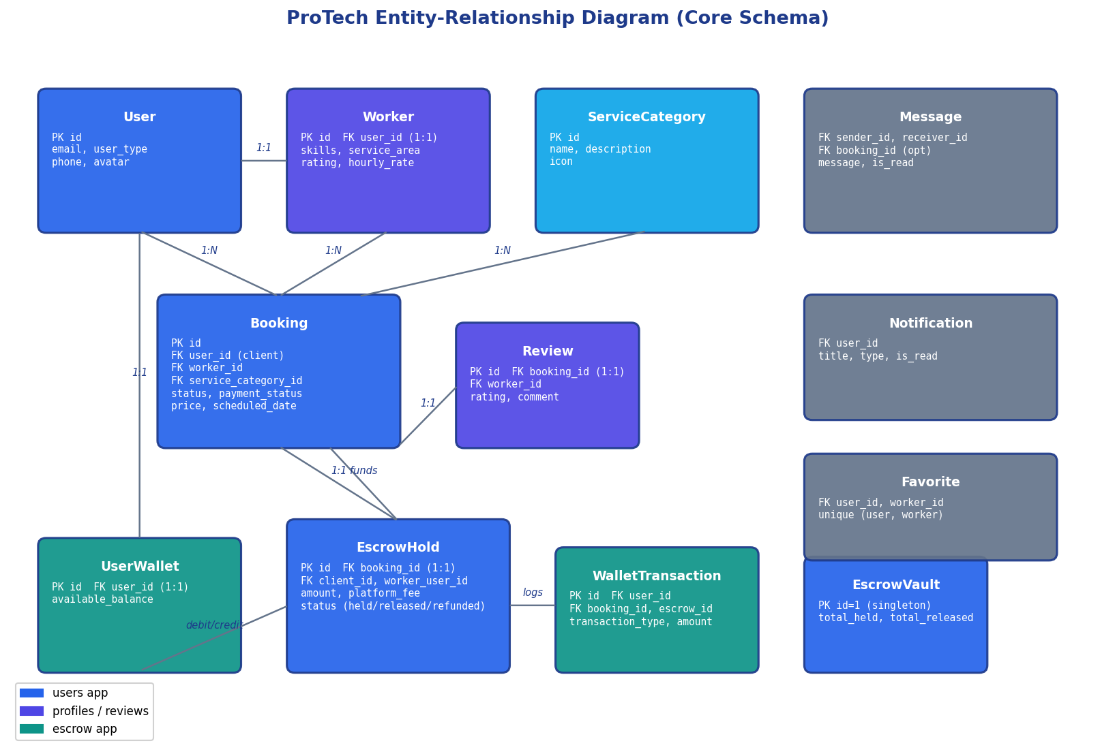
BACKUP — ER Diagram
Core database schema (users, bookings, escrow, reviews)
Manye Patrice | BACKUP SLIDE | Slide 36

Slide 37
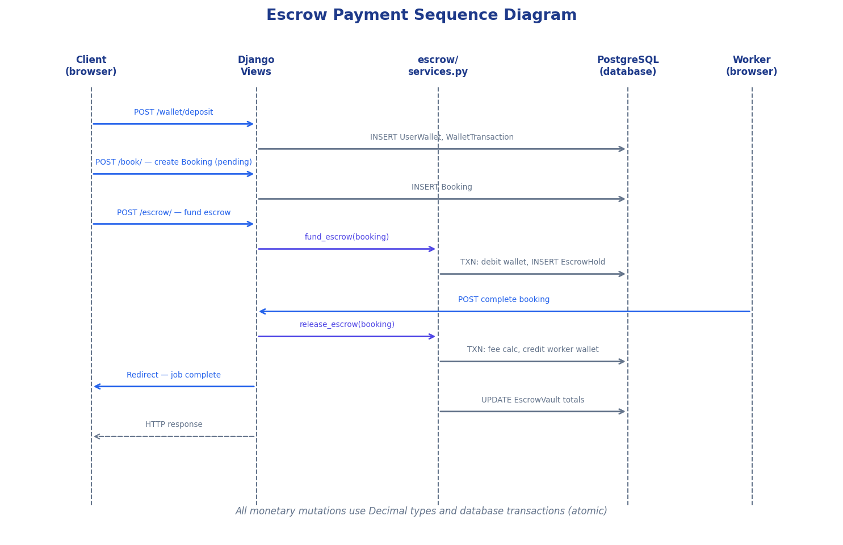
BACKUP — Escrow Sequence
Runtime flow: deposit → book → fund → complete → release
Manye Patrice | BACKUP SLIDE | Slide 37

Slide 38
Figure 5 — Browse Workers
[ INSERT SCREENSHOT HERE ]
URL: http://localhost/workers/ | Login: patricksmithson881.com / password123
PowerPoint: Insert → Pictures, or drag image into the dashed frame
Manye Patrice | BACKUP SLIDE | Slide 38

Slide 39
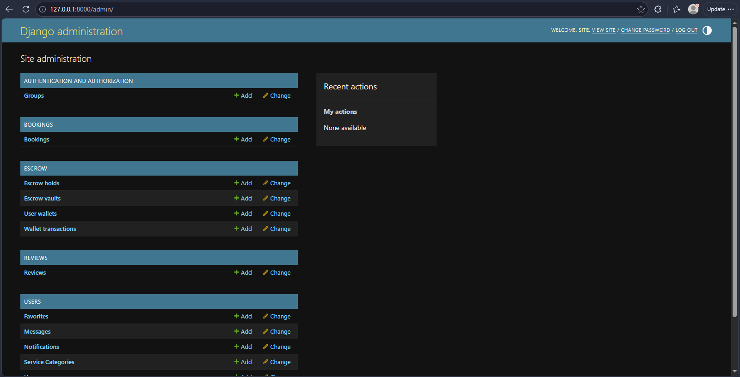
Figure 6 — Django Admin
[ INSERT SCREENSHOT HERE ]
URL: http://localhost/admin/ | Login: Superuser account
PowerPoint: Insert → Pictures, or drag image into the dashed frame
Manye Patrice | BACKUP SLIDE | Slide 39

Slide 40
BACKUP — Full Rubric Alignment
Requirement | Implementation | Evidence
Django + templates | Django 5.2 + Jinja2 | templates/
Auth & RBAC | Login, @user_type_required | users/
Password reset | /password-reset/ | users/urls.py
Admin CMS | Django Admin | /admin/
Security | CSRF, hashing, .env | settings.py
Tests | 17 passing | manage.py test
Docker | 4 services | docker-compose.yml
Redis cache | cache_utils.py | 300s worker cache
Logging | Per-app loggers | logs/django.log
Linting | flake8 + black | ci.yml
Manye Patrice | BACKUP SLIDE | Slide 40

Slide 41
BACKUP — Limitations
Demo wallet only — no live payment provider integrated.
Worker subscriptions specified but not yet coded.
No WebSocket real-time messaging.
17 tests — no browser E2E suite yet.
Growth charts are illustrative, not market research.
Manye Patrice | BACKUP SLIDE | Slide 41

Slide 42
BACKUP — References
Rochet & Tirole (2003) — two-sided markets
Evans & Schmalensee (2016) — Matchmakers
OWASP Top Ten (2021) — web security
Django, PostgreSQL, Redis, Docker documentation
Fielding (2000); Fowler (2002) — architecture patterns
Manye Patrice | BACKUP SLIDE | Slide 42

