Slide 2
Why?
Low-end devices
Limited development access
Various types (operating systems, CPUs)
C/C++ (Native) & JavaScript/LUA (scripted)
HawkTracer requirements
User-space only
Built-in to executable (as a library)
Low overhead
No persistent storage required
Portable to different platforms (Linux/Windows/macOS/…)
Easy to use

Slide 3
What is HawkTracer?
Low-overhead instrumentation-based profiler
(almost) no memory allocations and locks
Event-based data
Highly extensible
  Custom event types
  Custom transportation layers

Slide 4
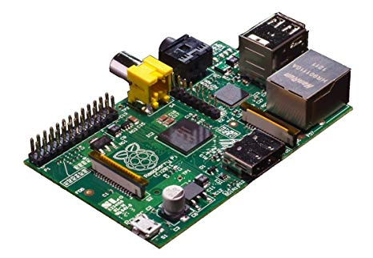

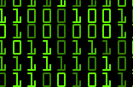
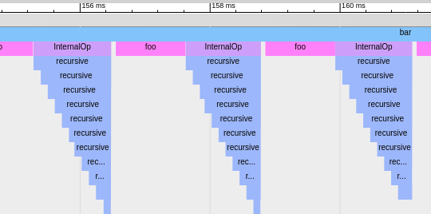
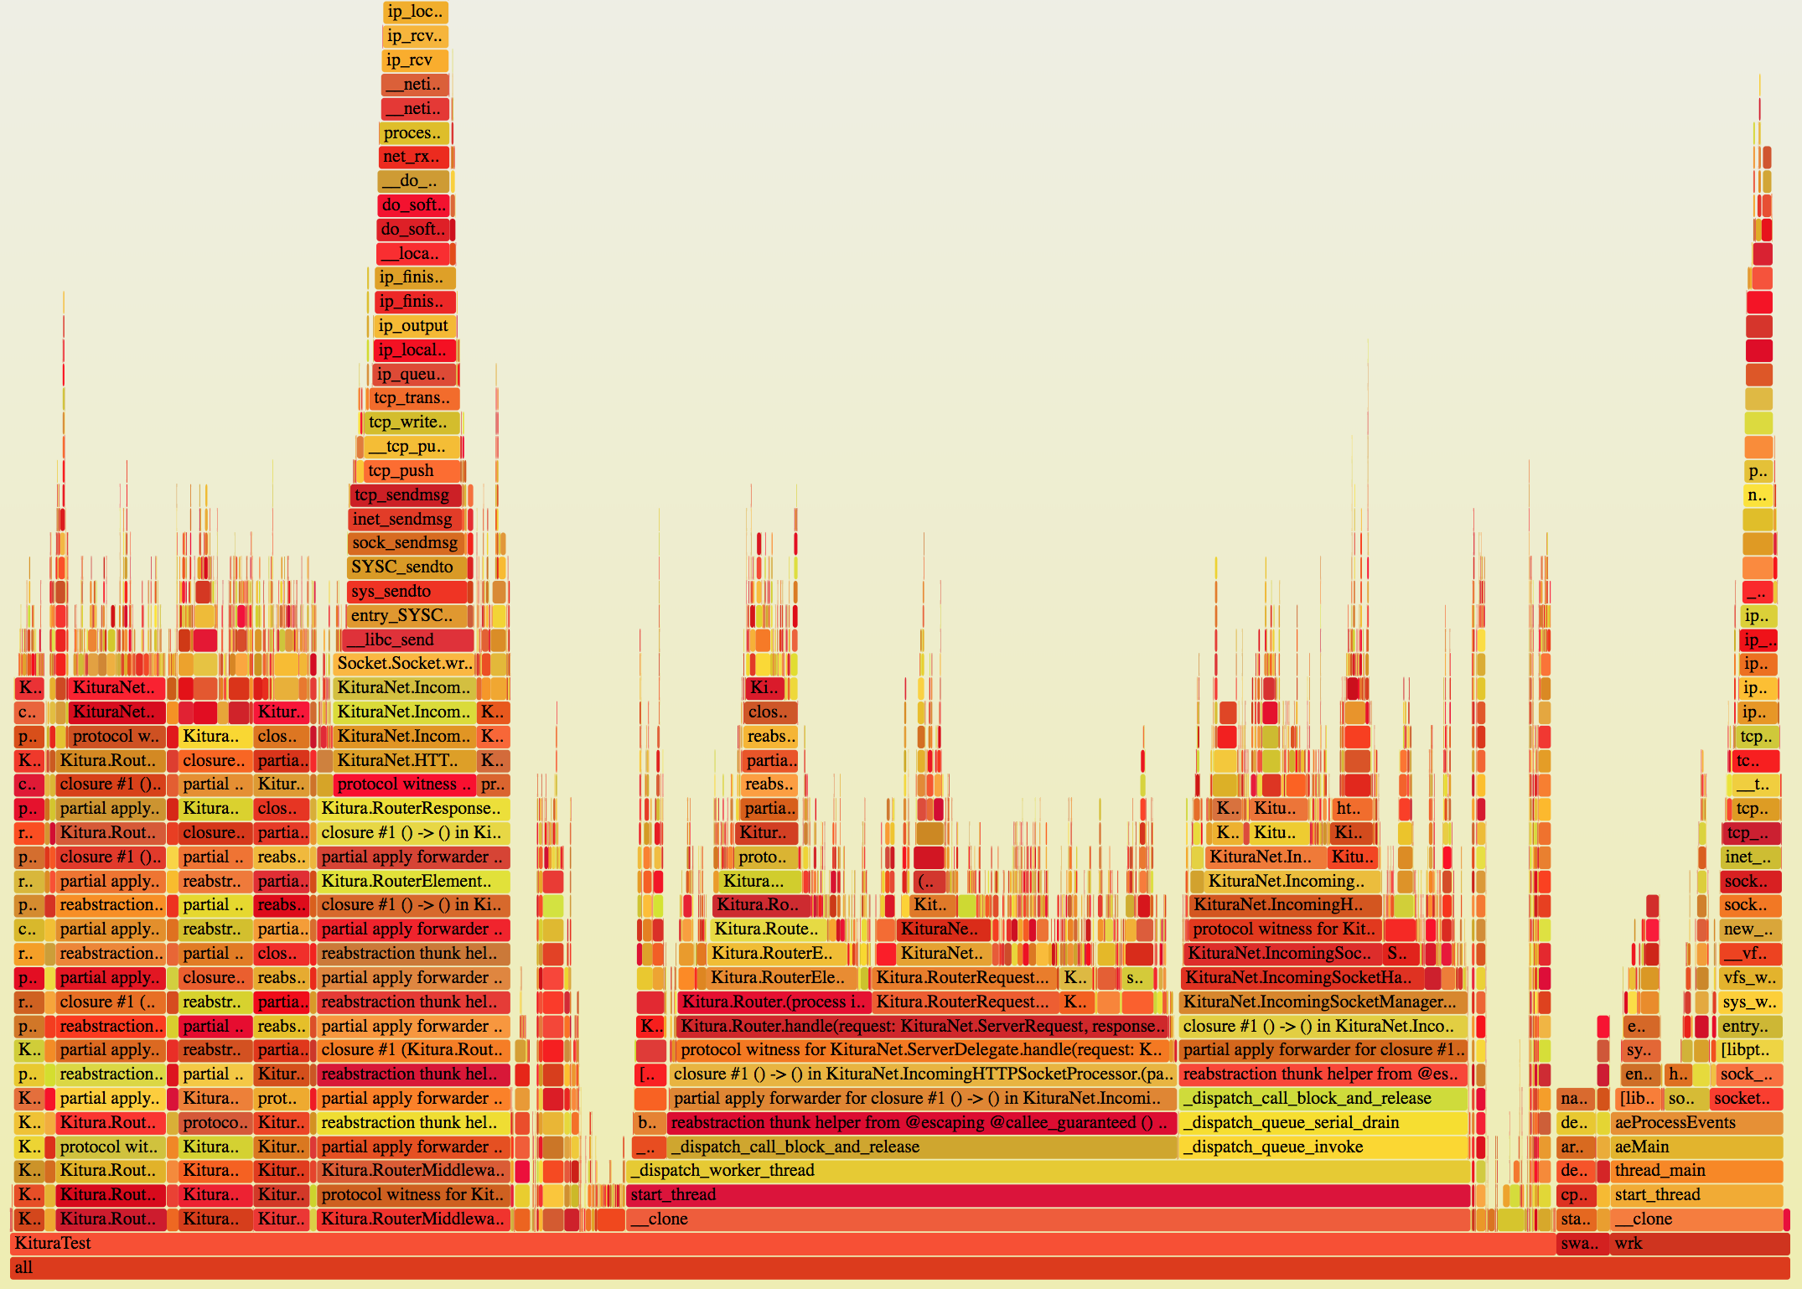
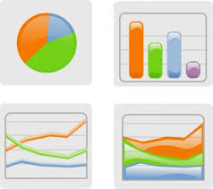
High-level design
Events
(HTDUMP binary stream)
HawkTracer Client
convert HTDUMP stream to:
Profiled device
(instrumented application +
HawkTracer library)
ChromeTrace
FlameGraphs
User-defined

Slide 5
High-level design 2
Profiled device
Developer’s desktop
Library
User application
Experimental
HawkTracer library
Client library
(C++)
Client library
(Rust)
Event
listeners
Timeline
(event buffer)
Events
HTDUMP
stream
Client library
bindings (Python)
End-user applications
Push event
HawkTracer
Converter
User-defined
client
HawkTracer
Converter-RS
Human-readable output
* ChromeTracing
* Callgrind
* Charts
* Others...
* ChromeTracing
* FlameGraph

Slide 6
Events
* struct with arbitrary fields
* supports inheritance
* base class: HT_Event
struct HT_Event
{
HT_EventKlass* klass;
uint64_t timestamp_ns;
uint64_t event_id;
};
typedef struct {
HT_Event base;
uint8_t field_1;
char* field_2;
} MyEvent;
MKCREFLECT_TypeInfo* mkcreflect_get_MyEvent_type_info(void);
size_t ht_MyEvent_get_size(HT_Event* VAR_NAME);
size_t ht_MyEvent_fnc_serialize(HT_Event* event, HT_Byte* buffer);
HT_EventKlass* ht_MyEvent_get_event_klass_instance(void);
HT_EventKlassId ht_MyEvent_register_event_klass(void);
HT_DECLARE_EVENT_KLASS(
MyEvent, // Event class name
HT_Event, // Base event
(INTEGER, uint8_t, field_1), // Field 1
(STRING, char*, field_2) // Field 2
)

Slide 7
Others
Custom allocator
Timeline feature
The same example in python/c/rust
ANSI C( not all the features though)
C support for scoped tracepoints
How many allocations (almost zero)
Performance of hawktracer (vs others?)
Slide about What is HawkTracer instead of Why?

Slide 8
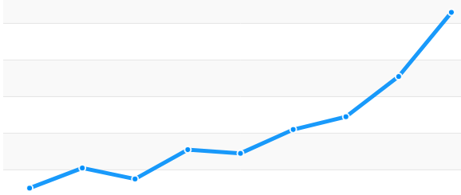
C++ Application
Allocates lots of memory
Python Client
Visualizer
Memory
usage
Allocation
count

