Slide 1
Python File I/O
IC/DAQ Lesson 7
Logan Foote and Sam Condon

Slide 2
File I/O
We have explored data acquisition with lab instruments, and now we want to save our data
We will save data using the following file types in Python
Plain text files
.txt, .log, .csv, etc
Binary files
.npy, etc
When running experiments, it is very important to save information about the experimental setup in addition to the data
Lab notebook by hand
Log files on computer

Slide 3
Plain text files
Stores 7-bit characters including letters, digits, punctuation, a few special characters
We can read/write strings from/to plain text files
‘w’: write
‘r’: read
‘a’: append

Slide 4
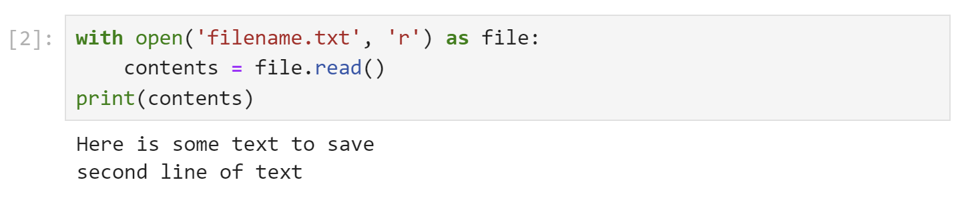
Plain text files

Slide 5
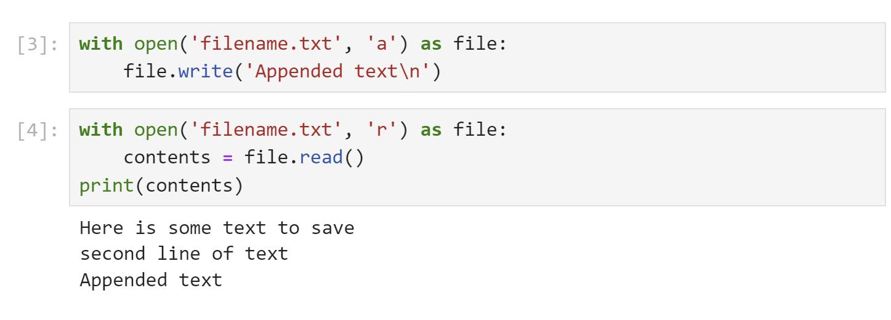
Plain text files

Slide 6
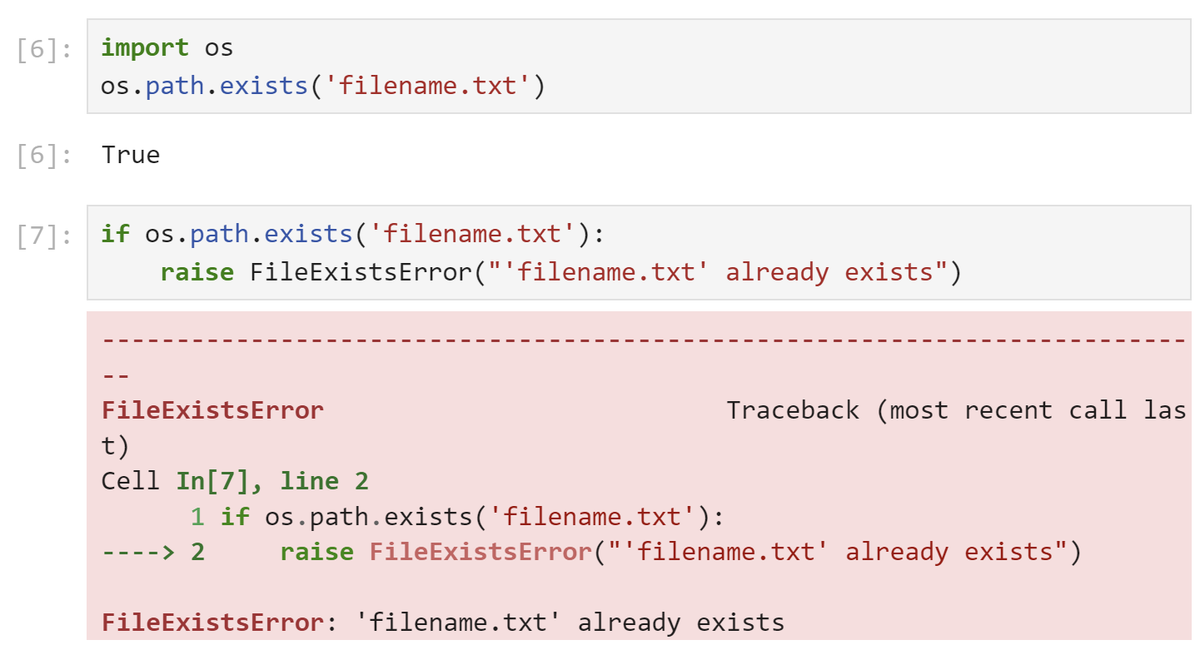
Plain text files

Slide 7
Plain text files – context manager
The with statement opens the file only within the indented portion
This ensures that the file is closed properly if an error occurs
Don’t do this
Do this instead

Slide 8
Plain text files – log files
We can use the .log extension for log files
Same behavior as .txt

Slide 9
Plain text files – csv files
csv files are used to store data in column/row format, with a header
Same behavior as other plain text files
Separate columns by , and rows by ‘\n’
time,voltage
0,5.4
1,5.2
2,5.6
3,5.6

Slide 10
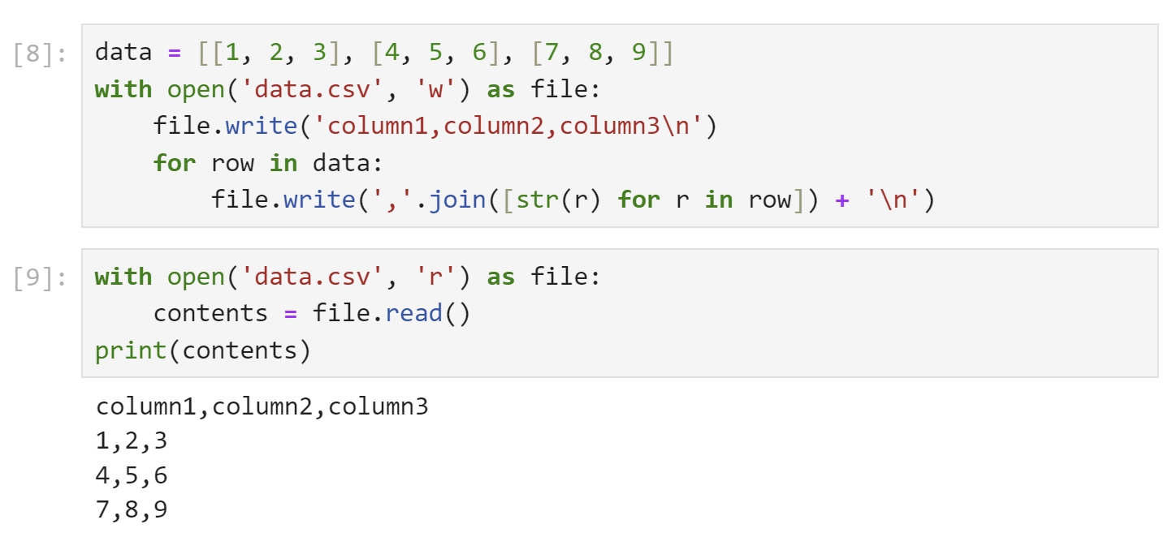
Plain text files – csv files

Slide 11
Plain text files – csv files
It is tedious to read/write csv files using the standard Python file handling system
Use pandas
Powerful dataframe manipulation
Easy file I/O
You will use this frequently as an astronomer
steep learning curve

Slide 12
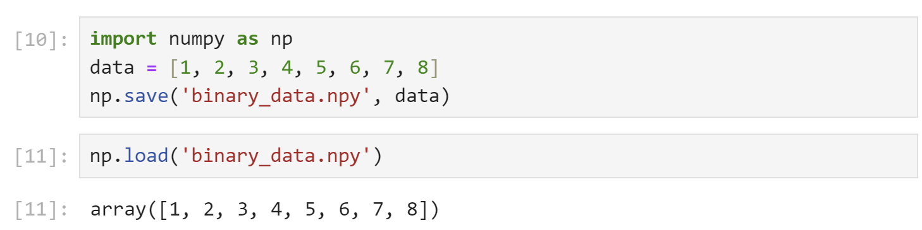
Binary files – npy files
Binary files are often the most memory-efficient way to store arrays of information
There are many different formats
In Python, use .npy files with numpy

Slide 13
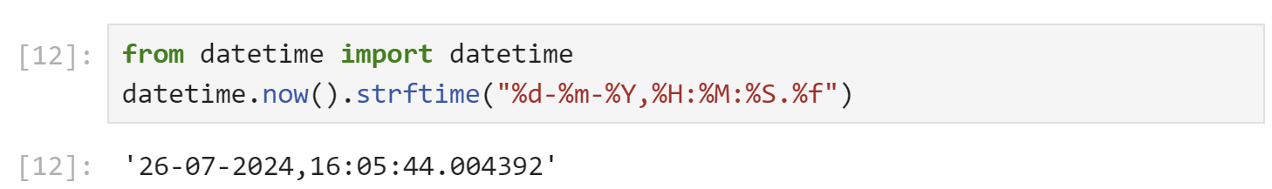
datetime
Module for handling dates and times
Very useful for logging

