Slide 1
Observational Astronomy Optics

Slide 2
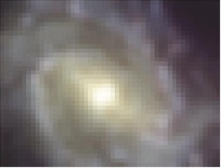
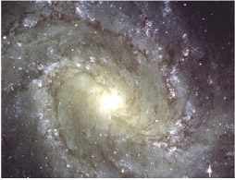

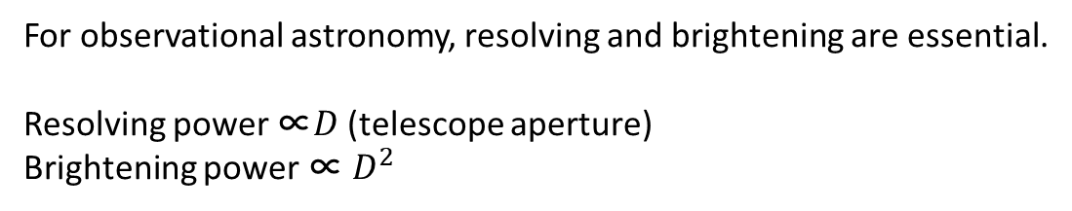
Power of Telescope
Magnification
Resolving
Brightening
Credit M. Bolte
For observational astronomy, resolving and brightening are essential.
Resolving power ∝$D$ (telescope aperture)
Brightening power ∝ $D^{2}$

Slide 3



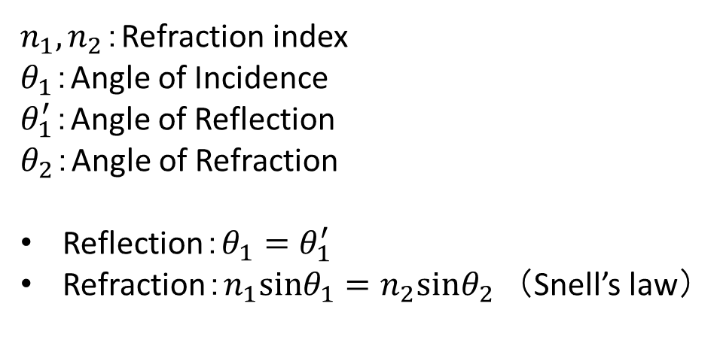


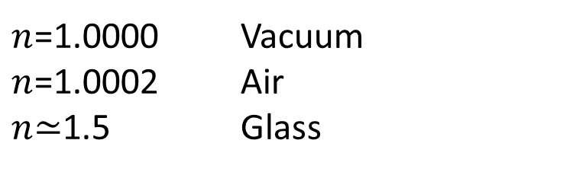
Reflection and Refraction
$$θ_{1}$$
$$θ_{1}^{′}$$
$n_{1}, n_{2}$：Refraction index
$θ_{1}$：Angle of Incidence
$θ_{1}^{′}$：Angle of Reflection
$θ_{2}$：Angle of Refraction
Reflection：$θ_{1}=θ_{1}^{′}$
Refraction：$n_{1}sinθ_{1}=n_{2}sinθ_{2}$ （Snell’s law）
$$n_{1}$$
$$n_{2}$$
$$θ_{2}$$
$n$=1.0000 Vacuum
$n$=1.0002 Air
$n$≃1.5 Glass

Slide 4
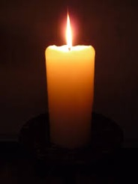


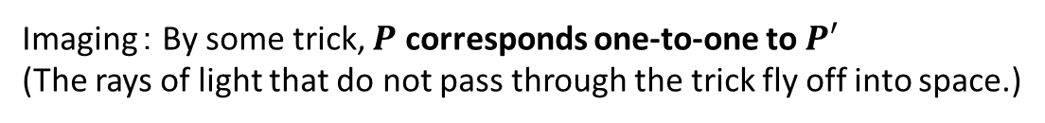



What are Imaging and Seeing?
Ray from an arbitral point $P$ on the frame is a diffused ray.
$$P$$
Tric
$$P^{′}$$
Imaging： By some trick, $P$ corresponds one-to-one to $P′$
(The rays of light that do not pass through the trick fly off into space.)
$$P$$
$$P^{′}$$
Seeing： By the lens of eye, $P$ corresponds one-to-one $P$’.

Slide 5



Rule of Thin Lens
Rule 1：
Any ray that passes through the center of the lens will not change its direction.
$$θ$$
$$θ$$
Strictly speaking, rays are vertically displaced, but if the lens is thin, the displacement is negligible.
Rule 2：
Any ray that enters parallel to the lens axis proceeds to the focal point
Any ray through the focal point proceeds parallel to the lens axis
Focal point
Collimated light
Focal point
Collimated
light
Focal length $f$

Slide 6

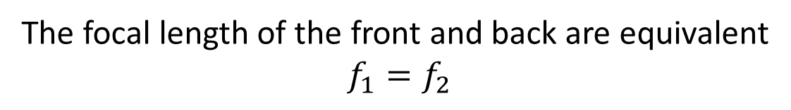

Thin Lens and the Focal Point
$$f_{1}$$
$$f_{2}$$
fp1
fp2
The focal length of the front and back are equivalent
$$f_{1}=f_{2}$$

Slide 7





Light from Astronomical Objects （Objects of Infinite Distance）
Because astronomical objects are very far away, the rays are parallel (collimated light).
The rays go through the focal point,
and the images of the objects appear on a screen at the focal point
$$f$$
Q: Where does the image of rays with angle$θ$ appear?
$$f$$
Collimated light
$$?$$
$$θ$$
$$?$$

Slide 8




Light from Astronomical Objects （Objects of Infinite Distance）
By rule 2, the ray through the focal point in front of the lens proceeds parallel to the axis.
fp
$$θ$$
$$f$$
By rule 1, the ray through the center of the lens does not change its direction.
fp
$$θ$$
$$f$$

Slide 9


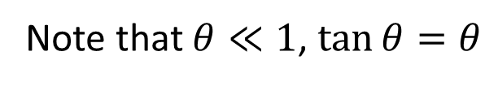
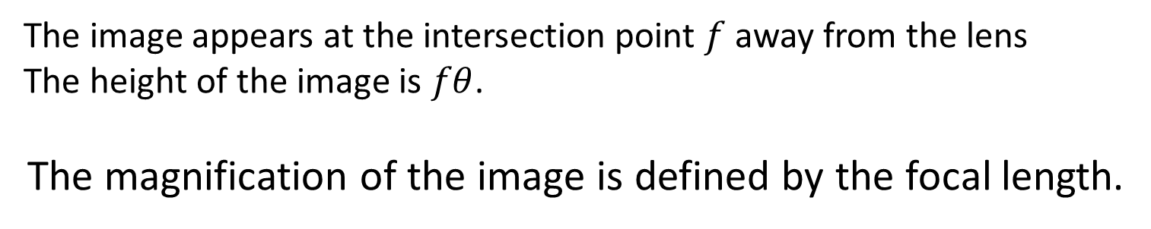


Light from Astronomical Objects （Objects of Infinite Distance）
$$f$$
$$θ$$
$$f$$
fp
$$f×θ$$
The image appears at the intersection point $f$ away from the lens
The height of the image is $fθ$.
The magnification of the image is defined by the focal length.
Note that $θ≪1$, $\tan{θ}=θ$

Slide 10
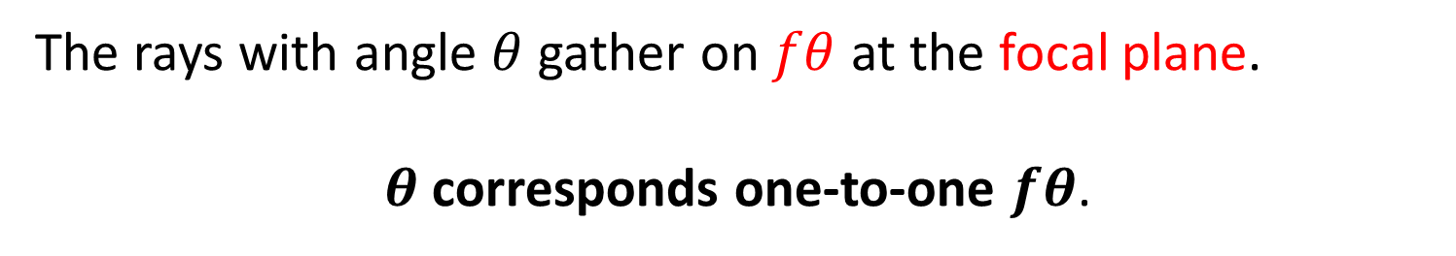
Light from Astronomical Objects （Objects of Infinite Distance）
$$θ$$
$$f$$
Focal Plane
The rays with angle $θ$ gather on $fθ$ at the focal plane.
$θ$ corresponds one-to-one $fθ$.

Slide 11






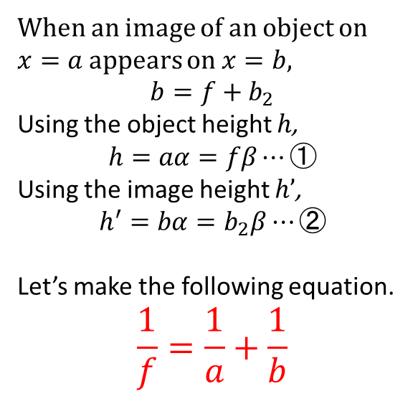









Objects of sFinite Distance
When an image of an object on $x=a$appears on $x=b$,
$$b=f+b_{2}$$
Using the object height $h$,
$$h=aα=fβ⋯①$$
Using the image height $h’$,
$$h^{′}=bα=b_{2}β⋯②$$
Let’s make the following equation.
$$\frac{1}{f}=\frac{1}{a}+\frac{1}{b}$$
$$h$$
$$β$$
$$b$$
$$α$$
))
$$b_{2}$$
)
)
))
$$a$$
$$f$$
$$o$$
$$h′$$
$$h$$
$$β$$
$$b$$
$$α$$
))
$$b_{2}$$
)
)
))
$$a$$
$$f$$
$$o$$
$$h′$$

Slide 12

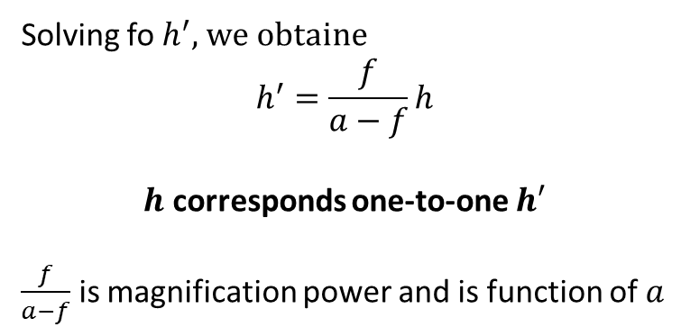

Objects of sFinite Distance
$$h$$
$$a$$
$$f$$
$$o$$
$$h′$$
Solving fo $h^{′}$, we obtaine
$$h^{′}=\frac{f}{a−f}h$$
$h$ corresponds one-to-one $h′$
$\frac{f}{a−f}$ is magnification power and is function of $a$

Slide 13

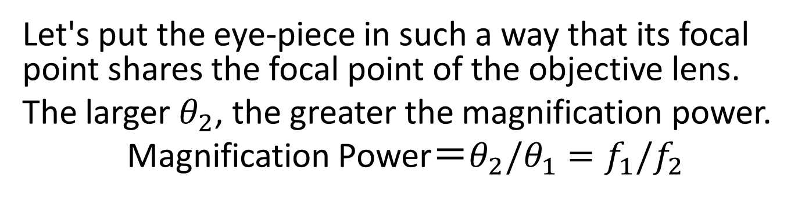



Astronomical Telescope
Collimated light
$θ_{1}$
$θ_{2}$
Objective lens
Eye-Piece
$f_{1}$
$f_{2}$
Let's put the eye-piece in such a way that its focal point shares the focal point of the objective lens.
The larger $θ_{2}$, the greater the magnification power.
Magnification Power＝$θ_{2}/θ_{1}=f_{1}/f_{2}$

Slide 14
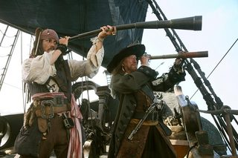






Telescope and Eye
When $a>2f$, it works as a telescope
Eye-piece
$$f_{o}$$
$$f_{o}$$
$$a$$
$$o$$
$$a$$
$$o$$
$$f_{e}$$
A minimized image appears behind the focal point.
By an eye-piece, making a magnified imaginary image

Slide 15
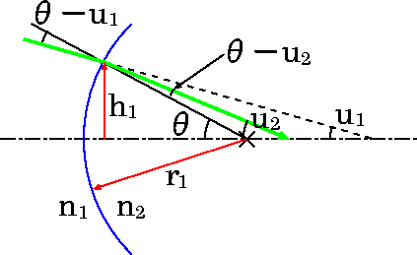

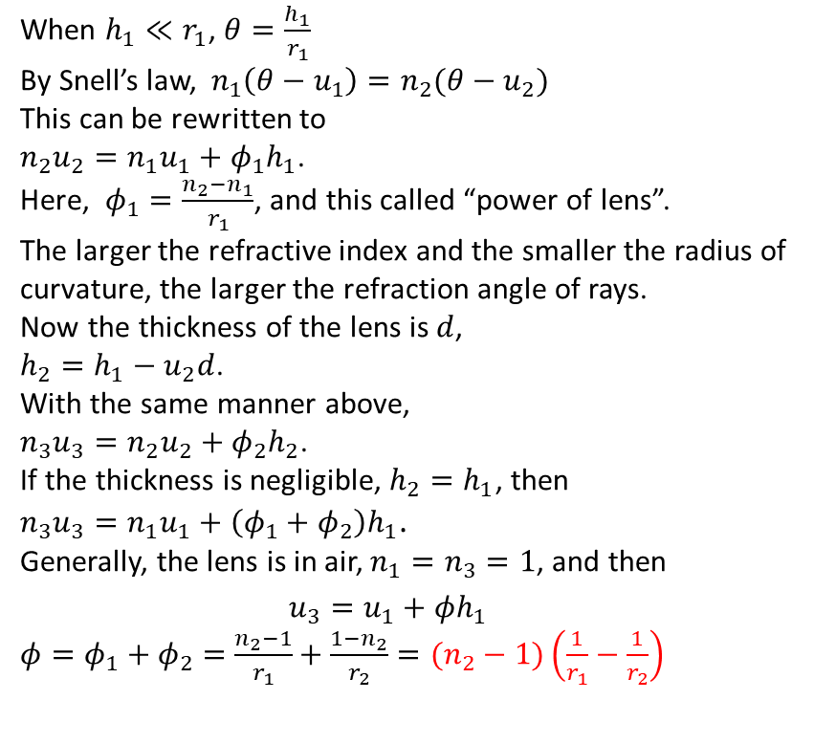






Focal Length
Focal length characterizes the lens
Focal length is characterized by the refraction index and curvature of the lens
Let’s set refraction indexes $n_{1}$ and $n_{2}$, their boundary (lens) is curved with a radius of curvature of $r_{1}$.
Green ray enters the lens at the height of $h_{1}$ with the angle of $u_{1}$and has the angle of $u_{2}$ after refraction.
When $h_{1}≪r_{1}$, $θ=\frac{h_{1}}{r_{1}}$
By Snell’s law, $n_{1}\left(θ−u_{1}\right)=n_{2}(θ−u_{2})$
This can be rewritten to
$n_{2}u_{2}=n_{1}u_{1}+φ_{1}h_{1}$.
Here, $φ_{1}=\frac{n_{2}−n_{1}}{r_{1}}$, and this called “power of lens”.
The larger the refractive index and the smaller the radius of curvature, the larger the refraction angle of rays.
Now the thickness of the lens is $d$,
$h_{2}=h_{1}−u_{2}d$.
With the same manner above,
$n_{3}u_{3}=n_{2}u_{2}+φ_{2}h_{2}$.
If the thickness is negligible, $h_{2}=h_{1}$, then
${n_{3}u}_{3}=n_{1}u_{1}+\left(φ_{1}+φ_{2}\right)h_{1}$.
Generally, the lens is in air, $n_{1}=n_{3}=1$, and then
$$u_{3}=u_{1}+φh_{1}$$
$φ=φ_{1}+φ_{2}=$ $\frac{n_{2}−1}{r_{1}}+\frac{1−n_{2}}{r_{2}}=(n_{2}−1)\left(\frac{1}{r_{1}}−\frac{1}{r_{2}}\right)$
$$d$$
$$h_{2}$$
$$u_{3}$$
$$r_{2}$$
$$n_{1}$$
$$n_{2}$$
$$n_{3}$$

Slide 16

Focal Lenght
To get the focal length, using $u_{3}$ by setting $u_{1}=0$,
$f=\frac{h_{1}}{u_{3}},$ and then,
$$\frac{1}{f}=φ=\left(n_{2}−1\right)\left(\frac{1}{r_{1}}−\frac{1}{r_{2}}\right).$$
Lens Maker’s Formula
The focal length of the lens is defined by $n_{2}$ and curvatures.
Using $n_{2}=1.5$ as usual glass,
$$\frac{1}{f}\sim \frac{1}{2}\left(\frac{1}{r_{1}}−\frac{1}{r_{2}}\right).$$
In special case of $r_{1}={−r}_{2}=r$,
$$f\sim r.$$
$$d$$
$$h_{2}$$
$$u_{3}$$
$$r_{2}$$
$$n_{1}$$
$$n_{2}$$
$$n_{3}$$

Slide 17

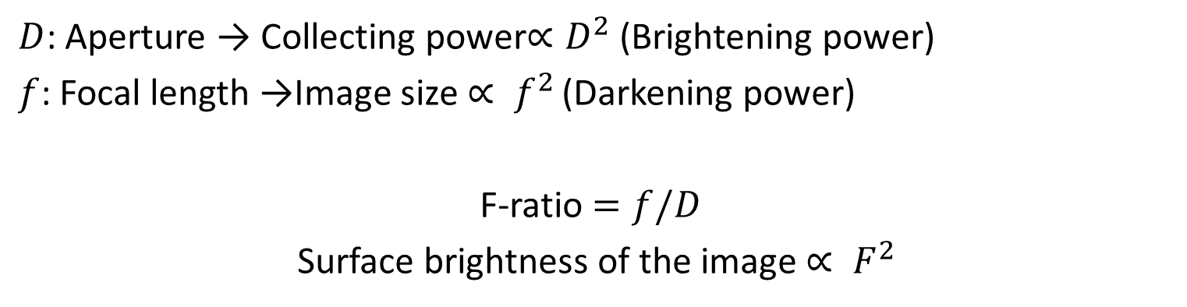


F-ratio and Surface Brightness
$$D$$
$$d$$
$$f$$
$D$: Aperture → Collecting power$∝D^{2}$ (Brightening power)
$f$: Focal length →Image size $∝ f^{2}$ (Darkening power)
F-ratio $=f/D$
Surface brightness of the image $∝ F^{2}$

Slide 18
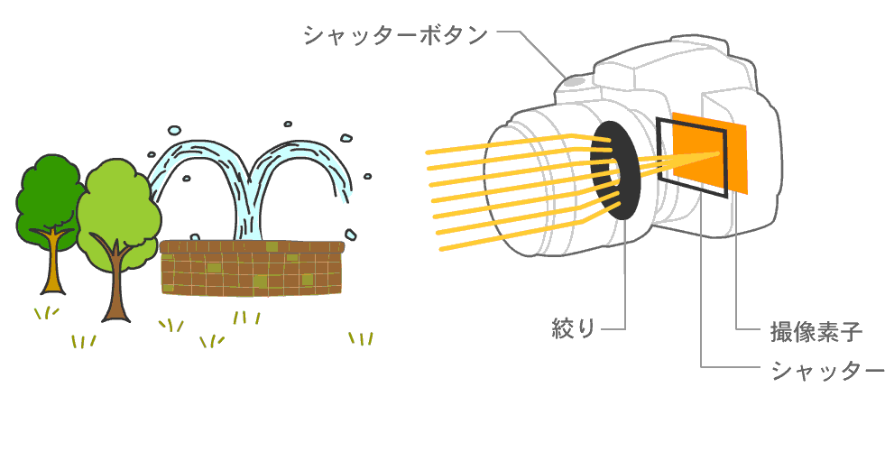
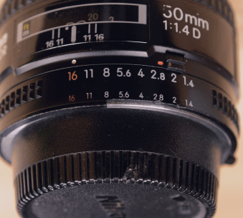
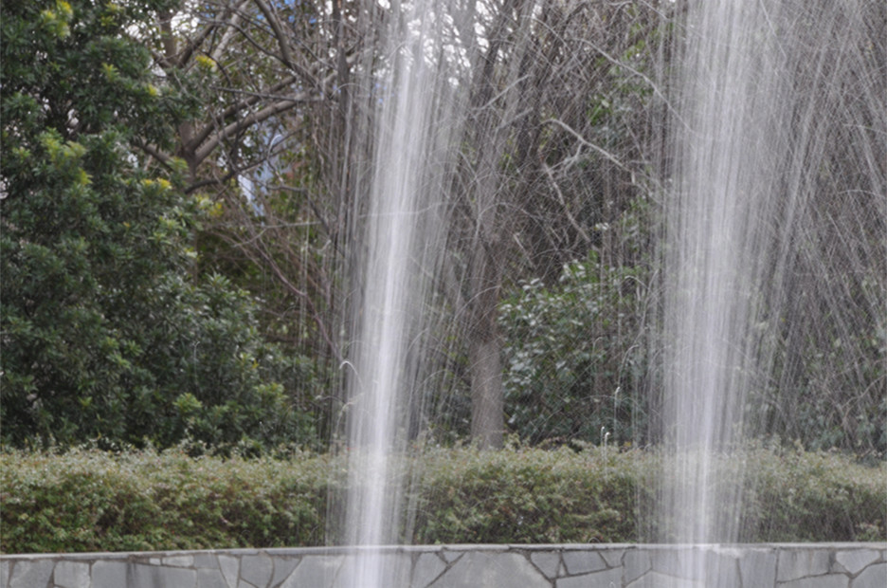
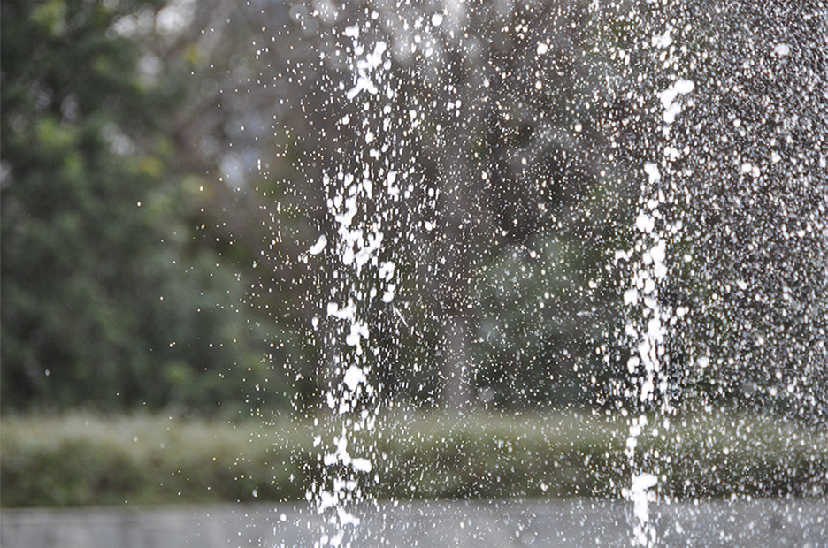

F-ratio and Surface Brightness
$$D ∝ \sqrt{2^{n}}$$
(Brightness$∝2^{n}$)
Iris : Aperture size
Large F（Dark） and Long exposure
Small F（Bright） and Short exposure
Pictures having equivalent brightness

Slide 19
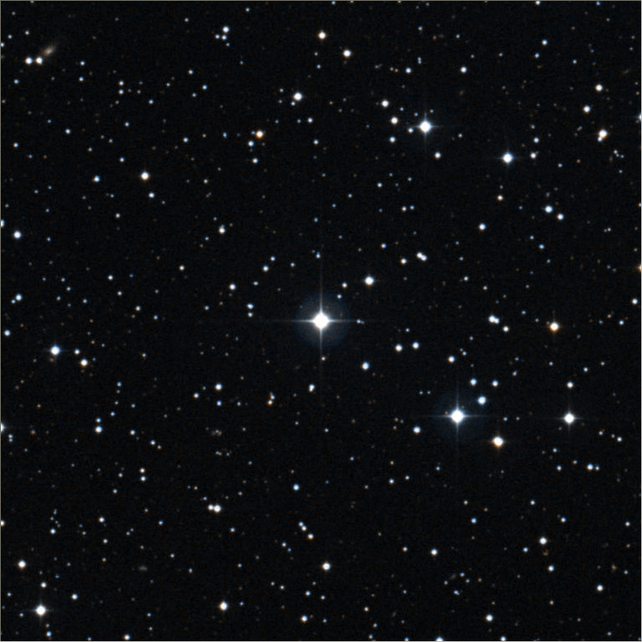
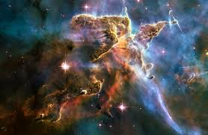

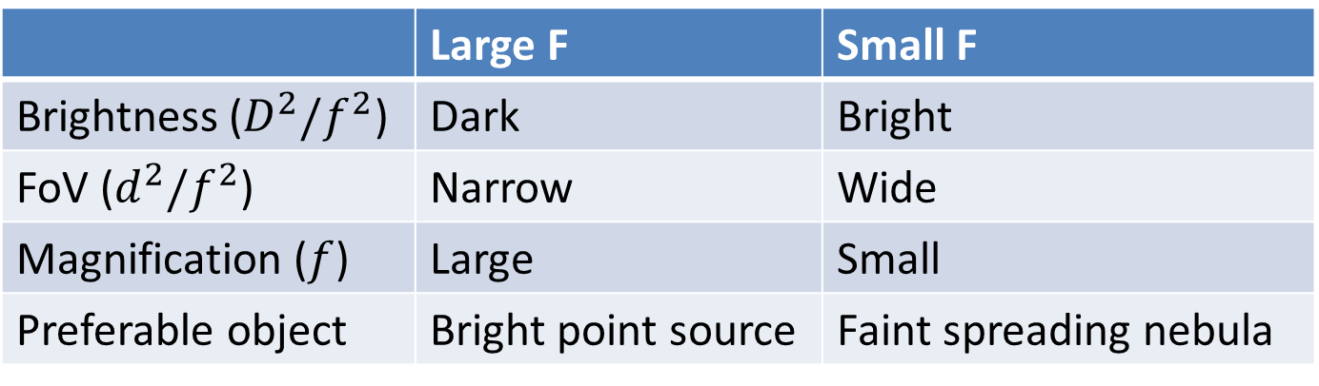



F-ratio and Field of View (FoV)
 | Large F | Small F
Brightness ($D^{2}/f^{2}$) | Dark | Bright
FoV ($d^{2}/f^{2}$) | Narrow | Wide
Magnification ($f$) | Large | Small
Preferable object | Bright point source | Faint spreading nebula
$$D$$
$$d$$
$$D$$
$$d$$
Detector
Detector
Large F
Small F
Using same size of a detector, small F-ratio gets large FoV.

Slide 20
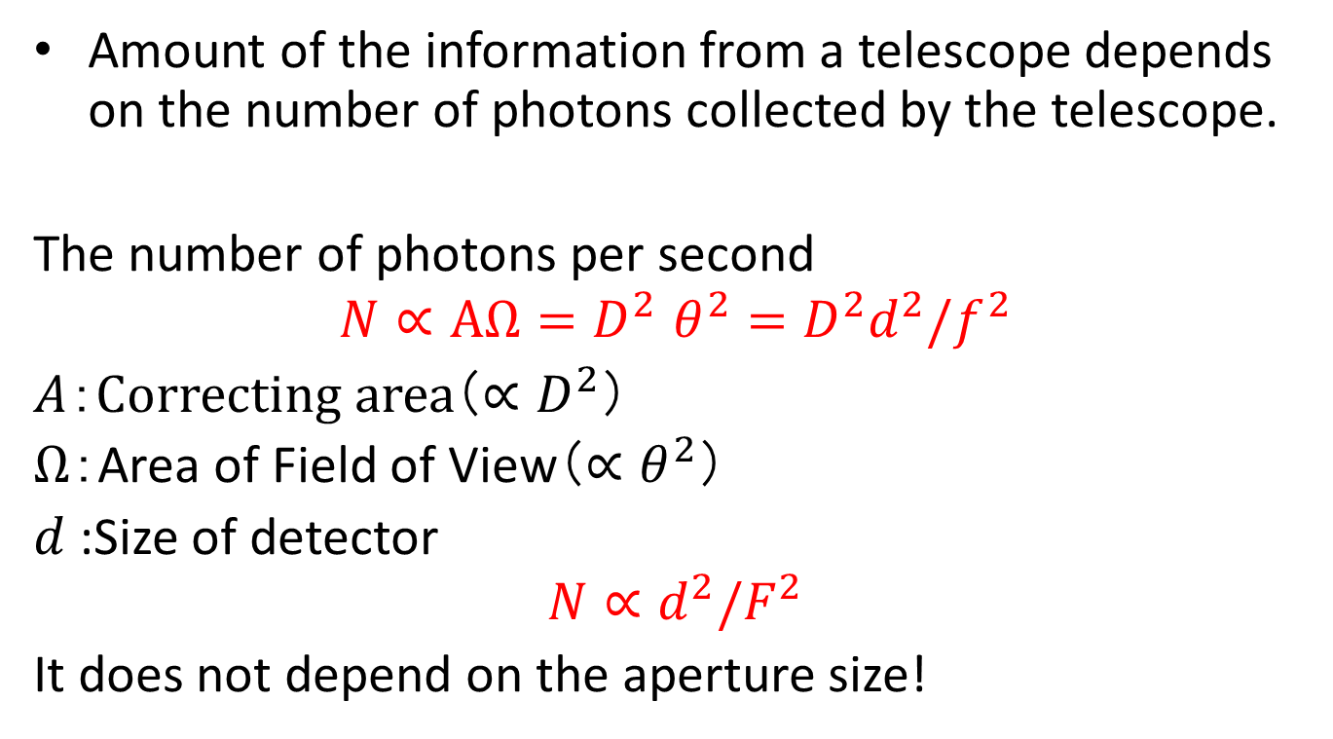
Amount of the Information
Amount of the information from a telescope depends on the number of photons collected by the telescope.
The number of photons per second
$$N∝AΩ{=D}^{2}θ^{2}=D^{2}d^{2}/f^{2}$$
$A$：Correcting area（$∝D^{2}$）
$Ω$：Area of Field of View（${∝θ}^{2}$）
$d$:Size of detector
$$N∝d^{2}/F^{2}$$
It does not depend on the aperture size!

Slide 21
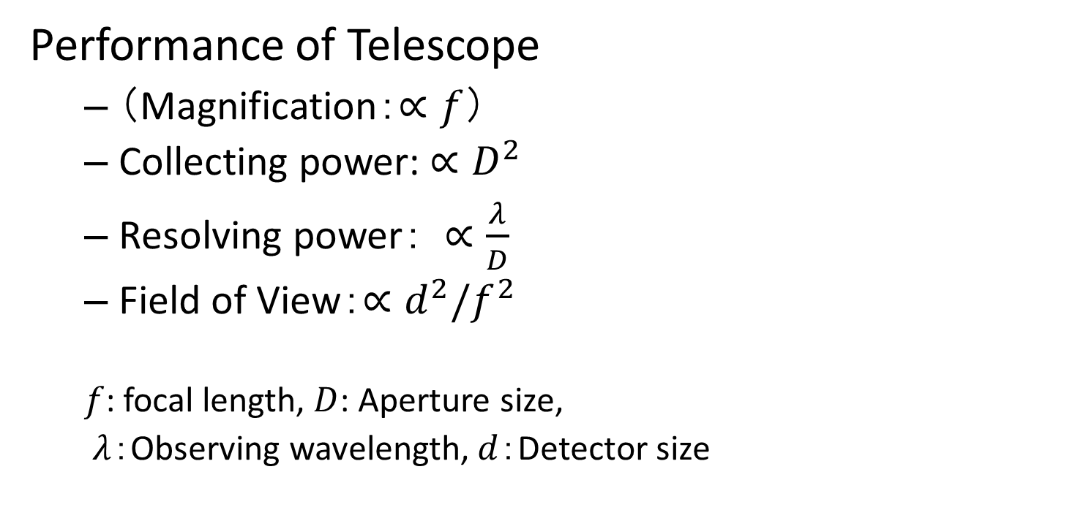
Summary
Performance of Telescope
（Magnification：$∝f$）
Collecting power:$∝D^{2}$
Resolving power： $∝\frac{λ}{D}$
Field of View：$∝d^{2}/f^{2}$
$f$: focal length, $D$: Aperture size,
$λ$：Observing wavelength, $d$：Detector size

Slide 22
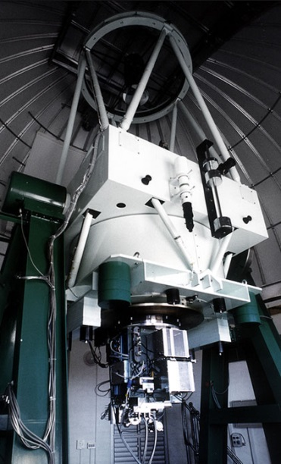
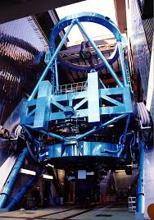
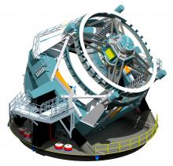
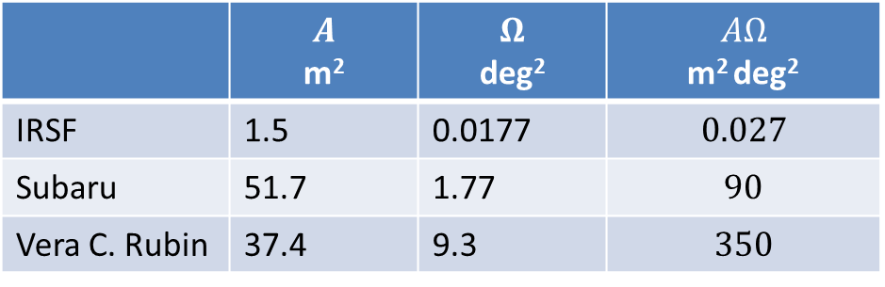
Telescopes
 | $$A$$ m² | $$Ω$$ deg² | $$AΩ$$ m² deg²
IRSF | 1.5 | 0.0177 | $$0.027$$
Subaru | 51.7 | 1.77 | $$90$$
Vera C. Rubin | 37.4 | 9.3 | $$350$$
IRSF（Jp）
Subaru（Jp）
Vera C. Rubin （USA）

