Slide 1
Magnitude and Atmosphere

Slide 2
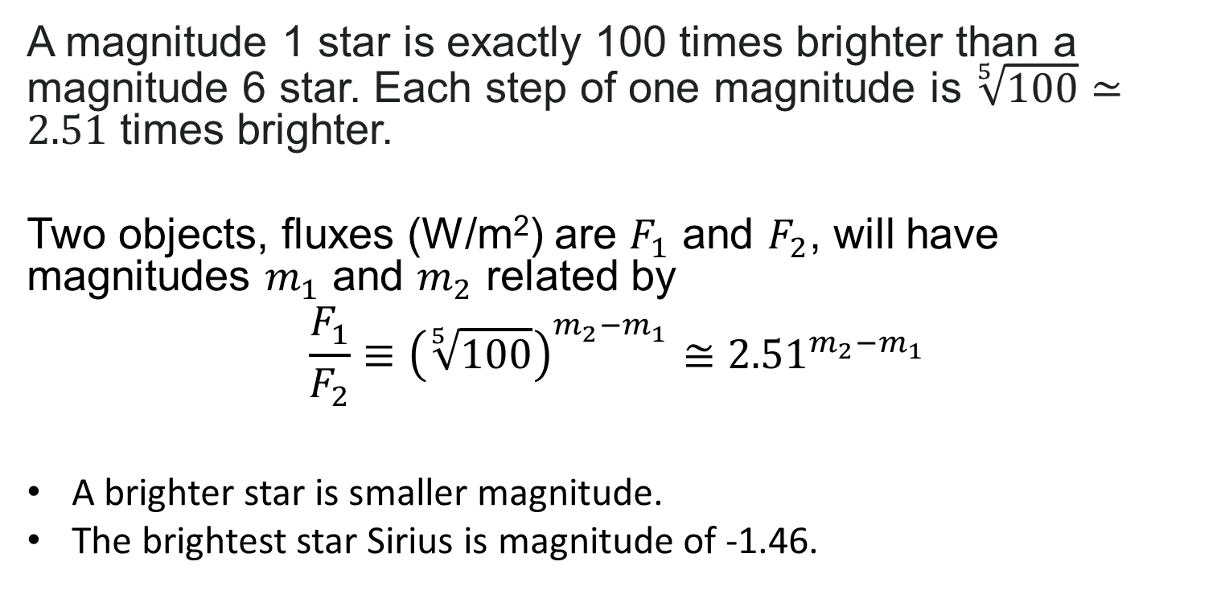
Apparent Magnitude （Definition of Brightness）
A magnitude 1 star is exactly 100 times brighter than a magnitude 6 star. Each step of one magnitude is $\sqrt[5]{100}≃2.51$ times brighter.
Two objects, fluxes (W/m²) are $F_{1}$ and $F_{2}$, will have magnitudes $m_{1}$ and $m_{2}$ related by
$$\frac{F_{1}}{F_{2}}≡{\left(\sqrt[5]{100}\right)}^{m_{2}−m_{1}}≅{2.51}^{m_{2}−m_{1}}$$
A brighter star is smaller magnitude.
The brightest star Sirius is magnitude of ‐1.46.

Slide 3
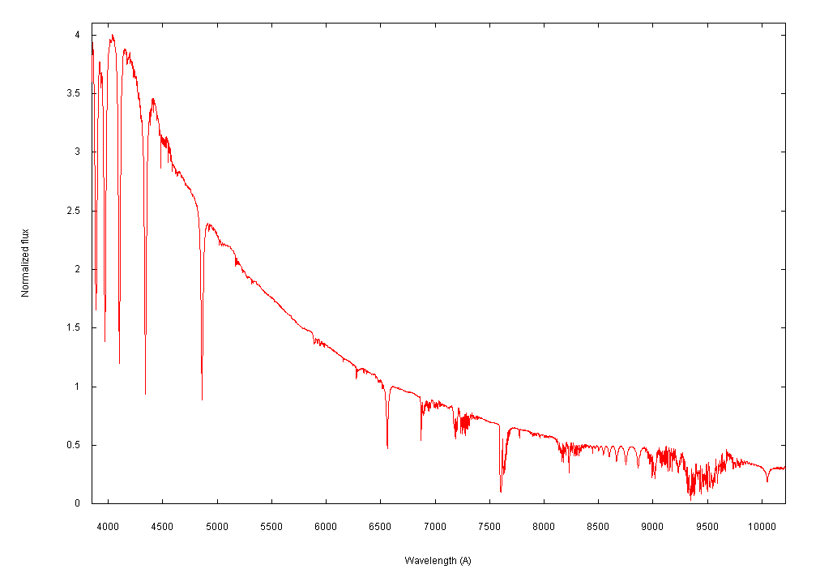
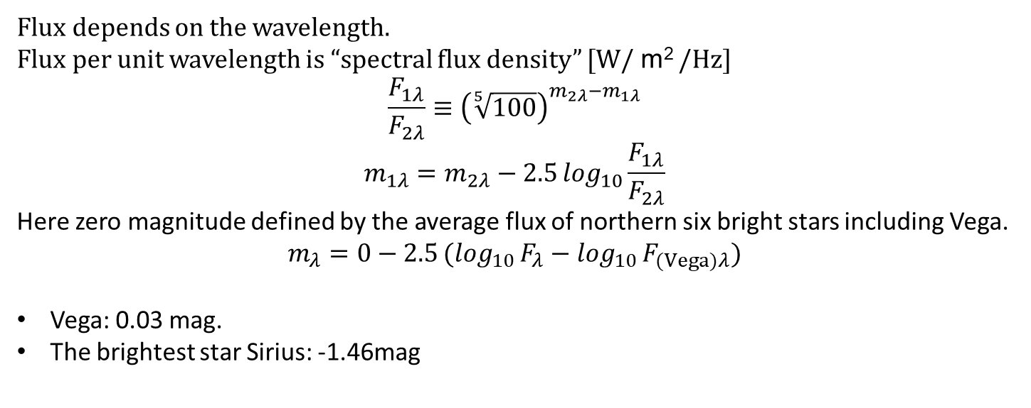
Vega Magnitude
Flux depends on the wavelength.
Flux per unit wavelength is “spectral flux density” [W/ m² /Hz]
$$\frac{F_{1λ}}{F_{2λ}}≡{\left(\sqrt[5]{100}\right)}^{m_{2λ}−m_{1λ}}$$
$$m_{1λ}=m_{2λ}−2.5\log_{10}{\frac{F_{1λ}}{F_{2λ}}}$$
Here zero magnitude defined by the average flux of northern six bright stars including Vega.
$$m_{λ}=0−2.5(\log_{10}{F_{λ}}−\log_{10}{F_{(Vega)λ}})$$
Vega: 0.03 mag.
The brightest star Sirius: -1.46mag
4
3.5
3
2.5
2
1
0.5
0
Normalized Flux
Spectrum of Vega
500 600 700 800 900 1000
Wavelength

Slide 4
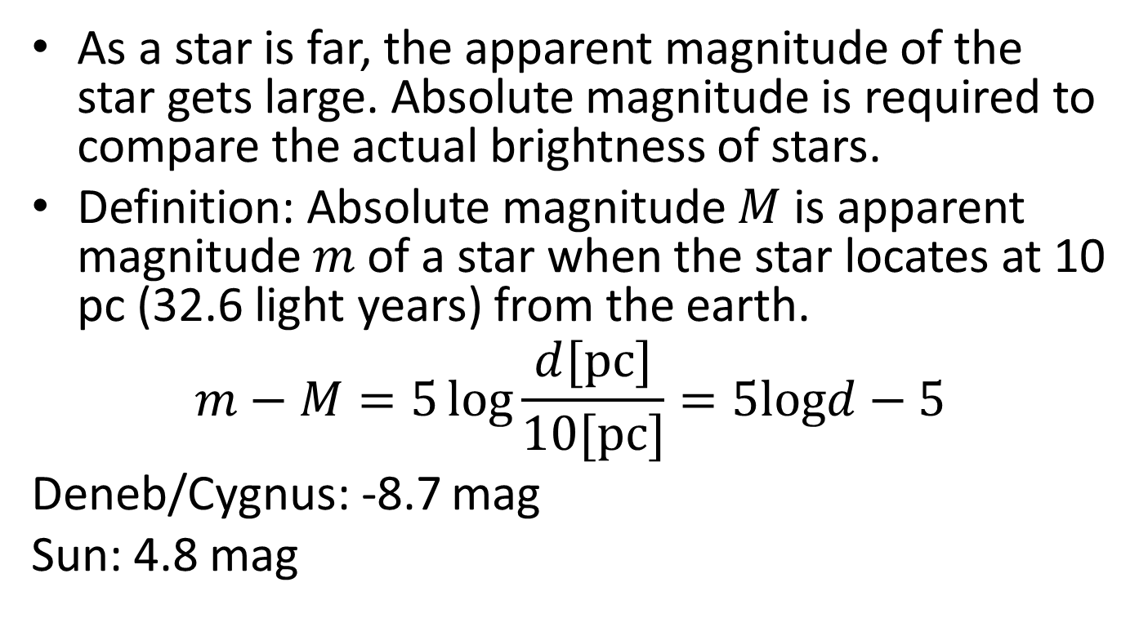
Absolute Magnitude and Distance
As a star is far, the apparent magnitude of the star gets large. Absolute magnitude is required to compare the actual brightness of stars.
Definition: Absolute magnitude $M$ is apparent magnitude $m$ of a star when the star locates at 10 pc (32.6 light years) from the earth.
$$m−M=5\log{\frac{d[pc]}{10[pc]}}=5logd−5$$
Deneb/Cygnus: -8.7 mag
Sun: 4.8 mag

Slide 5
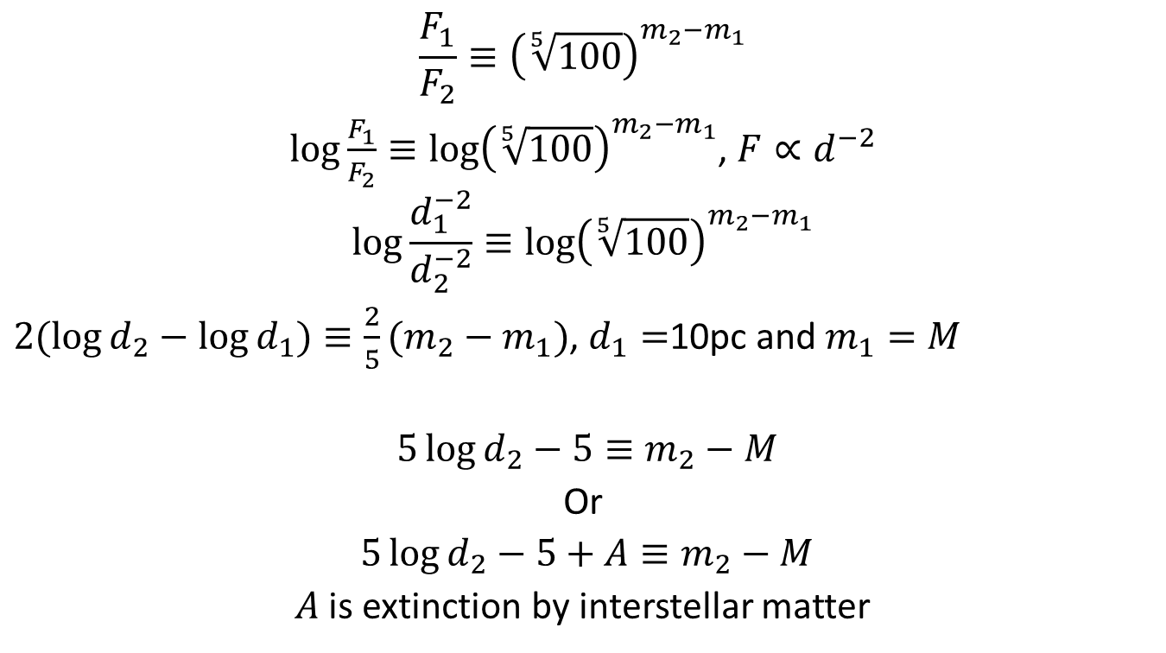
Answer
$$\frac{F_{1}}{F_{2}}≡{\left(\sqrt[5]{100}\right)}^{m_{2}−m_{1}}$$
$\log{\frac{F_{1}}{F_{2}}}≡\log{{\left(\sqrt[5]{100}\right)}^{m_{2}−m_{1}}}$, $F∝d^{−2}$
$$\log{\frac{d_{1}^{−2}}{d_{2}^{−2}}}≡\log{{\left(\sqrt[5]{100}\right)}^{m_{2}−m_{1}}}$$
$2(\log{d_{2}}−\log{d_{1}})≡\frac{2}{5}(m_{2}−m_{1})$, $d_{1}=$10pc and $m_{1}=M$
$5\log{d_{2}}−5≡m_{2}−M$
Or
$5\log{d_{2}}−5+A≡m_{2}−M$
$A$ is extinction by interstellar matter
$μ=m−M$ is proportional to $\log{d_{2}}$ and then it is called “Distance modulus”.

Slide 6
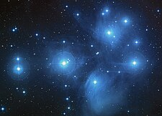
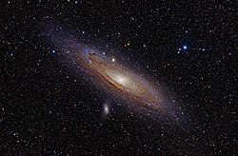
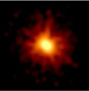
Distance Modulus
Ex. For a star 100pc distance from the Earth, we say “The distance modulus of the star is 5.”
and then we can understand that
“The apparent magnitude of the star is +5 compared to the absolute magnitude.”
D = 136 pc
µ = 5.7
D = 780 kpc
µ = 24.5
D = 2.3 Gpc
µ = 41.8

Slide 7
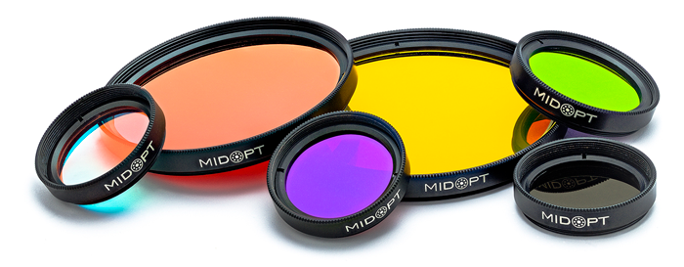
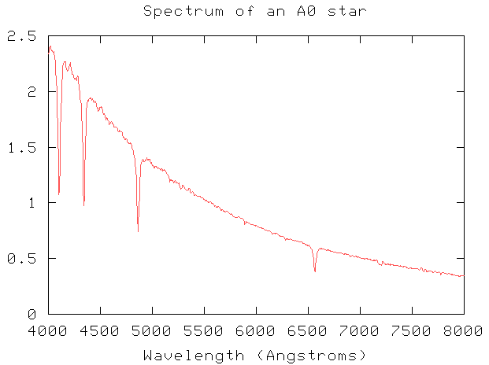
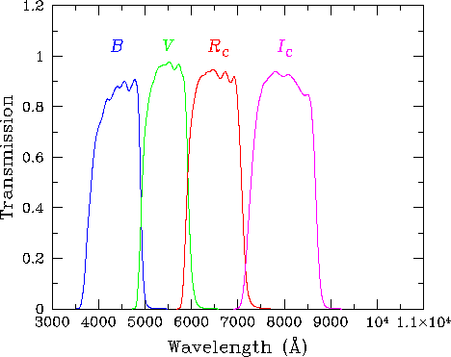
Filter System
Problem： Brightness of a star depends on wavelengths so it is impossible to compare the brightness observed by different wavelengths.
Solution: Observing by definite wavelengths with filters
Example of transmission of a filter system

Slide 8
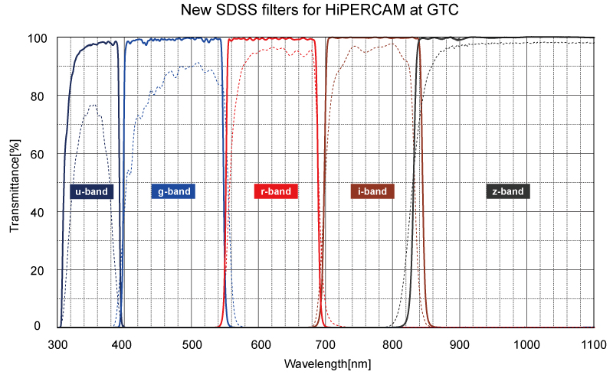
Filter System
Filter： A device that selectively transmits light of different wavelengths
Photometric System (Filter system): A set of well-defined filters, with a known sensitivity.
Ex.： Johnson system, SDSS system, Pan-STARRS system, 2MASS system
You can check it on Wikipedia.
While efforts are being made to use the same filter systems around the world, advances in thin-film technology are leading to the development of superior filters
Improvement of filter technology for 20 years

Slide 9
Requirement for Filters
High throughput at the designated wavelength band
Low leak at the other wavelength band
→Low noise
Steep cut-in and cut-off

Slide 10
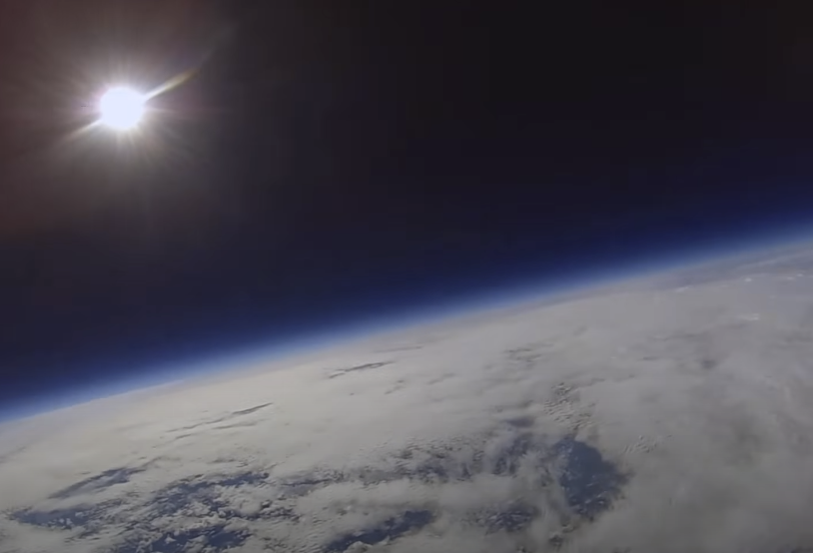
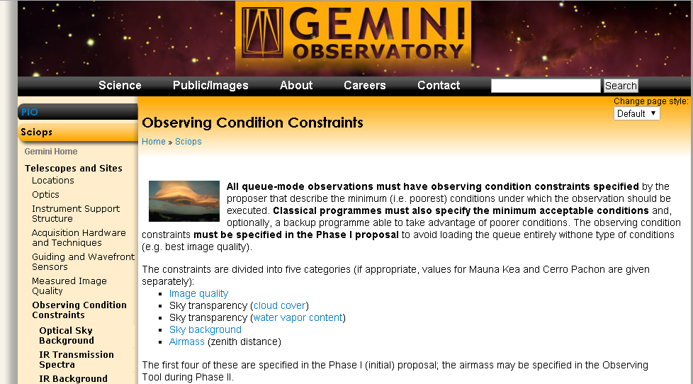
Atmosphere
Clouds: Hiding the stars
Attenuation: Dimming the starlight
Refraction: Displacing the star position, Chromatic aberration
Background light: Decreasing the contrast
Seeing: Degrading the resolution
Blue sky: Impossible to observe daytime
（Half of a year is impossible to observe）
Wind: Shaking the telescope and
sprinkling dust on the telescope
Humidity: Rusting the telescope
Temperature: Deforming the telescope
Ref. Web page of Gemini Obseravatory
http://www.gemini.edu/sciops/telescopes-and-sites/observing-condition-constraints#SkyTransparencyWater

Slide 11
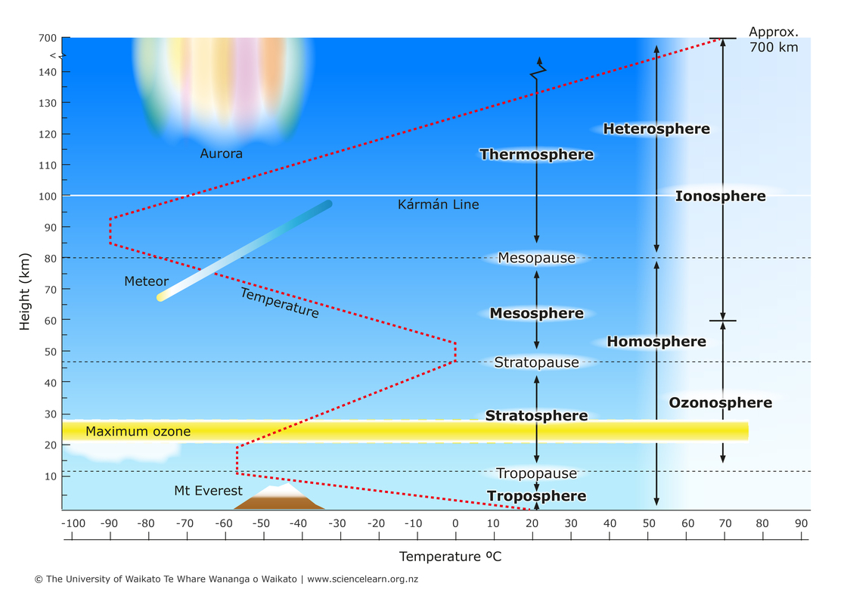
Atmosphere & Structure
Standard Atmosphere
Composition | Volume Ratio(%)
N₂ | 78.084
O₂ | 20.9476
Ar | 0.934
CO₂ | 0.0314
H₂O | 1～4
Most atmospheric phenomena occur in the troposphere, which is only 10 km above.
Atmospheric light and noctilucent clouds around 100 km also interfere with observations.

Slide 12
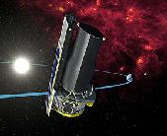
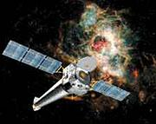
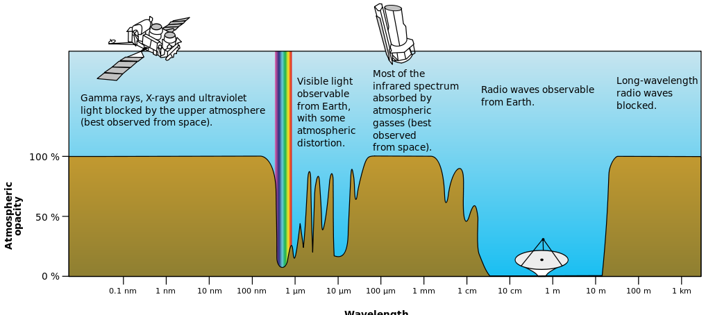
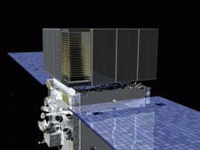
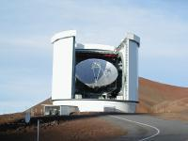
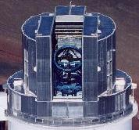
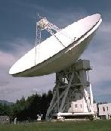
Opacity（Atmospheric Window） Absorption & Scattering by Atmosphere
Scattering by Atoms
Rayleigh Scattering
Absorption byO₂, O₃
Reflection by ionosphere
Absorption byCO₂，H₂O, CO
Wavelength
Wikipedia

Slide 13
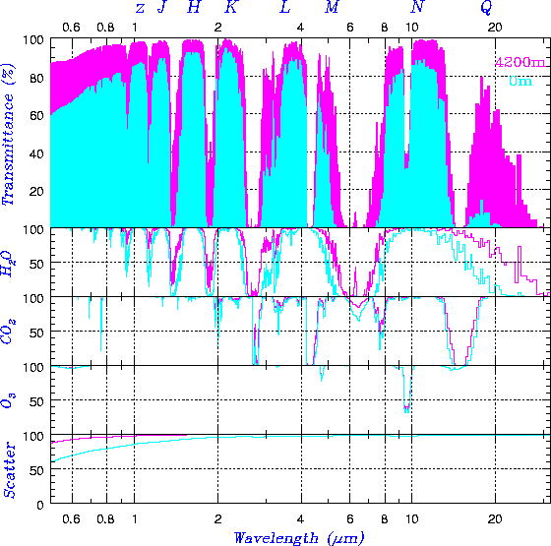
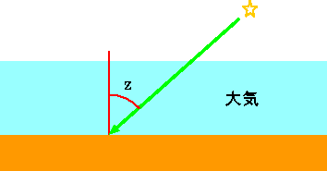
Opt-NIR Window of Atmosphere
紫：4,200 m
水：0 m
Absorption： Molecules (Water vaper and CO₂)
Scattering： Molecules and Aerosol
Atmosphere
The thickness of the atmosphere （Air Mass） is proportional to sec z
At z=60 deg, the thickness gets double that of at z=0. z < 60 is preferable for observations.
The higher the elevation, the drier and more transparent

Slide 14
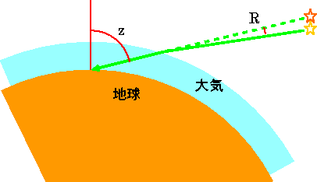
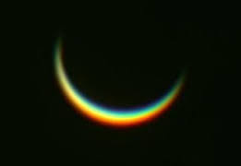
Atmospheric Refraction
Component | Refractivity
Atmosphere | 1.000293
N₂ | 1.000297
O₂ | 1.000272
CO₂ | 1.000450
Atmosphere
Earth
H₂O | 1.000252
Atmospheric refraction and dispersion
@z=45 deg, [arcsecond]
Refraction by atmospheric aberration
Wavelength μm | Sea level 0 m | Mauna Kea 4,200 m
0.5 | 57.51 | 35.98
1.0 | 56.51 | 35.36
2.0 | 56.27 | 35.21
Chromatic aberration
(Chromatic dispersion) by
Atmospheric refraction
Dispersion by atmospheric refraction

Slide 15
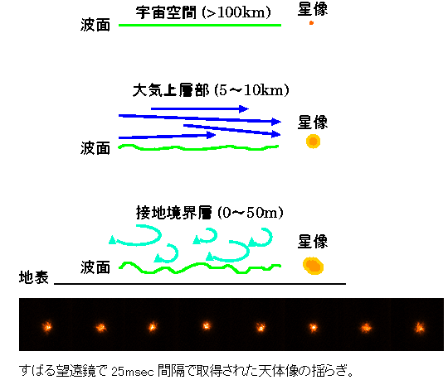
Seeing Image Degradation by Atmosphere
Seeing (size)：Apparent image size (angle) of a point source (star)
Image size of diffraction limited: 1.22λ/D
Atmospheric turbulence blurs the image size larger than the diffraction limited.
Seeing is induced by the inhomogeneity and fluctuation of the refractive index of the atmosphere.
Space > 100 km
PSF
 | Telescope Aperture /Diffraction limit |  |  | Seeing@ Mauna Kea
 | 0.5m | 2m | 8m
0.5 | 0”.25 | 0”.063 | 0”.016 | 0”.6
2 | 1”.0 | 0”.25 | 0”.063 | 0”.46
8 | 4”.0 | 1”.0 | 0”.25 | 0”.34
Wavefront
λ (μm)
Upper atmosphere 5 to 10 km
PSF
Wavefront
Ground layer
PSF
Seeing size ∝λ^{-0.2}
Wavefront
Seeing makes the aperture size meaningless in terms of resolution.

Slide 16
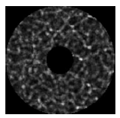
Scintillation
Due to refraction in the upper sky, the light entering and spilling out of the telescope's primary mirror fluctuates with time. This change the brightness of the stars and reduces the accuracy of photometry. This can be alleviated by averaging if the telescope is large enough.
Ideal wavefront
Turbulence
Distorted
wavefront
Aperture
Light that is inherently incident but is not incident due to refraction.
Light that is not inherently incident but is incident due to refraction.
Brightness distribution on a primary mirror
Ideally the mirror is illuminated uniformly, but it has a structure by air turbulence.

Slide 17
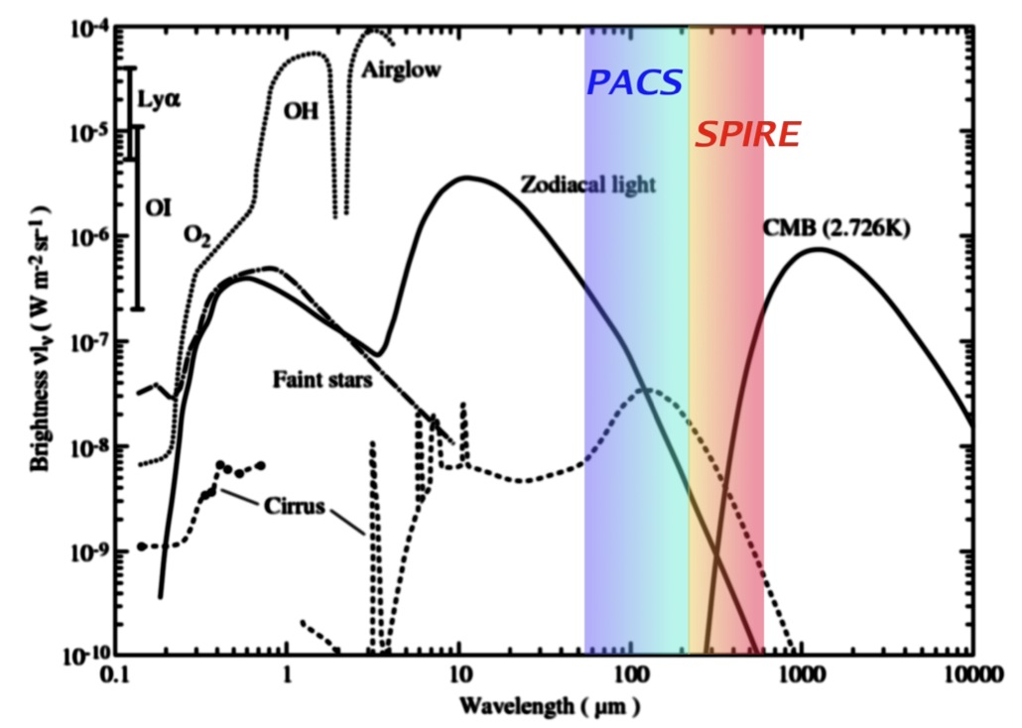
Sky Background Noise Glowing Atmosphere
The night sky appears dark, but it is glowing.
Radiation from Atmosphere
Component | Temp. | Emissivity
Thermalr adiaion from telescope | 273 K | 0.1
Thermal radiation from atmosphere | ～ 273 K | 1 - 透過率
Non thermal emission from atmosphere | --- | ---
Scattering light of sun light by dust in zodiacal plane | 5800 K | 3×10⁻¹⁴
Thermal radiation from zodiacal dust | 275 K | 7.1×10⁻⁸
Thermal radiation from dust in galactic plane | 17 K | 10⁻³
Thermal radiation from a space telescope | 10 K | 0.05
CMB | 2.73 K | 1.0
Zodiacal light
OH
Cirrus Cloud
Spectrum of Background Noise
From HP of HERSCHEL

Slide 18
Excellent Site
Good seeing （Stable atmosphere）
High fraction of clear night （Western side of the continents）
High transparency （High altitude mountain）
Dark sky （Cold and distant place from human activity）
A good observatory is unpopular, cold, dry, thin air, barren land.

Slide 19
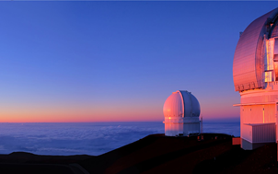
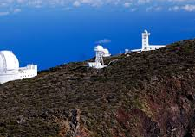
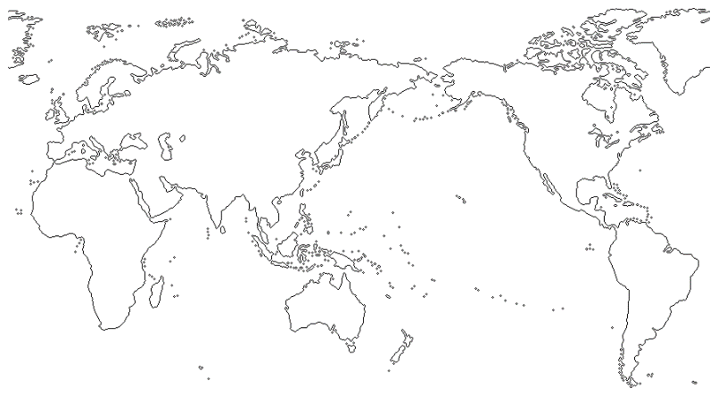
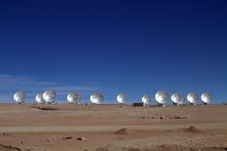
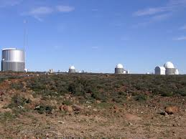
Popular Observatory in the World
Location | Height(m) | Spehere | 主な望遠鏡
Mauna Kea（USA） | 4,200 | N | Keck 10mx2, Subaru 8m、GEMINI 8m, (TMT30m)
Atacama（Chillie） | 4,800 | S | ALMA (TAO 6.5m, ELT 39m)
Mt. Graham（USA） | 3,200 | N | LBT8.4mx2
LaPalma（Spain） | 2,400 | N | GTC 10m
Las Campanas（Chillie） | 2,300 | S | Magellan 6.5m
Kit Peak（USA） | 2,100 | N | Mayall 4m, WIYN3.5m
Karoo （South Africa） | 1,800 | S | SALT10m
Antarctica | （3,800） | S

