Slide 1

ToxQuest An AI Decision Support Tool for Drug Discovery
ToxQuest helps drug developers confidently take the leap from in silico to preclinical testing by turning fragmented AI toxicity predictions into clear, explainable shortlists of safe, viable candidates.
Founder: Logan Germain, PhD Candidate

Slide 2
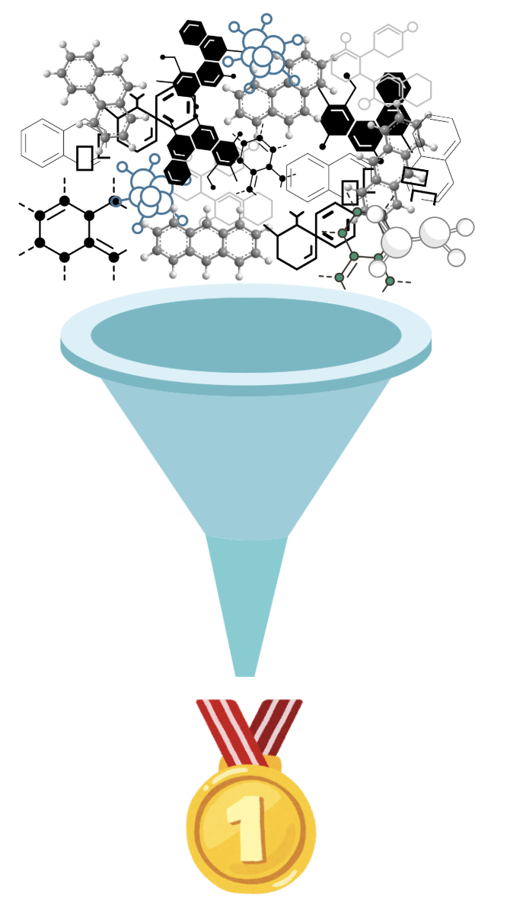
executive summary.
While many tools can tell you if a compound might be toxic, ToxQuest tells you which compounds are safe enough to prioritize for your next preclinical experiment. It’s the bridge between noisy in silico outputs and costly wet-lab validation.
It’s a decision-support engine that takes raw toxicity predictions from existing, validated AI models and distills them into a clear, ranked list of the safest candidate molecules.
ToxQuest implements a revolutionary approach by coordinating specialized AI toxicity prediction models through a game theory concept called "satisficing paths."

Slide 3
the problem.
Early-stage drug development suffers from astronomically high failure rates – 90% of drug candidates fail before clinical trials!
This is often due to toxicities that emerge.
Drug development for a single drug: $515.8 million USD when factoring in failures (2000-2018).
10+ years from initial discovery to market approval.

Slide 4

the gap.
Imagine this:
A team screens 300 molecules. They get outputs from leading AI models like DeepTox, ADMETlab, etc. → dozens of scores per compound. Now what? Manually cross-reference?
Each model might excel at predicting different kinds of toxicities, but these models don’t talk to each other.
Toxicity prediction models use different algorithms and data, leading to potentially contradictory results.
Key Gap: There is no AI coordination layer that weighs evidence from various sources available for early drug development toxicity prediction and provides you with your best candidates to proceed with.

Slide 5
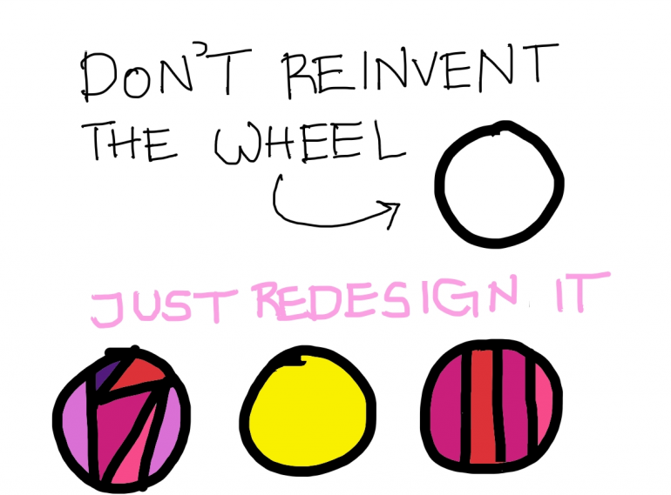
the opportunity.
ToxQuest is a cooperative multi-agent AI platform that leverages existing toxicity prediction models into one decision-making support tool.
We don’t reinvent the wheel. We use what’s already existing, trained and validated.
Users need decisions, not just toxicity scores. Plenty of great AI toxicity prediction tools exist out there, but they don’t directly help narrow down a list of candidate molecules.
Our Strategy: We integrate existing AI toxicity prediction tools into one simple coordination layer to provide users with their BEST candidates to proceed into pre-clinical testing with.

Slide 6
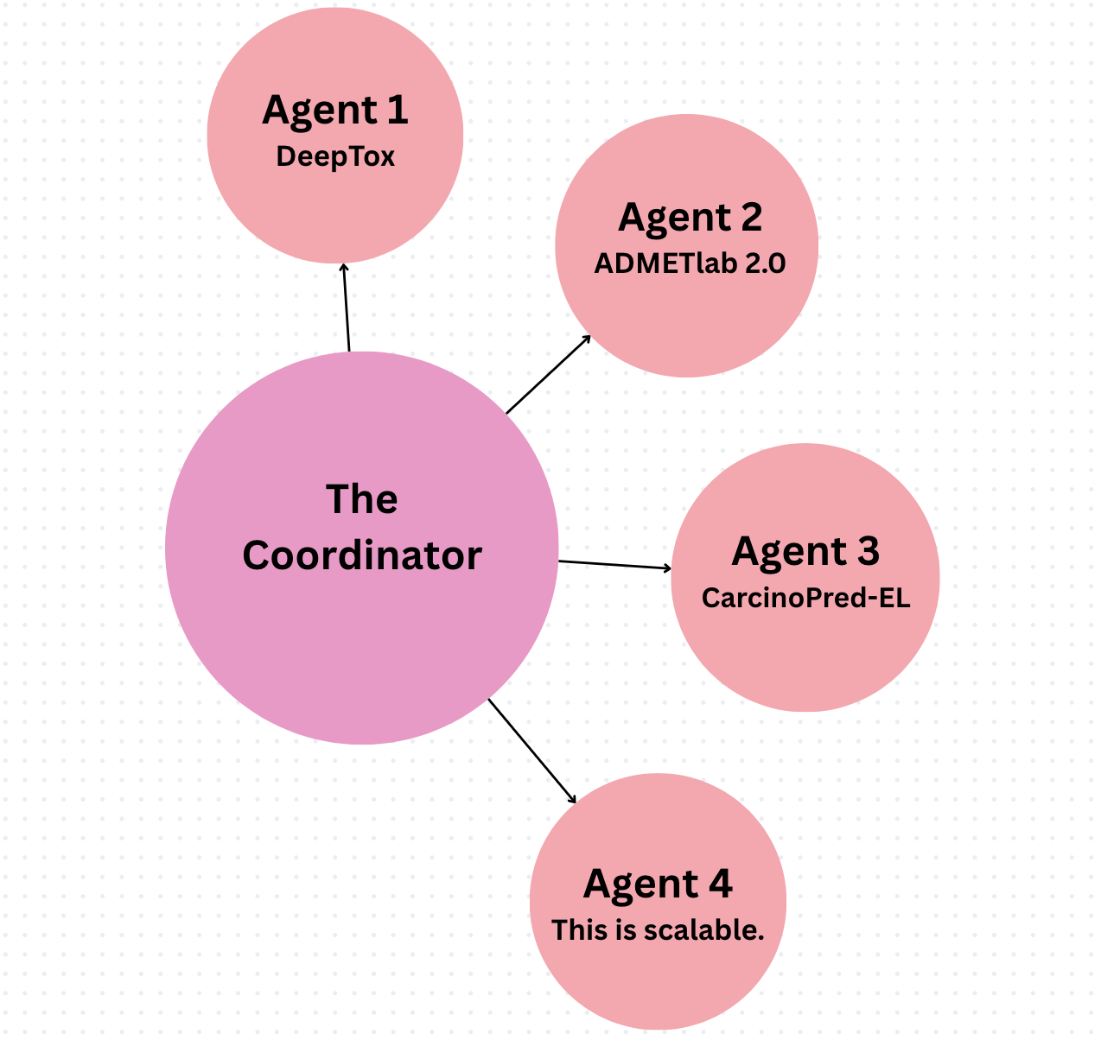
the game.
To use ToxQuest:
Client inputs a list of candidate molecules, obtained from virtual screening, generative models, rational design process, or any other source.
Each Agent (existing, open-source AI prediction model) makes their toxicity predictions independently.
The Coordinator (our algorithm) integrates each Agents predictions into one decision-making layer.
The Result: a clear and explainable shortlist of top-performing candidate molecules, ready for preclinical testing.
Notes:
All models treated equally.
Equal Standing: Each AI model (binding, toxicity, synthesis) is treated as an independent "player" with its own satisfaction criteria. No model is inherently more important than others. No Predetermined Hierarchy: Unlike weighted ranking systems where you'd need to decide in advance that "toxicity is 50% more important than binding," the satisficing path approach doesn't require assigning relative importance. Objective Thresholds: Each model simply defines what constitutes "satisfactory" for its domain (e.g., binding score > 7.5). These thresholds are based on scientific requirements rather than relative priorities. Emergent Balance: The balance emerges naturally through the path construction process rather than through explicit weighting or prioritization.

Slide 7
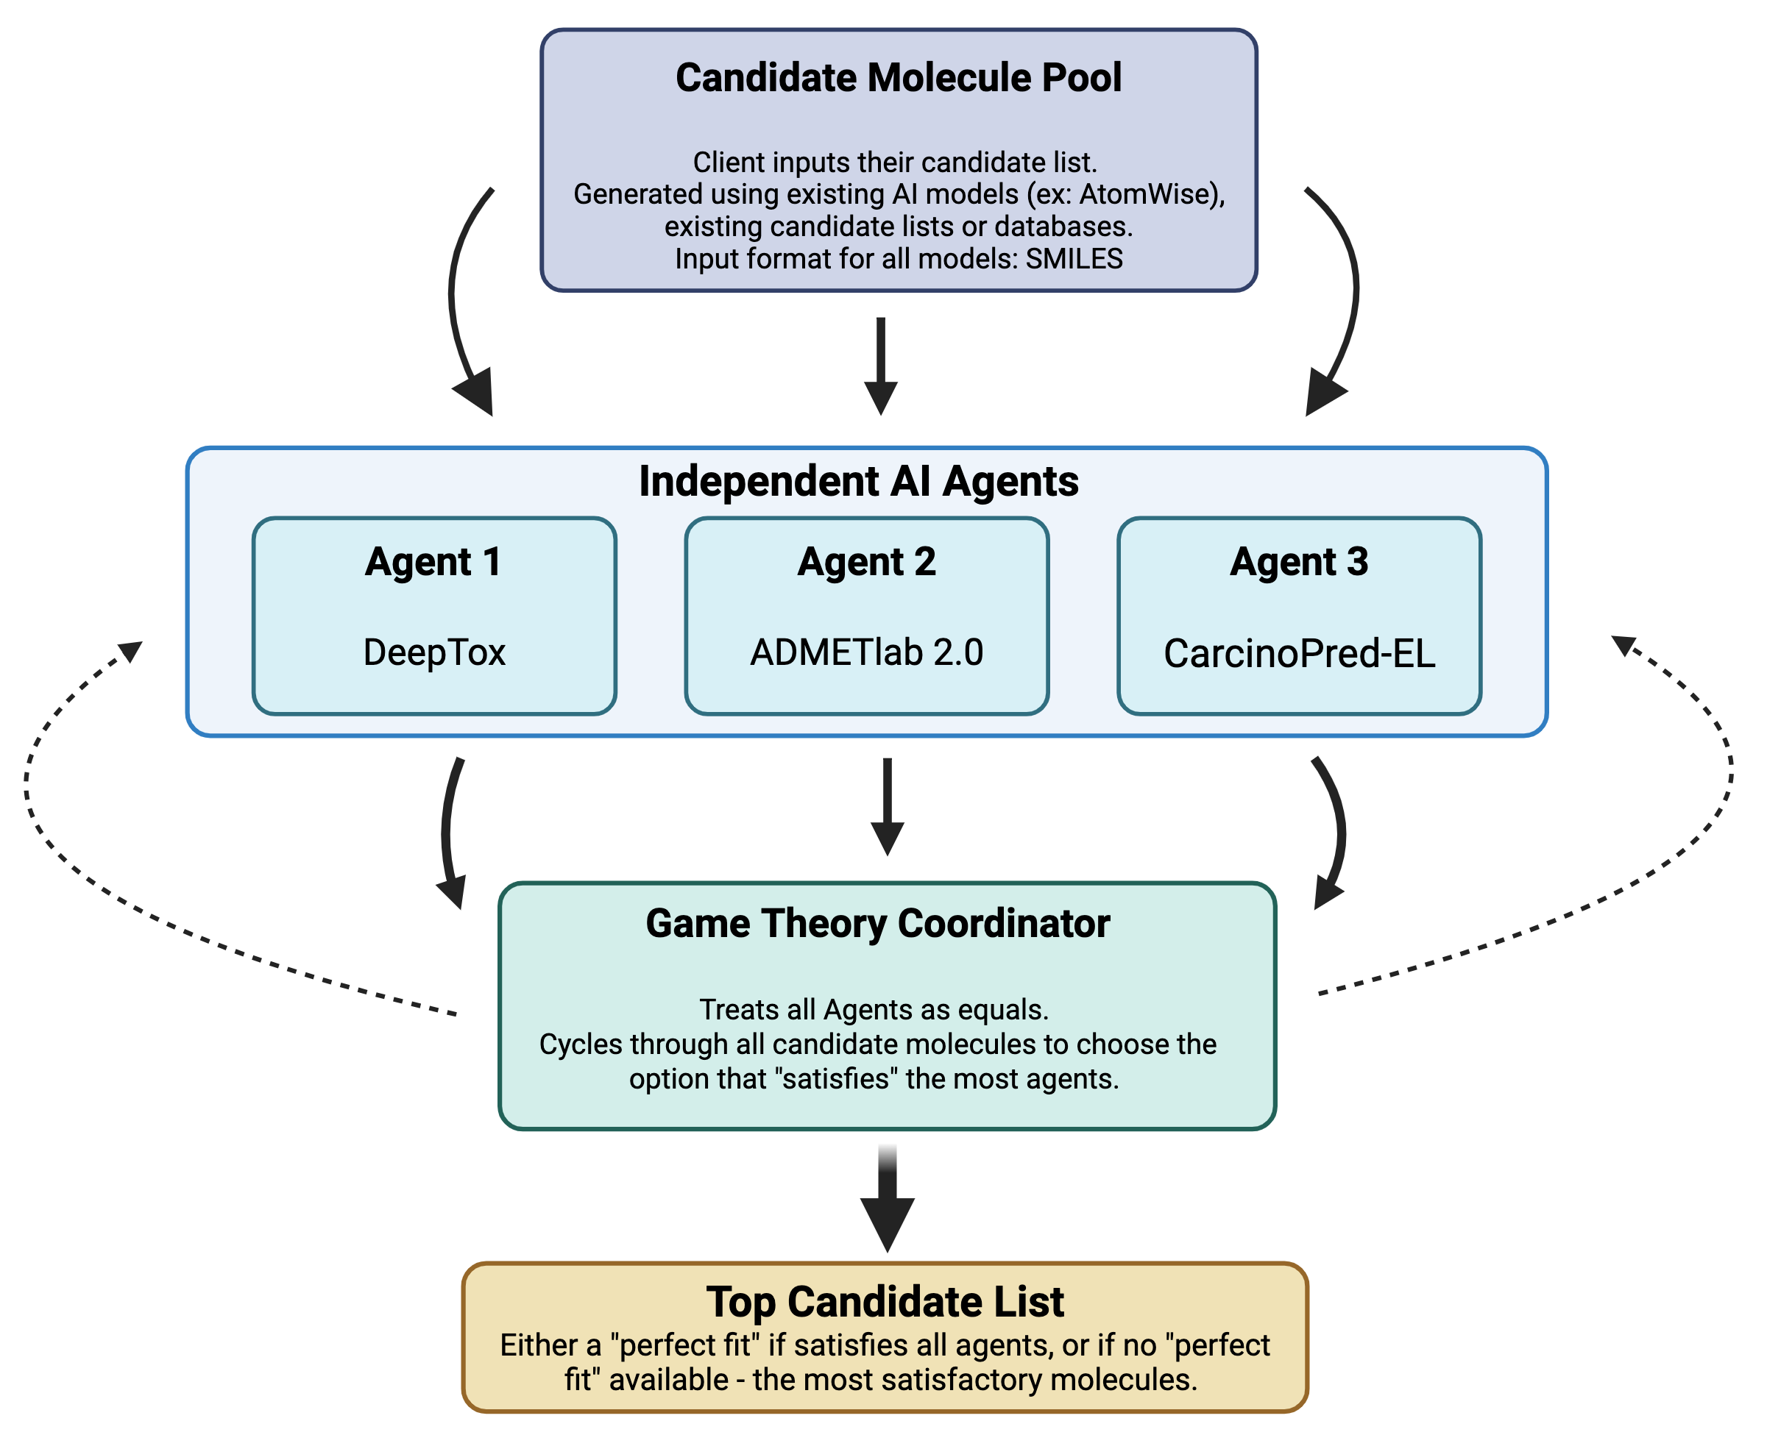
the concept.
ToxQuest Architecture Flow Chart
ToxQuest is based off the mathematical concept of “satisficing pathways” – a decision-making strategy that entails searching through available options until an acceptability threshold is met.
While “optimizing” strives for the absolute best, “satisficing” finds solutions that meet a certain threshold, often more efficiently.
By treating each AI model as an Agent with a defined satisfaction threshold,
And constructing paths that maintain satisfaction for the greatest number of Agents,
It's possible to reach an equilibrium where all models are satisfied (if such a state exists), otherwise the most “satisfying” candidate is found.
Notes:
All models treated equally.
Equal Standing: Each AI model (binding, toxicity, synthesis) is treated as an independent "player" with its own satisfaction criteria. No model is inherently more important than others. No Predetermined Hierarchy: Unlike weighted ranking systems where you'd need to decide in advance that "toxicity is 50% more important than binding," the satisficing path approach doesn't require assigning relative importance. Objective Thresholds: Each model simply defines what constitutes "satisfactory" for its domain (e.g., binding score > 7.5). These thresholds are based on scientific requirements rather than relative priorities. Emergent Balance: The balance emerges naturally through the path construction process rather than through explicit weighting or prioritization.

Slide 8
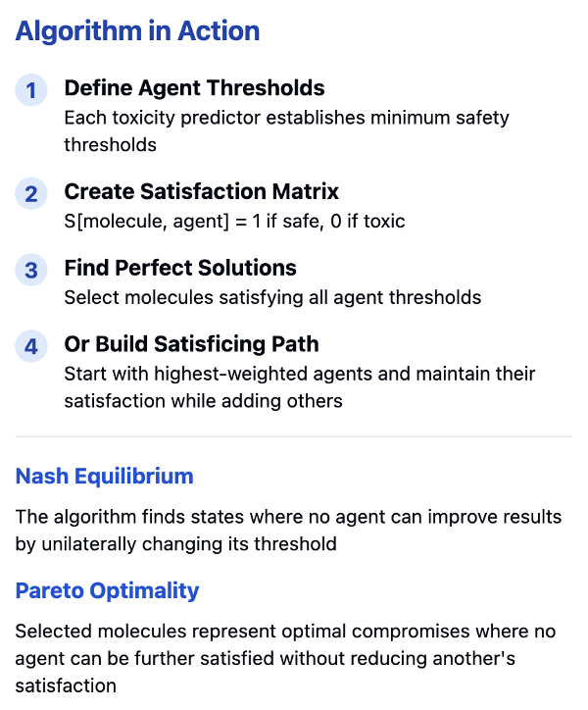
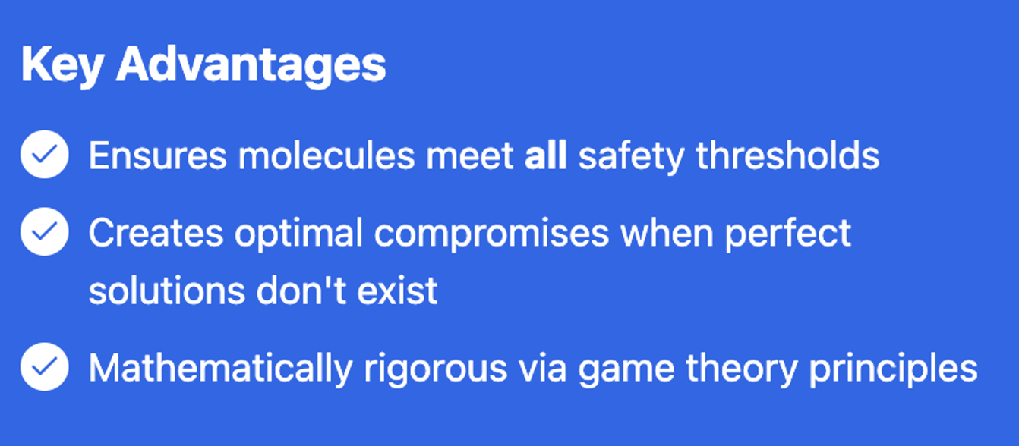
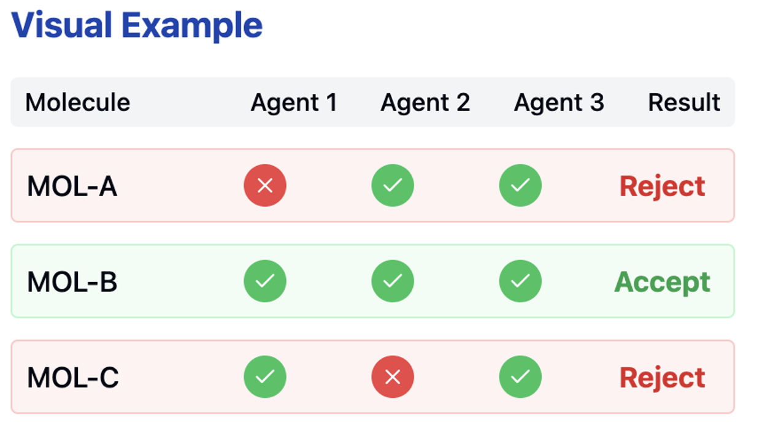
the theory.
Notes:
All models treated equally.
Equal Standing: Each AI model (binding, toxicity, synthesis) is treated as an independent "player" with its own satisfaction criteria. No model is inherently more important than others. No Predetermined Hierarchy: Unlike weighted ranking systems where you'd need to decide in advance that "toxicity is 50% more important than binding," the satisficing path approach doesn't require assigning relative importance. Objective Thresholds: Each model simply defines what constitutes "satisfactory" for its domain (e.g., binding score > 7.5). These thresholds are based on scientific requirements rather than relative priorities. Emergent Balance: The balance emerges naturally through the path construction process rather than through explicit weighting or prioritization.

Slide 9
the benefit.
Lower Development Cost | Integration of existing AI models allows for quicker implementation and deployment vs. developing/validating a new model from scratch.
Faster Time-to-Market | Narrows client candidate molecule list faster, earlier and better than other methods.
Explainability | Candidate list output is traceable to specific toxicity predictions from each Agent.
Differentiation | ToxQuest occupies a unique position as an AI tool coordinator/integrator rather than another competitor model.
Reliability | By incorporating multiple models, the output candidate list is high confidence.
Integration | Addresses the fragmentation of individual AI models who might specialize in different domains.
Adaptability | Not tied to any specific model, can accommodate emerging models.
Partnerships | Partnership opportunities with existing AI model providers.

Slide 10
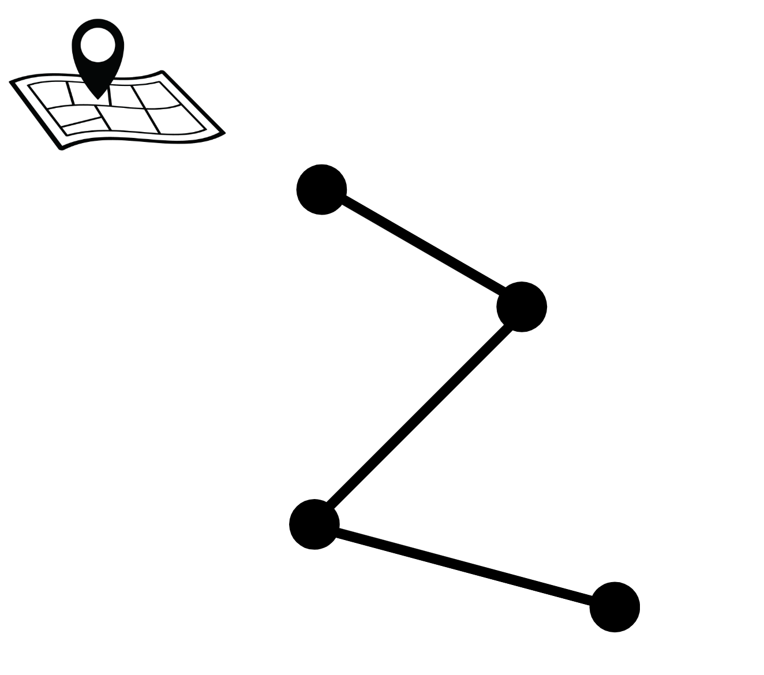

the IP strategy.
IP Strategy Road Map
Phase 1
Architecture and MVP creation on database of molecules with known safety and efficacy using narrow toxicity metrics.
The novelty of ToxQuest is in coordinating multiple existing models into one platform, preserving their autonomy, and integrating them through a game-theoretic, satisficing pathway. The IP would be on the architecture of the platform, not on the models themselves.
Phase 2
File for a utility patent to protect the decision-making algorithm and data flow architecture, not on the input models.
Phase 3
Develop a user-friendly interface that can be copy-writed.
Trademark the ToxQuest brand.

Slide 11
the market.
Market Tier | Our Definition | Size Estimate | Why us, now?
Total Addressable Market (TAM) | Global AI in Drug Discovery Market | $1.9 billion USD in 2023, CAGR of 29.6% 2024-2032 (Global Market Insights) | This is a fast-growing sector, with opportunity for early adoption in small biotech, later adoption by big pharma.
Service Available Market (SAM) | AI in predictive toxicology for drug discovery | $281 million USD in 2022, CAGR 29.5% 2023-2032 (Global Market Insights) | ToxQuest targets AI adopters who need explainable decisions where every $ spent matters in preclinical testing.
Service Obtainable Market (SOM) | Academic screening labs, CROs, early-stage biotech seeking to identify their top candidate molecules to proceed with. | 1% of SAM in first few years = $2.8 million/year (rough estimate). | Very limited direct competition for our coordination platform, but indirect competition from AI drug discovery platforms = lower SOM, but a growing SAM/TAM.

Slide 12
the drivers.
Growth Driver
AI in Toxicity Prediction for Drug Discovery is growing fast, driven by the ability to save time by predicting toxicity early and reducing expensive later-stage failures.
Cost Saving Driver
Toxicity failures account for approximately 30% of drug development failures, representing billions in wasted R&D spending that ToxQuest could help reduce.
Geographic Driver
Biotech in Canada is experiencing growth in public-private partnerships, now is a good opportunity for ToxQuest to partner with other biotech start-ups, CROs or academic labs who having received recent funding for drug discovery.
Acquisition Driver
The rising trend of pharmaceutical companies acquiring AI toxicity prediction startups makes ToxQuest's exit strategy viable. ToxQuest aim is not to be a huge, expensive endeavor but rather to be lean and student-driven, making it an appealing acquisition.

Slide 13
the business model.
Acquisition Strategy
ToxQuest would be structured as a focused, capital-efficient startup with the primary goal of acquisition within 3-5 years by a CRO, early-stage biotech or academic drug screening lab seeking to enhance their compound selection processes.
Technology Value Proposition
Integrate the most trusted open-source toxicity prediction models under a single coordination platform. First demonstrate with a pool of known drugs that ToxQuest accurately identifies the least toxic/best candidate to move forward with pre-clinical experiments.
Validation Strategy
Demonstrate that top candidates selected by ToxQuest have lower failure rates in subsequent toxicity testing, and that this generates a ROI based on avoided downstream preclinical toxicity experiment costs on compounds that would ultimately fail.
Financial Structure
Focus expenditures on technology development and validation rather than sales and marketing. Keep the team lean, and mostly student-entrepreneurs. Mentorship/consulting for IP, due diligence prior to market entry would be sought out.

Slide 14
the team.
Machine Learning Specialist
Creation of the core decision-making layer using satisficing paths
Domain Expert
Toxicology expertise and drug development knowledge
Business Development Lead
Sourcing funding opportunities, market and IP strategy analysis
Software Engineer
System architecture and data flow code implementation. Graphic interface design.

Slide 15
the exit strategy.
First Use-Case:
Secure NDAs + collaboration agreements with academic labs or small biotechs.
Publish selected outcomes to build brand + moat.
Exit Strategy: Acquisition for In-House Use.
A pharma or biotech buys the platform.
They don’t want key pipeline decisions dependent on an external service forever. Owning the tech = owning the risk.
Acquiring the platform allows them to modify thresholds, models, rules, and adapt it per therapeutic area.
Acquiring the platform early prevents competitors from using your system.

