Slide 1
12:30
+
Create alternate stylesheet
Finish powerpoint mockups
Schedule eye exam

Slide 2
12:30
+
Create alternate stylesheet
Finish powerpoint mockups
Schedule eye exam

Slide 3
12:30
Create alternate stylesheet
Finish powerpoint mockups
Schedule eye exam

Slide 4
12:30
+
Create alternate stylesheet
Finish powerpoint mockups
Schedule eye exam

Slide 5
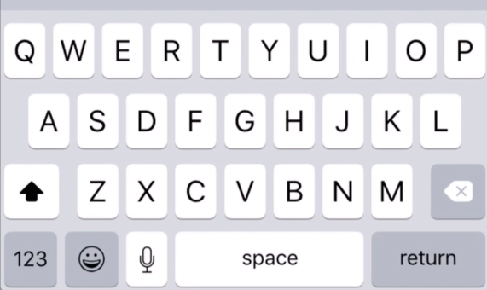
12:30
+
Create alternate stylesheet
Finish powerpoint mockups
Schedule eye exam

Slide 6
12:30
+
Find new apartment
Create alternate stylesheet
Finish powerpoint mockups
Schedule eye exam

