Slide 1

Bike Store Revenue Forecast
Logan Phillips
1/5/2024

Slide 2
Objectives
Forecast revenue for the next 6 months based on our available data.
Identify potential seasonal patterns in purchases.
Identify key drivers of revenue.

Slide 3
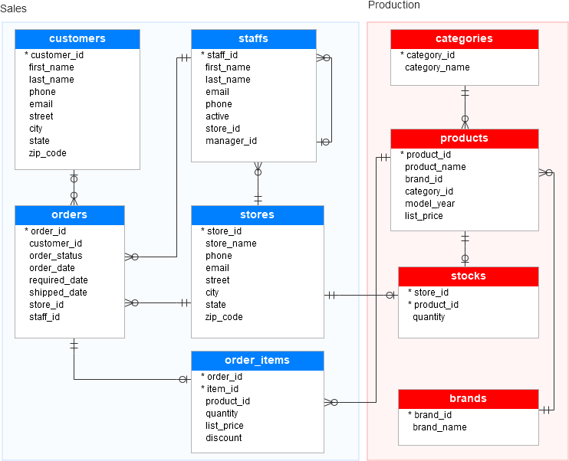
Data Source Overview
Table creation script, ERD image, and data population script were sourced from the following:
https://www.sqlservertutorial.net/sql-server-sample-database/
We have roughly 3 years of data (2016-2018), however, 2018 is short 3 days. With practicality and relevance in mind, this presentation will discuss 2018 as a full year.

Slide 4
Methodology
Data cleaning was done in SSMS(SQL Server Management Studio).
GitHub Data Preparation File
Data exploration was done in both SSMS and Tableau.
GitHub Data Exploration File
Modeling was done using Tableaus Forecast model.
How the Forecast Model Works

Slide 5
Key Findings
Revenue has declined 47% from 2017-2018
Electric Bike sales were the only bike category to see an increase in purchases (15%).
All locations had substantial revenue drops from 2017 to 2018 except Santa Cruz Bikes.

Slide 6
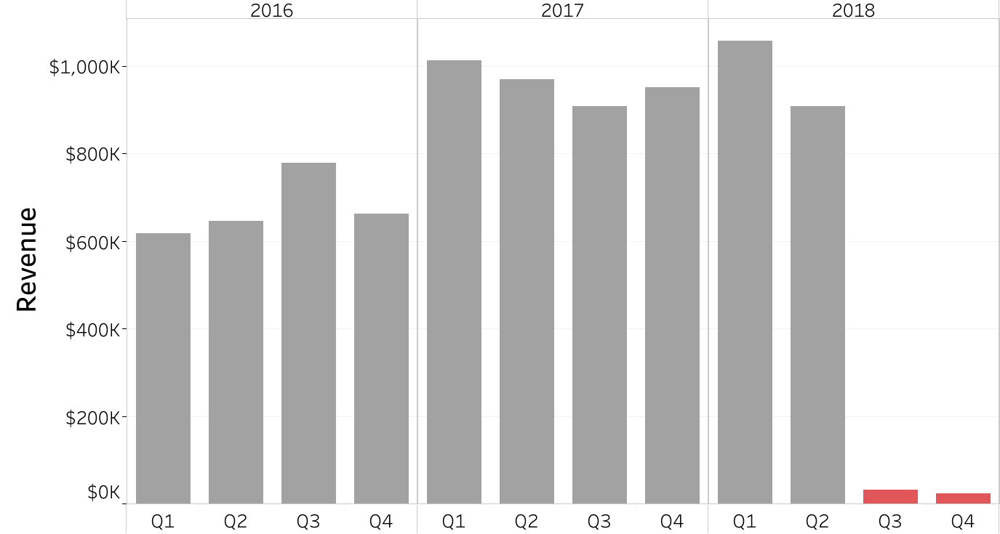
Declining Revenue

Slide 7
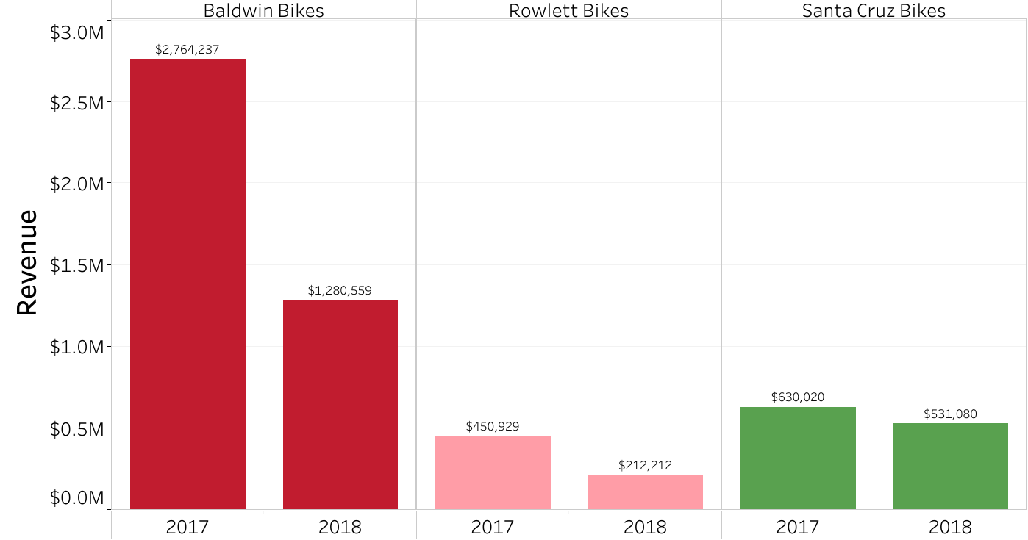
Santa Cruz Bikes Insight 1

Slide 8
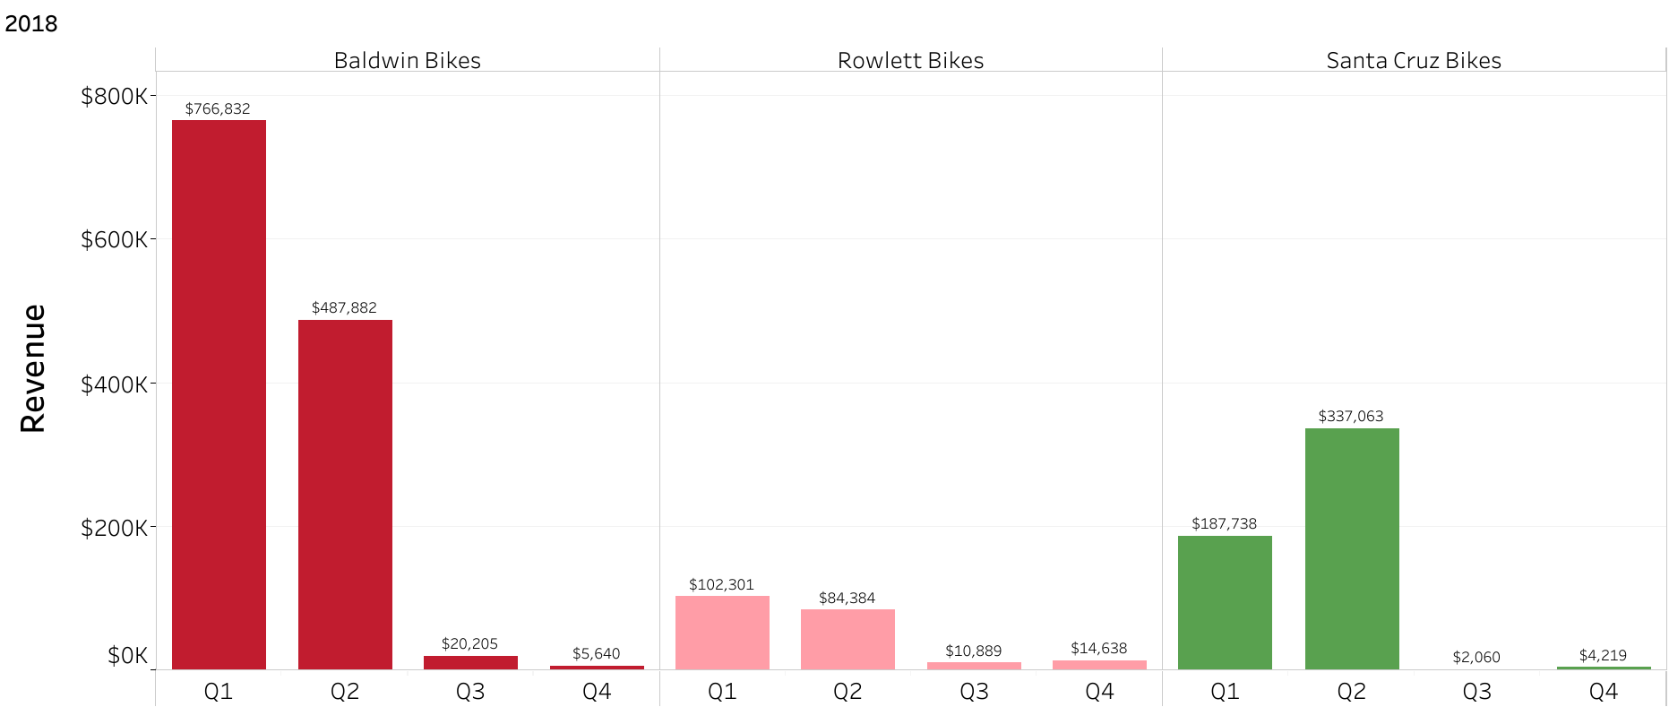
Santa Cruz Bikes Insight 2

Slide 9
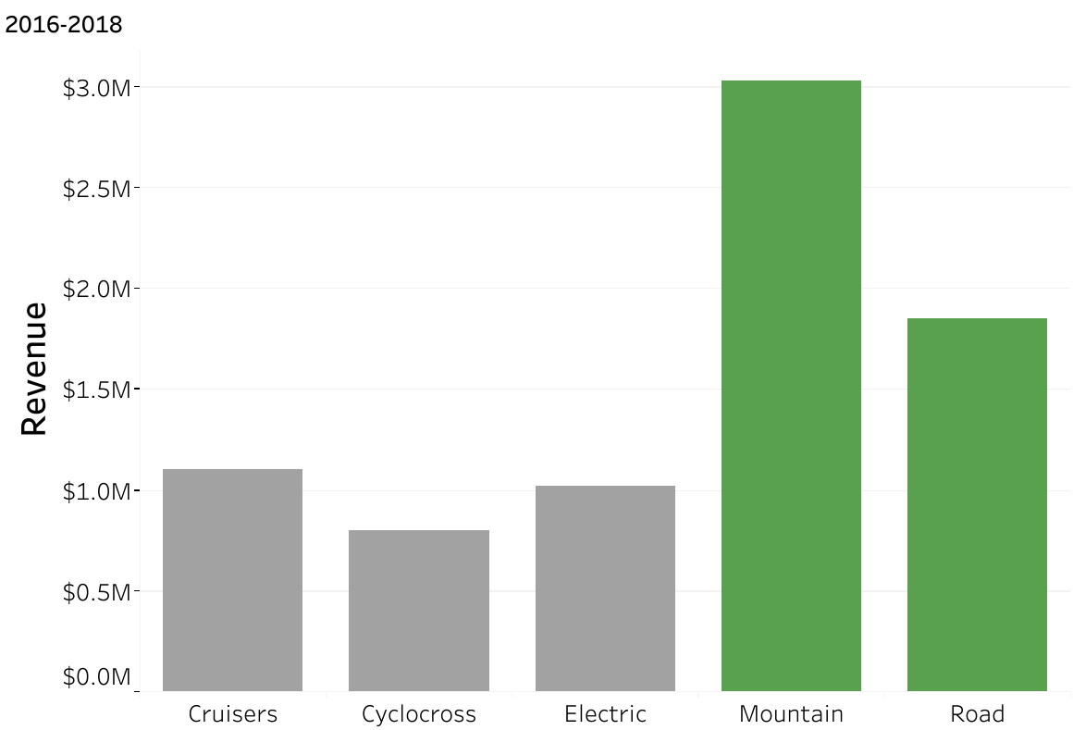
Key Drivers of Revenue

Slide 10
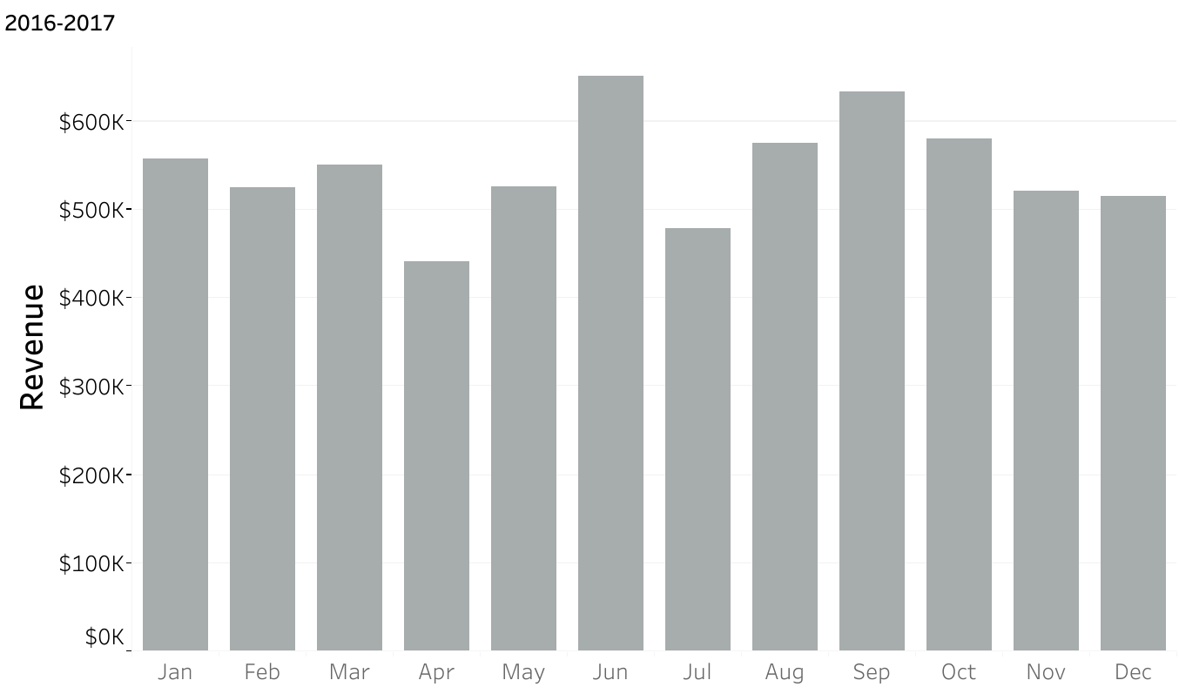
Seasonal Trends

Slide 11
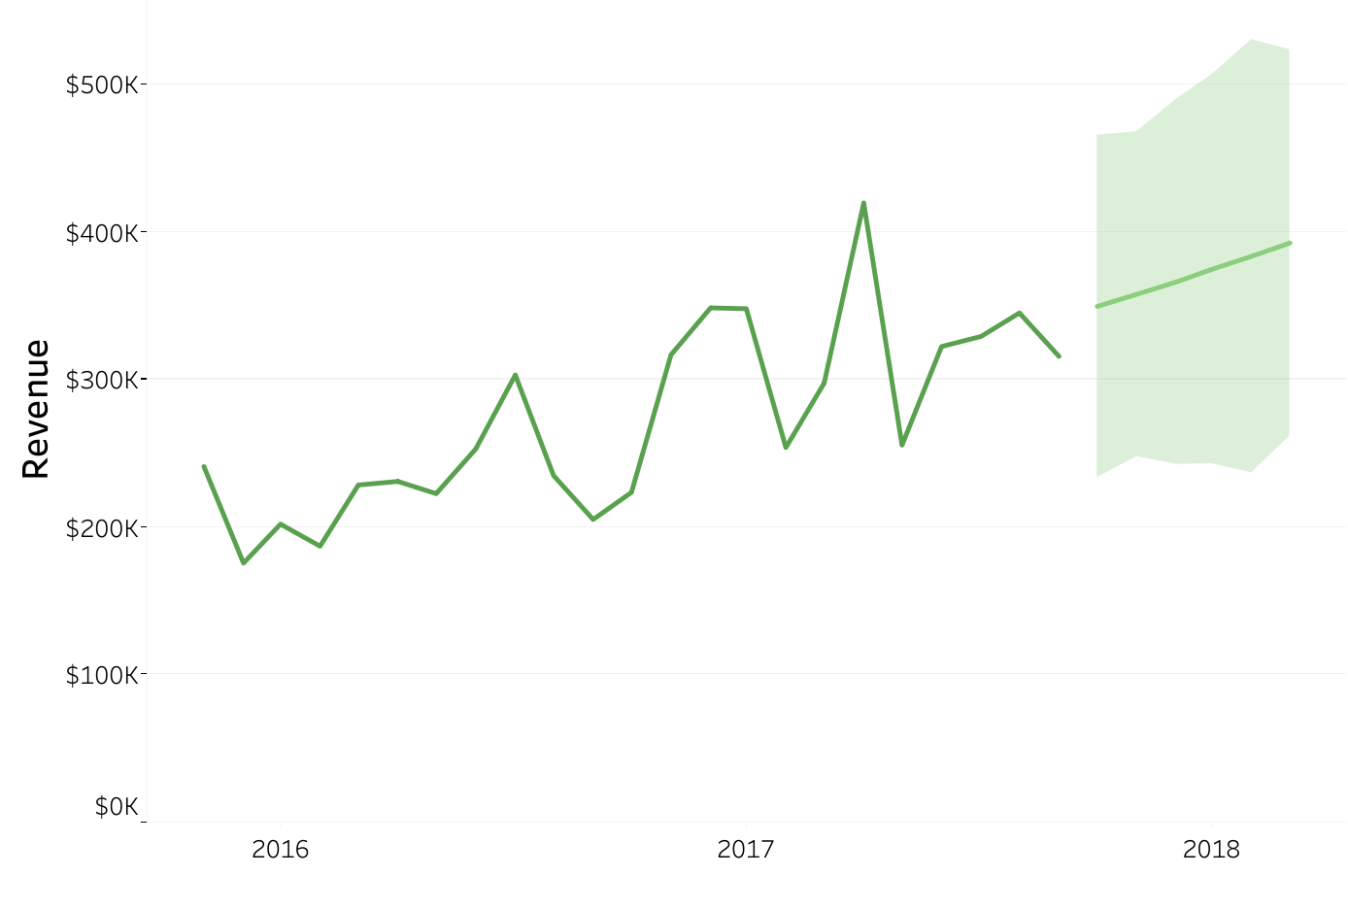
Revenue Forecast
Estimates
*Excluding 2018 data for the sake of having a meaningful forecast. Otherwise, a forecast would not be helpful considering our extreme drop in revenue the past 2 quarters.
Month | Year | Revenue
Dec | 2017 | $350k
Jan | 2018 | $358k
Feb | 2018 | $366k
Mar | 2018 | $375k
Apr | 2018 | $384k
May | 2018 | $393k

Slide 12
Next Steps
*Due to this being a fictional company with no data on these questions, I’m treating this as a consultation. If I had the data, I’m capable of answering many of these questions.
Finding the why and working towards solutions.
Did we change our marketing strategy from 2017 to 2018?
If running paid ads, we need to compare our campaign KPIs for 2017 and 2018. Did overall ad performance decline after changes to campaign(s) were made?
Compare our revenue by year based on in-store sales and online sales.
Are our customers and employees happy? Do they know something we don’t?
Evaluate customer reviews.
Implement surveys for employees.
Examine our fundamental business processes.
Each stores management needs to engage in a conversation about store operations, process, and strategy.
If process improvement fails to increase revenue, we can then look at other strategies with specific consideration to location.

Slide 13
Conclusion/Plan of Action
Revenue is down.
We need to improve our fundamental business processes in order to drive sales.
Action items:
Evaluating our marketing campaigns.
Customer and employee surveys.
Daily strategy meetings among managers. These can soon transition into weekly once everyone is on the same page.

Slide 14
Contact Information
Logan Phillips
loganphillips240@outlook.com
https://www.linkedin.com/in/loganlkp/

