Slide 1
Pivotal Trackie Preliminary Design Strategy
Logan Linn
Network Application Design

Slide 2
Categories of Classes
Activities
UI Implementation
API Implementation
Database Implementation
Helper Utilities

Slide 3
Activity Classes
StartActivity
Determines if user needs to log in by looking for token
Sets up database connections, loads data
LoginActivity
Attempt to get user’s token and store it
OverviewActivity
Landing screen once you have logged in
View & select projects
View activity feed for all projects
ProjectActivity
Most user interaction will occur here
View iterations, stories and their statuses
Move/rearrange stories within project
View project activity feed
StoryActivity
Interact with story tasks, comments, other details
View, add, edit
PreferencesActivity
View, edit app settings

Slide 4
API Implementation Goals
Create a well-designed interface that could be dropped into any another application
Work with the RESTful interface over HTTP using asynchronous tasks
Interpret a request’s XML response, map into object where necessary
Proper and effective use of factories
Proper and effective use of callbacks

Slide 5
API Implementation Classes
PivotalTracker
“Front end” class to authenticate users and execute API commands
PivotalTrackerResource
Project
Member
Story
Task
Attachment
Activity Feed
Token
RESTCommand & RESTCommandFactory
Commands describe a resource and associated REST operation (GET, PUT, POST, DELETE)
Help in mapping to a URL
Factory provides convenience to get any possible resource/operation combination
AsyncRESTTask
Execute RESTCommands (HTTP requests) in a separate thread and return results & progress asynchronously
PivotalTrackerDataType
Encapsulates the data types returned from the API

Slide 6
UI Implementation Goals
Multiple ListViews in single activity
Only 1 list displayed at a time
Stacked horizontally
Swiping horizontally switches to adjacent list
Lists show sets of stories that share 1 or more properties
Analogous to panels in the web application
Special attention to object/view reuse

Slide 7
UI Implementation Classes
StoryListAdapter
Map array of Story objects to a ListView row
StoryListView
Use StoryListAdapter for display
Implement onTouchEvent method to support horizontal swiping guestures
Pre

Slide 8
Database Implementation Classes
DatabaseAdapter
Agnostic interface to the database
Insert, update, delete functions
DatabaseAdapterListener
Asynchronous callback interface to database commands

Slide 9
Utility Classes
HttpUtility
Initiate HTTP requests
Setup the callback class
XmlUtility
Escaping XML output
Parse XML and map into objects

Slide 10
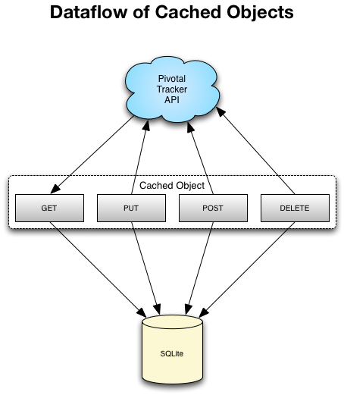
Caching and API-Database Interactions
Data acquired from the API (resources) will be cached locally to a SQLite database for performance

