Slide 1
ASL-CiC results
Logan Zhang
05/04/2023

Slide 2
Data Collection
10 subjects (3F7M, age 21-39, mean 26.5±5.1y)
2 sessions a week apart @SPMIC
1st session (45mins)
2nd session (30mins)
2D Product: LD=1.8s, PLD=1.8s, 30 repeats
3D Product: LD=1.8s, PLD=2s, 8 repeats
MPRAGE | 2D REST | 3D REST | 2D TASK | 3D TASK | TOF
2D REST | 3D REST | 2D TASK | 3D TASK

Slide 3
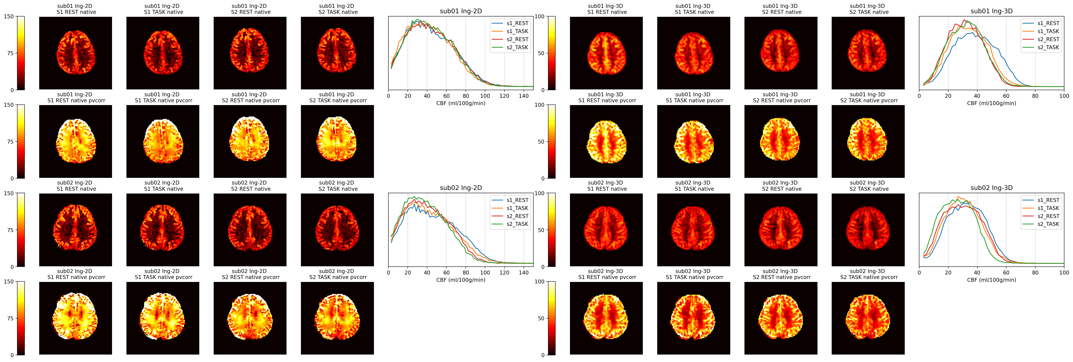
CBF estimation - 1

Slide 4
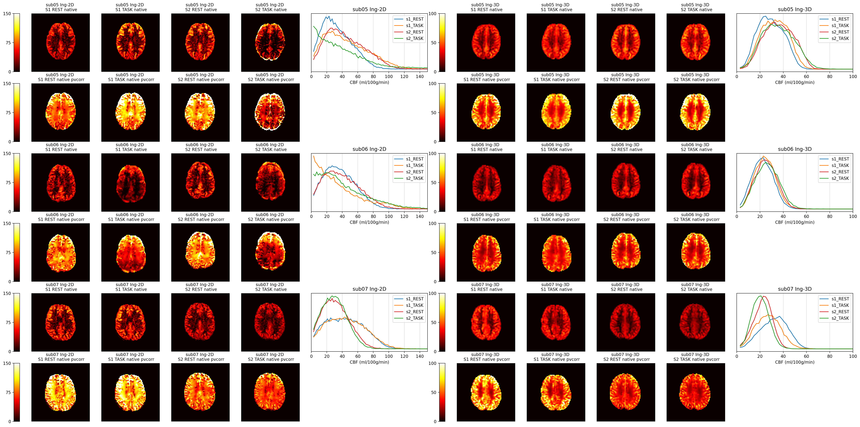
CBF estimation - 2

Slide 5
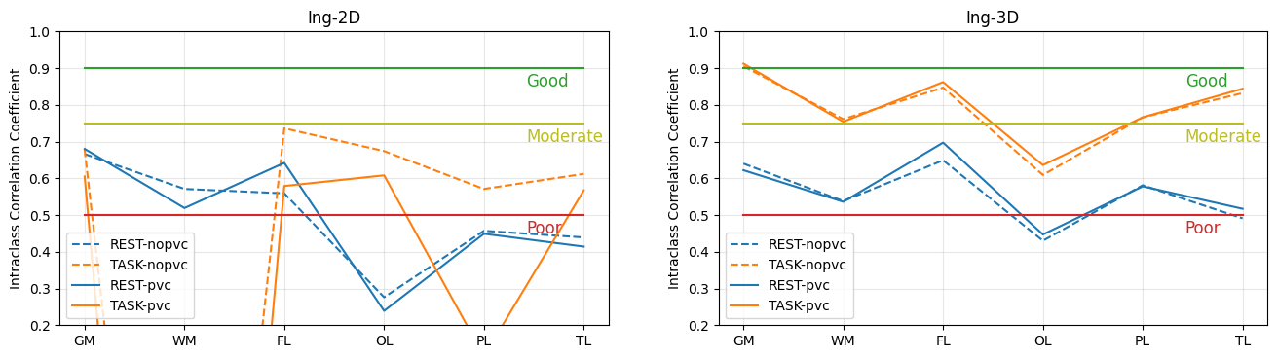
Repeatability - 1

Slide 6
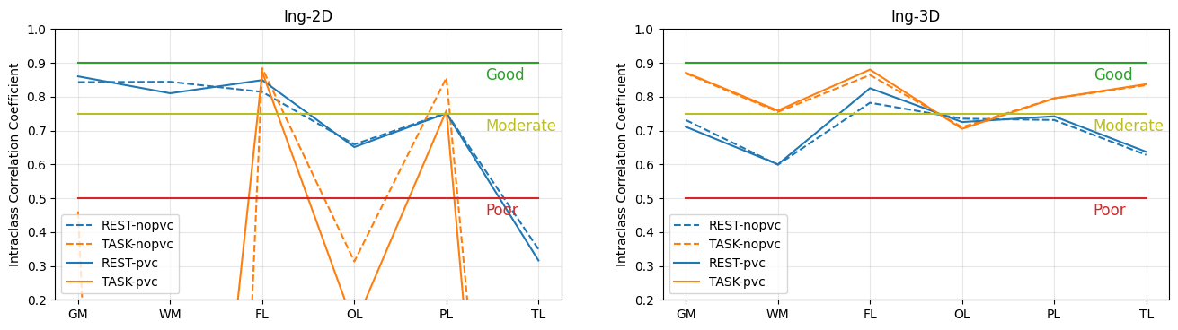
Repeatability - 2
Exclude ‘problematic’ sub03, 05, 06, 07 for 2D; sub03, 07 for 3D

Slide 7
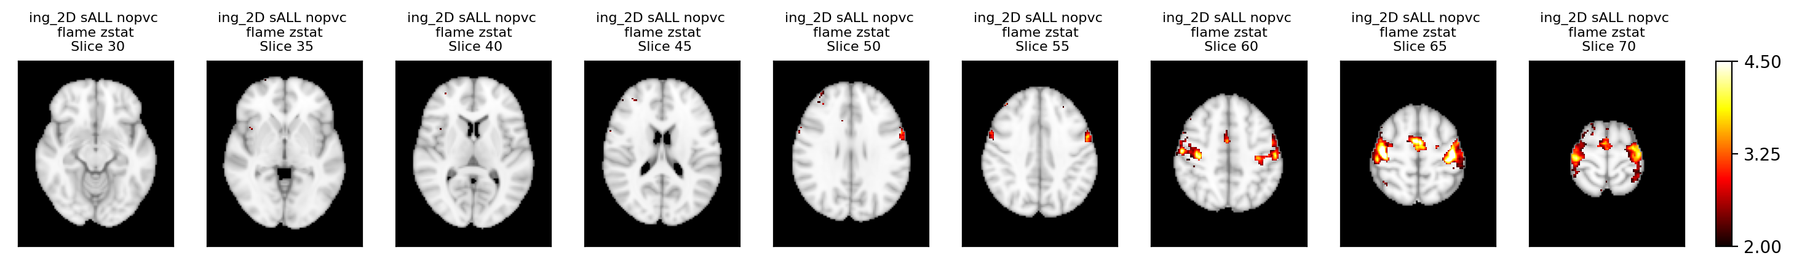
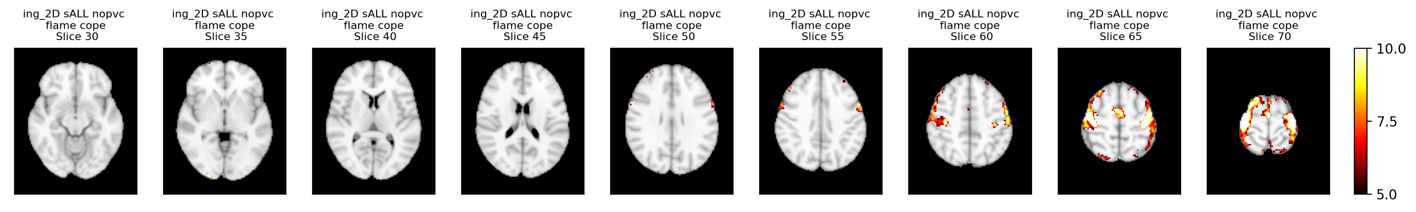

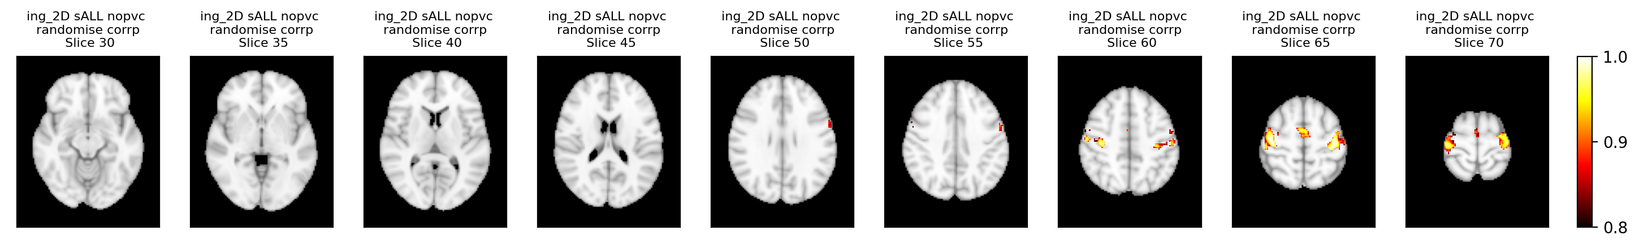
Detectability - 2D

Slide 8
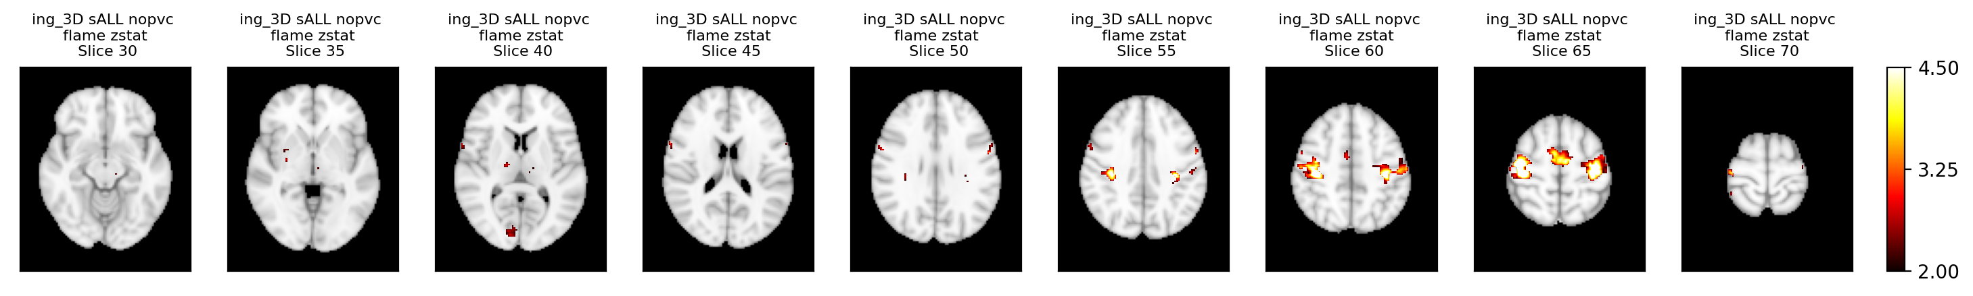
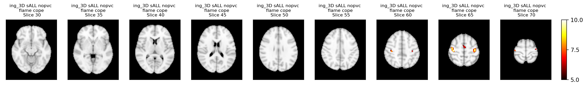
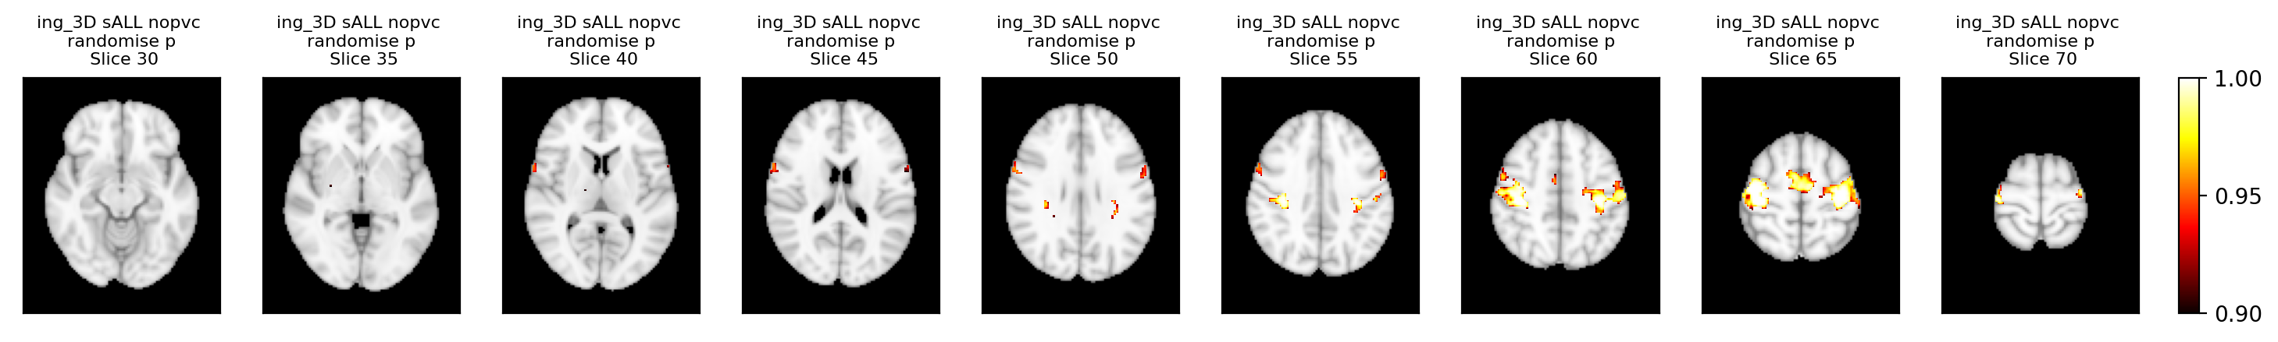
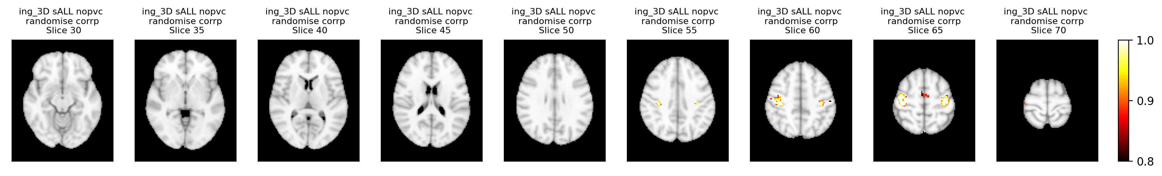
Detectability - 3D

Slide 9
Conclusion
Estimation:
Both 2D and 3D had good estimation, but in some cases 2D had more issues (motion, calibration, labelling...)
Repeatability:
2D had higher resting GM&WM ICC; 3D had higher task ICC
Using PVC slightly increase ICC in 3D
Detectability:
Both 2D and 3D showed higher CBF in bilateral motor cortices, but not in the visual cortex
3D had smaller effect sizes than 2D

