Slide 1
Pokemon Identification
Nathan Morrison
Logan Padon

Slide 2
Why this problem?
One-shot learning
Pokemon look unique
<6 unique colors per Pokemon
Designed to look different from each other
Unique shapes
Lots of TCG images, distorted in some way from the in-game sprites, often different art styles
Been attempted, but using complicated methods
Difficult problem (best known methods achieve 30%) so lower results could still be good progress
Limiting ourselves to the first 151, no shinies, no forms

Slide 3
Image Segmentation
Image segmentation is it’s own problem
Prebuilt models were interesting but often wrong
Possible Solutions: Accept segmenters as-is, crude segmentation

Slide 4
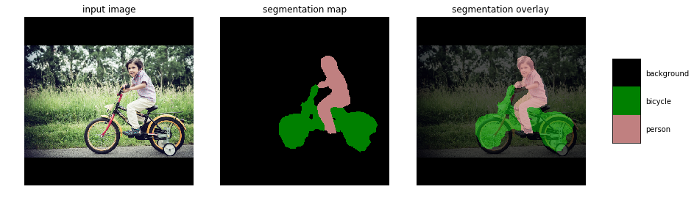
Image Segmentation in theory
Examples given by the prebuilt model we used

Slide 5
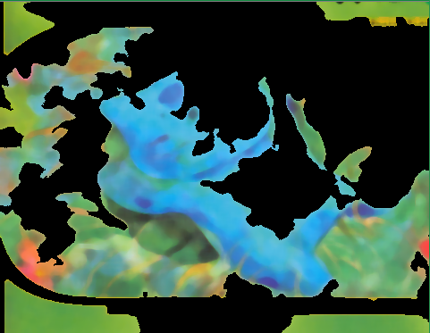
Image Segmentation in Practice

Slide 6
Color Aggregation
K-means clustering allows us to pick the find the 5 most common colors in a given image
We can compare the training image’s colors to the test image’s colors

Slide 7
Normalization Constant
Given an image:
For every possible color (chosenColor)
For every color in the image’s K-means cluster (imageColor)
Z += 1 / euclideanDistance(chosenColor, imageColor)

Slide 8
P(imageColors | classColors)
Given an image, and classColors
Take the closest color in classColor to imageColor
For each color in the test image’s k-cluster (imageColor)
P_temp[n] = 1/Z * 1/euclideanDistance(chosenColor, imageColor)
P = product(P_temp)

Slide 9
Current System
K-Colors
Pokemon
Image
…
Assumes independence for each color

Slide 10
System with Shape
Filtered Image
Classes
Image
Pokemon
K-Colors
Reshaping done by a Bayesian image segmentation

