Slide 1

LeBomb Defuse The Bomb Project
A Lebron James Inspired "Defuse The Bomb"
Programmed with Python on Raspberry Pi
Logan Pinel / Matthew Rivers / Blake Nico
Science of Computing 102 – Spring 2025

Slide 2
Overview
Outline
How it Operates
Our project consists of a trivia game in which correct answers defuse a bomb. You are given 5 minutes to do so otherwise you lose and the bomb in turn explodes.
The trivia is all inspired by statistics and accolades of Lebron James, the NBA forward who is widely regarded as the greatest player of all time.
The bomb is powered by a Raspberry Pi operating system, and consists of toggles, wires, buttons, and keypads. There is also a GUI powered by python code which helps to defuse the bomb.

Slide 3
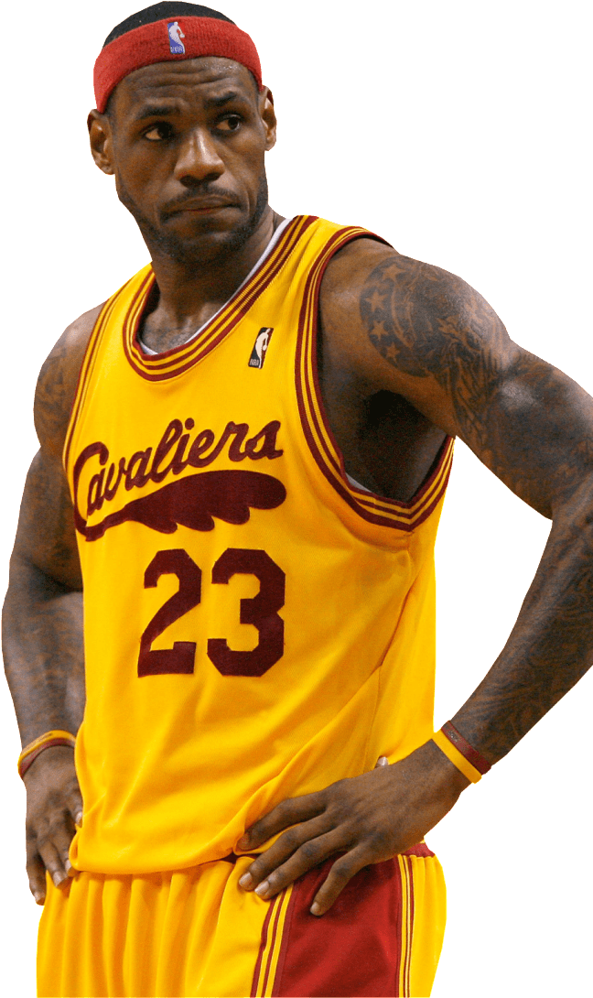
Phase 1: Cavaliers
The first phase consists of trivia questions regarding his career as a Cleveland Cavalier.
Questions range from career team statistics, accomplishments, and awards received by James.

Slide 4
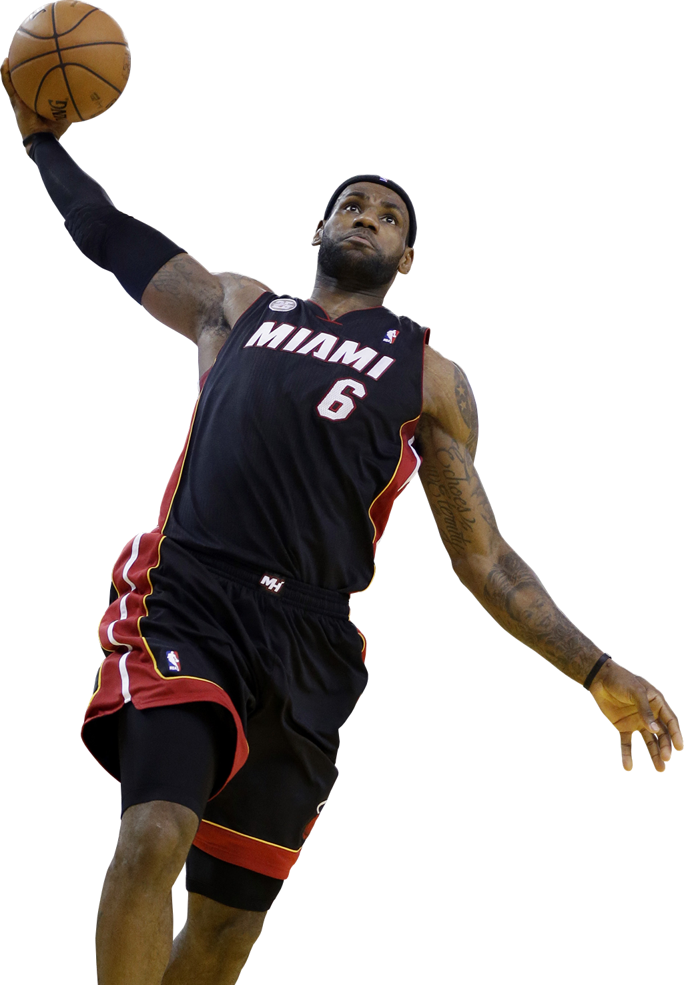
Phase 2: Heat
The second phase consists of trivia questions regarding his career with the Miami Heat.
Questions range from career team statistics, accomplishments, and awards received by James.

Slide 5
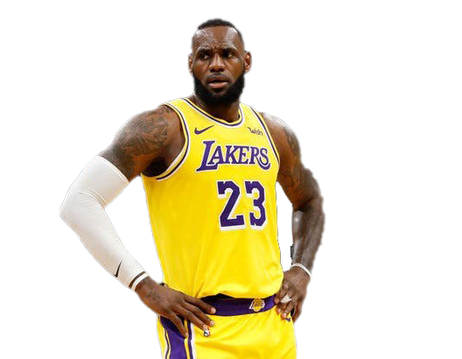
Phase 3: Lakers
The third phase consists of trivia questions regarding his career with the Los Angeles Lakers.
Questions range from career team statistics, accomplishments, and awards received by James.

Slide 6
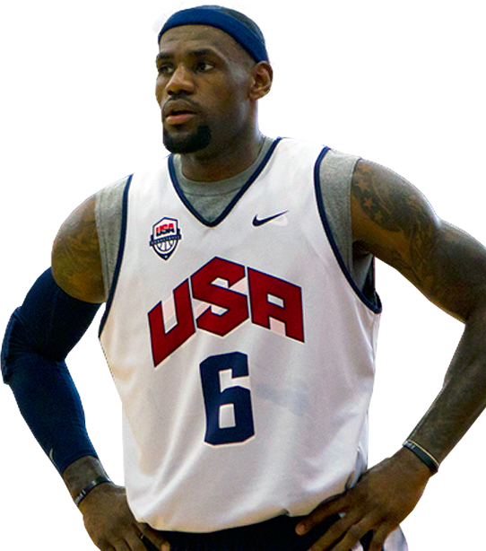
Final phase
The final phase prompts the user for the final passcode to defuse the bomb.
All the puzzles completed throughout other phases assist you in figuring out the required key.
Lebron also delivers a special hint to help you crack the code!

Slide 7

Future implementations
Looping sound throughout the game
Increased difficulty in trivia
More buttons for harder button puzzles
Image implementation

Slide 8
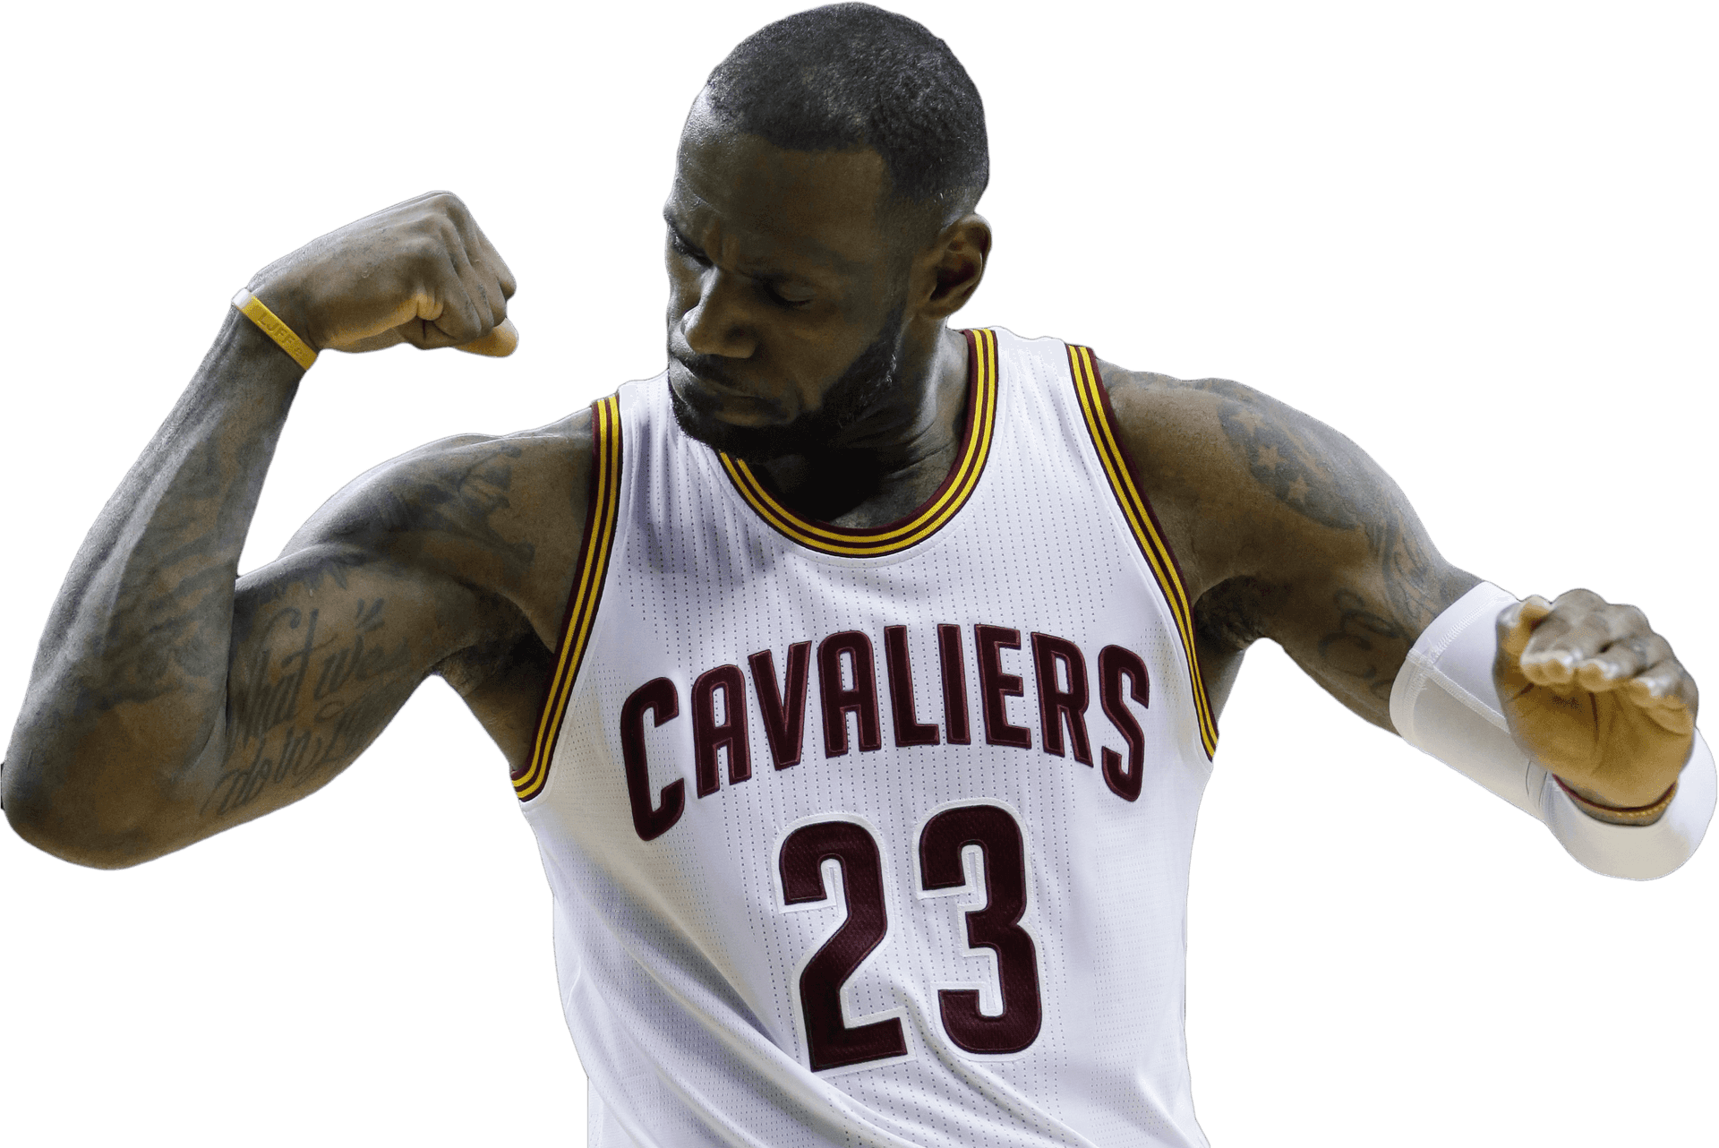
Thank you!

