Slide 1
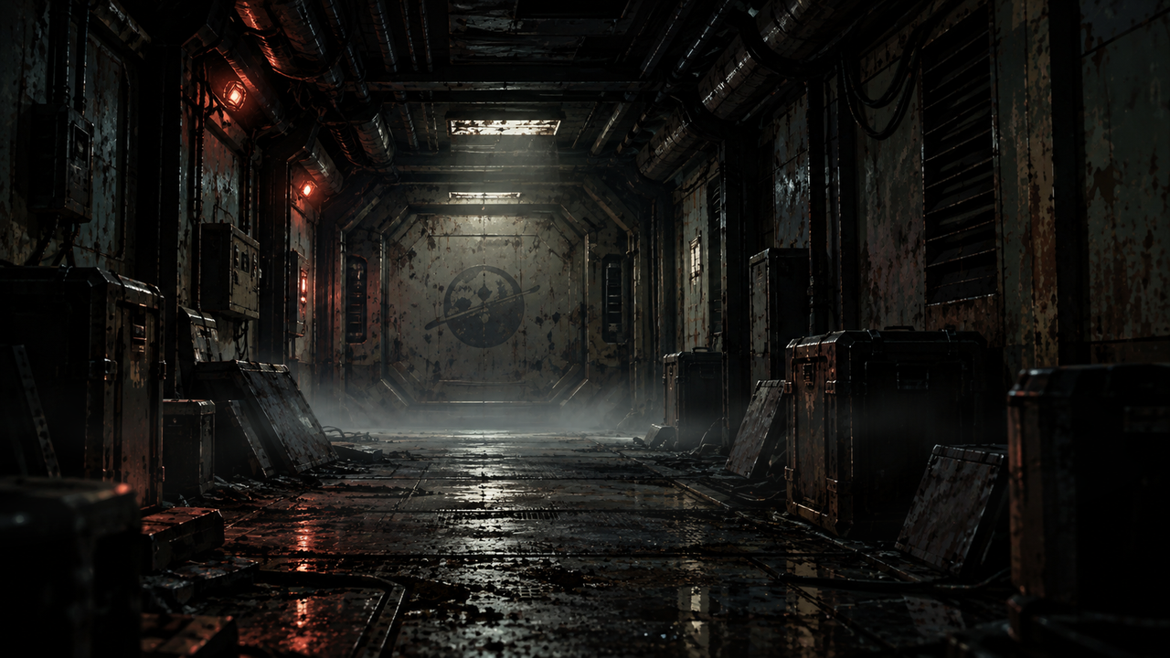
Notes:
DERELICT — STYLE BENCHMARK v4 — LIGHT FAILURE
16-second silent atmospheric loop. The camera and architecture remain fixed. More visible floor mist changes shape and position. Dust appears only in the ceiling light beam. Two interrupted-power sequences around 5–6 and 10–11 seconds visibly extinguish the ceiling fixture, with a brief recovery before the longer failure. The door spill, floor reflection, illuminated fog and dust dim with it. The red emergency lamps remain lit. Small changes in the existing emergency lamps remain localized. Three rats now cross the floor, as requested: two staggered crossings around 2–5 seconds and a nearer crossing around 10–12 seconds. The three rats are approximately 40% smaller and their fur is about half as bright as version 3; running poses, perspective scaling, small contact shadows and subdued wet-floor reflections are retained. This establishes animal presence in the derelict. No new clue is introduced.
In desktop PowerPoint: Slide Show > From Beginning. The embedded H.264 video is set to start on slide entry and loop. No timed slide advancement. Editing view shows a still poster. Use Right Arrow / a presentation remote to advance; clicking the video can pause it. Offline media is embedded.
Programmatic checks verify the file structure and media/start/loop settings. Desktop PowerPoint playback has not been tested here. The MP4 is supplied independently for direct viewing without PowerPoint.

