Slide 1
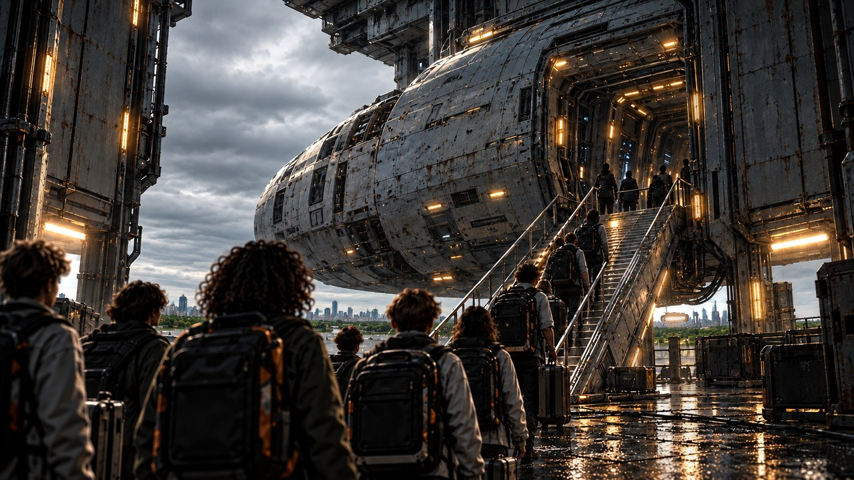
THE FAR HORIZON
01
Welcome to Pioneer
›
Notes:
SESSION 1. GM bible v12 is story authority. ENVIRONMENT: boarding.
Start when ready for this session. Doom is atmosphere, not a replacement for wonder or player choice.
VISUAL: Environment motion / native chapter typography
PLAYBACK: embedded silent H.264 background starts on slide entry and loops; advance with Right Arrow or remote. No slide timer. Static poster fallback retained. Faces and native evidence remain fixed for continuity. Desktop PowerPoint playback not tested in this environment.
OBJECT MOTION V2: {"stars": 0, "practical_light_cores": 28, "cloud_layers": 1, "foliage_layers": 0, "rain_scope": "light background drizzle in exterior terminal sky", "source_effects": "none"}

Slide 2
EARTH → ASTERIA-4
One world behind you.
A second home ahead.
›
Notes:
SESSION 1. GM bible v12 is story authority. ENVIRONMENT: boarding.
Earth is healthy. Record every fictional character’s personal Earth object for the Session 10 callback.
VISUAL: Native editable clue over boarding motion
PLAYBACK: embedded silent H.264 background starts on slide entry and loops; advance with Right Arrow or remote. No slide timer. Static poster fallback retained. Faces and native evidence remain fixed for continuity. Desktop PowerPoint playback not tested in this environment.
OBJECT MOTION V2: {"stars": 0, "practical_light_cores": 28, "cloud_layers": 1, "foliage_layers": 0, "rain_scope": "light background drizzle in exterior terminal sky", "source_effects": "none"}

Slide 3
›
Notes:
SESSION 1. GM bible v12 is story authority. ENVIRONMENT: boarding.
Play the boarding company scene; each group physically crosses the line. The woman by the boarding ramp is consistent with Mara Venn’s standalone portrait.
VISUAL: Scene restored from source 3 / boarding environment; native prop where needed
PLAYBACK: embedded silent H.264 background starts on slide entry and loops; advance with Right Arrow or remote. No slide timer. Static poster fallback retained. Faces and native evidence remain fixed for continuity. Desktop PowerPoint playback not tested in this environment.
OBJECT MOTION V2: {"stars": 0, "practical_light_cores": 28, "cloud_layers": 1, "foliage_layers": 0, "rain_scope": "light background drizzle in exterior terminal sky", "source_effects": "none"}

Slide 4
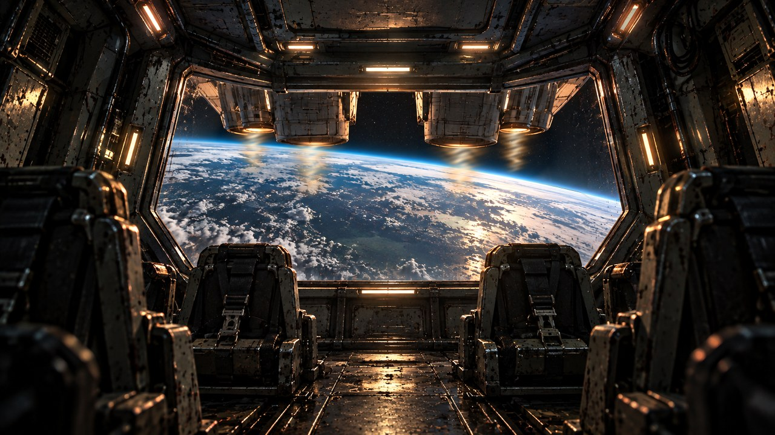
›
Notes:
SESSION 1. GM bible v12 is story authority. ENVIRONMENT: launch.
READ Session 1 Scene 2 Launch. Use the Earth-through-bridge artwork as a launch hold. A dedicated launch scene has been prepared for this edition. Do not begin crew introduction or tour until launch is complete. Launch now has dedicated artwork; preserve boarding → launch → introductions/tour.
VISUAL: Scene restored from source 4 / launch environment; native prop where needed
PLAYBACK: embedded silent H.264 background starts on slide entry and loops; advance with Right Arrow or remote. No slide timer. Static poster fallback retained. Faces and native evidence remain fixed for continuity. Desktop PowerPoint playback not tested in this environment.
OBJECT MOTION V2: {"stars": 3, "practical_light_cores": 28, "cloud_layers": 2, "foliage_layers": 0, "rain_scope": "none", "source_effects": "continuously replenished tapered nozzle exhaust with downward-flowing tongues and reflected thrust glow"}

Slide 5

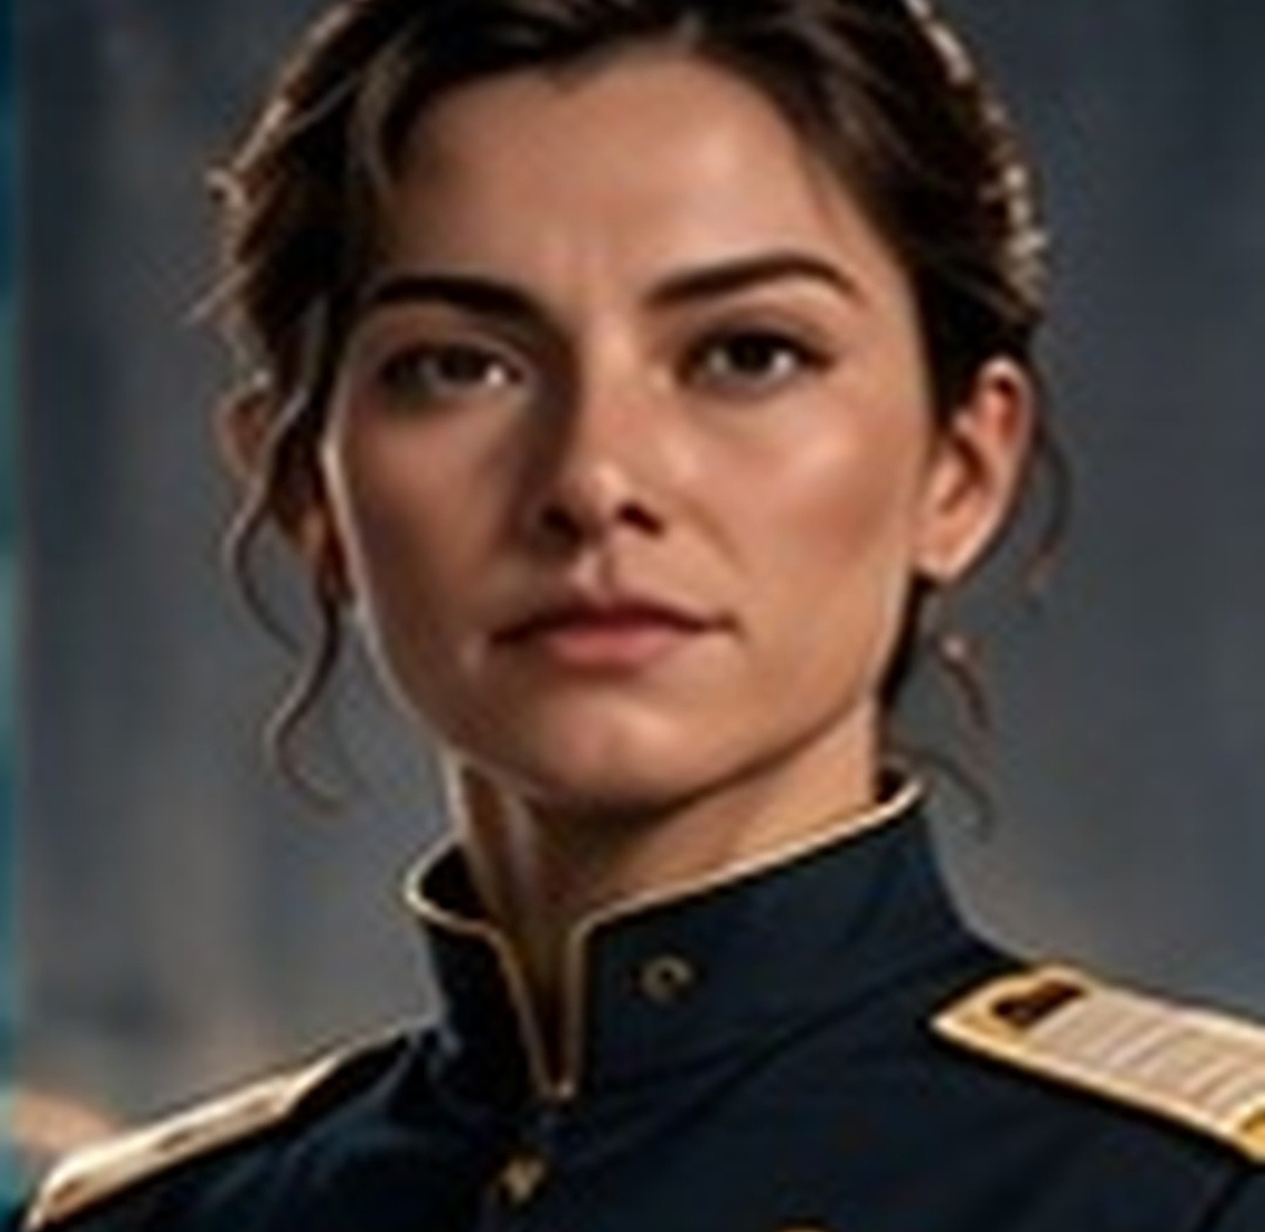


WELCOME ABOARD
Mara Venn
Juno Reyes
Tomas Rhee
›
Notes:
SESSION 1. GM bible v12 is story authority. ENVIRONMENT: bridge.
Crew introduction begins AFTER launch. Venn, Juno and Rhee greet Cohort 01.
VISUAL: Original canonical portraits 37,42,41 over bridge motion
PLAYBACK: embedded silent H.264 background starts on slide entry and loops; advance with Right Arrow or remote. No slide timer. Static poster fallback retained. Faces and native evidence remain fixed for continuity. Desktop PowerPoint playback not tested in this environment.
OBJECT MOTION V2: {"stars": 51, "practical_light_cores": 28, "cloud_layers": 2, "foliage_layers": 0, "rain_scope": "none", "source_effects": "none"}

Slide 6
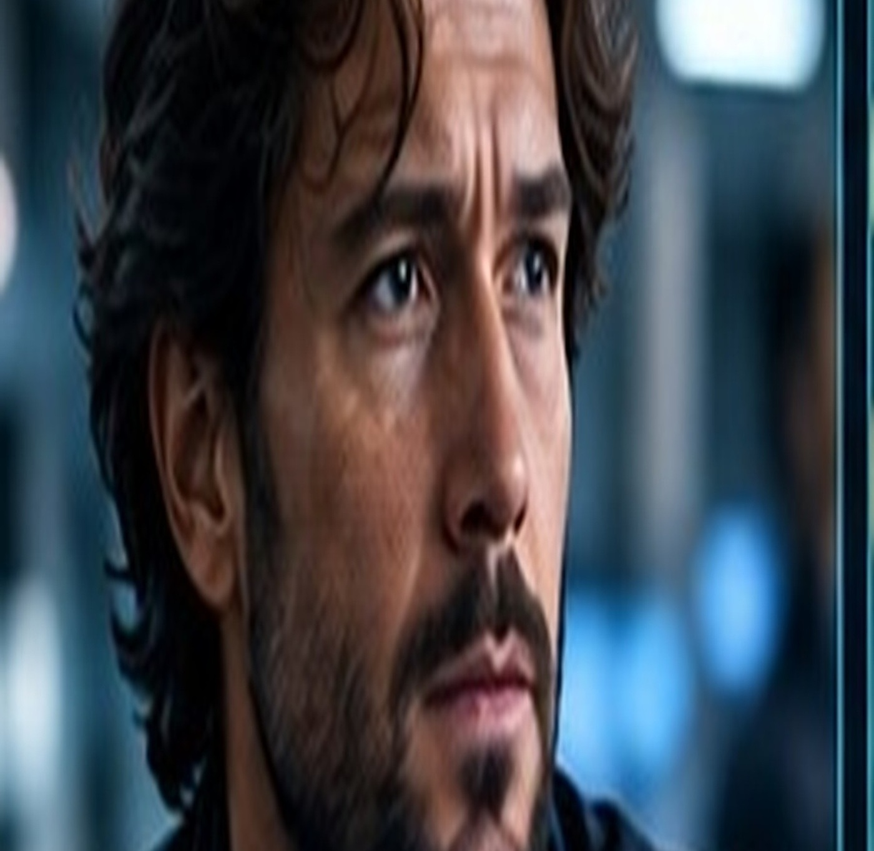
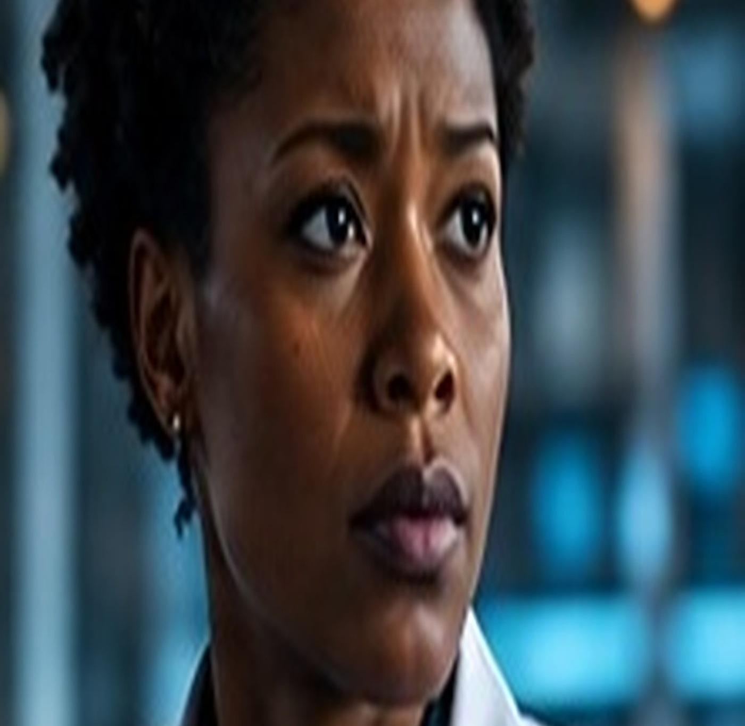
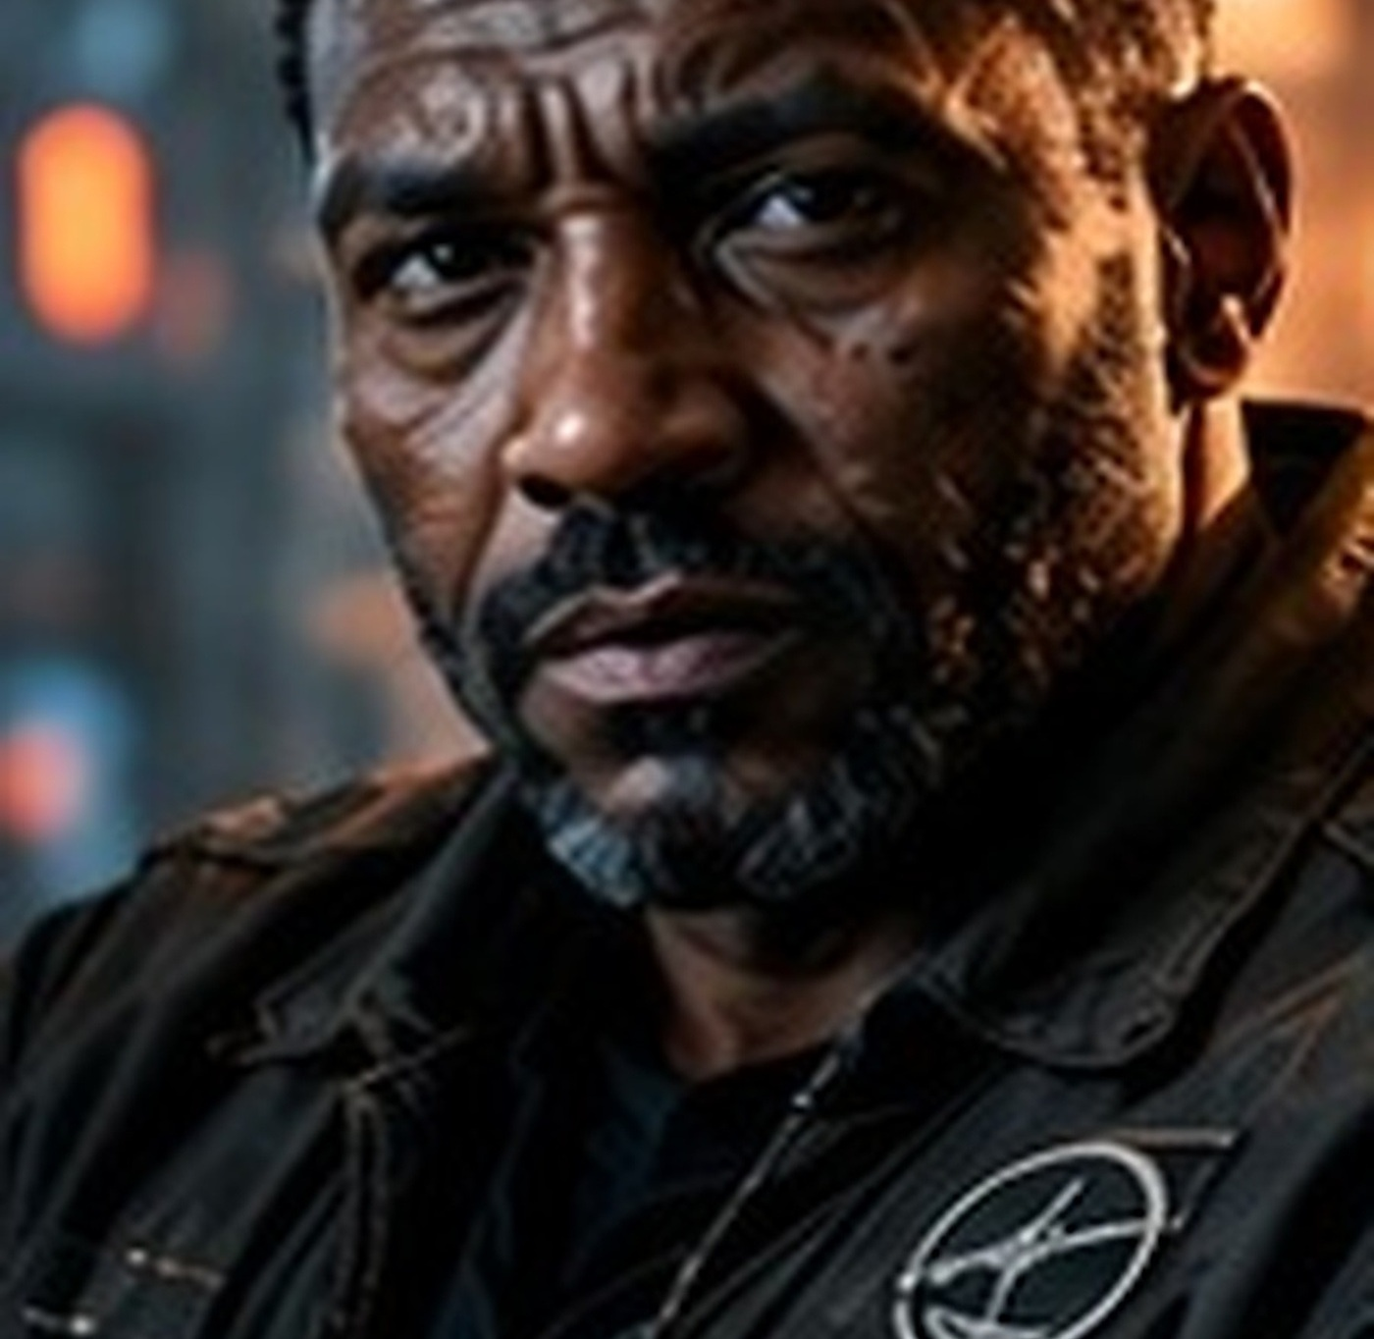
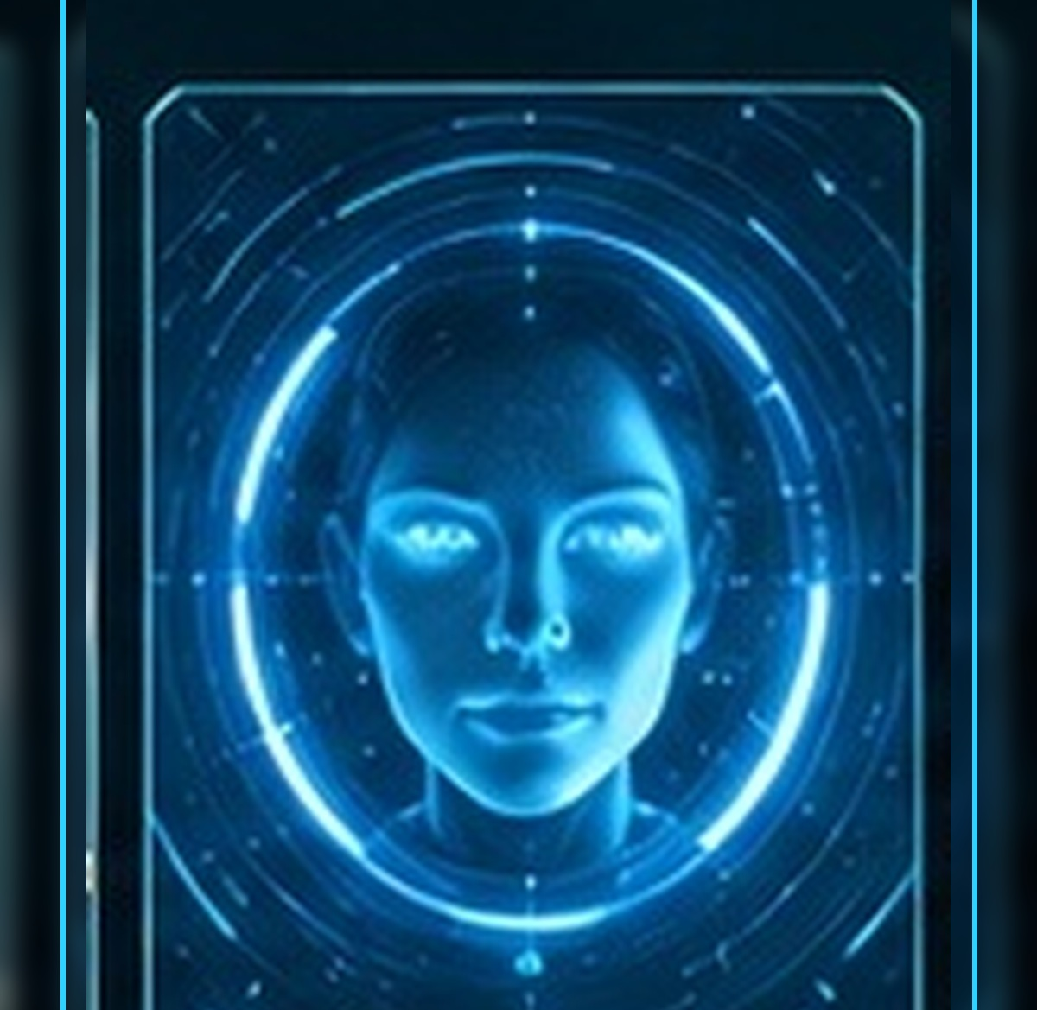
MEET YOUR CREW
Elias Vale
Nia Okafor
Marcus Bell
IRIS
›
Notes:
SESSION 1. GM bible v12 is story authority. ENVIRONMENT: bridge.
Introduce Vale, Okafor, Bell and IRIS. The standalone portraits are the continuity reference throughout this deck.
VISUAL: Original canonical portraits 39,40,43,44 over bridge motion
PLAYBACK: embedded silent H.264 background starts on slide entry and loops; advance with Right Arrow or remote. No slide timer. Static poster fallback retained. Faces and native evidence remain fixed for continuity. Desktop PowerPoint playback not tested in this environment.
OBJECT MOTION V2: {"stars": 51, "practical_light_cores": 28, "cloud_layers": 2, "foliage_layers": 0, "rain_scope": "none", "source_effects": "none"}

Slide 7
PIONEER · TOUR STOPS
COMMAND
SCIENCE / MEDICAL
HABITATION
ENGINEERING
COLONY SUPPORT
OBSERVATION / COMMON AREAS
›
Notes:
SESSION 1. GM bible v12 is story authority. ENVIRONMENT: bridge.
Readable orientation schematic, not a canonical scale floor plan. Move required clues to the route students choose. No GM reveal map projected.
VISUAL: Native schematic
PLAYBACK: embedded silent H.264 background starts on slide entry and loops; advance with Right Arrow or remote. No slide timer. Static poster fallback retained. Faces and native evidence remain fixed for continuity. Desktop PowerPoint playback not tested in this environment.
OBJECT MOTION V2: {"stars": 51, "practical_light_cores": 28, "cloud_layers": 2, "foliage_layers": 0, "rain_scope": "none", "source_effects": "none"}

Slide 8
›
Notes:
SESSION 1. GM bible v12 is story authority. ENVIRONMENT: bridge.
VISUAL: Scene restored from source 4 / bridge environment; native prop where needed
PLAYBACK: embedded silent H.264 background starts on slide entry and loops; advance with Right Arrow or remote. No slide timer. Static poster fallback retained. Faces and native evidence remain fixed for continuity. Desktop PowerPoint playback not tested in this environment.
OBJECT MOTION V2: {"stars": 51, "practical_light_cores": 28, "cloud_layers": 2, "foliage_layers": 0, "rain_scope": "none", "source_effects": "none"}

Slide 9
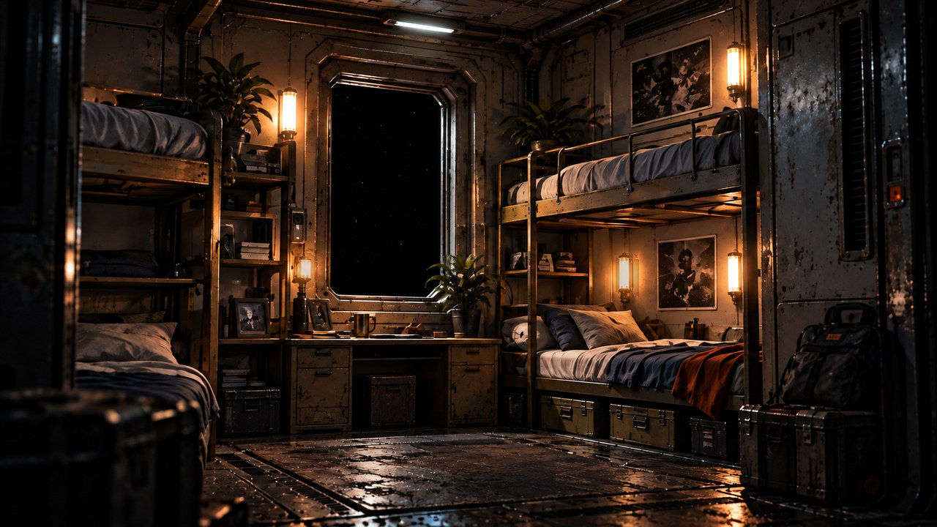
›
Notes:
SESSION 1. GM bible v12 is story authority. ENVIRONMENT: habitation.
VISUAL: Scene restored from source 5 / habitation environment; native prop where needed
PLAYBACK: embedded silent H.264 background starts on slide entry and loops; advance with Right Arrow or remote. No slide timer. Static poster fallback retained. Faces and native evidence remain fixed for continuity. Desktop PowerPoint playback not tested in this environment.
OBJECT MOTION V2: {"stars": 3, "practical_light_cores": 18, "cloud_layers": 0, "foliage_layers": 3, "rain_scope": "none", "source_effects": "none"}

Slide 10
OBSERVATION GLASS
The stars brighten.
›
Notes:
SESSION 1. GM bible v12 is story authority. ENVIRONMENT: bridge.
Read First Anomaly Seed. Do not show the full K-17 Fracture Entity here. Keep the almost-human shape ambiguous; IRIS cannot classify it.
VISUAL: Native editable clue over bridge motion
PLAYBACK: embedded silent H.264 background starts on slide entry and loops; advance with Right Arrow or remote. No slide timer. Static poster fallback retained. Faces and native evidence remain fixed for continuity. Desktop PowerPoint playback not tested in this environment.
OBJECT MOTION V2: {"stars": 51, "practical_light_cores": 28, "cloud_layers": 2, "foliage_layers": 0, "rain_scope": "none", "source_effects": "none"}

Slide 11
IRIS
Ship AI
›
Notes:
SESSION 1. GM bible v12 is story authority. ENVIRONMENT: bridge.
VISUAL: Original canonical portrait 44; contextual bridge motion
PLAYBACK: embedded silent H.264 background starts on slide entry and loops; advance with Right Arrow or remote. No slide timer. Static poster fallback retained. Faces and native evidence remain fixed for continuity. Desktop PowerPoint playback not tested in this environment.
OBJECT MOTION V2: {"stars": 51, "practical_light_cores": 28, "cloud_layers": 2, "foliage_layers": 0, "rain_scope": "none", "source_effects": "none"}

Slide 12
ROUTE LOG
“Route correction accepted.”
“No correction was entered.”
›
Notes:
SESSION 1. GM bible v12 is story authority. ENVIRONMENT: bridge.
Session 1 cliffhanger. Venn asks who entered the correction.
VISUAL: Native editable clue over bridge motion
PLAYBACK: embedded silent H.264 background starts on slide entry and loops; advance with Right Arrow or remote. No slide timer. Static poster fallback retained. Faces and native evidence remain fixed for continuity. Desktop PowerPoint playback not tested in this environment.
OBJECT MOTION V2: {"stars": 51, "practical_light_cores": 28, "cloud_layers": 2, "foliage_layers": 0, "rain_scope": "none", "source_effects": "none"}

Slide 13
THE FAR HORIZON
02
The Pioneer
›
Notes:
SESSION 2. GM bible v12 is story authority. ENVIRONMENT: habitation.
Start when ready for this session. Doom is atmosphere, not a replacement for wonder or player choice.
VISUAL: Environment motion / native chapter typography
PLAYBACK: embedded silent H.264 background starts on slide entry and loops; advance with Right Arrow or remote. No slide timer. Static poster fallback retained. Faces and native evidence remain fixed for continuity. Desktop PowerPoint playback not tested in this environment.
OBJECT MOTION V2: {"stars": 3, "practical_light_cores": 18, "cloud_layers": 0, "foliage_layers": 3, "rain_scope": "none", "source_effects": "none"}

Slide 14
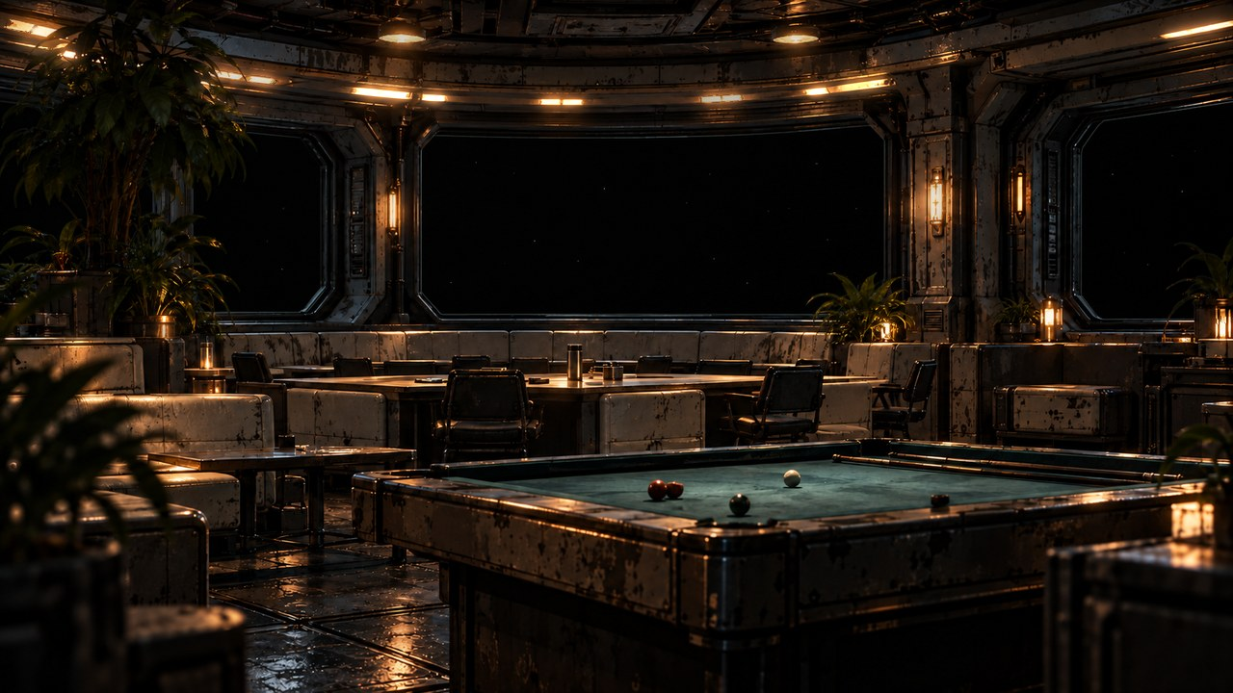
›
Notes:
SESSION 2. GM bible v12 is story authority. ENVIRONMENT: recreation.
Recreation dispute is a brief opening, not an alternative to the required maintenance encounter. Background crew are unnamed; do not identify these faces as canonical NPCs.
VISUAL: Scene restored from source 7 / recreation environment; native prop where needed
PLAYBACK: embedded silent H.264 background starts on slide entry and loops; advance with Right Arrow or remote. No slide timer. Static poster fallback retained. Faces and native evidence remain fixed for continuity. Desktop PowerPoint playback not tested in this environment.
OBJECT MOTION V2: {"stars": 32, "practical_light_cores": 28, "cloud_layers": 0, "foliage_layers": 4, "rain_scope": "none", "source_effects": "none"}

Slide 15
TOMAS RHEE
Chief engineer
›
Notes:
SESSION 2. GM bible v12 is story authority. ENVIRONMENT: recreation.
VISUAL: Original canonical portrait 41; contextual recreation motion
PLAYBACK: embedded silent H.264 background starts on slide entry and loops; advance with Right Arrow or remote. No slide timer. Static poster fallback retained. Faces and native evidence remain fixed for continuity. Desktop PowerPoint playback not tested in this environment.
OBJECT MOTION V2: {"stars": 32, "practical_light_cores": 28, "cloud_layers": 0, "foliage_layers": 4, "rain_scope": "none", "source_effects": "none"}

Slide 16
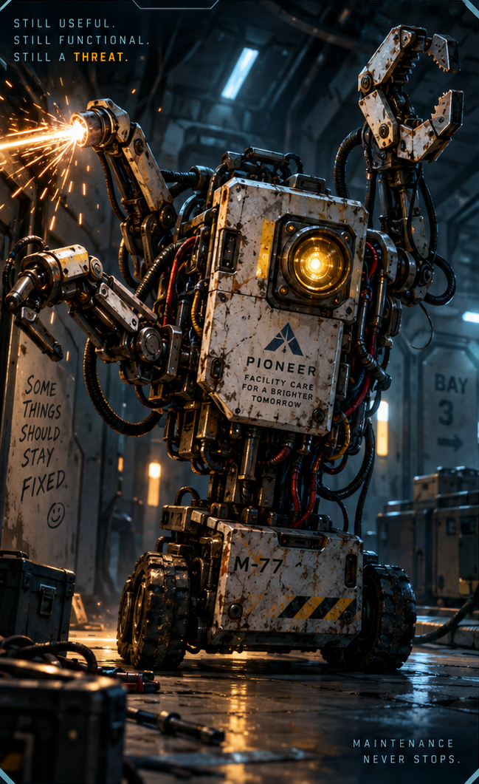
RUNAWAY MAINTENANCE UNITS
STOP THE UNITS
PROTECT THE SHIP
›
Notes:
SESSION 2. GM bible v12 is story authority. ENVIRONMENT: habitation.
Bible overrides dossier stats: one large unit 2 Threat Boxes plus two minor drones 1 each. Exactly 3 rounds. Stop them sealing three spaces / dismantling essential equipment. M-77 is canonical.
VISUAL: Supplied enemy dossier 1, non-destructive artwork crop; habitation motion
PLAYBACK: embedded silent H.264 background starts on slide entry and loops; advance with Right Arrow or remote. No slide timer. Static poster fallback retained. Faces and native evidence remain fixed for continuity. Desktop PowerPoint playback not tested in this environment.
OBJECT MOTION V2: {"stars": 3, "practical_light_cores": 18, "cloud_layers": 0, "foliage_layers": 3, "rain_scope": "none", "source_effects": "none"}

Slide 17
TOMAS RHEE
Chief engineer
›
Notes:
SESSION 2. GM bible v12 is story authority. ENVIRONMENT: habitation.
Rhee opens the service history.
VISUAL: Original canonical portrait 41; contextual habitation motion
PLAYBACK: embedded silent H.264 background starts on slide entry and loops; advance with Right Arrow or remote. No slide timer. Static poster fallback retained. Faces and native evidence remain fixed for continuity. Desktop PowerPoint playback not tested in this environment.
OBJECT MOTION V2: {"stars": 3, "practical_light_cores": 18, "cloud_layers": 0, "foliage_layers": 3, "rain_scope": "none", "source_effects": "none"}

Slide 18
MAINTENANCE RECORD
UNIT M-77 / HAB DECK
STATUS: REPAIRED
COMPLETED: TOMORROW 14:32
TECHNICIAN COHORT 01
“Collision with unrecorded passenger resolved.”
›
Notes:
SESSION 2. GM bible v12 is story authority. ENVIRONMENT: habitation.
Reveal after maintenance encounter; repeat at final explanation. Rat presence is ambient, not an explanation of the unrecorded passenger.
VISUAL: Native editable clue over habitation motion
PLAYBACK: embedded silent H.264 background starts on slide entry and loops; advance with Right Arrow or remote. No slide timer. Static poster fallback retained. Faces and native evidence remain fixed for continuity. Desktop PowerPoint playback not tested in this environment.
OBJECT MOTION V2: {"stars": 3, "practical_light_cores": 18, "cloud_layers": 0, "foliage_layers": 3, "rain_scope": "none", "source_effects": "none"}

Slide 19
IRIS
Ship AI
›
Notes:
SESSION 2. GM bible v12 is story authority. ENVIRONMENT: habitation.
Hold the mystery. Do not explain K-17 yet.
VISUAL: Original canonical portrait 44; contextual habitation motion
PLAYBACK: embedded silent H.264 background starts on slide entry and loops; advance with Right Arrow or remote. No slide timer. Static poster fallback retained. Faces and native evidence remain fixed for continuity. Desktop PowerPoint playback not tested in this environment.
OBJECT MOTION V2: {"stars": 3, "practical_light_cores": 18, "cloud_layers": 0, "foliage_layers": 3, "rain_scope": "none", "source_effects": "none"}

Slide 20
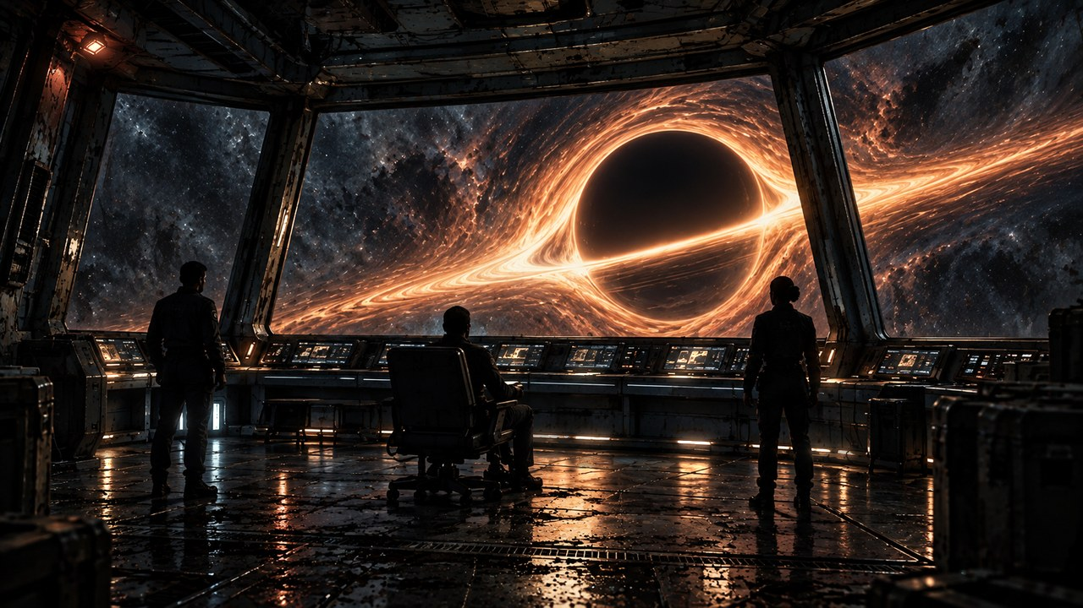
THE FAR HORIZON
03
The first anomaly
›
Notes:
SESSION 3. GM bible v12 is story authority. ENVIRONMENT: observation.
Start when ready for this session. Doom is atmosphere, not a replacement for wonder or player choice.
VISUAL: Environment motion / native chapter typography
PLAYBACK: embedded silent H.264 background starts on slide entry and loops; advance with Right Arrow or remote. No slide timer. Static poster fallback retained. Faces and native evidence remain fixed for continuity. Desktop PowerPoint playback not tested in this environment.
OBJECT MOTION V2: {"stars": 120, "practical_light_cores": 28, "cloud_layers": 0, "foliage_layers": 0, "rain_scope": "none", "source_effects": "none"}

Slide 21
›
Notes:
SESSION 3. GM bible v12 is story authority. ENVIRONMENT: observation.
VISUAL: Scene restored from source 11 / observation environment; native prop where needed
PLAYBACK: embedded silent H.264 background starts on slide entry and loops; advance with Right Arrow or remote. No slide timer. Static poster fallback retained. Faces and native evidence remain fixed for continuity. Desktop PowerPoint playback not tested in this environment.
OBJECT MOTION V2: {"stars": 120, "practical_light_cores": 28, "cloud_layers": 0, "foliage_layers": 0, "rain_scope": "none", "source_effects": "none"}

Slide 22
DR. ELIAS VALE
Astrophysicist · K-17 specialist
›
Notes:
SESSION 3. GM bible v12 is story authority. ENVIRONMENT: observation.
VISUAL: Original canonical portrait 39; contextual observation motion
PLAYBACK: embedded silent H.264 background starts on slide entry and loops; advance with Right Arrow or remote. No slide timer. Static poster fallback retained. Faces and native evidence remain fixed for continuity. Desktop PowerPoint playback not tested in this environment.
OBJECT MOTION V2: {"stars": 120, "practical_light_cores": 28, "cloud_layers": 0, "foliage_layers": 0, "rain_scope": "none", "source_effects": "none"}

Slide 23
ANOMALY READINGS
MASS / LENSING
THE READINGS DO NOT AGREE.
›
Notes:
SESSION 3. GM bible v12 is story authority. ENVIRONMENT: observation.
Science: normal physics cannot reconcile the two observations. Preserve uncertainty.
VISUAL: Native editable clue over observation motion
PLAYBACK: embedded silent H.264 background starts on slide entry and loops; advance with Right Arrow or remote. No slide timer. Static poster fallback retained. Faces and native evidence remain fixed for continuity. Desktop PowerPoint playback not tested in this environment.
OBJECT MOTION V2: {"stars": 120, "practical_light_cores": 28, "cloud_layers": 0, "foliage_layers": 0, "rain_scope": "none", "source_effects": "none"}

Slide 24
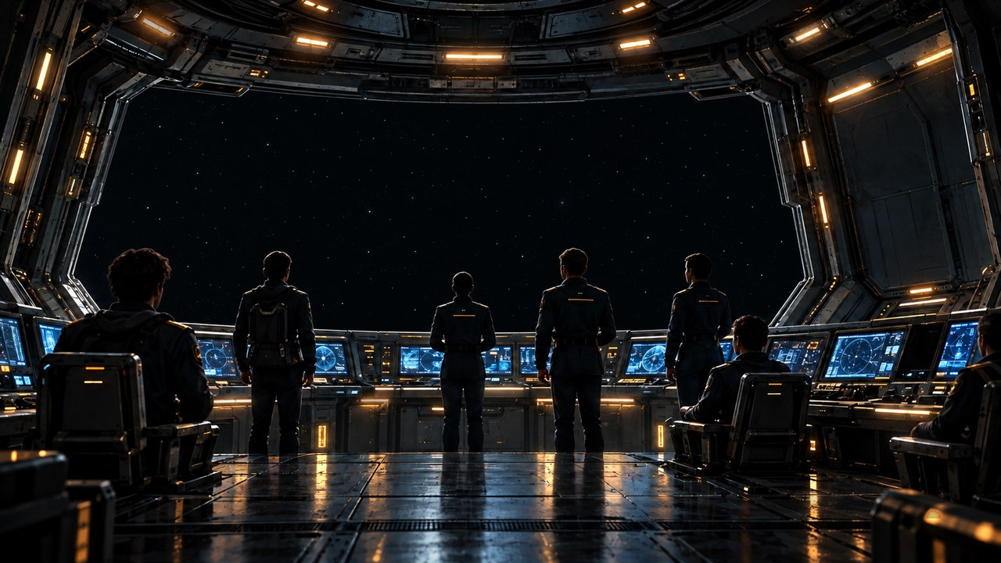
UNSYNCHRONIZED CLOCKS
THE CLOCKS WORK.
THEY DISAGREE.
›
Notes:
SESSION 3. GM bible v12 is story authority. ENVIRONMENT: bridge_deep_space.
Engineering privileged fact. Do not invent a canonical clock time.
VISUAL: Native editable clue over bridge_deep_space motion
PLAYBACK: embedded silent H.264 background starts on slide entry and loops; advance with Right Arrow or remote. No slide timer. Static poster fallback retained. Faces and native evidence remain fixed for continuity. Desktop PowerPoint playback not tested in this environment.
OBJECT MOTION V2: {"stars": 44, "practical_light_cores": 28, "cloud_layers": 0, "foliage_layers": 0, "rain_scope": "none", "source_effects": "none"}

Slide 25
DR. NIA OKAFOR
Chief medical officer
›
Notes:
SESSION 3. GM bible v12 is story authority. ENVIRONMENT: bridge_deep_space.
VISUAL: Original canonical portrait 40; contextual bridge_deep_space motion
PLAYBACK: embedded silent H.264 background starts on slide entry and loops; advance with Right Arrow or remote. No slide timer. Static poster fallback retained. Faces and native evidence remain fixed for continuity. Desktop PowerPoint playback not tested in this environment.
OBJECT MOTION V2: {"stars": 44, "practical_light_cores": 28, "cloud_layers": 0, "foliage_layers": 0, "rain_scope": "none", "source_effects": "none"}

Slide 26
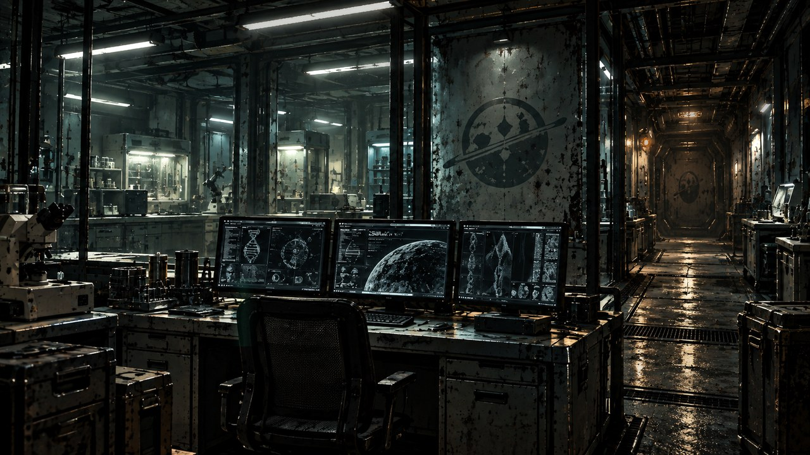
BIOMETRIC MONITOR
COHORT 01
BIOLOGICAL TIMING DRIFT
›
Notes:
SESSION 3. GM bible v12 is story authority. ENVIRONMENT: lab.
Colony: cellular timing drifts relative to ship time. Okafor knows the marker, not the exposure plan.
VISUAL: Native editable clue over lab motion
PLAYBACK: embedded silent H.264 background starts on slide entry and loops; advance with Right Arrow or remote. No slide timer. Static poster fallback retained. Faces and native evidence remain fixed for continuity. Desktop PowerPoint playback not tested in this environment.
OBJECT MOTION V2: {"stars": 0, "practical_light_cores": 28, "cloud_layers": 0, "foliage_layers": 0, "rain_scope": "none", "source_effects": "none"}

Slide 27
ARRIVAL ESTIMATE
37 DAYS
NAVIGATION: 102 DAYS
›
Notes:
SESSION 3. GM bible v12 is story authority. ENVIRONMENT: lab.
Flight privileged fact. No route change accounts for either estimate.
VISUAL: Native editable clue over lab motion
PLAYBACK: embedded silent H.264 background starts on slide entry and loops; advance with Right Arrow or remote. No slide timer. Static poster fallback retained. Faces and native evidence remain fixed for continuity. Desktop PowerPoint playback not tested in this environment.
OBJECT MOTION V2: {"stars": 0, "practical_light_cores": 28, "cloud_layers": 0, "foliage_layers": 0, "rain_scope": "none", "source_effects": "none"}

Slide 28
IRIS
Ship AI
›
Notes:
SESSION 3. GM bible v12 is story authority. ENVIRONMENT: lab.
Ask which estimate is right. Pause before the exact answer.
VISUAL: Original canonical portrait 44; contextual lab motion
PLAYBACK: embedded silent H.264 background starts on slide entry and loops; advance with Right Arrow or remote. No slide timer. Static poster fallback retained. Faces and native evidence remain fixed for continuity. Desktop PowerPoint playback not tested in this environment.
OBJECT MOTION V2: {"stars": 0, "practical_light_cores": 28, "cloud_layers": 0, "foliage_layers": 0, "rain_scope": "none", "source_effects": "none"}

Slide 29
WHICH ONE IS RIGHT?
“Both.”
›
Notes:
SESSION 3. GM bible v12 is story authority. ENVIRONMENT: lab.
The required IRIS line. Each department reports its privileged fact.
VISUAL: Native editable clue over lab motion
PLAYBACK: embedded silent H.264 background starts on slide entry and loops; advance with Right Arrow or remote. No slide timer. Static poster fallback retained. Faces and native evidence remain fixed for continuity. Desktop PowerPoint playback not tested in this environment.
OBJECT MOTION V2: {"stars": 0, "practical_light_cores": 28, "cloud_layers": 0, "foliage_layers": 0, "rain_scope": "none", "source_effects": "none"}

Slide 30
›
Notes:
SESSION 3. GM bible v12 is story authority. ENVIRONMENT: observation.
VISUAL: Scene restored from source 11 / observation environment; native prop where needed
PLAYBACK: embedded silent H.264 background starts on slide entry and loops; advance with Right Arrow or remote. No slide timer. Static poster fallback retained. Faces and native evidence remain fixed for continuity. Desktop PowerPoint playback not tested in this environment.
OBJECT MOTION V2: {"stars": 120, "practical_light_cores": 28, "cloud_layers": 0, "foliage_layers": 0, "rain_scope": "none", "source_effects": "none"}

Slide 31
UNOPENED PACKET
TIMESTAMP: +103 DAYS
SOURCE: CSV-01 PIONEER
›
Notes:
SESSION 3. GM bible v12 is story authority. ENVIRONMENT: observation.
Session 3 cliffhanger. End immediately. Arrival confirmation and Juno warning wait for Session 4.
VISUAL: Native editable clue over observation motion
PLAYBACK: embedded silent H.264 background starts on slide entry and loops; advance with Right Arrow or remote. No slide timer. Static poster fallback retained. Faces and native evidence remain fixed for continuity. Desktop PowerPoint playback not tested in this environment.
OBJECT MOTION V2: {"stars": 120, "practical_light_cores": 28, "cloud_layers": 0, "foliage_layers": 0, "rain_scope": "none", "source_effects": "none"}

Slide 32
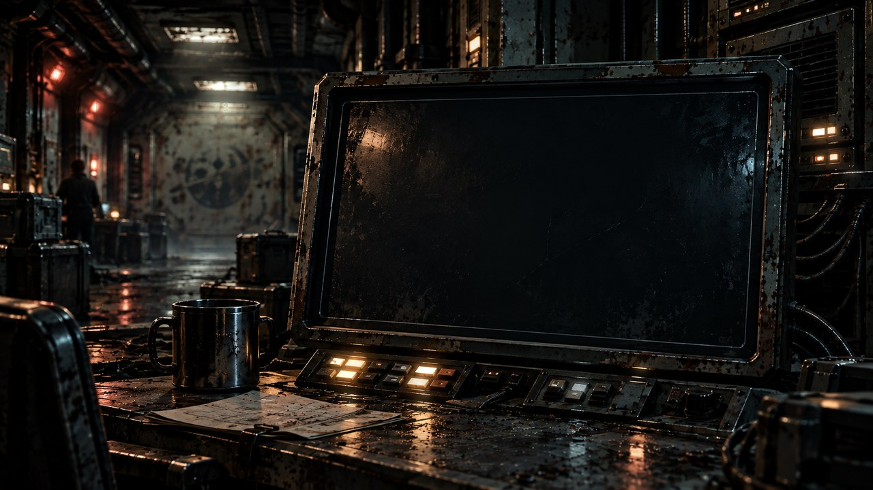
THE FAR HORIZON
04
The message
›
Notes:
SESSION 4. GM bible v12 is story authority. ENVIRONMENT: comms.
Start when ready for this session. Doom is atmosphere, not a replacement for wonder or player choice.
VISUAL: Environment motion / native chapter typography
PLAYBACK: embedded silent H.264 background starts on slide entry and loops; advance with Right Arrow or remote. No slide timer. Static poster fallback retained. Faces and native evidence remain fixed for continuity. Desktop PowerPoint playback not tested in this environment.
OBJECT MOTION V2: {"stars": 0, "practical_light_cores": 28, "cloud_layers": 0, "foliage_layers": 0, "rain_scope": "none", "source_effects": "none"}

Slide 33
JUNO REYES
Communications · logistics
›
Notes:
SESSION 4. GM bible v12 is story authority. ENVIRONMENT: comms.
VISUAL: Original canonical portrait 42; contextual comms motion
PLAYBACK: embedded silent H.264 background starts on slide entry and loops; advance with Right Arrow or remote. No slide timer. Static poster fallback retained. Faces and native evidence remain fixed for continuity. Desktop PowerPoint playback not tested in this environment.
OBJECT MOTION V2: {"stars": 0, "practical_light_cores": 28, "cloud_layers": 0, "foliage_layers": 0, "rain_scope": "none", "source_effects": "none"}

Slide 34
›
Notes:
SESSION 4. GM bible v12 is story authority. ENVIRONMENT: comms.
VISUAL: Scene restored from source 14 / comms environment; native prop where needed
PLAYBACK: embedded silent H.264 background starts on slide entry and loops; advance with Right Arrow or remote. No slide timer. Static poster fallback retained. Faces and native evidence remain fixed for continuity. Desktop PowerPoint playback not tested in this environment.
OBJECT MOTION V2: {"stars": 0, "practical_light_cores": 28, "cloud_layers": 0, "foliage_layers": 0, "rain_scope": "none", "source_effects": "none"}

Slide 35
PIONEER → PIONEER
ARRIVAL CONFIRMED
+103 DAYS
COHORT-CLASS SIGNATURE
PACKET DAMAGE: 61%
›
Notes:
SESSION 4. GM bible v12 is story authority. ENVIRONMENT: comms.
Reveal the warning on the next slide, after the transmission is established.
VISUAL: Native editable clue over comms motion
PLAYBACK: embedded silent H.264 background starts on slide entry and loops; advance with Right Arrow or remote. No slide timer. Static poster fallback retained. Faces and native evidence remain fixed for continuity. Desktop PowerPoint playback not tested in this environment.
OBJECT MOTION V2: {"stars": 0, "practical_light_cores": 28, "cloud_layers": 0, "foliage_layers": 0, "rain_scope": "none", "source_effects": "none"}

Slide 36
TRANSIENT LINE
DO NOT ANSWER
IF JUNO IS IN THE ROOM.
›
Notes:
SESSION 4. GM bible v12 is story authority. ENVIRONMENT: comms.
This warns about a possible action, not Juno’s character.
VISUAL: Native editable clue over comms motion
PLAYBACK: embedded silent H.264 background starts on slide entry and loops; advance with Right Arrow or remote. No slide timer. Static poster fallback retained. Faces and native evidence remain fixed for continuity. Desktop PowerPoint playback not tested in this environment.
OBJECT MOTION V2: {"stars": 0, "practical_light_cores": 28, "cloud_layers": 0, "foliage_layers": 0, "rain_scope": "none", "source_effects": "none"}

Slide 37
THE FORBIDDEN REPLY
Juno Reyes
Mara Venn
IRIS
›
Notes:
SESSION 4. GM bible v12 is story authority. ENVIRONMENT: comms.
Juno reaches toward transmit. Report / hide / reply / delete / investigate, or accept a student option. Replace original reaction art which misidentifies NPCs.
VISUAL: Original canonical portraits 42,37,44 over comms motion
PLAYBACK: embedded silent H.264 background starts on slide entry and loops; advance with Right Arrow or remote. No slide timer. Static poster fallback retained. Faces and native evidence remain fixed for continuity. Desktop PowerPoint playback not tested in this environment.
OBJECT MOTION V2: {"stars": 0, "practical_light_cores": 28, "cloud_layers": 0, "foliage_layers": 0, "rain_scope": "none", "source_effects": "none"}

Slide 38
›
Notes:
SESSION 4. GM bible v12 is story authority. ENVIRONMENT: comms.
VISUAL: Scene restored from source 14 / comms environment; native prop where needed
PLAYBACK: embedded silent H.264 background starts on slide entry and loops; advance with Right Arrow or remote. No slide timer. Static poster fallback retained. Faces and native evidence remain fixed for continuity. Desktop PowerPoint playback not tested in this environment.
OBJECT MOTION V2: {"stars": 0, "practical_light_cores": 28, "cloud_layers": 0, "foliage_layers": 0, "rain_scope": "none", "source_effects": "none"}

Slide 39
PARTIAL DECRYPT
COORDINATE NEAR K-17
FAR HORIZON TRANSPONDER
›
Notes:
SESSION 4. GM bible v12 is story authority. ENVIRONMENT: comms.
Packet partially decrypts regardless of the class decision; a weak human-built transponder motivates the derelict approach. No numeric coordinates invented.
VISUAL: Native editable clue over comms motion
PLAYBACK: embedded silent H.264 background starts on slide entry and loops; advance with Right Arrow or remote. No slide timer. Static poster fallback retained. Faces and native evidence remain fixed for continuity. Desktop PowerPoint playback not tested in this environment.
OBJECT MOTION V2: {"stars": 0, "practical_light_cores": 28, "cloud_layers": 0, "foliage_layers": 0, "rain_scope": "none", "source_effects": "none"}

Slide 40
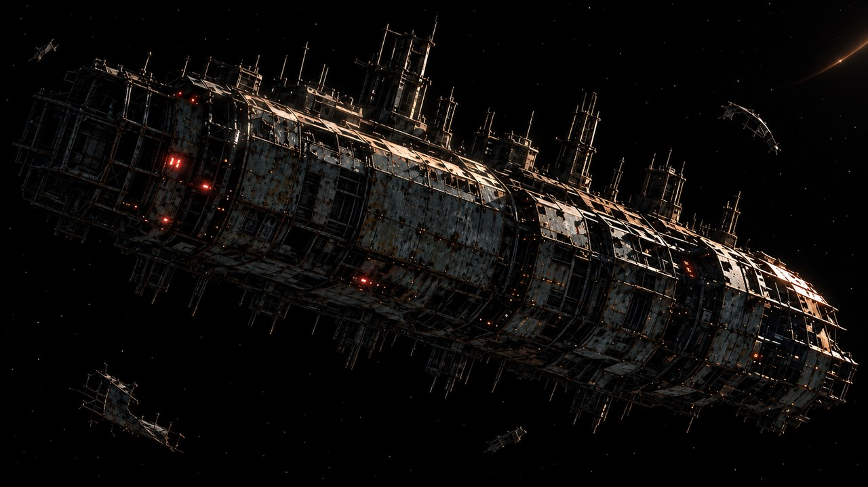
THE FAR HORIZON
05
The silent ship
›
Notes:
SESSION 5. GM bible v12 is story authority. ENVIRONMENT: derelict_exterior.
Start when ready for this session. Doom is atmosphere, not a replacement for wonder or player choice.
VISUAL: Environment motion / native chapter typography
PLAYBACK: embedded silent H.264 background starts on slide entry and loops; advance with Right Arrow or remote. No slide timer. Static poster fallback retained. Faces and native evidence remain fixed for continuity. Desktop PowerPoint playback not tested in this environment.
OBJECT MOTION V2: {"stars": 111, "practical_light_cores": 28, "cloud_layers": 0, "foliage_layers": 0, "rain_scope": "none", "source_effects": "none"}

Slide 41
›
Notes:
SESSION 5. GM bible v12 is story authority. ENVIRONMENT: derelict_exterior.
VISUAL: Scene restored from source 17 / derelict_exterior environment; native prop where needed
PLAYBACK: embedded silent H.264 background starts on slide entry and loops; advance with Right Arrow or remote. No slide timer. Static poster fallback retained. Faces and native evidence remain fixed for continuity. Desktop PowerPoint playback not tested in this environment.
OBJECT MOTION V2: {"stars": 111, "practical_light_cores": 28, "cloud_layers": 0, "foliage_layers": 0, "rain_scope": "none", "source_effects": "none"}

Slide 42
MARCUS BELL
Security · expedition lead
›
Notes:
SESSION 5. GM bible v12 is story authority. ENVIRONMENT: derelict_exterior.
VISUAL: Original canonical portrait 43; contextual derelict_exterior motion
PLAYBACK: embedded silent H.264 background starts on slide entry and loops; advance with Right Arrow or remote. No slide timer. Static poster fallback retained. Faces and native evidence remain fixed for continuity. Desktop PowerPoint playback not tested in this environment.
OBJECT MOTION V2: {"stars": 111, "practical_light_cores": 28, "cloud_layers": 0, "foliage_layers": 0, "rain_scope": "none", "source_effects": "none"}

Slide 43
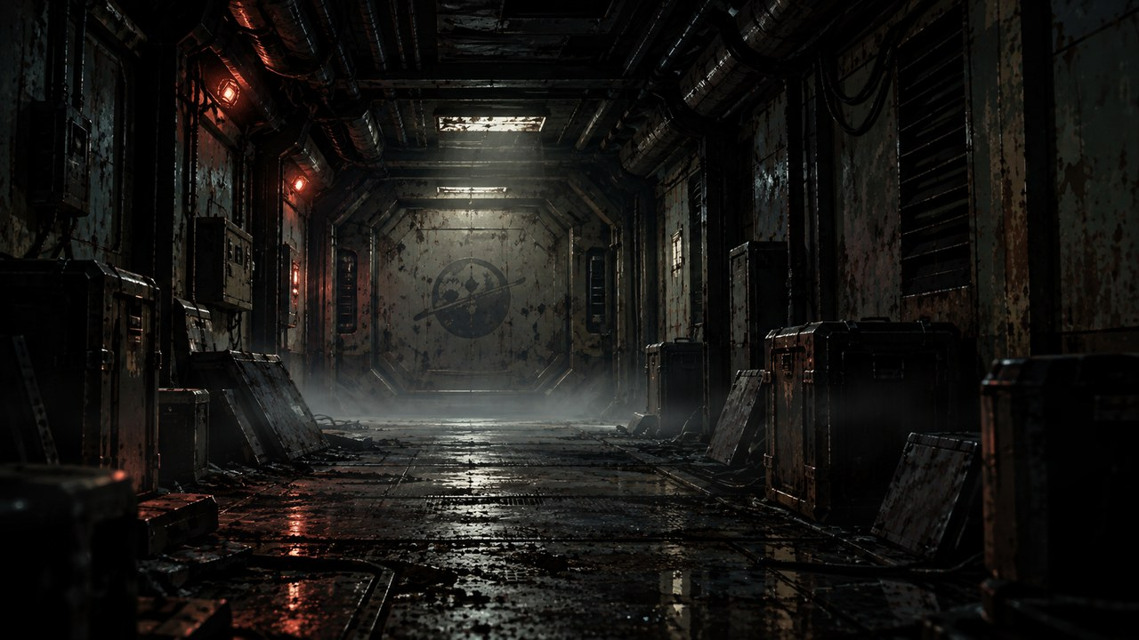
DERELICT · POSSIBLE ROUTES
DOCKING COLLAR
CORRIDOR
ARCHIVE
SECURITY SYSTEMS
FLIGHT RECORDER
RETURN ROUTE
›
Notes:
SESSION 5. GM bible v12 is story authority. ENVIRONMENT: derelict.
Readable orientation schematic, not a canonical scale floor plan. Move required clues to the route students choose. No GM reveal map projected.
VISUAL: Native schematic
PLAYBACK: embedded silent H.264 background starts on slide entry and loops; advance with Right Arrow or remote. No slide timer. Static poster fallback retained. Faces and native evidence remain fixed for continuity. Desktop PowerPoint playback not tested in this environment.

Slide 44
›
Notes:
SESSION 5. GM bible v12 is story authority. ENVIRONMENT: derelict.
VISUAL: Scene restored from source 18 / derelict environment; native prop where needed
PLAYBACK: embedded silent H.264 background starts on slide entry and loops; advance with Right Arrow or remote. No slide timer. Static poster fallback retained. Faces and native evidence remain fixed for continuity. Desktop PowerPoint playback not tested in this environment.

Slide 45
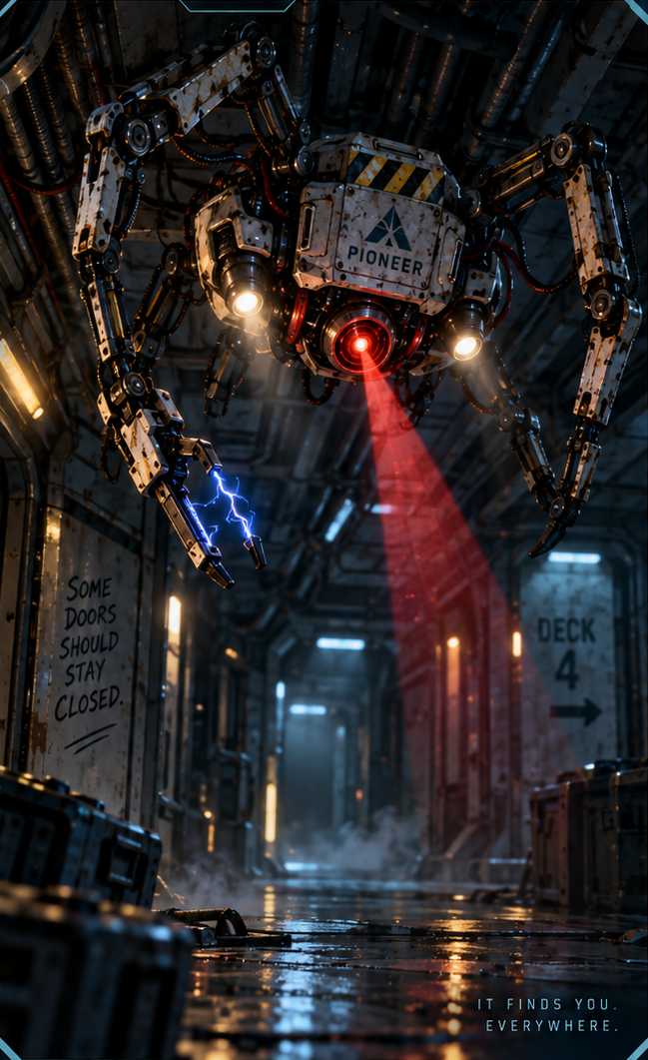
DERELICT SECURITY DRONE
REACH THE BLACK BOX
›
Notes:
SESSION 5. GM bible v12 is story authority. ENVIRONMENT: derelict.
2–3 standard drones, 2 Threat Boxes each. Preserve or reach black box before lockdown; maximum 3 rounds.
VISUAL: Supplied enemy dossier 2, non-destructive artwork crop; derelict motion
PLAYBACK: embedded silent H.264 background starts on slide entry and loops; advance with Right Arrow or remote. No slide timer. Static poster fallback retained. Faces and native evidence remain fixed for continuity. Desktop PowerPoint playback not tested in this environment.

Slide 46
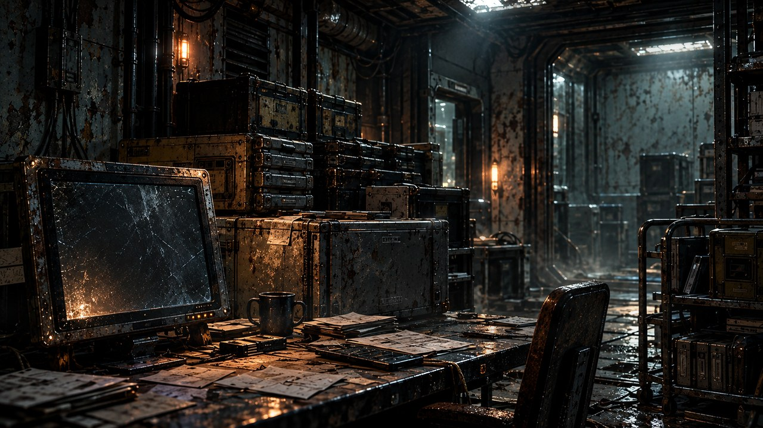
RECOVERED BLACK BOX
FAR HORIZON
FLIGHT RECORDER
›
Notes:
SESSION 5. GM bible v12 is story authority. ENVIRONMENT: archive.
VISUAL: Scene restored from source 53 / archive environment; native prop where needed
PLAYBACK: embedded silent H.264 background starts on slide entry and loops; advance with Right Arrow or remote. No slide timer. Static poster fallback retained. Faces and native evidence remain fixed for continuity. Desktop PowerPoint playback not tested in this environment.
OBJECT MOTION V2: {"stars": 0, "practical_light_cores": 28, "cloud_layers": 0, "foliage_layers": 0, "rain_scope": "none", "source_effects": "none"}

Slide 47
BLACK BOX TRANSCRIPT
APPROACH BEACON IDENTIFIED AS OUR OWN.
“K-17 is where it will be.”
“Where are the children?”
“The children are not aboard.”
“Both routes are correct.”
›
Notes:
SESSION 5. GM bible v12 is story authority. ENVIRONMENT: archive.
Read the full transcript from the bible. Do not explain that the derelict is a failed possible future yet.
VISUAL: Native editable clue over archive motion
PLAYBACK: embedded silent H.264 background starts on slide entry and loops; advance with Right Arrow or remote. No slide timer. Static poster fallback retained. Faces and native evidence remain fixed for continuity. Desktop PowerPoint playback not tested in this environment.
OBJECT MOTION V2: {"stars": 0, "practical_light_cores": 28, "cloud_layers": 0, "foliage_layers": 0, "rain_scope": "none", "source_effects": "none"}

Slide 48
CHILD’S DRAWING
HOME
›
Notes:
SESSION 5. GM bible v12 is story authority. ENVIRONMENT: archive.
VISUAL: Scene restored from source 54 / archive environment; native prop where needed
PLAYBACK: embedded silent H.264 background starts on slide entry and loops; advance with Right Arrow or remote. No slide timer. Static poster fallback retained. Faces and native evidence remain fixed for continuity. Desktop PowerPoint playback not tested in this environment.
OBJECT MOTION V2: {"stars": 0, "practical_light_cores": 28, "cloud_layers": 0, "foliage_layers": 0, "rain_scope": "none", "source_effects": "none"}

Slide 49
ON THE REVERSE
WE WAITED FOR YOU.
›
Notes:
SESSION 5. GM bible v12 is story authority. ENVIRONMENT: archive.
Repeat this clue at the school in Session 10.
VISUAL: Native editable clue over archive motion
PLAYBACK: embedded silent H.264 background starts on slide entry and loops; advance with Right Arrow or remote. No slide timer. Static poster fallback retained. Faces and native evidence remain fixed for continuity. Desktop PowerPoint playback not tested in this environment.
OBJECT MOTION V2: {"stars": 0, "practical_light_cores": 28, "cloud_layers": 0, "foliage_layers": 0, "rain_scope": "none", "source_effects": "none"}

Slide 50
›
Notes:
SESSION 5. GM bible v12 is story authority. ENVIRONMENT: derelict_exterior.
VISUAL: Scene restored from source 17 / derelict_exterior environment; native prop where needed
PLAYBACK: embedded silent H.264 background starts on slide entry and loops; advance with Right Arrow or remote. No slide timer. Static poster fallback retained. Faces and native evidence remain fixed for continuity. Desktop PowerPoint playback not tested in this environment.
OBJECT MOTION V2: {"stars": 111, "practical_light_cores": 28, "cloud_layers": 0, "foliage_layers": 0, "rain_scope": "none", "source_effects": "none"}

Slide 51
THE FAR HORIZON
06
The records
›
Notes:
SESSION 6. GM bible v12 is story authority. ENVIRONMENT: archive.
Start when ready for this session. Doom is atmosphere, not a replacement for wonder or player choice.
VISUAL: Environment motion / native chapter typography
PLAYBACK: embedded silent H.264 background starts on slide entry and loops; advance with Right Arrow or remote. No slide timer. Static poster fallback retained. Faces and native evidence remain fixed for continuity. Desktop PowerPoint playback not tested in this environment.
OBJECT MOTION V2: {"stars": 0, "practical_light_cores": 28, "cloud_layers": 0, "foliage_layers": 0, "rain_scope": "none", "source_effects": "none"}

Slide 52
›
Notes:
SESSION 6. GM bible v12 is story authority. ENVIRONMENT: archive.
VISUAL: Scene restored from source 20 / archive environment; native prop where needed
PLAYBACK: embedded silent H.264 background starts on slide entry and loops; advance with Right Arrow or remote. No slide timer. Static poster fallback retained. Faces and native evidence remain fixed for continuity. Desktop PowerPoint playback not tested in this environment.
OBJECT MOTION V2: {"stars": 0, "practical_light_cores": 28, "cloud_layers": 0, "foliage_layers": 0, "rain_scope": "none", "source_effects": "none"}

Slide 53
DR. ELIAS VALE
Astrophysicist · K-17 specialist
›
Notes:
SESSION 6. GM bible v12 is story authority. ENVIRONMENT: archive.
VISUAL: Original canonical portrait 39; contextual archive motion
PLAYBACK: embedded silent H.264 background starts on slide entry and loops; advance with Right Arrow or remote. No slide timer. Static poster fallback retained. Faces and native evidence remain fixed for continuity. Desktop PowerPoint playback not tested in this environment.
OBJECT MOTION V2: {"stars": 0, "practical_light_cores": 28, "cloud_layers": 0, "foliage_layers": 0, "rain_scope": "none", "source_effects": "none"}

Slide 54
AUTHENTICATION: VALID
SAME TIMESTAMP
RECORD A
RECORD B
PIONEER
ARRIVED SAFELY
PIONEER
LOST NEAR K-17
AUTHENTIC
AUTHENTIC
RECORD C
RECORD D
PIONEER
RETURNED TO SOL
PIONEER ESTABLISHED
ASTERIA SETTLEMENT
AUTHENTIC
AUTHENTIC
›
Notes:
SESSION 6. GM bible v12 is story authority. ENVIRONMENT: archive.
All four records authenticate. Original evidence-wall artwork uses conflicting names and incomplete records, so it is replaced.
VISUAL: Native editable clue over archive motion
PLAYBACK: embedded silent H.264 background starts on slide entry and loops; advance with Right Arrow or remote. No slide timer. Static poster fallback retained. Faces and native evidence remain fixed for continuity. Desktop PowerPoint playback not tested in this environment.
OBJECT MOTION V2: {"stars": 0, "practical_light_cores": 28, "cloud_layers": 0, "foliage_layers": 0, "rain_scope": "none", "source_effects": "none"}

Slide 55
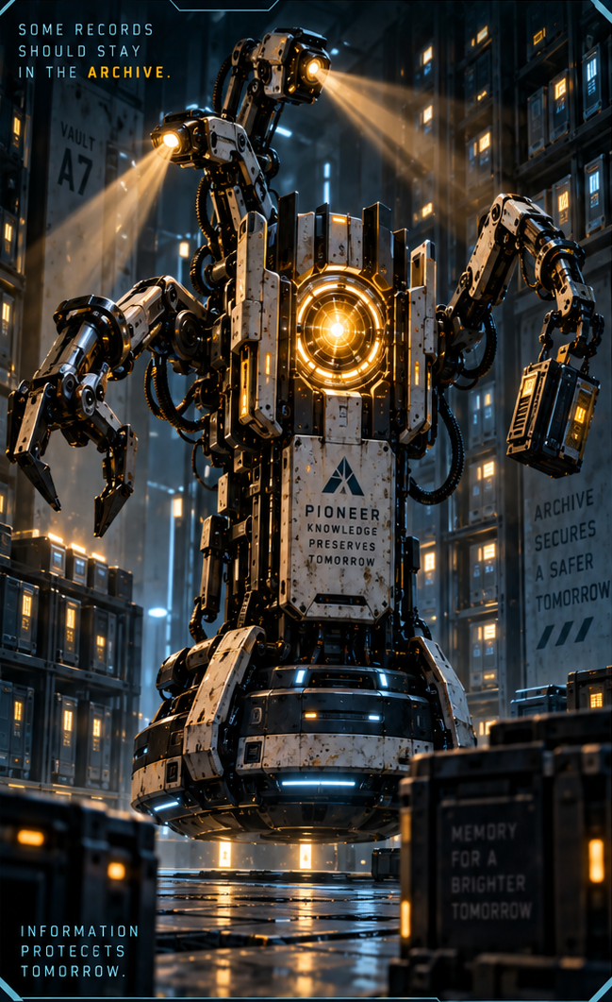
ARCHIVE GUARDIAN
PRESERVE THE EVIDENCE
›
Notes:
SESSION 6. GM bible v12 is story authority. ENVIRONMENT: archive.
One standard Guardian, 2 Threat Boxes; two only if needed. Round 1 manifest, round 2 black-box duplicate, round 3 name-match alert threatened.
VISUAL: Supplied enemy dossier 4, non-destructive artwork crop; archive motion
PLAYBACK: embedded silent H.264 background starts on slide entry and loops; advance with Right Arrow or remote. No slide timer. Static poster fallback retained. Faces and native evidence remain fixed for continuity. Desktop PowerPoint playback not tested in this environment.
OBJECT MOTION V2: {"stars": 0, "practical_light_cores": 28, "cloud_layers": 0, "foliage_layers": 0, "rain_scope": "none", "source_effects": "none"}

Slide 56
CREW MANIFEST
COHORT 01
›
Notes:
SESSION 6. GM bible v12 is story authority. ENVIRONMENT: archive.
Teacher: use a fictional character’s identity. Do not use real student names. The old prop contained noncanonical names / roles.
VISUAL: Native editable clue over archive motion
PLAYBACK: embedded silent H.264 background starts on slide entry and loops; advance with Right Arrow or remote. No slide timer. Static poster fallback retained. Faces and native evidence remain fixed for continuity. Desktop PowerPoint playback not tested in this environment.
OBJECT MOTION V2: {"stars": 0, "practical_light_cores": 28, "cloud_layers": 0, "foliage_layers": 0, "rain_scope": "none", "source_effects": "none"}

Slide 57
NAME MATCH
COHORT 01 IDENTITY MATCH
ZARA QUINN
ASTERIA SCHOOL ARCHIVE
SIX YEARS AFTER LAUNCH
›
Notes:
SESSION 6. GM bible v12 is story authority. ENVIRONMENT: archive.
Zara Quinn is an editable fictional default. Replace only with a fictional class character if appropriate, never a real student name.
VISUAL: Native editable clue over archive motion
PLAYBACK: embedded silent H.264 background starts on slide entry and loops; advance with Right Arrow or remote. No slide timer. Static poster fallback retained. Faces and native evidence remain fixed for continuity. Desktop PowerPoint playback not tested in this environment.
OBJECT MOTION V2: {"stars": 0, "practical_light_cores": 28, "cloud_layers": 0, "foliage_layers": 0, "rain_scope": "none", "source_effects": "none"}

Slide 58
CONTAINMENT ORDERS
Marcus Bell
Mara Venn
›
Notes:
SESSION 6. GM bible v12 is story authority. ENVIRONMENT: archive.
Bell holds containment orders; Venn interrupts him. Do not give Bell scientific knowledge he does not have.
VISUAL: Original canonical portraits 43,37 over archive motion
PLAYBACK: embedded silent H.264 background starts on slide entry and loops; advance with Right Arrow or remote. No slide timer. Static poster fallback retained. Faces and native evidence remain fixed for continuity. Desktop PowerPoint playback not tested in this environment.
OBJECT MOTION V2: {"stars": 0, "practical_light_cores": 28, "cloud_layers": 0, "foliage_layers": 0, "rain_scope": "none", "source_effects": "none"}

Slide 59
THE FAR HORIZON
07
The truth
›
Notes:
SESSION 7. GM bible v12 is story authority. ENVIRONMENT: lab.
Start when ready for this session. Doom is atmosphere, not a replacement for wonder or player choice.
VISUAL: Environment motion / native chapter typography
PLAYBACK: embedded silent H.264 background starts on slide entry and loops; advance with Right Arrow or remote. No slide timer. Static poster fallback retained. Faces and native evidence remain fixed for continuity. Desktop PowerPoint playback not tested in this environment.
OBJECT MOTION V2: {"stars": 0, "practical_light_cores": 28, "cloud_layers": 0, "foliage_layers": 0, "rain_scope": "none", "source_effects": "none"}

Slide 60
›
Notes:
SESSION 7. GM bible v12 is story authority. ENVIRONMENT: lab.
VISUAL: Scene restored from source 23 / lab environment; native prop where needed
PLAYBACK: embedded silent H.264 background starts on slide entry and loops; advance with Right Arrow or remote. No slide timer. Static poster fallback retained. Faces and native evidence remain fixed for continuity. Desktop PowerPoint playback not tested in this environment.
OBJECT MOTION V2: {"stars": 0, "practical_light_cores": 28, "cloud_layers": 0, "foliage_layers": 0, "rain_scope": "none", "source_effects": "none"}

Slide 61
DR. NIA OKAFOR
Chief medical officer
›
Notes:
SESSION 7. GM bible v12 is story authority. ENVIRONMENT: lab.
VISUAL: Original canonical portrait 40; contextual lab motion
PLAYBACK: embedded silent H.264 background starts on slide entry and loops; advance with Right Arrow or remote. No slide timer. Static poster fallback retained. Faces and native evidence remain fixed for continuity. Desktop PowerPoint playback not tested in this environment.
OBJECT MOTION V2: {"stars": 0, "practical_light_cores": 28, "cloud_layers": 0, "foliage_layers": 0, "rain_scope": "none", "source_effects": "none"}

Slide 62
CLASSIFIED: FH-LR-17
REPAIR · RESILIENCE
BIOLOGICAL TIMING / K-17
›
Notes:
SESSION 7. GM bible v12 is story authority. ENVIRONMENT: lab.
Use the full genetics clue in the bible; compatibility does not make the students destined or chosen by blood.
VISUAL: Native editable clue over lab motion
PLAYBACK: embedded silent H.264 background starts on slide entry and loops; advance with Right Arrow or remote. No slide timer. Static poster fallback retained. Faces and native evidence remain fixed for continuity. Desktop PowerPoint playback not tested in this environment.
OBJECT MOTION V2: {"stars": 0, "practical_light_cores": 28, "cloud_layers": 0, "foliage_layers": 0, "rain_scope": "none", "source_effects": "none"}

Slide 63
DR. ELIAS VALE
Astrophysicist · K-17 specialist
›
Notes:
SESSION 7. GM bible v12 is story authority. ENVIRONMENT: lab.
VISUAL: Original canonical portrait 39; contextual lab motion
PLAYBACK: embedded silent H.264 background starts on slide entry and loops; advance with Right Arrow or remote. No slide timer. Static poster fallback retained. Faces and native evidence remain fixed for continuity. Desktop PowerPoint playback not tested in this environment.
OBJECT MOTION V2: {"stars": 0, "practical_light_cores": 28, "cloud_layers": 0, "foliage_layers": 0, "rain_scope": "none", "source_effects": "none"}

Slide 64
THE CORRELATION
COHORT RESPONSE
MAY PRECEDE APPROACH
›
Notes:
SESSION 7. GM bible v12 is story authority. ENVIRONMENT: lab.
Biological timing resembles K-17 signal. This replaces the original misleading species-similarity chart.
VISUAL: Native editable clue over lab motion
PLAYBACK: embedded silent H.264 background starts on slide entry and loops; advance with Right Arrow or remote. No slide timer. Static poster fallback retained. Faces and native evidence remain fixed for continuity. Desktop PowerPoint playback not tested in this environment.
OBJECT MOTION V2: {"stars": 0, "practical_light_cores": 28, "cloud_layers": 0, "foliage_layers": 0, "rain_scope": "none", "source_effects": "none"}

Slide 65
ROUTE VARIATION APPROVED
DO NOT ALTER COURSE
BECAUSE OF OBJECT K-17
WITHOUT COMMAND AUTHORIZATION.
›
Notes:
SESSION 7. GM bible v12 is story authority. ENVIRONMENT: lab.
Venn’s handwritten objection follows.
VISUAL: Native editable clue over lab motion
PLAYBACK: embedded silent H.264 background starts on slide entry and loops; advance with Right Arrow or remote. No slide timer. Static poster fallback retained. Faces and native evidence remain fixed for continuity. Desktop PowerPoint playback not tested in this environment.
OBJECT MOTION V2: {"stars": 0, "practical_light_cores": 28, "cloud_layers": 0, "foliage_layers": 0, "rain_scope": "none", "source_effects": "none"}

Slide 66
CAPTAIN MARA VENN
Mission commander
›
Notes:
SESSION 7. GM bible v12 is story authority. ENVIRONMENT: lab.
VISUAL: Original canonical portrait 37; contextual lab motion
PLAYBACK: embedded silent H.264 background starts on slide entry and loops; advance with Right Arrow or remote. No slide timer. Static poster fallback retained. Faces and native evidence remain fixed for continuity. Desktop PowerPoint playback not tested in this environment.
OBJECT MOTION V2: {"stars": 0, "practical_light_cores": 28, "cloud_layers": 0, "foliage_layers": 0, "rain_scope": "none", "source_effects": "none"}

Slide 67
VENN’S HANDWRITING
“They are children.
I will not spend them
without answers.”
›
Notes:
SESSION 7. GM bible v12 is story authority. ENVIRONMENT: lab.
VISUAL: Native editable clue over lab motion
PLAYBACK: embedded silent H.264 background starts on slide entry and loops; advance with Right Arrow or remote. No slide timer. Static poster fallback retained. Faces and native evidence remain fixed for continuity. Desktop PowerPoint playback not tested in this environment.
OBJECT MOTION V2: {"stars": 0, "practical_light_cores": 28, "cloud_layers": 0, "foliage_layers": 0, "rain_scope": "none", "source_effects": "none"}

Slide 68
WHAT EACH ADULT KNEW
Mara Venn
Elias Vale
Nia Okafor
Marcus Bell
›
Notes:
SESSION 7. GM bible v12 is story authority. ENVIRONMENT: lab.
Venn: route + suspected response, not mechanism. Vale: anomalous signal resembled cohort data. Okafor: marker, not deliberate exposure. Bell: containment orders, not science. Replaces group artwork with inconsistent NPC identities.
VISUAL: Original canonical portraits 37,39,40,43 over lab motion
PLAYBACK: embedded silent H.264 background starts on slide entry and loops; advance with Right Arrow or remote. No slide timer. Static poster fallback retained. Faces and native evidence remain fixed for continuity. Desktop PowerPoint playback not tested in this environment.
OBJECT MOTION V2: {"stars": 0, "practical_light_cores": 28, "cloud_layers": 0, "foliage_layers": 0, "rain_scope": "none", "source_effects": "none"}

Slide 69
YOUR DECISION
HOW DO WE APPROACH K-17?
›
Notes:
SESSION 7. GM bible v12 is story authority. ENVIRONMENT: lab.
Session 7 endpoint: students gain explicit decision-making authority over future approach.
VISUAL: Native editable clue over lab motion
PLAYBACK: embedded silent H.264 background starts on slide entry and loops; advance with Right Arrow or remote. No slide timer. Static poster fallback retained. Faces and native evidence remain fixed for continuity. Desktop PowerPoint playback not tested in this environment.
OBJECT MOTION V2: {"stars": 0, "practical_light_cores": 28, "cloud_layers": 0, "foliage_layers": 0, "rain_scope": "none", "source_effects": "none"}

Slide 70
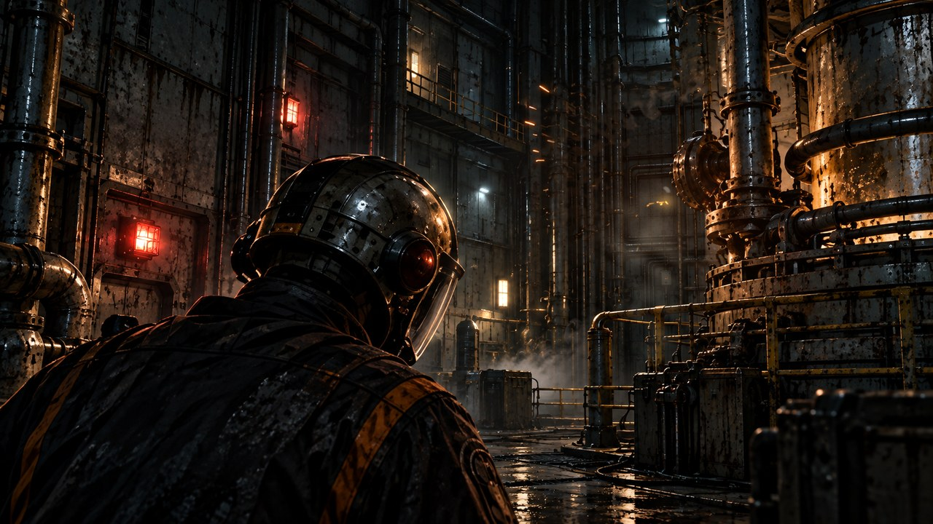
THE FAR HORIZON
08
The cost
›
Notes:
SESSION 8. GM bible v12 is story authority. ENVIRONMENT: reactor.
Start when ready for this session. Doom is atmosphere, not a replacement for wonder or player choice.
VISUAL: Environment motion / native chapter typography
PLAYBACK: embedded silent H.264 background starts on slide entry and loops; advance with Right Arrow or remote. No slide timer. Static poster fallback retained. Faces and native evidence remain fixed for continuity. Desktop PowerPoint playback not tested in this environment.
OBJECT MOTION V2: {"stars": 0, "practical_light_cores": 28, "cloud_layers": 0, "foliage_layers": 0, "rain_scope": "none", "source_effects": "ballistic emitted sparks and continuously curling pale vapor, with reflected welding glow"}

Slide 71
›
Notes:
SESSION 8. GM bible v12 is story authority. ENVIRONMENT: reactor.
VISUAL: Scene restored from source 26 / reactor environment; native prop where needed
PLAYBACK: embedded silent H.264 background starts on slide entry and loops; advance with Right Arrow or remote. No slide timer. Static poster fallback retained. Faces and native evidence remain fixed for continuity. Desktop PowerPoint playback not tested in this environment.
OBJECT MOTION V2: {"stars": 0, "practical_light_cores": 28, "cloud_layers": 0, "foliage_layers": 0, "rain_scope": "none", "source_effects": "ballistic emitted sparks and continuously curling pale vapor, with reflected welding glow"}

Slide 72
TOMAS RHEE
Chief engineer
›
Notes:
SESSION 8. GM bible v12 is story authority. ENVIRONMENT: reactor.
VISUAL: Original canonical portrait 41; contextual reactor motion
PLAYBACK: embedded silent H.264 background starts on slide entry and loops; advance with Right Arrow or remote. No slide timer. Static poster fallback retained. Faces and native evidence remain fixed for continuity. Desktop PowerPoint playback not tested in this environment.
OBJECT MOTION V2: {"stars": 0, "practical_light_cores": 28, "cloud_layers": 0, "foliage_layers": 0, "rain_scope": "none", "source_effects": "ballistic emitted sparks and continuously curling pale vapor, with reflected welding glow"}

Slide 73
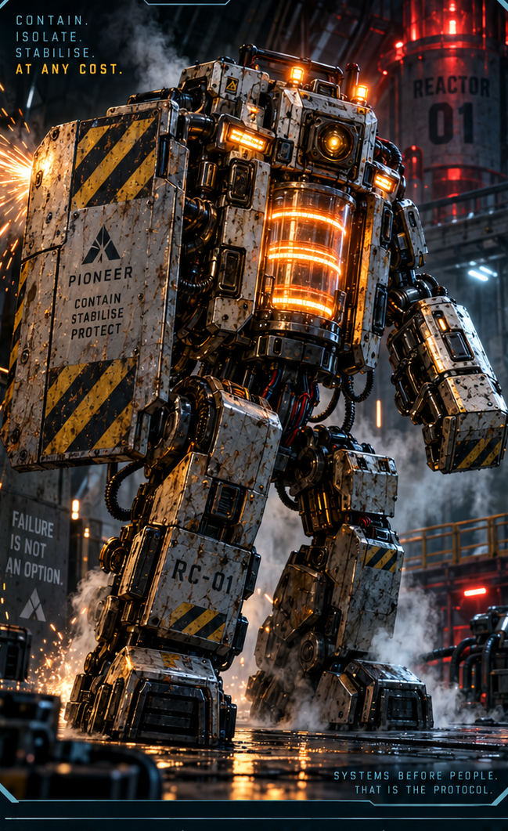
REACTOR CONTAINMENT UNIT
KEEP SYSTEMS COHERENT
›
Notes:
SESSION 8. GM bible v12 is story authority. ENVIRONMENT: reactor.
Dangerous 3 Threat Boxes. Containment logic, not malice. 3 rounds with a changing environment; attacks alone cannot win.
VISUAL: Supplied enemy dossier 3, non-destructive artwork crop; reactor motion
PLAYBACK: embedded silent H.264 background starts on slide entry and loops; advance with Right Arrow or remote. No slide timer. Static poster fallback retained. Faces and native evidence remain fixed for continuity. Desktop PowerPoint playback not tested in this environment.
OBJECT MOTION V2: {"stars": 0, "practical_light_cores": 28, "cloud_layers": 0, "foliage_layers": 0, "rain_scope": "none", "source_effects": "ballistic emitted sparks and continuously curling pale vapor, with reflected welding glow"}

Slide 74
›
Notes:
SESSION 8. GM bible v12 is story authority. ENVIRONMENT: reactor.
VISUAL: Scene restored from source 27 / reactor environment; native prop where needed
PLAYBACK: embedded silent H.264 background starts on slide entry and loops; advance with Right Arrow or remote. No slide timer. Static poster fallback retained. Faces and native evidence remain fixed for continuity. Desktop PowerPoint playback not tested in this environment.
OBJECT MOTION V2: {"stars": 0, "practical_light_cores": 28, "cloud_layers": 0, "foliage_layers": 0, "rain_scope": "none", "source_effects": "ballistic emitted sparks and continuously curling pale vapor, with reflected welding glow"}

Slide 75
NO CONFIGURATION SAVES EVERYTHING
POWER: 37%
LIFE SUPPORT: 62%
NAVIGATION: 58%
›
Notes:
SESSION 8. GM bible v12 is story authority. ENVIRONMENT: reactor.
Communications array goes offline if power diverted. Accept a credible student alternative with a real cost.
VISUAL: Native editable clue over reactor motion
PLAYBACK: embedded silent H.264 background starts on slide entry and loops; advance with Right Arrow or remote. No slide timer. Static poster fallback retained. Faces and native evidence remain fixed for continuity. Desktop PowerPoint playback not tested in this environment.
OBJECT MOTION V2: {"stars": 0, "practical_light_cores": 28, "cloud_layers": 0, "foliage_layers": 0, "rain_scope": "none", "source_effects": "ballistic emitted sparks and continuously curling pale vapor, with reflected welding glow"}

Slide 76
IRIS
Ship AI
›
Notes:
SESSION 8. GM bible v12 is story authority. ENVIRONMENT: reactor.
VISUAL: Original canonical portrait 44; contextual reactor motion
PLAYBACK: embedded silent H.264 background starts on slide entry and loops; advance with Right Arrow or remote. No slide timer. Static poster fallback retained. Faces and native evidence remain fixed for continuity. Desktop PowerPoint playback not tested in this environment.
OBJECT MOTION V2: {"stars": 0, "practical_light_cores": 28, "cloud_layers": 0, "foliage_layers": 0, "rain_scope": "none", "source_effects": "ballistic emitted sparks and continuously curling pale vapor, with reflected welding glow"}

Slide 77
DAMAGE REPORT
What did you protect?
What did it cost?
›
Notes:
SESSION 8. GM bible v12 is story authority. ENVIRONMENT: reactor.
Record the class’s actual sacrifice in the GM notes before Session 9. Do not imply fixed casualties.
VISUAL: Native editable clue over reactor motion
PLAYBACK: embedded silent H.264 background starts on slide entry and loops; advance with Right Arrow or remote. No slide timer. Static poster fallback retained. Faces and native evidence remain fixed for continuity. Desktop PowerPoint playback not tested in this environment.
OBJECT MOTION V2: {"stars": 0, "practical_light_cores": 28, "cloud_layers": 0, "foliage_layers": 0, "rain_scope": "none", "source_effects": "ballistic emitted sparks and continuously curling pale vapor, with reflected welding glow"}

Slide 78
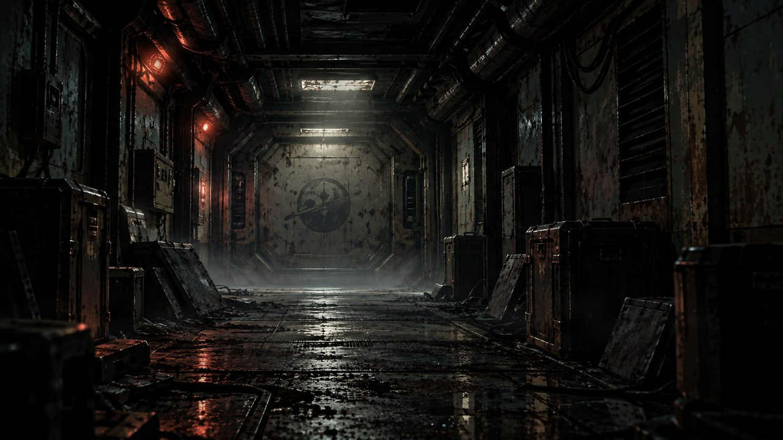
›
Notes:
SESSION 8. GM bible v12 is story authority. ENVIRONMENT: aftermath.
Background figures are unnamed Cohort / crew. Carry the actual cost forward.
VISUAL: Scene restored from source 28 / aftermath environment; native prop where needed
PLAYBACK: embedded silent H.264 background starts on slide entry and loops; advance with Right Arrow or remote. No slide timer. Static poster fallback retained. Faces and native evidence remain fixed for continuity. Desktop PowerPoint playback not tested in this environment.
OBJECT MOTION V2: {"stars": 0, "practical_light_cores": 28, "cloud_layers": 0, "foliage_layers": 0, "rain_scope": "none", "source_effects": "none"}

Slide 79
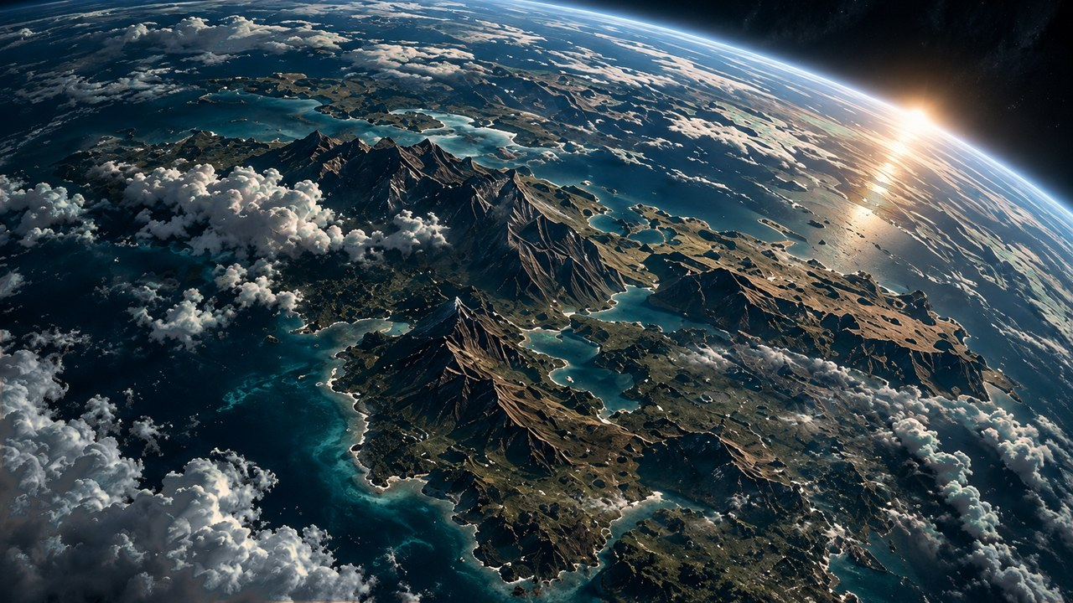
THE FAR HORIZON
09
Arrival
›
Notes:
SESSION 9. GM bible v12 is story authority. ENVIRONMENT: orbit.
Start when ready for this session. Doom is atmosphere, not a replacement for wonder or player choice.
VISUAL: Environment motion / native chapter typography
PLAYBACK: embedded silent H.264 background starts on slide entry and loops; advance with Right Arrow or remote. No slide timer. Static poster fallback retained. Faces and native evidence remain fixed for continuity. Desktop PowerPoint playback not tested in this environment.
OBJECT MOTION V2: {"stars": 10, "practical_light_cores": 0, "cloud_layers": 2, "foliage_layers": 0, "rain_scope": "none", "source_effects": "none"}

Slide 80
›
Notes:
SESSION 9. GM bible v12 is story authority. ENVIRONMENT: orbit.
VISUAL: Scene restored from source 30 / orbit environment; native prop where needed
PLAYBACK: embedded silent H.264 background starts on slide entry and loops; advance with Right Arrow or remote. No slide timer. Static poster fallback retained. Faces and native evidence remain fixed for continuity. Desktop PowerPoint playback not tested in this environment.
OBJECT MOTION V2: {"stars": 10, "practical_light_cores": 0, "cloud_layers": 2, "foliage_layers": 0, "rain_scope": "none", "source_effects": "none"}

Slide 81
CAPTAIN MARA VENN
Mission commander
›
Notes:
SESSION 9. GM bible v12 is story authority. ENVIRONMENT: orbit.
VISUAL: Original canonical portrait 37; contextual orbit motion
PLAYBACK: embedded silent H.264 background starts on slide entry and loops; advance with Right Arrow or remote. No slide timer. Static poster fallback retained. Faces and native evidence remain fixed for continuity. Desktop PowerPoint playback not tested in this environment.
OBJECT MOTION V2: {"stars": 10, "practical_light_cores": 0, "cloud_layers": 2, "foliage_layers": 0, "rain_scope": "none", "source_effects": "none"}

Slide 82
ORBITAL SURVEY
ARTIFICIAL STRUCTURES
CONSTRUCTION AGE: 5–8 YEARS
ATMOSPHERE: AS PROJECTED
POWER: INTERMITTENT
HUMAN BIOSIGNS: INCONCLUSIVE
›
Notes:
SESSION 9. GM bible v12 is story authority. ENVIRONMENT: orbit.
Allow 60 seconds of Asteria wonder before this evidence. Carry the actual Session 8 sacrifice forward. No confirmed survivors.
VISUAL: Native editable clue over orbit motion
PLAYBACK: embedded silent H.264 background starts on slide entry and loops; advance with Right Arrow or remote. No slide timer. Static poster fallback retained. Faces and native evidence remain fixed for continuity. Desktop PowerPoint playback not tested in this environment.
OBJECT MOTION V2: {"stars": 10, "practical_light_cores": 0, "cloud_layers": 2, "foliage_layers": 0, "rain_scope": "none", "source_effects": "none"}

Slide 83
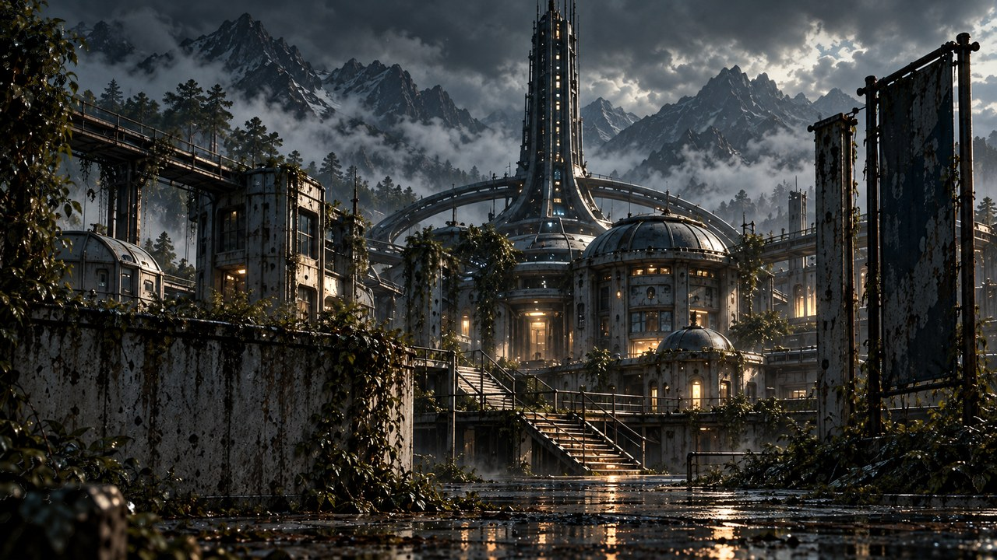
ASTERIA · PLACES TO EXPLORE
COLONY STREETS
CENTRAL HUB
SCHOOL
GREENHOUSE
ARCHIVE
OLD LAB
›
Notes:
SESSION 9. GM bible v12 is story authority. ENVIRONMENT: colony.
Readable orientation schematic, not a canonical scale floor plan. Move required clues to the route students choose. No GM reveal map projected.
VISUAL: Native schematic
PLAYBACK: embedded silent H.264 background starts on slide entry and loops; advance with Right Arrow or remote. No slide timer. Static poster fallback retained. Faces and native evidence remain fixed for continuity. Desktop PowerPoint playback not tested in this environment.
OBJECT MOTION V2: {"stars": 0, "practical_light_cores": 18, "cloud_layers": 1, "foliage_layers": 10, "rain_scope": "outdoor colony: depth-separated rain plus wet-floor impacts", "source_effects": "none"}

Slide 84
SETTLEMENT BEACON
WELCOME, COHORT 01.
YOU ARE LATE.
›
Notes:
SESSION 9. GM bible v12 is story authority. ENVIRONMENT: colony.
Session 9 cliffhanger. Do not reveal the colony photo before Session 10.
VISUAL: Native editable clue over colony motion
PLAYBACK: embedded silent H.264 background starts on slide entry and loops; advance with Right Arrow or remote. No slide timer. Static poster fallback retained. Faces and native evidence remain fixed for continuity. Desktop PowerPoint playback not tested in this environment.
OBJECT MOTION V2: {"stars": 0, "practical_light_cores": 18, "cloud_layers": 1, "foliage_layers": 10, "rain_scope": "outdoor colony: depth-separated rain plus wet-floor impacts", "source_effects": "none"}

Slide 85
THE FAR HORIZON
10
The colony
›
Notes:
SESSION 10. GM bible v12 is story authority. ENVIRONMENT: colony.
Start when ready for this session. Doom is atmosphere, not a replacement for wonder or player choice.
VISUAL: Environment motion / native chapter typography
PLAYBACK: embedded silent H.264 background starts on slide entry and loops; advance with Right Arrow or remote. No slide timer. Static poster fallback retained. Faces and native evidence remain fixed for continuity. Desktop PowerPoint playback not tested in this environment.
OBJECT MOTION V2: {"stars": 0, "practical_light_cores": 18, "cloud_layers": 1, "foliage_layers": 10, "rain_scope": "outdoor colony: depth-separated rain plus wet-floor impacts", "source_effects": "none"}

Slide 86
›
Notes:
SESSION 10. GM bible v12 is story authority. ENVIRONMENT: colony.
VISUAL: Scene restored from source 31 / colony environment; native prop where needed
PLAYBACK: embedded silent H.264 background starts on slide entry and loops; advance with Right Arrow or remote. No slide timer. Static poster fallback retained. Faces and native evidence remain fixed for continuity. Desktop PowerPoint playback not tested in this environment.
OBJECT MOTION V2: {"stars": 0, "practical_light_cores": 18, "cloud_layers": 1, "foliage_layers": 10, "rain_scope": "outdoor colony: depth-separated rain plus wet-floor impacts", "source_effects": "none"}

Slide 87
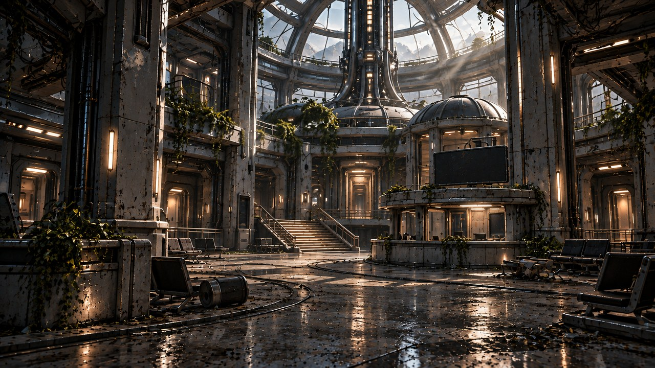
›
Notes:
SESSION 10. GM bible v12 is story authority. ENVIRONMENT: hub.
VISUAL: Scene restored from source 76 / hub environment; native prop where needed
PLAYBACK: embedded silent H.264 background starts on slide entry and loops; advance with Right Arrow or remote. No slide timer. Static poster fallback retained. Faces and native evidence remain fixed for continuity. Desktop PowerPoint playback not tested in this environment.
OBJECT MOTION V2: {"stars": 0, "practical_light_cores": 18, "cloud_layers": 1, "foliage_layers": 5, "rain_scope": "none", "source_effects": "none"}

Slide 88
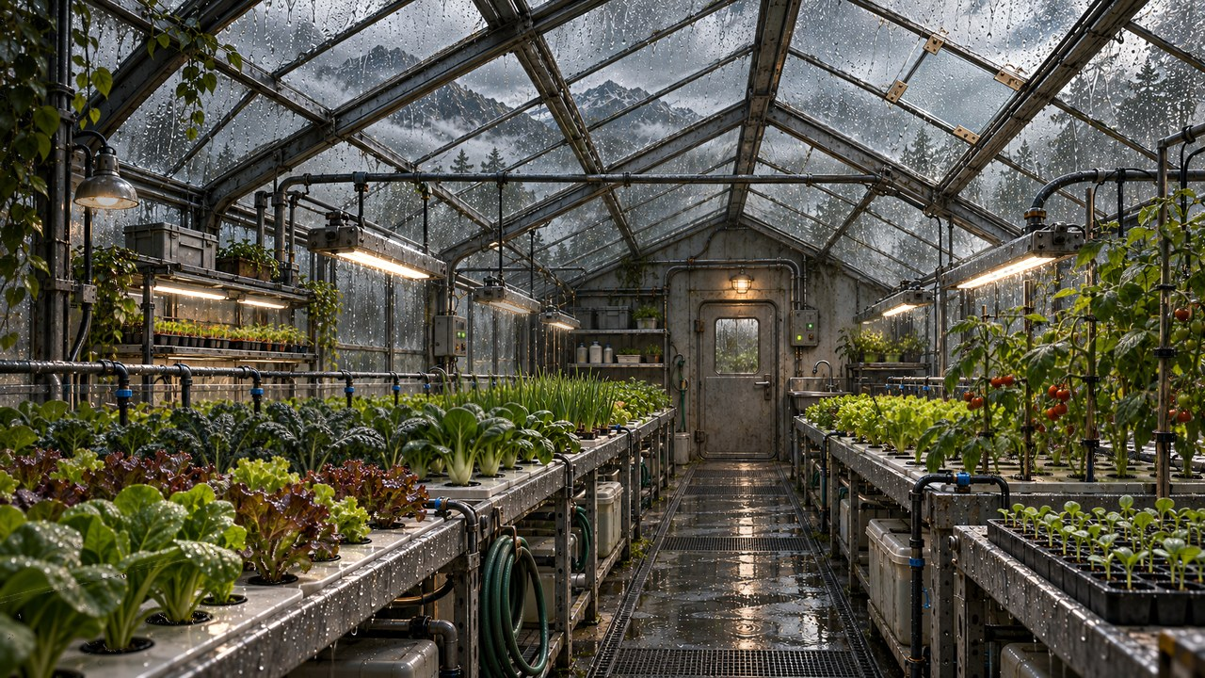
›
Notes:
SESSION 10. GM bible v12 is story authority. ENVIRONMENT: greenhouse.
Optional brief montage; cut freely to protect the school scene.
VISUAL: Scene restored from source 78 / greenhouse environment; native prop where needed
PLAYBACK: embedded silent H.264 background starts on slide entry and loops; advance with Right Arrow or remote. No slide timer. Static poster fallback retained. Faces and native evidence remain fixed for continuity. Desktop PowerPoint playback not tested in this environment.
OBJECT MOTION V2: {"stars": 0, "practical_light_cores": 18, "cloud_layers": 1, "foliage_layers": 5, "rain_scope": "rain behind greenhouse roof glazing, with indoor plants occluding it", "source_effects": "none"}

Slide 89
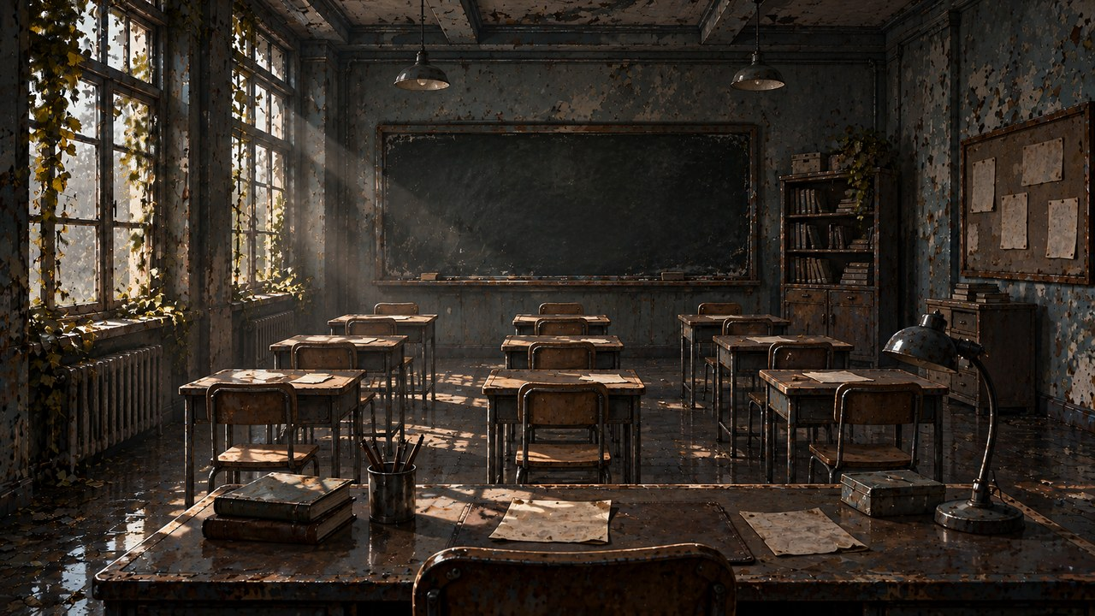
›
Notes:
SESSION 10. GM bible v12 is story authority. ENVIRONMENT: school.
VISUAL: Scene restored from source 32 / school environment; native prop where needed
PLAYBACK: embedded silent H.264 background starts on slide entry and loops; advance with Right Arrow or remote. No slide timer. Static poster fallback retained. Faces and native evidence remain fixed for continuity. Desktop PowerPoint playback not tested in this environment.
OBJECT MOTION V2: {"stars": 0, "practical_light_cores": 0, "cloud_layers": 0, "foliage_layers": 2, "rain_scope": "none", "source_effects": "none"}

Slide 90
THE SCHOOL
CLASSROOM
TEACHER’S DESK
NOTICEBOARD
CORRIDOR
STORAGE
ARCHIVE
›
Notes:
SESSION 10. GM bible v12 is story authority. ENVIRONMENT: school.
Readable orientation schematic, not a canonical scale floor plan. Move required clues to the route students choose. No GM reveal map projected.
VISUAL: Native schematic
PLAYBACK: embedded silent H.264 background starts on slide entry and loops; advance with Right Arrow or remote. No slide timer. Static poster fallback retained. Faces and native evidence remain fixed for continuity. Desktop PowerPoint playback not tested in this environment.
OBJECT MOTION V2: {"stars": 0, "practical_light_cores": 0, "cloud_layers": 0, "foliage_layers": 2, "rain_scope": "none", "source_effects": "none"}

Slide 91
HOME CALLBACK
HOME
›
Notes:
SESSION 10. GM bible v12 is story authority. ENVIRONMENT: school.
VISUAL: Scene restored from source 54 / school environment; native prop where needed
PLAYBACK: embedded silent H.264 background starts on slide entry and loops; advance with Right Arrow or remote. No slide timer. Static poster fallback retained. Faces and native evidence remain fixed for continuity. Desktop PowerPoint playback not tested in this environment.
OBJECT MOTION V2: {"stars": 0, "practical_light_cores": 0, "cloud_layers": 0, "foliage_layers": 2, "rain_scope": "none", "source_effects": "none"}

Slide 92
CHILD’S DRAWING
HOME IS WHERE
WE DECIDED TO STAY.
›
Notes:
SESSION 10. GM bible v12 is story authority. ENVIRONMENT: school.
VISUAL: Native editable clue over school motion
PLAYBACK: embedded silent H.264 background starts on slide entry and loops; advance with Right Arrow or remote. No slide timer. Static poster fallback retained. Faces and native evidence remain fixed for continuity. Desktop PowerPoint playback not tested in this environment.
OBJECT MOTION V2: {"stars": 0, "practical_light_cores": 0, "cloud_layers": 0, "foliage_layers": 2, "rain_scope": "none", "source_effects": "none"}

Slide 93
THE IMPOSSIBLE PHOTOGRAPH
ASTERIA SCHOOL · COHORT 01
You recognize yourselves.
Older.
›
Notes:
SESSION 10. GM bible v12 is story authority. ENVIRONMENT: school.
Read photo reveal from bible: Venn, Vale and older Cohort 01. Hold eight seconds of silence. Native photographic-caption artifact stands in for a literal face-matched photograph; no invented class or NPC likenesses.
VISUAL: Native editable clue over school motion
PLAYBACK: embedded silent H.264 background starts on slide entry and loops; advance with Right Arrow or remote. No slide timer. Static poster fallback retained. Faces and native evidence remain fixed for continuity. Desktop PowerPoint playback not tested in this environment.
OBJECT MOTION V2: {"stars": 0, "practical_light_cores": 0, "cloud_layers": 0, "foliage_layers": 2, "rain_scope": "none", "source_effects": "none"}

Slide 94
ON THE TEACHER’S DESK
The object you brought from Earth.
›
Notes:
SESSION 10. GM bible v12 is story authority. ENVIRONMENT: school.
Name the fictional character and describe the same scratch / sticker. Use the object recorded in Session 1.
VISUAL: Native editable clue over school motion
PLAYBACK: embedded silent H.264 background starts on slide entry and loops; advance with Right Arrow or remote. No slide timer. Static poster fallback retained. Faces and native evidence remain fixed for continuity. Desktop PowerPoint playback not tested in this environment.
OBJECT MOTION V2: {"stars": 0, "practical_light_cores": 0, "cloud_layers": 0, "foliage_layers": 2, "rain_scope": "none", "source_effects": "none"}

Slide 95
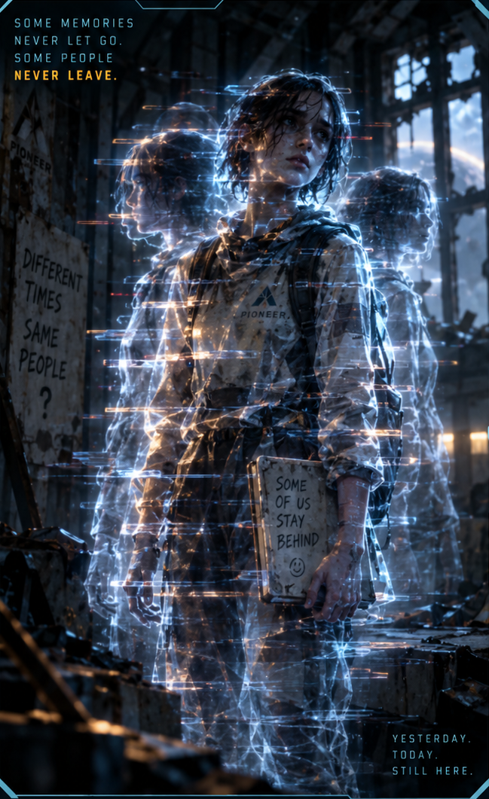
COLONY ECHO
RECOGNIZE · CONNECT
PROTECT THE PHOTOGRAPH
›
Notes:
SESSION 10. GM bible v12 is story authority. ENVIRONMENT: school.
Dangerous 3 Threat Boxes. Not purely hostile: stabilizes through recognition, naming or calm address. Preserve photo/archive evidence. Combat optional.
VISUAL: Supplied enemy dossier 5, non-destructive artwork crop; school motion
PLAYBACK: embedded silent H.264 background starts on slide entry and loops; advance with Right Arrow or remote. No slide timer. Static poster fallback retained. Faces and native evidence remain fixed for continuity. Desktop PowerPoint playback not tested in this environment.
OBJECT MOTION V2: {"stars": 0, "practical_light_cores": 0, "cloud_layers": 0, "foliage_layers": 2, "rain_scope": "none", "source_effects": "none"}

Slide 96
COLONY RECORDS
SUCCESSFUL
LOST
RETURNED
›
Notes:
SESSION 10. GM bible v12 is story authority. ENVIRONMENT: school.
Contradictory possible colony outcomes; do not pick one for the class.
VISUAL: Native editable clue over school motion
PLAYBACK: embedded silent H.264 background starts on slide entry and loops; advance with Right Arrow or remote. No slide timer. Static poster fallback retained. Faces and native evidence remain fixed for continuity. Desktop PowerPoint playback not tested in this environment.
OBJECT MOTION V2: {"stars": 0, "practical_light_cores": 0, "cloud_layers": 0, "foliage_layers": 2, "rain_scope": "none", "source_effects": "none"}

Slide 97
POSSIBLE FUTURES
Not one history.
More than one possible future.
›
Notes:
SESSION 10. GM bible v12 is story authority. ENVIRONMENT: school.
The colony was built by a possible future Cohort 01. Let the class connect the emotional evidence.
VISUAL: Native editable clue over school motion
PLAYBACK: embedded silent H.264 background starts on slide entry and loops; advance with Right Arrow or remote. No slide timer. Static poster fallback retained. Faces and native evidence remain fixed for continuity. Desktop PowerPoint playback not tested in this environment.
OBJECT MOTION V2: {"stars": 0, "practical_light_cores": 0, "cloud_layers": 0, "foliage_layers": 2, "rain_scope": "none", "source_effects": "none"}

Slide 98
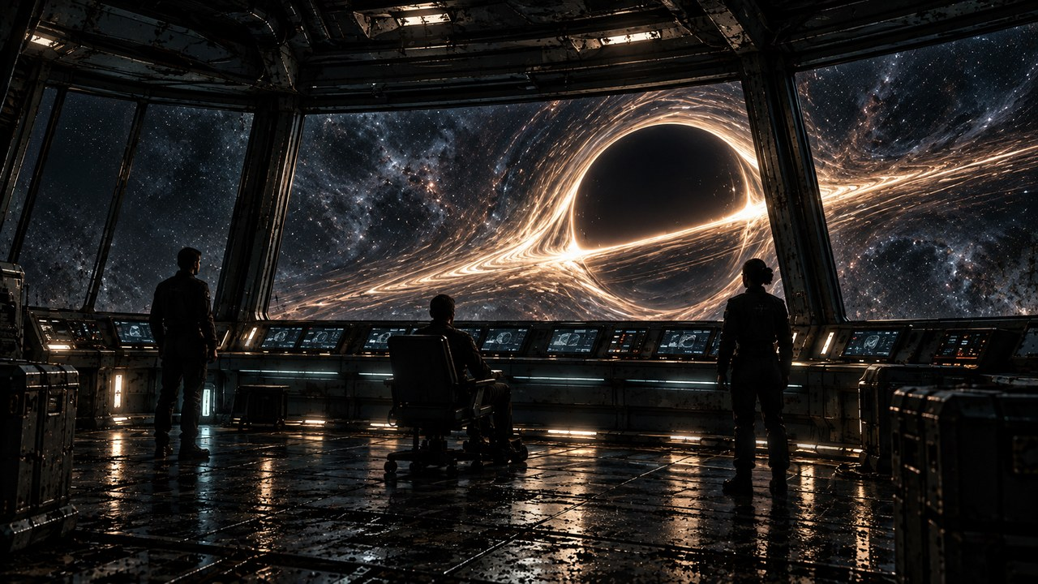
THE FAR HORIZON
11
What do we do?
›
Notes:
SESSION 11. GM bible v12 is story authority. ENVIRONMENT: final_anomaly.
Start when ready for this session. Doom is atmosphere, not a replacement for wonder or player choice.
VISUAL: Environment motion / native chapter typography
PLAYBACK: embedded silent H.264 background starts on slide entry and loops; advance with Right Arrow or remote. No slide timer. Static poster fallback retained. Faces and native evidence remain fixed for continuity. Desktop PowerPoint playback not tested in this environment.
OBJECT MOTION V2: {"stars": 120, "practical_light_cores": 28, "cloud_layers": 0, "foliage_layers": 0, "rain_scope": "none", "source_effects": "none"}

Slide 99
MAINTENANCE RECORD
UNIT M-77 / HAB DECK
STATUS: REPAIRED
COMPLETED: TOMORROW 14:32
TECHNICIAN COHORT 01
“Collision with unrecorded passenger resolved.”
›
Notes:
SESSION 11. GM bible v12 is story authority. ENVIRONMENT: final_anomaly.
Reveal after maintenance encounter; repeat at final explanation. Rat presence is ambient, not an explanation of the unrecorded passenger.
VISUAL: Native editable clue over final_anomaly motion
PLAYBACK: embedded silent H.264 background starts on slide entry and loops; advance with Right Arrow or remote. No slide timer. Static poster fallback retained. Faces and native evidence remain fixed for continuity. Desktop PowerPoint playback not tested in this environment.
OBJECT MOTION V2: {"stars": 120, "practical_light_cores": 28, "cloud_layers": 0, "foliage_layers": 0, "rain_scope": "none", "source_effects": "none"}

Slide 100
FUTURE TRANSMISSION
ARRIVAL CONFIRMED
SOURCE: CSV-01 PIONEER
TIMESTAMP: +103 DAYS
›
Notes:
SESSION 11. GM bible v12 is story authority. ENVIRONMENT: comms.
Session 11 callback. Explain under preserved possibilities, not simple prophecy.
VISUAL: Native editable clue over comms motion
PLAYBACK: embedded silent H.264 background starts on slide entry and loops; advance with Right Arrow or remote. No slide timer. Static poster fallback retained. Faces and native evidence remain fixed for continuity. Desktop PowerPoint playback not tested in this environment.
OBJECT MOTION V2: {"stars": 0, "practical_light_cores": 28, "cloud_layers": 0, "foliage_layers": 0, "rain_scope": "none", "source_effects": "none"}

Slide 101
›
Notes:
SESSION 11. GM bible v12 is story authority. ENVIRONMENT: derelict_exterior.
VISUAL: Scene restored from source 17 / derelict_exterior environment; native prop where needed
PLAYBACK: embedded silent H.264 background starts on slide entry and loops; advance with Right Arrow or remote. No slide timer. Static poster fallback retained. Faces and native evidence remain fixed for continuity. Desktop PowerPoint playback not tested in this environment.
OBJECT MOTION V2: {"stars": 111, "practical_light_cores": 28, "cloud_layers": 0, "foliage_layers": 0, "rain_scope": "none", "source_effects": "none"}

Slide 102
THE IMPOSSIBLE PHOTOGRAPH
ASTERIA SCHOOL · COHORT 01
You recognize yourselves.
Older.
›
Notes:
SESSION 11. GM bible v12 is story authority. ENVIRONMENT: final_anomaly.
Read photo reveal from bible: Venn, Vale and older Cohort 01. Hold eight seconds of silence. Native photographic-caption artifact stands in for a literal face-matched photograph; no invented class or NPC likenesses.
VISUAL: Native editable clue over final_anomaly motion
PLAYBACK: embedded silent H.264 background starts on slide entry and loops; advance with Right Arrow or remote. No slide timer. Static poster fallback retained. Faces and native evidence remain fixed for continuity. Desktop PowerPoint playback not tested in this environment.
OBJECT MOTION V2: {"stars": 120, "practical_light_cores": 28, "cloud_layers": 0, "foliage_layers": 0, "rain_scope": "none", "source_effects": "none"}

Slide 103
K-17
Unchosen possibilities
can become real.
›
Notes:
SESSION 11. GM bible v12 is story authority. ENVIRONMENT: final_anomaly.
Explain the full mechanism now. Cohort biological compatibility permits overlap; consequential coordinated CHOICE is the deeper key.
VISUAL: Native editable clue over final_anomaly motion
PLAYBACK: embedded silent H.264 background starts on slide entry and loops; advance with Right Arrow or remote. No slide timer. Static poster fallback retained. Faces and native evidence remain fixed for continuity. Desktop PowerPoint playback not tested in this environment.
OBJECT MOTION V2: {"stars": 120, "practical_light_cores": 28, "cloud_layers": 0, "foliage_layers": 0, "rain_scope": "none", "source_effects": "none"}

Slide 104
THE WARNING RESOLVED
Juno Reyes
IRIS
›
Notes:
SESSION 11. GM bible v12 is story authority. ENVIRONMENT: final_anomaly.
IRIS explains that in one future Juno answers the message and completes the communication loop. The warning concerned her action, not her character.
VISUAL: Original canonical portraits 42,44 over final_anomaly motion
PLAYBACK: embedded silent H.264 background starts on slide entry and loops; advance with Right Arrow or remote. No slide timer. Static poster fallback retained. Faces and native evidence remain fixed for continuity. Desktop PowerPoint playback not tested in this environment.
OBJECT MOTION V2: {"stars": 120, "practical_light_cores": 28, "cloud_layers": 0, "foliage_layers": 0, "rain_scope": "none", "source_effects": "none"}

Slide 105
CAPTAIN MARA VENN
Mission commander
›
Notes:
SESSION 11. GM bible v12 is story authority. ENVIRONMENT: final_anomaly.
Venn admits deliberate routing and yields the final choice to Cohort 01.
VISUAL: Original canonical portrait 37; contextual final_anomaly motion
PLAYBACK: embedded silent H.264 background starts on slide entry and loops; advance with Right Arrow or remote. No slide timer. Static poster fallback retained. Faces and native evidence remain fixed for continuity. Desktop PowerPoint playback not tested in this environment.
OBJECT MOTION V2: {"stars": 120, "practical_light_cores": 28, "cloud_layers": 0, "foliage_layers": 0, "rain_scope": "none", "source_effects": "none"}

Slide 106
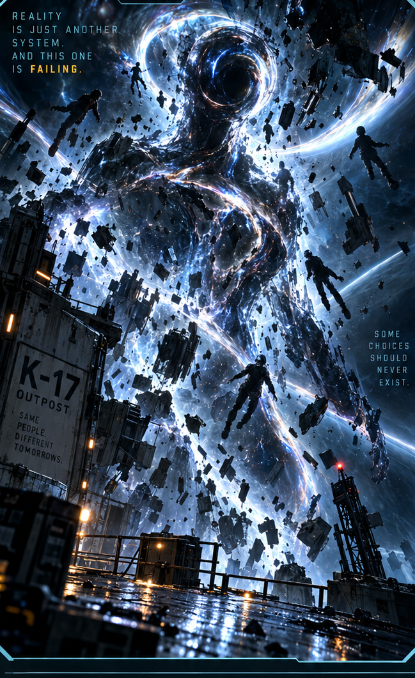
K-17 FRACTURE ENTITY
SURVIVE
SYNCHRONIZE
COMMIT
›
Notes:
SESSION 11. GM bible v12 is story authority. ENVIRONMENT: final_anomaly.
Boss 5 Threat Boxes; attacks cannot permanently defeat it. Phases: SURVIVE, SYNCHRONIZE, COMMIT. Final Threat Box disappears only with a shared consequential choice.
VISUAL: Supplied enemy dossier 6, non-destructive artwork crop; final_anomaly motion
PLAYBACK: embedded silent H.264 background starts on slide entry and loops; advance with Right Arrow or remote. No slide timer. Static poster fallback retained. Faces and native evidence remain fixed for continuity. Desktop PowerPoint playback not tested in this environment.
OBJECT MOTION V2: {"stars": 120, "practical_light_cores": 28, "cloud_layers": 0, "foliage_layers": 0, "rain_scope": "none", "source_effects": "none"}

Slide 107
SURVIVE → SYNCHRONIZE
Tomas Rhee
Elias Vale
Nia Okafor
IRIS
›
Notes:
SESSION 11. GM bible v12 is story authority. ENVIRONMENT: final_anomaly.
Give all four departments one function and action. One combined plan removes 2 Threat Boxes.
VISUAL: Original canonical portraits 41,39,40,44 over final_anomaly motion
PLAYBACK: embedded silent H.264 background starts on slide entry and loops; advance with Right Arrow or remote. No slide timer. Static poster fallback retained. Faces and native evidence remain fixed for continuity. Desktop PowerPoint playback not tested in this environment.
OBJECT MOTION V2: {"stars": 120, "practical_light_cores": 28, "cloud_layers": 0, "foliage_layers": 0, "rain_scope": "none", "source_effects": "none"}

Slide 108
COMMIT
RETURN TO EARTH
STAY ON ASTERIA
INVESTIGATE K-17
SEAL / PAUSE THE CONNECTION
YOUR PLAN — WITH A COST
›
Notes:
SESSION 11. GM bible v12 is story authority. ENVIRONMENT: final_anomaly.
No roll for the final choice. Give companies 45 seconds to persuade, then vote or reach consensus.
VISUAL: Native editable clue over final_anomaly motion
PLAYBACK: embedded silent H.264 background starts on slide entry and loops; advance with Right Arrow or remote. No slide timer. Static poster fallback retained. Faces and native evidence remain fixed for continuity. Desktop PowerPoint playback not tested in this environment.
OBJECT MOTION V2: {"stars": 120, "practical_light_cores": 28, "cloud_layers": 0, "foliage_layers": 0, "rain_scope": "none", "source_effects": "none"}

Slide 109
›
Notes:
SESSION 11. GM bible v12 is story authority. ENVIRONMENT: final_anomaly.
This visual holds the choice; it does not mandate investigation.
VISUAL: Scene restored from source 35 / final_anomaly environment; native prop where needed
PLAYBACK: embedded silent H.264 background starts on slide entry and loops; advance with Right Arrow or remote. No slide timer. Static poster fallback retained. Faces and native evidence remain fixed for continuity. Desktop PowerPoint playback not tested in this environment.
OBJECT MOTION V2: {"stars": 120, "practical_light_cores": 28, "cloud_layers": 0, "foliage_layers": 0, "rain_scope": "none", "source_effects": "none"}

Slide 110
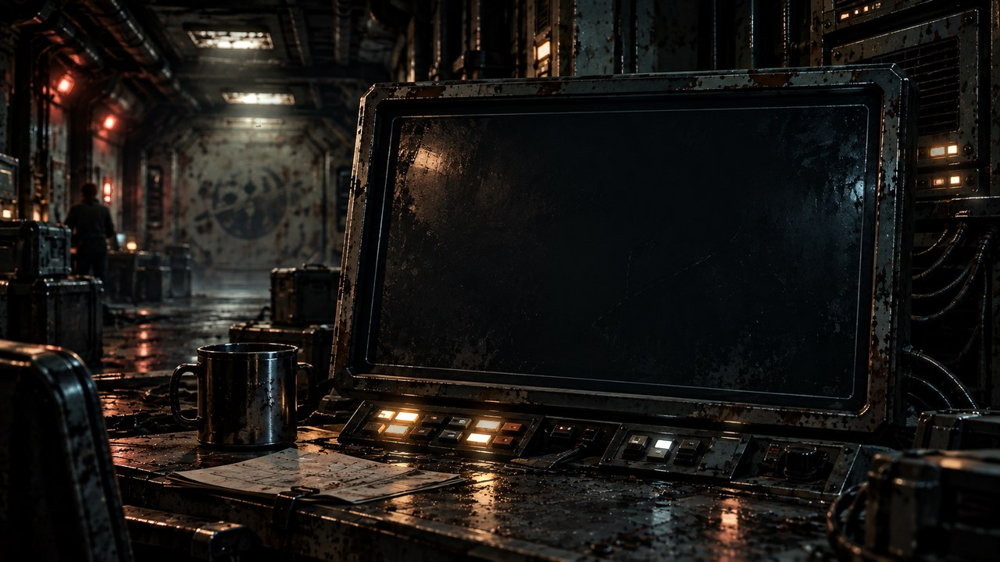
THE FAR HORIZON
12
Change
›
Notes:
SESSION 12. GM bible v12 is story authority. ENVIRONMENT: finale.
Start when ready for this session. Doom is atmosphere, not a replacement for wonder or player choice.
VISUAL: Environment motion / native chapter typography
PLAYBACK: embedded silent H.264 background starts on slide entry and loops; advance with Right Arrow or remote. No slide timer. Static poster fallback retained. Faces and native evidence remain fixed for continuity. Desktop PowerPoint playback not tested in this environment.
OBJECT MOTION V2: {"stars": 0, "practical_light_cores": 28, "cloud_layers": 0, "foliage_layers": 0, "rain_scope": "none", "source_effects": "none"}

Slide 111
AFTER THE CHOICE
A future you chose.
›
Notes:
SESSION 12. GM bible v12 is story authority. ENVIRONMENT: finale.
Read consequences appropriate to the actual class decision. Do not mandate a colony ending. The four ending frameworks in the bible all remain available.
VISUAL: Native editable clue over finale motion
PLAYBACK: embedded silent H.264 background starts on slide entry and loops; advance with Right Arrow or remote. No slide timer. Static poster fallback retained. Faces and native evidence remain fixed for continuity. Desktop PowerPoint playback not tested in this environment.
OBJECT MOTION V2: {"stars": 0, "practical_light_cores": 28, "cloud_layers": 0, "foliage_layers": 0, "rain_scope": "none", "source_effects": "none"}

Slide 112
FINAL CREW LOG
PIONEER
CREW LOG
COHORT 01
›
Notes:
SESSION 12. GM bible v12 is story authority. ENVIRONMENT: finale.
VISUAL: Scene restored from source 66 / finale environment; native prop where needed
PLAYBACK: embedded silent H.264 background starts on slide entry and loops; advance with Right Arrow or remote. No slide timer. Static poster fallback retained. Faces and native evidence remain fixed for continuity. Desktop PowerPoint playback not tested in this environment.
OBJECT MOTION V2: {"stars": 0, "practical_light_cores": 28, "cloud_layers": 0, "foliage_layers": 0, "rain_scope": "none", "source_effects": "none"}

Slide 113
YOUR FINAL SCENE
CALLBACK · CHOICE · COST
CHANGE · FINAL IMAGE
›
Notes:
SESSION 12. GM bible v12 is story authority. ENVIRONMENT: finale.
Each company performs its chosen ending. Preserve visible transformation and one personal callback.
VISUAL: Native editable clue over finale motion
PLAYBACK: embedded silent H.264 background starts on slide entry and loops; advance with Right Arrow or remote. No slide timer. Static poster fallback retained. Faces and native evidence remain fixed for continuity. Desktop PowerPoint playback not tested in this environment.
OBJECT MOTION V2: {"stars": 0, "practical_light_cores": 28, "cloud_layers": 0, "foliage_layers": 0, "rain_scope": "none", "source_effects": "none"}

Slide 114
IRIS
Ship AI
›
Notes:
SESSION 12. GM bible v12 is story authority. ENVIRONMENT: finale.
VISUAL: Original canonical portrait 44; contextual finale motion
PLAYBACK: embedded silent H.264 background starts on slide entry and loops; advance with Right Arrow or remote. No slide timer. Static poster fallback retained. Faces and native evidence remain fixed for continuity. Desktop PowerPoint playback not tested in this environment.
OBJECT MOTION V2: {"stars": 0, "practical_light_cores": 28, "cloud_layers": 0, "foliage_layers": 0, "rain_scope": "none", "source_effects": "none"}

Slide 115
COHORT 01
Define home.
›
Notes:
SESSION 12. GM bible v12 is story authority. ENVIRONMENT: finale.
One sentence per student. Do not discuss or correct. End after the final sentence.
VISUAL: Native editable clue over finale motion
PLAYBACK: embedded silent H.264 background starts on slide entry and loops; advance with Right Arrow or remote. No slide timer. Static poster fallback retained. Faces and native evidence remain fixed for continuity. Desktop PowerPoint playback not tested in this environment.
OBJECT MOTION V2: {"stars": 0, "practical_light_cores": 28, "cloud_layers": 0, "foliage_layers": 0, "rain_scope": "none", "source_effects": "none"}

