Slide 1
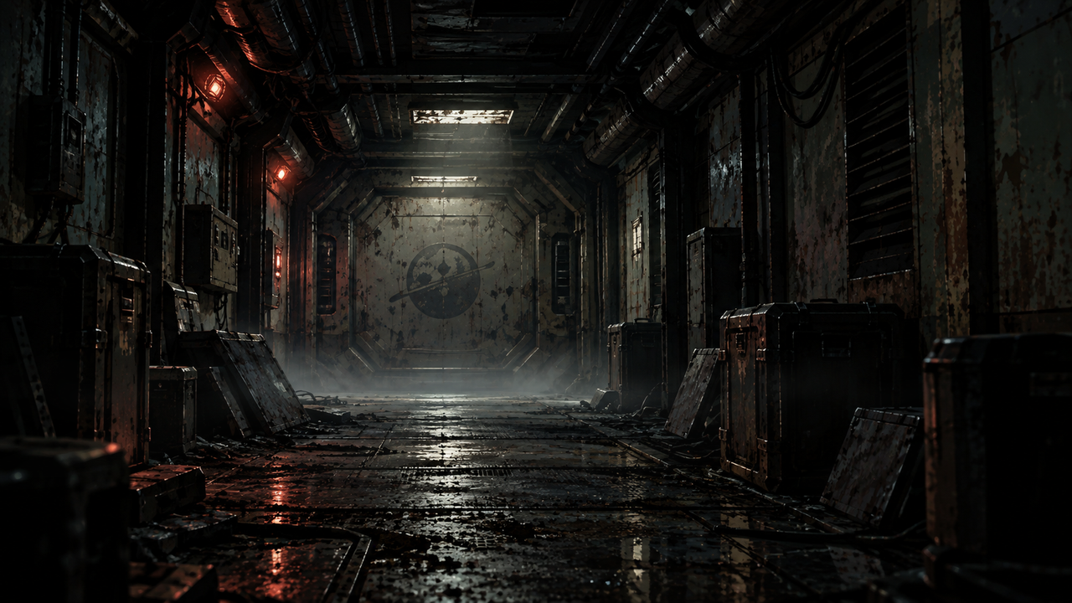
Notes:
DERELICT — STYLE BENCHMARK v2
16-second silent atmospheric loop. The camera and architecture remain fixed. Floor mist slowly changes shape and position. Dust appears only in the ceiling light beam. Two short dips in the overhead light affect the fixture, door and floor reflection. Small changes in the existing emergency lamps remain localized. No creature, story clue or new canonical event is introduced.
In desktop PowerPoint: Slide Show > From Beginning. The embedded H.264 video is set to start on slide entry and loop. No timed slide advancement. Editing view shows a still poster. Use Right Arrow / a presentation remote to advance; clicking the video can pause it. Offline media is embedded.
Programmatic checks verify the file structure and media/start/loop settings. Desktop PowerPoint playback has not been tested here. The MP4 is supplied independently for direct viewing without PowerPoint.

