Slide 1
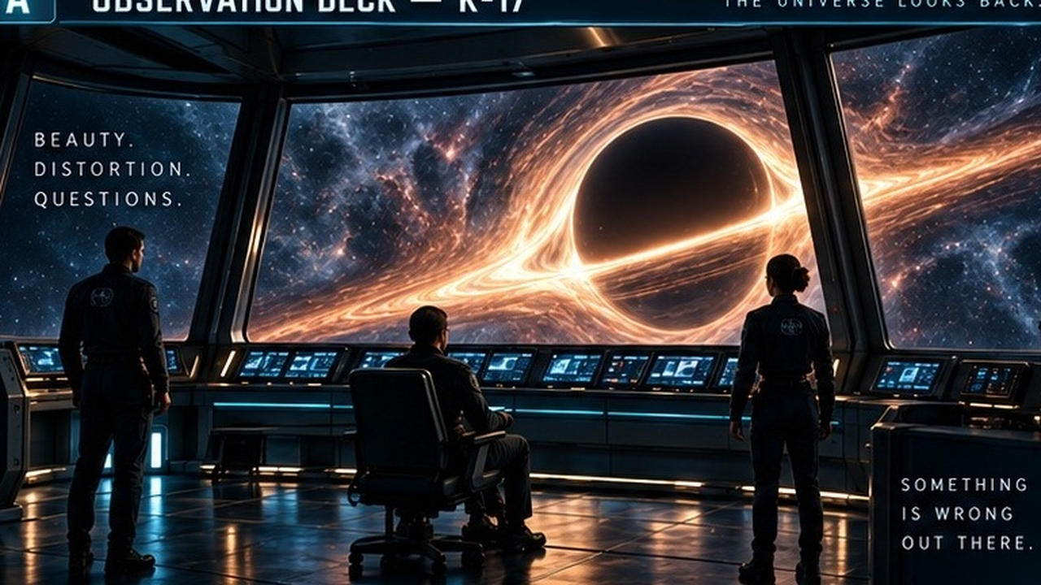
Notes:
Pioneer observation deck
Moving orbital filaments, subtly breathing amber window light, blue console glow and star glints. The people and ship interior remain anchored.
AUTOMATIC BACKGROUND: the embedded 12-second silent H.264 MP4 begins at slide entry and loops indefinitely. There are no automatic slide advances. Use Right Arrow, Page Down or a presentation remote to advance. Clicking directly on the video can pause/resume it. The looping background is intentionally atmospheric, not a character-acting animation. No voices, APIs, network access or external media files are needed.
In desktop PowerPoint: Slide Show > From Beginning. In editing view, a static poster is expected. If the classroom installation blocks media, use File > Info > Optimize Media Compatibility. Start the slideshow again to inspect automatic playback. Desktop playback has not been run in this Linux workspace.
Source: original immersive deck artwork; bible is the story authority. Sample preparation retained the original artwork; visual 35 has a non-story adjacent-panel sliver cropped away. No Telltale screenshots were accessed or copied.

Slide 2
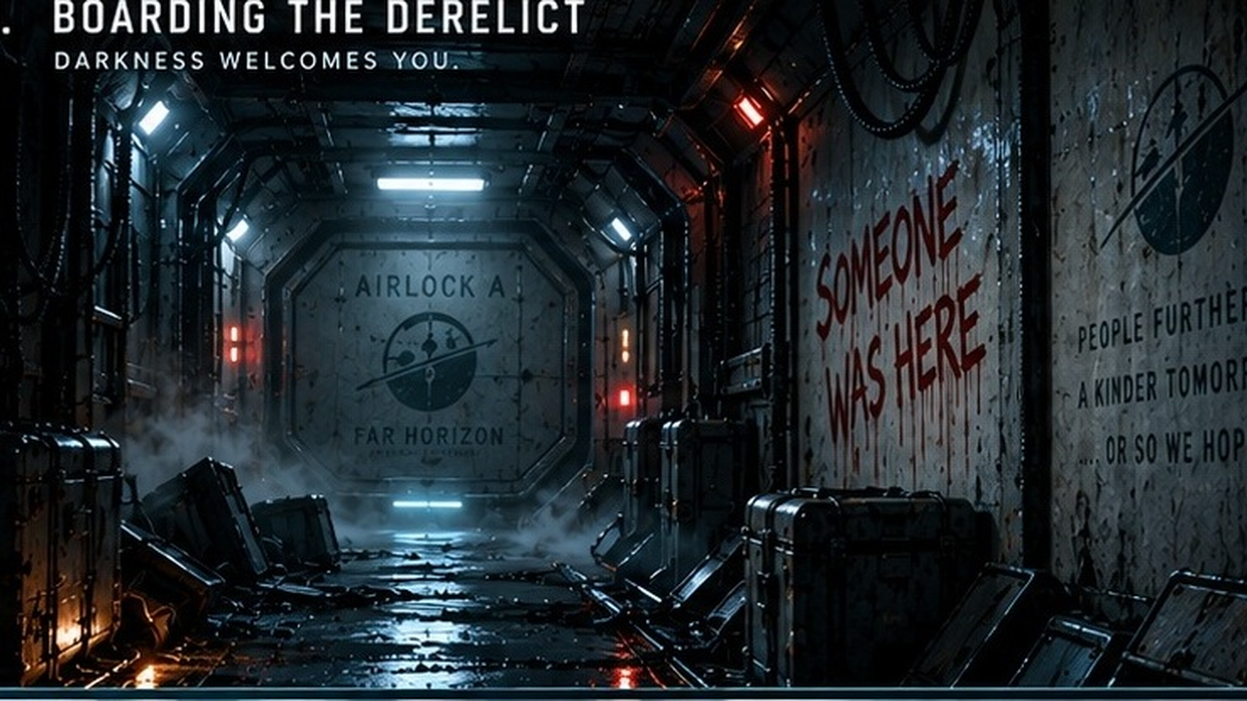
Notes:
Boarding the derelict
Drifting low fog and suspended dust with slow, localized lamp instability and a breathing red warning light. No hard flashes or strobe effects.
AUTOMATIC BACKGROUND: the embedded 12-second silent H.264 MP4 begins at slide entry and loops indefinitely. There are no automatic slide advances. Use Right Arrow, Page Down or a presentation remote to advance. Clicking directly on the video can pause/resume it. The looping background is intentionally atmospheric, not a character-acting animation. No voices, APIs, network access or external media files are needed.
In desktop PowerPoint: Slide Show > From Beginning. In editing view, a static poster is expected. If the classroom installation blocks media, use File > Info > Optimize Media Compatibility. Start the slideshow again to inspect automatic playback. Desktop playback has not been run in this Linux workspace.
Source: original immersive deck artwork; bible is the story authority. Sample preparation retained the original artwork; visual 35 has a non-story adjacent-panel sliver cropped away. No Telltale screenshots were accessed or copied.

Slide 3
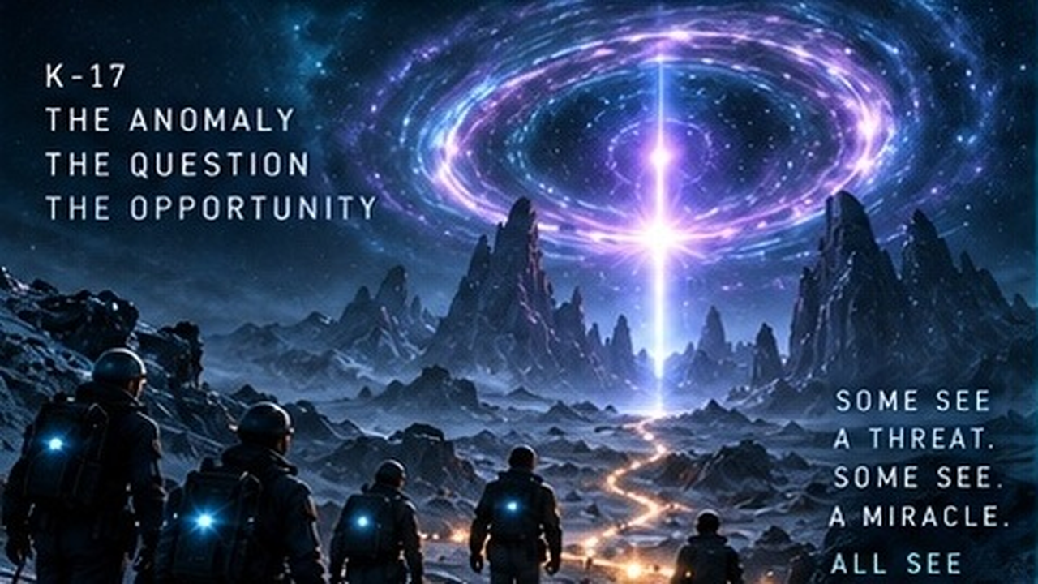
Notes:
K-17: commit to a future
Travelling violet portal filaments, shifting interior light and a slowly pulsing central beam. Terrain and silhouetted crew remain anchored. This is a late-campaign visual, not the subtle Session 1 seed.
AUTOMATIC BACKGROUND: the embedded 12-second silent H.264 MP4 begins at slide entry and loops indefinitely. There are no automatic slide advances. Use Right Arrow, Page Down or a presentation remote to advance. Clicking directly on the video can pause/resume it. The looping background is intentionally atmospheric, not a character-acting animation. No voices, APIs, network access or external media files are needed.
In desktop PowerPoint: Slide Show > From Beginning. In editing view, a static poster is expected. If the classroom installation blocks media, use File > Info > Optimize Media Compatibility. Start the slideshow again to inspect automatic playback. Desktop playback has not been run in this Linux workspace.
Source: original immersive deck artwork; bible is the story authority. Sample preparation retained the original artwork; visual 35 has a non-story adjacent-panel sliver cropped away. No Telltale screenshots were accessed or copied.

