Slide 1
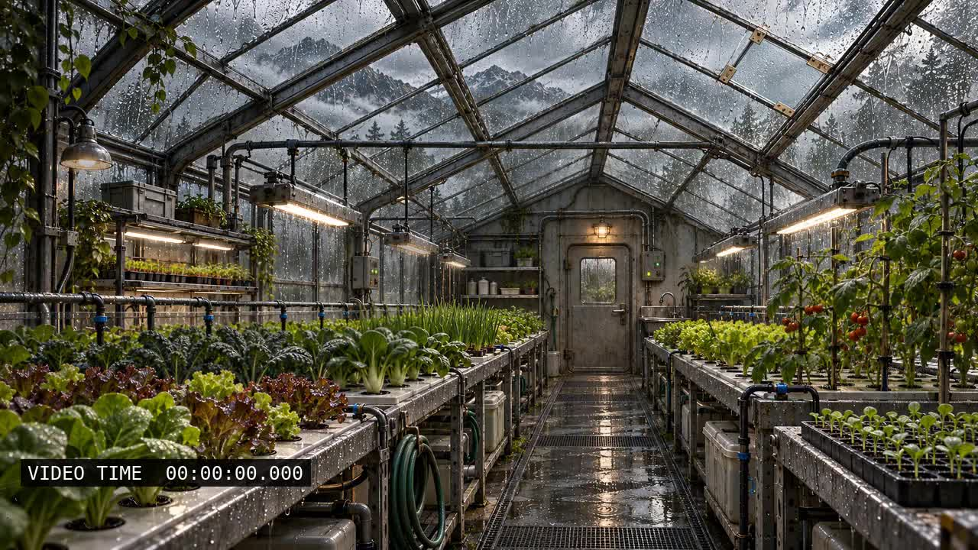
1 — CURRENT VIDEO TIMING
Slide Show → From Beginning. Wait 5 seconds without clicking the picture; then advance with Right Arrow.
Notes:
Diagnostic only. The VIDEO TIME counter is burned into the media: if it changes, the media is playing. Do not click the picture to start it. Note which slide starts moving automatically in browser Slide Show. The animated-image control is deliberately lower resolution and shorter than the master video; it is not a replacement for the approved artwork.

Slide 2
2 — ALTERNATIVE AUTOMATIC PLAY
Slide Show → From Beginning. Wait 5 seconds without clicking the picture; then advance with Right Arrow.
Notes:
Diagnostic only. The VIDEO TIME counter is burned into the media: if it changes, the media is playing. Do not click the picture to start it. Note which slide starts moving automatically in browser Slide Show. The animated-image control is deliberately lower resolution and shorter than the master video; it is not a replacement for the approved artwork.

Slide 3
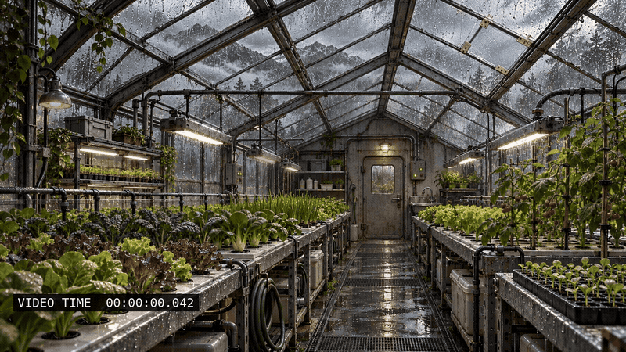
3 — ANIMATED IMAGE CONTROL
Slide Show → From Beginning. Wait 5 seconds without clicking the picture; then advance with Right Arrow.
Notes:
Diagnostic only. The VIDEO TIME counter is burned into the media: if it changes, the media is playing. Do not click the picture to start it. Note which slide starts moving automatically in browser Slide Show. The animated-image control is deliberately lower resolution and shorter than the master video; it is not a replacement for the approved artwork.

