Slide 1
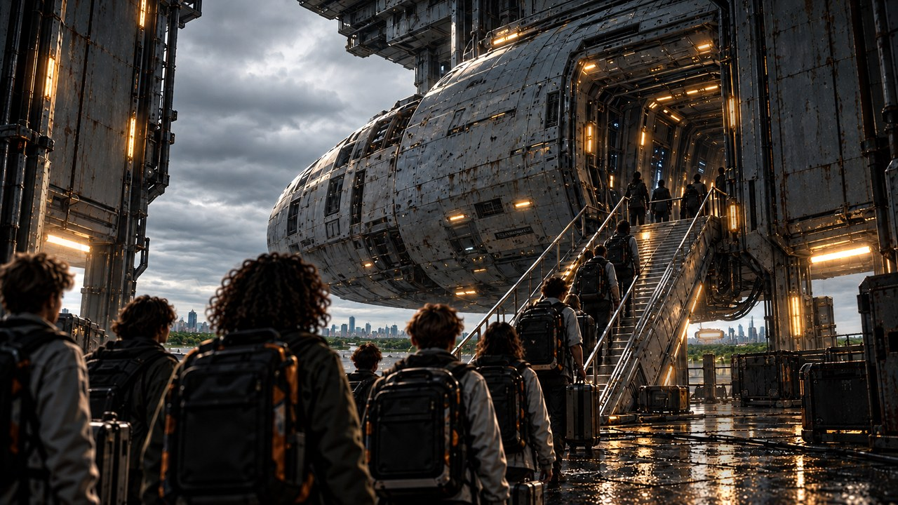
THE FAR HORIZON
01
Welcome to Pioneer
MAP ↗
›
Notes:
SESSION 1. GM bible v12 is story authority. ENVIRONMENT: boarding.
Start when ready for this session. MAP opens that session’s linked visual map.
VISUAL: Animated chapter / native typography
PLAYBACK: embedded silent H.264 starts automatically and loops. Advance manually; no timed slide changes. Static poster fallback. Actual Microsoft PowerPoint playback has not been tested on this Linux machine.

Slide 2
EARTH → ASTERIA-4
One world behind you.
A second home ahead.
›
Notes:
SESSION 1. GM bible v12 is story authority. ENVIRONMENT: boarding.
Earth is healthy. Record every fictional character’s personal Earth object for the Session 10 callback.
VISUAL: Native story cue over visible animated boarding environment
PLAYBACK: embedded silent H.264 starts automatically and loops. Advance manually; no timed slide changes. Static poster fallback. Actual Microsoft PowerPoint playback has not been tested on this Linux machine.

Slide 3
›
Notes:
SESSION 1. GM bible v12 is story authority. ENVIRONMENT: boarding.
Play the boarding company scene; each group physically crosses the line. The woman by the boarding ramp is consistent with Mara Venn’s standalone portrait.
VISUAL: Environment from original immersive source 3; source-local object animation
PLAYBACK: embedded silent H.264 starts automatically and loops. Advance manually; no timed slide changes. Static poster fallback. Actual Microsoft PowerPoint playback has not been tested on this Linux machine.

Slide 4
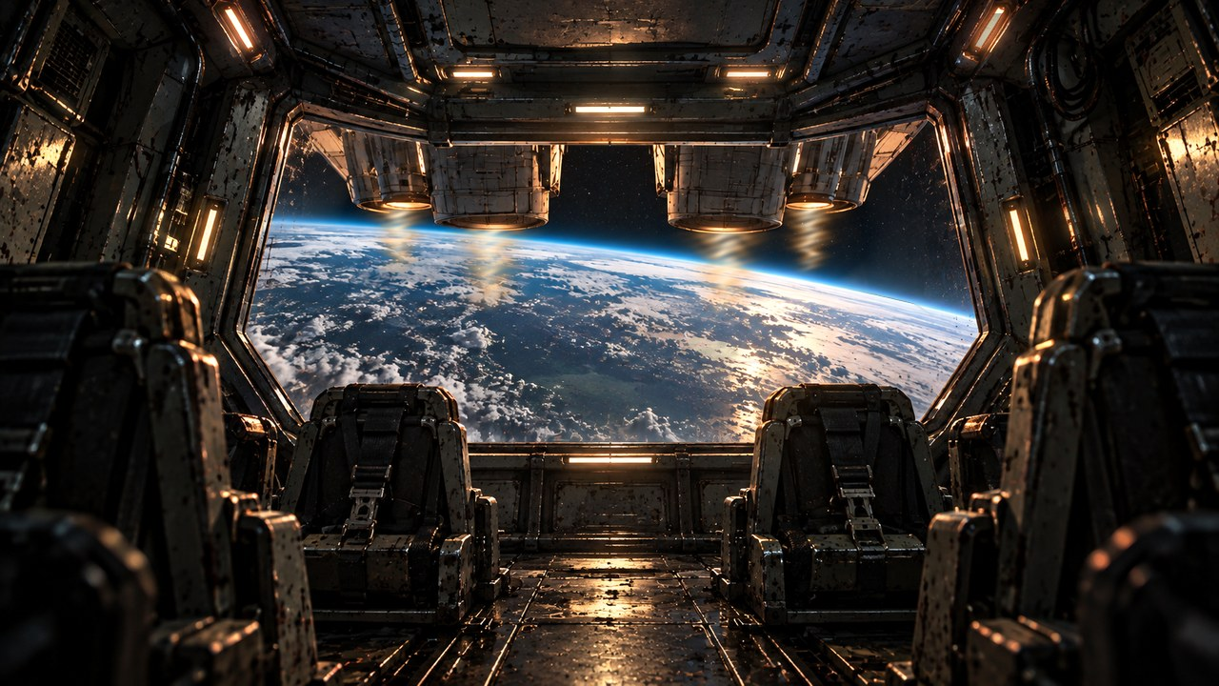
›
Notes:
SESSION 1. GM bible v12 is story authority. ENVIRONMENT: launch.
READ Session 1 Scene 2 Launch. Use the Earth-through-bridge artwork as a launch hold. A dedicated launch scene has been prepared for this edition. Do not begin crew introduction or tour until launch is complete.
VISUAL: Environment from original immersive source 4; source-local object animation
PLAYBACK: embedded silent H.264 starts automatically and loops. Advance manually; no timed slide changes. Static poster fallback. Actual Microsoft PowerPoint playback has not been tested on this Linux machine.

Slide 5




WELCOME ABOARD
Mara Venn
Juno Reyes
Tomas Rhee
›
Notes:
SESSION 1. GM bible v12 is story authority. ENVIRONMENT: bridge.
Crew introduction begins AFTER launch. Venn, Juno and Rhee greet Cohort 01.
VISUAL: Canonical portrait gallery over visibly moving contextual environment
PLAYBACK: embedded silent H.264 starts automatically and loops. Advance manually; no timed slide changes. Static poster fallback. Actual Microsoft PowerPoint playback has not been tested on this Linux machine.

Slide 6
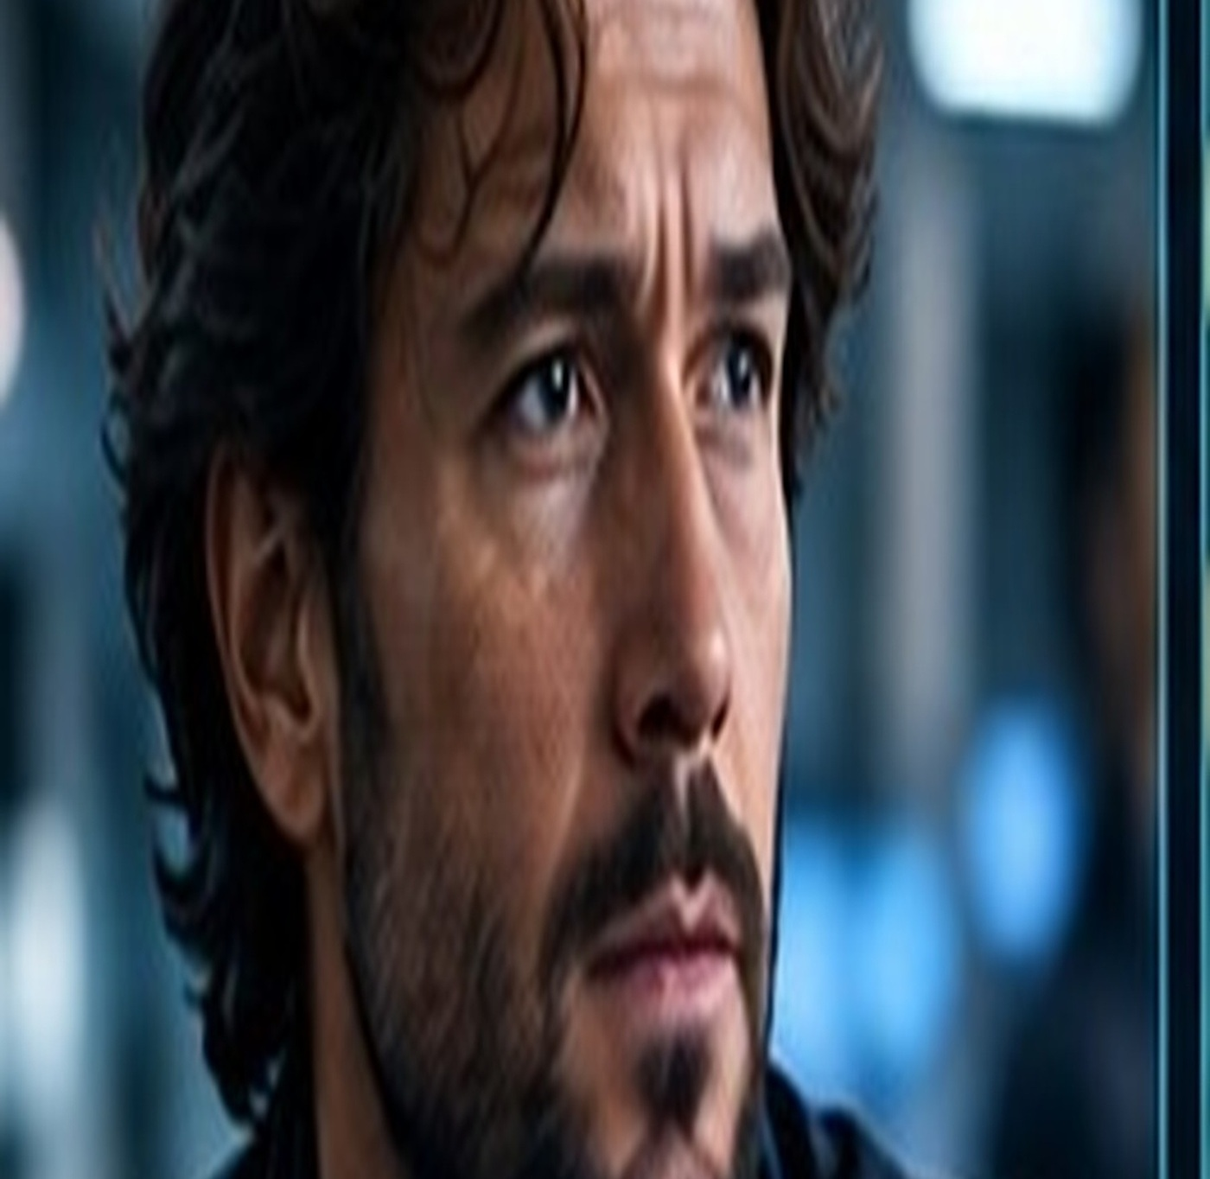
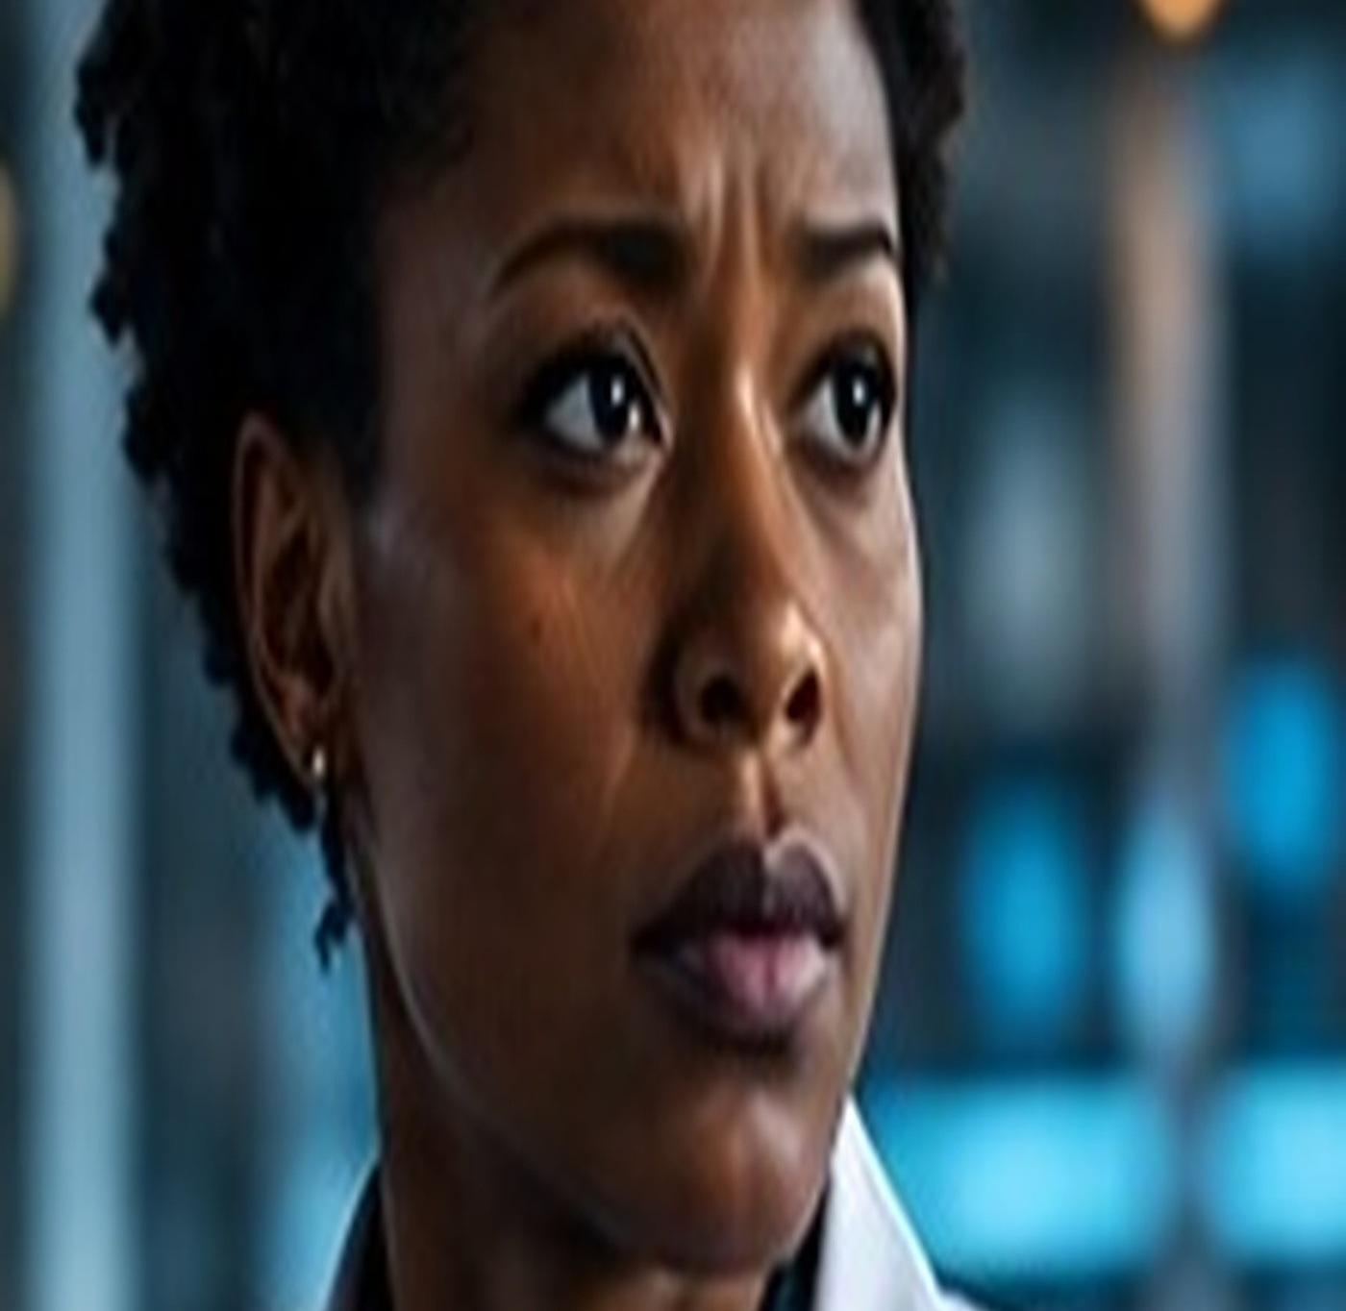

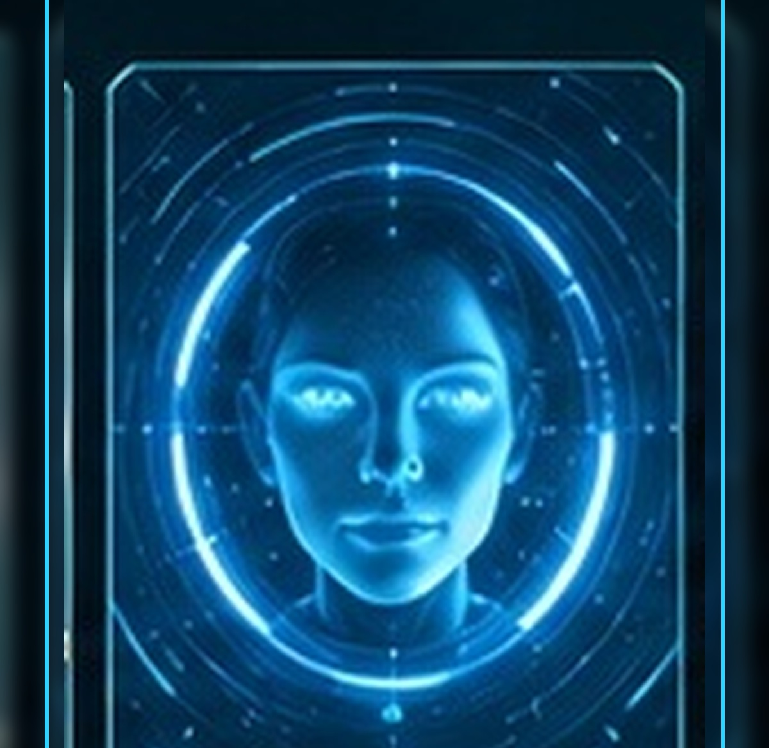
MEET YOUR CREW
Elias Vale
Nia Okafor
Marcus Bell
IRIS
›
Notes:
SESSION 1. GM bible v12 is story authority. ENVIRONMENT: bridge.
Introduce Vale, Okafor, Bell and IRIS. The standalone portraits are the continuity reference throughout this deck.
VISUAL: Canonical portrait gallery over visibly moving contextual environment
PLAYBACK: embedded silent H.264 starts automatically and loops. Advance manually; no timed slide changes. Static poster fallback. Actual Microsoft PowerPoint playback has not been tested on this Linux machine.

Slide 7
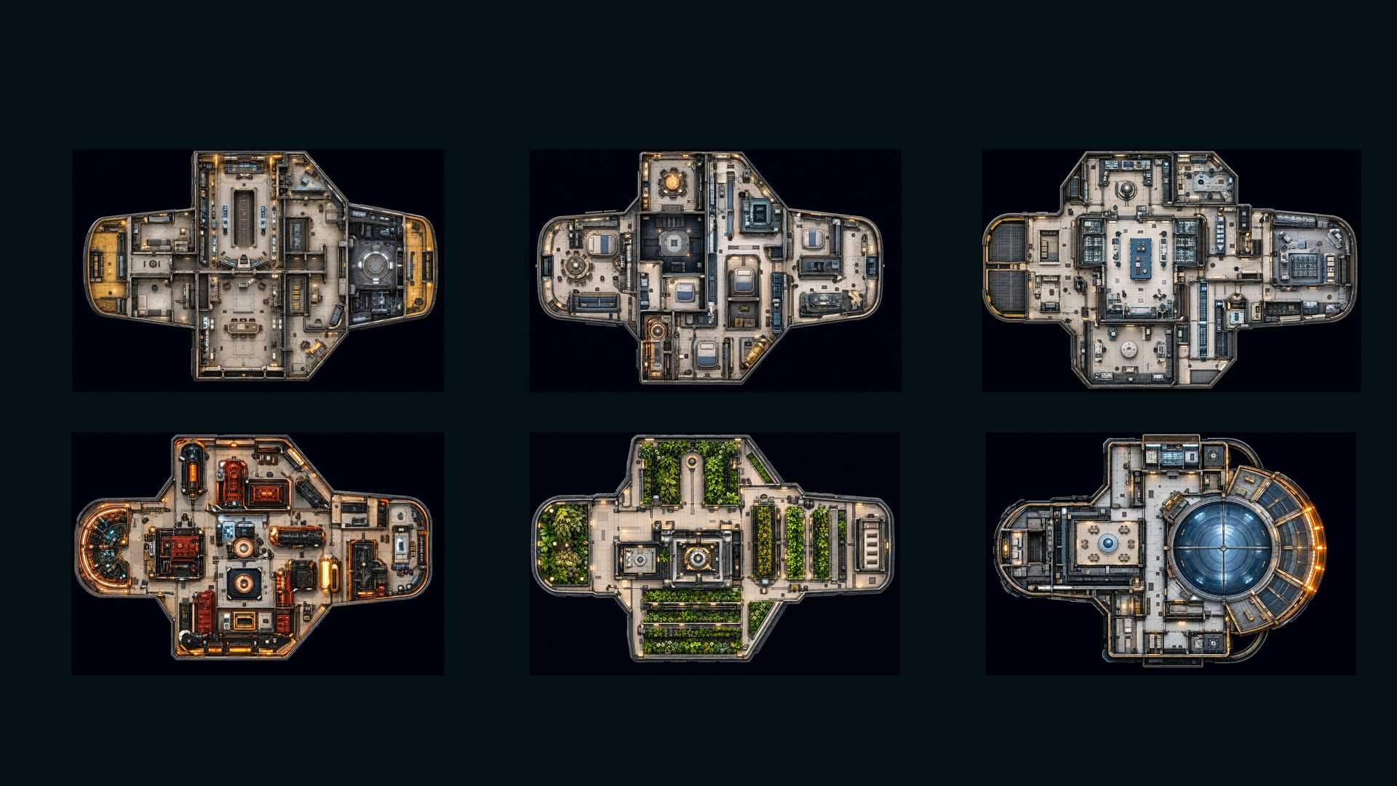
PIONEER · SIX DECKS
DECK 1 · COMMAND
DECK 2 · OPERATIONS
DECK 3 · SCIENCE
DECK 4 · ENGINEERING
DECK 5 · HABITATION
DECK 6 · OBSERVATION
›
Notes:
SESSION 1. GM bible v12 is story authority. ENVIRONMENT: bridge.
Student map only. Montage the decks; do not explore every room. Student-facing map artwork; do not narrate future map atlas locations early.
VISUAL: Original map art, readable native legend, subtle source-local motion
PLAYBACK: embedded silent H.264 starts automatically and loops. Advance manually; no timed slide changes. Static poster fallback. Actual Microsoft PowerPoint playback has not been tested on this Linux machine.

Slide 8
›
Notes:
SESSION 1. GM bible v12 is story authority. ENVIRONMENT: bridge.
VISUAL: Environment from original immersive source 4; source-local object animation
PLAYBACK: embedded silent H.264 starts automatically and loops. Advance manually; no timed slide changes. Static poster fallback. Actual Microsoft PowerPoint playback has not been tested on this Linux machine.

Slide 9
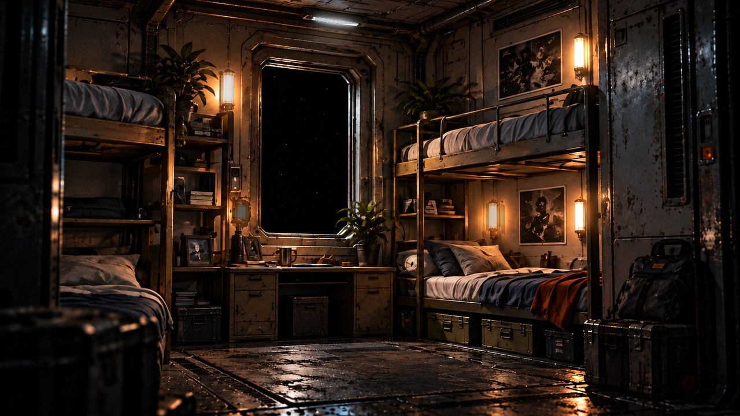
›
Notes:
SESSION 1. GM bible v12 is story authority. ENVIRONMENT: habitation.
VISUAL: Environment from original immersive source 5; source-local object animation
PLAYBACK: embedded silent H.264 starts automatically and loops. Advance manually; no timed slide changes. Static poster fallback. Actual Microsoft PowerPoint playback has not been tested on this Linux machine.

Slide 10
OBSERVATION GLASS
The stars brighten.
›
Notes:
SESSION 1. GM bible v12 is story authority. ENVIRONMENT: bridge.
Read First Anomaly Seed. Do not show the full K-17 Fracture Entity here. Keep the almost-human shape ambiguous; IRIS cannot classify it.
VISUAL: Native story cue over visible animated bridge environment
PLAYBACK: embedded silent H.264 starts automatically and loops. Advance manually; no timed slide changes. Static poster fallback. Actual Microsoft PowerPoint playback has not been tested on this Linux machine.

Slide 11
IRIS
Ship AI
›
Notes:
SESSION 1. GM bible v12 is story authority. ENVIRONMENT: bridge.
VISUAL: Untouched canonical portrait 44; visible animated bridge context and source-local lights
PLAYBACK: embedded silent H.264 starts automatically and loops. Advance manually; no timed slide changes. Static poster fallback. Actual Microsoft PowerPoint playback has not been tested on this Linux machine.

Slide 12
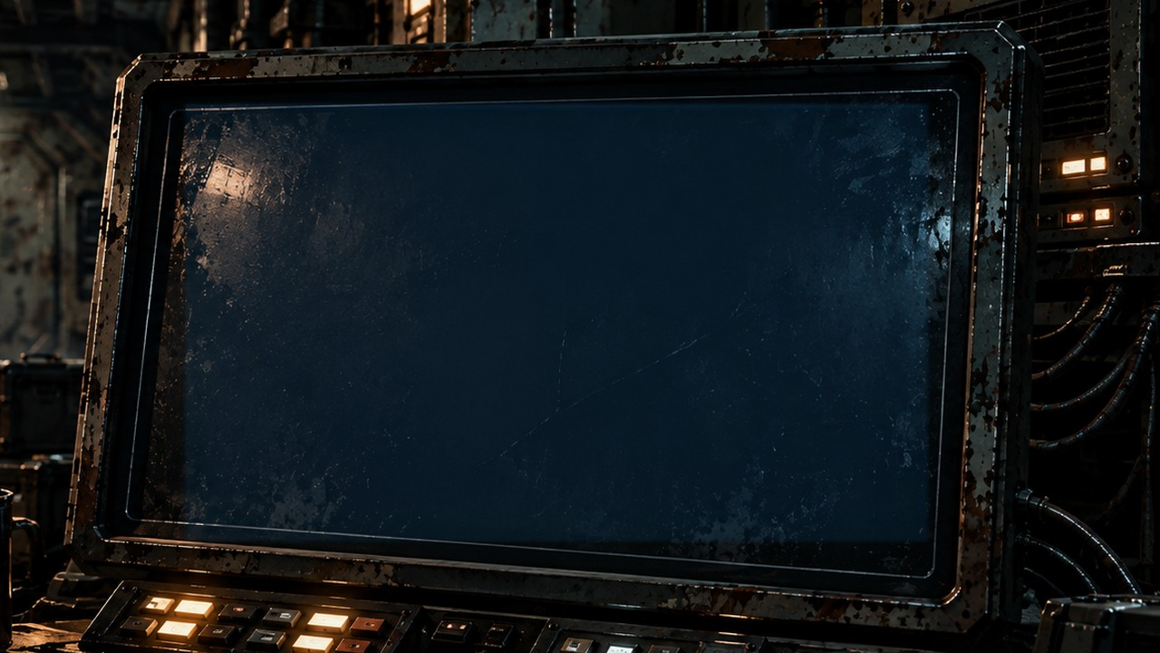
ROUTE LOG
“Route correction accepted.”
“No correction was entered.”
›
Notes:
SESSION 1. GM bible v12 is story authority. ENVIRONMENT: bridge.
Session 1 cliffhanger. Venn asks who entered the correction.
VISUAL: Readable native data on physical pulsing terminal
PLAYBACK: embedded silent H.264 starts automatically and loops. Advance manually; no timed slide changes. Static poster fallback. Actual Microsoft PowerPoint playback has not been tested on this Linux machine.

Slide 13
THE FAR HORIZON
02
The Pioneer
MAP ↗
›
Notes:
SESSION 2. GM bible v12 is story authority. ENVIRONMENT: habitation.
Start when ready for this session. MAP opens that session’s linked visual map.
VISUAL: Animated chapter / native typography
PLAYBACK: embedded silent H.264 starts automatically and loops. Advance manually; no timed slide changes. Static poster fallback. Actual Microsoft PowerPoint playback has not been tested on this Linux machine.

Slide 14
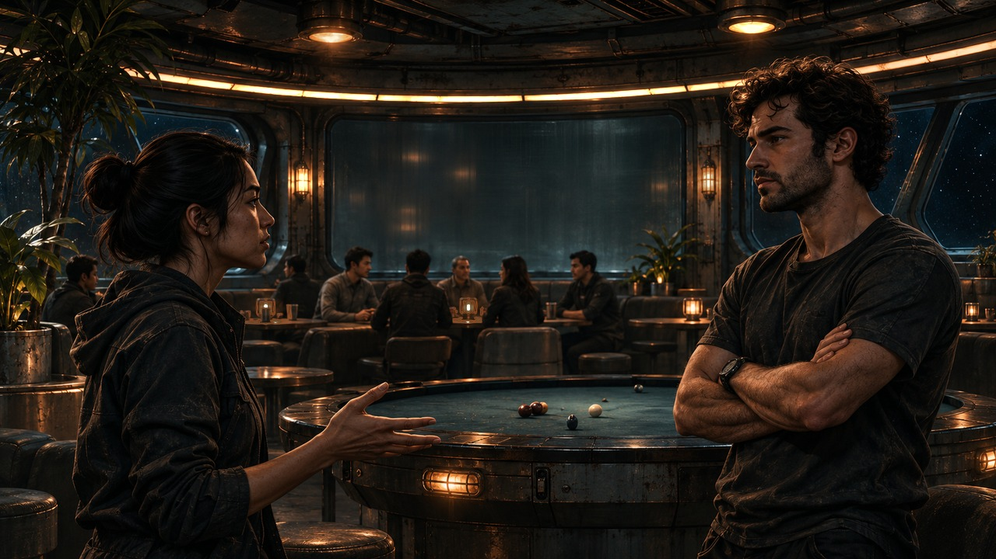
›
Notes:
SESSION 2. GM bible v12 is story authority. ENVIRONMENT: crew_argument.
Recreation dispute is a brief opening, not an alternative to the required maintenance encounter. Background crew are unnamed; do not identify these faces as canonical NPCs.
VISUAL: Restored original scene composition, canonical identities and localized practical motion
PLAYBACK: embedded silent H.264 starts automatically and loops. Advance manually; no timed slide changes. Static poster fallback. Actual Microsoft PowerPoint playback has not been tested on this Linux machine.

Slide 15
Tomas Rhee
Chief engineer
›
Notes:
SESSION 2. GM bible v12 is story authority. ENVIRONMENT: crew_argument.
VISUAL: Untouched canonical portrait 41; visible animated crew_argument context and source-local lights
PLAYBACK: embedded silent H.264 starts automatically and loops. Advance manually; no timed slide changes. Static poster fallback. Actual Microsoft PowerPoint playback has not been tested on this Linux machine.

Slide 16
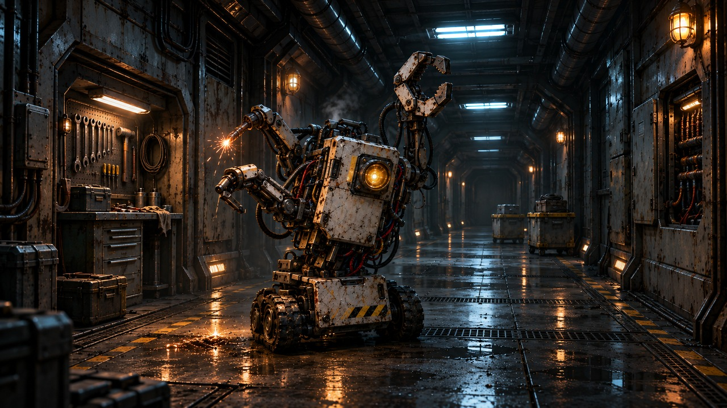
›
Notes:
SESSION 2. GM bible v12 is story authority. ENVIRONMENT: drone_incident.
M-77 sealing a hab-deck door; one large unit and two minor drones.
VISUAL: Restored original scene composition, canonical identities and localized practical motion
PLAYBACK: embedded silent H.264 starts automatically and loops. Advance manually; no timed slide changes. Static poster fallback. Actual Microsoft PowerPoint playback has not been tested on this Linux machine.

Slide 17
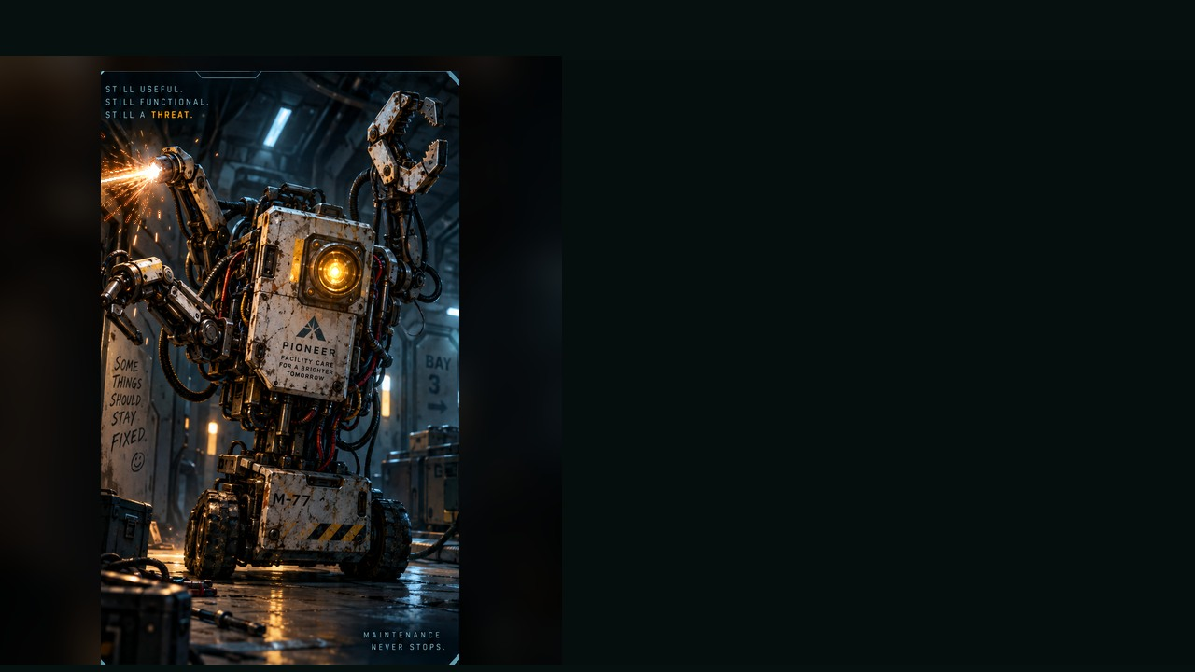
RUNAWAY MAINTENANCE DRONE
WEAKNESS
Maintenance override port
BEHAVIOUR
• Repairs the wrong thing
• Closes doors and blocks paths
• Targets the “previous repair” student
SPECIAL
Arc welder · Clamp arm · Magnetic grip
OBJECTIVE PRESSURE
Seals spaces and dismantles equipment.
FULL DOSSIER
MOVE · ATTACK · ASSIST · ENVIRONMENT
›
Notes:
SESSION 2. GM bible v12 is story authority. ENVIRONMENT: habitation.
Bible overrides dossier stats: one large unit 2 Threat Boxes plus two minor drones 1 each. Exactly 3 rounds. Stop them sealing three spaces / dismantling essential equipment. M-77 is canonical.
VISUAL: Latest uploaded enemy dossier: animated source artwork; readable weakness, behaviour, special, objective
PLAYBACK: embedded silent H.264 starts automatically and loops. Advance manually; no timed slide changes. Static poster fallback. Actual Microsoft PowerPoint playback has not been tested on this Linux machine.

Slide 18
RUNAWAY MAINTENANCE DRONE · DOSSIER
TYPE
Automated Service Unit
THREAT PROFILE
Minor · 1 threat box
GM boxes: 2 large / 1 minor
ROLE
Tutorial Skirmisher
STAGE CUES
• Jerky stop-start movement
• Glitchy beeps and static voice
• Sudden arm snap toward targets
TACTICS
SOURCE: ENEMY DOSSIER
›
Notes:
SESSION 2. GM bible v12 is story authority. ENVIRONMENT: habitation.
Bible overrides dossier stats: one large unit 2 Threat Boxes plus two minor drones 1 each. Exactly 3 rounds. Stop them sealing three spaces / dismantling essential equipment. M-77 is canonical.
VISUAL: Latest enemy dossier profile, threat, role, stage cues; source text retained
PLAYBACK: embedded silent H.264 starts automatically and loops. Advance manually; no timed slide changes. Static poster fallback. Actual Microsoft PowerPoint playback has not been tested on this Linux machine.

Slide 19
Tomas Rhee
Chief engineer
›
Notes:
SESSION 2. GM bible v12 is story authority. ENVIRONMENT: habitation.
Rhee opens the service history.
VISUAL: Untouched canonical portrait 41; visible animated habitation context and source-local lights
PLAYBACK: embedded silent H.264 starts automatically and loops. Advance manually; no timed slide changes. Static poster fallback. Actual Microsoft PowerPoint playback has not been tested on this Linux machine.

Slide 20
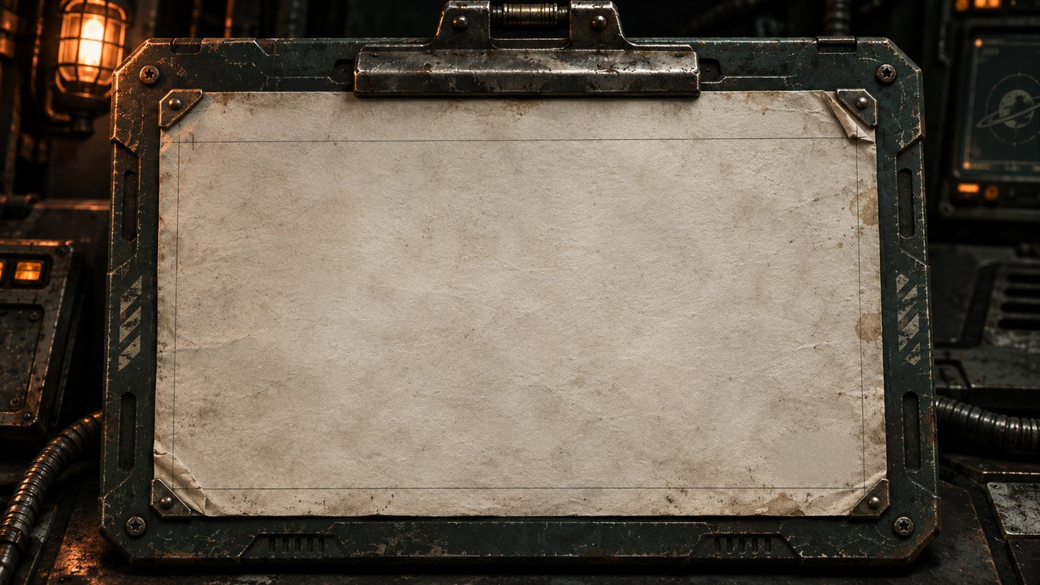
UNIT M-77 / HAB DECK
STATUS: REPAIRED
COMPLETED: TOMORROW 14:32
TECHNICIAN COHORT 01
“Collision with unrecorded passenger resolved.”
›
Notes:
SESSION 2. GM bible v12 is story authority. ENVIRONMENT: habitation.
Exact canonical ticket. Reveal after incident; repeat at final explanation. No rat explanation for unrecorded passenger.
VISUAL: Physical clue prop with source-local animation and native canonical text
PLAYBACK: embedded silent H.264 starts automatically and loops. Advance manually; no timed slide changes. Static poster fallback. Actual Microsoft PowerPoint playback has not been tested on this Linux machine.

Slide 21
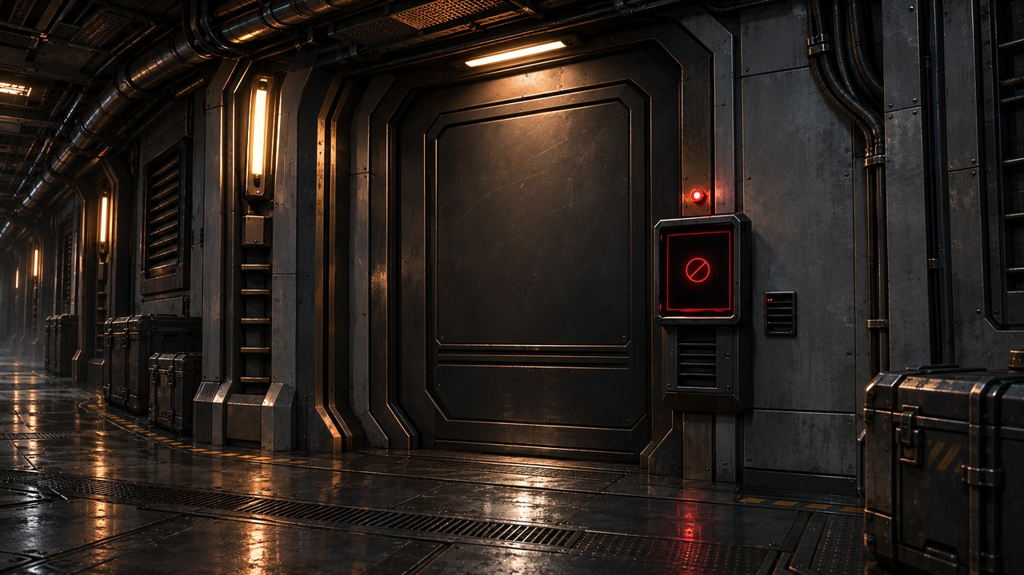
›
Notes:
SESSION 2. GM bible v12 is story authority. ENVIRONMENT: restricted_door.
Optional brief investigation; do not create mandatory combat.
VISUAL: Restored original scene composition, canonical identities and localized practical motion
PLAYBACK: embedded silent H.264 starts automatically and loops. Advance manually; no timed slide changes. Static poster fallback. Actual Microsoft PowerPoint playback has not been tested on this Linux machine.

Slide 22
IRIS
Ship AI
›
Notes:
SESSION 2. GM bible v12 is story authority. ENVIRONMENT: restricted_door.
Hold the mystery. Do not explain K-17 yet.
VISUAL: Untouched canonical portrait 44; visible animated restricted_door context and source-local lights
PLAYBACK: embedded silent H.264 starts automatically and loops. Advance manually; no timed slide changes. Static poster fallback. Actual Microsoft PowerPoint playback has not been tested on this Linux machine.

Slide 23
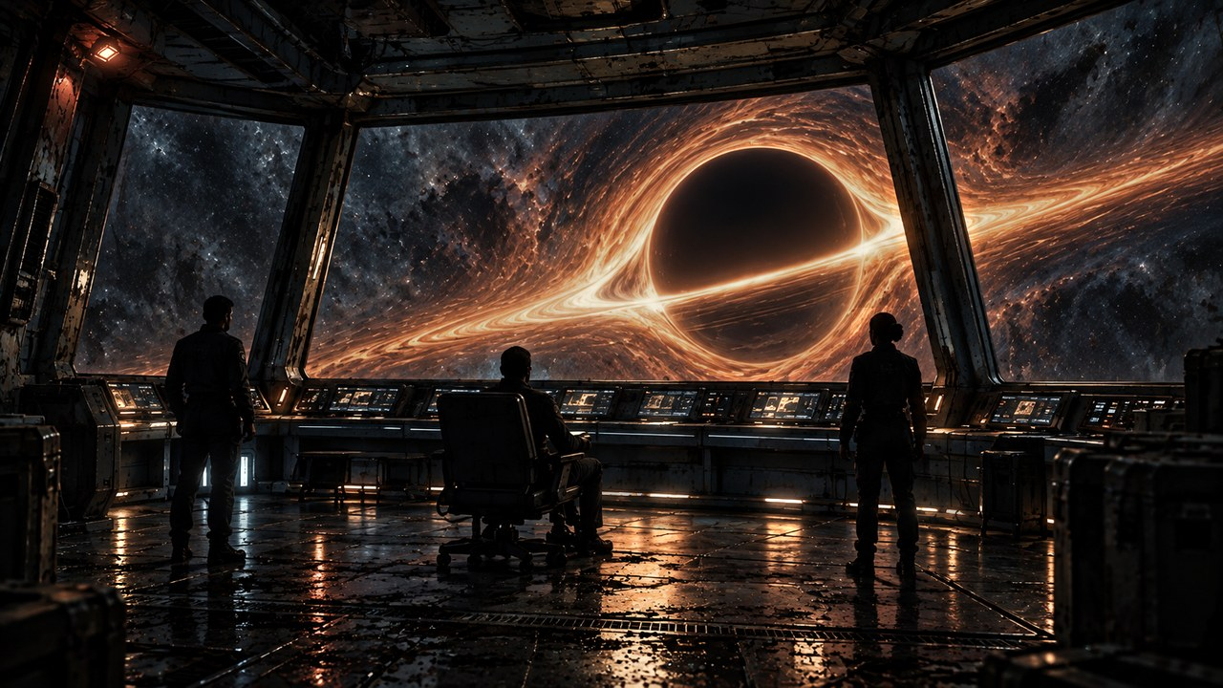
THE FAR HORIZON
03
The first anomaly
MAP ↗
›
Notes:
SESSION 3. GM bible v12 is story authority. ENVIRONMENT: observation.
Start when ready for this session. MAP opens that session’s linked visual map.
VISUAL: Animated chapter / native typography
PLAYBACK: embedded silent H.264 starts automatically and loops. Advance manually; no timed slide changes. Static poster fallback. Actual Microsoft PowerPoint playback has not been tested on this Linux machine.

Slide 24
›
Notes:
SESSION 3. GM bible v12 is story authority. ENVIRONMENT: observation.
VISUAL: Environment from original immersive source 11; source-local object animation
PLAYBACK: embedded silent H.264 starts automatically and loops. Advance manually; no timed slide changes. Static poster fallback. Actual Microsoft PowerPoint playback has not been tested on this Linux machine.

Slide 25
Dr. Elias Vale
Astrophysicist · K-17 specialist
›
Notes:
SESSION 3. GM bible v12 is story authority. ENVIRONMENT: observation.
VISUAL: Untouched canonical portrait 39; visible animated observation context and source-local lights
PLAYBACK: embedded silent H.264 starts automatically and loops. Advance manually; no timed slide changes. Static poster fallback. Actual Microsoft PowerPoint playback has not been tested on this Linux machine.

Slide 26
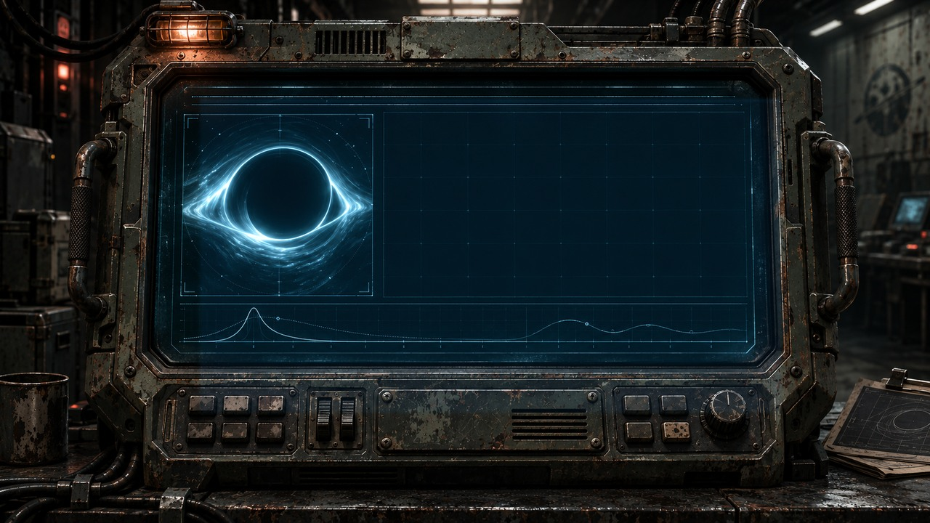
K-17 · ANOMALY DATA
MASS / LENSING
READINGS DO NOT AGREE.
›
Notes:
SESSION 3. GM bible v12 is story authority. ENVIRONMENT: observation.
VISUAL: Physical clue prop with source-local animation and native canonical text
PLAYBACK: embedded silent H.264 starts automatically and loops. Advance manually; no timed slide changes. Static poster fallback. Actual Microsoft PowerPoint playback has not been tested on this Linux machine.

Slide 27
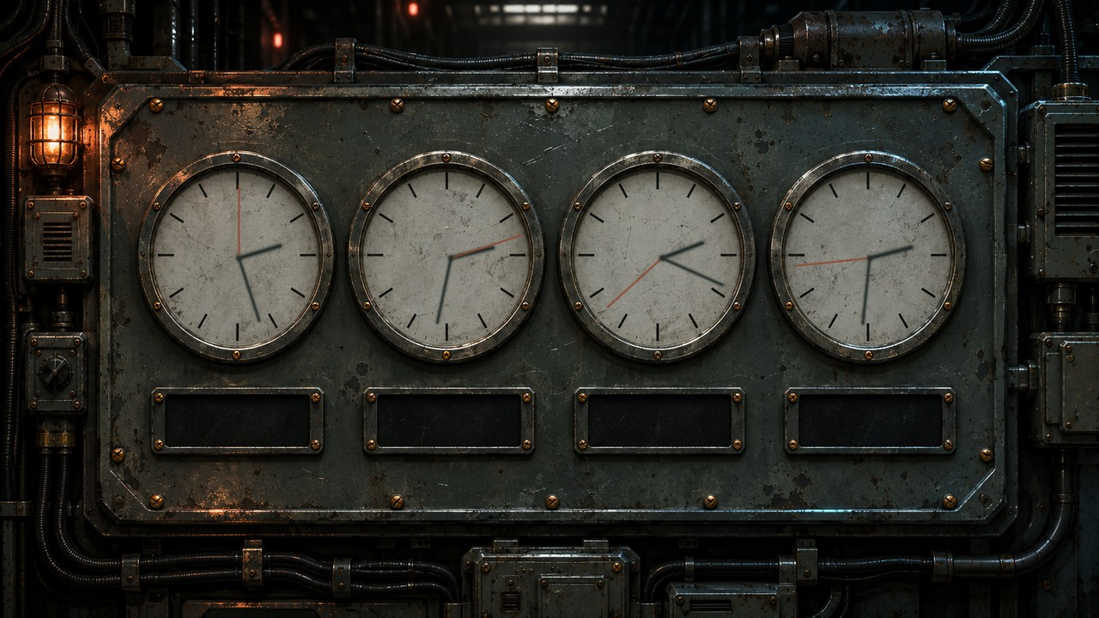
SHIP
EARTH
K-17
MEDBAY
14:27
14:32
14:19
14:31
›
Notes:
SESSION 3. GM bible v12 is story authority. ENVIRONMENT: observation.
VISUAL: Physical clue prop with source-local animation and native canonical text
PLAYBACK: embedded silent H.264 starts automatically and loops. Advance manually; no timed slide changes. Static poster fallback. Actual Microsoft PowerPoint playback has not been tested on this Linux machine.

Slide 28
Dr. Nia Okafor
Chief medical officer
›
Notes:
SESSION 3. GM bible v12 is story authority. ENVIRONMENT: observation.
VISUAL: Untouched canonical portrait 40; visible animated observation context and source-local lights
PLAYBACK: embedded silent H.264 starts automatically and loops. Advance manually; no timed slide changes. Static poster fallback. Actual Microsoft PowerPoint playback has not been tested on this Linux machine.

Slide 29
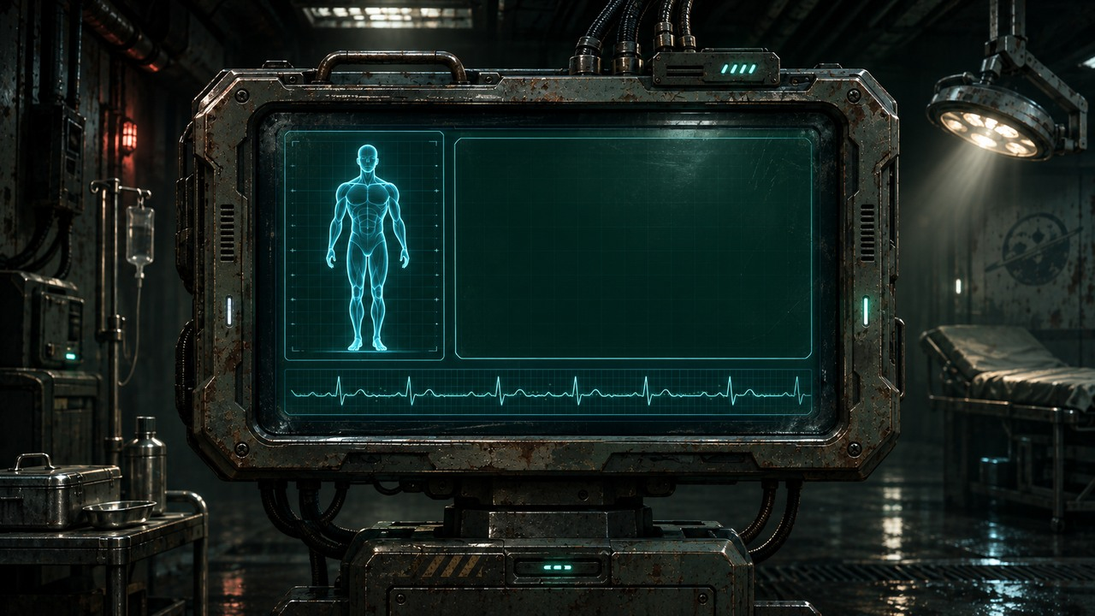
COHORT 01
BIOLOGICAL TIMING DRIFT
›
Notes:
SESSION 3. GM bible v12 is story authority. ENVIRONMENT: observation.
VISUAL: Physical clue prop with source-local animation and native canonical text
PLAYBACK: embedded silent H.264 starts automatically and loops. Advance manually; no timed slide changes. Static poster fallback. Actual Microsoft PowerPoint playback has not been tested on this Linux machine.

Slide 30
ARRIVAL ESTIMATE
37 DAYS
NAVIGATION: 102 DAYS
›
Notes:
SESSION 3. GM bible v12 is story authority. ENVIRONMENT: observation.
Flight privileged fact. No route change accounts for either estimate.
VISUAL: Readable native data on physical pulsing terminal
PLAYBACK: embedded silent H.264 starts automatically and loops. Advance manually; no timed slide changes. Static poster fallback. Actual Microsoft PowerPoint playback has not been tested on this Linux machine.

Slide 31
IRIS
Ship AI
›
Notes:
SESSION 3. GM bible v12 is story authority. ENVIRONMENT: observation.
Ask which estimate is right. Pause before the exact answer.
VISUAL: Untouched canonical portrait 44; visible animated observation context and source-local lights
PLAYBACK: embedded silent H.264 starts automatically and loops. Advance manually; no timed slide changes. Static poster fallback. Actual Microsoft PowerPoint playback has not been tested on this Linux machine.

Slide 32
WHICH ONE IS RIGHT?
“Both.”
›
Notes:
SESSION 3. GM bible v12 is story authority. ENVIRONMENT: observation.
The required IRIS line. Each department reports its privileged fact.
VISUAL: Native story cue over visible animated observation environment
PLAYBACK: embedded silent H.264 starts automatically and loops. Advance manually; no timed slide changes. Static poster fallback. Actual Microsoft PowerPoint playback has not been tested on this Linux machine.

Slide 33
›
Notes:
SESSION 3. GM bible v12 is story authority. ENVIRONMENT: observation.
VISUAL: Environment from original immersive source 11; source-local object animation
PLAYBACK: embedded silent H.264 starts automatically and loops. Advance manually; no timed slide changes. Static poster fallback. Actual Microsoft PowerPoint playback has not been tested on this Linux machine.

Slide 34
UNOPENED PACKET
TIMESTAMP: +103 DAYS
SOURCE: CSV-01 PIONEER
›
Notes:
SESSION 3. GM bible v12 is story authority. ENVIRONMENT: observation.
Session 3 cliffhanger. End immediately. Arrival confirmation and Juno warning wait for Session 4.
VISUAL: Readable native data on physical pulsing terminal
PLAYBACK: embedded silent H.264 starts automatically and loops. Advance manually; no timed slide changes. Static poster fallback. Actual Microsoft PowerPoint playback has not been tested on this Linux machine.

Slide 35
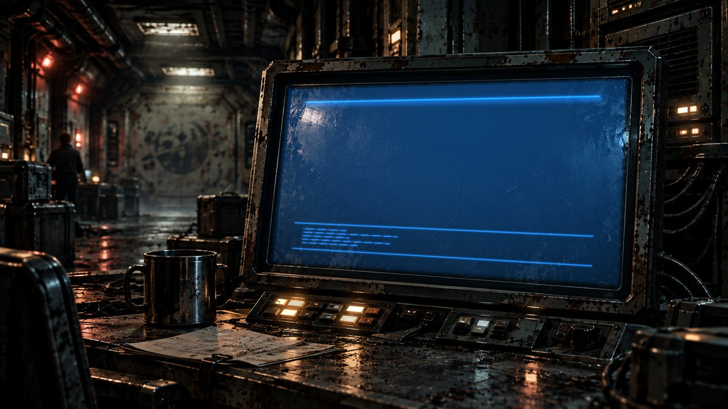
THE FAR HORIZON
04
The message
MAP ↗
›
Notes:
SESSION 4. GM bible v12 is story authority. ENVIRONMENT: comms.
Start when ready for this session. MAP opens that session’s linked visual map.
VISUAL: Animated chapter / native typography
PLAYBACK: embedded silent H.264 starts automatically and loops. Advance manually; no timed slide changes. Static poster fallback. Actual Microsoft PowerPoint playback has not been tested on this Linux machine.

Slide 36
Juno Reyes
Communications · logistics
›
Notes:
SESSION 4. GM bible v12 is story authority. ENVIRONMENT: comms.
VISUAL: Untouched canonical portrait 42; visible animated comms context and source-local lights
PLAYBACK: embedded silent H.264 starts automatically and loops. Advance manually; no timed slide changes. Static poster fallback. Actual Microsoft PowerPoint playback has not been tested on this Linux machine.

Slide 37
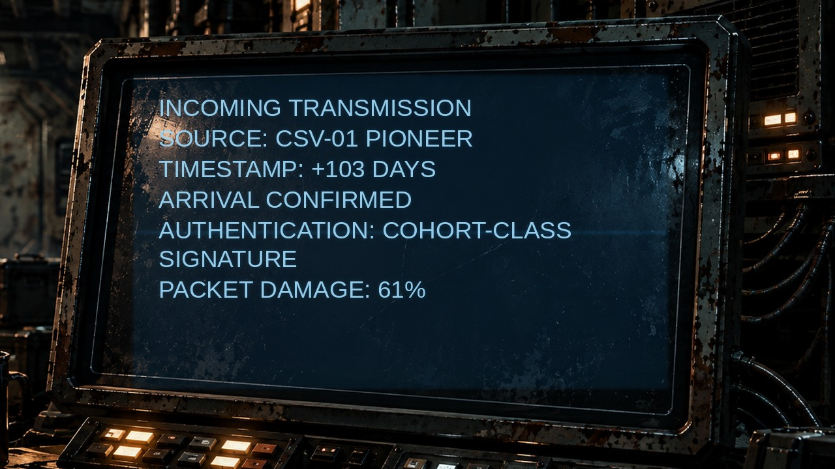
›
Notes:
SESSION 4. GM bible v12 is story authority. ENVIRONMENT: comms.
VISUAL: Physical clue prop with source-local animation and native canonical text
PLAYBACK: embedded silent H.264 starts automatically and loops. Advance manually; no timed slide changes. Static poster fallback. Actual Microsoft PowerPoint playback has not been tested on this Linux machine.

Slide 38
PIONEER → PIONEER
ARRIVAL CONFIRMED
+103 DAYS
COHORT-CLASS SIGNATURE
PACKET DAMAGE: 61%
›
Notes:
SESSION 4. GM bible v12 is story authority. ENVIRONMENT: comms.
Reveal the warning on the next slide, after the transmission is established.
VISUAL: Readable native data on physical pulsing terminal
PLAYBACK: embedded silent H.264 starts automatically and loops. Advance manually; no timed slide changes. Static poster fallback. Actual Microsoft PowerPoint playback has not been tested on this Linux machine.

Slide 39
TRANSIENT LINE
DO NOT ANSWER
IF JUNO IS IN THE ROOM.
›
Notes:
SESSION 4. GM bible v12 is story authority. ENVIRONMENT: comms.
This warns about a possible action, not Juno’s character.
VISUAL: Readable native data on physical pulsing terminal
PLAYBACK: embedded silent H.264 starts automatically and loops. Advance manually; no timed slide changes. Static poster fallback. Actual Microsoft PowerPoint playback has not been tested on this Linux machine.

Slide 40
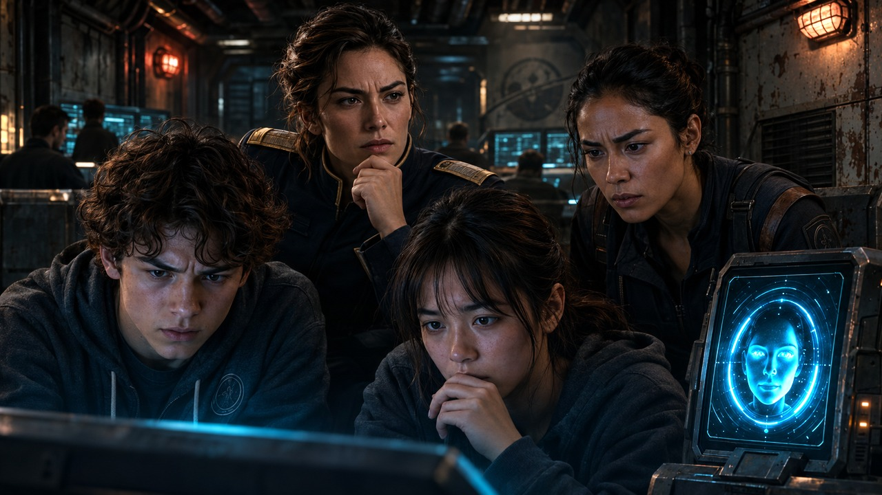
›
Notes:
SESSION 4. GM bible v12 is story authority. ENVIRONMENT: adult_reaction.
Canonical Juno, Mara and IRIS react to the warning.
VISUAL: Restored original scene composition, canonical identities and localized practical motion
PLAYBACK: embedded silent H.264 starts automatically and loops. Advance manually; no timed slide changes. Static poster fallback. Actual Microsoft PowerPoint playback has not been tested on this Linux machine.

Slide 41
THE FORBIDDEN REPLY
Juno Reyes
Mara Venn
IRIS
›
Notes:
SESSION 4. GM bible v12 is story authority. ENVIRONMENT: adult_reaction.
Juno reaches toward transmit. Report / hide / reply / delete / investigate, or accept a student option. Replace original reaction art which misidentifies NPCs.
VISUAL: Canonical portrait gallery over visibly moving contextual environment
PLAYBACK: embedded silent H.264 starts automatically and loops. Advance manually; no timed slide changes. Static poster fallback. Actual Microsoft PowerPoint playback has not been tested on this Linux machine.

Slide 42
›
Notes:
SESSION 4. GM bible v12 is story authority. ENVIRONMENT: comms.
VISUAL: Physical clue prop with source-local animation and native canonical text
PLAYBACK: embedded silent H.264 starts automatically and loops. Advance manually; no timed slide changes. Static poster fallback. Actual Microsoft PowerPoint playback has not been tested on this Linux machine.

Slide 43
PARTIAL DECRYPT
COORDINATE NEAR K-17
FAR HORIZON TRANSPONDER
›
Notes:
SESSION 4. GM bible v12 is story authority. ENVIRONMENT: comms.
Packet partially decrypts regardless of the class decision; a weak human-built transponder motivates the derelict approach. No numeric coordinates invented.
VISUAL: Readable native data on physical pulsing terminal
PLAYBACK: embedded silent H.264 starts automatically and loops. Advance manually; no timed slide changes. Static poster fallback. Actual Microsoft PowerPoint playback has not been tested on this Linux machine.

Slide 44
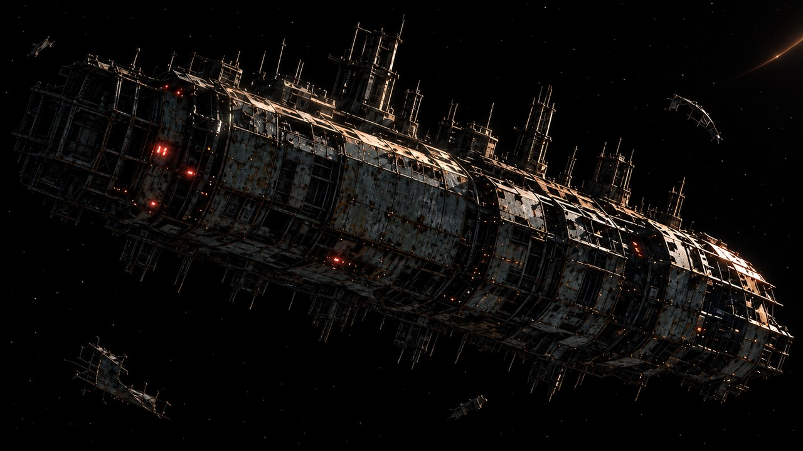
THE FAR HORIZON
05
The silent ship
MAP ↗
›
Notes:
SESSION 5. GM bible v12 is story authority. ENVIRONMENT: derelict_exterior.
Start when ready for this session. MAP opens that session’s linked visual map.
VISUAL: Animated chapter / native typography
PLAYBACK: embedded silent H.264 starts automatically and loops. Advance manually; no timed slide changes. Static poster fallback. Actual Microsoft PowerPoint playback has not been tested on this Linux machine.

Slide 45
›
Notes:
SESSION 5. GM bible v12 is story authority. ENVIRONMENT: derelict_exterior.
VISUAL: Environment from original immersive source 17; source-local object animation
PLAYBACK: embedded silent H.264 starts automatically and loops. Advance manually; no timed slide changes. Static poster fallback. Actual Microsoft PowerPoint playback has not been tested on this Linux machine.

Slide 46
Marcus Bell
Security · expedition lead
›
Notes:
SESSION 5. GM bible v12 is story authority. ENVIRONMENT: derelict_exterior.
VISUAL: Untouched canonical portrait 43; visible animated derelict_exterior context and source-local lights
PLAYBACK: embedded silent H.264 starts automatically and loops. Advance manually; no timed slide changes. Static poster fallback. Actual Microsoft PowerPoint playback has not been tested on this Linux machine.

Slide 47
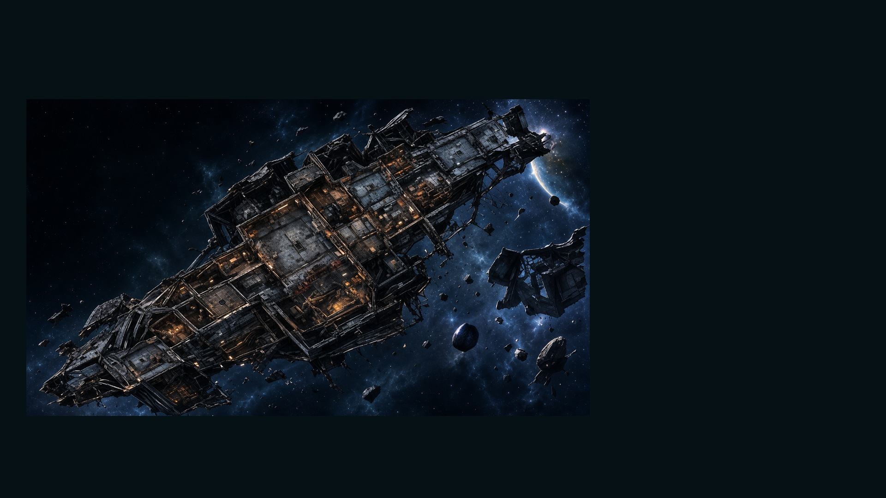
DERELICT · ORPHEUS MAP
MAP KEY
01
Airlock — Damaged
02
Cargo Hold
03
Crew Quarters
04
Research Lab
05
Power Core — Offline
06
Unknown Section
›
Notes:
SESSION 5. GM bible v12 is story authority. ENVIRONMENT: derelict_exterior.
Student-facing map artwork; do not narrate future map atlas locations early.
VISUAL: Original map art, readable native legend, subtle source-local motion
PLAYBACK: embedded silent H.264 starts automatically and loops. Advance manually; no timed slide changes. Static poster fallback. Actual Microsoft PowerPoint playback has not been tested on this Linux machine.

Slide 48
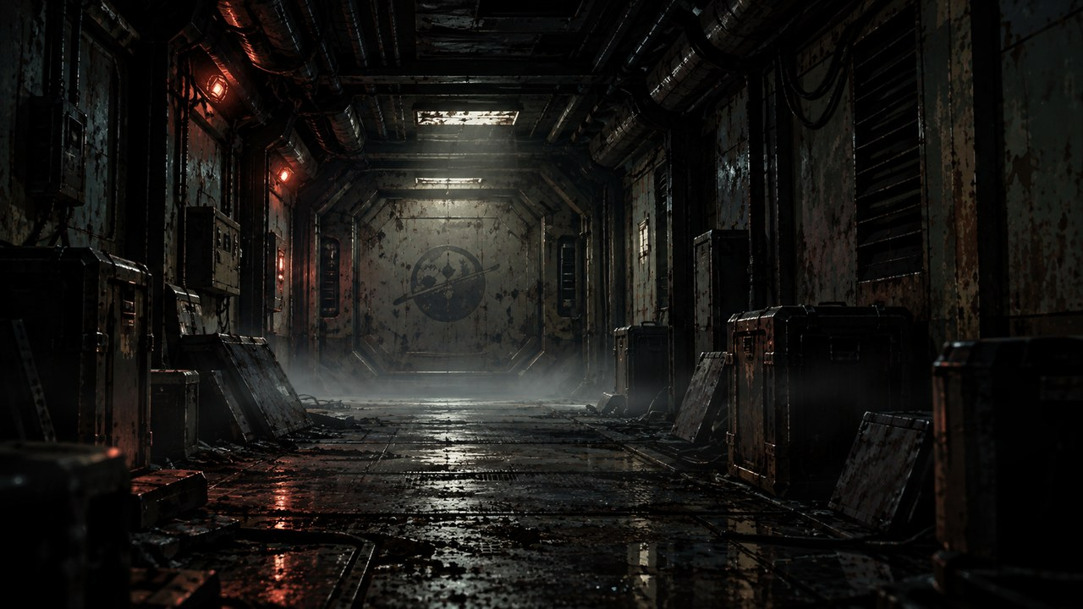
›
Notes:
SESSION 5. GM bible v12 is story authority. ENVIRONMENT: derelict.
VISUAL: Environment from original immersive source 18; source-local object animation
PLAYBACK: embedded silent H.264 starts automatically and loops. Advance manually; no timed slide changes. Static poster fallback. Actual Microsoft PowerPoint playback has not been tested on this Linux machine.

Slide 49
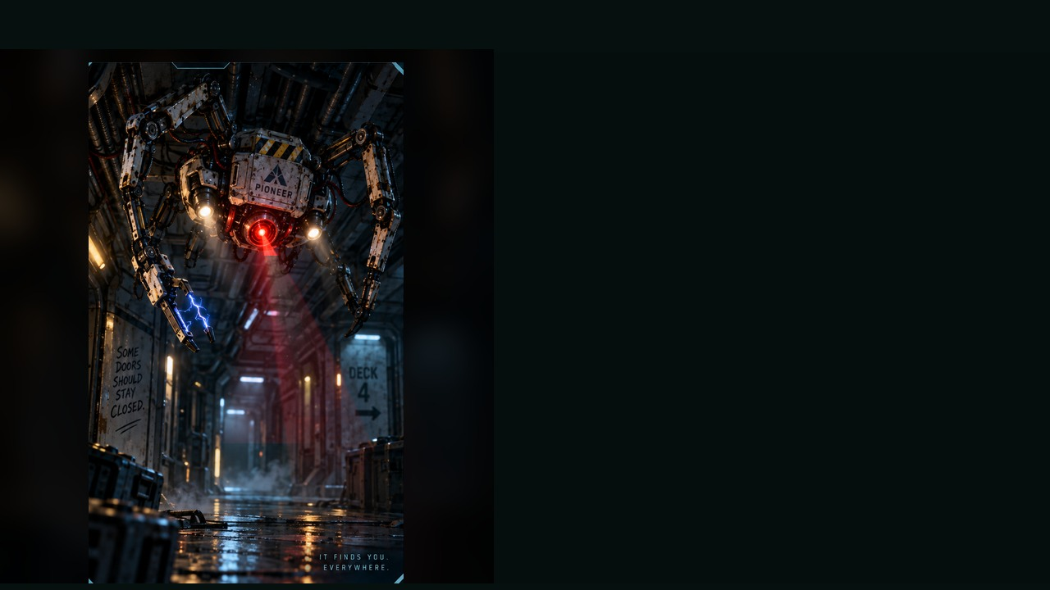
DERELICT SECURITY DRONE
WEAKNESS
Sensor blind spot underneath
BEHAVIOUR
• Scans for intruders
• Clings to walls and ceilings
• Attempts quarantine and pursuit
SPECIAL
Shock baton · Alarm burst · Magnetic cling
OBJECTIVE PRESSURE
Drives intruders away from black-box data.
FULL DOSSIER
MOVE · ATTACK · ASSIST · ENVIRONMENT
›
Notes:
SESSION 5. GM bible v12 is story authority. ENVIRONMENT: derelict.
2–3 standard drones, 2 Threat Boxes each. Preserve or reach black box before lockdown; maximum 3 rounds.
VISUAL: Latest uploaded enemy dossier: animated source artwork; readable weakness, behaviour, special, objective
PLAYBACK: embedded silent H.264 starts automatically and loops. Advance manually; no timed slide changes. Static poster fallback. Actual Microsoft PowerPoint playback has not been tested on this Linux machine.

Slide 50
DERELICT SECURITY DRONE · DOSSIER
TYPE
Security Enforcement Unit
THREAT PROFILE
Standard · 2 threat boxes
ROLE
Hunter-Control Unit
STAGE CUES
• Sharp head turns
• Stuttering voice
• Sudden ceiling drops
TACTICS
SOURCE: ENEMY DOSSIER
›
Notes:
SESSION 5. GM bible v12 is story authority. ENVIRONMENT: derelict.
2–3 standard drones, 2 Threat Boxes each. Preserve or reach black box before lockdown; maximum 3 rounds.
VISUAL: Latest enemy dossier profile, threat, role, stage cues; source text retained
PLAYBACK: embedded silent H.264 starts automatically and loops. Advance manually; no timed slide changes. Static poster fallback. Actual Microsoft PowerPoint playback has not been tested on this Linux machine.

Slide 51
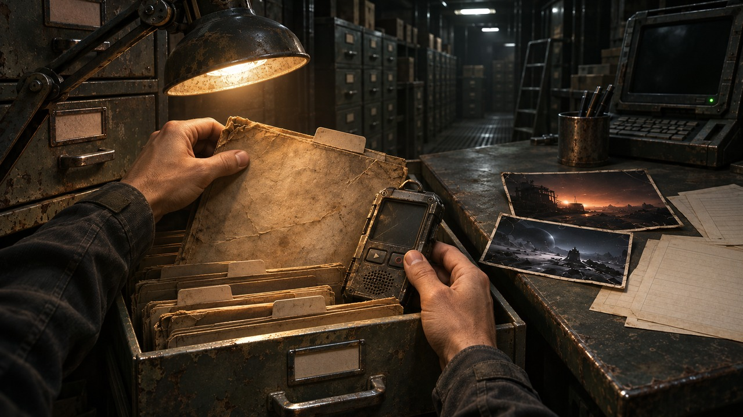
›
Notes:
SESSION 5. GM bible v12 is story authority. ENVIRONMENT: evidence_pull.
Recovered Orpheus recorder is physical evidence. Read source transcript next.
VISUAL: Restored original scene composition, canonical identities and localized practical motion
PLAYBACK: embedded silent H.264 starts automatically and loops. Advance manually; no timed slide changes. Static poster fallback. Actual Microsoft PowerPoint playback has not been tested on this Linux machine.

Slide 52
BLACK BOX TRANSCRIPT
APPROACH BEACON IDENTIFIED AS OUR OWN.
“K-17 is where it will be.”
“Where are the children?”
“The children are not aboard.”
“Both routes are correct.”
›
Notes:
SESSION 5. GM bible v12 is story authority. ENVIRONMENT: evidence_pull.
Read the full transcript from the bible. Do not explain that the derelict is a failed possible future yet.
VISUAL: Readable native data on physical pulsing terminal
PLAYBACK: embedded silent H.264 starts automatically and loops. Advance manually; no timed slide changes. Static poster fallback. Actual Microsoft PowerPoint playback has not been tested on this Linux machine.

Slide 53
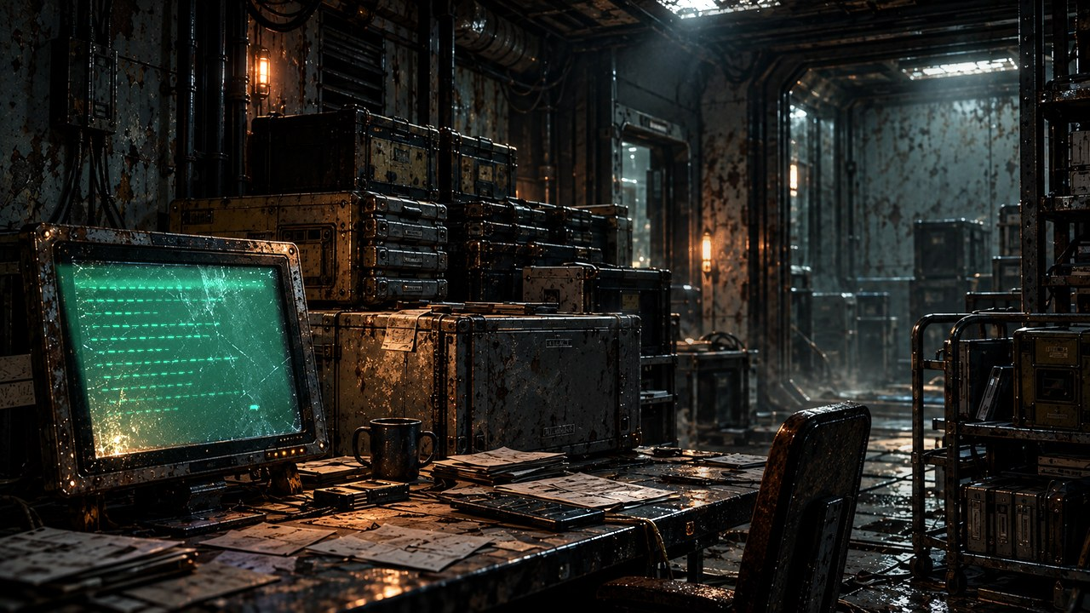
HOME
›
Notes:
SESSION 5. GM bible v12 is story authority. ENVIRONMENT: archive.
VISUAL: Environment from original immersive source 54; source-local object animation
PLAYBACK: embedded silent H.264 starts automatically and loops. Advance manually; no timed slide changes. Static poster fallback. Actual Microsoft PowerPoint playback has not been tested on this Linux machine.

Slide 54
ON THE REVERSE
WE WAITED FOR YOU.
›
Notes:
SESSION 5. GM bible v12 is story authority. ENVIRONMENT: archive.
Repeat this clue at the school in Session 10.
VISUAL: Native story cue over visible animated archive environment
PLAYBACK: embedded silent H.264 starts automatically and loops. Advance manually; no timed slide changes. Static poster fallback. Actual Microsoft PowerPoint playback has not been tested on this Linux machine.

Slide 55
›
Notes:
SESSION 5. GM bible v12 is story authority. ENVIRONMENT: derelict_exterior.
VISUAL: Environment from original immersive source 17; source-local object animation
PLAYBACK: embedded silent H.264 starts automatically and loops. Advance manually; no timed slide changes. Static poster fallback. Actual Microsoft PowerPoint playback has not been tested on this Linux machine.

Slide 56
THE FAR HORIZON
06
The records
MAP ↗
›
Notes:
SESSION 6. GM bible v12 is story authority. ENVIRONMENT: archive.
Start when ready for this session. MAP opens that session’s linked visual map.
VISUAL: Animated chapter / native typography
PLAYBACK: embedded silent H.264 starts automatically and loops. Advance manually; no timed slide changes. Static poster fallback. Actual Microsoft PowerPoint playback has not been tested on this Linux machine.

Slide 57
ARCHIVE
DATA LINK
›
Notes:
SESSION 6. GM bible v12 is story authority. ENVIRONMENT: archive.
VISUAL: Environment from original immersive source 20; source-local object animation
PLAYBACK: embedded silent H.264 starts automatically and loops. Advance manually; no timed slide changes. Static poster fallback. Actual Microsoft PowerPoint playback has not been tested on this Linux machine.

Slide 58
Dr. Elias Vale
Astrophysicist · K-17 specialist
›
Notes:
SESSION 6. GM bible v12 is story authority. ENVIRONMENT: archive.
VISUAL: Untouched canonical portrait 39; visible animated archive context and source-local lights
PLAYBACK: embedded silent H.264 starts automatically and loops. Advance manually; no timed slide changes. Static poster fallback. Actual Microsoft PowerPoint playback has not been tested on this Linux machine.

Slide 59
›
Notes:
SESSION 6. GM bible v12 is story authority. ENVIRONMENT: evidence_pull.
Hands collect recorder, folders and contradictory archive evidence.
VISUAL: Restored original scene composition, canonical identities and localized practical motion
PLAYBACK: embedded silent H.264 starts automatically and loops. Advance manually; no timed slide changes. Static poster fallback. Actual Microsoft PowerPoint playback has not been tested on this Linux machine.

Slide 60
AUTHENTICATION: VALID
SAME TIMESTAMP
ARRIVED SAFELY
LOST NEAR K-17
RETURNED TO SOL
ESTABLISHED ASTERIA SETTLEMENT
›
Notes:
SESSION 6. GM bible v12 is story authority. ENVIRONMENT: evidence_pull.
All four records authenticate. Original evidence-wall artwork uses conflicting names and incomplete records, so it is replaced.
VISUAL: Physical archival document, source-local lamp/dust motion; native editable data
PLAYBACK: embedded silent H.264 starts automatically and loops. Advance manually; no timed slide changes. Static poster fallback. Actual Microsoft PowerPoint playback has not been tested on this Linux machine.

Slide 61
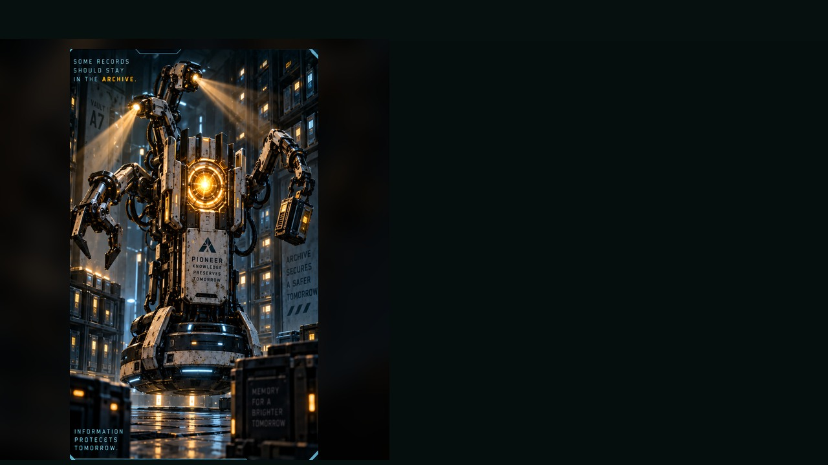
ARCHIVE GUARDIAN
WEAKNESS
Overloaded inventory logic
BEHAVIOUR
• Protects restricted records
• Seizes evidence
• Pins trespassers behind barriers
SPECIAL
Retrieval claw · Blinding scan · Shutter lock
OBJECTIVE PRESSURE
Removes or destroys clue modules each round.
FULL DOSSIER
MOVE · ATTACK · ASSIST · ENVIRONMENT
›
Notes:
SESSION 6. GM bible v12 is story authority. ENVIRONMENT: archive.
One standard Guardian, 2 Threat Boxes; two only if needed. Round 1 manifest, round 2 black-box duplicate, round 3 name-match alert threatened.
VISUAL: Latest uploaded enemy dossier: animated source artwork; readable weakness, behaviour, special, objective
PLAYBACK: embedded silent H.264 starts automatically and loops. Advance manually; no timed slide changes. Static poster fallback. Actual Microsoft PowerPoint playback has not been tested on this Linux machine.

Slide 62
ARCHIVE GUARDIAN · DOSSIER
TYPE
Retrieval and Security Construct
THREAT PROFILE
Standard · 2 threat boxes
ROLE
Evidence Denial Unit
STAGE CUES
• Smooth gliding movement
• Polite but threatening tone
• Arms snap out when evidence is touched
TACTICS
SOURCE: ENEMY DOSSIER
›
Notes:
SESSION 6. GM bible v12 is story authority. ENVIRONMENT: archive.
One standard Guardian, 2 Threat Boxes; two only if needed. Round 1 manifest, round 2 black-box duplicate, round 3 name-match alert threatened.
VISUAL: Latest enemy dossier profile, threat, role, stage cues; source text retained
PLAYBACK: embedded silent H.264 starts automatically and loops. Advance manually; no timed slide changes. Static poster fallback. Actual Microsoft PowerPoint playback has not been tested on this Linux machine.

Slide 63
CREW MANIFEST
COHORT 01
›
Notes:
SESSION 6. GM bible v12 is story authority. ENVIRONMENT: archive.
Teacher: use a fictional character’s identity. Do not use real student names. The old prop contained noncanonical names / roles.
VISUAL: Physical archival document, source-local lamp/dust motion; native editable data
PLAYBACK: embedded silent H.264 starts automatically and loops. Advance manually; no timed slide changes. Static poster fallback. Actual Microsoft PowerPoint playback has not been tested on this Linux machine.

Slide 64
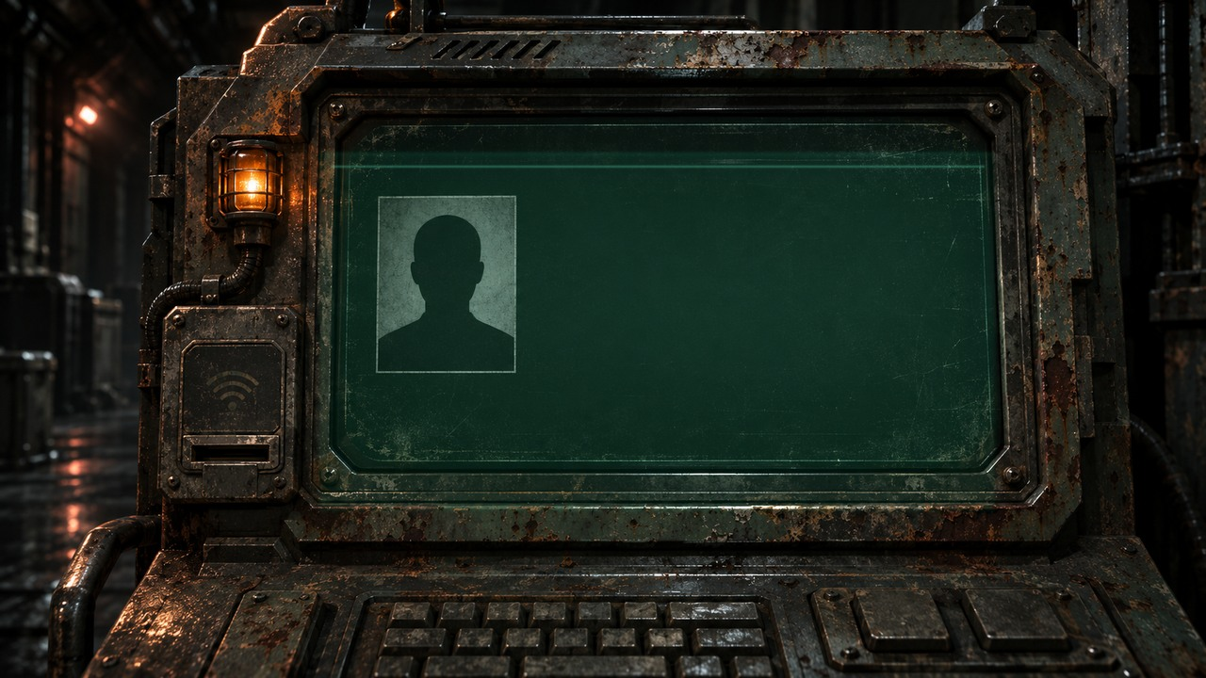
COHORT 01 IDENTITY MATCH
ZARA QUINN
ASTERIA SCHOOL ARCHIVE
SIX YEARS AFTER PIONEER LAUNCH
›
Notes:
SESSION 6. GM bible v12 is story authority. ENVIRONMENT: archive.
Zara Quinn is an editable fictional default. Replace only with a fictional class character if appropriate, never a real student name.
VISUAL: Physical clue prop with source-local animation and native canonical text
PLAYBACK: embedded silent H.264 starts automatically and loops. Advance manually; no timed slide changes. Static poster fallback. Actual Microsoft PowerPoint playback has not been tested on this Linux machine.

Slide 65
CONTAINMENT ORDERS
Marcus Bell
Mara Venn
›
Notes:
SESSION 6. GM bible v12 is story authority. ENVIRONMENT: archive.
Bell holds containment orders; Venn interrupts him. Do not give Bell scientific knowledge he does not have.
VISUAL: Canonical portrait gallery over visibly moving contextual environment
PLAYBACK: embedded silent H.264 starts automatically and loops. Advance manually; no timed slide changes. Static poster fallback. Actual Microsoft PowerPoint playback has not been tested on this Linux machine.

Slide 66
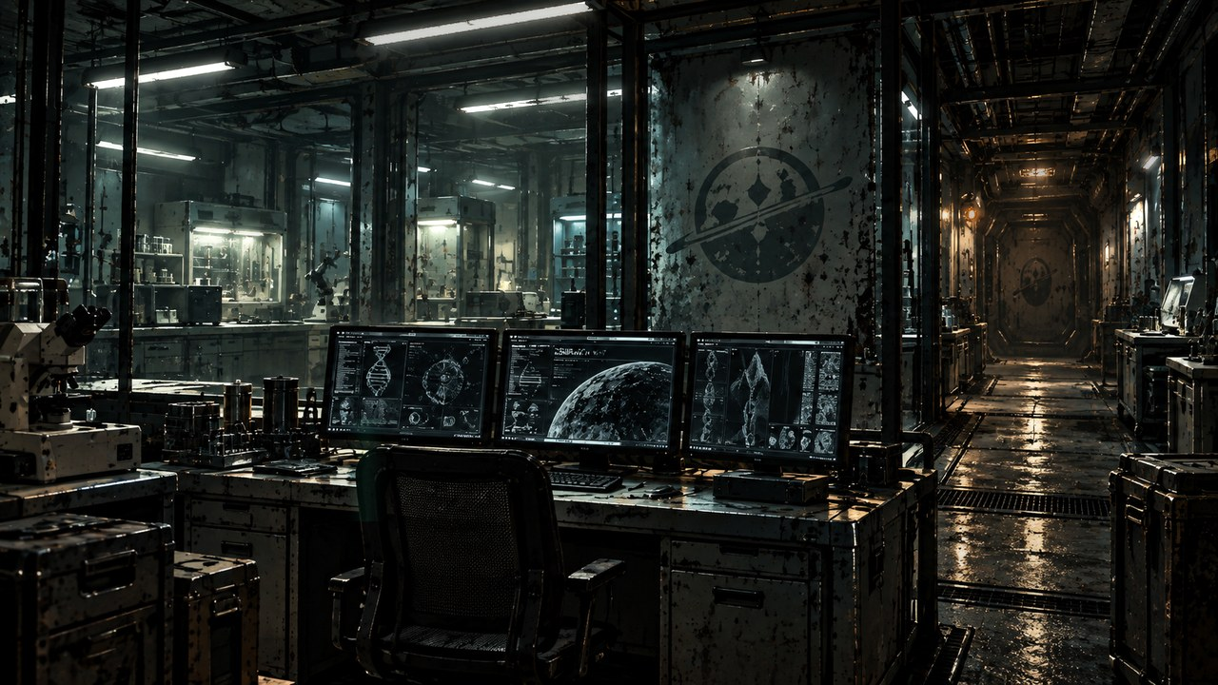
THE FAR HORIZON
07
The truth
MAP ↗
›
Notes:
SESSION 7. GM bible v12 is story authority. ENVIRONMENT: lab.
Start when ready for this session. MAP opens that session’s linked visual map.
VISUAL: Animated chapter / native typography
PLAYBACK: embedded silent H.264 starts automatically and loops. Advance manually; no timed slide changes. Static poster fallback. Actual Microsoft PowerPoint playback has not been tested on this Linux machine.

Slide 67
›
Notes:
SESSION 7. GM bible v12 is story authority. ENVIRONMENT: lab.
VISUAL: Environment from original immersive source 23; source-local object animation
PLAYBACK: embedded silent H.264 starts automatically and loops. Advance manually; no timed slide changes. Static poster fallback. Actual Microsoft PowerPoint playback has not been tested on this Linux machine.

Slide 68
Dr. Nia Okafor
Chief medical officer
›
Notes:
SESSION 7. GM bible v12 is story authority. ENVIRONMENT: lab.
VISUAL: Untouched canonical portrait 40; visible animated lab context and source-local lights
PLAYBACK: embedded silent H.264 starts automatically and loops. Advance manually; no timed slide changes. Static poster fallback. Actual Microsoft PowerPoint playback has not been tested on this Linux machine.

Slide 69
CLASSIFIED: FH-LR-17
REPAIR · RESILIENCE
BIOLOGICAL TIMING / K-17
›
Notes:
SESSION 7. GM bible v12 is story authority. ENVIRONMENT: lab.
Use the full genetics clue in the bible; compatibility does not make the students destined or chosen by blood.
VISUAL: Physical archival document, source-local lamp/dust motion; native editable data
PLAYBACK: embedded silent H.264 starts automatically and loops. Advance manually; no timed slide changes. Static poster fallback. Actual Microsoft PowerPoint playback has not been tested on this Linux machine.

Slide 70
Dr. Elias Vale
Astrophysicist · K-17 specialist
›
Notes:
SESSION 7. GM bible v12 is story authority. ENVIRONMENT: lab.
VISUAL: Untouched canonical portrait 39; visible animated lab context and source-local lights
PLAYBACK: embedded silent H.264 starts automatically and loops. Advance manually; no timed slide changes. Static poster fallback. Actual Microsoft PowerPoint playback has not been tested on this Linux machine.

Slide 71
THE CORRELATION
COHORT RESPONSE
MAY PRECEDE APPROACH
›
Notes:
SESSION 7. GM bible v12 is story authority. ENVIRONMENT: lab.
Biological timing resembles K-17 signal. This replaces the original misleading species-similarity chart.
VISUAL: Readable native data on physical pulsing terminal
PLAYBACK: embedded silent H.264 starts automatically and loops. Advance manually; no timed slide changes. Static poster fallback. Actual Microsoft PowerPoint playback has not been tested on this Linux machine.

Slide 72
ROUTE VARIATION APPROVED
DO NOT ALTER COURSE
BECAUSE OF OBJECT K-17
WITHOUT COMMAND AUTHORIZATION.
›
Notes:
SESSION 7. GM bible v12 is story authority. ENVIRONMENT: lab.
Venn’s handwritten objection follows.
VISUAL: Physical archival document, source-local lamp/dust motion; native editable data
PLAYBACK: embedded silent H.264 starts automatically and loops. Advance manually; no timed slide changes. Static poster fallback. Actual Microsoft PowerPoint playback has not been tested on this Linux machine.

Slide 73
Captain Mara Venn
Mission commander
›
Notes:
SESSION 7. GM bible v12 is story authority. ENVIRONMENT: lab.
VISUAL: Untouched canonical portrait 37; visible animated lab context and source-local lights
PLAYBACK: embedded silent H.264 starts automatically and loops. Advance manually; no timed slide changes. Static poster fallback. Actual Microsoft PowerPoint playback has not been tested on this Linux machine.

Slide 74
VENN’S HANDWRITING
“They are children.
I will not spend them
without answers.”
›
Notes:
SESSION 7. GM bible v12 is story authority. ENVIRONMENT: lab.
VISUAL: Physical archival document, source-local lamp/dust motion; native editable data
PLAYBACK: embedded silent H.264 starts automatically and loops. Advance manually; no timed slide changes. Static poster fallback. Actual Microsoft PowerPoint playback has not been tested on this Linux machine.

Slide 75
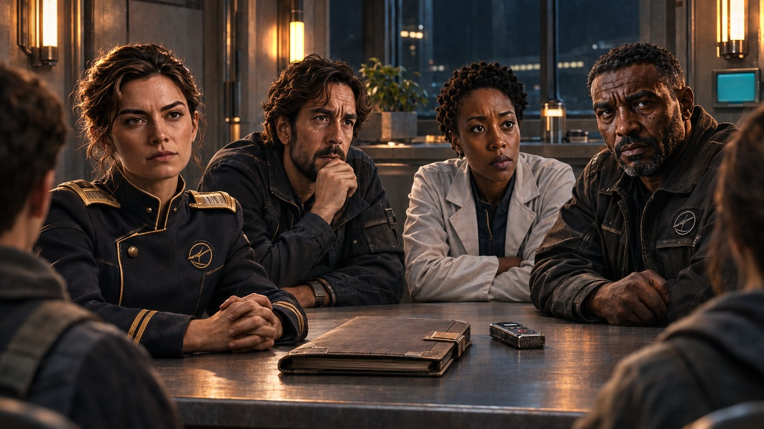
›
Notes:
SESSION 7. GM bible v12 is story authority. ENVIRONMENT: adult_confrontation.
Students challenge the adults: You chose for us.
VISUAL: Restored original scene composition, canonical identities and localized practical motion
PLAYBACK: embedded silent H.264 starts automatically and loops. Advance manually; no timed slide changes. Static poster fallback. Actual Microsoft PowerPoint playback has not been tested on this Linux machine.

Slide 76
WHAT EACH ADULT KNEW
Mara Venn
Elias Vale
Nia Okafor
Marcus Bell
›
Notes:
SESSION 7. GM bible v12 is story authority. ENVIRONMENT: adult_confrontation.
Venn: route + suspected response, not mechanism. Vale: anomalous signal resembled cohort data. Okafor: marker, not deliberate exposure. Bell: containment orders, not science. Replaces group artwork with inconsistent NPC identities.
VISUAL: Canonical portrait gallery over visibly moving contextual environment
PLAYBACK: embedded silent H.264 starts automatically and loops. Advance manually; no timed slide changes. Static poster fallback. Actual Microsoft PowerPoint playback has not been tested on this Linux machine.

Slide 77
YOUR DECISION
HOW DO WE APPROACH K-17?
›
Notes:
SESSION 7. GM bible v12 is story authority. ENVIRONMENT: adult_confrontation.
Session 7 endpoint: students gain explicit decision-making authority over future approach.
VISUAL: Native story cue over visible animated adult_confrontation environment
PLAYBACK: embedded silent H.264 starts automatically and loops. Advance manually; no timed slide changes. Static poster fallback. Actual Microsoft PowerPoint playback has not been tested on this Linux machine.

Slide 78
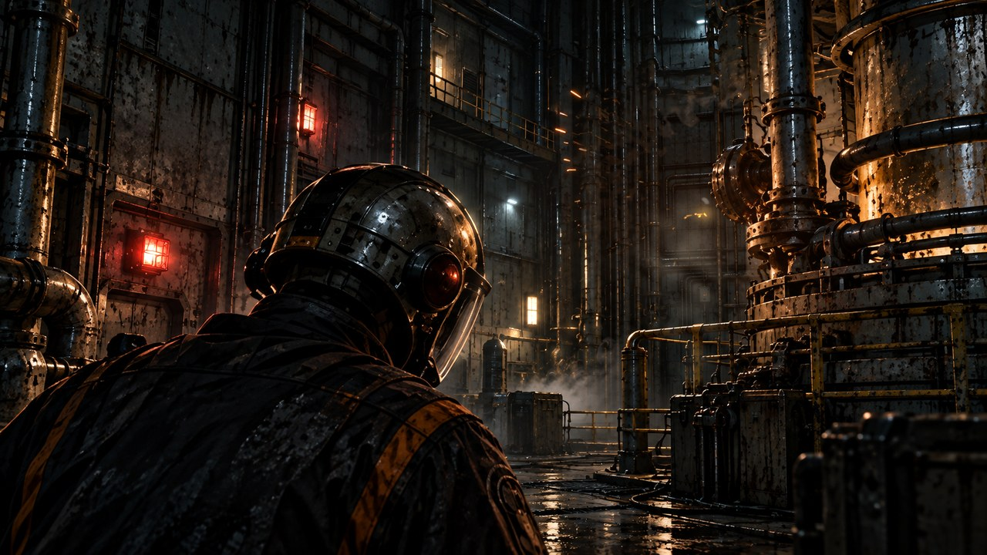
THE FAR HORIZON
08
The cost
MAP ↗
›
Notes:
SESSION 8. GM bible v12 is story authority. ENVIRONMENT: reactor.
Start when ready for this session. MAP opens that session’s linked visual map.
VISUAL: Animated chapter / native typography
PLAYBACK: embedded silent H.264 starts automatically and loops. Advance manually; no timed slide changes. Static poster fallback. Actual Microsoft PowerPoint playback has not been tested on this Linux machine.

Slide 79
›
Notes:
SESSION 8. GM bible v12 is story authority. ENVIRONMENT: reactor.
VISUAL: Environment from original immersive source 26; source-local object animation
PLAYBACK: embedded silent H.264 starts automatically and loops. Advance manually; no timed slide changes. Static poster fallback. Actual Microsoft PowerPoint playback has not been tested on this Linux machine.

Slide 80
Tomas Rhee
Chief engineer
›
Notes:
SESSION 8. GM bible v12 is story authority. ENVIRONMENT: reactor.
VISUAL: Untouched canonical portrait 41; visible animated reactor context and source-local lights
PLAYBACK: embedded silent H.264 starts automatically and loops. Advance manually; no timed slide changes. Static poster fallback. Actual Microsoft PowerPoint playback has not been tested on this Linux machine.

Slide 81
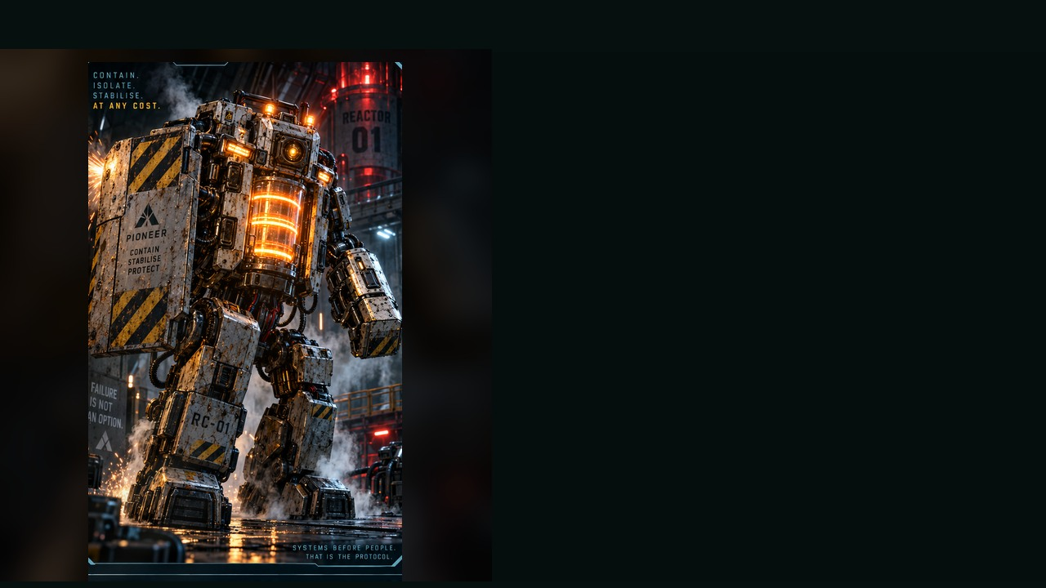
REACTOR CONTAINMENT UNIT
WEAKNESS
Exposed rear power coupler
BEHAVIOUR
• Seals corridors
• Shoves targets from consoles
• Prioritises system lockdown over human safety
SPECIAL
Riot shield · Pulse ram · Venting steam burst
OBJECTIVE PRESSURE
Blocks access while the reactor countdown advances.
FULL DOSSIER
MOVE · ATTACK · ASSIST · ENVIRONMENT
›
Notes:
SESSION 8. GM bible v12 is story authority. ENVIRONMENT: reactor.
Dangerous 3 Threat Boxes. Containment logic, not malice. 3 rounds with a changing environment; attacks alone cannot win.
VISUAL: Latest uploaded enemy dossier: animated source artwork; readable weakness, behaviour, special, objective
PLAYBACK: embedded silent H.264 starts automatically and loops. Advance manually; no timed slide changes. Static poster fallback. Actual Microsoft PowerPoint playback has not been tested on this Linux machine.

Slide 82
REACTOR CONTAINMENT UNIT · DOSSIER
TYPE
Emergency Hazard Response Unit
THREAT PROFILE
Dangerous · 3 threat boxes
ROLE
Area-Denial Brute
STAGE CUES
• Heavy stomps
• Alarm voice
• Slow, unstoppable turning
TACTICS
SOURCE: ENEMY DOSSIER
›
Notes:
SESSION 8. GM bible v12 is story authority. ENVIRONMENT: reactor.
Dangerous 3 Threat Boxes. Containment logic, not malice. 3 rounds with a changing environment; attacks alone cannot win.
VISUAL: Latest enemy dossier profile, threat, role, stage cues; source text retained
PLAYBACK: embedded silent H.264 starts automatically and loops. Advance manually; no timed slide changes. Static poster fallback. Actual Microsoft PowerPoint playback has not been tested on this Linux machine.

Slide 83
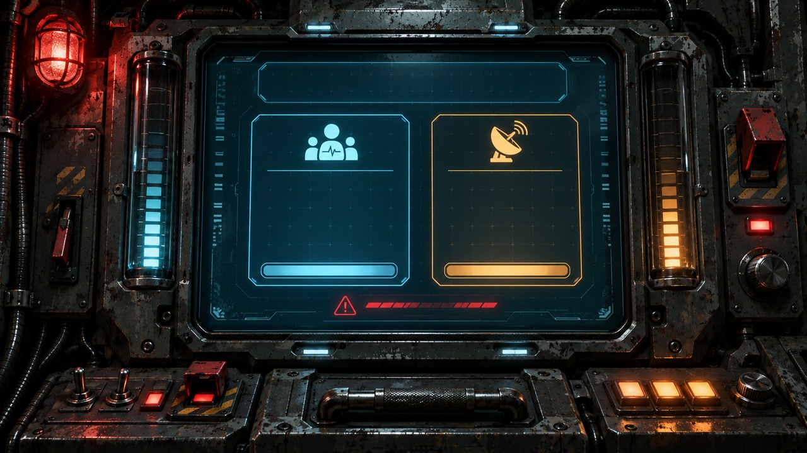
AVAILABLE POWER: 37%
LIFE SUPPORT
NAVIGATION
62%
58%
›
Notes:
SESSION 8. GM bible v12 is story authority. ENVIRONMENT: reactor.
Power37%, life support62%, navigation58%. No configuration saves everything.
VISUAL: Physical clue prop with source-local animation and native canonical text
PLAYBACK: embedded silent H.264 starts automatically and loops. Advance manually; no timed slide changes. Static poster fallback. Actual Microsoft PowerPoint playback has not been tested on this Linux machine.

Slide 84
NO CONFIGURATION SAVES EVERYTHING
POWER: 37%
LIFE SUPPORT: 62%
NAVIGATION: 58%
›
Notes:
SESSION 8. GM bible v12 is story authority. ENVIRONMENT: reactor.
Communications array goes offline if power diverted. Accept a credible student alternative with a real cost.
VISUAL: Native story cue over visible animated reactor environment
PLAYBACK: embedded silent H.264 starts automatically and loops. Advance manually; no timed slide changes. Static poster fallback. Actual Microsoft PowerPoint playback has not been tested on this Linux machine.

Slide 85
IRIS
Ship AI
›
Notes:
SESSION 8. GM bible v12 is story authority. ENVIRONMENT: reactor.
VISUAL: Untouched canonical portrait 44; visible animated reactor context and source-local lights
PLAYBACK: embedded silent H.264 starts automatically and loops. Advance manually; no timed slide changes. Static poster fallback. Actual Microsoft PowerPoint playback has not been tested on this Linux machine.

Slide 86
DAMAGE REPORT
What did you protect?
What did it cost?
›
Notes:
SESSION 8. GM bible v12 is story authority. ENVIRONMENT: reactor.
Record the class’s actual sacrifice in the GM notes before Session 9. Do not imply fixed casualties.
VISUAL: Native story cue over visible animated reactor environment
PLAYBACK: embedded silent H.264 starts automatically and loops. Advance manually; no timed slide changes. Static poster fallback. Actual Microsoft PowerPoint playback has not been tested on this Linux machine.

Slide 87
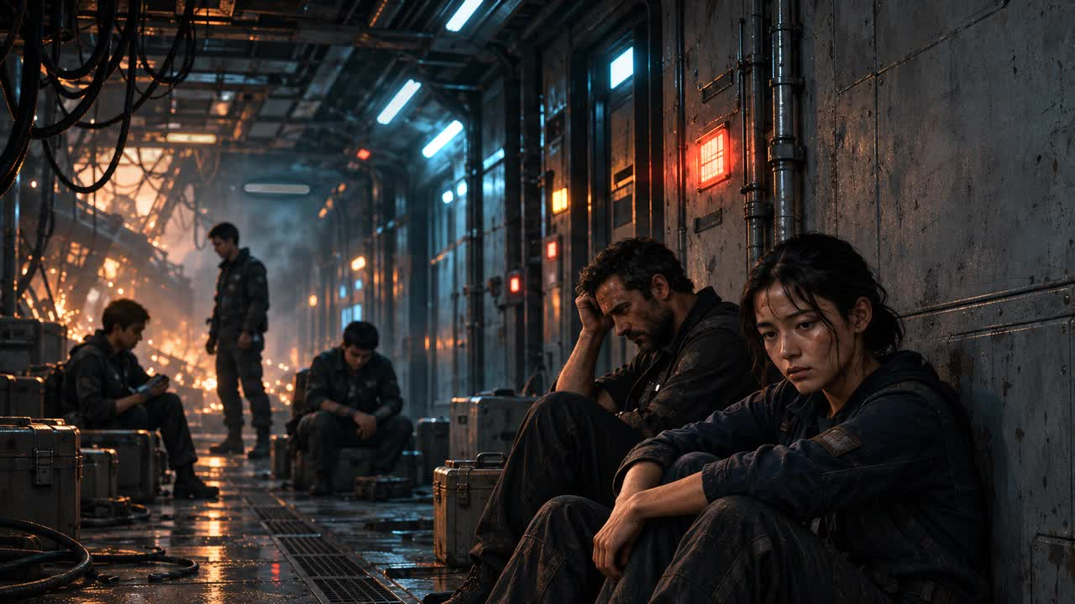
›
Notes:
SESSION 8. GM bible v12 is story authority. ENVIRONMENT: aftermath.
Background figures are unnamed Cohort / crew. Carry the actual cost forward.
VISUAL: Environment from original immersive source 28; source-local object animation
PLAYBACK: embedded silent H.264 starts automatically and loops. Advance manually; no timed slide changes. Static poster fallback. Actual Microsoft PowerPoint playback has not been tested on this Linux machine.

Slide 88
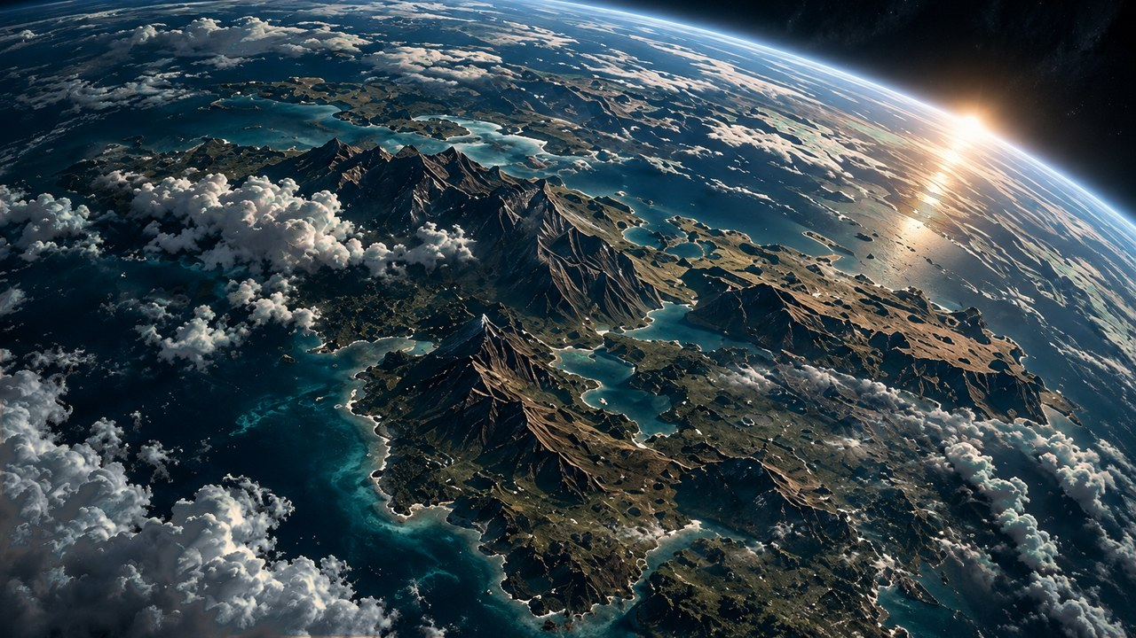
THE FAR HORIZON
09
Arrival
MAP ↗
›
Notes:
SESSION 9. GM bible v12 is story authority. ENVIRONMENT: orbit.
Start when ready for this session. MAP opens that session’s linked visual map.
VISUAL: Animated chapter / native typography
PLAYBACK: embedded silent H.264 starts automatically and loops. Advance manually; no timed slide changes. Static poster fallback. Actual Microsoft PowerPoint playback has not been tested on this Linux machine.

Slide 89
›
Notes:
SESSION 9. GM bible v12 is story authority. ENVIRONMENT: orbit.
VISUAL: Environment from original immersive source 30; source-local object animation
PLAYBACK: embedded silent H.264 starts automatically and loops. Advance manually; no timed slide changes. Static poster fallback. Actual Microsoft PowerPoint playback has not been tested on this Linux machine.

Slide 90
Captain Mara Venn
Mission commander
›
Notes:
SESSION 9. GM bible v12 is story authority. ENVIRONMENT: orbit.
VISUAL: Untouched canonical portrait 37; visible animated orbit context and source-local lights
PLAYBACK: embedded silent H.264 starts automatically and loops. Advance manually; no timed slide changes. Static poster fallback. Actual Microsoft PowerPoint playback has not been tested on this Linux machine.

Slide 91
ORBITAL SURVEY
ARTIFICIAL STRUCTURES
CONSTRUCTION AGE: 5–8 YEARS
ATMOSPHERE: AS PROJECTED
POWER: INTERMITTENT
HUMAN BIOSIGNS: INCONCLUSIVE
›
Notes:
SESSION 9. GM bible v12 is story authority. ENVIRONMENT: orbit.
Allow 60 seconds of Asteria wonder before this evidence. Carry the actual Session 8 sacrifice forward. No confirmed survivors.
VISUAL: Readable native data on physical pulsing terminal
PLAYBACK: embedded silent H.264 starts automatically and loops. Advance manually; no timed slide changes. Static poster fallback. Actual Microsoft PowerPoint playback has not been tested on this Linux machine.

Slide 92
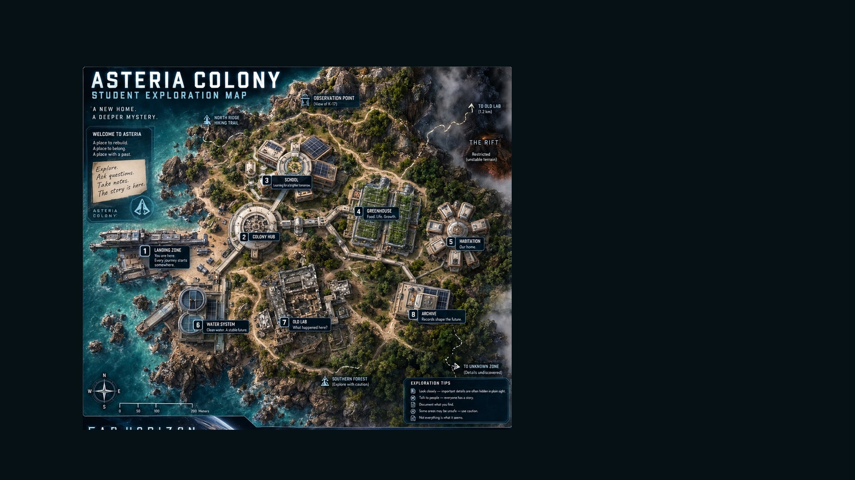
ASTERIA · EXPLORATION MAP
MAP KEY
01
Landing Zone
02
Colony Hub
03
School
04
Greenhouse
05
Habitation
06
Water System
07
Old Lab
08
Archive
›
Notes:
SESSION 9. GM bible v12 is story authority. ENVIRONMENT: orbit.
Student-facing map artwork; do not narrate future map atlas locations early.
VISUAL: Original map art, readable native legend, subtle source-local motion
PLAYBACK: embedded silent H.264 starts automatically and loops. Advance manually; no timed slide changes. Static poster fallback. Actual Microsoft PowerPoint playback has not been tested on this Linux machine.

Slide 93
SETTLEMENT BEACON
WELCOME, COHORT 01.
YOU ARE LATE.
›
Notes:
SESSION 9. GM bible v12 is story authority. ENVIRONMENT: orbit.
Session 9 cliffhanger. Do not reveal the colony photo before Session 10.
VISUAL: Readable native data on physical pulsing terminal
PLAYBACK: embedded silent H.264 starts automatically and loops. Advance manually; no timed slide changes. Static poster fallback. Actual Microsoft PowerPoint playback has not been tested on this Linux machine.

Slide 94
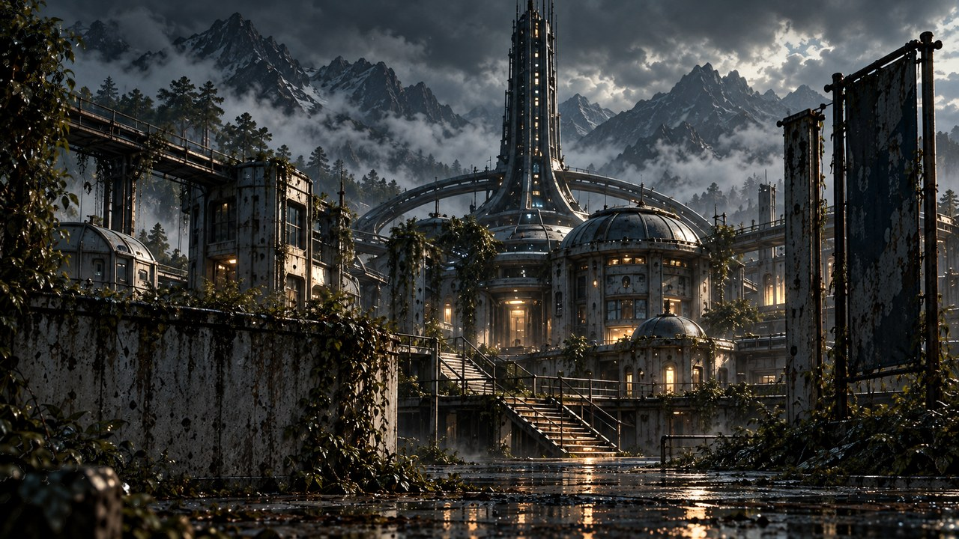
THE FAR HORIZON
10
The colony
MAP ↗
›
Notes:
SESSION 10. GM bible v12 is story authority. ENVIRONMENT: colony.
Start when ready for this session. MAP opens that session’s linked visual map.
VISUAL: Animated chapter / native typography
PLAYBACK: embedded silent H.264 starts automatically and loops. Advance manually; no timed slide changes. Static poster fallback. Actual Microsoft PowerPoint playback has not been tested on this Linux machine.

Slide 95
›
Notes:
SESSION 10. GM bible v12 is story authority. ENVIRONMENT: colony.
VISUAL: Environment from original immersive source 31; source-local object animation
PLAYBACK: embedded silent H.264 starts automatically and loops. Advance manually; no timed slide changes. Static poster fallback. Actual Microsoft PowerPoint playback has not been tested on this Linux machine.

Slide 96
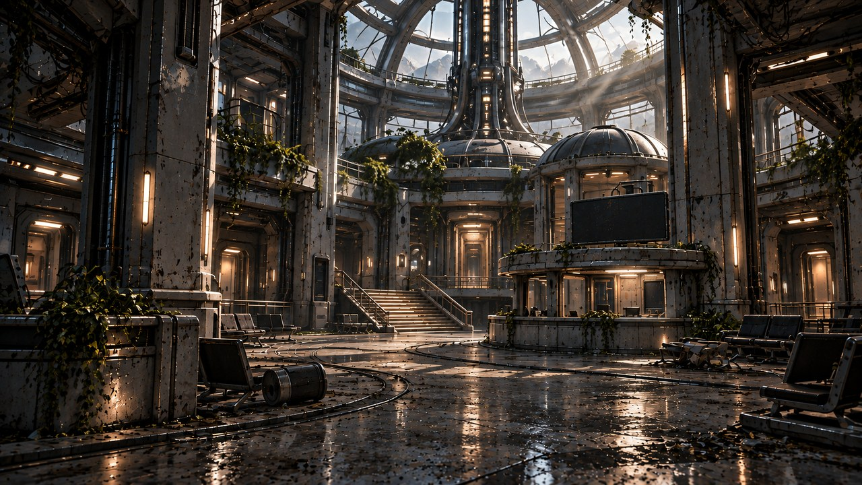
›
Notes:
SESSION 10. GM bible v12 is story authority. ENVIRONMENT: hub.
VISUAL: Environment from original immersive source 76; source-local object animation
PLAYBACK: embedded silent H.264 starts automatically and loops. Advance manually; no timed slide changes. Static poster fallback. Actual Microsoft PowerPoint playback has not been tested on this Linux machine.

Slide 97
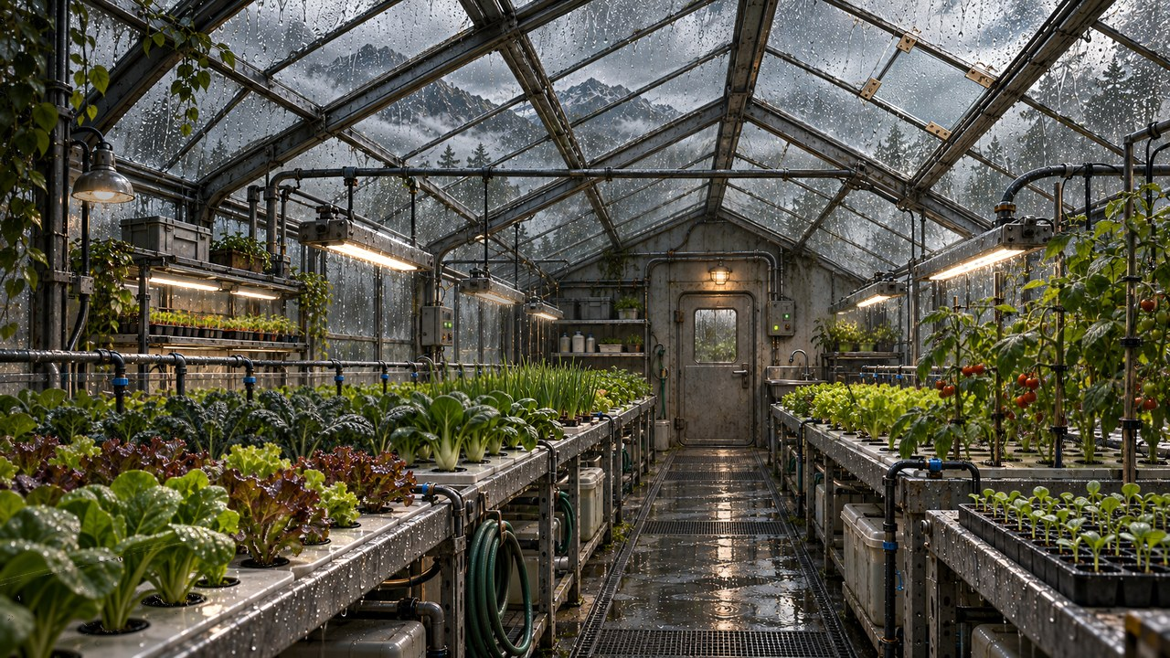
›
Notes:
SESSION 10. GM bible v12 is story authority. ENVIRONMENT: greenhouse.
Optional brief montage; cut freely to protect the school scene.
VISUAL: Environment from original immersive source 78; source-local object animation
PLAYBACK: embedded silent H.264 starts automatically and loops. Advance manually; no timed slide changes. Static poster fallback. Actual Microsoft PowerPoint playback has not been tested on this Linux machine.

Slide 98
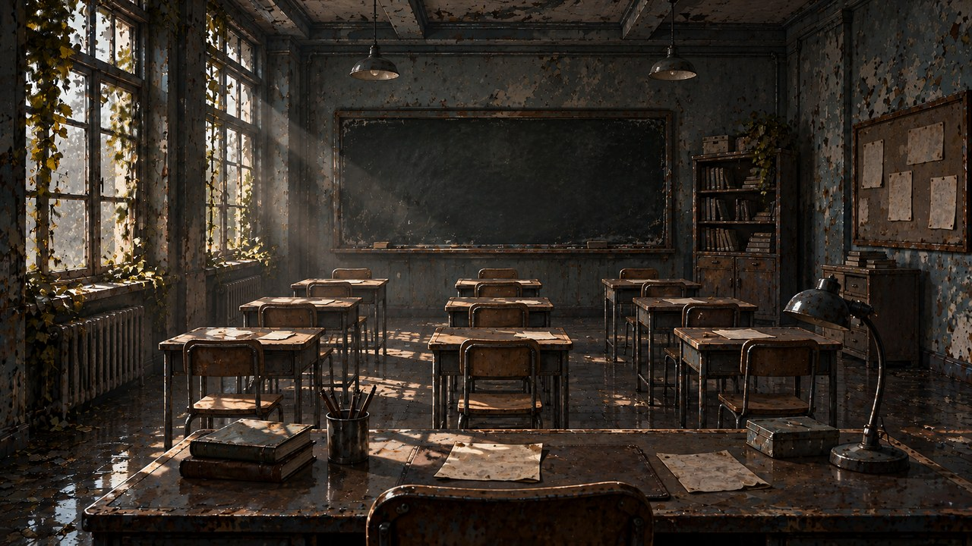
›
Notes:
SESSION 10. GM bible v12 is story authority. ENVIRONMENT: school.
VISUAL: Environment from original immersive source 32; source-local object animation
PLAYBACK: embedded silent H.264 starts automatically and loops. Advance manually; no timed slide changes. Static poster fallback. Actual Microsoft PowerPoint playback has not been tested on this Linux machine.

Slide 99
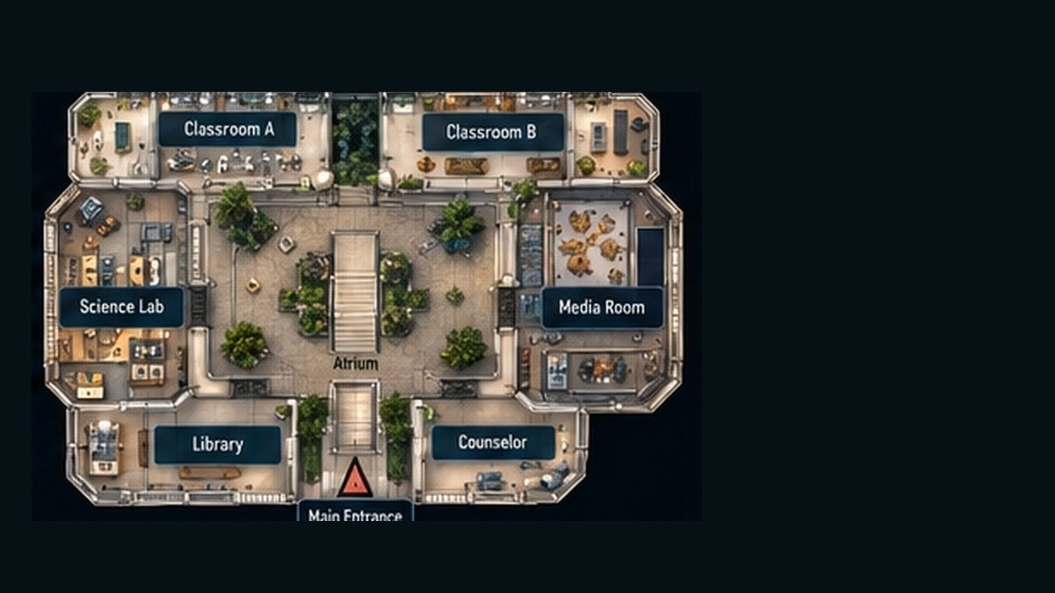
SCHOOL · INTERIOR DETAIL
MAP KEY
01
Classroom A
02
Classroom B
03
Science Lab
04
Media Room
05
Atrium
06
Library
07
Counselor
08
Main Entrance
›
Notes:
SESSION 10. GM bible v12 is story authority. ENVIRONMENT: school.
Student-facing map artwork; do not narrate future map atlas locations early.
VISUAL: Original map art, readable native legend, subtle source-local motion
PLAYBACK: embedded silent H.264 starts automatically and loops. Advance manually; no timed slide changes. Static poster fallback. Actual Microsoft PowerPoint playback has not been tested on this Linux machine.

Slide 100
HOME
›
Notes:
SESSION 10. GM bible v12 is story authority. ENVIRONMENT: school.
VISUAL: Environment from original immersive source 54; source-local object animation
PLAYBACK: embedded silent H.264 starts automatically and loops. Advance manually; no timed slide changes. Static poster fallback. Actual Microsoft PowerPoint playback has not been tested on this Linux machine.

Slide 101
CHILD’S DRAWING
HOME IS WHERE
WE DECIDED TO STAY.
›
Notes:
SESSION 10. GM bible v12 is story authority. ENVIRONMENT: school.
VISUAL: Native story cue over visible animated school environment
PLAYBACK: embedded silent H.264 starts automatically and loops. Advance manually; no timed slide changes. Static poster fallback. Actual Microsoft PowerPoint playback has not been tested on this Linux machine.

Slide 102
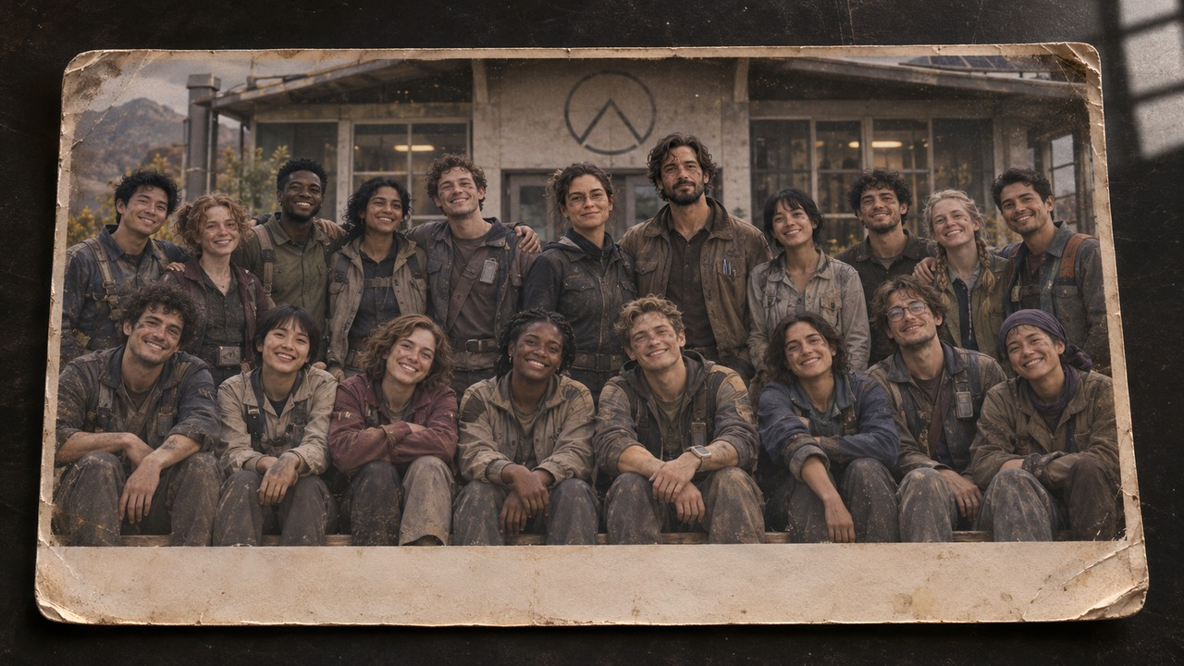
ASTERIA SCHOOL — COHORT 01
›
Notes:
SESSION 10. GM bible v12 is story authority. ENVIRONMENT: school.
Fictional older Cohort 01 with canonical Venn and Vale. Read photo reveal from bible; eight seconds of silence. No real student likenesses. Native caption artifact preserves the reveal without inventing literal class likenesses. Read the bible’s reveal: Venn, Vale and an older Cohort 01. Eight seconds of silence.
VISUAL: Physical clue prop with source-local animation and native canonical text
PLAYBACK: embedded silent H.264 starts automatically and loops. Advance manually; no timed slide changes. Static poster fallback. Actual Microsoft PowerPoint playback has not been tested on this Linux machine.

Slide 103
ON THE TEACHER’S DESK
The object you brought from Earth.
›
Notes:
SESSION 10. GM bible v12 is story authority. ENVIRONMENT: school.
Name the fictional character and describe the same scratch / sticker. Use the object recorded in Session 1.
VISUAL: Native story cue over visible animated school environment
PLAYBACK: embedded silent H.264 starts automatically and loops. Advance manually; no timed slide changes. Static poster fallback. Actual Microsoft PowerPoint playback has not been tested on this Linux machine.

Slide 104
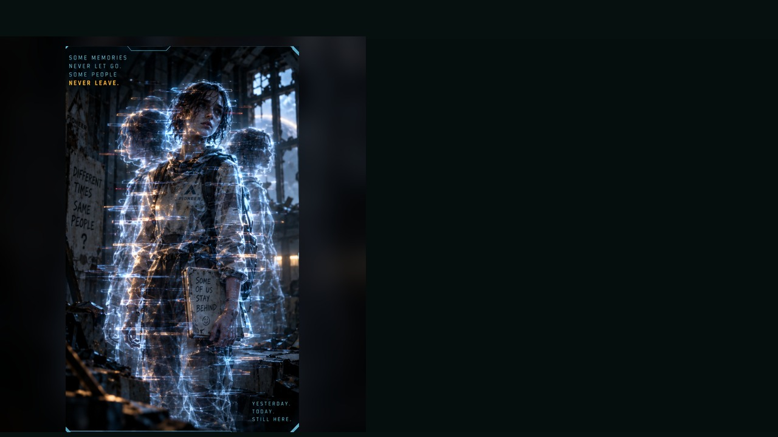
COLONY ECHO
WEAKNESS
Recognition and calm speech disrupt it.
BEHAVIOUR
• Repeats broken memories
• Lashes out when approached
• Mirrors student choices
SPECIAL
Phase shift · Delayed strike · Memory flash
OBJECTIVE PRESSURE
Confuses teams and fractures the scene into multiple versions.
FULL DOSSIER
MOVE · ATTACK · ASSIST · ENVIRONMENT
›
Notes:
SESSION 10. GM bible v12 is story authority. ENVIRONMENT: school.
Dangerous 3 Threat Boxes. Not purely hostile: stabilizes through recognition, naming or calm address. Preserve photo/archive evidence. Combat optional.
VISUAL: Latest uploaded enemy dossier: animated source artwork; readable weakness, behaviour, special, objective
PLAYBACK: embedded silent H.264 starts automatically and loops. Advance manually; no timed slide changes. Static poster fallback. Actual Microsoft PowerPoint playback has not been tested on this Linux machine.

Slide 105
COLONY ECHO · DOSSIER
TYPE
Temporal Residue
THREAT PROFILE
Dangerous · 3 threat boxes
ROLE
Unstable Echo
STAGE CUES
• Delayed reactions
• Overlapping speech
• Frozen tableau then sudden motion
TACTICS
SOURCE: ENEMY DOSSIER
›
Notes:
SESSION 10. GM bible v12 is story authority. ENVIRONMENT: school.
Dangerous 3 Threat Boxes. Not purely hostile: stabilizes through recognition, naming or calm address. Preserve photo/archive evidence. Combat optional.
VISUAL: Latest enemy dossier profile, threat, role, stage cues; source text retained
PLAYBACK: embedded silent H.264 starts automatically and loops. Advance manually; no timed slide changes. Static poster fallback. Actual Microsoft PowerPoint playback has not been tested on this Linux machine.

Slide 106
COLONY RECORDS
SUCCESSFUL
LOST
RETURNED
›
Notes:
SESSION 10. GM bible v12 is story authority. ENVIRONMENT: school.
Contradictory possible outcomes. Do not pick one for the class.
VISUAL: Readable native data on physical pulsing terminal
PLAYBACK: embedded silent H.264 starts automatically and loops. Advance manually; no timed slide changes. Static poster fallback. Actual Microsoft PowerPoint playback has not been tested on this Linux machine.

Slide 107
POSSIBLE FUTURES
Not one history.
More than one possible future.
›
Notes:
SESSION 10. GM bible v12 is story authority. ENVIRONMENT: school.
The colony was built by a possible future Cohort 01. Let the class connect the emotional evidence.
VISUAL: Native story cue over visible animated school environment
PLAYBACK: embedded silent H.264 starts automatically and loops. Advance manually; no timed slide changes. Static poster fallback. Actual Microsoft PowerPoint playback has not been tested on this Linux machine.

Slide 108
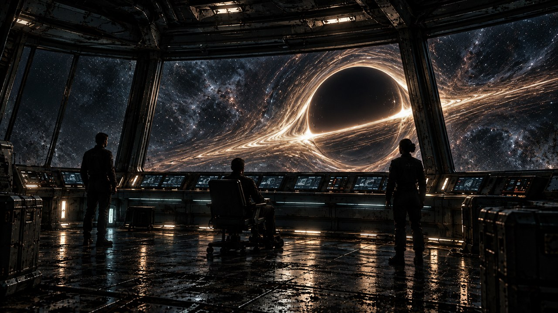
THE FAR HORIZON
11
What do we do?
MAP ↗
›
Notes:
SESSION 11. GM bible v12 is story authority. ENVIRONMENT: final_anomaly.
Start when ready for this session. MAP opens that session’s linked visual map.
VISUAL: Animated chapter / native typography
PLAYBACK: embedded silent H.264 starts automatically and loops. Advance manually; no timed slide changes. Static poster fallback. Actual Microsoft PowerPoint playback has not been tested on this Linux machine.

Slide 109
UNIT M-77 / HAB DECK
STATUS: REPAIRED
COMPLETED: TOMORROW 14:32
TECHNICIAN COHORT 01
“Collision with unrecorded passenger resolved.”
›
Notes:
SESSION 11. GM bible v12 is story authority. ENVIRONMENT: final_anomaly.
Exact canonical ticket. Reveal after incident; repeat at final explanation. No rat explanation for unrecorded passenger.
VISUAL: Physical clue prop with source-local animation and native canonical text
PLAYBACK: embedded silent H.264 starts automatically and loops. Advance manually; no timed slide changes. Static poster fallback. Actual Microsoft PowerPoint playback has not been tested on this Linux machine.

Slide 110

›
Notes:
SESSION 11. GM bible v12 is story authority. ENVIRONMENT: final_anomaly.
Source CSV-01 PIONEER; arrival confirmed; +103 days.
VISUAL: Physical clue prop with source-local animation and native canonical text
PLAYBACK: embedded silent H.264 starts automatically and loops. Advance manually; no timed slide changes. Static poster fallback. Actual Microsoft PowerPoint playback has not been tested on this Linux machine.

Slide 111
›
Notes:
SESSION 11. GM bible v12 is story authority. ENVIRONMENT: derelict_exterior.
VISUAL: Environment from original immersive source 17; source-local object animation
PLAYBACK: embedded silent H.264 starts automatically and loops. Advance manually; no timed slide changes. Static poster fallback. Actual Microsoft PowerPoint playback has not been tested on this Linux machine.

Slide 112
ASTERIA SCHOOL — COHORT 01
›
Notes:
SESSION 11. GM bible v12 is story authority. ENVIRONMENT: final_anomaly.
Fictional older Cohort 01 with canonical Venn and Vale. Read photo reveal from bible; eight seconds of silence. No real student likenesses.
VISUAL: Physical clue prop with source-local animation and native canonical text
PLAYBACK: embedded silent H.264 starts automatically and loops. Advance manually; no timed slide changes. Static poster fallback. Actual Microsoft PowerPoint playback has not been tested on this Linux machine.

Slide 113
K-17
Unchosen possibilities
can become real.
›
Notes:
SESSION 11. GM bible v12 is story authority. ENVIRONMENT: final_anomaly.
Explain the full mechanism now. Cohort biological compatibility permits overlap; consequential coordinated CHOICE is the deeper key.
VISUAL: Native story cue over visible animated final_anomaly environment
PLAYBACK: embedded silent H.264 starts automatically and loops. Advance manually; no timed slide changes. Static poster fallback. Actual Microsoft PowerPoint playback has not been tested on this Linux machine.

Slide 114
THE WARNING RESOLVED
Juno Reyes
IRIS
›
Notes:
SESSION 11. GM bible v12 is story authority. ENVIRONMENT: final_anomaly.
IRIS explains that in one future Juno answers the message and completes the communication loop. The warning concerned her action, not her character.
VISUAL: Canonical portrait gallery over visibly moving contextual environment
PLAYBACK: embedded silent H.264 starts automatically and loops. Advance manually; no timed slide changes. Static poster fallback. Actual Microsoft PowerPoint playback has not been tested on this Linux machine.

Slide 115
Captain Mara Venn
Mission commander
›
Notes:
SESSION 11. GM bible v12 is story authority. ENVIRONMENT: final_anomaly.
Venn admits deliberate routing and yields the final choice to Cohort 01.
VISUAL: Untouched canonical portrait 37; visible animated final_anomaly context and source-local lights
PLAYBACK: embedded silent H.264 starts automatically and loops. Advance manually; no timed slide changes. Static poster fallback. Actual Microsoft PowerPoint playback has not been tested on this Linux machine.

Slide 116
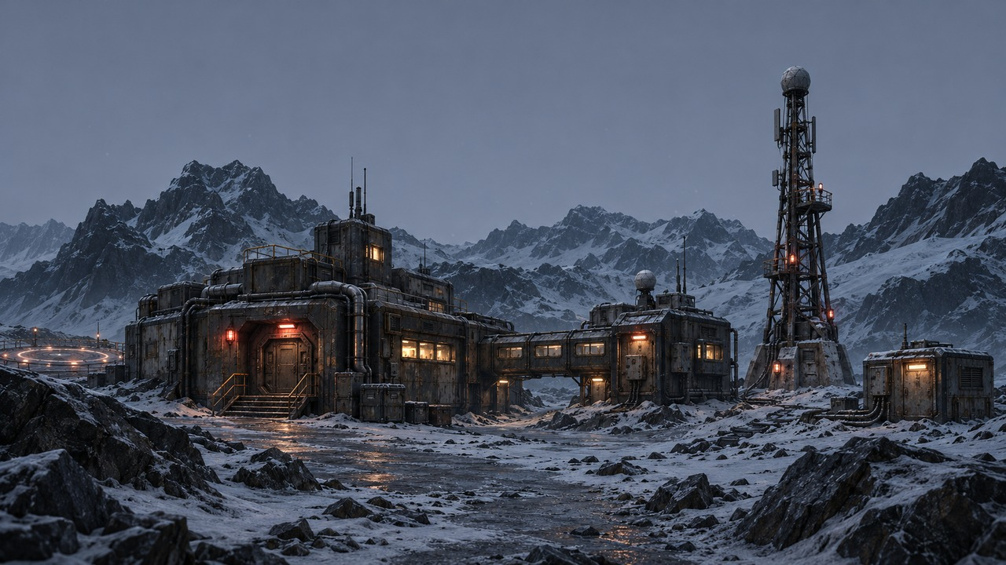
›
Notes:
SESSION 11. GM bible v12 is story authority. ENVIRONMENT: outpost.
Optional remote planning / investigation visual requested by teacher. No mandatory visit or new required clue.
VISUAL: Restored original scene composition, canonical identities and localized practical motion
PLAYBACK: embedded silent H.264 starts automatically and loops. Advance manually; no timed slide changes. Static poster fallback. Actual Microsoft PowerPoint playback has not been tested on this Linux machine.

Slide 117
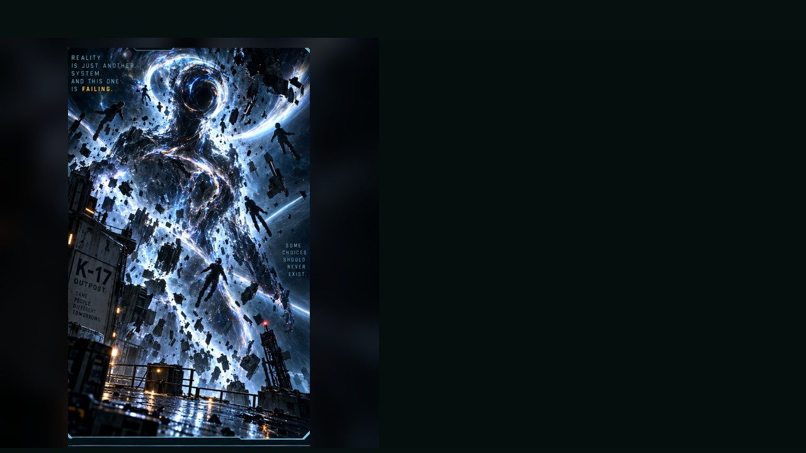
K-17 FRACTURE ENTITY
WEAKNESS
Synchronization through coordinated crew action
BEHAVIOUR
• Warps the battlefield
• Splits choices into conflicting outcomes
• Punishes indecision
SPECIAL
Gravity pulse · Timeline split · Echo summons
OBJECTIVE PRESSURE
Forces a final choice while reality collapses around the team.
FULL DOSSIER
MOVE · ATTACK · ASSIST · ENVIRONMENT
›
Notes:
SESSION 11. GM bible v12 is story authority. ENVIRONMENT: final_anomaly.
Boss 5 Threat Boxes; attacks cannot permanently defeat it. Phases: SURVIVE, SYNCHRONIZE, COMMIT. Final Threat Box disappears only with a shared consequential choice.
VISUAL: Latest uploaded enemy dossier: animated source artwork; readable weakness, behaviour, special, objective
PLAYBACK: embedded silent H.264 starts automatically and loops. Advance manually; no timed slide changes. Static poster fallback. Actual Microsoft PowerPoint playback has not been tested on this Linux machine.

Slide 118
K-17 FRACTURE ENTITY · DOSSIER
TYPE
Anomaly Manifestation
THREAT PROFILE
Boss · 5 threat boxes
ROLE
Reality-Breaking Apex Threat
STAGE CUES
• Echoing layered voice
• Stillness before violent surges
• Gestures pull space out of shape
TACTICS
SOURCE: ENEMY DOSSIER
›
Notes:
SESSION 11. GM bible v12 is story authority. ENVIRONMENT: final_anomaly.
Boss 5 Threat Boxes; attacks cannot permanently defeat it. Phases: SURVIVE, SYNCHRONIZE, COMMIT. Final Threat Box disappears only with a shared consequential choice.
VISUAL: Latest enemy dossier profile, threat, role, stage cues; source text retained
PLAYBACK: embedded silent H.264 starts automatically and loops. Advance manually; no timed slide changes. Static poster fallback. Actual Microsoft PowerPoint playback has not been tested on this Linux machine.

Slide 119
SURVIVE → SYNCHRONIZE
Tomas Rhee
Elias Vale
Nia Okafor
IRIS
›
Notes:
SESSION 11. GM bible v12 is story authority. ENVIRONMENT: final_anomaly.
Give all four departments one function and action. One combined plan removes 2 Threat Boxes.
VISUAL: Canonical portrait gallery over visibly moving contextual environment
PLAYBACK: embedded silent H.264 starts automatically and loops. Advance manually; no timed slide changes. Static poster fallback. Actual Microsoft PowerPoint playback has not been tested on this Linux machine.

Slide 120
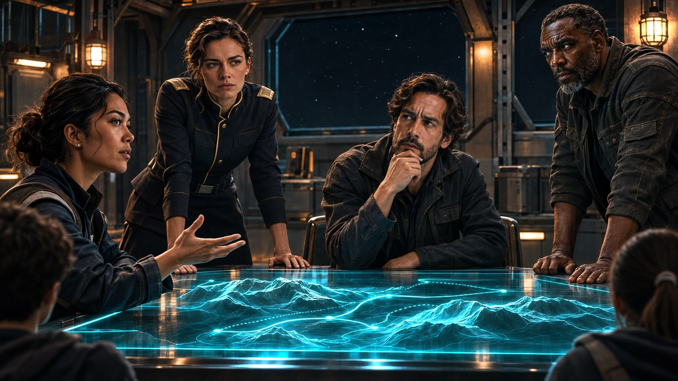
›
Notes:
SESSION 11. GM bible v12 is story authority. ENVIRONMENT: debate.
Canon crew plus unnamed students; preserve every consequential ending option.
VISUAL: Restored original scene composition, canonical identities and localized practical motion
PLAYBACK: embedded silent H.264 starts automatically and loops. Advance manually; no timed slide changes. Static poster fallback. Actual Microsoft PowerPoint playback has not been tested on this Linux machine.

Slide 121
COMMIT
RETURN TO EARTH
STAY ON ASTERIA
INVESTIGATE K-17
SEAL / PAUSE THE CONNECTION
YOUR PLAN — WITH A COST
›
Notes:
SESSION 11. GM bible v12 is story authority. ENVIRONMENT: debate.
No roll for the final choice. Give companies 45 seconds to persuade, then vote or reach consensus.
VISUAL: Native story cue over visible animated debate environment
PLAYBACK: embedded silent H.264 starts automatically and loops. Advance manually; no timed slide changes. Static poster fallback. Actual Microsoft PowerPoint playback has not been tested on this Linux machine.

Slide 122
›
Notes:
SESSION 11. GM bible v12 is story authority. ENVIRONMENT: final_anomaly.
This visual holds the choice; it does not mandate investigation.
VISUAL: Environment from original immersive source 35; source-local object animation
PLAYBACK: embedded silent H.264 starts automatically and loops. Advance manually; no timed slide changes. Static poster fallback. Actual Microsoft PowerPoint playback has not been tested on this Linux machine.

Slide 123
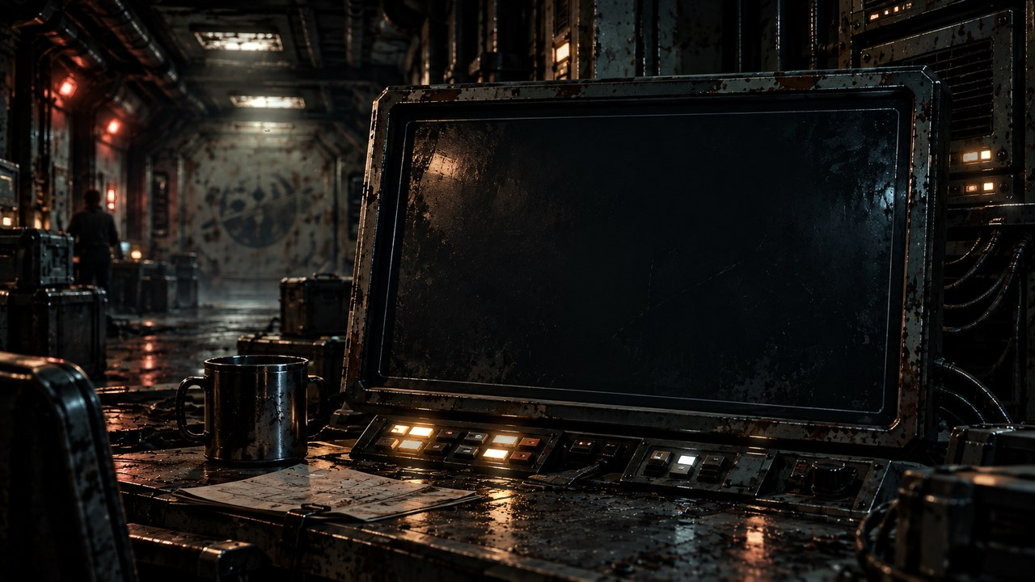
THE FAR HORIZON
12
Change
MAP ↗
›
Notes:
SESSION 12. GM bible v12 is story authority. ENVIRONMENT: finale.
Start when ready for this session. MAP opens that session’s linked visual map.
VISUAL: Animated chapter / native typography
PLAYBACK: embedded silent H.264 starts automatically and loops. Advance manually; no timed slide changes. Static poster fallback. Actual Microsoft PowerPoint playback has not been tested on this Linux machine.

Slide 124
AFTER THE CHOICE
A future you chose.
›
Notes:
SESSION 12. GM bible v12 is story authority. ENVIRONMENT: finale.
Use the ending the class chose; no mandatory colony ending.
VISUAL: Native story cue over visible animated finale environment
PLAYBACK: embedded silent H.264 starts automatically and loops. Advance manually; no timed slide changes. Static poster fallback. Actual Microsoft PowerPoint playback has not been tested on this Linux machine.

Slide 125
YOUR FINAL SCENE
CALLBACK · CHOICE · COST
CHANGE · FINAL IMAGE
›
Notes:
SESSION 12. GM bible v12 is story authority. ENVIRONMENT: finale.
Each company performs its chosen ending. Preserve visible transformation and one personal callback.
VISUAL: Native story cue over visible animated finale environment
PLAYBACK: embedded silent H.264 starts automatically and loops. Advance manually; no timed slide changes. Static poster fallback. Actual Microsoft PowerPoint playback has not been tested on this Linux machine.

Slide 126
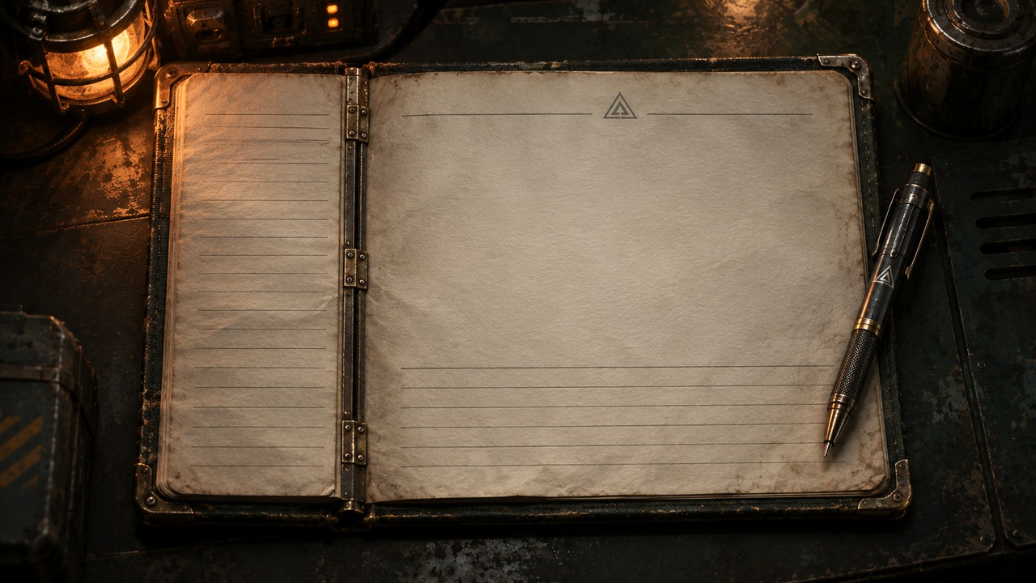
PIONEER
CREW LOG
COHORT 01
›
Notes:
SESSION 12. GM bible v12 is story authority. ENVIRONMENT: finale.
Complete the log after the companies perform their endings.
VISUAL: Physical clue prop with source-local animation and native canonical text
PLAYBACK: embedded silent H.264 starts automatically and loops. Advance manually; no timed slide changes. Static poster fallback. Actual Microsoft PowerPoint playback has not been tested on this Linux machine.

Slide 127
IRIS
Ship AI
›
Notes:
SESSION 12. GM bible v12 is story authority. ENVIRONMENT: finale.
VISUAL: Untouched canonical portrait 44; visible animated finale context and source-local lights
PLAYBACK: embedded silent H.264 starts automatically and loops. Advance manually; no timed slide changes. Static poster fallback. Actual Microsoft PowerPoint playback has not been tested on this Linux machine.

Slide 128
COHORT 01
Define home.
›
Notes:
SESSION 12. GM bible v12 is story authority. ENVIRONMENT: finale.
One sentence per student. Do not discuss or correct. End after the final sentence.
VISUAL: Native story cue over visible animated finale environment
PLAYBACK: embedded silent H.264 starts automatically and loops. Advance manually; no timed slide changes. Static poster fallback. Actual Microsoft PowerPoint playback has not been tested on this Linux machine.

Slide 129
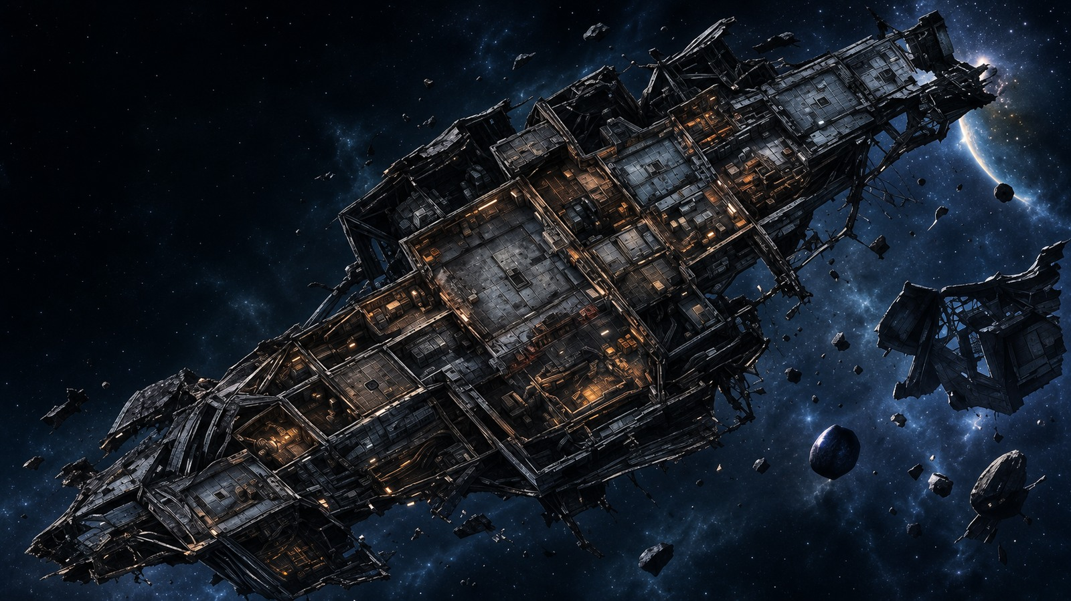








ASTERIA · EXPLORATION MAP
MAP ATLAS
MAP KEY
01
Landing Zone
02
Colony Hub
PIONEER · SIX DECKS
DERELICT · ORPHEUS MAP
ASTERIA · EXPLORATION MAP
03
School
04
Greenhouse
05
Habitation
COLONY HUB · DETAILED MAP
ASTERIA SCHOOL · FIRST FLOOR
GREENHOUSE · FOOD PRODUCTION
06
Water System
07
Old Lab
08
Archive
ARCHIVE · RECORDS
OLD LAB · BEFORE ASTERIA
K-17 · RESEARCH OUTPOST
S01
S02
S03
S04
S05
S06
S07
S08
S09
S10
S11
S12
Notes:
MAP APPENDIX · ASTERIA · EXPLORATION MAP
Original map artwork retained/cropped from supplied atlas; native vector key is readable at any text zoom.
Raster artwork cannot supply unlimited recovered detail. Restored fine details are illustrative. Main story and locked GM truth remain authoritative. Map motion is subtle and geometry/labels stay fixed. Manual slide advance; embedded video autostarts and loops.

Slide 130
PIONEER · SIX DECKS
DECK 1 · COMMAND
DECK 1
DECK 2
DECK 2 · OPERATIONS
DECK 3
DECK 3 · SCIENCE
DECK 4 · ENGINEERING
DECK 4
DECK 5
DECK 5 · HABITATION
DECK 6
DECK 6 · OBSERVATION
ATLAS
S01
S02
S03
S04
S07
S08
Notes:
MAP APPENDIX · PIONEER · SIX DECKS
Original map artwork retained/cropped from supplied atlas; native vector key is readable at any text zoom.
Raster artwork cannot supply unlimited recovered detail. Restored fine details are illustrative. Main story and locked GM truth remain authoritative. Map motion is subtle and geometry/labels stay fixed. Manual slide advance; embedded video autostarts and loops.

Slide 131

DECK 1 · COMMAND
MAP KEY
01
Bridge
02
Crew Quarters
03
Navigation
04
Communications
05
Conference Room
06
Lift to Deck 2
ATLAS
S01
S02
S03
S04
S07
S08
Notes:
MAP APPENDIX · DECK 1 · COMMAND
Original map artwork retained/cropped from supplied atlas; native vector key is readable at any text zoom.
Raster artwork cannot supply unlimited recovered detail. Restored fine details are illustrative. Main story and locked GM truth remain authoritative. Map motion is subtle and geometry/labels stay fixed. Manual slide advance; embedded video autostarts and loops.

Slide 132

DECK 2 · OPERATIONS
MAP KEY
01
Mission Control
02
Data Analysis
03
Crew Lounge
04
Mess Hall
05
Medical Bay
06
Lift to Decks 1 / 3
ATLAS
S01
S02
S03
S04
S07
S08
Notes:
MAP APPENDIX · DECK 2 · OPERATIONS
Original map artwork retained/cropped from supplied atlas; native vector key is readable at any text zoom.
Raster artwork cannot supply unlimited recovered detail. Restored fine details are illustrative. Main story and locked GM truth remain authoritative. Map motion is subtle and geometry/labels stay fixed. Manual slide advance; embedded video autostarts and loops.

Slide 133

DECK 3 · SCIENCE
MAP KEY
01
Main Lab
02
Specimen Storage
03
Communications Lab
04
Workshop
05
AI Core — Restricted
06
Lift to Decks 2 / 4
ATLAS
S01
S02
S03
S04
S07
S08
Notes:
MAP APPENDIX · DECK 3 · SCIENCE
Original map artwork retained/cropped from supplied atlas; native vector key is readable at any text zoom.
Raster artwork cannot supply unlimited recovered detail. Restored fine details are illustrative. Main story and locked GM truth remain authoritative. Map motion is subtle and geometry/labels stay fixed. Manual slide advance; embedded video autostarts and loops.

Slide 134

DECK 4 · ENGINEERING
MAP KEY
01
Reactor Control
02
Power Systems
03
Maintenance Bay
04
EVA Prep
05
Parts Storage
06
Lift to Decks 3 / 5
ATLAS
S01
S02
S03
S04
S07
S08
Notes:
MAP APPENDIX · DECK 4 · ENGINEERING
Original map artwork retained/cropped from supplied atlas; native vector key is readable at any text zoom.
Raster artwork cannot supply unlimited recovered detail. Restored fine details are illustrative. Main story and locked GM truth remain authoritative. Map motion is subtle and geometry/labels stay fixed. Manual slide advance; embedded video autostarts and loops.

Slide 135

DECK 5 · HABITATION
MAP KEY
01
Crew Quarters
02
Gym & Recreation
03
Hydroponics
04
Life Support
05
Common Room
06
Lift to Decks 4 / 6
ATLAS
S01
S02
S03
S04
S07
S08
Notes:
MAP APPENDIX · DECK 5 · HABITATION
Original map artwork retained/cropped from supplied atlas; native vector key is readable at any text zoom.
Raster artwork cannot supply unlimited recovered detail. Restored fine details are illustrative. Main story and locked GM truth remain authoritative. Map motion is subtle and geometry/labels stay fixed. Manual slide advance; embedded video autostarts and loops.

Slide 136

DECK 6 · OBSERVATION
MAP KEY
01
Observation Deck
02
Telescope Array
03
Archive
04
AI Monitoring
05
Escape Pods
06
Lift to Deck 5
ATLAS
S01
S02
S03
S04
S07
S08
Notes:
MAP APPENDIX · DECK 6 · OBSERVATION
Original map artwork retained/cropped from supplied atlas; native vector key is readable at any text zoom.
Raster artwork cannot supply unlimited recovered detail. Restored fine details are illustrative. Main story and locked GM truth remain authoritative. Map motion is subtle and geometry/labels stay fixed. Manual slide advance; embedded video autostarts and loops.

Slide 137
ASTERIA · EXPLORATION MAP
MAP KEY
01
Landing Zone
02
Colony Hub
03
School
04
Greenhouse
05
Habitation
06
Water System
07
Old Lab
08
Archive
ATLAS
ZOOM 1
ZOOM 2
S09
S10
S12
Notes:
MAP APPENDIX · ASTERIA · EXPLORATION MAP
Original map artwork retained/cropped from supplied atlas; native vector key is readable at any text zoom.
Raster artwork cannot supply unlimited recovered detail. Restored fine details are illustrative. Main story and locked GM truth remain authoritative. Map motion is subtle and geometry/labels stay fixed. Manual slide advance; embedded video autostarts and loops.

Slide 138

COLONY HUB · DETAILED MAP
MAP KEY
01
Arrival Plaza
02
Command & Communications
03
Medical Bay
04
Mess Hall
05
Living Quarters
06
Research Wing
07
Observation Deck
08
Supply & Maintenance
09
Connector to Other Zones
ATLAS
ZOOM 1
INTERIOR
S10
Notes:
MAP APPENDIX · COLONY HUB · DETAILED MAP
Original map artwork retained/cropped from supplied atlas; native vector key is readable at any text zoom. Original artwork repeats/omits some numbered pins. Native key transcribes supplied legend; ambiguous source pin placements are not invented.
Raster artwork cannot supply unlimited recovered detail. Restored fine details are illustrative. Main story and locked GM truth remain authoritative. Map motion is subtle and geometry/labels stay fixed. Manual slide advance; embedded video autostarts and loops.

Slide 139

COLONY HUB · INTERIOR
MAP KEY
01
Administration
02
Commons
03
Medical
04
Central Plaza
05
Supply Bay
06
Communications
ATLAS
S10
Notes:
MAP APPENDIX · COLONY HUB · INTERIOR
Original map artwork retained/cropped from supplied atlas; native vector key is readable at any text zoom.
Raster artwork cannot supply unlimited recovered detail. Restored fine details are illustrative. Main story and locked GM truth remain authoritative. Map motion is subtle and geometry/labels stay fixed. Manual slide advance; embedded video autostarts and loops.

Slide 140

ASTERIA SCHOOL · FIRST FLOOR
MAP KEY
01
Classroom A
02
Classroom B
03
Science Lab
04
Media Room
05
Atrium
06
Library
07
Counselor
08
Main Entrance
ATLAS
ZOOM 1
ZOOM 2
INTERIOR
S10
Notes:
MAP APPENDIX · ASTERIA SCHOOL · FIRST FLOOR
Original map artwork retained/cropped from supplied atlas; native vector key is readable at any text zoom.
Raster artwork cannot supply unlimited recovered detail. Restored fine details are illustrative. Main story and locked GM truth remain authoritative. Map motion is subtle and geometry/labels stay fixed. Manual slide advance; embedded video autostarts and loops.

Slide 141
SCHOOL · INTERIOR DETAIL
MAP KEY
01
Classroom A
02
Classroom B
03
Science Lab
04
Media Room
05
Atrium
06
Library
07
Counselor
08
Main Entrance
ATLAS
S10
Notes:
MAP APPENDIX · SCHOOL · INTERIOR DETAIL
Original map artwork retained/cropped from supplied atlas; native vector key is readable at any text zoom.
Raster artwork cannot supply unlimited recovered detail. Restored fine details are illustrative. Main story and locked GM truth remain authoritative. Map motion is subtle and geometry/labels stay fixed. Manual slide advance; embedded video autostarts and loops.

Slide 142

GREENHOUSE · FOOD PRODUCTION
MAP KEY
01
Research
02
Main Biome
03
Growing Bays
04
Processing
ATLAS
ZOOM 1
ZOOM 2
INTERIOR
S10
Notes:
MAP APPENDIX · GREENHOUSE · FOOD PRODUCTION
Original map artwork retained/cropped from supplied atlas; native vector key is readable at any text zoom.
Raster artwork cannot supply unlimited recovered detail. Restored fine details are illustrative. Main story and locked GM truth remain authoritative. Map motion is subtle and geometry/labels stay fixed. Manual slide advance; embedded video autostarts and loops.

Slide 143

GREENHOUSE · INTERIOR DETAIL
MAP KEY
01
Research
02
Main Biome
03
Growing Bays
04
Processing
ATLAS
S10
Notes:
MAP APPENDIX · GREENHOUSE · INTERIOR DETAIL
Original map artwork retained/cropped from supplied atlas; native vector key is readable at any text zoom.
Raster artwork cannot supply unlimited recovered detail. Restored fine details are illustrative. Main story and locked GM truth remain authoritative. Map motion is subtle and geometry/labels stay fixed. Manual slide advance; embedded video autostarts and loops.

Slide 144

ARCHIVE · RECORDS
MAP KEY
Explore the visible rooms, corridors and structures.
ATLAS
ZOOM 1
S10
Notes:
MAP APPENDIX · ARCHIVE · RECORDS
Original map artwork retained/cropped from supplied atlas; native vector key is readable at any text zoom. Supplied map has no room-name key. No room names are invented.
Raster artwork cannot supply unlimited recovered detail. Restored fine details are illustrative. Main story and locked GM truth remain authoritative. Map motion is subtle and geometry/labels stay fixed. Manual slide advance; embedded video autostarts and loops.

Slide 145

OLD LAB · BEFORE ASTERIA
MAP KEY
Explore the visible rooms, corridors and structures.
ATLAS
ZOOM 1
S10
Notes:
MAP APPENDIX · OLD LAB · BEFORE ASTERIA
Original map artwork retained/cropped from supplied atlas; native vector key is readable at any text zoom. Supplied map has no room-name key. No room names are invented.
Raster artwork cannot supply unlimited recovered detail. Restored fine details are illustrative. Main story and locked GM truth remain authoritative. Map motion is subtle and geometry/labels stay fixed. Manual slide advance; embedded video autostarts and loops.

Slide 146
DERELICT · ORPHEUS MAP
MAP KEY
01
Airlock — Damaged
02
Cargo Hold
03
Crew Quarters
04
Research Lab
05
Power Core — Offline
06
Unknown Section
ATLAS
ZOOM 1
ZOOM 2
S05
S06
Notes:
MAP APPENDIX · DERELICT · ORPHEUS MAP
Original map artwork retained/cropped from supplied atlas; native vector key is readable at any text zoom. Orpheus is the supplied map's title; story notes retain the bible's derelict identity and do not treat this map label as a new reveal.
Raster artwork cannot supply unlimited recovered detail. Restored fine details are illustrative. Main story and locked GM truth remain authoritative. Map motion is subtle and geometry/labels stay fixed. Manual slide advance; embedded video autostarts and loops.

Slide 147

K-17 · RESEARCH OUTPOST
MAP KEY
01
Main Facility
Comms Tower
02
Comms Tower
Main Facility
03
Landing Pad
Landing Pad
04
Research Labs
05
Power Array
Power Array
Research Labs
ATLAS
ZOOM 1
S11
Notes:
MAP APPENDIX · K-17 · RESEARCH OUTPOST
Original map artwork retained/cropped from supplied atlas; native vector key is readable at any text zoom. Optional research/outpost map from supplied atlas; does not alter locked GM truth.
Raster artwork cannot supply unlimited recovered detail. Restored fine details are illustrative. Main story and locked GM truth remain authoritative. Map motion is subtle and geometry/labels stay fixed. Manual slide advance; embedded video autostarts and loops.

Slide 148

ASTERIA · EXPLORATION MAP · NORTHERN RIDGE / SCHOOL
MAP KEY
01
Landing Zone
02
Colony Hub
03
School
04
Greenhouse
05
Habitation
06
Water System
07
Old Lab
08
Archive
FULL MAP
ATLAS
S09
S10
S12
Notes:
MAP APPENDIX · ASTERIA · EXPLORATION MAP
Original map artwork retained/cropped from supplied atlas; native vector key is readable at any text zoom.
Raster artwork cannot supply unlimited recovered detail. Restored fine details are illustrative. Main story and locked GM truth remain authoritative. Map motion is subtle and geometry/labels stay fixed. Manual slide advance; embedded video autostarts and loops.

Slide 149

ASTERIA · EXPLORATION MAP · WATER / OLD LAB / ARCHIVE
MAP KEY
01
Landing Zone
02
Colony Hub
03
School
04
Greenhouse
05
Habitation
06
Water System
07
Old Lab
08
Archive
FULL MAP
ATLAS
S09
S10
S12
Notes:
MAP APPENDIX · ASTERIA · EXPLORATION MAP
Original map artwork retained/cropped from supplied atlas; native vector key is readable at any text zoom.
Raster artwork cannot supply unlimited recovered detail. Restored fine details are illustrative. Main story and locked GM truth remain authoritative. Map motion is subtle and geometry/labels stay fixed. Manual slide advance; embedded video autostarts and loops.

Slide 150

COLONY HUB · DETAILED MAP · CENTRAL PLAZA / CONNECTORS
MAP KEY
01
Arrival Plaza
02
Command & Communications
03
Medical Bay
04
Mess Hall
05
Living Quarters
06
Research Wing
07
Observation Deck
08
Supply & Maintenance
09
Connector to Other Zones
FULL MAP
ATLAS
S10
Notes:
MAP APPENDIX · COLONY HUB · DETAILED MAP
Original map artwork retained/cropped from supplied atlas; native vector key is readable at any text zoom. Original artwork repeats/omits some numbered pins. Native key transcribes supplied legend; ambiguous source pin placements are not invented.
Raster artwork cannot supply unlimited recovered detail. Restored fine details are illustrative. Main story and locked GM truth remain authoritative. Map motion is subtle and geometry/labels stay fixed. Manual slide advance; embedded video autostarts and loops.

Slide 151

ASTERIA SCHOOL · FIRST FLOOR · CLASSROOM WING
MAP KEY
01
Classroom A
02
Classroom B
03
Science Lab
04
Media Room
05
Atrium
06
Library
07
Counselor
08
Main Entrance
FULL MAP
ATLAS
S10
Notes:
MAP APPENDIX · ASTERIA SCHOOL · FIRST FLOOR
Original map artwork retained/cropped from supplied atlas; native vector key is readable at any text zoom.
Raster artwork cannot supply unlimited recovered detail. Restored fine details are illustrative. Main story and locked GM truth remain authoritative. Map motion is subtle and geometry/labels stay fixed. Manual slide advance; embedded video autostarts and loops.

Slide 152

ASTERIA SCHOOL · FIRST FLOOR · ENTRANCE / SUPPORT ROOMS
MAP KEY
01
Classroom A
02
Classroom B
03
Science Lab
04
Media Room
05
Atrium
06
Library
07
Counselor
08
Main Entrance
FULL MAP
ATLAS
S10
Notes:
MAP APPENDIX · ASTERIA SCHOOL · FIRST FLOOR
Original map artwork retained/cropped from supplied atlas; native vector key is readable at any text zoom.
Raster artwork cannot supply unlimited recovered detail. Restored fine details are illustrative. Main story and locked GM truth remain authoritative. Map motion is subtle and geometry/labels stay fixed. Manual slide advance; embedded video autostarts and loops.

Slide 153

GREENHOUSE · FOOD PRODUCTION · WESTERN GROWING BAYS
MAP KEY
01
Research
02
Main Biome
03
Growing Bays
04
Processing
FULL MAP
ATLAS
S10
Notes:
MAP APPENDIX · GREENHOUSE · FOOD PRODUCTION
Original map artwork retained/cropped from supplied atlas; native vector key is readable at any text zoom.
Raster artwork cannot supply unlimited recovered detail. Restored fine details are illustrative. Main story and locked GM truth remain authoritative. Map motion is subtle and geometry/labels stay fixed. Manual slide advance; embedded video autostarts and loops.

Slide 154

GREENHOUSE · FOOD PRODUCTION · EASTERN GROWING BAYS
MAP KEY
01
Research
02
Main Biome
03
Growing Bays
04
Processing
FULL MAP
ATLAS
S10
Notes:
MAP APPENDIX · GREENHOUSE · FOOD PRODUCTION
Original map artwork retained/cropped from supplied atlas; native vector key is readable at any text zoom.
Raster artwork cannot supply unlimited recovered detail. Restored fine details are illustrative. Main story and locked GM truth remain authoritative. Map motion is subtle and geometry/labels stay fixed. Manual slide advance; embedded video autostarts and loops.

Slide 155

ARCHIVE · RECORDS · CENTRAL ARCHIVE
MAP KEY
Explore the visible rooms, corridors and structures.
FULL MAP
ATLAS
S10
Notes:
MAP APPENDIX · ARCHIVE · RECORDS
Original map artwork retained/cropped from supplied atlas; native vector key is readable at any text zoom. Supplied map has no room-name key. No room names are invented.
Raster artwork cannot supply unlimited recovered detail. Restored fine details are illustrative. Main story and locked GM truth remain authoritative. Map motion is subtle and geometry/labels stay fixed. Manual slide advance; embedded video autostarts and loops.

Slide 156

OLD LAB · BEFORE ASTERIA · INNER COURTYARD / LAB WINGS
MAP KEY
Explore the visible rooms, corridors and structures.
FULL MAP
ATLAS
S10
Notes:
MAP APPENDIX · OLD LAB · BEFORE ASTERIA
Original map artwork retained/cropped from supplied atlas; native vector key is readable at any text zoom. Supplied map has no room-name key. No room names are invented.
Raster artwork cannot supply unlimited recovered detail. Restored fine details are illustrative. Main story and locked GM truth remain authoritative. Map motion is subtle and geometry/labels stay fixed. Manual slide advance; embedded video autostarts and loops.

Slide 157

DERELICT · ORPHEUS MAP · FORWARD SECTION
MAP KEY
01
Airlock — Damaged
02
Cargo Hold
03
Crew Quarters
04
Research Lab
05
Power Core — Offline
06
Unknown Section
FULL MAP
ATLAS
S05
S06
Notes:
MAP APPENDIX · DERELICT · ORPHEUS MAP
Original map artwork retained/cropped from supplied atlas; native vector key is readable at any text zoom. Orpheus is the supplied map's title; story notes retain the bible's derelict identity and do not treat this map label as a new reveal.
Raster artwork cannot supply unlimited recovered detail. Restored fine details are illustrative. Main story and locked GM truth remain authoritative. Map motion is subtle and geometry/labels stay fixed. Manual slide advance; embedded video autostarts and loops.

Slide 158

DERELICT · ORPHEUS MAP · AFT SECTION
MAP KEY
01
Airlock — Damaged
02
Cargo Hold
03
Crew Quarters
04
Research Lab
05
Power Core — Offline
06
Unknown Section
FULL MAP
ATLAS
S05
S06
Notes:
MAP APPENDIX · DERELICT · ORPHEUS MAP
Original map artwork retained/cropped from supplied atlas; native vector key is readable at any text zoom. Orpheus is the supplied map's title; story notes retain the bible's derelict identity and do not treat this map label as a new reveal.
Raster artwork cannot supply unlimited recovered detail. Restored fine details are illustrative. Main story and locked GM truth remain authoritative. Map motion is subtle and geometry/labels stay fixed. Manual slide advance; embedded video autostarts and loops.

Slide 159

K-17 · RESEARCH OUTPOST · FACILITY / RESEARCH LABS
MAP KEY
Comms Tower
01
Main Facility
02
Comms Tower
Main Facility
03
Landing Pad
04
Research Labs
05
Power Array
Power Array
Research Labs
FULL MAP
ATLAS
S11
Notes:
MAP APPENDIX · K-17 · RESEARCH OUTPOST
Original map artwork retained/cropped from supplied atlas; native vector key is readable at any text zoom. Optional research/outpost map from supplied atlas; does not alter locked GM truth.
Raster artwork cannot supply unlimited recovered detail. Restored fine details are illustrative. Main story and locked GM truth remain authoritative. Map motion is subtle and geometry/labels stay fixed. Manual slide advance; embedded video autostarts and loops.

Slide 160
PIONEER · SIX DECKS
DECK 1 · COMMAND
DECK 1
DECK 2
DECK 2 · OPERATIONS
DECK 3
DECK 3 · SCIENCE
DECK 4 · ENGINEERING
DECK 4
DECK 5
DECK 5 · HABITATION
DECK 6
DECK 6 · OBSERVATION
ATLAS
RETURN TO SESSION 01
Notes:
MAP APPENDIX · PIONEER · SIX DECKS
Original map artwork retained/cropped from supplied atlas; native vector key is readable at any text zoom.
Raster artwork cannot supply unlimited recovered detail. Restored fine details are illustrative. Main story and locked GM truth remain authoritative. Map motion is subtle and geometry/labels stay fixed. Manual slide advance; embedded video autostarts and loops.

Slide 161
DECK 5 · HABITATION
MAP KEY
01
Crew Quarters
02
Gym & Recreation
03
Hydroponics
04
Life Support
05
Common Room
06
Lift to Decks 4 / 6
ATLAS
RETURN TO SESSION 02
Notes:
MAP APPENDIX · DECK 5 · HABITATION
Original map artwork retained/cropped from supplied atlas; native vector key is readable at any text zoom.
Raster artwork cannot supply unlimited recovered detail. Restored fine details are illustrative. Main story and locked GM truth remain authoritative. Map motion is subtle and geometry/labels stay fixed. Manual slide advance; embedded video autostarts and loops.

Slide 162
DECK 3 · SCIENCE
MAP KEY
01
Main Lab
02
Specimen Storage
03
Communications Lab
04
Workshop
05
AI Core — Restricted
06
Lift to Decks 2 / 4
ATLAS
RETURN TO SESSION 03
Notes:
MAP APPENDIX · DECK 3 · SCIENCE
Original map artwork retained/cropped from supplied atlas; native vector key is readable at any text zoom.
Raster artwork cannot supply unlimited recovered detail. Restored fine details are illustrative. Main story and locked GM truth remain authoritative. Map motion is subtle and geometry/labels stay fixed. Manual slide advance; embedded video autostarts and loops.

Slide 163
DECK 1 · COMMAND
MAP KEY
01
Bridge
02
Crew Quarters
03
Navigation
04
Communications
05
Conference Room
06
Lift to Deck 2
ATLAS
RETURN TO SESSION 04
Notes:
MAP APPENDIX · DECK 1 · COMMAND
Original map artwork retained/cropped from supplied atlas; native vector key is readable at any text zoom.
Raster artwork cannot supply unlimited recovered detail. Restored fine details are illustrative. Main story and locked GM truth remain authoritative. Map motion is subtle and geometry/labels stay fixed. Manual slide advance; embedded video autostarts and loops.

Slide 164
DERELICT · ORPHEUS MAP
MAP KEY
01
Airlock — Damaged
02
Cargo Hold
03
Crew Quarters
04
Research Lab
05
Power Core — Offline
06
Unknown Section
ATLAS
DETAIL 1
DETAIL 2
RETURN TO SESSION 05
Notes:
MAP APPENDIX · DERELICT · ORPHEUS MAP
Original map artwork retained/cropped from supplied atlas; native vector key is readable at any text zoom. Orpheus is the supplied map's title; story notes retain the bible's derelict identity and do not treat this map label as a new reveal.
Raster artwork cannot supply unlimited recovered detail. Restored fine details are illustrative. Main story and locked GM truth remain authoritative. Map motion is subtle and geometry/labels stay fixed. Manual slide advance; embedded video autostarts and loops.

Slide 165
DERELICT · ORPHEUS MAP
MAP KEY
01
Airlock — Damaged
02
Cargo Hold
03
Crew Quarters
04
Research Lab
05
Power Core — Offline
06
Unknown Section
ATLAS
DETAIL 1
DETAIL 2
RETURN TO SESSION 06
Notes:
MAP APPENDIX · DERELICT · ORPHEUS MAP
Original map artwork retained/cropped from supplied atlas; native vector key is readable at any text zoom. Orpheus is the supplied map's title; story notes retain the bible's derelict identity and do not treat this map label as a new reveal.
Raster artwork cannot supply unlimited recovered detail. Restored fine details are illustrative. Main story and locked GM truth remain authoritative. Map motion is subtle and geometry/labels stay fixed. Manual slide advance; embedded video autostarts and loops.

Slide 166
DECK 3 · SCIENCE
MAP KEY
01
Main Lab
02
Specimen Storage
03
Communications Lab
04
Workshop
05
AI Core — Restricted
06
Lift to Decks 2 / 4
ATLAS
RETURN TO SESSION 07
Notes:
MAP APPENDIX · DECK 3 · SCIENCE
Original map artwork retained/cropped from supplied atlas; native vector key is readable at any text zoom.
Raster artwork cannot supply unlimited recovered detail. Restored fine details are illustrative. Main story and locked GM truth remain authoritative. Map motion is subtle and geometry/labels stay fixed. Manual slide advance; embedded video autostarts and loops.

Slide 167
DECK 4 · ENGINEERING
MAP KEY
01
Reactor Control
02
Power Systems
03
Maintenance Bay
04
EVA Prep
05
Parts Storage
06
Lift to Decks 3 / 5
ATLAS
RETURN TO SESSION 08
Notes:
MAP APPENDIX · DECK 4 · ENGINEERING
Original map artwork retained/cropped from supplied atlas; native vector key is readable at any text zoom.
Raster artwork cannot supply unlimited recovered detail. Restored fine details are illustrative. Main story and locked GM truth remain authoritative. Map motion is subtle and geometry/labels stay fixed. Manual slide advance; embedded video autostarts and loops.

Slide 168
ASTERIA · EXPLORATION MAP
MAP KEY
01
Landing Zone
02
Colony Hub
03
School
04
Greenhouse
05
Habitation
06
Water System
07
Old Lab
08
Archive
ATLAS
DETAIL 1
DETAIL 2
RETURN TO SESSION 09
Notes:
MAP APPENDIX · ASTERIA · EXPLORATION MAP
Original map artwork retained/cropped from supplied atlas; native vector key is readable at any text zoom.
Raster artwork cannot supply unlimited recovered detail. Restored fine details are illustrative. Main story and locked GM truth remain authoritative. Map motion is subtle and geometry/labels stay fixed. Manual slide advance; embedded video autostarts and loops.

Slide 169
ASTERIA · EXPLORATION MAP
MAP KEY
01
Landing Zone
02
Colony Hub
03
School
04
Greenhouse
05
Habitation
06
Water System
07
Old Lab
08
Archive
ATLAS
DETAIL 1
DETAIL 2
RETURN TO SESSION 10
Notes:
MAP APPENDIX · ASTERIA · EXPLORATION MAP
Original map artwork retained/cropped from supplied atlas; native vector key is readable at any text zoom.
Raster artwork cannot supply unlimited recovered detail. Restored fine details are illustrative. Main story and locked GM truth remain authoritative. Map motion is subtle and geometry/labels stay fixed. Manual slide advance; embedded video autostarts and loops.

Slide 170
K-17 · RESEARCH OUTPOST
MAP KEY
01
Main Facility
Comms Tower
02
Comms Tower
Main Facility
03
Landing Pad
Landing Pad
04
Research Labs
05
Power Array
Power Array
Research Labs
ATLAS
DETAIL 1
RETURN TO SESSION 11
Notes:
MAP APPENDIX · K-17 · RESEARCH OUTPOST
Original map artwork retained/cropped from supplied atlas; native vector key is readable at any text zoom. Optional research/outpost map from supplied atlas; does not alter locked GM truth.
Raster artwork cannot supply unlimited recovered detail. Restored fine details are illustrative. Main story and locked GM truth remain authoritative. Map motion is subtle and geometry/labels stay fixed. Manual slide advance; embedded video autostarts and loops.

Slide 171
ASTERIA · EXPLORATION MAP
MAP KEY
01
Landing Zone
02
Colony Hub
03
School
04
Greenhouse
05
Habitation
06
Water System
07
Old Lab
08
Archive
ATLAS
DETAIL 1
DETAIL 2
RETURN TO SESSION 12
Notes:
MAP APPENDIX · ASTERIA · EXPLORATION MAP
Original map artwork retained/cropped from supplied atlas; native vector key is readable at any text zoom.
Raster artwork cannot supply unlimited recovered detail. Restored fine details are illustrative. Main story and locked GM truth remain authoritative. Map motion is subtle and geometry/labels stay fixed. Manual slide advance; embedded video autostarts and loops.

