Slide 1
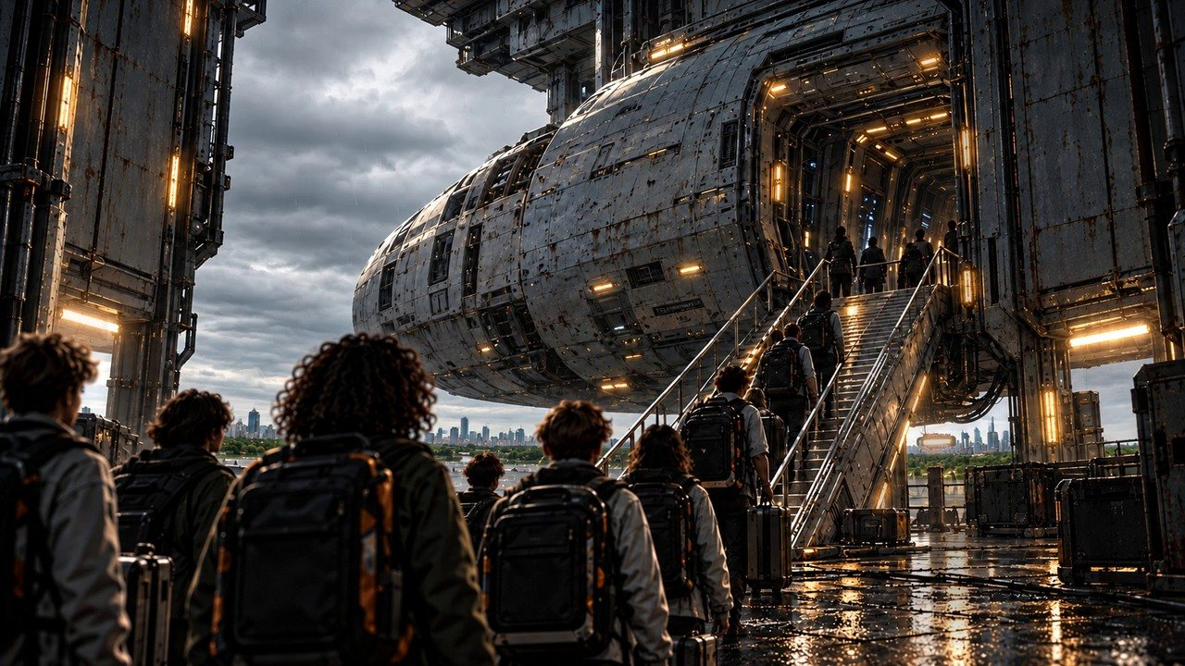
THE FAR HORIZON
01
Welcome to Pioneer
MAP ↗
›
Notes:
SESSION 1. GM bible v12 is story authority. ENVIRONMENT: boarding.
Start when ready for this session. MAP opens that session’s linked visual map.
VISUAL: Animated chapter / native typography
PLAYBACK: embedded silent H.264 starts automatically and loops. Advance manually; no timed slide changes. Static poster fallback. Actual Microsoft PowerPoint playback has not been tested on this Linux machine.

Slide 2
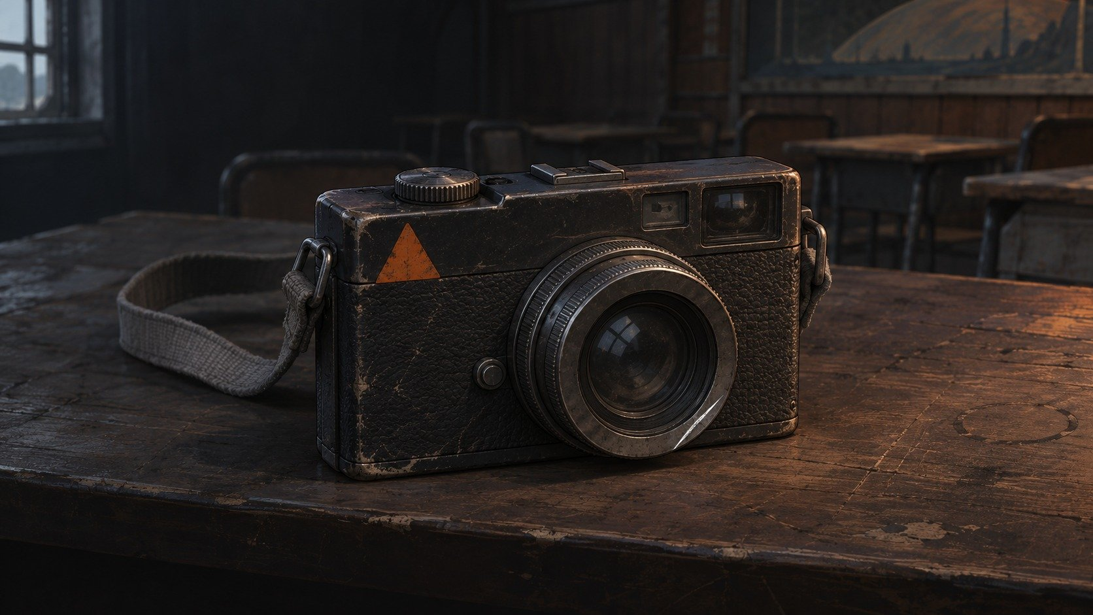
EARTH → ASTERIA-4
One world behind you.
A second home ahead.
AN EARTH KEEPSAKE
FLIGHT / C01-01
SCIENCE / C01-02
ENGINEERING / C01-03
COLONY / C01-04
›
Notes:
SESSION 1. GM bible v12 is story authority. ENVIRONMENT: boarding.
Earth is healthy. Record every fictional character’s personal Earth object for the Session 10 callback.
VISUAL: Native story cue over visible animated boarding environment
PLAYBACK: embedded silent H.264 starts automatically and loops. Advance manually; no timed slide changes. Static poster fallback. Actual Microsoft PowerPoint playback has not been tested on this Linux machine.

Slide 3
MAP ↗
›
Notes:
SESSION 1. GM bible v12 is story authority. ENVIRONMENT: boarding.
Play the boarding company scene; each group physically crosses the line. The woman by the boarding ramp is consistent with Mara Venn’s standalone portrait.
VISUAL: Environment from original immersive source 3; source-local object animation
PLAYBACK: embedded silent H.264 starts automatically and loops. Advance manually; no timed slide changes. Static poster fallback. Actual Microsoft PowerPoint playback has not been tested on this Linux machine.

Slide 4
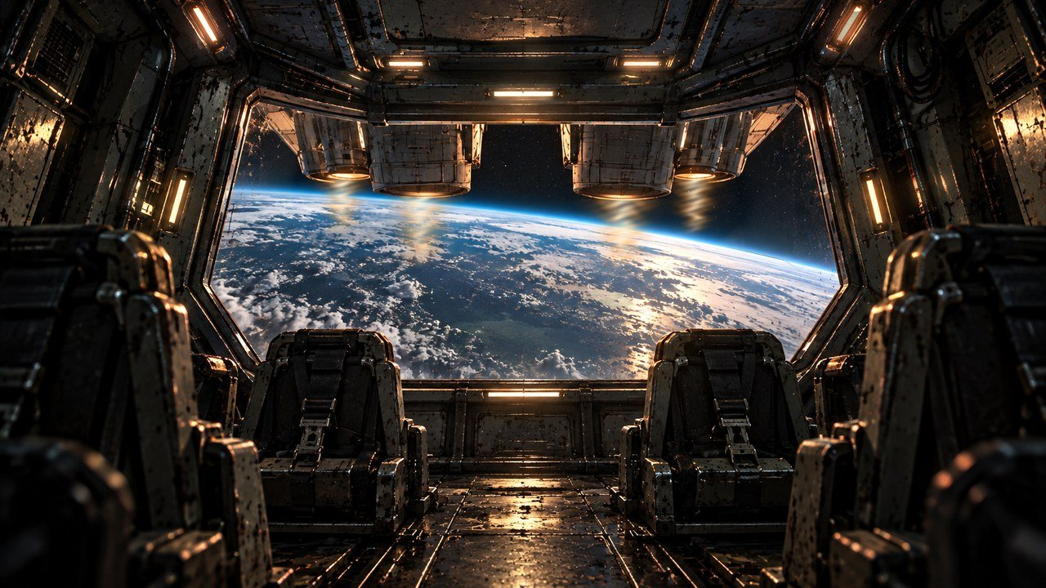
›
Notes:
SESSION 1. GM bible v12 is story authority. ENVIRONMENT: launch.
READ Session 1 Scene 2 Launch. Use the Earth-through-bridge artwork as a launch hold. A dedicated launch scene has been prepared for this edition. Do not begin crew introduction or tour until launch is complete.
VISUAL: Environment from original immersive source 4; source-local object animation
PLAYBACK: embedded silent H.264 starts automatically and loops. Advance manually; no timed slide changes. Static poster fallback. Actual Microsoft PowerPoint playback has not been tested on this Linux machine.

Slide 5




WELCOME ABOARD
Mara Venn
Juno Reyes
Tomas Rhee
›
Notes:
SESSION 1. GM bible v12 is story authority. ENVIRONMENT: bridge.
Crew introduction begins AFTER launch. Venn, Juno and Rhee greet Cohort 01.
VISUAL: Canonical portrait gallery over visibly moving contextual environment
PLAYBACK: embedded silent H.264 starts automatically and loops. Advance manually; no timed slide changes. Static poster fallback. Actual Microsoft PowerPoint playback has not been tested on this Linux machine.

Slide 6

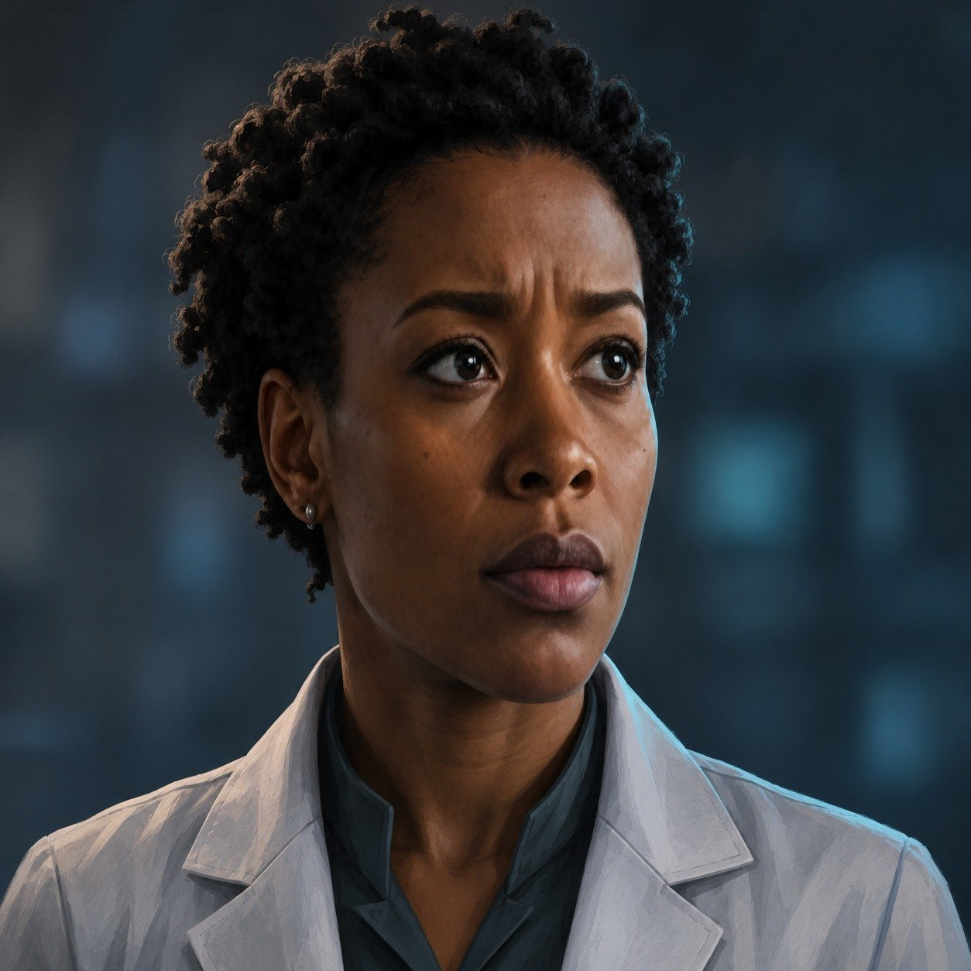

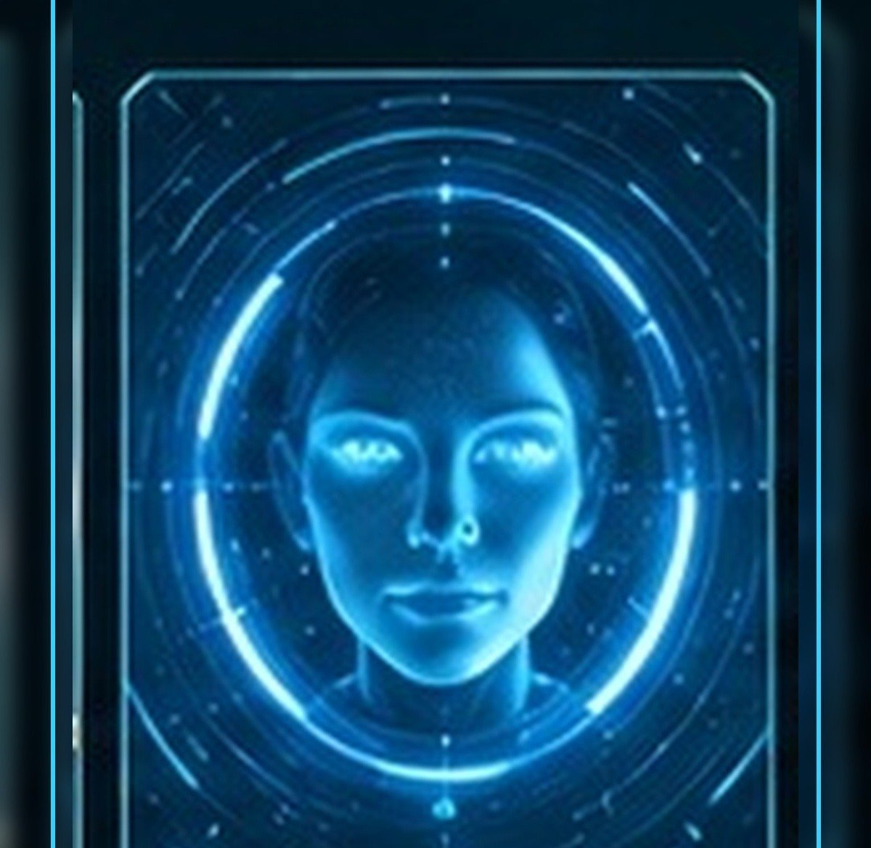
MEET YOUR CREW
Elias Vale
Nia Okafor
Marcus Bell
IRIS
›
Notes:
SESSION 1. GM bible v12 is story authority. ENVIRONMENT: bridge.
Introduce Vale, Okafor, Bell and IRIS. The standalone portraits are the continuity reference throughout this deck.
VISUAL: Canonical portrait gallery over visibly moving contextual environment
PLAYBACK: embedded silent H.264 starts automatically and loops. Advance manually; no timed slide changes. Static poster fallback. Actual Microsoft PowerPoint playback has not been tested on this Linux machine.

Slide 7
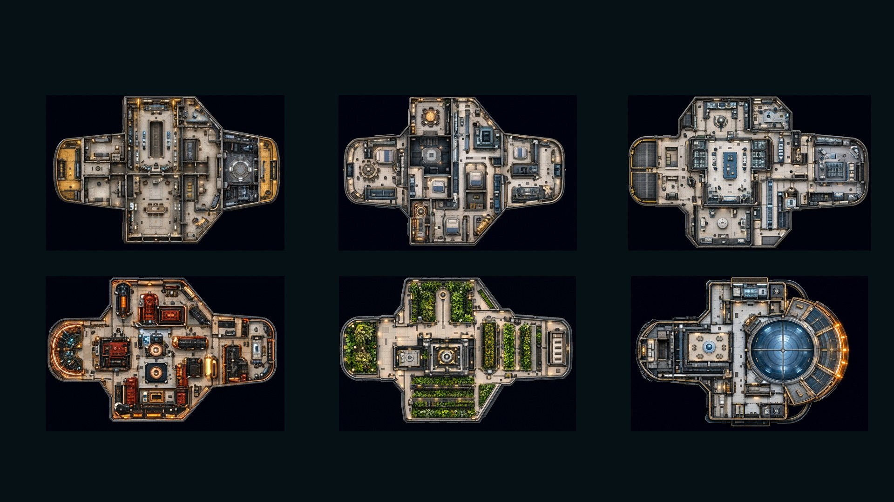
PIONEER · SIX DECKS
DECK 1 · COMMAND
DECK 2 · OPERATIONS
DECK 3 · SCIENCE
DECK 4 · ENGINEERING
DECK 5 · HABITATION
DECK 6 · OBSERVATION
MAP ↗
›
Notes:
SESSION 1. GM bible v12 is story authority. ENVIRONMENT: bridge.
Student map only. Montage the decks; do not explore every room. Student-facing map artwork; do not narrate future map atlas locations early.
VISUAL: Original map art, readable native legend, subtle source-local motion
PLAYBACK: embedded silent H.264 starts automatically and loops. Advance manually; no timed slide changes. Static poster fallback. Actual Microsoft PowerPoint playback has not been tested on this Linux machine.

Slide 8
MAP ↗
›
Notes:
SESSION 1. GM bible v12 is story authority. ENVIRONMENT: bridge.
VISUAL: Environment from original immersive source 4; source-local object animation
PLAYBACK: embedded silent H.264 starts automatically and loops. Advance manually; no timed slide changes. Static poster fallback. Actual Microsoft PowerPoint playback has not been tested on this Linux machine.

Slide 9
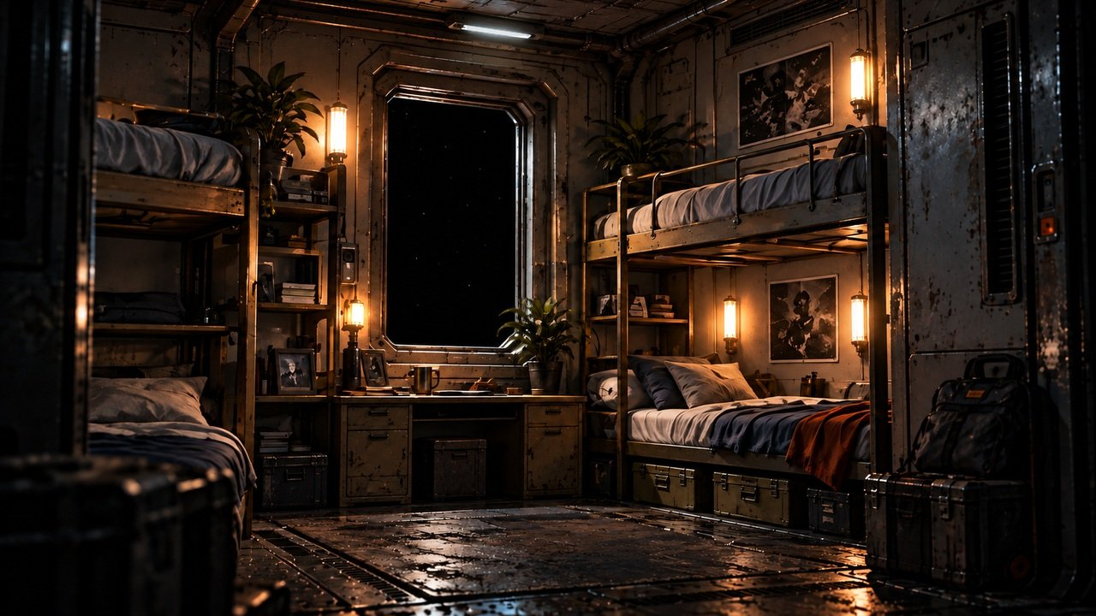
MAP ↗
›
Notes:
SESSION 1. GM bible v12 is story authority. ENVIRONMENT: habitation.
VISUAL: Environment from original immersive source 5; source-local object animation
PLAYBACK: embedded silent H.264 starts automatically and loops. Advance manually; no timed slide changes. Static poster fallback. Actual Microsoft PowerPoint playback has not been tested on this Linux machine.

Slide 10

OBSERVATION GLASS
The stars brighten.
LENSING
›
Notes:
SESSION 1. GM bible v12 is story authority. ENVIRONMENT: bridge.
Read First Anomaly Seed. Do not show the full K-17 Fracture Entity here. Keep the almost-human shape ambiguous; IRIS cannot classify it.
VISUAL: Native story cue over visible animated bridge environment
PLAYBACK: embedded silent H.264 starts automatically and loops. Advance manually; no timed slide changes. Static poster fallback. Actual Microsoft PowerPoint playback has not been tested on this Linux machine.

Slide 11
IRIS
Ship AI
›
Notes:
SESSION 1. GM bible v12 is story authority. ENVIRONMENT: bridge.
VISUAL: Canonical portrait identity with restored framing: 44; visible animated bridge context and source-local lights
PLAYBACK: embedded silent H.264 starts automatically and loops. Advance manually; no timed slide changes. Static poster fallback. Actual Microsoft PowerPoint playback has not been tested on this Linux machine.

Slide 12
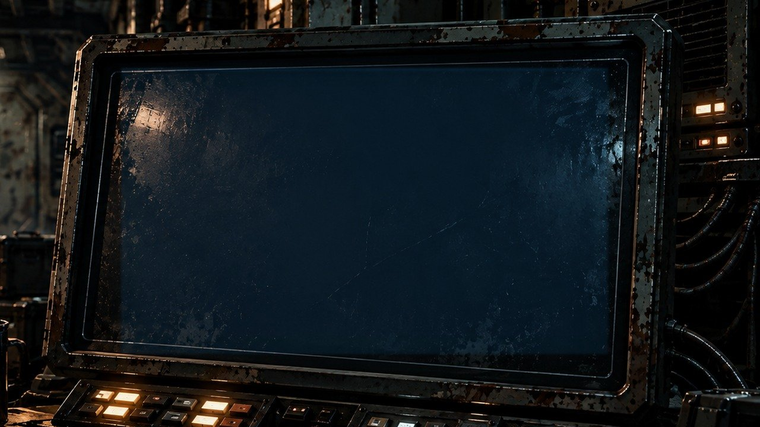
ROUTE LOG
“Route correction accepted.”
“No correction was entered.”
›
Notes:
SESSION 1. GM bible v12 is story authority. ENVIRONMENT: bridge.
Session 1 cliffhanger. Venn asks who entered the correction.
VISUAL: Readable native data on physical pulsing terminal
PLAYBACK: embedded silent H.264 starts automatically and loops. Advance manually; no timed slide changes. Static poster fallback. Actual Microsoft PowerPoint playback has not been tested on this Linux machine.

Slide 13
THE FAR HORIZON
02
The Pioneer
MAP ↗
›
Notes:
SESSION 2. GM bible v12 is story authority. ENVIRONMENT: habitation.
Start when ready for this session. MAP opens that session’s linked visual map.
VISUAL: Animated chapter / native typography
PLAYBACK: embedded silent H.264 starts automatically and loops. Advance manually; no timed slide changes. Static poster fallback. Actual Microsoft PowerPoint playback has not been tested on this Linux machine.

Slide 14
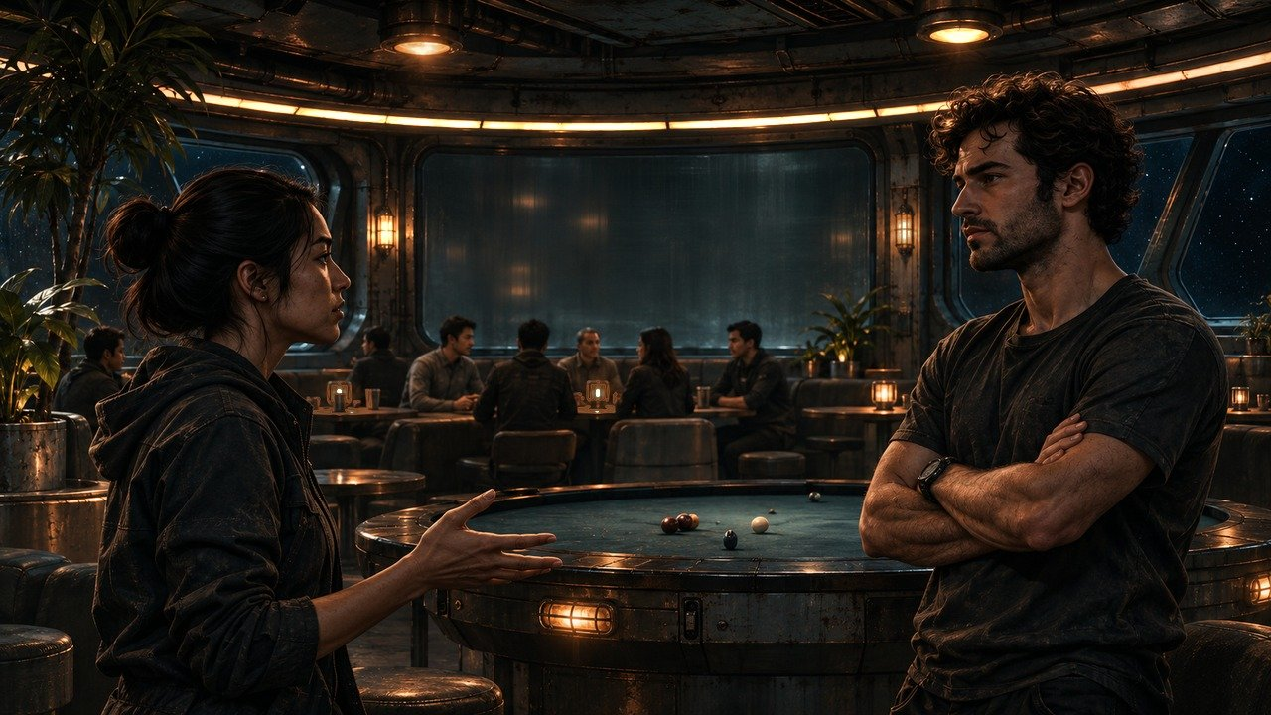
MAP ↗
›
Notes:
SESSION 2. GM bible v12 is story authority. ENVIRONMENT: crew_argument.
Recreation dispute is a brief opening, not an alternative to the required maintenance encounter. Background crew are unnamed; do not identify these faces as canonical NPCs.
VISUAL: Restored original scene composition, canonical identities and localized practical motion
PLAYBACK: embedded silent H.264 starts automatically and loops. Advance manually; no timed slide changes. Static poster fallback. Actual Microsoft PowerPoint playback has not been tested on this Linux machine.

Slide 15
Tomas Rhee
Chief engineer
›
Notes:
SESSION 2. GM bible v12 is story authority. ENVIRONMENT: crew_argument.
VISUAL: Canonical portrait identity with restored framing: 41; visible animated crew_argument context and source-local lights
PLAYBACK: embedded silent H.264 starts automatically and loops. Advance manually; no timed slide changes. Static poster fallback. Actual Microsoft PowerPoint playback has not been tested on this Linux machine.

Slide 16
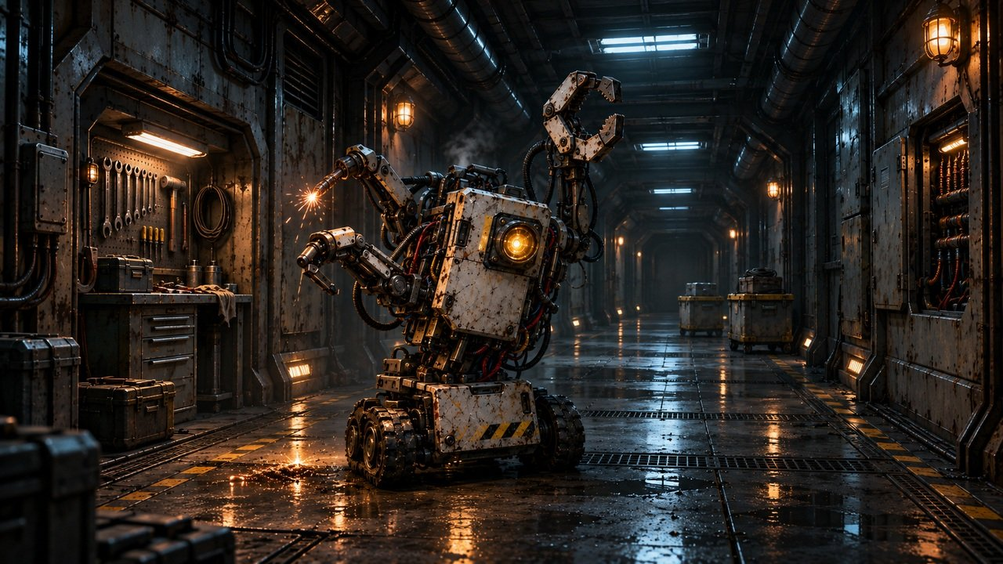
MAP ↗
›
Notes:
SESSION 2. GM bible v12 is story authority. ENVIRONMENT: drone_incident.
M-77 sealing a hab-deck door; one large unit and two minor drones.
VISUAL: Restored original scene composition, canonical identities and localized practical motion
PLAYBACK: embedded silent H.264 starts automatically and loops. Advance manually; no timed slide changes. Static poster fallback. Actual Microsoft PowerPoint playback has not been tested on this Linux machine.

Slide 17
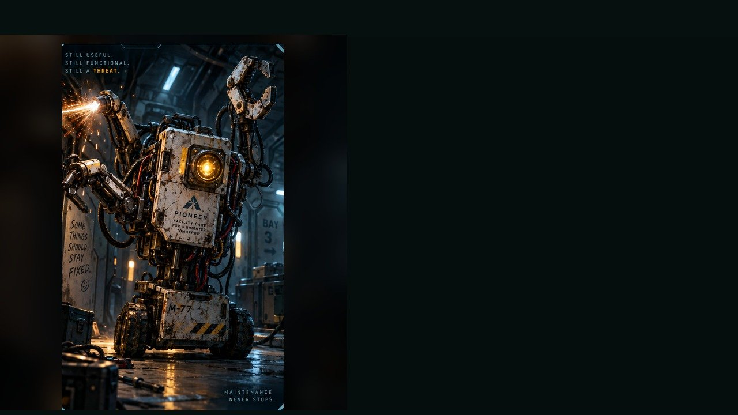
RUNAWAY MAINTENANCE DRONE
WEAKNESS
Maintenance override port
BEHAVIOUR
• Repairs the wrong thing
• Closes doors and blocks paths
“PLEASE DO NOT INTERFERE WITH
YOUR PREVIOUS REPAIR.”
SPECIAL
Arc welder · Clamp arm · Magnetic grip
OVERRIDE PORT
OBJECTIVE PRESSURE
ROUND 3
Seals spaces and dismantles equipment.
FULL DOSSIER
MOVE · ATTACK · ASSIST · ENVIRONMENT
›
Notes:
SESSION 2. GM bible v12 is story authority. ENVIRONMENT: habitation.
Bible overrides dossier stats: one large unit 2 Threat Boxes plus two minor drones 1 each. Exactly 3 rounds. Stop them sealing three spaces / dismantling essential equipment. M-77 is canonical.
VISUAL: Latest uploaded enemy dossier: animated source artwork; readable weakness, behaviour, special, objective
PLAYBACK: embedded silent H.264 starts automatically and loops. Advance manually; no timed slide changes. Static poster fallback. Actual Microsoft PowerPoint playback has not been tested on this Linux machine.
TEACHER ONLY — source role: Tutorial Skirmisher
Source performance cues: Jerky stop-start movement; Glitchy beeps and static voice; Sudden arm snap toward targets
Encounter: one large unit with 2 threat boxes, plus two minor drones with 1 each. Round 3: PLEASE DO NOT INTERFERE WITH YOUR PREVIOUS REPAIR. Do not reveal this line before Round 3.

Slide 18
RUNAWAY MAINTENANCE DRONE · DOSSIER
TYPE
Automated Service Unit
ENCOUNTER
1 large unit: 2 threat boxes
2 minor drones: 1 threat box each
SOURCE PROFILE
Minor repair drone: 1 threat box
OBSERVABLE SIGNS
• Stops and starts abruptly
• Glitching beeps and static voice
• Arm snaps toward targets
TACTICS
PIONEER · CONTACT PROFILE
›
Notes:
SESSION 2. GM bible v12 is story authority. ENVIRONMENT: habitation.
Bible overrides dossier stats: one large unit 2 Threat Boxes plus two minor drones 1 each. Exactly 3 rounds. Stop them sealing three spaces / dismantling essential equipment. M-77 is canonical.
VISUAL: Latest enemy dossier profile, threat, role, stage cues; source text retained
PLAYBACK: embedded silent H.264 starts automatically and loops. Advance manually; no timed slide changes. Static poster fallback. Actual Microsoft PowerPoint playback has not been tested on this Linux machine.
TEACHER ONLY — source role: Tutorial Skirmisher
Source performance cues: Jerky stop-start movement; Glitchy beeps and static voice; Sudden arm snap toward targets
Encounter: one large unit with 2 threat boxes, plus two minor drones with 1 each. Round 3: PLEASE DO NOT INTERFERE WITH YOUR PREVIOUS REPAIR. Do not reveal this line before Round 3.

Slide 19
Tomas Rhee
Chief engineer
›
Notes:
SESSION 2. GM bible v12 is story authority. ENVIRONMENT: habitation.
Rhee opens the service history.
VISUAL: Canonical portrait identity with restored framing: 41; visible animated habitation context and source-local lights
PLAYBACK: embedded silent H.264 starts automatically and loops. Advance manually; no timed slide changes. Static poster fallback. Actual Microsoft PowerPoint playback has not been tested on this Linux machine.

Slide 20
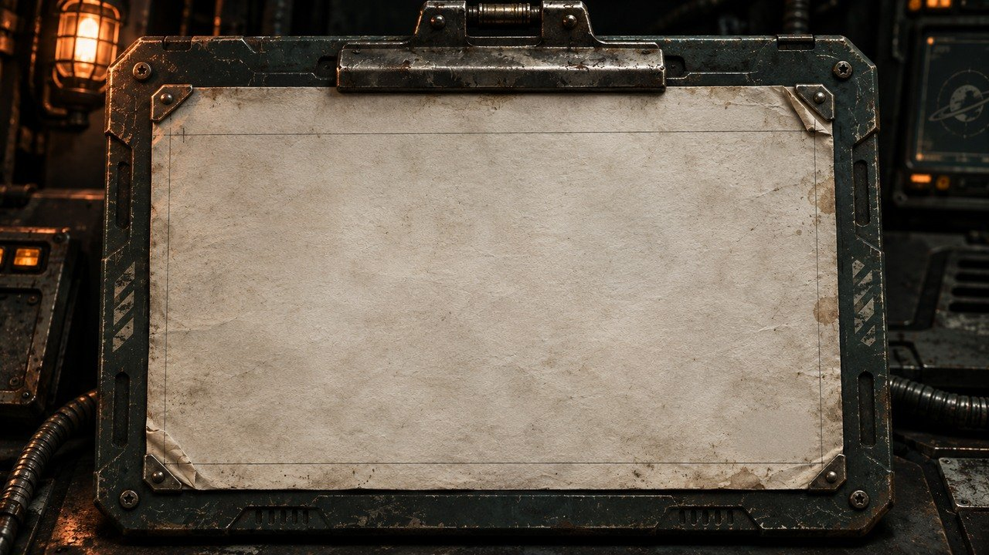
UNIT M-77 / HAB DECK
STATUS: REPAIRED
COMPLETED: TOMORROW 14:32
TECHNICIAN COHORT 01
“Collision with unrecorded passenger resolved.”
›
Notes:
SESSION 2. GM bible v12 is story authority. ENVIRONMENT: habitation.
Exact canonical ticket. Reveal after incident; repeat at final explanation. No rat explanation for unrecorded passenger.
VISUAL: Physical clue prop with source-local animation and native canonical text
PLAYBACK: embedded silent H.264 starts automatically and loops. Advance manually; no timed slide changes. Static poster fallback. Actual Microsoft PowerPoint playback has not been tested on this Linux machine.

Slide 21
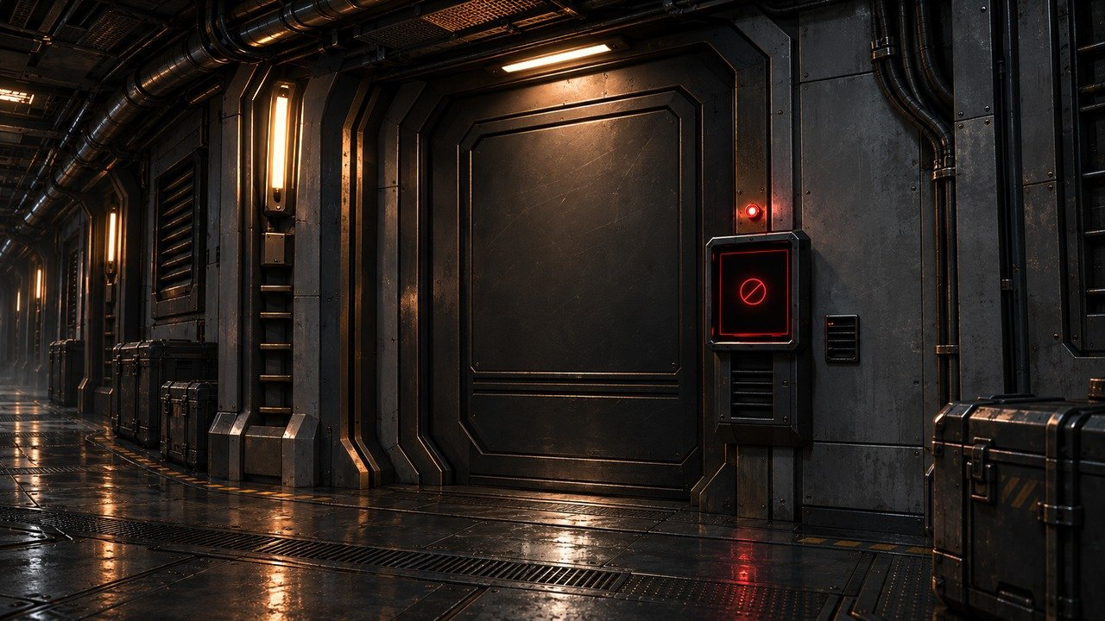
MAP ↗
›
Notes:
SESSION 2. GM bible v12 is story authority. ENVIRONMENT: restricted_door.
Optional brief investigation; do not create mandatory combat.
VISUAL: Restored original scene composition, canonical identities and localized practical motion
PLAYBACK: embedded silent H.264 starts automatically and loops. Advance manually; no timed slide changes. Static poster fallback. Actual Microsoft PowerPoint playback has not been tested on this Linux machine.

Slide 22
IRIS
Ship AI
›
Notes:
SESSION 2. GM bible v12 is story authority. ENVIRONMENT: restricted_door.
Hold the mystery. Do not explain K-17 yet.
VISUAL: Canonical portrait identity with restored framing: 44; visible animated restricted_door context and source-local lights
PLAYBACK: embedded silent H.264 starts automatically and loops. Advance manually; no timed slide changes. Static poster fallback. Actual Microsoft PowerPoint playback has not been tested on this Linux machine.

Slide 23
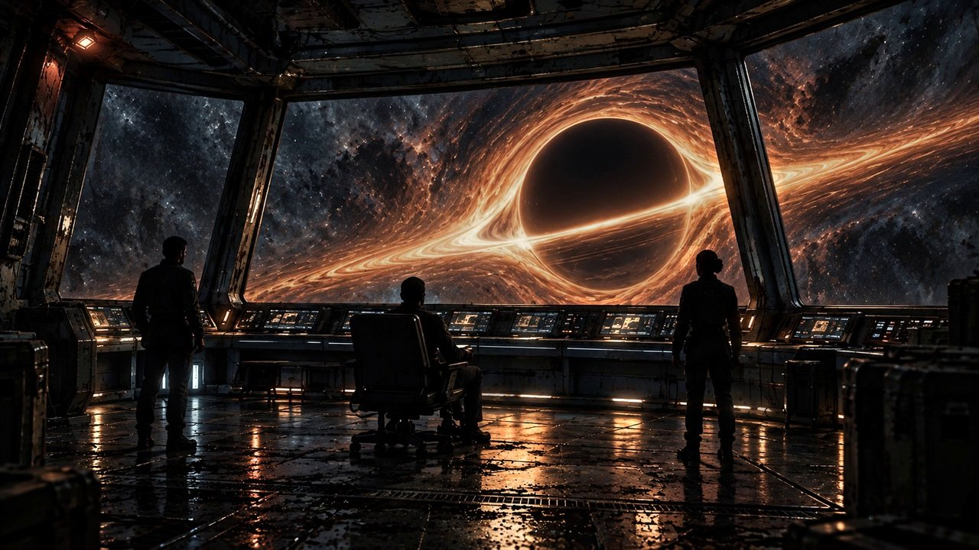
THE FAR HORIZON
03
The first anomaly
MAP ↗
›
Notes:
SESSION 3. GM bible v12 is story authority. ENVIRONMENT: observation.
Start when ready for this session. MAP opens that session’s linked visual map.
VISUAL: Animated chapter / native typography
PLAYBACK: embedded silent H.264 starts automatically and loops. Advance manually; no timed slide changes. Static poster fallback. Actual Microsoft PowerPoint playback has not been tested on this Linux machine.

Slide 24
MAP ↗
›
Notes:
SESSION 3. GM bible v12 is story authority. ENVIRONMENT: observation.
VISUAL: Environment from original immersive source 11; source-local object animation
PLAYBACK: embedded silent H.264 starts automatically and loops. Advance manually; no timed slide changes. Static poster fallback. Actual Microsoft PowerPoint playback has not been tested on this Linux machine.

Slide 25


Dr. Elias Vale
Astrophysicist · K-17 specialist
CONCERNED
RESOLVED
LISTEN
›
Notes:
SESSION 3. GM bible v12 is story authority. ENVIRONMENT: observation.
VISUAL: Canonical portrait identity with restored framing: 39; visible animated observation context and source-local lights
PLAYBACK: embedded silent H.264 starts automatically and loops. Advance manually; no timed slide changes. Static poster fallback. Actual Microsoft PowerPoint playback has not been tested on this Linux machine.

Slide 26
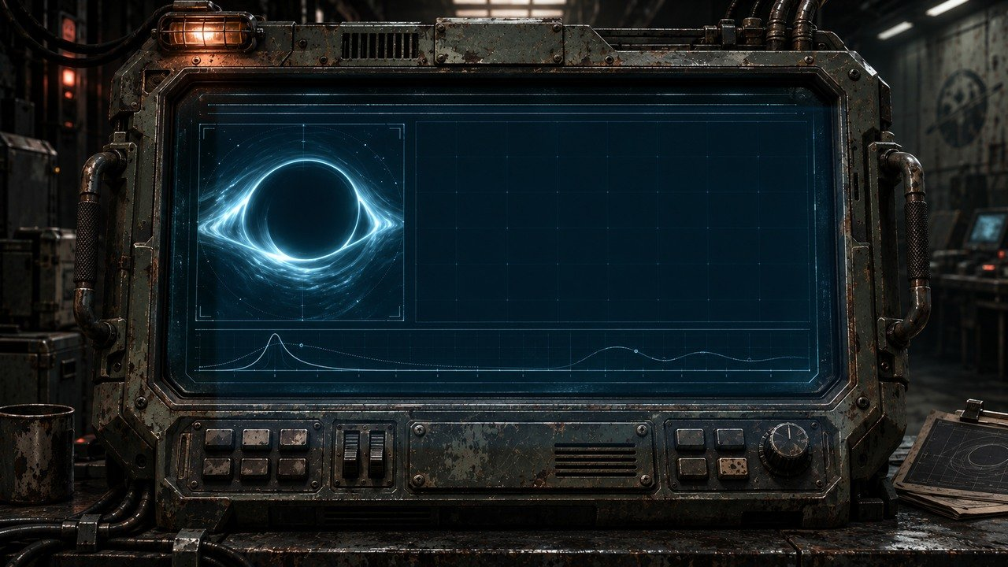
MASS / LENSING
FROM MASS MODEL
OBSERVED LENSING
FIT: INCONSISTENT
›
Notes:
SESSION 3. GM bible v12 is story authority. ENVIRONMENT: observation.
VISUAL: Physical clue prop with source-local animation and native canonical text
PLAYBACK: embedded silent H.264 starts automatically and loops. Advance manually; no timed slide changes. Static poster fallback. Actual Microsoft PowerPoint playback has not been tested on this Linux machine.

Slide 27
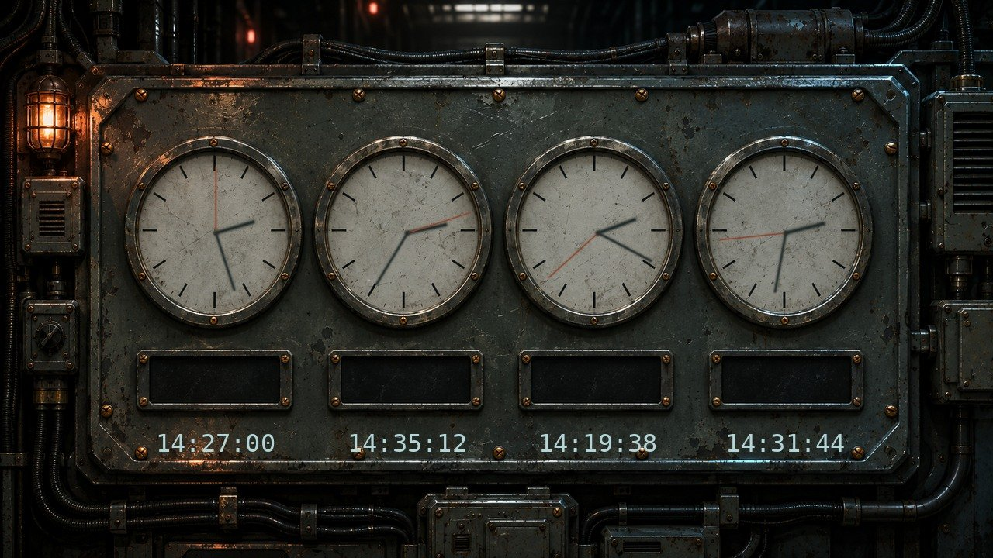
SHIP STANDARD · ALL CLOCKS LOCAL
BRIDGE
ENGINEERING
HABITATION
MEDBAY
HARDWARE VALID · SYNCHRONIZATION LOST
›
Notes:
SESSION 3. GM bible v12 is story authority. ENVIRONMENT: observation.
VISUAL: Physical clue prop with source-local animation and native canonical text
PLAYBACK: embedded silent H.264 starts automatically and loops. Advance manually; no timed slide changes. Static poster fallback. Actual Microsoft PowerPoint playback has not been tested on this Linux machine.

Slide 28
Dr. Nia Okafor
Chief medical officer
›
Notes:
SESSION 3. GM bible v12 is story authority. ENVIRONMENT: observation.
VISUAL: Canonical portrait identity with restored framing: 40; visible animated observation context and source-local lights
PLAYBACK: embedded silent H.264 starts automatically and loops. Advance manually; no timed slide changes. Static poster fallback. Actual Microsoft PowerPoint playback has not been tested on this Linux machine.

Slide 29
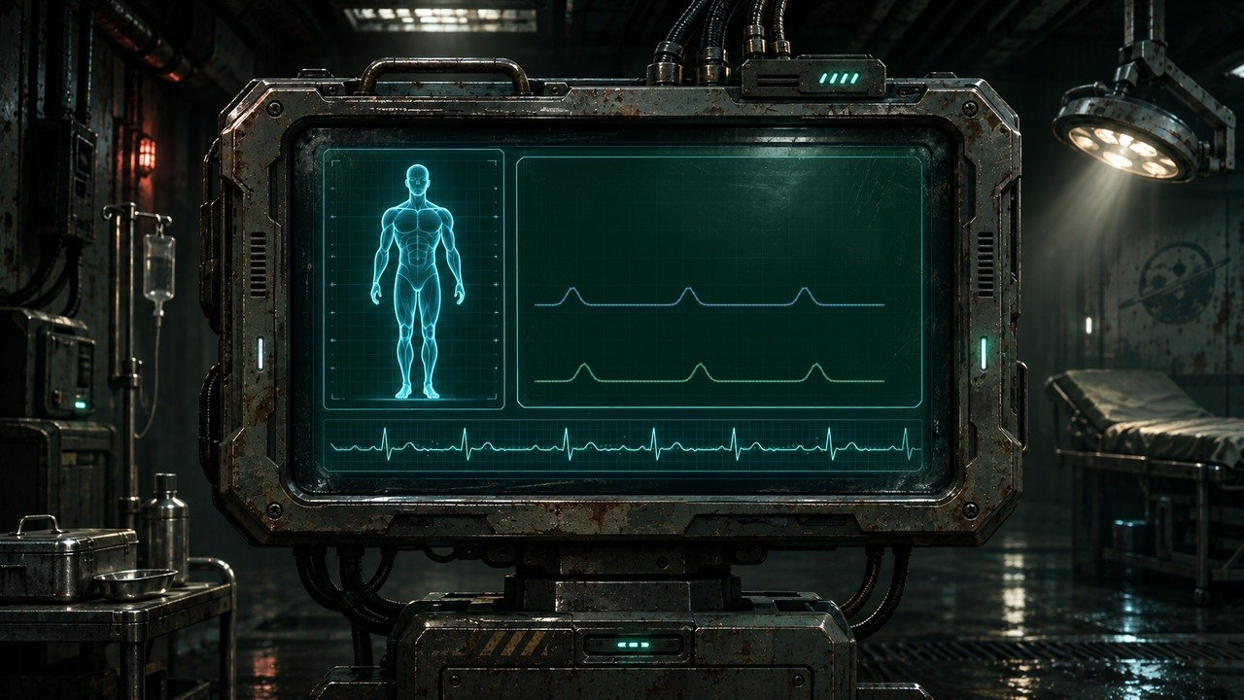
COHORT 01
SHIP TIME
CELLULAR RESPONSE
TIMING DRIFT
›
Notes:
SESSION 3. GM bible v12 is story authority. ENVIRONMENT: observation.
VISUAL: Physical clue prop with source-local animation and native canonical text
PLAYBACK: embedded silent H.264 starts automatically and loops. Advance manually; no timed slide changes. Static poster fallback. Actual Microsoft PowerPoint playback has not been tested on this Linux machine.

Slide 30
ARRIVAL ESTIMATE
37 DAYS
NAVIGATION: 102 DAYS
›
Notes:
SESSION 3. GM bible v12 is story authority. ENVIRONMENT: observation.
Flight privileged fact. No route change accounts for either estimate.
VISUAL: Readable native data on physical pulsing terminal
PLAYBACK: embedded silent H.264 starts automatically and loops. Advance manually; no timed slide changes. Static poster fallback. Actual Microsoft PowerPoint playback has not been tested on this Linux machine.

Slide 31
IRIS
Ship AI
›
Notes:
SESSION 3. GM bible v12 is story authority. ENVIRONMENT: observation.
Ask which estimate is right. Pause before the exact answer.
VISUAL: Canonical portrait identity with restored framing: 44; visible animated observation context and source-local lights
PLAYBACK: embedded silent H.264 starts automatically and loops. Advance manually; no timed slide changes. Static poster fallback. Actual Microsoft PowerPoint playback has not been tested on this Linux machine.

Slide 32
WHICH ONE IS RIGHT?
“Both.”
›
Notes:
SESSION 3. GM bible v12 is story authority. ENVIRONMENT: observation.
The required IRIS line. Each department reports its privileged fact.
VISUAL: Native story cue over visible animated observation environment
PLAYBACK: embedded silent H.264 starts automatically and loops. Advance manually; no timed slide changes. Static poster fallback. Actual Microsoft PowerPoint playback has not been tested on this Linux machine.

Slide 33

LENSING
›
Notes:
SESSION 3. GM bible v12 is story authority. ENVIRONMENT: observation.
VISUAL: Environment from original immersive source 11; source-local object animation
PLAYBACK: embedded silent H.264 starts automatically and loops. Advance manually; no timed slide changes. Static poster fallback. Actual Microsoft PowerPoint playback has not been tested on this Linux machine.

Slide 34
UNOPENED PACKET
TIMESTAMP: +103 DAYS
SOURCE: CSV-01 PIONEER
›
Notes:
SESSION 3. GM bible v12 is story authority. ENVIRONMENT: observation.
Session 3 cliffhanger. End immediately. Arrival confirmation and Juno warning wait for Session 4.
VISUAL: Readable native data on physical pulsing terminal
PLAYBACK: embedded silent H.264 starts automatically and loops. Advance manually; no timed slide changes. Static poster fallback. Actual Microsoft PowerPoint playback has not been tested on this Linux machine.

Slide 35
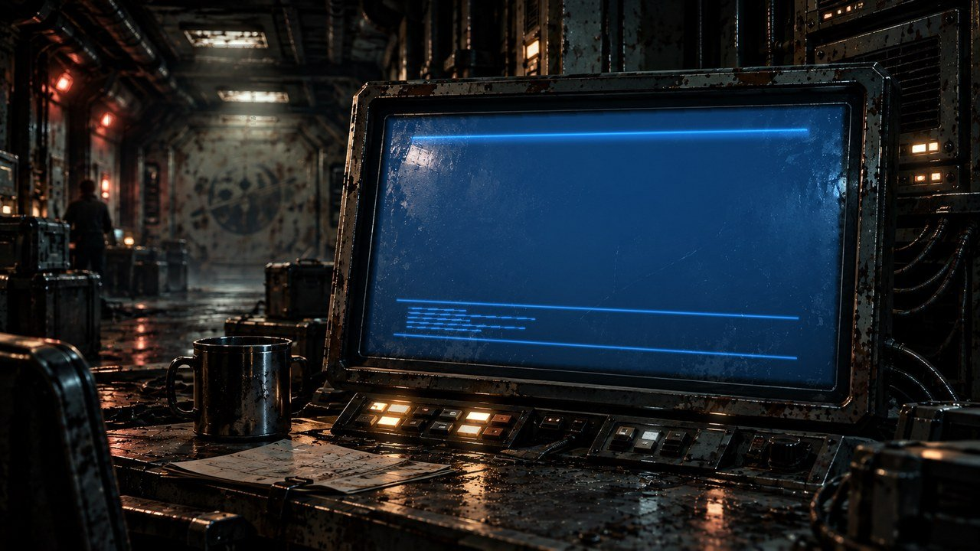
THE FAR HORIZON
04
The message
MAP ↗
›
Notes:
SESSION 4. GM bible v12 is story authority. ENVIRONMENT: comms.
Start when ready for this session. MAP opens that session’s linked visual map.
VISUAL: Animated chapter / native typography
PLAYBACK: embedded silent H.264 starts automatically and loops. Advance manually; no timed slide changes. Static poster fallback. Actual Microsoft PowerPoint playback has not been tested on this Linux machine.

Slide 36
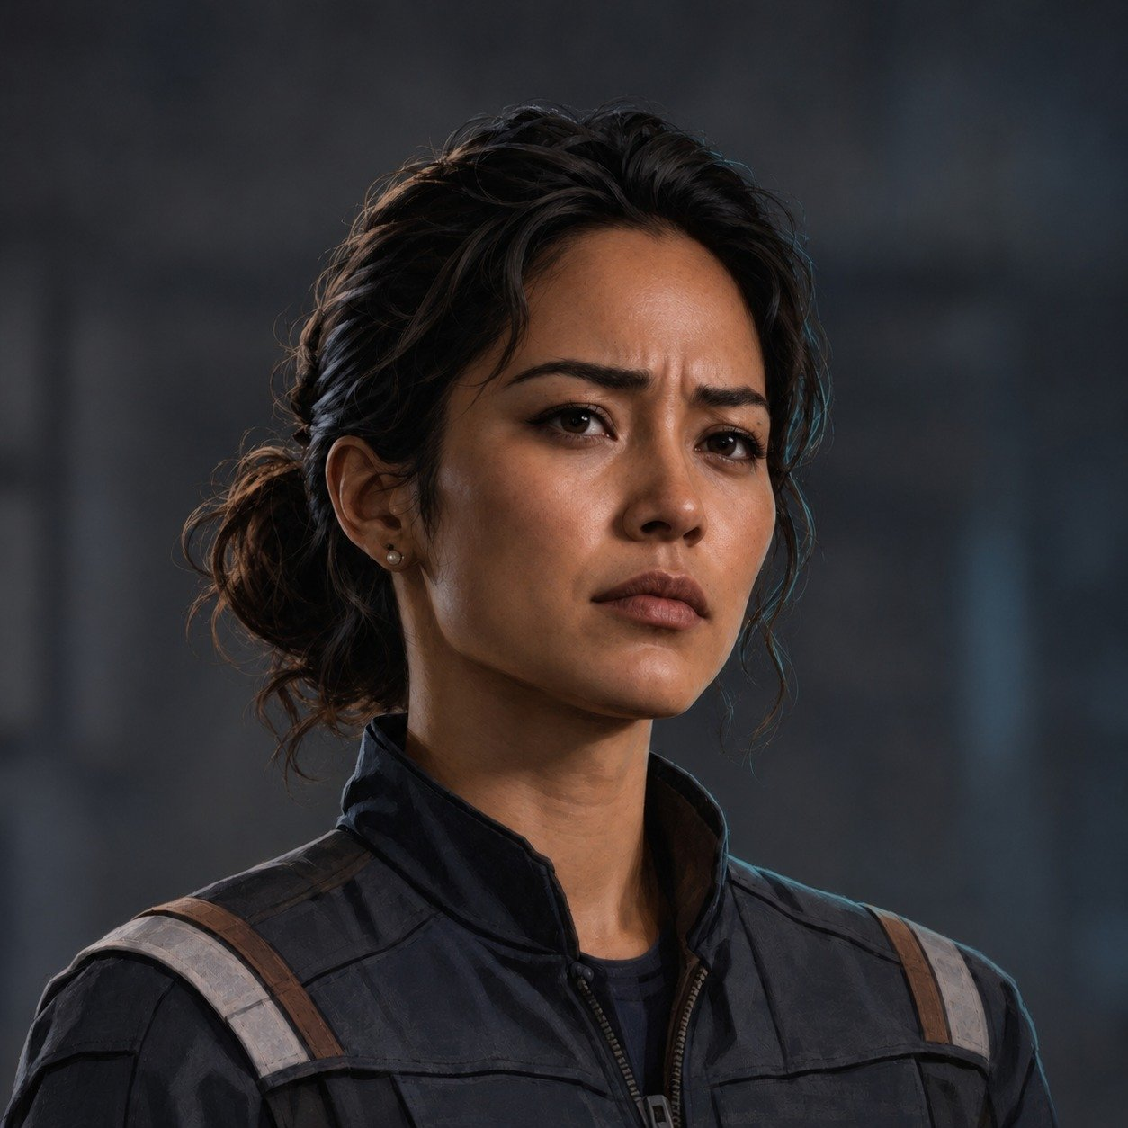

Juno Reyes
Communications · logistics
CONCERNED
RESOLVED
LISTEN
›
Notes:
SESSION 4. GM bible v12 is story authority. ENVIRONMENT: comms.
VISUAL: Canonical portrait identity with restored framing: 42; visible animated comms context and source-local lights
PLAYBACK: embedded silent H.264 starts automatically and loops. Advance manually; no timed slide changes. Static poster fallback. Actual Microsoft PowerPoint playback has not been tested on this Linux machine.

Slide 37
INCOMING TRANSMISSION
SOURCE: CSV-01 PIONEER
TIMESTAMP: +103 DAYS
ARRIVAL CONFIRMED
COHORT-CLASS SIGNATURE
PACKET DAMAGE: 61%
›
Notes:
SESSION 4. GM bible v12 is story authority. ENVIRONMENT: comms.
Message reveals once as native text, then remains readable over a looping blue monitor.
VISUAL: Physical monitor and one-time native PowerPoint text entrance
PLAYBACK: embedded silent H.264 starts automatically and loops. Advance manually; no timed slide changes. Static poster fallback. Actual Microsoft PowerPoint playback has not been tested on this Linux machine.

Slide 38
PIONEER → PIONEER
ARRIVAL CONFIRMED
+103 DAYS
COHORT-CLASS SIGNATURE
PACKET DAMAGE: 61%
›
Notes:
SESSION 4. GM bible v12 is story authority. ENVIRONMENT: comms.
Reveal the warning on the next slide, after the transmission is established.
VISUAL: Readable native data on physical pulsing terminal
PLAYBACK: embedded silent H.264 starts automatically and loops. Advance manually; no timed slide changes. Static poster fallback. Actual Microsoft PowerPoint playback has not been tested on this Linux machine.

Slide 39
TRANSIENT LINE
DO NOT ANSWER
IF JUNO IS IN THE ROOM.
›
Notes:
SESSION 4. GM bible v12 is story authority. ENVIRONMENT: comms.
This warns about a possible action, not Juno’s character.
VISUAL: Readable native data on physical pulsing terminal
PLAYBACK: embedded silent H.264 starts automatically and loops. Advance manually; no timed slide changes. Static poster fallback. Actual Microsoft PowerPoint playback has not been tested on this Linux machine.

Slide 40
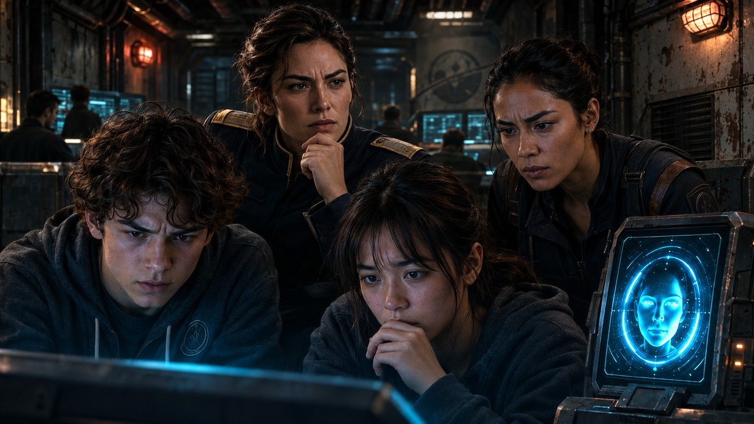
MAP ↗
›
Notes:
SESSION 4. GM bible v12 is story authority. ENVIRONMENT: adult_reaction.
Canonical Juno, Mara and IRIS react to the warning.
VISUAL: Restored original scene composition, canonical identities and localized practical motion
PLAYBACK: embedded silent H.264 starts automatically and loops. Advance manually; no timed slide changes. Static poster fallback. Actual Microsoft PowerPoint playback has not been tested on this Linux machine.

Slide 41
THE FORBIDDEN REPLY
Juno Reyes
Mara Venn
IRIS
›
Notes:
SESSION 4. GM bible v12 is story authority. ENVIRONMENT: adult_reaction.
Juno reaches toward transmit. Report / hide / reply / delete / investigate, or accept a student option. Replace original reaction art which misidentifies NPCs.
VISUAL: Canonical portrait gallery over visibly moving contextual environment
PLAYBACK: embedded silent H.264 starts automatically and loops. Advance manually; no timed slide changes. Static poster fallback. Actual Microsoft PowerPoint playback has not been tested on this Linux machine.

Slide 42
INCOMING TRANSMISSION
SOURCE: CSV-01 PIONEER
TIMESTAMP: +103 DAYS
ARRIVAL CONFIRMED
COHORT-CLASS SIGNATURE
PACKET DAMAGE: 61%
›
Notes:
SESSION 4. GM bible v12 is story authority. ENVIRONMENT: comms.
Message reveals once as native text, then remains readable over a looping blue monitor.
VISUAL: Physical monitor and one-time native PowerPoint text entrance
PLAYBACK: embedded silent H.264 starts automatically and loops. Advance manually; no timed slide changes. Static poster fallback. Actual Microsoft PowerPoint playback has not been tested on this Linux machine.

Slide 43
PARTIAL DECRYPT
COORDINATE NEAR K-17
FAR HORIZON TRANSPONDER
›
Notes:
SESSION 4. GM bible v12 is story authority. ENVIRONMENT: comms.
Packet partially decrypts regardless of the class decision; a weak human-built transponder motivates the derelict approach. No numeric coordinates invented.
VISUAL: Readable native data on physical pulsing terminal
PLAYBACK: embedded silent H.264 starts automatically and loops. Advance manually; no timed slide changes. Static poster fallback. Actual Microsoft PowerPoint playback has not been tested on this Linux machine.

Slide 44
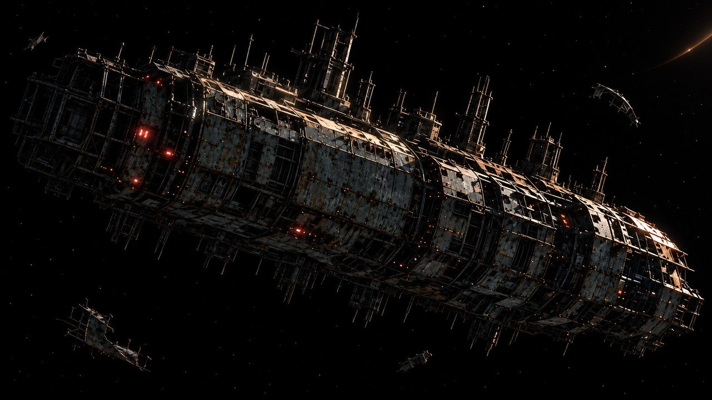
THE FAR HORIZON
05
The silent ship
MAP ↗
›
Notes:
SESSION 5. GM bible v12 is story authority. ENVIRONMENT: derelict_exterior.
Start when ready for this session. MAP opens that session’s linked visual map.
VISUAL: Animated chapter / native typography
PLAYBACK: embedded silent H.264 starts automatically and loops. Advance manually; no timed slide changes. Static poster fallback. Actual Microsoft PowerPoint playback has not been tested on this Linux machine.

Slide 45
MAP ↗
›
Notes:
SESSION 5. GM bible v12 is story authority. ENVIRONMENT: derelict_exterior.
VISUAL: Environment from original immersive source 17; source-local object animation
PLAYBACK: embedded silent H.264 starts automatically and loops. Advance manually; no timed slide changes. Static poster fallback. Actual Microsoft PowerPoint playback has not been tested on this Linux machine.

Slide 46


Marcus Bell
Security · expedition lead
CONCERNED
RESOLVED
LISTEN
›
Notes:
SESSION 5. GM bible v12 is story authority. ENVIRONMENT: derelict_exterior.
VISUAL: Canonical portrait identity with restored framing: 43; visible animated derelict_exterior context and source-local lights
PLAYBACK: embedded silent H.264 starts automatically and loops. Advance manually; no timed slide changes. Static poster fallback. Actual Microsoft PowerPoint playback has not been tested on this Linux machine.

Slide 47
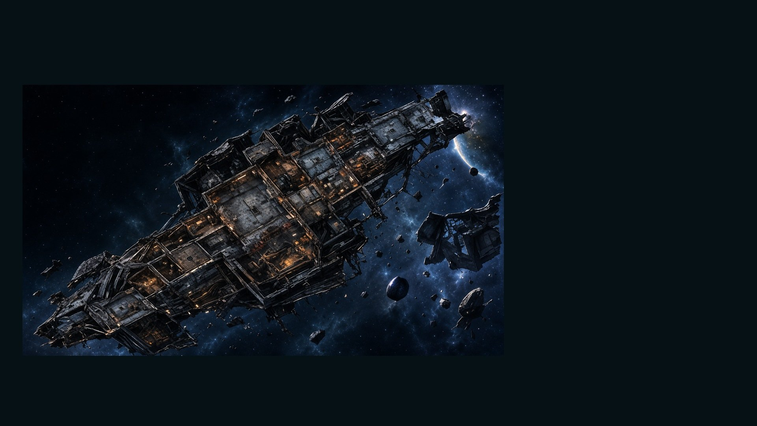
DERELICT · ORPHEUS MAP
MAP KEY
•
Airlock —
Damaged
•
Cargo Hold
•
Crew Quarters
•
Research Lab
•
Power Core —
Offline
•
Unknown Section
MAP ↗
›
Notes:
SESSION 5. GM bible v12 is story authority. ENVIRONMENT: derelict_exterior.
Student-facing map artwork; do not narrate future map atlas locations early.
VISUAL: Original map art, readable native legend, subtle source-local motion
PLAYBACK: embedded silent H.264 starts automatically and loops. Advance manually; no timed slide changes. Static poster fallback. Actual Microsoft PowerPoint playback has not been tested on this Linux machine.

Slide 48
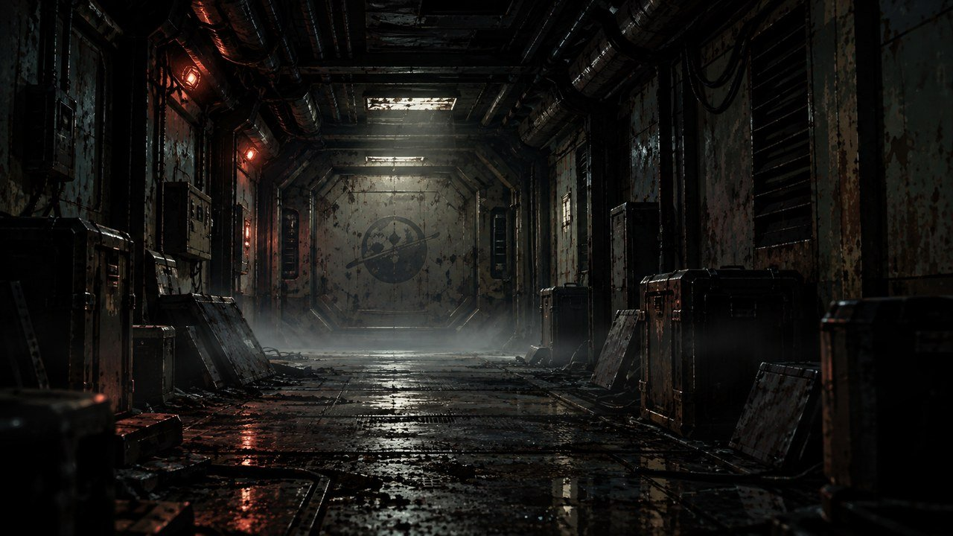
MAP ↗
›
Notes:
SESSION 5. GM bible v12 is story authority. ENVIRONMENT: derelict.
VISUAL: Environment from original immersive source 18; source-local object animation
PLAYBACK: embedded silent H.264 starts automatically and loops. Advance manually; no timed slide changes. Static poster fallback. Actual Microsoft PowerPoint playback has not been tested on this Linux machine.

Slide 49
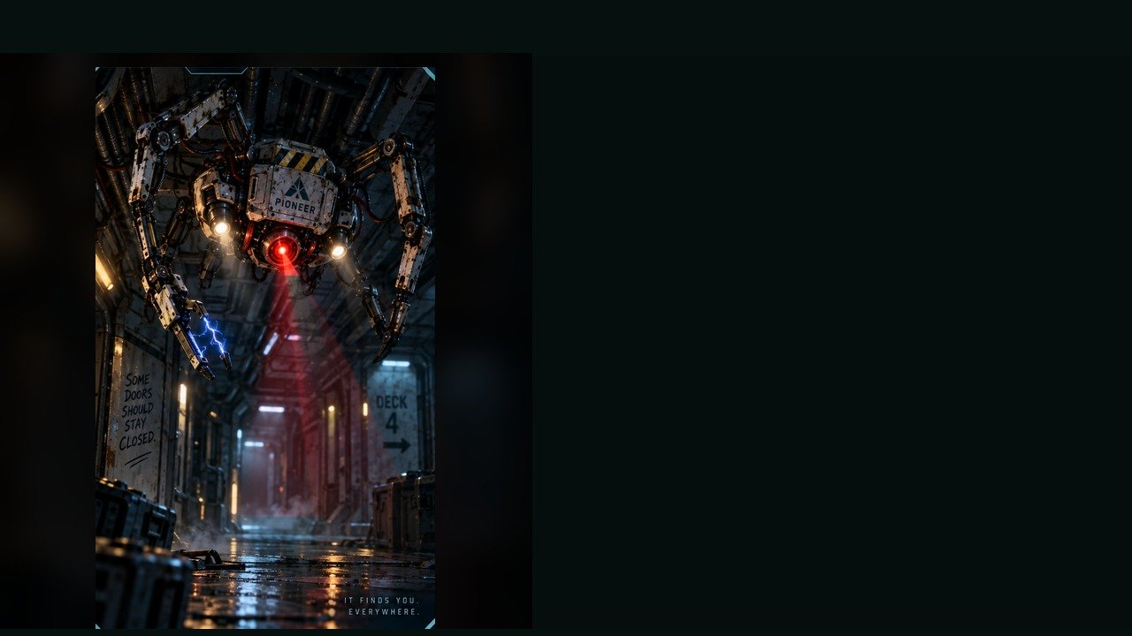
DERELICT SECURITY DRONE
WEAKNESS
Sensor blind spot underneath
BEHAVIOUR
• Scans for intruders
• Clings to walls and ceilings
• Attempts quarantine and pursuit
UNDERBODY
SPECIAL
Shock baton · Alarm burst · Magnetic cling
OBJECTIVE PRESSURE
Drives intruders away from black-box data.
FULL DOSSIER
MOVE · ATTACK · ASSIST · ENVIRONMENT
›
Notes:
SESSION 5. GM bible v12 is story authority. ENVIRONMENT: derelict.
2–3 standard drones, 2 Threat Boxes each. Preserve or reach black box before lockdown; maximum 3 rounds.
VISUAL: Latest uploaded enemy dossier: animated source artwork; readable weakness, behaviour, special, objective
PLAYBACK: embedded silent H.264 starts automatically and loops. Advance manually; no timed slide changes. Static poster fallback. Actual Microsoft PowerPoint playback has not been tested on this Linux machine.
TEACHER ONLY — source role: Hunter-Control Unit
Source performance cues: Sharp head turns; Stuttering voice; Sudden ceiling drops

Slide 50
DERELICT SECURITY DRONE · DOSSIER
TYPE
Security Enforcement Unit
THREAT PROFILE
Standard · 2 threat boxes
SYSTEM / NATURE
Security enforcement
OBSERVABLE SIGNS
• Sharp tracking movements
• Stuttering identification voice
• Can drop from ceilings
TACTICS
PIONEER · CONTACT PROFILE
›
Notes:
SESSION 5. GM bible v12 is story authority. ENVIRONMENT: derelict.
2–3 standard drones, 2 Threat Boxes each. Preserve or reach black box before lockdown; maximum 3 rounds.
VISUAL: Latest enemy dossier profile, threat, role, stage cues; source text retained
PLAYBACK: embedded silent H.264 starts automatically and loops. Advance manually; no timed slide changes. Static poster fallback. Actual Microsoft PowerPoint playback has not been tested on this Linux machine.
TEACHER ONLY — source role: Hunter-Control Unit
Source performance cues: Sharp head turns; Stuttering voice; Sudden ceiling drops

Slide 51
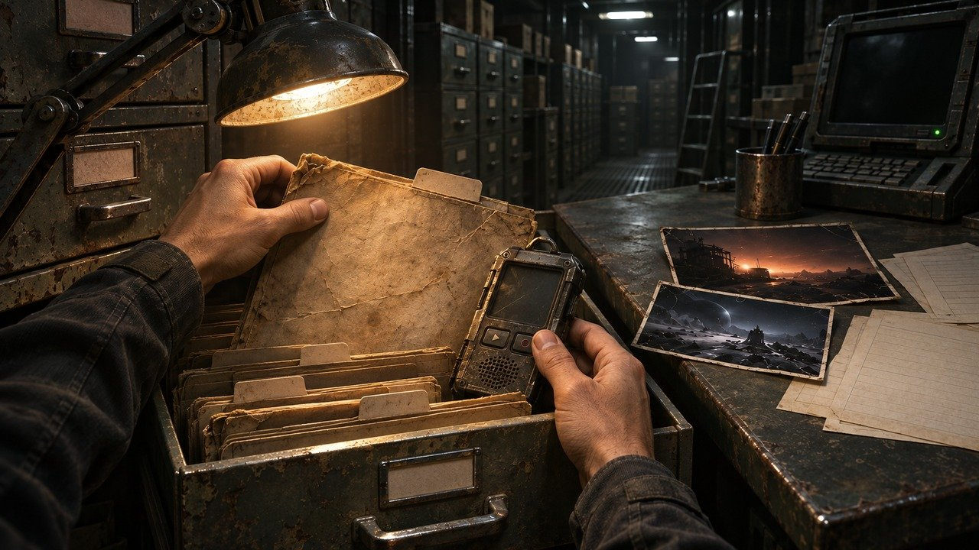
MAP ↗
›
Notes:
SESSION 5. GM bible v12 is story authority. ENVIRONMENT: evidence_pull.
Recovered Orpheus recorder is physical evidence. Read source transcript next.
VISUAL: Restored original scene composition, canonical identities and localized practical motion
PLAYBACK: embedded silent H.264 starts automatically and loops. Advance manually; no timed slide changes. Static poster fallback. Actual Microsoft PowerPoint playback has not been tested on this Linux machine.

Slide 52
BLACK BOX TRANSCRIPT
BEACON: IDENTIFIED AS OUR OWN.
NAVIGATION: “K-17 is where it will be.”
CREW: “Where are the children?”
RESPONSE: “The children are not aboard.”
IRIS-LIKE VOICE: “Both routes are correct.”
›
Notes:
SESSION 5. GM bible v12 is story authority. ENVIRONMENT: evidence_pull.
Read the full transcript from the bible. Do not explain that the derelict is a failed possible future yet.
VISUAL: Readable native data on physical pulsing terminal
PLAYBACK: embedded silent H.264 starts automatically and loops. Advance manually; no timed slide changes. Static poster fallback. Actual Microsoft PowerPoint playback has not been tested on this Linux machine.

Slide 53
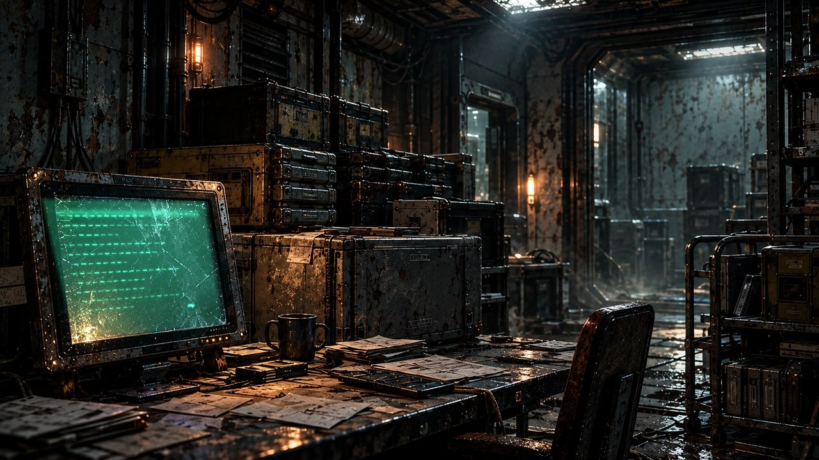
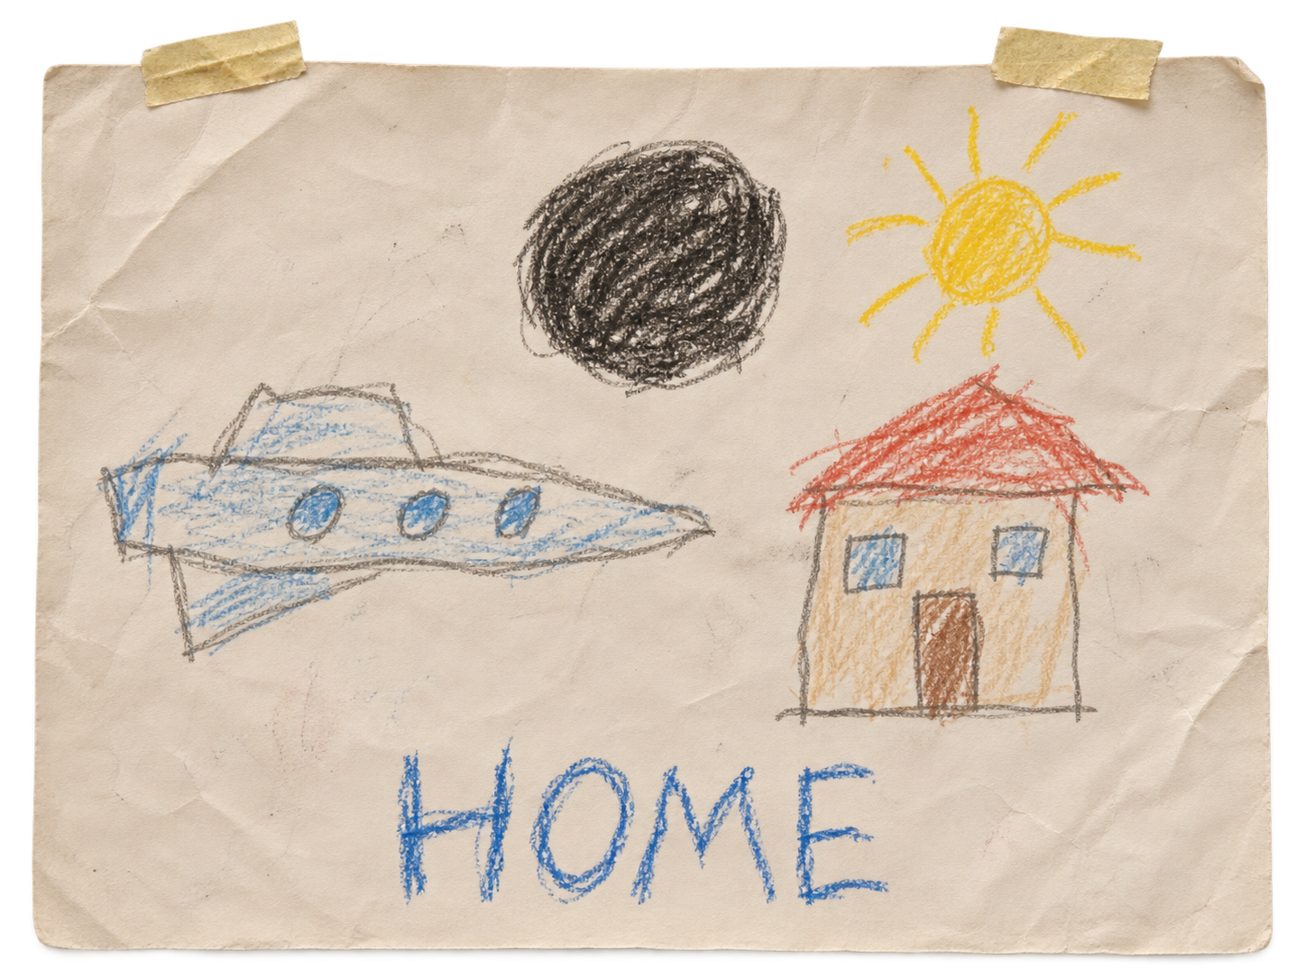
›
Notes:
SESSION 5. GM bible v12 is story authority. ENVIRONMENT: archive.
VISUAL: Environment from original immersive source 54; source-local object animation
PLAYBACK: embedded silent H.264 starts automatically and loops. Advance manually; no timed slide changes. Static poster fallback. Actual Microsoft PowerPoint playback has not been tested on this Linux machine.
SCENE UPDATE: physical child crayon drawing on worn paper. Canonical caption: HOME Reverse-side clue remains WE WAITED FOR YOU.

Slide 54
ON THE REVERSE
WE WAITED FOR YOU.
›
Notes:
SESSION 5. GM bible v12 is story authority. ENVIRONMENT: archive.
Repeat this clue at the school in Session 10.
VISUAL: Native story cue over visible animated archive environment
PLAYBACK: embedded silent H.264 starts automatically and loops. Advance manually; no timed slide changes. Static poster fallback. Actual Microsoft PowerPoint playback has not been tested on this Linux machine.

Slide 55
›
Notes:
SESSION 5. GM bible v12 is story authority. ENVIRONMENT: derelict_exterior.
VISUAL: Environment from original immersive source 17; source-local object animation
PLAYBACK: embedded silent H.264 starts automatically and loops. Advance manually; no timed slide changes. Static poster fallback. Actual Microsoft PowerPoint playback has not been tested on this Linux machine.

Slide 56
THE FAR HORIZON
06
The records
MAP ↗
›
Notes:
SESSION 6. GM bible v12 is story authority. ENVIRONMENT: archive.
Start when ready for this session. MAP opens that session’s linked visual map.
VISUAL: Animated chapter / native typography
PLAYBACK: embedded silent H.264 starts automatically and loops. Advance manually; no timed slide changes. Static poster fallback. Actual Microsoft PowerPoint playback has not been tested on this Linux machine.

Slide 57
ARCHIVE
DATA LINK
MAP ↗
›
Notes:
SESSION 6. GM bible v12 is story authority. ENVIRONMENT: archive.
VISUAL: Environment from original immersive source 20; source-local object animation
PLAYBACK: embedded silent H.264 starts automatically and loops. Advance manually; no timed slide changes. Static poster fallback. Actual Microsoft PowerPoint playback has not been tested on this Linux machine.

Slide 58
Dr. Elias Vale
Astrophysicist · K-17 specialist
CONCERNED
RESOLVED
LISTEN
›
Notes:
SESSION 6. GM bible v12 is story authority. ENVIRONMENT: archive.
VISUAL: Canonical portrait identity with restored framing: 39; visible animated archive context and source-local lights
PLAYBACK: embedded silent H.264 starts automatically and loops. Advance manually; no timed slide changes. Static poster fallback. Actual Microsoft PowerPoint playback has not been tested on this Linux machine.

Slide 59
MAP ↗
›
Notes:
SESSION 6. GM bible v12 is story authority. ENVIRONMENT: evidence_pull.
Hands collect recorder, folders and contradictory archive evidence.
VISUAL: Restored original scene composition, canonical identities and localized practical motion
PLAYBACK: embedded silent H.264 starts automatically and loops. Advance manually; no timed slide changes. Static poster fallback. Actual Microsoft PowerPoint playback has not been tested on this Linux machine.

Slide 60
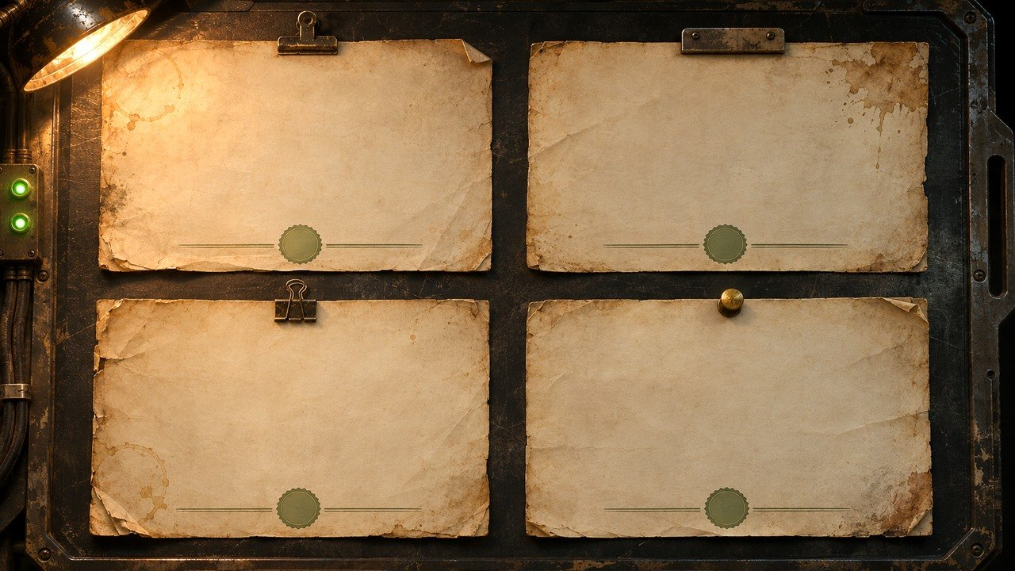
PIONEER · RECORD A
PIONEER · RECORD B
ARRIVED SAFELY
LOST NEAR K-17
TIMESTAMP: SAME RECORDED INSTANT
TIMESTAMP: SAME RECORDED INSTANT
AUTHENTICATION: VALID
AUTHENTICATION: VALID
PIONEER · RECORD C
PIONEER · RECORD D
RETURNED TO SOL
ESTABLISHED ASTERIA SETTLEMENT
TIMESTAMP: SAME RECORDED INSTANT
TIMESTAMP: SAME RECORDED INSTANT
AUTHENTICATION: VALID
AUTHENTICATION: VALID
›
Notes:
SESSION 6. GM bible v12 is story authority. ENVIRONMENT: evidence_pull.
All four records authenticate. Original evidence-wall artwork uses conflicting names and incomplete records, so it is replaced.
VISUAL: Physical clue prop with source-local animation and native canonical text
PLAYBACK: embedded silent H.264 starts automatically and loops. Advance manually; no timed slide changes. Static poster fallback. Actual Microsoft PowerPoint playback has not been tested on this Linux machine.

Slide 61
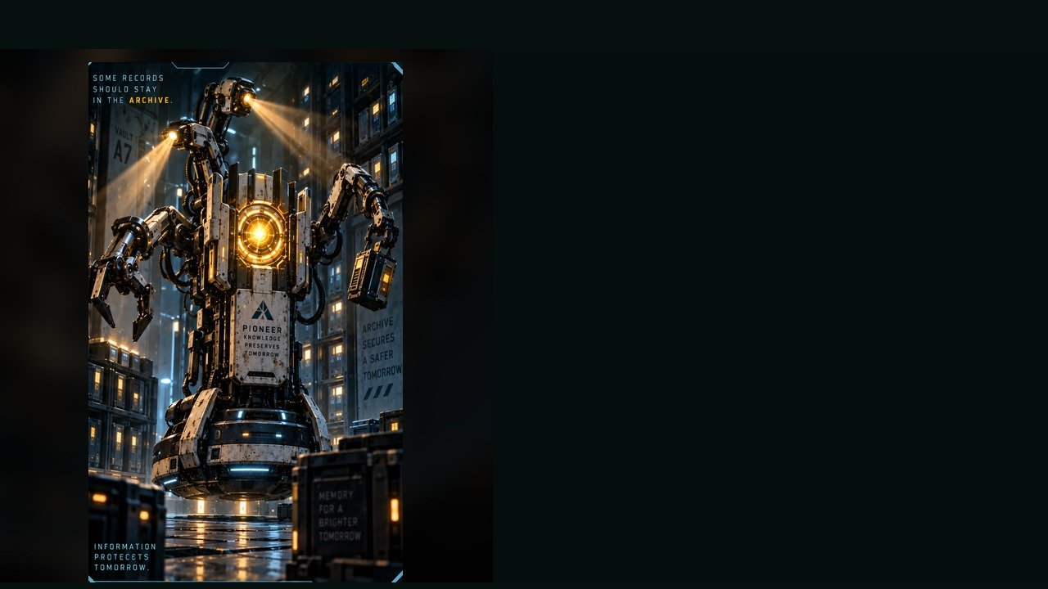
ARCHIVE GUARDIAN
WEAKNESS
Overloaded inventory logic
BEHAVIOUR
• Protects restricted records
• Seizes evidence
• Pins trespassers behind barriers
SPECIAL
Retrieval claw · Blinding scan · Shutter lock
INVENTORY LOGIC
OBJECTIVE PRESSURE
Removes or destroys clue modules each round.
FULL DOSSIER
MOVE · ATTACK · ASSIST · ENVIRONMENT
›
Notes:
SESSION 6. GM bible v12 is story authority. ENVIRONMENT: archive.
One standard Guardian, 2 Threat Boxes; two only if needed. Round 1 manifest, round 2 black-box duplicate, round 3 name-match alert threatened.
VISUAL: Latest uploaded enemy dossier: animated source artwork; readable weakness, behaviour, special, objective
PLAYBACK: embedded silent H.264 starts automatically and loops. Advance manually; no timed slide changes. Static poster fallback. Actual Microsoft PowerPoint playback has not been tested on this Linux machine.
TEACHER ONLY — source role: Evidence Denial Unit
Source performance cues: Smooth gliding movement; Polite but threatening tone; Arms snap out when evidence is touched

Slide 62
ARCHIVE GUARDIAN · DOSSIER
TYPE
Retrieval and Security Construct
THREAT PROFILE
Standard · 2 threat boxes
SYSTEM / NATURE
Archive retrieval and restriction
OBSERVABLE SIGNS
• Smooth gliding movement
• Polite warning voice
• Arms extend when evidence is touched
TACTICS
PIONEER · CONTACT PROFILE
›
Notes:
SESSION 6. GM bible v12 is story authority. ENVIRONMENT: archive.
One standard Guardian, 2 Threat Boxes; two only if needed. Round 1 manifest, round 2 black-box duplicate, round 3 name-match alert threatened.
VISUAL: Latest enemy dossier profile, threat, role, stage cues; source text retained
PLAYBACK: embedded silent H.264 starts automatically and loops. Advance manually; no timed slide changes. Static poster fallback. Actual Microsoft PowerPoint playback has not been tested on this Linux machine.
TEACHER ONLY — source role: Evidence Denial Unit
Source performance cues: Smooth gliding movement; Polite but threatening tone; Arms snap out when evidence is touched

Slide 63
COHORT 01 · FLIGHT
COHORT 01 · SCIENCE
Orion Kade
Lyra Seo
Nova Lin
Cai Mercer
Mira Volkov
Jalen Rafiq
Dax Ren
Selene Park
Theo Vale
COHORT 01 · ENGINEERING
COHORT 01 · COLONY
Kai Mercer
Elara Chen
Vera Sol
Milo Hart
Jae Orion
Nia Rowan
Zara Quinn
Pax Rhee
Luna Keung
›
Notes:
SESSION 6. GM bible v12 is story authority. ENVIRONMENT: archive.
Teacher: use a fictional character’s identity. Do not use real student names. The old prop contained noncanonical names / roles.
VISUAL: Physical clue prop with source-local animation and native canonical text
PLAYBACK: embedded silent H.264 starts automatically and loops. Advance manually; no timed slide changes. Static poster fallback. Actual Microsoft PowerPoint playback has not been tested on this Linux machine.

Slide 64
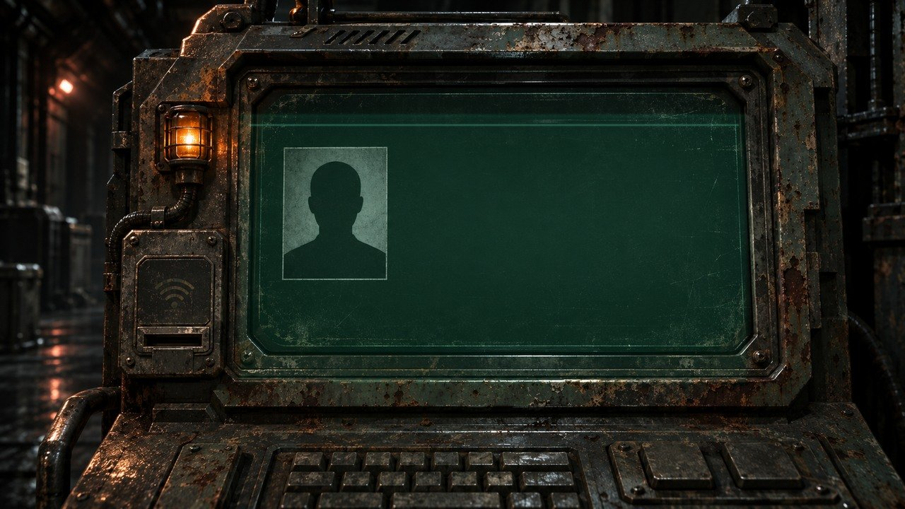
COHORT 01 IDENTITY MATCH
ZARA QUINN
ASTERIA SCHOOL ARCHIVE
SIX YEARS AFTER PIONEER LAUNCH
›
Notes:
SESSION 6. GM bible v12 is story authority. ENVIRONMENT: archive.
Zara Quinn is an editable fictional default. Replace only with a fictional class character if appropriate, never a real student name.
VISUAL: Physical clue prop with source-local animation and native canonical text
PLAYBACK: embedded silent H.264 starts automatically and loops. Advance manually; no timed slide changes. Static poster fallback. Actual Microsoft PowerPoint playback has not been tested on this Linux machine.

Slide 65
CONTAINMENT ORDERS
Marcus Bell
Mara Venn
›
Notes:
SESSION 6. GM bible v12 is story authority. ENVIRONMENT: archive.
Bell holds containment orders; Venn interrupts him. Do not give Bell scientific knowledge he does not have.
VISUAL: Canonical portrait gallery over visibly moving contextual environment
PLAYBACK: embedded silent H.264 starts automatically and loops. Advance manually; no timed slide changes. Static poster fallback. Actual Microsoft PowerPoint playback has not been tested on this Linux machine.

Slide 66
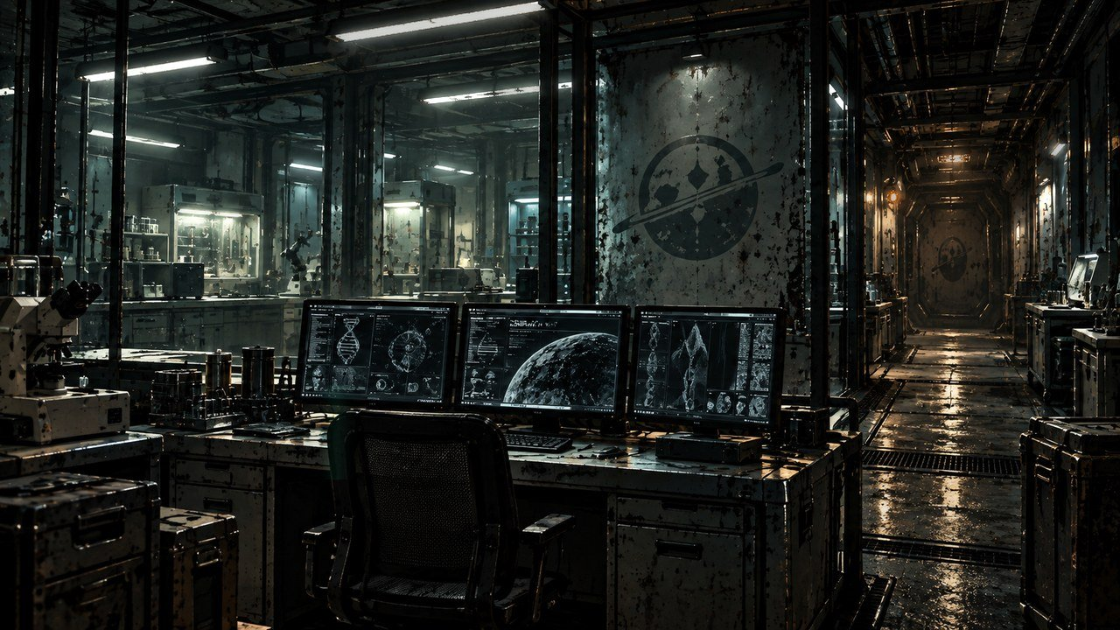
THE FAR HORIZON
07
The truth
MAP ↗
›
Notes:
SESSION 7. GM bible v12 is story authority. ENVIRONMENT: lab.
Start when ready for this session. MAP opens that session’s linked visual map.
VISUAL: Animated chapter / native typography
PLAYBACK: embedded silent H.264 starts automatically and loops. Advance manually; no timed slide changes. Static poster fallback. Actual Microsoft PowerPoint playback has not been tested on this Linux machine.

Slide 67
MAP ↗
›
Notes:
SESSION 7. GM bible v12 is story authority. ENVIRONMENT: lab.
VISUAL: Environment from original immersive source 23; source-local object animation
PLAYBACK: embedded silent H.264 starts automatically and loops. Advance manually; no timed slide changes. Static poster fallback. Actual Microsoft PowerPoint playback has not been tested on this Linux machine.

Slide 68
Dr. Nia Okafor
Chief medical officer
›
Notes:
SESSION 7. GM bible v12 is story authority. ENVIRONMENT: lab.
VISUAL: Canonical portrait identity with restored framing: 40; visible animated lab context and source-local lights
PLAYBACK: embedded silent H.264 starts automatically and loops. Advance manually; no timed slide changes. Static poster fallback. Actual Microsoft PowerPoint playback has not been tested on this Linux machine.

Slide 69
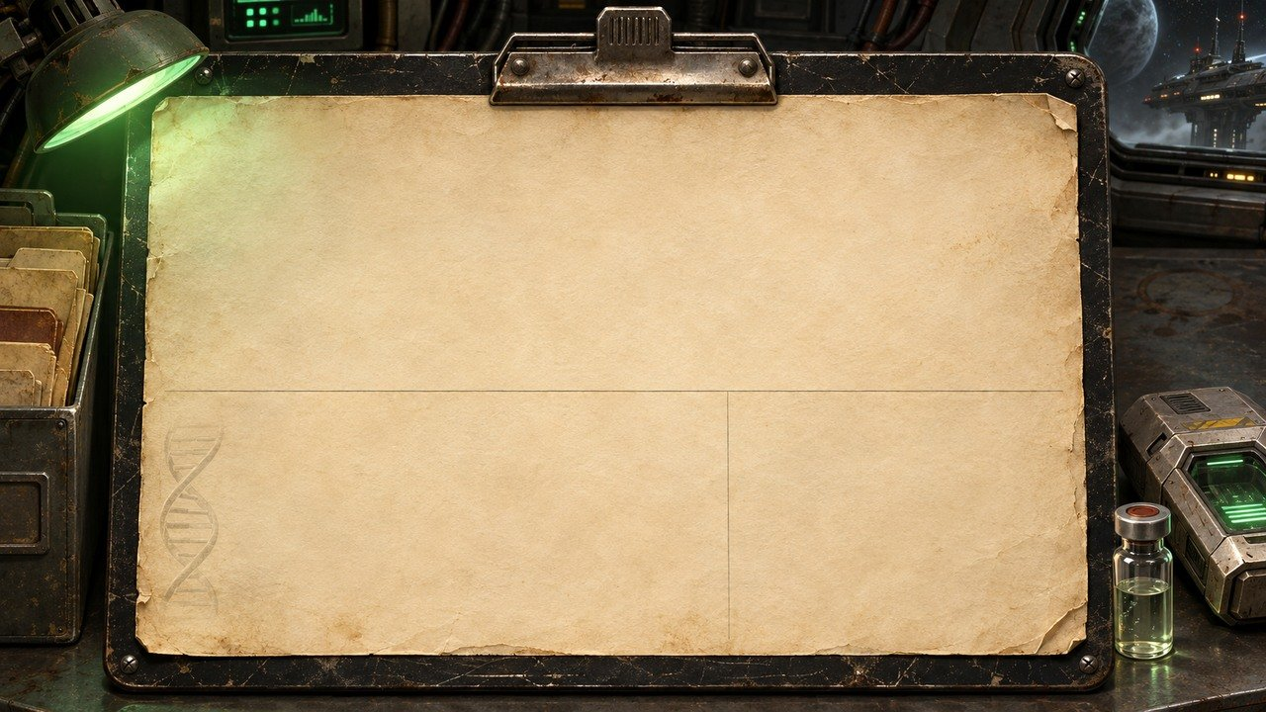
CLASSIFIED: FH-LR-17
BIOLOGICAL PROFILE · COHORT 01
Cellular repair
Radiation tolerance
Extended longevity projection
Neuroplasticity
Low-gravity resilience
Suspended-animation tolerance
PATTERN RESEMBLANCE
COHORT 01
K-17 SIGNAL
›
Notes:
SESSION 7. GM bible v12 is story authority. ENVIRONMENT: lab.
Use the full genetics clue in the bible; compatibility does not make the students destined or chosen by blood.
VISUAL: Physical clue prop with source-local animation and native canonical text
PLAYBACK: embedded silent H.264 starts automatically and loops. Advance manually; no timed slide changes. Static poster fallback. Actual Microsoft PowerPoint playback has not been tested on this Linux machine.

Slide 70
Dr. Elias Vale
Astrophysicist · K-17 specialist
CONCERNED
RESOLVED
LISTEN
›
Notes:
SESSION 7. GM bible v12 is story authority. ENVIRONMENT: lab.
VISUAL: Canonical portrait identity with restored framing: 39; visible animated lab context and source-local lights
PLAYBACK: embedded silent H.264 starts automatically and loops. Advance manually; no timed slide changes. Static poster fallback. Actual Microsoft PowerPoint playback has not been tested on this Linux machine.

Slide 71
THE CORRELATION
COHORT RESPONSE
MAY PRECEDE APPROACH
›
Notes:
SESSION 7. GM bible v12 is story authority. ENVIRONMENT: lab.
Biological timing resembles K-17 signal. This replaces the original misleading species-similarity chart.
VISUAL: Readable native data on physical pulsing terminal
PLAYBACK: embedded silent H.264 starts automatically and loops. Advance manually; no timed slide changes. Static poster fallback. Actual Microsoft PowerPoint playback has not been tested on this Linux machine.

Slide 72
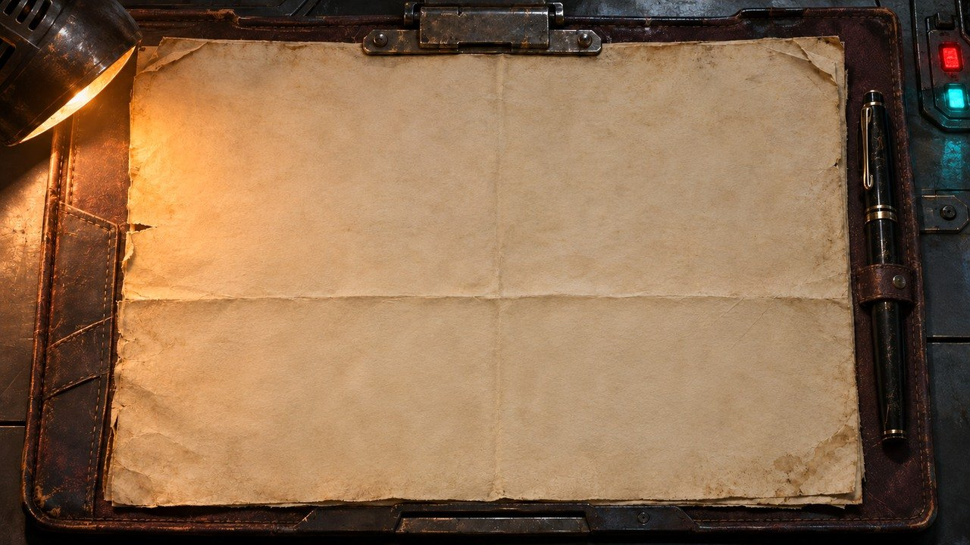
ROUTE VARIATION APPROVED
DO NOT ALTER COURSE BECAUSE OF OBJECT K-17 WITHOUT COMMAND AUTHORIZATION.
›
Notes:
SESSION 7. GM bible v12 is story authority. ENVIRONMENT: lab.
Venn’s handwritten objection follows.
VISUAL: Physical clue prop with source-local animation and native canonical text
PLAYBACK: embedded silent H.264 starts automatically and loops. Advance manually; no timed slide changes. Static poster fallback. Actual Microsoft PowerPoint playback has not been tested on this Linux machine.

Slide 73


Captain Mara Venn
Mission commander
CONCERNED
RESOLVED
LISTEN
›
Notes:
SESSION 7. GM bible v12 is story authority. ENVIRONMENT: lab.
VISUAL: Canonical portrait identity with restored framing: 37; visible animated lab context and source-local lights
PLAYBACK: embedded silent H.264 starts automatically and loops. Advance manually; no timed slide changes. Static poster fallback. Actual Microsoft PowerPoint playback has not been tested on this Linux machine.

Slide 74
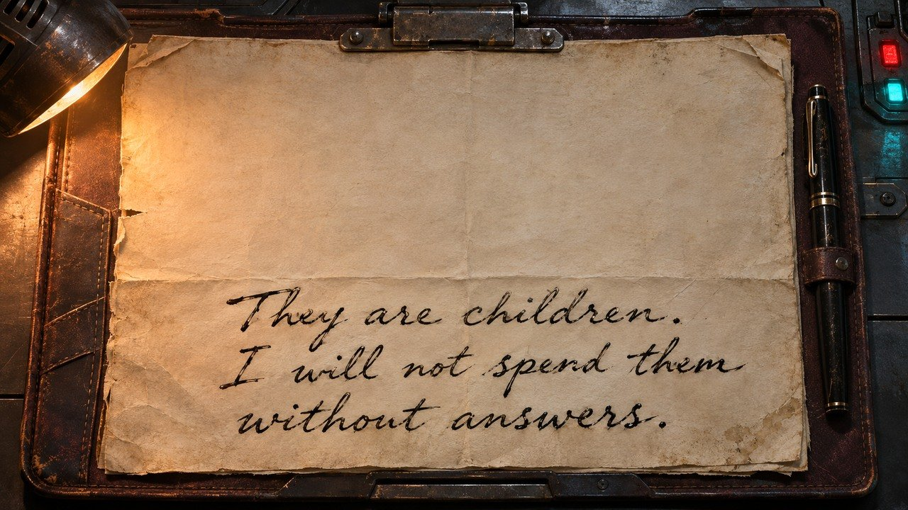
CAPTAIN MARA VENN
COMMAND FILE · HANDWRITTEN NOTE
›
Notes:
SESSION 7. GM bible v12 is story authority. ENVIRONMENT: lab.
VISUAL: Physical clue prop with source-local animation and native canonical text
PLAYBACK: embedded silent H.264 starts automatically and loops. Advance manually; no timed slide changes. Static poster fallback. Actual Microsoft PowerPoint playback has not been tested on this Linux machine.

Slide 75
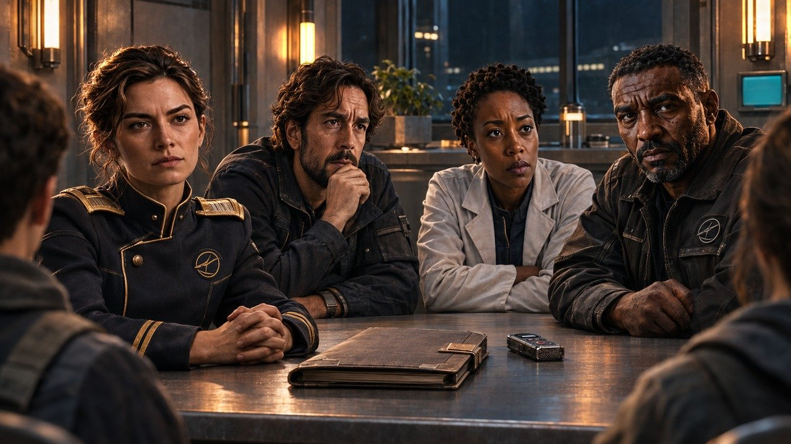
MAP ↗
›
Notes:
SESSION 7. GM bible v12 is story authority. ENVIRONMENT: adult_confrontation.
Students challenge the adults: You chose for us.
VISUAL: Restored original scene composition, canonical identities and localized practical motion
PLAYBACK: embedded silent H.264 starts automatically and loops. Advance manually; no timed slide changes. Static poster fallback. Actual Microsoft PowerPoint playback has not been tested on this Linux machine.

Slide 76
WHAT EACH ADULT KNEW
Mara Venn
Elias Vale
Nia Okafor
Marcus Bell
›
Notes:
SESSION 7. GM bible v12 is story authority. ENVIRONMENT: adult_confrontation.
Venn: route + suspected response, not mechanism. Vale: anomalous signal resembled cohort data. Okafor: marker, not deliberate exposure. Bell: containment orders, not science. Replaces group artwork with inconsistent NPC identities.
VISUAL: Canonical portrait gallery over visibly moving contextual environment
PLAYBACK: embedded silent H.264 starts automatically and loops. Advance manually; no timed slide changes. Static poster fallback. Actual Microsoft PowerPoint playback has not been tested on this Linux machine.

Slide 77
YOUR DECISION
HOW DO WE APPROACH K-17?
›
Notes:
SESSION 7. GM bible v12 is story authority. ENVIRONMENT: adult_confrontation.
Session 7 endpoint: students gain explicit decision-making authority over future approach.
VISUAL: Native story cue over visible animated adult_confrontation environment
PLAYBACK: embedded silent H.264 starts automatically and loops. Advance manually; no timed slide changes. Static poster fallback. Actual Microsoft PowerPoint playback has not been tested on this Linux machine.

Slide 78
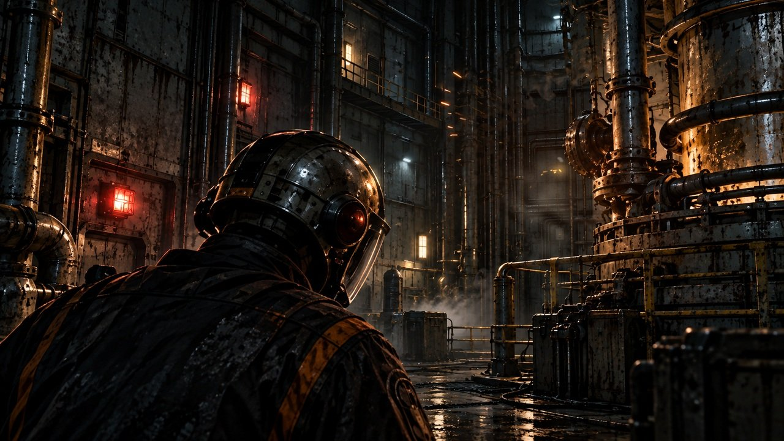
THE FAR HORIZON
08
The cost
MAP ↗
›
Notes:
SESSION 8. GM bible v12 is story authority. ENVIRONMENT: reactor.
Start when ready for this session. MAP opens that session’s linked visual map.
VISUAL: Animated chapter / native typography
PLAYBACK: embedded silent H.264 starts automatically and loops. Advance manually; no timed slide changes. Static poster fallback. Actual Microsoft PowerPoint playback has not been tested on this Linux machine.

Slide 79
MAP ↗
›
Notes:
SESSION 8. GM bible v12 is story authority. ENVIRONMENT: reactor.
VISUAL: Environment from original immersive source 26; source-local object animation
PLAYBACK: embedded silent H.264 starts automatically and loops. Advance manually; no timed slide changes. Static poster fallback. Actual Microsoft PowerPoint playback has not been tested on this Linux machine.

Slide 80
Tomas Rhee
Chief engineer
›
Notes:
SESSION 8. GM bible v12 is story authority. ENVIRONMENT: reactor.
VISUAL: Canonical portrait identity with restored framing: 41; visible animated reactor context and source-local lights
PLAYBACK: embedded silent H.264 starts automatically and loops. Advance manually; no timed slide changes. Static poster fallback. Actual Microsoft PowerPoint playback has not been tested on this Linux machine.

Slide 81
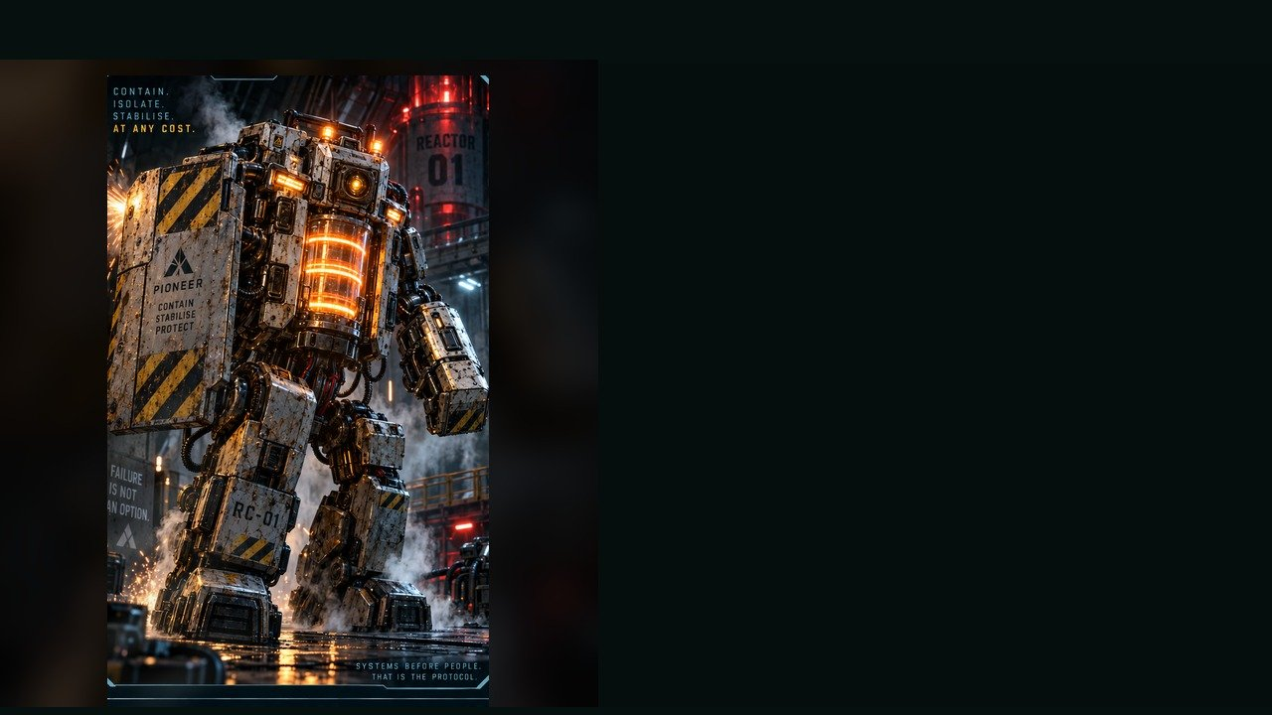
REACTOR CONTAINMENT UNIT
WEAKNESS
Exposed rear power coupler
BEHAVIOUR
• Seals corridors
• Shoves targets from consoles
• Prioritises system lockdown over human safety
SPECIAL
Riot shield · Pulse ram · Venting steam burst
REAR ACCESS
OBJECTIVE PRESSURE
Blocks access while the reactor countdown advances.
FULL DOSSIER
MOVE · ATTACK · ASSIST · ENVIRONMENT
›
Notes:
SESSION 8. GM bible v12 is story authority. ENVIRONMENT: reactor.
Dangerous 3 Threat Boxes. Containment logic, not malice. 3 rounds with a changing environment; attacks alone cannot win.
VISUAL: Latest uploaded enemy dossier: animated source artwork; readable weakness, behaviour, special, objective
PLAYBACK: embedded silent H.264 starts automatically and loops. Advance manually; no timed slide changes. Static poster fallback. Actual Microsoft PowerPoint playback has not been tested on this Linux machine.
TEACHER ONLY — source role: Area-Denial Brute
Source performance cues: Heavy stomps; Alarm voice; Slow, unstoppable turning

Slide 82
REACTOR CONTAINMENT UNIT · DOSSIER
TYPE
Emergency Hazard Response Unit
THREAT PROFILE
Dangerous · 3 threat boxes
SYSTEM / NATURE
Emergency containment
OBSERVABLE SIGNS
• Heavy footsteps
• Alarm voice
• Slow, persistent turning
TACTICS
PIONEER · CONTACT PROFILE
›
Notes:
SESSION 8. GM bible v12 is story authority. ENVIRONMENT: reactor.
Dangerous 3 Threat Boxes. Containment logic, not malice. 3 rounds with a changing environment; attacks alone cannot win.
VISUAL: Latest enemy dossier profile, threat, role, stage cues; source text retained
PLAYBACK: embedded silent H.264 starts automatically and loops. Advance manually; no timed slide changes. Static poster fallback. Actual Microsoft PowerPoint playback has not been tested on this Linux machine.
TEACHER ONLY — source role: Area-Denial Brute
Source performance cues: Heavy stomps; Alarm voice; Slow, unstoppable turning

Slide 83
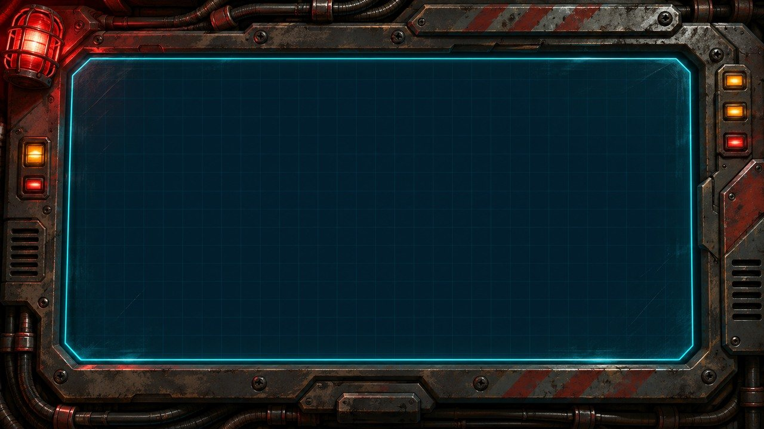
AVAILABLE POWER: 37%
LIFE SUPPORT DEMAND: 62%
NAVIGATION DEMAND: 58%
COMMUNICATIONS ARRAY: OFFLINE
IF POWER DIVERTED
NO CONFIGURATION SAVES EVERYTHING.
›
Notes:
SESSION 8. GM bible v12 is story authority. ENVIRONMENT: reactor.
Power37%, life support62%, navigation58%. No configuration saves everything.
VISUAL: Physical clue prop with source-local animation and native canonical text
PLAYBACK: embedded silent H.264 starts automatically and loops. Advance manually; no timed slide changes. Static poster fallback. Actual Microsoft PowerPoint playback has not been tested on this Linux machine.

Slide 84
NO CONFIGURATION SAVES EVERYTHING
AVAILABLE POWER: 37%
LIFE SUPPORT DEMAND: 62%
NAVIGATION DEMAND: 58%
COMMUNICATIONS ARRAY:
OFFLINE IF POWER DIVERTED
›
Notes:
SESSION 8. GM bible v12 is story authority. ENVIRONMENT: reactor.
Communications array goes offline if power diverted. Accept a credible student alternative with a real cost.
VISUAL: Native story cue over visible animated reactor environment
PLAYBACK: embedded silent H.264 starts automatically and loops. Advance manually; no timed slide changes. Static poster fallback. Actual Microsoft PowerPoint playback has not been tested on this Linux machine.

Slide 85
IRIS
Ship AI
›
Notes:
SESSION 8. GM bible v12 is story authority. ENVIRONMENT: reactor.
VISUAL: Canonical portrait identity with restored framing: 44; visible animated reactor context and source-local lights
PLAYBACK: embedded silent H.264 starts automatically and loops. Advance manually; no timed slide changes. Static poster fallback. Actual Microsoft PowerPoint playback has not been tested on this Linux machine.

Slide 86
DAMAGE REPORT
What did you protect?
What did it cost?
›
Notes:
SESSION 8. GM bible v12 is story authority. ENVIRONMENT: reactor.
Record the class’s actual sacrifice in the GM notes before Session 9. Do not imply fixed casualties.
VISUAL: Native story cue over visible animated reactor environment
PLAYBACK: embedded silent H.264 starts automatically and loops. Advance manually; no timed slide changes. Static poster fallback. Actual Microsoft PowerPoint playback has not been tested on this Linux machine.
COMPACT EDITION: record the actual class sacrifice in the GM notes and main final log (slide 126). Continue through the single story sequence; there are no cost branches or saved automatic state.

Slide 87
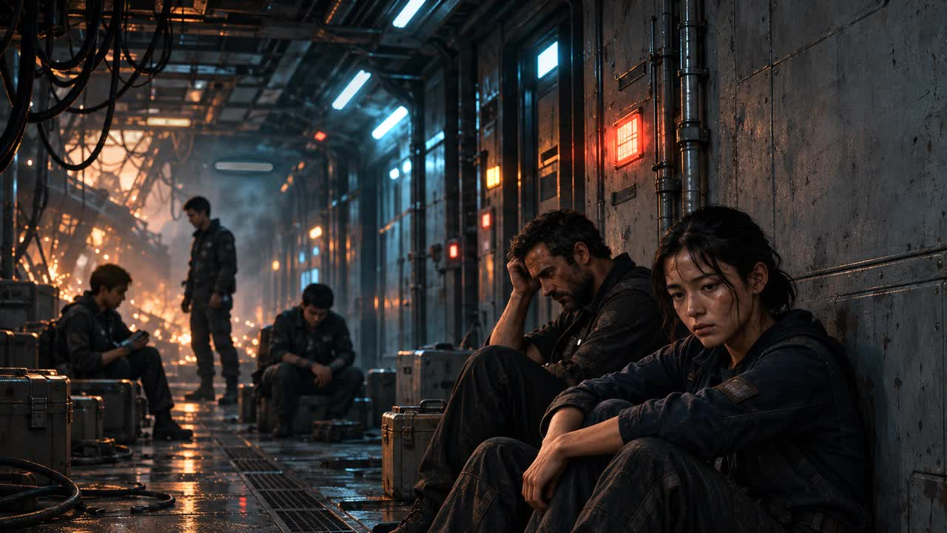
MAP ↗
›
Notes:
SESSION 8. GM bible v12 is story authority. ENVIRONMENT: aftermath.
Background figures are unnamed Cohort / crew. Carry the actual cost forward.
VISUAL: Environment from original immersive source 28; source-local object animation
PLAYBACK: embedded silent H.264 starts automatically and loops. Advance manually; no timed slide changes. Static poster fallback. Actual Microsoft PowerPoint playback has not been tested on this Linux machine.
COMPACT EDITION: record the actual class sacrifice in the GM notes and main final log (slide 126). Continue through the single story sequence; there are no cost branches or saved automatic state.

Slide 88
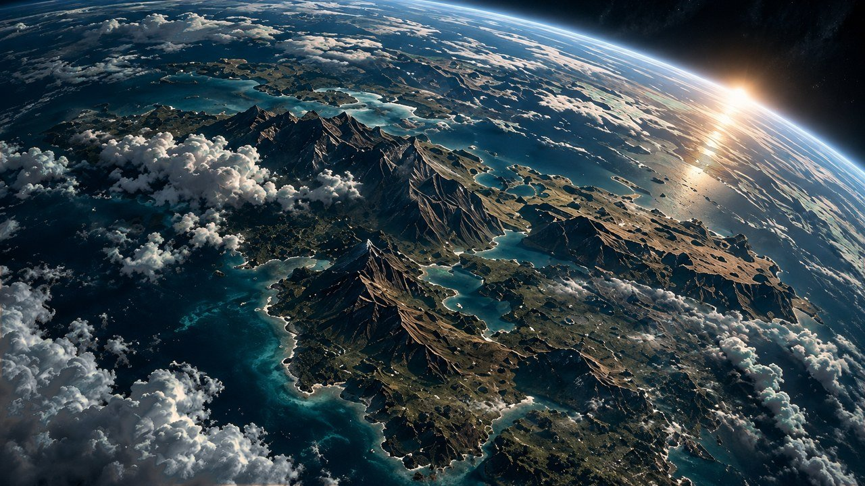
THE FAR HORIZON
09
Arrival
MAP ↗
›
Notes:
SESSION 9. GM bible v12 is story authority. ENVIRONMENT: orbit.
Start when ready for this session. MAP opens that session’s linked visual map.
VISUAL: Animated chapter / native typography
PLAYBACK: embedded silent H.264 starts automatically and loops. Advance manually; no timed slide changes. Static poster fallback. Actual Microsoft PowerPoint playback has not been tested on this Linux machine.
COMPACT EDITION: record the actual class sacrifice in the GM notes and main final log (slide 126). Continue through the single story sequence; there are no cost branches or saved automatic state.

Slide 89
MAP ↗
›
Notes:
SESSION 9. GM bible v12 is story authority. ENVIRONMENT: orbit.
VISUAL: Environment from original immersive source 30; source-local object animation
PLAYBACK: embedded silent H.264 starts automatically and loops. Advance manually; no timed slide changes. Static poster fallback. Actual Microsoft PowerPoint playback has not been tested on this Linux machine.

Slide 90
Captain Mara Venn
Mission commander
CONCERNED
RESOLVED
LISTEN
›
Notes:
SESSION 9. GM bible v12 is story authority. ENVIRONMENT: orbit.
VISUAL: Canonical portrait identity with restored framing: 37; visible animated orbit context and source-local lights
PLAYBACK: embedded silent H.264 starts automatically and loops. Advance manually; no timed slide changes. Static poster fallback. Actual Microsoft PowerPoint playback has not been tested on this Linux machine.

Slide 91
ORBITAL SURVEY
ARTIFICIAL STRUCTURES
CONSTRUCTION AGE: 5–8 YEARS
ATMOSPHERE: AS PROJECTED
POWER: INTERMITTENT
HUMAN BIOSIGNS: INCONCLUSIVE
›
Notes:
SESSION 9. GM bible v12 is story authority. ENVIRONMENT: orbit.
Allow 60 seconds of Asteria wonder before this evidence. Carry the actual Session 8 sacrifice forward. No confirmed survivors.
VISUAL: Readable native data on physical pulsing terminal
PLAYBACK: embedded silent H.264 starts automatically and loops. Advance manually; no timed slide changes. Static poster fallback. Actual Microsoft PowerPoint playback has not been tested on this Linux machine.

Slide 92
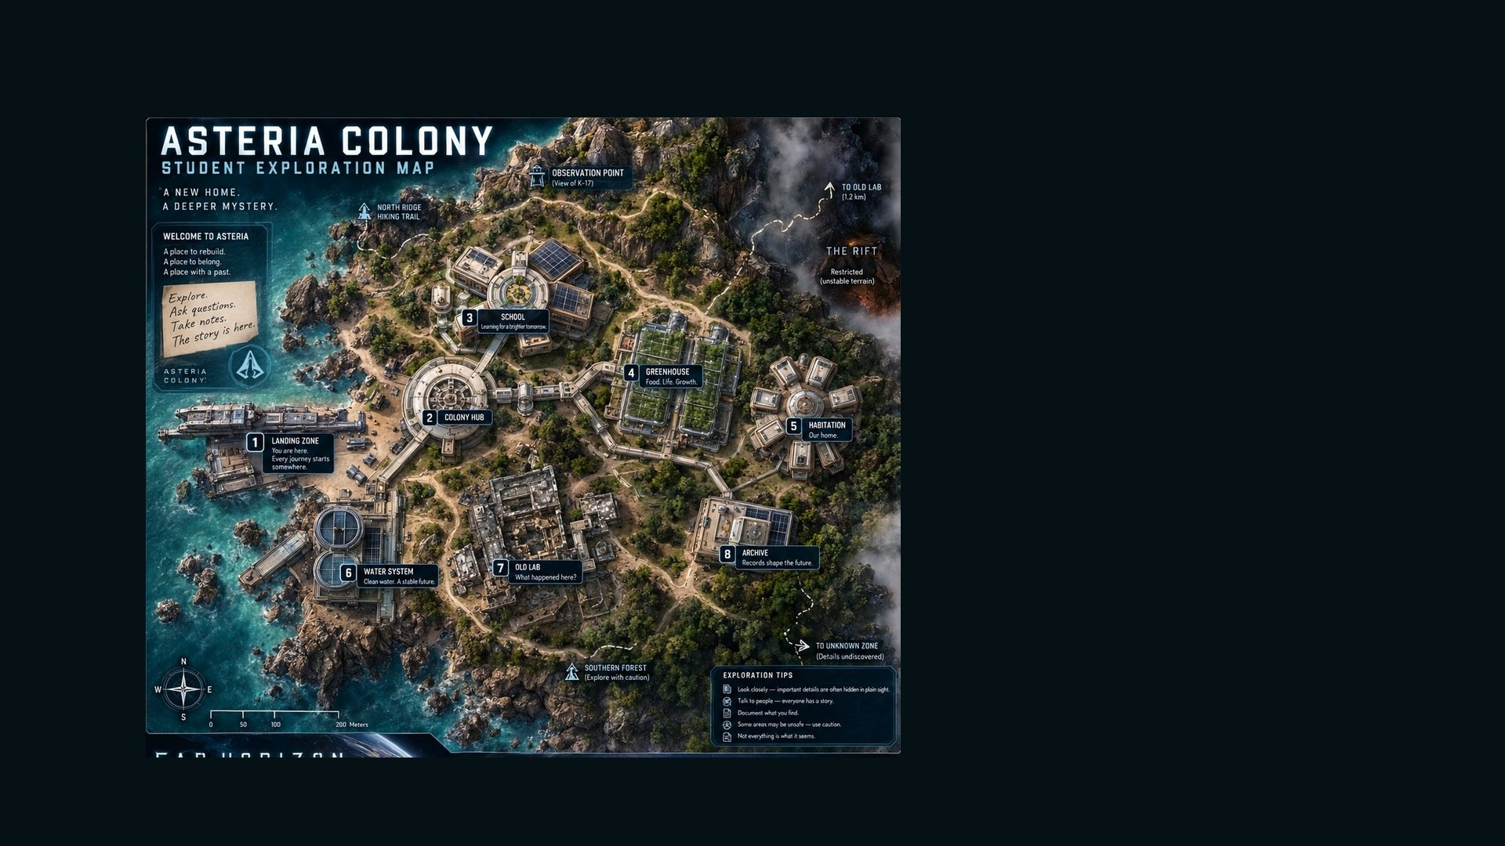
ASTERIA · EXPLORATION MAP
Observation Point —
View of K-17
MAP KEY
North Ridge
Hiking Trail
•
•
The Rift — Restricted /
unstable terrain
01
Landing Zone
•
02
Colony Hub
3
03
School
4
04
Greenhouse
2
5
1
05
Habitation
06
Water System
7
8
6
07
Old Lab
Southern Forest —
Explore with caution
08
Archive
•
MAP ↗
›
Notes:
SESSION 9. GM bible v12 is story authority. ENVIRONMENT: orbit.
Student-facing map artwork; do not narrate future map atlas locations early.
VISUAL: Original map art, readable native legend, subtle source-local motion
PLAYBACK: embedded silent H.264 starts automatically and loops. Advance manually; no timed slide changes. Static poster fallback. Actual Microsoft PowerPoint playback has not been tested on this Linux machine.

Slide 93
SETTLEMENT BEACON
WELCOME, COHORT 01.
YOU ARE LATE.
›
Notes:
SESSION 9. GM bible v12 is story authority. ENVIRONMENT: orbit.
Session 9 cliffhanger. Do not reveal the colony photo before Session 10.
VISUAL: Readable native data on physical pulsing terminal
PLAYBACK: embedded silent H.264 starts automatically and loops. Advance manually; no timed slide changes. Static poster fallback. Actual Microsoft PowerPoint playback has not been tested on this Linux machine.

Slide 94
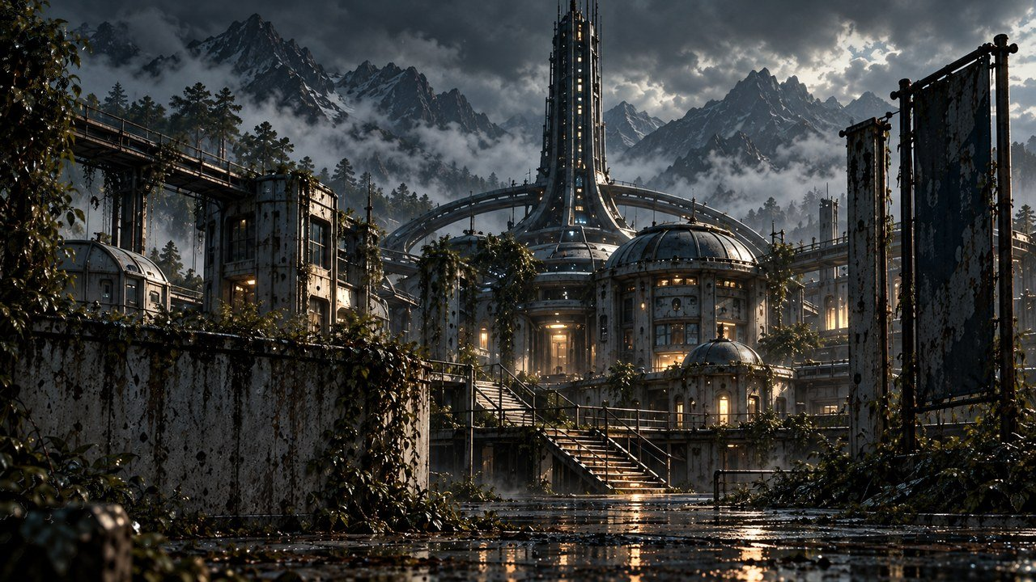
THE FAR HORIZON
10
The colony
MAP ↗
›
Notes:
SESSION 10. GM bible v12 is story authority. ENVIRONMENT: colony.
Start when ready for this session. MAP opens that session’s linked visual map.
VISUAL: Animated chapter / native typography
PLAYBACK: embedded silent H.264 starts automatically and loops. Advance manually; no timed slide changes. Static poster fallback. Actual Microsoft PowerPoint playback has not been tested on this Linux machine.
COMPACT EDITION: record the actual class sacrifice in the GM notes and main final log (slide 126). Continue through the single story sequence; there are no cost branches or saved automatic state.

Slide 95
MAP ↗
›
Notes:
SESSION 10. GM bible v12 is story authority. ENVIRONMENT: colony.
VISUAL: Environment from original immersive source 31; source-local object animation
PLAYBACK: embedded silent H.264 starts automatically and loops. Advance manually; no timed slide changes. Static poster fallback. Actual Microsoft PowerPoint playback has not been tested on this Linux machine.

Slide 96
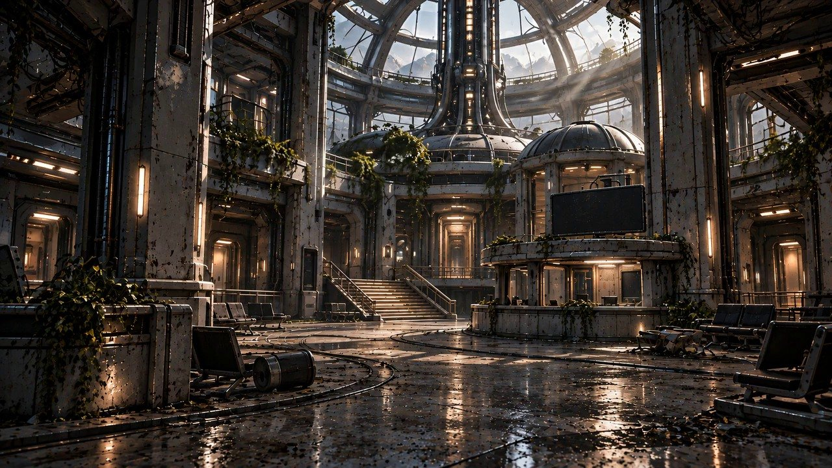
MAP ↗
›
Notes:
SESSION 10. GM bible v12 is story authority. ENVIRONMENT: hub.
VISUAL: Environment from original immersive source 76; source-local object animation
PLAYBACK: embedded silent H.264 starts automatically and loops. Advance manually; no timed slide changes. Static poster fallback. Actual Microsoft PowerPoint playback has not been tested on this Linux machine.

Slide 97
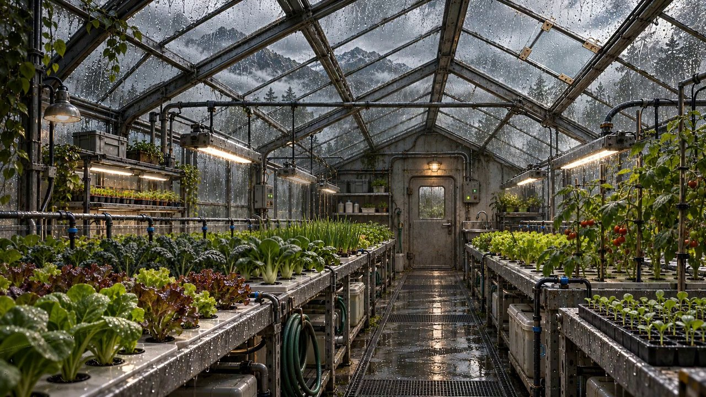
MAP ↗
›
Notes:
SESSION 10. GM bible v12 is story authority. ENVIRONMENT: greenhouse.
Optional brief montage; cut freely to protect the school scene.
VISUAL: Environment from original immersive source 78; source-local object animation
PLAYBACK: embedded silent H.264 starts automatically and loops. Advance manually; no timed slide changes. Static poster fallback. Actual Microsoft PowerPoint playback has not been tested on this Linux machine.

Slide 98
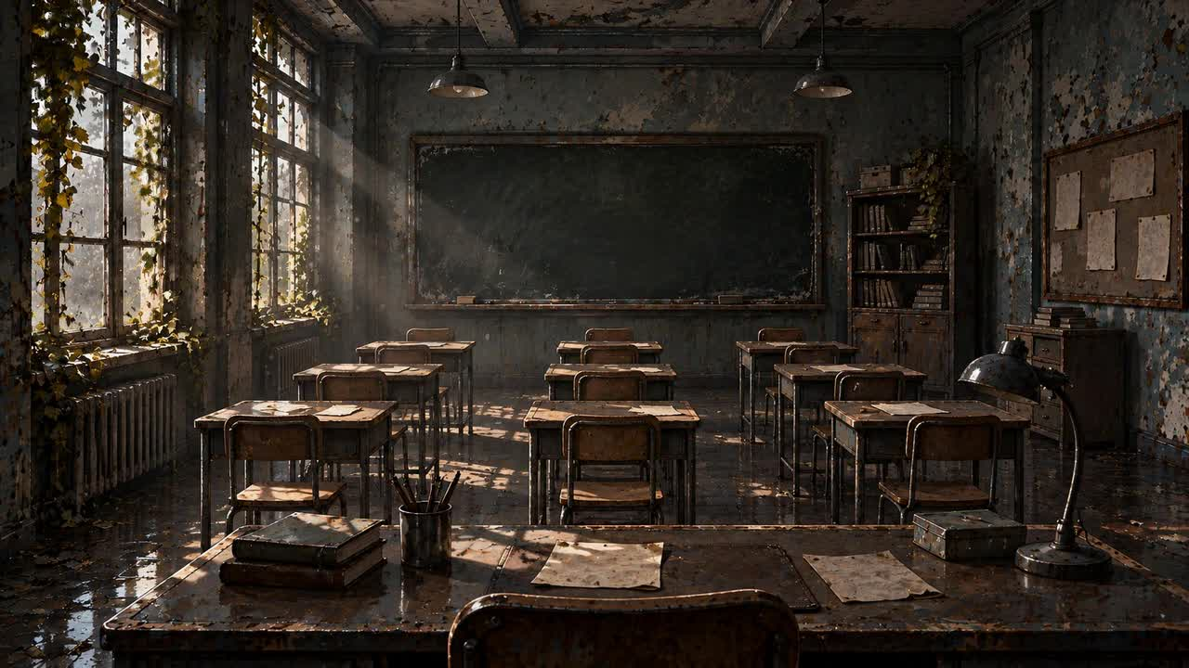
MAP ↗
›
Notes:
SESSION 10. GM bible v12 is story authority. ENVIRONMENT: school.
VISUAL: Environment from original immersive source 32; source-local object animation
PLAYBACK: embedded silent H.264 starts automatically and loops. Advance manually; no timed slide changes. Static poster fallback. Actual Microsoft PowerPoint playback has not been tested on this Linux machine.

Slide 99
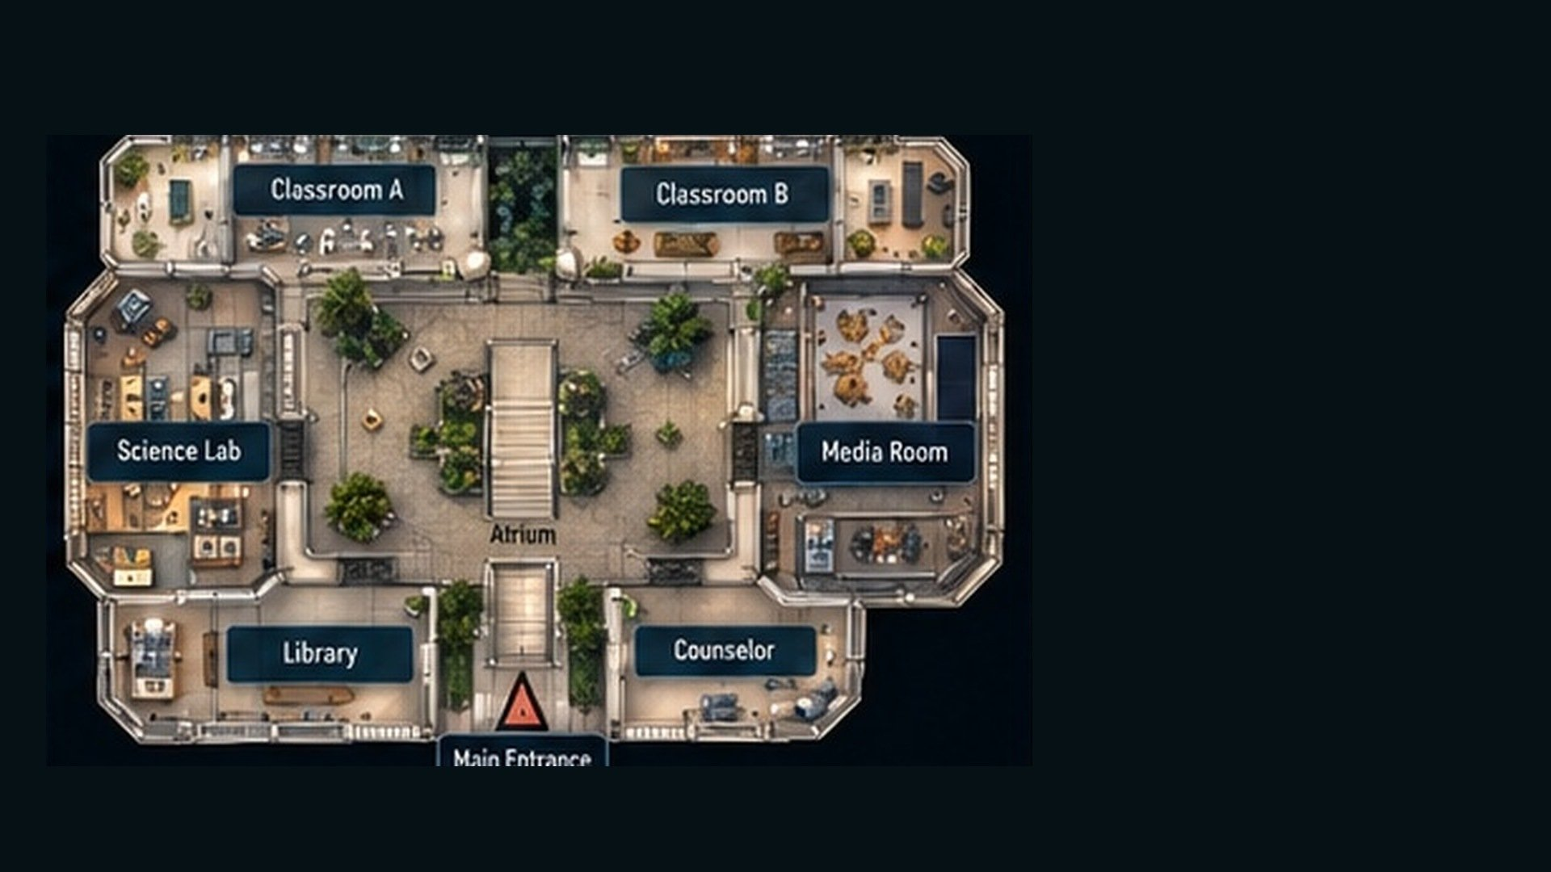
SCHOOL · INTERIOR DETAIL
MAP KEY
Classroom A
Classroom B
01
Classroom A
02
Classroom B
03
Science Lab
04
Media Room
Science Lab
Media Room
05
Atrium
Atrium
06
Library
07
Counselor
Library
Counselor
08
Main Entrance
Main Entrance
MAP ↗
›
Notes:
SESSION 10. GM bible v12 is story authority. ENVIRONMENT: school.
Student-facing map artwork; do not narrate future map atlas locations early.
VISUAL: Original map art, readable native legend, subtle source-local motion
PLAYBACK: embedded silent H.264 starts automatically and loops. Advance manually; no timed slide changes. Static poster fallback. Actual Microsoft PowerPoint playback has not been tested on this Linux machine.

Slide 100
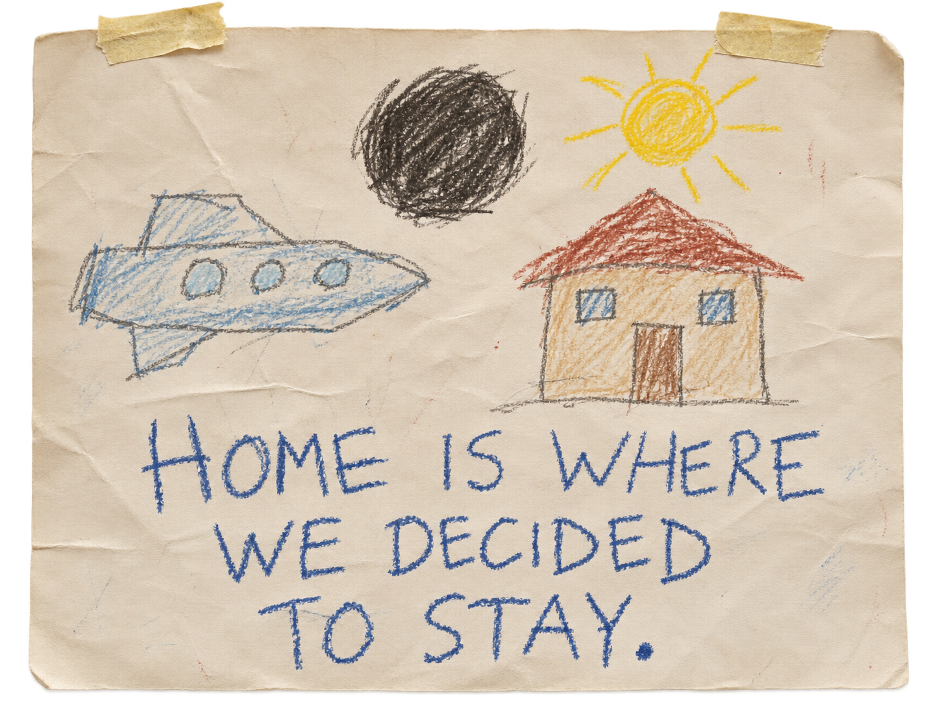
›
Notes:
SESSION 10. GM bible v12 is story authority. ENVIRONMENT: school.
VISUAL: Environment from original immersive source 54; source-local object animation
PLAYBACK: embedded silent H.264 starts automatically and loops. Advance manually; no timed slide changes. Static poster fallback. Actual Microsoft PowerPoint playback has not been tested on this Linux machine.
SCENE UPDATE: physical child crayon drawing on worn paper. Canonical caption: HOME IS WHERE WE DECIDED TO STAY. The following native quote card remains unchanged for classroom readability.

Slide 101
CHILD’S DRAWING
HOME IS WHERE
WE DECIDED TO STAY.
›
Notes:
SESSION 10. GM bible v12 is story authority. ENVIRONMENT: school.
VISUAL: Native story cue over visible animated school environment
PLAYBACK: embedded silent H.264 starts automatically and loops. Advance manually; no timed slide changes. Static poster fallback. Actual Microsoft PowerPoint playback has not been tested on this Linux machine.

Slide 102
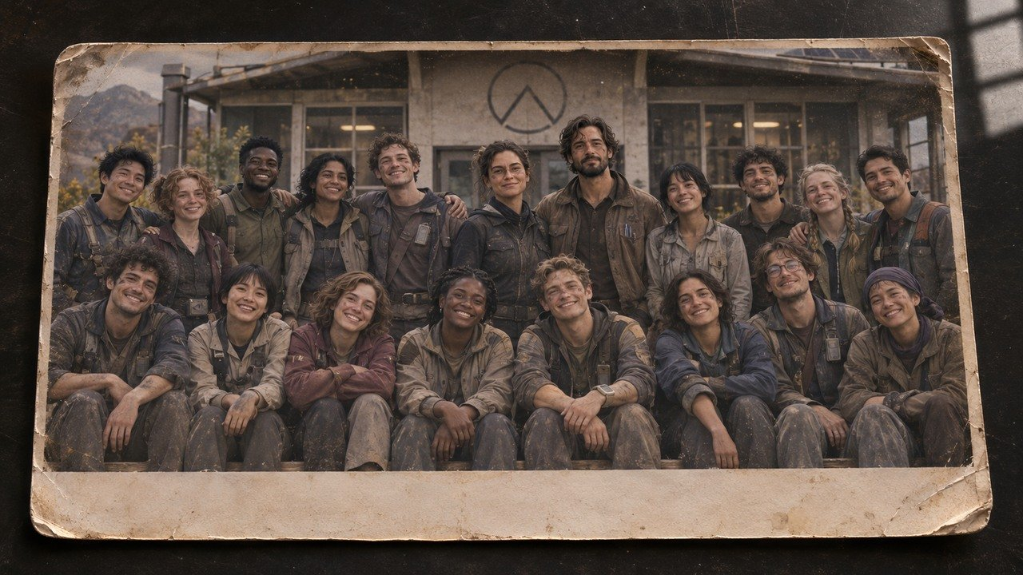
ASTERIA SCHOOL — COHORT 01
FLIGHT / C01-01
SCIENCE / C01-02
ENGINEERING / C01-03
COLONY / C01-04
›
Notes:
SESSION 10. GM bible v12 is story authority. ENVIRONMENT: school.
Fictional older Cohort 01 with canonical Venn and Vale. Read photo reveal from bible; eight seconds of silence. No real student likenesses. Native caption artifact preserves the reveal without inventing literal class likenesses. Read the bible’s reveal: Venn, Vale and an older Cohort 01. Eight seconds of silence.
VISUAL: Physical clue prop with source-local animation and native canonical text
PLAYBACK: embedded silent H.264 starts automatically and loops. Advance manually; no timed slide changes. Static poster fallback. Actual Microsoft PowerPoint playback has not been tested on this Linux machine.

Slide 103
›
Notes:
SESSION 10. GM bible v12 is story authority. ENVIRONMENT: school.
Editable fictional default camera: orange triangle sticker and silver lens-rim scuff. Replace with the actual Session 1 fictional character object before projecting if different. Name the fictional character and describe the same scratch / sticker. Use the object recorded in Session 1.
VISUAL: Repeated physical keepsake with source-local daylight/dust motion
PLAYBACK: embedded silent H.264 starts automatically and loops. Advance manually; no timed slide changes. Static poster fallback. Actual Microsoft PowerPoint playback has not been tested on this Linux machine.

Slide 104
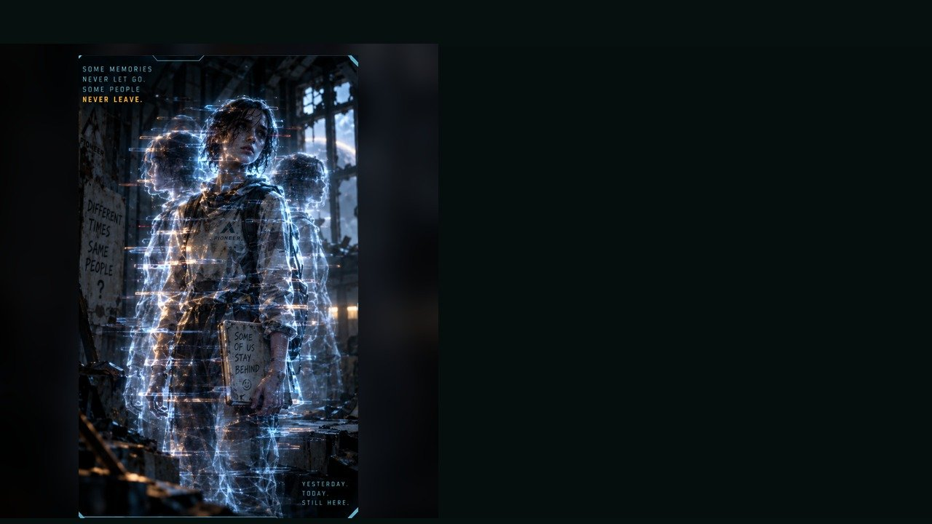
COLONY ECHO
WEAKNESS
Recognition and calm speech disrupt it.
BEHAVIOUR
• Repeats broken memories
• Lashes out when approached
• Mirrors student choices
SPECIAL
Phase shift · Delayed strike · Memory flash
RECOGNIZE · SPEAK CALMLY
OBJECTIVE PRESSURE
Confuses teams and fractures the scene into multiple versions.
FULL DOSSIER
MOVE · ATTACK · ASSIST · ENVIRONMENT
›
Notes:
SESSION 10. GM bible v12 is story authority. ENVIRONMENT: school.
Dangerous 3 Threat Boxes. Not purely hostile: stabilizes through recognition, naming or calm address. Preserve photo/archive evidence. Combat optional.
VISUAL: Latest uploaded enemy dossier: animated source artwork; readable weakness, behaviour, special, objective
PLAYBACK: embedded silent H.264 starts automatically and loops. Advance manually; no timed slide changes. Static poster fallback. Actual Microsoft PowerPoint playback has not been tested on this Linux machine.
TEACHER ONLY — source role: Unstable Echo
Source performance cues: Delayed reactions; Overlapping speech; Frozen tableau then sudden motion

Slide 105
COLONY ECHO · DOSSIER
TYPE
Temporal Residue
THREAT PROFILE
Dangerous · 3 threat boxes
SYSTEM / NATURE
Unstable temporal residue
OBSERVABLE SIGNS
• Delayed reactions
• Overlapping speech
• Freezes, then moves suddenly
TACTICS
PIONEER · CONTACT PROFILE
›
Notes:
SESSION 10. GM bible v12 is story authority. ENVIRONMENT: school.
Dangerous 3 Threat Boxes. Not purely hostile: stabilizes through recognition, naming or calm address. Preserve photo/archive evidence. Combat optional.
VISUAL: Latest enemy dossier profile, threat, role, stage cues; source text retained
PLAYBACK: embedded silent H.264 starts automatically and loops. Advance manually; no timed slide changes. Static poster fallback. Actual Microsoft PowerPoint playback has not been tested on this Linux machine.
TEACHER ONLY — source role: Unstable Echo
Source performance cues: Delayed reactions; Overlapping speech; Frozen tableau then sudden motion

Slide 106
COLONY RECORDS
SUCCESSFUL
LOST
RETURNED
›
Notes:
SESSION 10. GM bible v12 is story authority. ENVIRONMENT: school.
Contradictory possible outcomes. Do not pick one for the class.
VISUAL: Readable native data on physical pulsing terminal
PLAYBACK: embedded silent H.264 starts automatically and loops. Advance manually; no timed slide changes. Static poster fallback. Actual Microsoft PowerPoint playback has not been tested on this Linux machine.

Slide 107
POSSIBLE FUTURES
Not one history.
More than one possible future.
›
Notes:
SESSION 10. GM bible v12 is story authority. ENVIRONMENT: school.
The colony was built by a possible future Cohort 01. Let the class connect the emotional evidence.
VISUAL: Native story cue over visible animated school environment
PLAYBACK: embedded silent H.264 starts automatically and loops. Advance manually; no timed slide changes. Static poster fallback. Actual Microsoft PowerPoint playback has not been tested on this Linux machine.

Slide 108
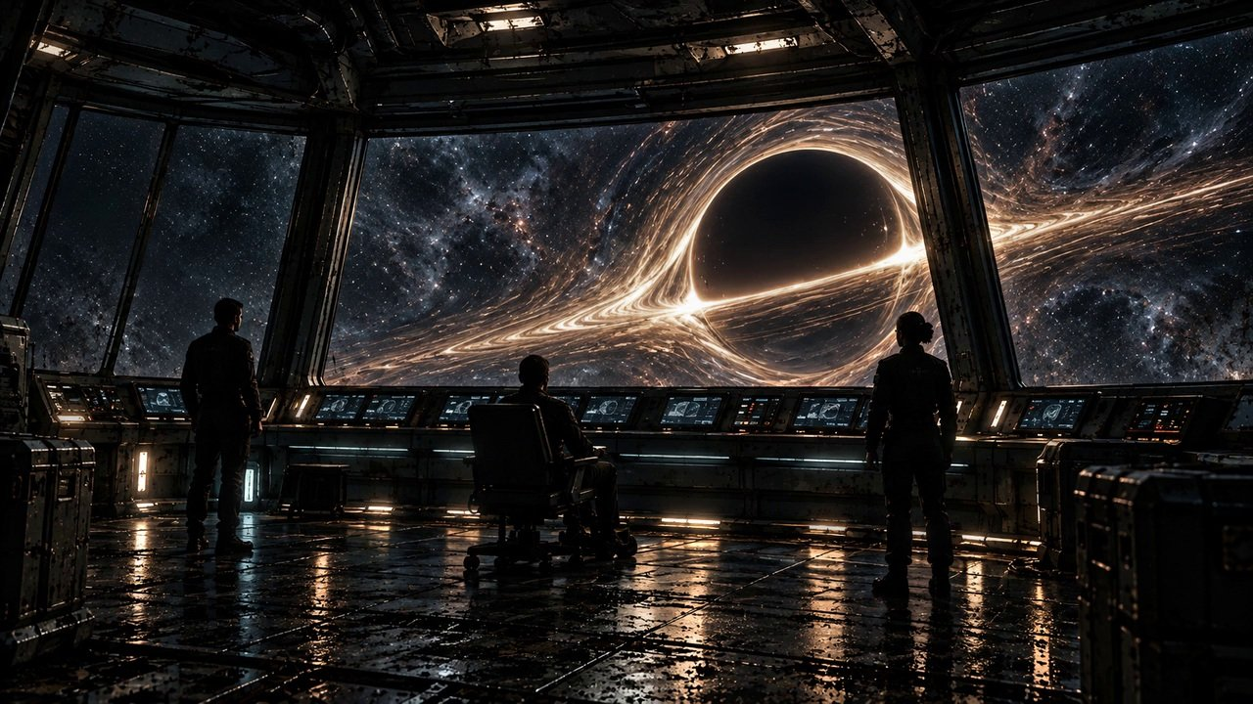
THE FAR HORIZON
11
What do we do?
MAP ↗
›
Notes:
SESSION 11. GM bible v12 is story authority. ENVIRONMENT: final_anomaly.
Start when ready for this session. MAP opens that session’s linked visual map.
VISUAL: Animated chapter / native typography
PLAYBACK: embedded silent H.264 starts automatically and loops. Advance manually; no timed slide changes. Static poster fallback. Actual Microsoft PowerPoint playback has not been tested on this Linux machine.
COMPACT EDITION: record the actual class sacrifice in the GM notes and main final log (slide 126). Continue through the single story sequence; there are no cost branches or saved automatic state.

Slide 109
UNIT M-77 / HAB DECK
STATUS: REPAIRED
COMPLETED: TOMORROW 14:32
TECHNICIAN COHORT 01
“Collision with unrecorded passenger resolved.”
›
Notes:
SESSION 11. GM bible v12 is story authority. ENVIRONMENT: final_anomaly.
Exact canonical ticket. Reveal after incident; repeat at final explanation. No rat explanation for unrecorded passenger.
VISUAL: Physical clue prop with source-local animation and native canonical text
PLAYBACK: embedded silent H.264 starts automatically and loops. Advance manually; no timed slide changes. Static poster fallback. Actual Microsoft PowerPoint playback has not been tested on this Linux machine.

Slide 110

›
Notes:
SESSION 11. GM bible v12 is story authority. ENVIRONMENT: final_anomaly.
Source CSV-01 PIONEER; arrival confirmed; +103 days.
VISUAL: Physical clue prop with source-local animation and native canonical text
PLAYBACK: embedded silent H.264 starts automatically and loops. Advance manually; no timed slide changes. Static poster fallback. Actual Microsoft PowerPoint playback has not been tested on this Linux machine.

Slide 111
›
Notes:
SESSION 11. GM bible v12 is story authority. ENVIRONMENT: derelict_exterior.
VISUAL: Environment from original immersive source 17; source-local object animation
PLAYBACK: embedded silent H.264 starts automatically and loops. Advance manually; no timed slide changes. Static poster fallback. Actual Microsoft PowerPoint playback has not been tested on this Linux machine.

Slide 112
ASTERIA SCHOOL — COHORT 01
FLIGHT / C01-01
SCIENCE / C01-02
ENGINEERING / C01-03
COLONY / C01-04
›
Notes:
SESSION 11. GM bible v12 is story authority. ENVIRONMENT: final_anomaly.
Fictional older Cohort 01 with canonical Venn and Vale. Read photo reveal from bible; eight seconds of silence. No real student likenesses.
VISUAL: Physical clue prop with source-local animation and native canonical text
PLAYBACK: embedded silent H.264 starts automatically and loops. Advance manually; no timed slide changes. Static poster fallback. Actual Microsoft PowerPoint playback has not been tested on this Linux machine.

Slide 113
K-17
Unchosen possibilities
can become real.
›
Notes:
SESSION 11. GM bible v12 is story authority. ENVIRONMENT: final_anomaly.
Explain the full mechanism now. Cohort biological compatibility permits overlap; consequential coordinated CHOICE is the deeper key.
VISUAL: Native story cue over visible animated final_anomaly environment
PLAYBACK: embedded silent H.264 starts automatically and loops. Advance manually; no timed slide changes. Static poster fallback. Actual Microsoft PowerPoint playback has not been tested on this Linux machine.

Slide 114
THE WARNING RESOLVED
Juno Reyes
IRIS
›
Notes:
SESSION 11. GM bible v12 is story authority. ENVIRONMENT: final_anomaly.
IRIS explains that in one future Juno answers the message and completes the communication loop. The warning concerned her action, not her character.
VISUAL: Canonical portrait gallery over visibly moving contextual environment
PLAYBACK: embedded silent H.264 starts automatically and loops. Advance manually; no timed slide changes. Static poster fallback. Actual Microsoft PowerPoint playback has not been tested on this Linux machine.

Slide 115
Captain Mara Venn
Mission commander
CONCERNED
RESOLVED
LISTEN
›
Notes:
SESSION 11. GM bible v12 is story authority. ENVIRONMENT: final_anomaly.
Venn admits deliberate routing and yields the final choice to Cohort 01.
VISUAL: Canonical portrait identity with restored framing: 37; visible animated final_anomaly context and source-local lights
PLAYBACK: embedded silent H.264 starts automatically and loops. Advance manually; no timed slide changes. Static poster fallback. Actual Microsoft PowerPoint playback has not been tested on this Linux machine.

Slide 116

REMOTE SURVEY · K-17 OUTPOST
MAP ↗
›
Notes:
SESSION 11. GM bible v12 is story authority. ENVIRONMENT: outpost.
Optional remote planning / investigation visual requested by teacher. No mandatory visit or new required clue.
VISUAL: Restored original scene composition, canonical identities and localized practical motion
PLAYBACK: embedded silent H.264 starts automatically and loops. Advance manually; no timed slide changes. Static poster fallback. Actual Microsoft PowerPoint playback has not been tested on this Linux machine.

Slide 117

K-17 FRACTURE ENTITY
WEAKNESS
Synchronization through coordinated crew action
BEHAVIOUR
• Warps the battlefield
• Splits choices into conflicting outcomes
• Punishes indecision
SPECIAL
Gravity pulse · Timeline split · Echo summons
COORDINATED CREW ACTION
OBJECTIVE PRESSURE
Forces a final choice while reality collapses around the team.
FULL DOSSIER
MOVE · ATTACK · ASSIST · ENVIRONMENT
›
Notes:
SESSION 11. GM bible v12 is story authority. ENVIRONMENT: final_anomaly.
Boss 5 Threat Boxes; attacks cannot permanently defeat it. Phases: SURVIVE, SYNCHRONIZE, COMMIT. Final Threat Box disappears only with a shared consequential choice.
VISUAL: Latest uploaded enemy dossier: animated source artwork; readable weakness, behaviour, special, objective
PLAYBACK: embedded silent H.264 starts automatically and loops. Advance manually; no timed slide changes. Static poster fallback. Actual Microsoft PowerPoint playback has not been tested on this Linux machine.
TEACHER ONLY — source role: Reality-Breaking Apex Threat
Source performance cues: Echoing layered voice; Stillness before violent surges; Gestures pull space out of shape

Slide 118
K-17 FRACTURE ENTITY · DOSSIER
TYPE
Anomaly Manifestation
THREAT PROFILE
Boss · 5 threat boxes
SYSTEM / NATURE
K-17 anomaly manifestation
OBSERVABLE SIGNS
• Layered, echoing voice
• Stillness before a surge
• Space bends around its gestures
TACTICS
PIONEER · CONTACT PROFILE
›
Notes:
SESSION 11. GM bible v12 is story authority. ENVIRONMENT: final_anomaly.
Boss 5 Threat Boxes; attacks cannot permanently defeat it. Phases: SURVIVE, SYNCHRONIZE, COMMIT. Final Threat Box disappears only with a shared consequential choice.
VISUAL: Latest enemy dossier profile, threat, role, stage cues; source text retained
PLAYBACK: embedded silent H.264 starts automatically and loops. Advance manually; no timed slide changes. Static poster fallback. Actual Microsoft PowerPoint playback has not been tested on this Linux machine.
TEACHER ONLY — source role: Reality-Breaking Apex Threat
Source performance cues: Echoing layered voice; Stillness before violent surges; Gestures pull space out of shape

Slide 119
SURVIVE → SYNCHRONIZE
Tomas Rhee
Elias Vale
Nia Okafor
IRIS
›
Notes:
SESSION 11. GM bible v12 is story authority. ENVIRONMENT: final_anomaly.
Give all four departments one function and action. One combined plan removes 2 Threat Boxes.
VISUAL: Canonical portrait gallery over visibly moving contextual environment
PLAYBACK: embedded silent H.264 starts automatically and loops. Advance manually; no timed slide changes. Static poster fallback. Actual Microsoft PowerPoint playback has not been tested on this Linux machine.

Slide 120

›
Notes:
SESSION 11. GM bible v12 is story authority. ENVIRONMENT: debate.
Canon crew plus unnamed students; preserve every consequential ending option.
VISUAL: Restored original scene composition, canonical identities and localized practical motion
PLAYBACK: embedded silent H.264 starts automatically and loops. Advance manually; no timed slide changes. Static poster fallback. Actual Microsoft PowerPoint playback has not been tested on this Linux machine.

Slide 121
COMMIT
RETURN TO EARTH
STAY ON ASTERIA
INVESTIGATE K-17
SEAL / PAUSE THE CONNECTION
YOUR PLAN — WITH A COST
ENDING
›
Notes:
SESSION 11. GM bible v12 is story authority. ENVIRONMENT: debate.
No roll for the final choice. Give companies 45 seconds to persuade, then vote or reach consensus.
VISUAL: Native story cue over visible animated debate environment
PLAYBACK: embedded silent H.264 starts automatically and loops. Advance manually; no timed slide changes. Static poster fallback. Actual Microsoft PowerPoint playback has not been tested on this Linux machine.

Slide 122
›
Notes:
SESSION 11. GM bible v12 is story authority. ENVIRONMENT: final_anomaly.
This visual holds the choice; it does not mandate investigation.
VISUAL: Environment from original immersive source 35; source-local object animation
PLAYBACK: embedded silent H.264 starts automatically and loops. Advance manually; no timed slide changes. Static poster fallback. Actual Microsoft PowerPoint playback has not been tested on this Linux machine.

Slide 123

THE FAR HORIZON
12
Change
ENDING
MAP ↗
›
Notes:
SESSION 12. GM bible v12 is story authority. ENVIRONMENT: finale.
Start when ready for this session. MAP opens that session’s linked visual map.
VISUAL: Animated chapter / native typography
PLAYBACK: embedded silent H.264 starts automatically and loops. Advance manually; no timed slide changes. Static poster fallback. Actual Microsoft PowerPoint playback has not been tested on this Linux machine.
COMPACT EDITION: record the actual class sacrifice in the GM notes and main final log (slide 126). Continue through the single story sequence; there are no cost branches or saved automatic state.

Slide 124
AFTER THE CHOICE
A future you chose.
›
Notes:
SESSION 12. GM bible v12 is story authority. ENVIRONMENT: finale.
Use the ending the class chose; no mandatory colony ending.
VISUAL: Native story cue over visible animated finale environment
PLAYBACK: embedded silent H.264 starts automatically and loops. Advance manually; no timed slide changes. Static poster fallback. Actual Microsoft PowerPoint playback has not been tested on this Linux machine.

Slide 125
YOUR FINAL SCENE
CALLBACK · CHOICE · COST
CHANGE · FINAL IMAGE
›
Notes:
SESSION 12. GM bible v12 is story authority. ENVIRONMENT: finale.
Each company performs its chosen ending. Preserve visible transformation and one personal callback.
VISUAL: Native story cue over visible animated finale environment
PLAYBACK: embedded silent H.264 starts automatically and loops. Advance manually; no timed slide changes. Static poster fallback. Actual Microsoft PowerPoint playback has not been tested on this Linux machine.

Slide 126

PIONEER · COHORT 01
CREW LOG
CHOICE
[OUR CHOSEN FUTURE]
[WHAT WE GAVE UP]
CALLBACK
[OBJECT / LINE / IMAGE]
›
Notes:
SESSION 12. GM bible v12 is story authority. ENVIRONMENT: finale.
Complete the log after the companies perform their endings.
VISUAL: Physical clue prop with source-local animation and native canonical text
PLAYBACK: embedded silent H.264 starts automatically and loops. Advance manually; no timed slide changes. Static poster fallback. Actual Microsoft PowerPoint playback has not been tested on this Linux machine.

Slide 127
IRIS
Ship AI
›
Notes:
SESSION 12. GM bible v12 is story authority. ENVIRONMENT: finale.
VISUAL: Canonical portrait identity with restored framing: 44; visible animated finale context and source-local lights
PLAYBACK: embedded silent H.264 starts automatically and loops. Advance manually; no timed slide changes. Static poster fallback. Actual Microsoft PowerPoint playback has not been tested on this Linux machine.

Slide 128
COHORT 01
Define home.
›
Notes:
SESSION 12. GM bible v12 is story authority. ENVIRONMENT: finale.
One sentence per student. Do not discuss or correct. End after the final sentence.
VISUAL: Native story cue over visible animated finale environment
PLAYBACK: embedded silent H.264 starts automatically and loops. Advance manually; no timed slide changes. Static poster fallback. Actual Microsoft PowerPoint playback has not been tested on this Linux machine.

Slide 129
WHICH FUTURE DID YOU CHOOSE?
The cost remains part of the story.
RETURN TO EARTH
STAY ON ASTERIA
INVESTIGATE K-17
SEAL / PAUSE THE CONNECTION
OUR OWN PLAN
SESSION 11
SESSION 12
Notes:
Choose the ending the class actually selected. Each option opens one illustration. No custom show or stored cost is used. SESSION 11 returns to debate; SESSION 12 returns to its opening. The class final log remains editable on main slide 126.

Slide 130
AFTER THE CHOICE
We chose to return to Earth.
ENDING OPTIONS
FINAL SCENE
›
Notes:
Hold this animated environment for the chosen ending. Preserve the actual class cost and student alternatives. FINAL SCENE opens main slide 125; the following editable log is main slide 126. ENDING OPTIONS returns to the five choices. No persistent state is selected.

Slide 131
AFTER THE CHOICE
We chose to make Asteria our home.
ENDING OPTIONS
FINAL SCENE
›
Notes:
Hold this animated environment for the chosen ending. Preserve the actual class cost and student alternatives. FINAL SCENE opens main slide 125; the following editable log is main slide 126. ENDING OPTIONS returns to the five choices. No persistent state is selected.

Slide 132
AFTER THE CHOICE
We chose to investigate K-17.
ENDING OPTIONS
FINAL SCENE
›
Notes:
Hold this animated environment for the chosen ending. Preserve the actual class cost and student alternatives. FINAL SCENE opens main slide 125; the following editable log is main slide 126. ENDING OPTIONS returns to the five choices. No persistent state is selected.

Slide 133

AFTER THE CHOICE
We chose to pause the connection.
ENDING OPTIONS
FINAL SCENE
›
Notes:
Hold this animated environment for the chosen ending. Preserve the actual class cost and student alternatives. FINAL SCENE opens main slide 125; the following editable log is main slide 126. ENDING OPTIONS returns to the five choices. No persistent state is selected.

Slide 134
AFTER THE CHOICE
We chose our own consequential plan.
ENDING OPTIONS
FINAL SCENE
›
Notes:
Hold this animated environment for the chosen ending. Preserve the actual class cost and student alternatives. FINAL SCENE opens main slide 125; the following editable log is main slide 126. ENDING OPTIONS returns to the five choices. No persistent state is selected.

Slide 135









ASTERIA · EXPLORATION MAP
MAP ATLAS
Observation Point —
View of K-17
MAP KEY
North Ridge
Hiking Trail
•
•
The Rift — Restricted /
unstable terrain
01
Landing Zone
•
02
Colony Hub
PIONEER · SIX DECKS
DERELICT · ORPHEUS MAP
ASTERIA · EXPLORATION MAP
3
03
School
4
04
Greenhouse
2
5
1
05
Habitation
COLONY HUB · DETAILED MAP
ASTERIA SCHOOL · FIRST FLOOR
GREENHOUSE · FOOD PRODUCTION
06
Water System
7
8
6
07
Old Lab
Southern Forest —
Explore with caution
08
Archive
•
ARCHIVE · RECORDS
OLD LAB · BEFORE ASTERIA
K-17 · RESEARCH OUTPOST
S01
S02
S03
S04
S05
S06
S07
S08
S09
S10
S11
S12
Notes:
MAP APPENDIX · ASTERIA · EXPLORATION MAP
Original map footprint retained; native labels/pins use recoverable source anchors only.
Unplaced source-key entries use bullets; ambiguous original assignments are not invented. Fine restored texture is illustrative, not recovered survey data. Map geometry and labels remain fixed. Manual slide advancement; embedded video autostarts and loops.

Slide 136
PIONEER · SIX DECKS
DECK 1 · COMMAND
DECK 1
DECK 2
DECK 2 · OPERATIONS
DECK 3
DECK 3 · SCIENCE
DECK 4 · ENGINEERING
DECK 4
DECK 5
DECK 5 · HABITATION
DECK 6
DECK 6 · OBSERVATION
ATLAS
S01
S02
S03
S04
S07
S08
BACK
Notes:
MAP APPENDIX · PIONEER · SIX DECKS
Original map footprint retained; native labels/pins use recoverable source anchors only.
Unplaced source-key entries use bullets; ambiguous original assignments are not invented. Fine restored texture is illustrative, not recovered survey data. Map geometry and labels remain fixed. Manual slide advancement; embedded video autostarts and loops.

Slide 137

DECK 1 · COMMAND
MAP KEY
01
Bridge
•
Crew Quarters
1
3
03
Navigation
•
Communications
•
Conference Room
•
Lift to Deck 2
ATLAS
S01
S02
S03
S04
S07
S08
BACK
Notes:
MAP APPENDIX · DECK 1 · COMMAND
Original map footprint retained; native labels/pins use recoverable source anchors only.
Unplaced source-key entries use bullets; ambiguous original assignments are not invented. Fine restored texture is illustrative, not recovered survey data. Map geometry and labels remain fixed. Manual slide advancement; embedded video autostarts and loops.

Slide 138

DECK 2 · OPERATIONS
MAP KEY
•
Mission Control
•
Data Analysis
•
Crew Lounge
•
Mess Hall
•
Medical Bay
•
Lift to Decks 1 / 3
ATLAS
S01
S02
S03
S04
S07
S08
BACK
Notes:
MAP APPENDIX · DECK 2 · OPERATIONS
Original map footprint retained; native labels/pins use recoverable source anchors only.
Unplaced source-key entries use bullets; ambiguous original assignments are not invented. Fine restored texture is illustrative, not recovered survey data. Map geometry and labels remain fixed. Manual slide advancement; embedded video autostarts and loops.

Slide 139

DECK 3 · SCIENCE
MAP KEY
•
Main Lab
•
Specimen
Storage
•
Communications
Lab
•
Workshop
•
AI Core —
Restricted
•
Lift to Decks 2 / 4
ATLAS
S01
S02
S03
S04
S07
S08
BACK
Notes:
MAP APPENDIX · DECK 3 · SCIENCE
Original map footprint retained; native labels/pins use recoverable source anchors only.
Unplaced source-key entries use bullets; ambiguous original assignments are not invented. Fine restored texture is illustrative, not recovered survey data. Map geometry and labels remain fixed. Manual slide advancement; embedded video autostarts and loops.

Slide 140

DECK 4 · ENGINEERING
MAP KEY
•
Reactor Control
•
Power Systems
•
Maintenance Bay
•
EVA Prep
•
Parts Storage
•
Lift to Decks 3 / 5
ATLAS
S01
S02
S03
S04
S07
S08
BACK
Notes:
MAP APPENDIX · DECK 4 · ENGINEERING
Original map footprint retained; native labels/pins use recoverable source anchors only.
Unplaced source-key entries use bullets; ambiguous original assignments are not invented. Fine restored texture is illustrative, not recovered survey data. Map geometry and labels remain fixed. Manual slide advancement; embedded video autostarts and loops.

Slide 141

DECK 5 · HABITATION
MAP KEY
•
Crew Quarters
•
Gym &
Recreation
5
03
Hydroponics
3
04
Life Support
6
05
Common Room
06
Lift to Decks 4 / 6
4
ATLAS
S01
S02
S03
S04
S07
S08
BACK
Notes:
MAP APPENDIX · DECK 5 · HABITATION
Original map footprint retained; native labels/pins use recoverable source anchors only.
Unplaced source-key entries use bullets; ambiguous original assignments are not invented. Fine restored texture is illustrative, not recovered survey data. Map geometry and labels remain fixed. Manual slide advancement; embedded video autostarts and loops.

Slide 142

DECK 6 · OBSERVATION
MAP KEY
01
Observation Deck
•
Telescope Array
•
Archive
•
AI Monitoring
•
Escape Pods
1
•
Lift to Deck 5
ATLAS
S01
S02
S03
S04
S07
S08
BACK
Notes:
MAP APPENDIX · DECK 6 · OBSERVATION
Original map footprint retained; native labels/pins use recoverable source anchors only.
Unplaced source-key entries use bullets; ambiguous original assignments are not invented. Fine restored texture is illustrative, not recovered survey data. Map geometry and labels remain fixed. Manual slide advancement; embedded video autostarts and loops.

Slide 143
ASTERIA · EXPLORATION MAP
Observation Point —
View of K-17
MAP KEY
North Ridge
Hiking Trail
•
•
The Rift — Restricted /
unstable terrain
01
Landing Zone
•
02
Colony Hub
3
03
School
4
04
Greenhouse
2
5
1
05
Habitation
06
Water System
7
8
6
07
Old Lab
Southern Forest —
Explore with caution
08
Archive
•
ATLAS
ZOOM 1
ZOOM 2
S09
S10
S12
BACK
Notes:
MAP APPENDIX · ASTERIA · EXPLORATION MAP
Original map footprint retained; native labels/pins use recoverable source anchors only.
Unplaced source-key entries use bullets; ambiguous original assignments are not invented. Fine restored texture is illustrative, not recovered survey data. Map geometry and labels remain fixed. Manual slide advancement; embedded video autostarts and loops.

Slide 144

COLONY HUB · DETAILED MAP
MAP KEY
01
Arrival Plaza
•
Command &
Communications
•
Medical Bay
•
Mess Hall
9
05
Living Quarters
1
06
Research Wing
5
•
Observation Deck
6
•
Supply &
Maintenance
09
Connector to Other
Zones
ATLAS
ZOOM 1
INTERIOR
S10
BACK
Notes:
MAP APPENDIX · COLONY HUB · DETAILED MAP
Original map footprint retained; native labels/pins use recoverable source anchors only. Original artwork repeats/omits some numbered pins. Native key transcribes supplied legend; ambiguous source pin placements are not invented.
Unplaced source-key entries use bullets; ambiguous original assignments are not invented. Fine restored texture is illustrative, not recovered survey data. Map geometry and labels remain fixed. Manual slide advancement; embedded video autostarts and loops.

Slide 145

COLONY HUB · INTERIOR
Administration
MAP KEY
01
Administration
02
Commons
03
Medical
04
Central Plaza
Commons
Medical
05
Supply Bay
Central Plaza
06
Communications
Supply Bay
Communications
ENTRANCE
ATLAS
S10
BACK
Notes:
MAP APPENDIX · COLONY HUB · INTERIOR
Original map footprint retained; native labels/pins use recoverable source anchors only.
Unplaced source-key entries use bullets; ambiguous original assignments are not invented. Fine restored texture is illustrative, not recovered survey data. Map geometry and labels remain fixed. Manual slide advancement; embedded video autostarts and loops.

Slide 146

ASTERIA SCHOOL · FIRST FLOOR
MAP KEY
•
Classroom A
•
Classroom B
Central
courtyard
•
Science Lab
•
•
Media Room
•
Atrium
•
Library
Entrance steps
•
Counselor
•
•
Main Entrance
ATLAS
ZOOM 1
ZOOM 2
INTERIOR
S10
BACK
Notes:
MAP APPENDIX · ASTERIA SCHOOL · FIRST FLOOR
Original map footprint retained; native labels/pins use recoverable source anchors only.
Unplaced source-key entries use bullets; ambiguous original assignments are not invented. Fine restored texture is illustrative, not recovered survey data. Map geometry and labels remain fixed. Manual slide advancement; embedded video autostarts and loops.

Slide 147
SCHOOL · INTERIOR DETAIL
MAP KEY
Classroom A
Classroom B
01
Classroom A
02
Classroom B
03
Science Lab
04
Media Room
Science Lab
Media Room
05
Atrium
Atrium
06
Library
07
Counselor
Library
Counselor
08
Main Entrance
Main Entrance
ATLAS
S10
BACK
Notes:
MAP APPENDIX · SCHOOL · INTERIOR DETAIL
Original map footprint retained; native labels/pins use recoverable source anchors only.
Unplaced source-key entries use bullets; ambiguous original assignments are not invented. Fine restored texture is illustrative, not recovered survey data. Map geometry and labels remain fixed. Manual slide advancement; embedded video autostarts and loops.

Slide 148

GREENHOUSE · FOOD PRODUCTION
MAP KEY
•
Research
•
Main Biome
•
Growing Bays
•
Processing
Western growing
bays
Eastern growing
bays
Central
glasshouse
•
•
•
ATLAS
ZOOM 1
ZOOM 2
INTERIOR
S10
BACK
Notes:
MAP APPENDIX · GREENHOUSE · FOOD PRODUCTION
Original map footprint retained; native labels/pins use recoverable source anchors only.
Unplaced source-key entries use bullets; ambiguous original assignments are not invented. Fine restored texture is illustrative, not recovered survey data. Map geometry and labels remain fixed. Manual slide advancement; embedded video autostarts and loops.

Slide 149

GREENHOUSE · INTERIOR DETAIL
MAP KEY
01
Research
02
Main Biome
03
Growing Bays
Main Biome
04
Processing
Research
Growing Bays
Processing
ATLAS
S10
BACK
Notes:
MAP APPENDIX · GREENHOUSE · INTERIOR DETAIL
Original map footprint retained; native labels/pins use recoverable source anchors only.
Unplaced source-key entries use bullets; ambiguous original assignments are not invented. Fine restored texture is illustrative, not recovered survey data. Map geometry and labels remain fixed. Manual slide advancement; embedded video autostarts and loops.

Slide 150

ARCHIVE · RECORDS
MAP KEY
Explore the visible rooms, corridors and structures.
ATLAS
ZOOM 1
S10
BACK
Notes:
MAP APPENDIX · ARCHIVE · RECORDS
Original map footprint retained; native labels/pins use recoverable source anchors only. Supplied map has no room-name key. No room names are invented.
Unplaced source-key entries use bullets; ambiguous original assignments are not invented. Fine restored texture is illustrative, not recovered survey data. Map geometry and labels remain fixed. Manual slide advancement; embedded video autostarts and loops.

Slide 151

OLD LAB · BEFORE ASTERIA
MAP KEY
Explore the visible rooms, corridors and structures.
ATLAS
ZOOM 1
S10
BACK
Notes:
MAP APPENDIX · OLD LAB · BEFORE ASTERIA
Original map footprint retained; native labels/pins use recoverable source anchors only. Supplied map has no room-name key. No room names are invented.
Unplaced source-key entries use bullets; ambiguous original assignments are not invented. Fine restored texture is illustrative, not recovered survey data. Map geometry and labels remain fixed. Manual slide advancement; embedded video autostarts and loops.

Slide 152
DERELICT · ORPHEUS MAP
MAP KEY
•
Airlock —
Damaged
•
Cargo Hold
•
Crew Quarters
•
Research Lab
•
Power Core —
Offline
•
Unknown Section
ATLAS
ZOOM 1
ZOOM 2
S05
S06
BACK
Notes:
MAP APPENDIX · DERELICT · ORPHEUS MAP
Original map footprint retained; native labels/pins use recoverable source anchors only. Orpheus is the supplied map's title; story notes retain the bible's derelict identity and do not treat this map label as a new reveal.
Unplaced source-key entries use bullets; ambiguous original assignments are not invented. Fine restored texture is illustrative, not recovered survey data. Map geometry and labels remain fixed. Manual slide advancement; embedded video autostarts and loops.

Slide 153

K-17 · RESEARCH OUTPOST
MAP KEY
01
Main Facility
Comms Tower
02
Comms Tower
2
03
Landing Pad
Main Facility
1
04
Research Labs
Landing Pad
05
Power Array
3
5
4
Power Array
Research Labs
ATLAS
ZOOM 1
S11
BACK
Notes:
MAP APPENDIX · K-17 · RESEARCH OUTPOST
Original map footprint retained; native labels/pins use recoverable source anchors only. Optional research/outpost map from supplied atlas; does not alter locked GM truth.
Unplaced source-key entries use bullets; ambiguous original assignments are not invented. Fine restored texture is illustrative, not recovered survey data. Map geometry and labels remain fixed. Manual slide advancement; embedded video autostarts and loops.

Slide 154

ASTERIA · EXPLORATION MAP · NORTHERN RIDGE / SCHOOL
MAP KEY
Observation Point —
View of K-17
01
Landing Zone
•
North Ridge
Hiking Trail
02
Colony Hub
•
03
School
04
Greenhouse
05
Habitation
3
06
Water System
07
Old Lab
4
08
Archive
2
FULL MAP
ATLAS
S09
S10
S12
BACK
Notes:
MAP APPENDIX · ASTERIA · EXPLORATION MAP
Original map footprint retained; native labels/pins use recoverable source anchors only.
Unplaced source-key entries use bullets; ambiguous original assignments are not invented. Fine restored texture is illustrative, not recovered survey data. Map geometry and labels remain fixed. Manual slide advancement; embedded video autostarts and loops.

Slide 155

ASTERIA · EXPLORATION MAP · WATER / OLD LAB / ARCHIVE
MAP KEY
2
5
01
Landing Zone
02
Colony Hub
03
School
8
04
Greenhouse
6
7
05
Habitation
Southern Forest —
Explore with caution
06
Water System
•
07
Old Lab
08
Archive
FULL MAP
ATLAS
S09
S10
S12
BACK
Notes:
MAP APPENDIX · ASTERIA · EXPLORATION MAP
Original map footprint retained; native labels/pins use recoverable source anchors only.
Unplaced source-key entries use bullets; ambiguous original assignments are not invented. Fine restored texture is illustrative, not recovered survey data. Map geometry and labels remain fixed. Manual slide advancement; embedded video autostarts and loops.

Slide 156

COLONY HUB · DETAILED MAP · CENTRAL PLAZA / CONNECTORS
MAP KEY
01
Arrival Plaza
•
Command &
Communications
•
Medical Bay
•
Mess Hall
9
05
Living Quarters
1
06
Research Wing
•
Observation Deck
5
6
•
Supply &
Maintenance
09
Connector to Other
Zones
FULL MAP
ATLAS
S10
BACK
Notes:
MAP APPENDIX · COLONY HUB · DETAILED MAP
Original map footprint retained; native labels/pins use recoverable source anchors only. Original artwork repeats/omits some numbered pins. Native key transcribes supplied legend; ambiguous source pin placements are not invented.
Unplaced source-key entries use bullets; ambiguous original assignments are not invented. Fine restored texture is illustrative, not recovered survey data. Map geometry and labels remain fixed. Manual slide advancement; embedded video autostarts and loops.

Slide 157

ASTERIA SCHOOL · FIRST FLOOR · CLASSROOM WING
MAP KEY
•
Classroom A
•
Classroom B
•
Science Lab
•
Media Room
Central
courtyard
•
Atrium
•
•
Library
•
Counselor
•
Main Entrance
FULL MAP
ATLAS
S10
BACK
Notes:
MAP APPENDIX · ASTERIA SCHOOL · FIRST FLOOR
Original map footprint retained; native labels/pins use recoverable source anchors only.
Unplaced source-key entries use bullets; ambiguous original assignments are not invented. Fine restored texture is illustrative, not recovered survey data. Map geometry and labels remain fixed. Manual slide advancement; embedded video autostarts and loops.

Slide 158

ASTERIA SCHOOL · FIRST FLOOR · ENTRANCE / SUPPORT ROOMS
MAP KEY
•
Classroom A
•
Classroom B
•
Science Lab
•
Media Room
Entrance steps
•
•
Atrium
•
Library
•
Counselor
•
Main Entrance
FULL MAP
ATLAS
S10
BACK
Notes:
MAP APPENDIX · ASTERIA SCHOOL · FIRST FLOOR
Original map footprint retained; native labels/pins use recoverable source anchors only.
Unplaced source-key entries use bullets; ambiguous original assignments are not invented. Fine restored texture is illustrative, not recovered survey data. Map geometry and labels remain fixed. Manual slide advancement; embedded video autostarts and loops.

Slide 159

GREENHOUSE · FOOD PRODUCTION · WESTERN GROWING BAYS
MAP KEY
•
Research
•
Main Biome
•
Growing Bays
•
Processing
Western growing
bays
Central
glasshouse
•
•
FULL MAP
ATLAS
S10
BACK
Notes:
MAP APPENDIX · GREENHOUSE · FOOD PRODUCTION
Original map footprint retained; native labels/pins use recoverable source anchors only.
Unplaced source-key entries use bullets; ambiguous original assignments are not invented. Fine restored texture is illustrative, not recovered survey data. Map geometry and labels remain fixed. Manual slide advancement; embedded video autostarts and loops.

Slide 160

GREENHOUSE · FOOD PRODUCTION · EASTERN GROWING BAYS
MAP KEY
•
Research
•
Main Biome
•
Growing Bays
•
Processing
Eastern growing
bays
Central
glasshouse
•
•
FULL MAP
ATLAS
S10
BACK
Notes:
MAP APPENDIX · GREENHOUSE · FOOD PRODUCTION
Original map footprint retained; native labels/pins use recoverable source anchors only.
Unplaced source-key entries use bullets; ambiguous original assignments are not invented. Fine restored texture is illustrative, not recovered survey data. Map geometry and labels remain fixed. Manual slide advancement; embedded video autostarts and loops.

Slide 161

ARCHIVE · RECORDS · CENTRAL ARCHIVE
MAP KEY
Explore the visible rooms, corridors and structures.
FULL MAP
ATLAS
S10
BACK
Notes:
MAP APPENDIX · ARCHIVE · RECORDS
Original map footprint retained; native labels/pins use recoverable source anchors only. Supplied map has no room-name key. No room names are invented.
Unplaced source-key entries use bullets; ambiguous original assignments are not invented. Fine restored texture is illustrative, not recovered survey data. Map geometry and labels remain fixed. Manual slide advancement; embedded video autostarts and loops.

Slide 162

OLD LAB · BEFORE ASTERIA · INNER COURTYARD / LAB WINGS
MAP KEY
Explore the visible rooms, corridors and structures.
FULL MAP
ATLAS
S10
BACK
Notes:
MAP APPENDIX · OLD LAB · BEFORE ASTERIA
Original map footprint retained; native labels/pins use recoverable source anchors only. Supplied map has no room-name key. No room names are invented.
Unplaced source-key entries use bullets; ambiguous original assignments are not invented. Fine restored texture is illustrative, not recovered survey data. Map geometry and labels remain fixed. Manual slide advancement; embedded video autostarts and loops.

Slide 163

DERELICT · ORPHEUS MAP · FORWARD SECTION
MAP KEY
•
Airlock —
Damaged
•
Cargo Hold
•
Crew Quarters
•
Research Lab
•
Power Core —
Offline
•
Unknown Section
FULL MAP
ATLAS
S05
S06
BACK
Notes:
MAP APPENDIX · DERELICT · ORPHEUS MAP
Original map footprint retained; native labels/pins use recoverable source anchors only. Orpheus is the supplied map's title; story notes retain the bible's derelict identity and do not treat this map label as a new reveal.
Unplaced source-key entries use bullets; ambiguous original assignments are not invented. Fine restored texture is illustrative, not recovered survey data. Map geometry and labels remain fixed. Manual slide advancement; embedded video autostarts and loops.

Slide 164

DERELICT · ORPHEUS MAP · AFT SECTION
MAP KEY
•
Airlock —
Damaged
•
Cargo Hold
•
Crew Quarters
•
Research Lab
•
Power Core —
Offline
•
Unknown Section
FULL MAP
ATLAS
S05
S06
BACK
Notes:
MAP APPENDIX · DERELICT · ORPHEUS MAP
Original map footprint retained; native labels/pins use recoverable source anchors only. Orpheus is the supplied map's title; story notes retain the bible's derelict identity and do not treat this map label as a new reveal.
Unplaced source-key entries use bullets; ambiguous original assignments are not invented. Fine restored texture is illustrative, not recovered survey data. Map geometry and labels remain fixed. Manual slide advancement; embedded video autostarts and loops.

Slide 165

K-17 · RESEARCH OUTPOST · FACILITY / RESEARCH LABS
MAP KEY
Comms Tower
01
Main Facility
2
02
Comms Tower
Main Facility
03
Landing Pad
1
04
Research Labs
05
Power Array
5
4
Power Array
Research Labs
FULL MAP
ATLAS
S11
BACK
Notes:
MAP APPENDIX · K-17 · RESEARCH OUTPOST
Original map footprint retained; native labels/pins use recoverable source anchors only. Optional research/outpost map from supplied atlas; does not alter locked GM truth.
Unplaced source-key entries use bullets; ambiguous original assignments are not invented. Fine restored texture is illustrative, not recovered survey data. Map geometry and labels remain fixed. Manual slide advancement; embedded video autostarts and loops.

Slide 166
PIONEER · KNOWN DECKS
DECK 1 · COMMAND
DECK 1
DECK 2
DECK 2 · OPERATIONS
DECK 3
DECK 3 · SCIENCE
DECK 4 · ENGINEERING
DECK 4
DECK 5
DECK 5 · HABITATION
DECK 6
DECK 6 · OBSERVATION
S01
S02
S03
S04
S07
S08
BACK
Notes:
MAP APPENDIX · PIONEER · SIX DECKS
Original map footprint retained; native labels/pins use recoverable source anchors only.
Unplaced source-key entries use bullets; ambiguous original assignments are not invented. Fine restored texture is illustrative, not recovered survey data. Map geometry and labels remain fixed. Manual slide advancement; embedded video autostarts and loops.

Slide 167


PIONEER · SIX DECKS
KNOWN SHIP MAPS
DECK 1 · COMMAND
DECK 2 · OPERATIONS
DECK 3 · SCIENCE
DECK 4 · ENGINEERING
DECK 5 · HABITATION
DECK 6 · OBSERVATION
PIONEER · SIX DECKS
DERELICT · ORPHEUS MAP
S01
S02
S03
S04
S05
S06
S07
S08
BACK
Notes:
MAP APPENDIX · KNOWN SHIP MAPS
Known-locations navigation only. No future colony or K-17 map imagery is reachable from the early Pioneer/Orpheus galleries. Native labels remain editable.

