Slide 1
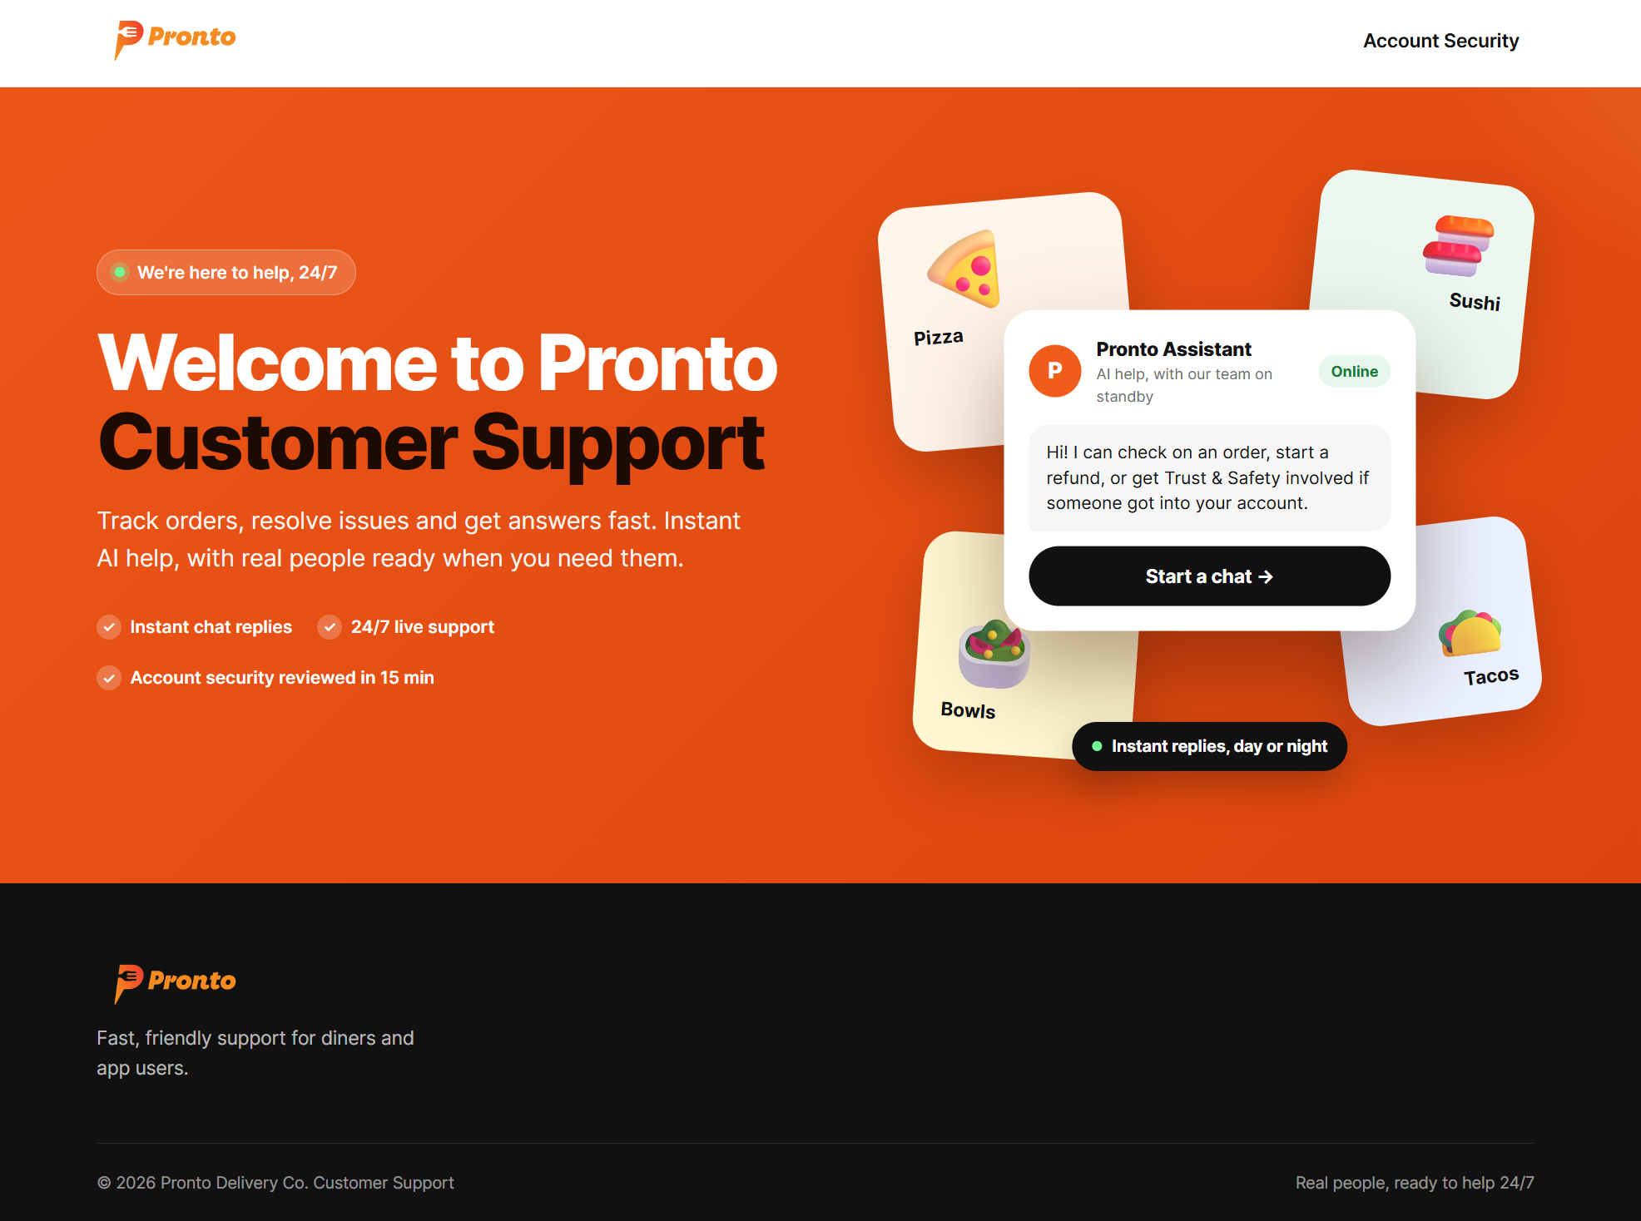
Pronto: The Most Secure Food Delivery App
SALESFORCE IDEATHON · OCT 2, 2026
Cloud 9 · Logan Rosson, Logan Riley, Jung Ko
Notes:
Hook: When a Pronto account gets hacked, the real customer is locked out of the very channels they'd use to ask for help. Our build makes sure every one of those reports reaches a human fast.

Slide 2
Pronto is a food delivery application
We architected Pronto to tackle the most expensive blind spot in food delivery: automated Account Takeover (ATO) defense.
1
Ordering logistics
Only half the battle
2
Fraud
Biggest threat to margins
3
Account takeover
Where we focused
Notes:
Set up the 'why' before the 'what': ordering logistics are table stakes, fraud is what erodes margins, and account takeover is the fraud that hurts both the customer and Pronto at once.

Slide 3
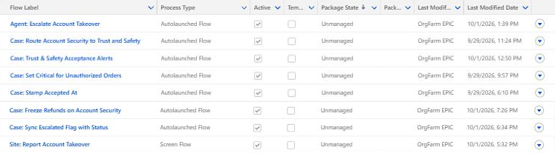
What we built inside Salesforce.
1
Agentforce agent, 6 subagents
8
custom flows
Setup → Flows: the 8 flows we built this week
1
customer site + report form
1
Trust & Safety dashboard
Notes:
Everything on this slide is live in our org. Read the flow names: the agent escalation, the routing to Trust & Safety, the 15-minute alerts, and the site's report form.

Slide 4
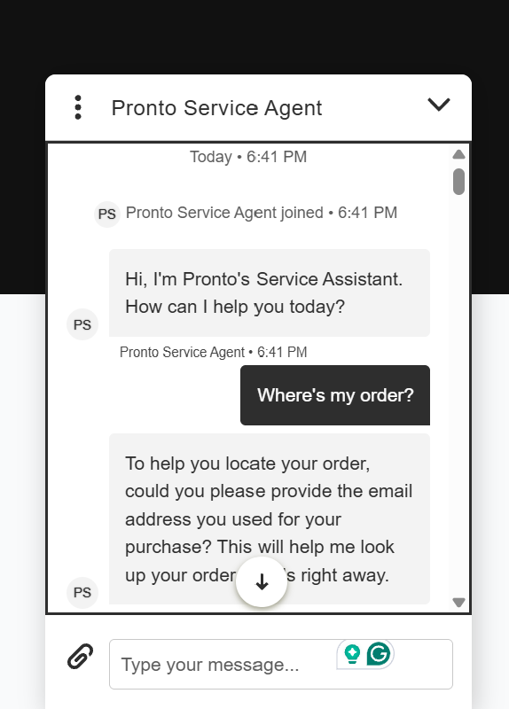

Baseline: a live Pronto support site with Agentforce chat.
PUBLIC URL
orgfarm-5ac03fa632-dev-ed.develop.my.site.com/customers
Experience Cloud site with Embedded Messaging chat
“Start a chat” opens the agent; Account Security page handles no-login reports
Section 1 workshop exercises completed
Notes:
This is the published site judges can open. The chat bubble is the Agentforce Service Agent. Mention which Section 1 exercises we completed.

Slide 5
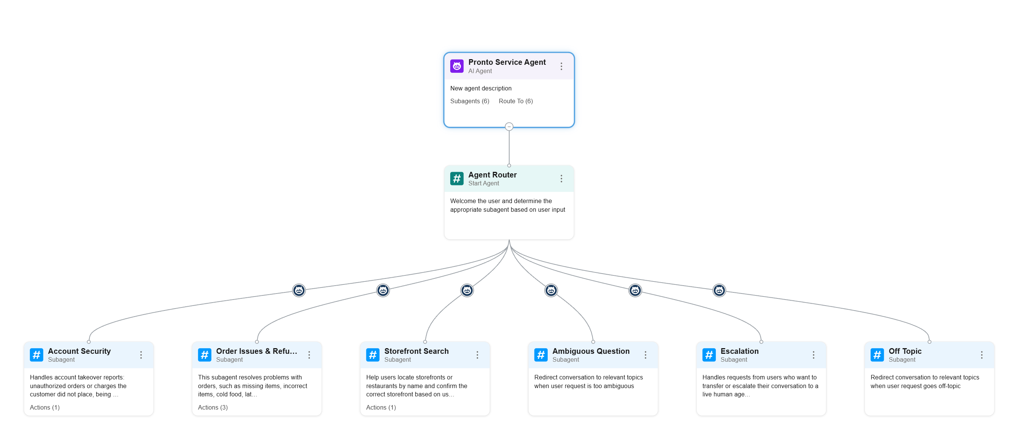
Inside Agentforce Builder: one router, six subagents.
Notes:
This is our agent in Agentforce Builder. The Agent Router greets the customer and picks one of six subagents: Account Security, Order Issues & Refunds, Storefront Search, Ambiguous Question, Escalation and Off Topic.

Slide 6
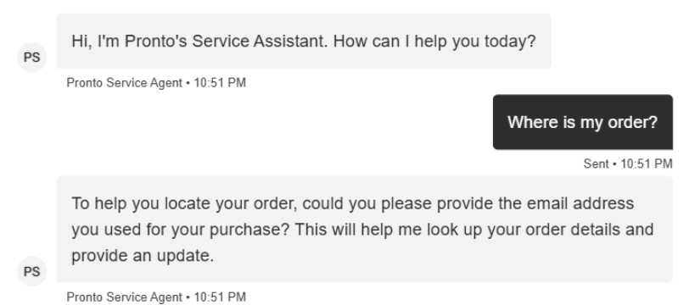
Our Agentforce agent answering a real order question.
1
Greets the customer
Opens with its own name: Pronto's Service Assistant.
2
Asks for the order email first
It checks who you are before it shares any order details.
3
Never asks for secrets
No password, no card number, no codes in chat.
Live chat on our site
Notes:
This is a real conversation with our agent on the live site. Point out that it asks for the email on the order before it looks anything up.

Slide 7
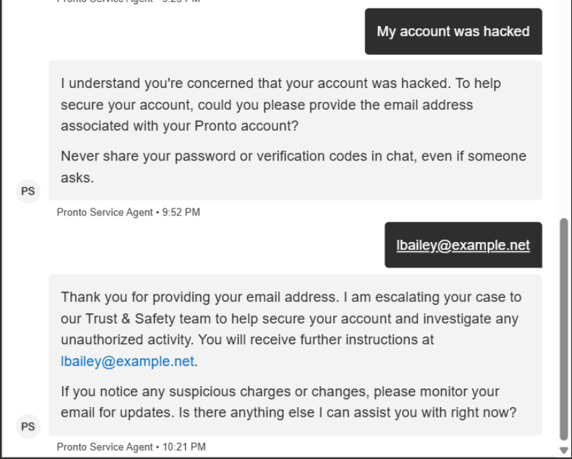
Our agent handling a real hacked-account message.
1
Recognizes the problem
Routes "My account was hacked" to our Account Security subagent.
2
Warns the customer
"Never share your password or verification codes in chat."
3
Hands off to Trust & Safety
Takes the account email and tells the customer the team will follow up there.
Notes:
Real transcript from our live site. The agent picks the Account Security subagent, warns about sharing passwords and codes, and hands off to Trust & Safety.

Slide 8
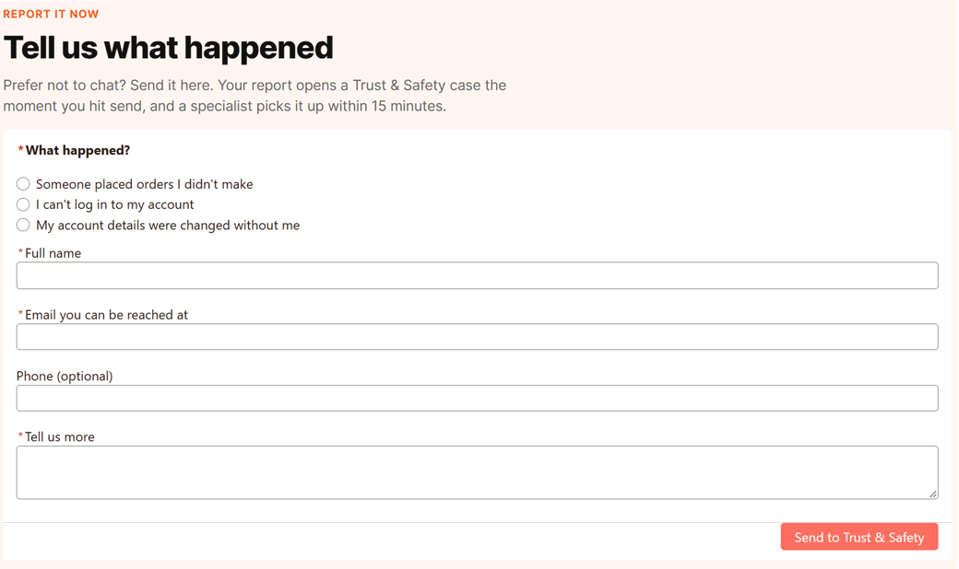
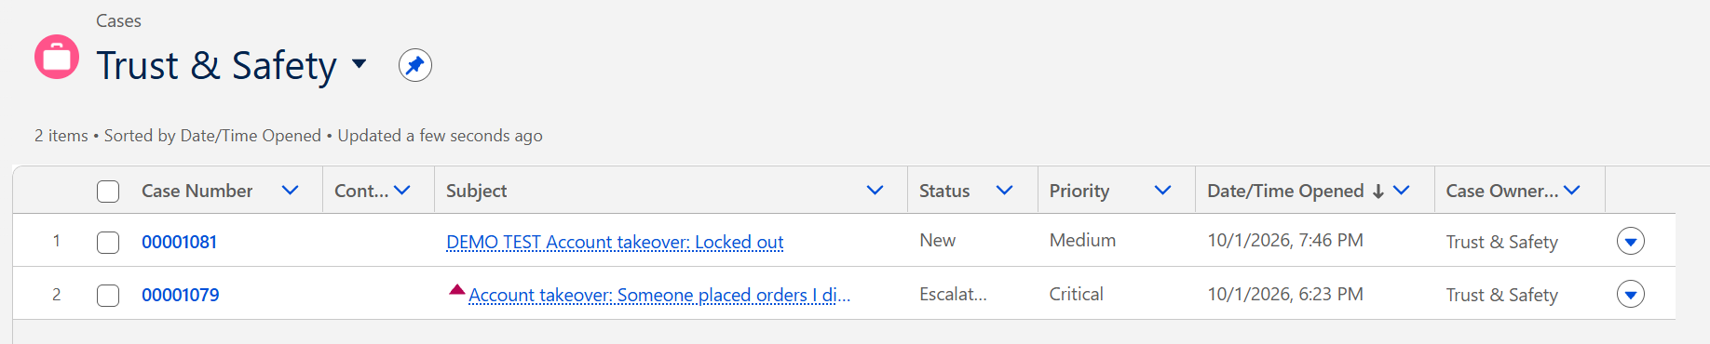
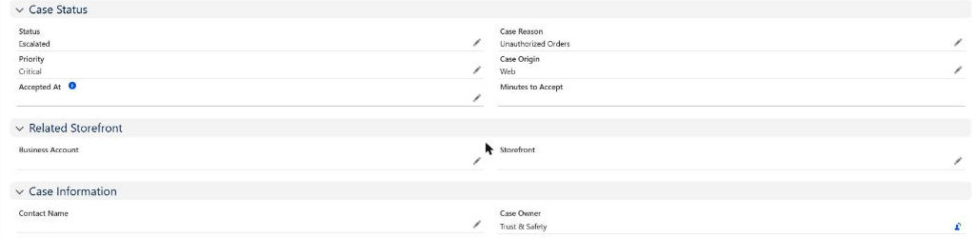
Behind the scenes: a report becomes a case.
1
Customer sends the form (no login)
2
A case lands in the Trust & Safety queue
3
Critical, Web, owned by Trust & Safety
Nobody typed anything into Salesforce: the form created the case and the routing flow placed it.
Notes:
Screenshots, not live. 1: the Account Security form a locked-out customer fills in. 2: seconds later the case is in the Trust & Safety queue list in Salesforce. 3: the case record: Priority Critical, Origin Web, Owner Trust & Safety, Status Escalated because nobody accepted it within 15 minutes.

Slide 9
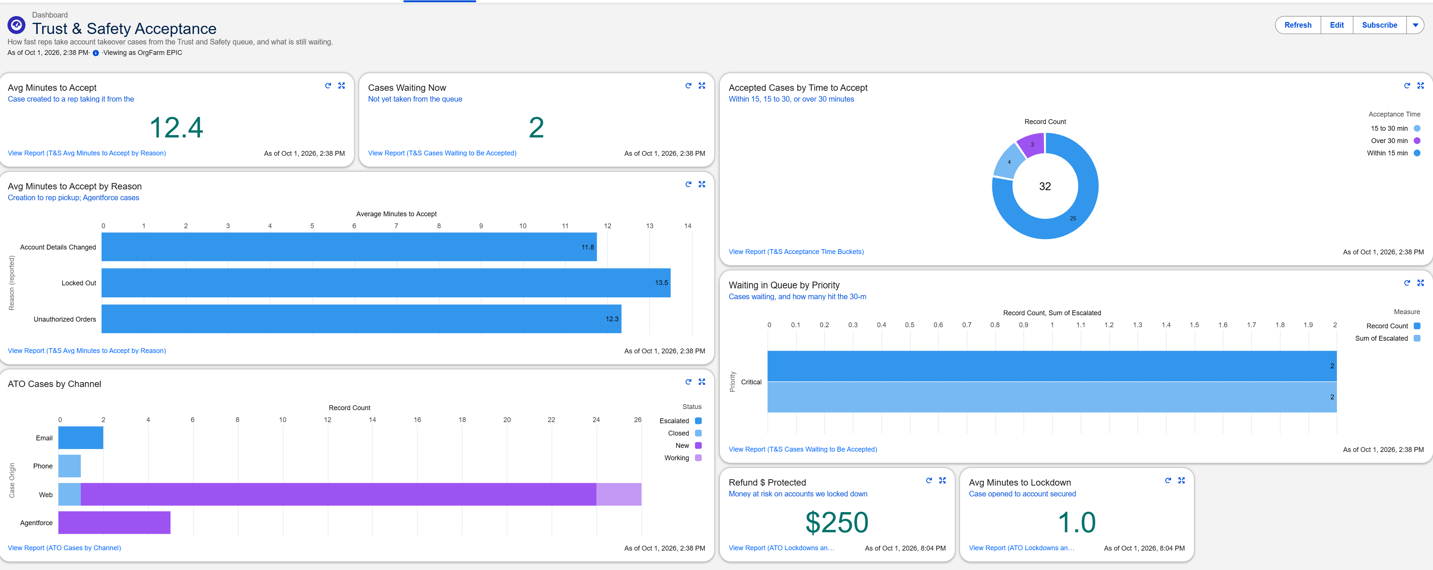
The dashboard shows where we miss the 15-minute window.
Insight: “Locked Out” cases are slowest (13.6 min avg) and 7 of 32 were accepted after 15 min. Next: push Locked Out to the top of the queue.
Notes:
Trust & Safety Acceptance dashboard: average 12.4 minutes to accept, a donut of acceptance time buckets, cases by channel, refund dollars protected ($250) and average 1.0 minute to lockdown. The dashboard was exported as an image for the submission. Actionable insight: Locked Out is closest to breaching 15 minutes, so we'd prioritize it.

Slide 10
Live demo: the agent finds a customer by email.
1
2
3
4
5
Click “Start a chat” on the site
Ask “Where is my order?”
Give the email lbailey@ example.net
Open the flow Identify Customer By Email
Open the flow Get Orders By Contact
How the email connects
Email → customer record → orders. The agent never asks for a password or card number.
Before we present
Open the site in a private window
Have Setup → Flows open in a second tab
Look only in Flow Builder; never click Save
Notes:
Speaker 2 clicks, Speaker 3 talks. Full click-by-click steps are in the team script. If anything is slow, stay on the slides and keep talking.

Slide 11

Thank you. Questions?
Cloud 9
Logan Rosson, Logan Riley, Jung Ko

