Slide 1
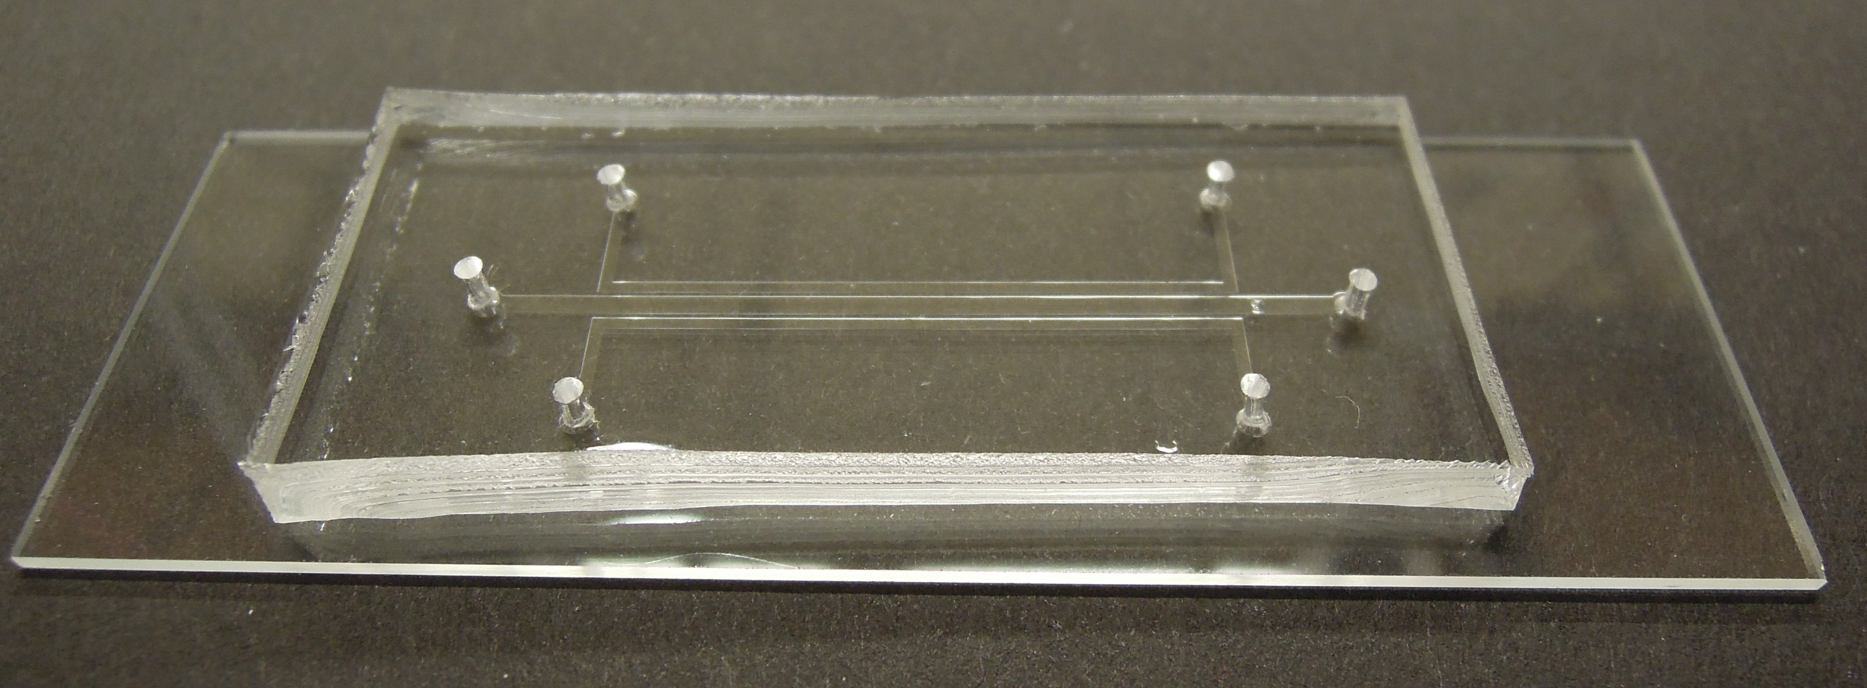

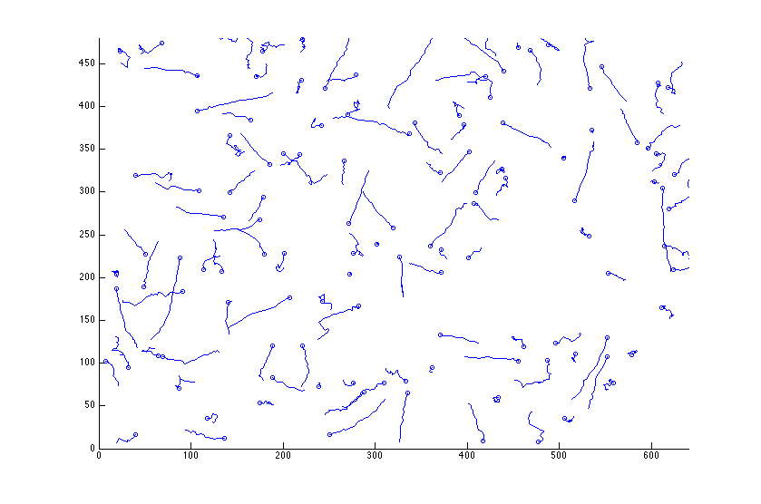
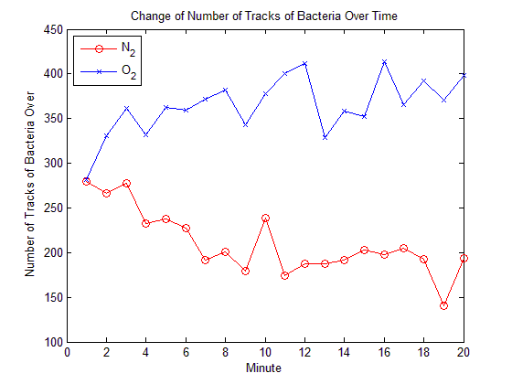
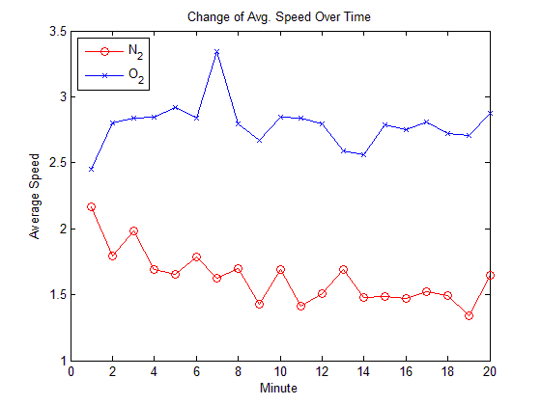
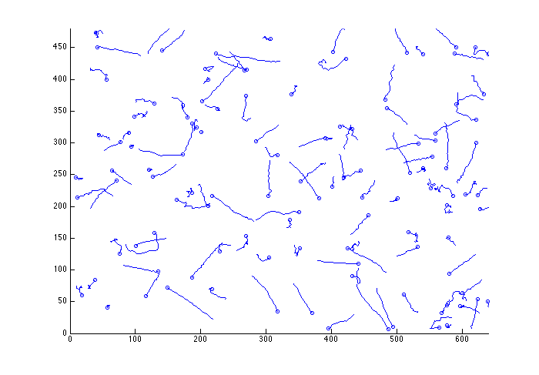
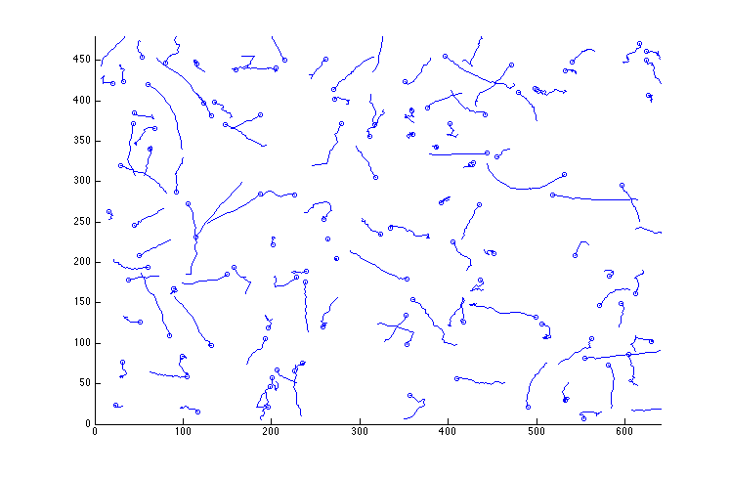
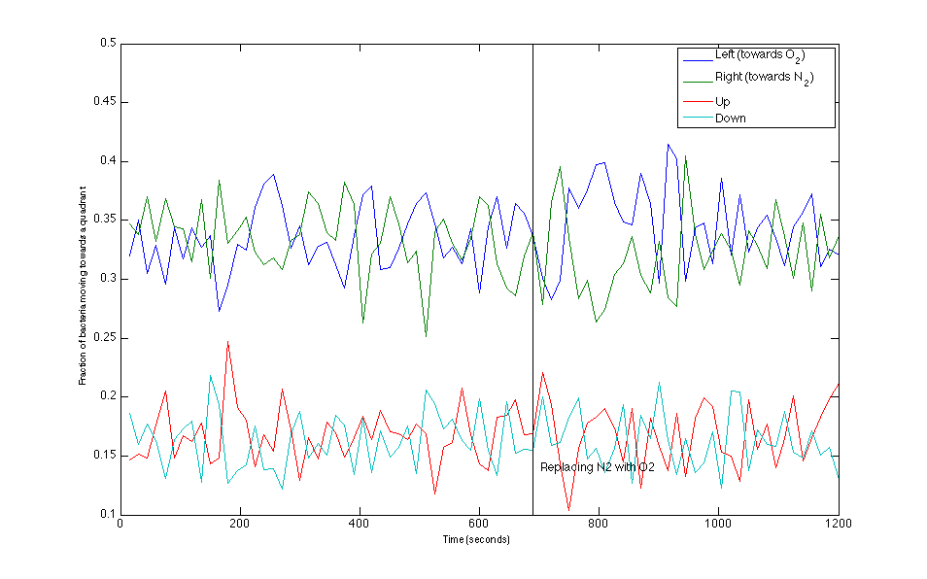

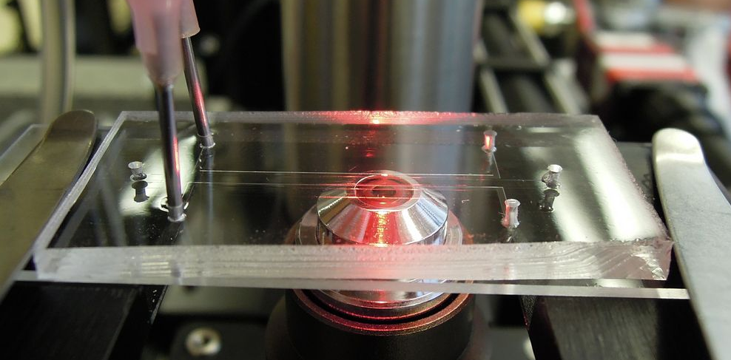
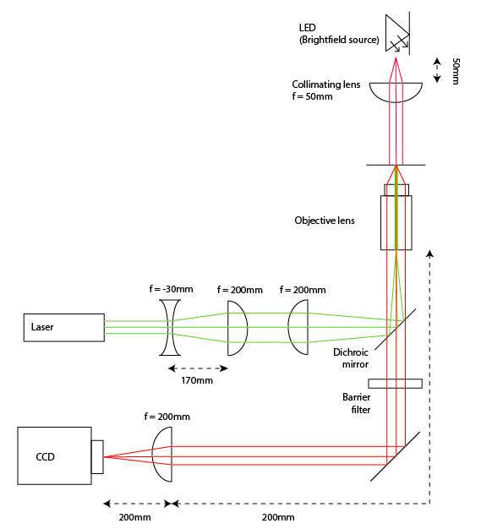
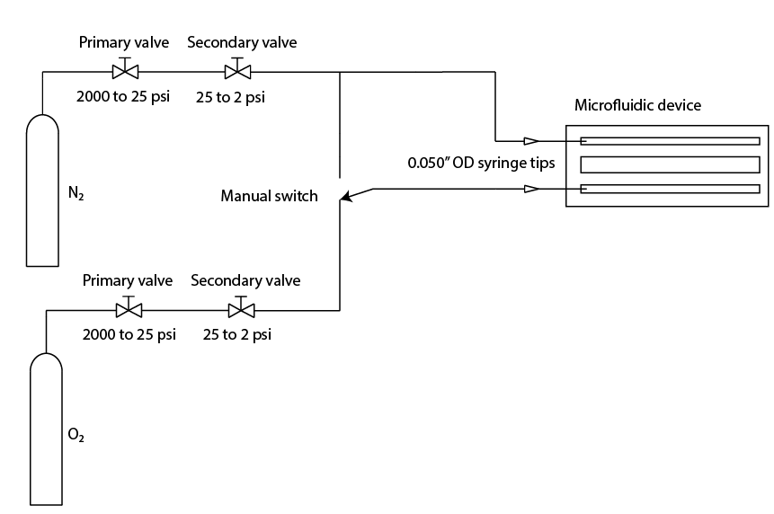
Aerotactic Behavior in B. subtilis
Kiarash Adl, Brian Djaja, Katarina Struckmann, Logan Williams, Filippo Menolascina, Steven Nagle
20.345 Bioinstrumentation Project Lab
Abstract
Results
Bacterial movement is influenced by environmental gradients on all levels of scale. While significant effort has been made to understand responses to chemical gradients, or chemotactic responses, less literature exists characterizing responses to gas gradients, or aerotactic responses. We have developed an apparatus for characterizing aerotactic bacterial motion, based on three microfluidic channels, fabricated from PDMS. We have shown as a proof of concept that the response of B. subtilis to a gradient of nitrogen and oxygen can be observed, through changes in population density. Quantitative analysis of bacterial motion was attempted, but inconclusive due to a high degree of random-walk behavior.
Comparing bacteria population and speed on two opposite sides of the channel (near oxygen and near nitrogen)
Traces of bacterial movement, tracked with MATLAB
Prior to oxygen flow
Aerotaxis
The movement of bacteria in response to a gas gradient, aerotaxis, is a field that has emerged within the past 10 years¹; as such, it has not been studied to the extent of chemotaxis, the movement of bacteria in response to a chemical gradient. While models of chemotactic movement exist^{2,3}, definitive models for aerotaxis have not yet been developed.
Aerotaxis has a broad range of applications. For example, the signaling proteins utilized in for aerotactic responses in bacteria can be potentially engineered for turning on gene expression in the presence of a certain oxygen concentration, or lack thereof. A definitive model for aerotactic behavior is the key to unlocking these applications.
+1 minute
+3 minutes
Direction of bacterial movement in the center of the channel.
Qualitative view of bacterial gradients after beginning gas flow (brightfield microscopy)
O₂
N₂
+10 min
Experiment
O₂
+5 min
N₂
The microfluidic device is composed of the elastomeric material Polydimethylsiloxane (PDMS). The device has three parallel channels formed by indentations in the PDMS.
Bacillus subtilis was obtained from Filippo Menolascina and cultured in Cap Assay Min (CAM), a minimal nutrient broth designed to increase the aerotactic response of the bacteria by placing them in mild starvation conditions. CAM contains trace amounts of tryptone, histidine, methionine, tryptophan, several mineral salts, and a phosphate buffer (pH = 7). The bacteria was cultured with
shaking for approximately 24
hours prior to experimentation.
O₂
+0 min
N₂
Each channel is 600 microns wide and 50 microns deep, with 200 microns of separation between each channel. Bacteria were injected into the center channel and allowed to settle before data collection began. Oxygen and nitrogen flows were directed through the outside channels.
Conclusions
While B. cereus does not respond to aerotaxis, B. subtilis demonstrates a weak but distinguishable response. Its aerotactic behavior was visually verified, as the bacteria tended to accumulate on the oxygenated side of the channel and dissipate from the nitrogenated side. The unsuccessful fluorescence system impeded efforts to quantify the aerotactic response of B. subtilis and produce a model analogous to those for chemotaxis, but photographic gradient above clearly demonstrates a qualitative response that further experiments could successfully quantify.
Our device provides a suitable testbed for conducting aerotaxis experiments, but it requires refinement to capture quantitative data. Some suggested improvements include a better fluorescence system using dye that does not impede bacterial movement or photobleach quickly, using a laser with a wavelength closer to the dye’s absorption peak. Improving the fluorescence system would improve the quality of tracking data, by allowing bacteria to be more reliably distinguished from the background, allowing additional insight into aerotactic behavior.
The microscope used for the project was a standard 4f brightfield microscope based around inverted 200mm Nikon objectives.
N₂ and O₂ gases each flow through two regulators, dropping their pressure to 2 psi before they enter the device through 0.050” OD syringe tips.
Both channels were flushed with N₂ for 11.5 minutes before one channel was switched to a flow of O₂.
Acknowledgments
References
We’d like to thank Filippo Menolascina from the Center for Environmental Microfluidics for providing an introduction, masks, devices, supplies, and guidance throughout this project. We’d also like to thank Professor Nagle for assisting greatly with analysis of our data and the use of the 20.309 lab space, as well as ordering parts and supplies for us, and the 20.109 staff for allowing us to use their lab for bacteria culturing.
¹ Taylor, B.L, Igor B. Zhulin, and Mark S. Johnson. “Aerotaxis and other energy-sensing behavior in bacteria.”Annu Rev Microbiol. 1999;53:103-28.
² Tindall, M.K., P.K. Maini, S.L. Porter, & J.P. Armitage. “Overview of Mathematical Approaches Used to Model Bacterial Chemotaxis I: The Single Cell.” Bull Math Biol. 2008 Aug;70(6):1525-69. doi: 10.1007/s11538-008-9321-6. Epub 2008 Jul 19.
³ Tindall, M.K., P.K. Maini, S.L. Porter, & J.P. Armitage. “Overview of Mathematical Approaches Used to Model Bacterial Chemotaxis II: Bacterial Populations.” Bull Math Biol. 2008 Aug;70(6):1570-607. doi: 10.1007/s11538-008-9322-5. Epub 2008 Jul 19.
MAY 2013

