Slide 1

My Special Number - 10
By Matthew Balogh

Slide 2
Even Number
10 is an even number because it can be divided evenly.
With 2 numbers all the way to 10 like:
1,2
3,4
5,6
7,8
9,10

Slide 3
Two Digits
Ten is the first number to have two digits.
1,2,3,4,5,6,7,8,9,10

Slide 4
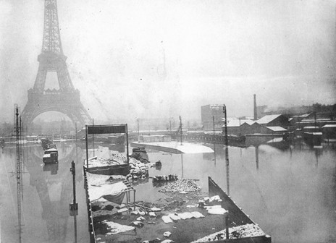
History About Ten
Is there anything?
Yes, there is! Paris flooded in 1910!!!!!!!!!!

Slide 5
Applaud
Scroll down to learn more!

