Slide 1
Wars Game
Game by Matthew Balogh

Slide 2
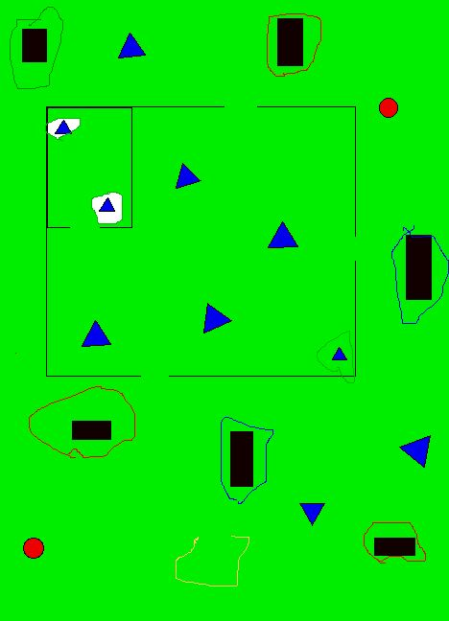
Notes:
hcnyfvy

