Slide 1
Superstore Report
Done by
Logesh S
Hamsageetha G
Priyadharshini c
Shruthi S

Slide 2
PROBLEM STATEMENT
To create five dimension table and one fact table from one excel source.
To create star schema.
To extract data from Excel source
To transform Excel source to Mysql destination.
To visualize that processed data using power BI.

Slide 3
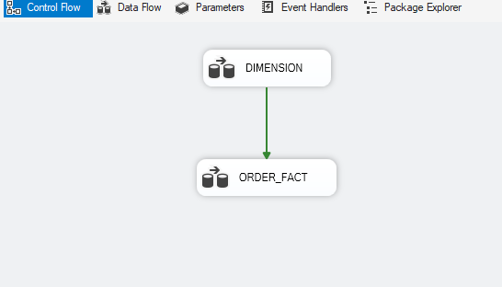
SSIS
Control Flow
Dimension Table
Fact Table

Slide 4
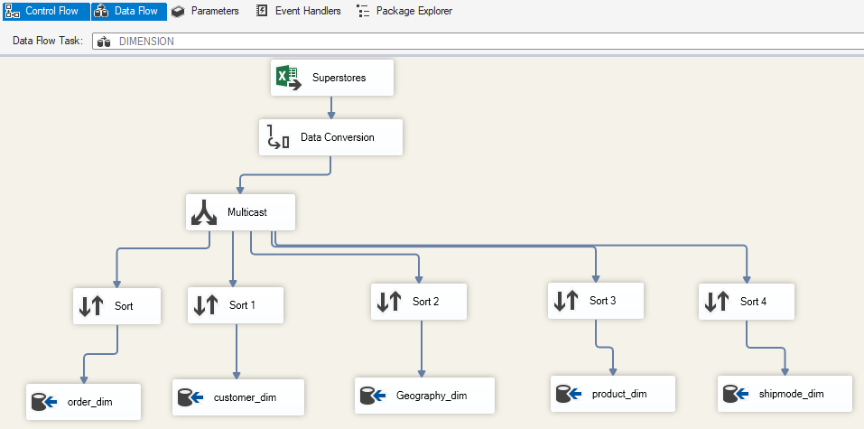
SSIS
Data Flow (Dimension Table)
Source Loaded
Data conversion
Multicast
Sort(to remove duplicates)
Mysql Destination (ODBC)

Slide 5
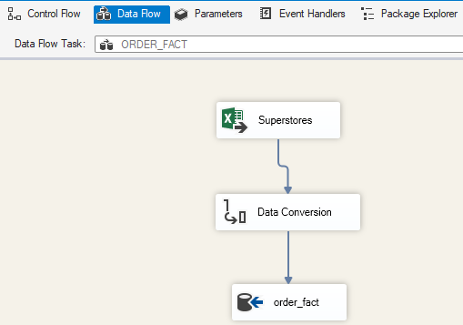
SSIS
Data flow ( Fact table)
Same source loaded
Data conversion
Mysql Destination (ODBC)
Event Handlers(Onerror)

Slide 6
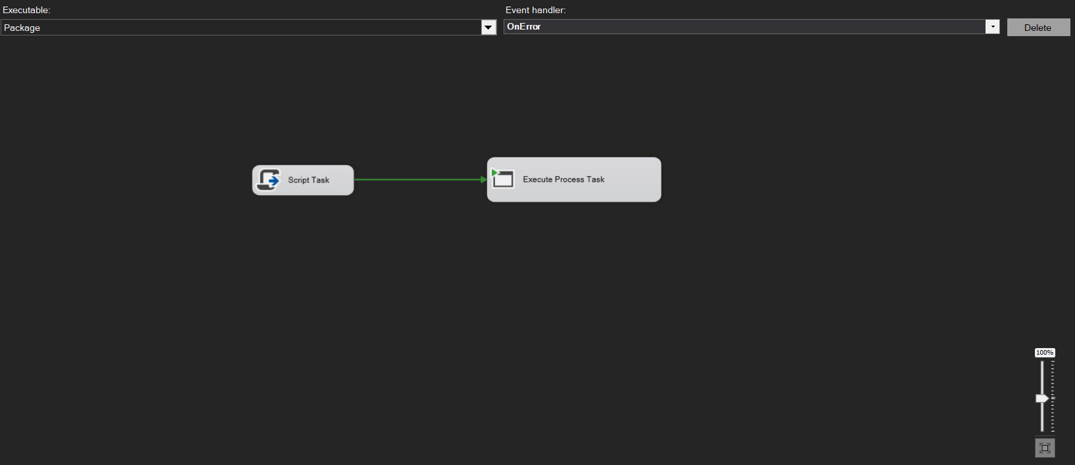
EVENT HANDLERS
SSIS event handlers are the simplest means of turning an SSIS script into a reliable system that is auditable, reacts appropriately to error conditions.
This Script task is used for creating a errorlog file in local machine
This Execute Process Task is used for running python which used for send mail

Slide 7
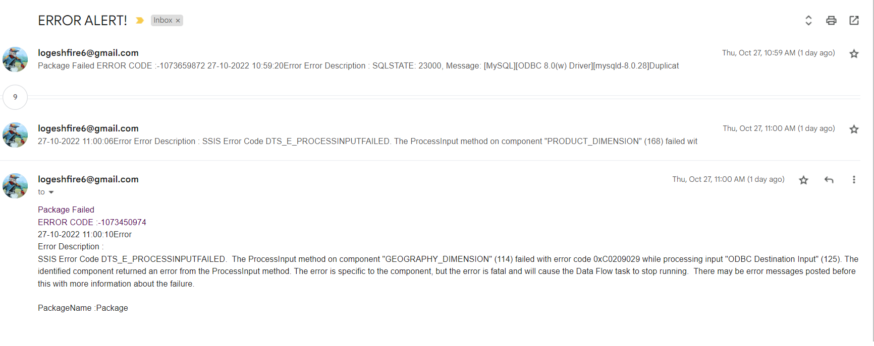
EVENT HANDLERS-EMAIL

Slide 8
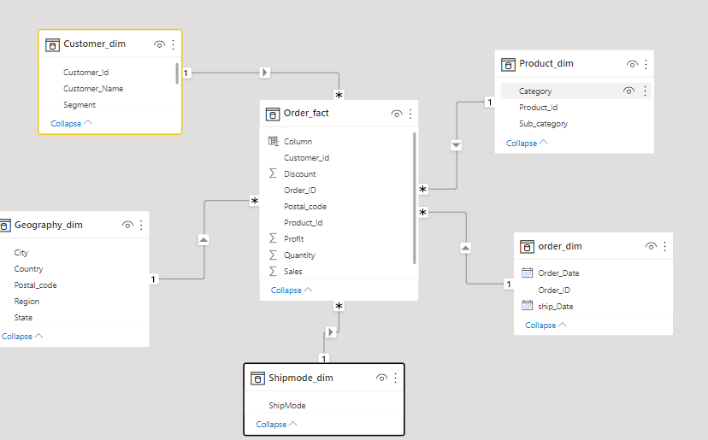
POWER BI
Created a Star schema
Fact Table :
Order_fact
Dimension Table :
Order_dim
Shipmode_dim
Geography_dim
Product_dim
Customer_dim

Slide 9
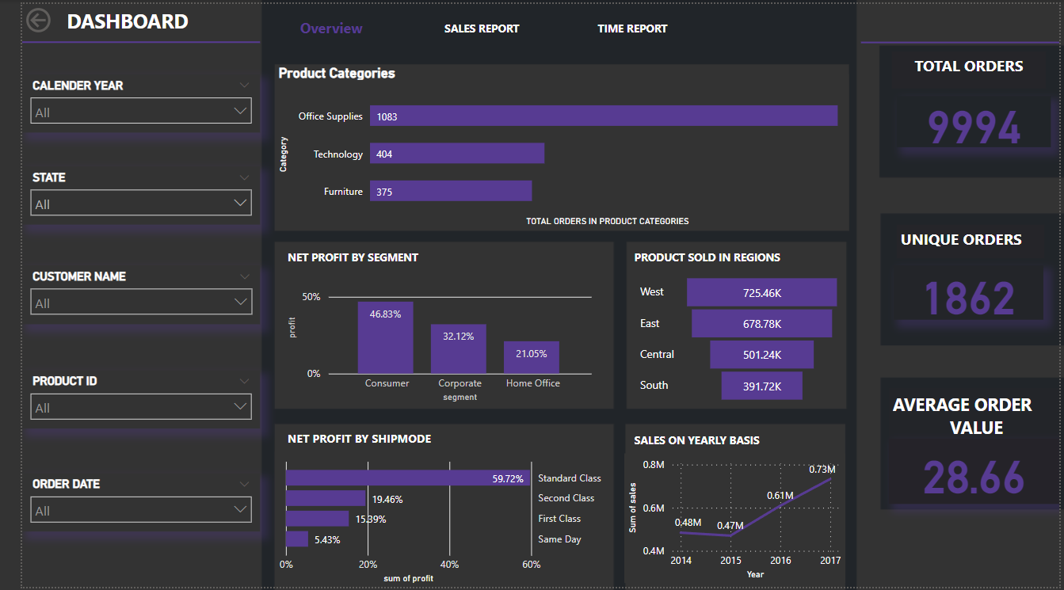
Dashboard
Page navigator
Insights
OVERVIEW PAGE

Slide 10
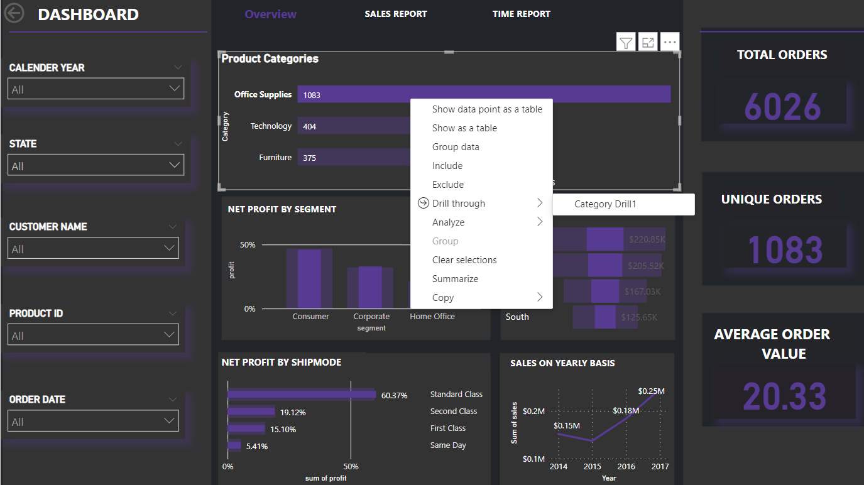
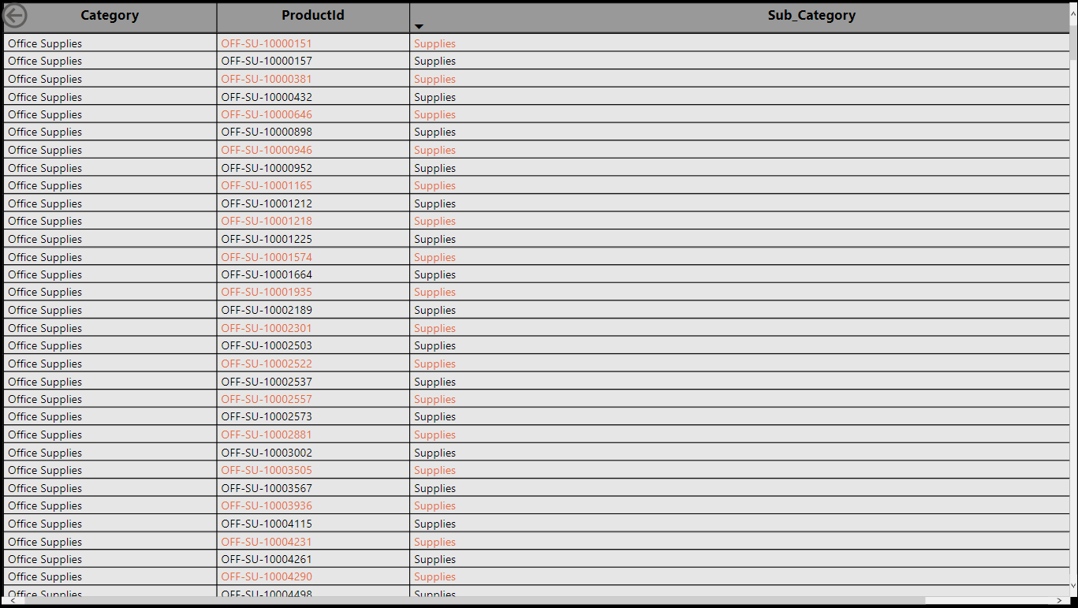
Drill Through From Product Categories

Slide 11
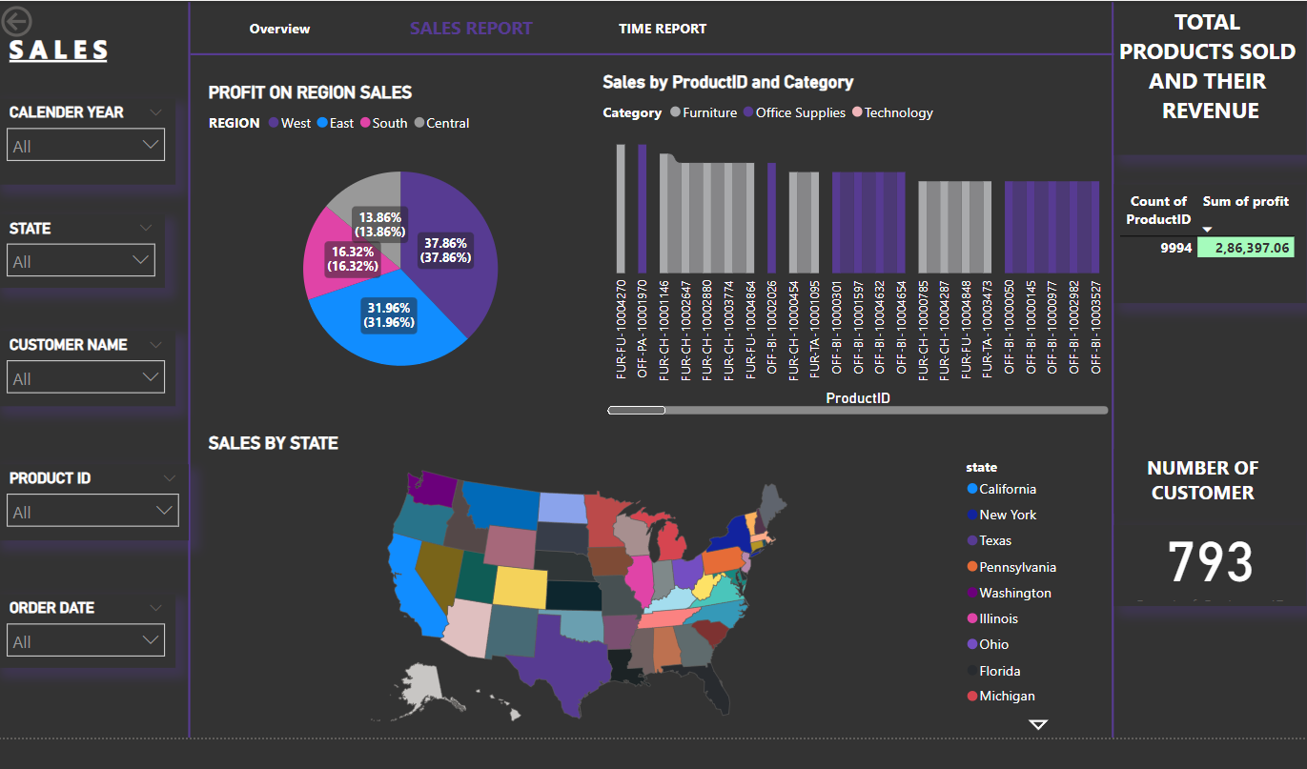
Sales Report

Slide 12
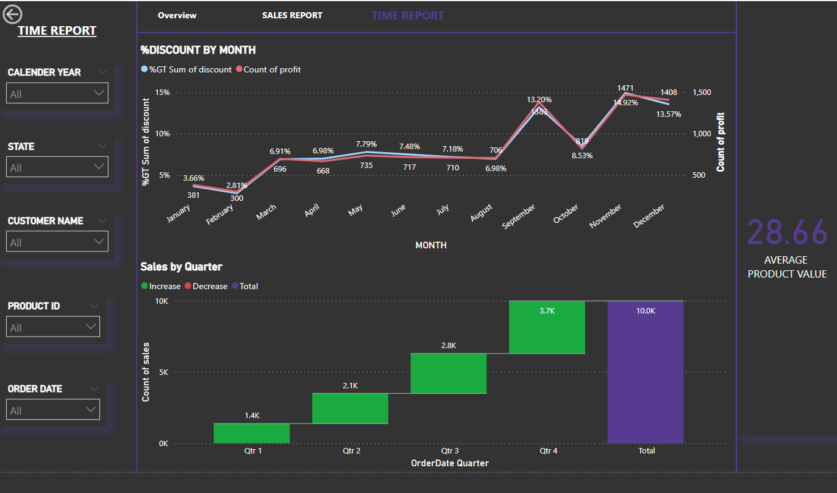
Time Report Page

Slide 13
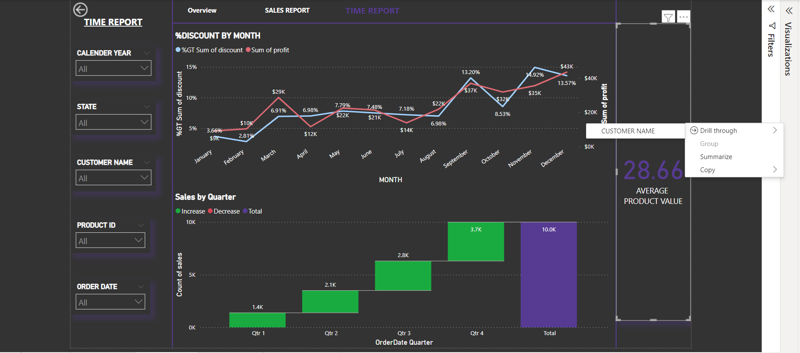
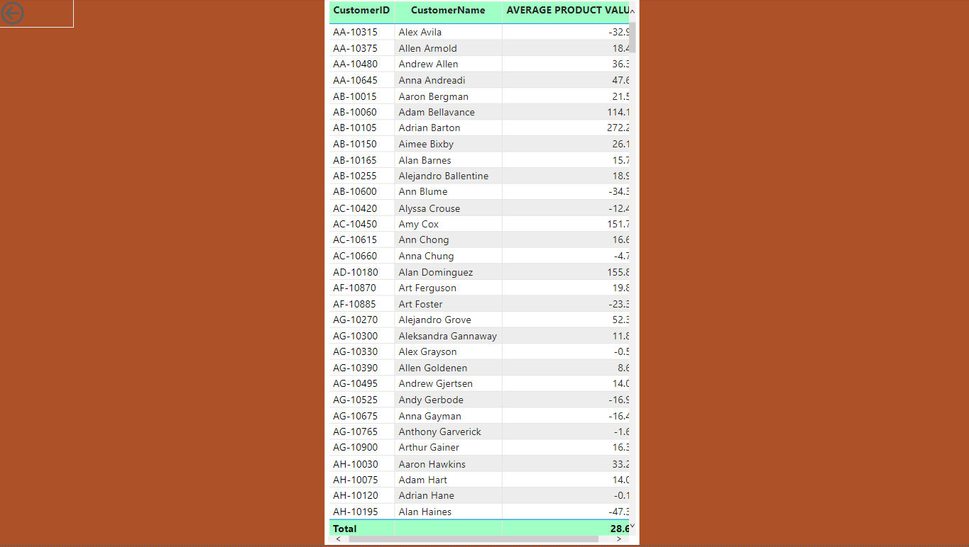
DRILL THROUGH TIME REPORT
PRODUCT VALUE

Slide 14
Insights
From the overview page we can observe the total orders for the specified calendar year , State, Customer Name , Product ID, Order Date which is available in slicers.
In the sales report we can observe the products sold and their revenue for a specific region and state.
In time report we can observe the average product value for specific Month and Quarter specified.
As a conclusion we can conclude that whenever there is a decrease in discount simultaneously there is a fall in profit.
From years 2014,2015,2016,2017,the sales have been tremendously increasing yearly. Cities in West region have sold bigger number of products.
California tops in sales.
Products sold in December have huge profit of $43K with the discount of 13.57%.

Slide 15
THANK YOU

