Slide 1
LOGESH S
2021503519
9460EFB22AD115D9D2B4276BDC861B59
Madras Institute of Technology
logeshct2004@gmail.com

Slide 2
PROJECT TITLE:
Visualize Your Imagination: A Prompto Image Generator.

Slide 3
AGENDA
Research & Development: Explore AI-based image generation techniques and natural language processing models.
Model Training & Optimization: Develop and fine-tune a machine learning model for generating images from text prompts.
User Interface Design: Create an intuitive interface for users to input prompts and view generated images.
Testing & Evaluation: Ensure image quality and coherence through rigorous testing and evaluation.
Documentation & Deployment: Document development process and deploy the system for public use.
User Engagement & Feedback: Encourage user interaction and gather feedback for continuous improvement.

Slide 4
PROBLEM STATEMENT:
The process of translating textual prompts into visual imagery often poses a significant challenge, requiring creative interpretation and artistic skill. Traditional methods of image creation can be time-consuming and may not always capture the essence of the original prompt.
There is a need for a more efficient and accessible solution that enables users to effortlessly generate high-quality images from textual prompts, unlocking new avenues for creative expression and exploration. This project aims to address this need by developing an AI-powered image generation system that seamlessly converts textual input into visually compelling images, providing users with a powerful tool to visualize their imagination with ease.

Slide 5
PROJECT OVERVIEW:
"Visualize Your Imagination: A PromptTo Image Generator" aims to revolutionize the process of creating visual content by leveraging artificial intelligence and natural language processing techniques. The project focuses on developing a user-friendly platform where users can input textual prompts and instantly receive generated images that encapsulate the essence of their ideas.
Key Components:
AI-Powered Image Generation: Utilize Stable Diffusion methods to translate textual prompts into realistic images.
User Interface Design: Create an intuitive interface for users to input prompts and view generated images.

Slide 6
END USER:
Artists and Designers
Content Creators
Educators and Students
Businesses and Marketers
General Users

Slide 7
SOLUTION AND IT'S VALUE PROPOSITION:
SOLUTION:
"Visualize Your Imagination" offers an AI-powered platform that seamlessly generates high-quality images from textual prompts using Stable Diffusion methods and natural language processing.
VALUE PROPOSITION:
Unlock your creativity with ease! "Visualize Your Imagination" empowers users to effortlessly transform ideas into visually compelling images, revolutionizing the creative process and enabling new avenues for expression.

Slide 8
WOW FACTOR OF SOLUTION:
Wow Factor: Transforming Text into Art and get the image size as your wish.
Experience the Magic:
Instantly generate stunning images from simple text prompts.
Witness your ideas come to life with realism and vibrancy.
Explore endless creative possibilities with just a few keystrokes.
Empowering everyone to be an artist, regardless of skill level.
Redefining the boundaries of imagination and creativity.

Slide 9
MODELING:
Stable Diffusion Methods: Utilize cutting-edge Stable Diffusion techniques for image generation.
Natural Language Processing (NLP): Incorporate NLP models to interpret and process textual prompts.
Machine Learning Integration: Train and optimize machine learning models for efficient image generation.
Quality Assurance: Implement rigorous testing to ensure image quality and coherence.
Iterative Improvement: Continuously refine models based on user feedback and performance evaluation.

Slide 10
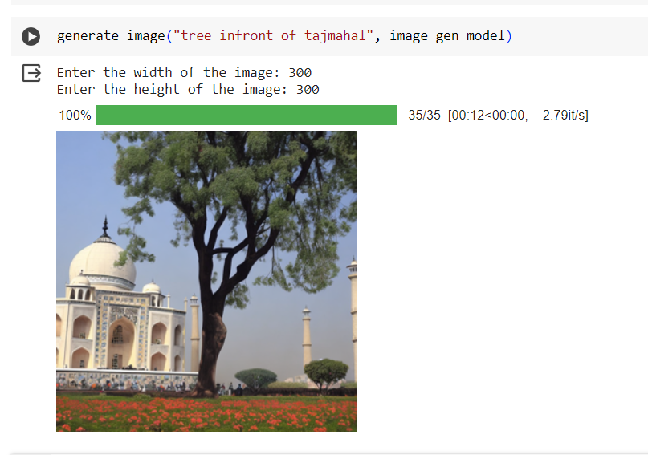
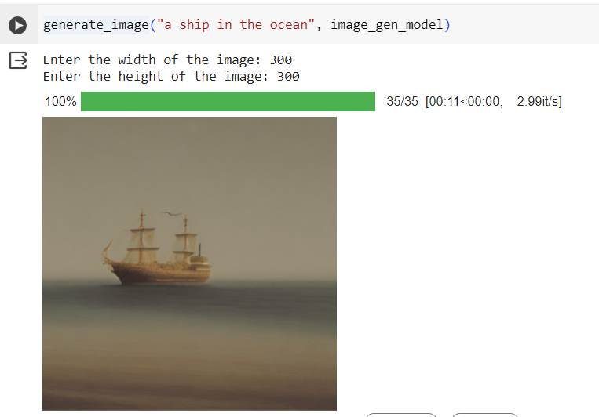
RESULTS:

Slide 11
REFERENCES:
Dhariwal, P., et al, "Stable Diffusion: A PrompTo Image Generation",2021.
Radford, A., et al, "Language Models are Unsupervised Multitask Learners",2019.

Slide 12
THANK YOU

