Slide 1
ETFS Overview
7/17/2017

Slide 2
Overview
What is Team Foundation Server?
What is ETFS?
Source control
Work tracking and Agile tools
DevOps and Continuous Integration/Delivery
Testing platform and tools
Integration
Other ALM suite comparison
Notes:
https://www.visualstudio.com/en-us/docs/concepts

Slide 3
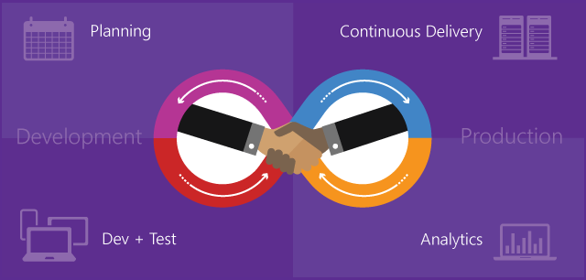
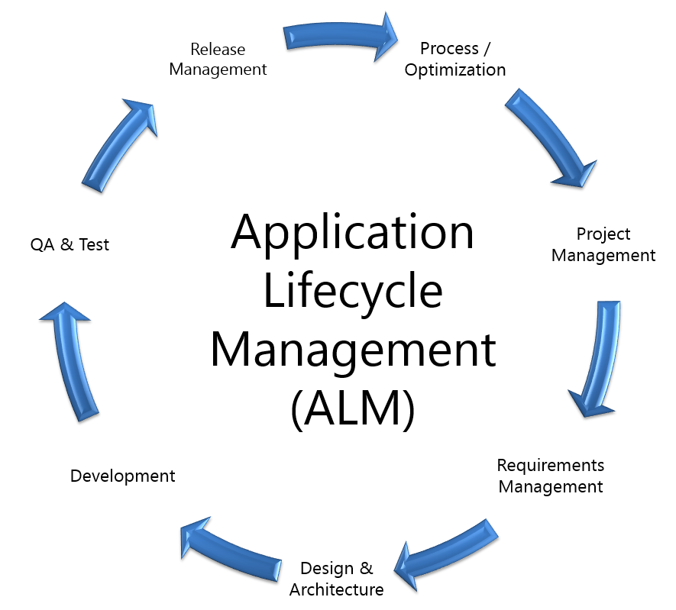
What is Team Foundation Server?
Microsoft Team Foundation Server (TFS) is an on-premises platform that provides the services and tools to support developing and continuously deploying software.
Main areas that support software development include:
Source control to manage versioning of software files
Agile tracking tools to support planning and tracking work, code defects, issues
DevOps tools to support building, testing, and continuous release of software apps.
* Visual Studio Team Services (VSTS) is the cloud-hosted equivalent to TFS.
Notes:
https://www.visualstudio.com/en-us/docs/concepts

Slide 4
What is 3M Enterprise TFS (ETFS)?
ALM service for all 3M software teams
Infrastructure hosted in 3M Data Centers
High availability instance of Team Foundation Server
Load balanced across multiple machines
99.9% uptime since 2015
System Support 24x7x365
IT Help Desk via 3-1000
IT CSHS Support
http://ithelp.mmm.com/Request.aspx?Id=CHBS-SR
Backups follow 3M standards for data retention

Slide 5
Who is the ETFS Team?
Service Manager
Initial contact of new teams
Provide training
Maintain relationship with teams
IT Operations Team (IT Commercial Software & Hosting Services)
System Maintenance
Provide 24x7x365 3M corporate IT support
Focused on production system
Operations (Ops)
DevOps
Team onboarding tasks
Service enhancements
Test updates/upgrades, update documentation
Perform DevOps role for division teams as needed

Slide 6
Demo Basic Interface Features
Notes:
Top menu – hubs
Home page
Dashboards

Slide 7
Source Control
Git
Standard Git repositories
Multiple repositories per Team Project
Branch policies
Work item integration
Code reviews with Pull Requests
Team Foundation Version Control
Original centralized model – 2005
Only one repository per Team Project
Can have TFVC and Git repos in same Team Project
Full work item integration
Code Search coming soon
Notes:
https://www.visualstudio.com/en-us/docs/git/overview
https://www.visualstudio.com/en-us/docs/tfvc/overview

Slide 8
Demo Source Control
Notes:
Code hub
Explore source code
Pull request – Active Safety – Android

Slide 9
Work Tracking and Agile Tools
Feature, Product Backlog Item, Task, Bug, Issue
Process templates – Scrum (default), Agile, CMMI
Customizable fields, forms, and workflows
Backlogs
Kanban boards
Capacity planning
Charting
Dashboards
Custom reports – SSRS/SSAS with OLAP (PowerBI coming)
Direct integration with MS Office products
Notes:
https://www.visualstudio.com/en-us/docs/work/overview

Slide 10
Demo Work Tracking and Agile Tools
Notes:
Backlogs – Product, Sprint
Kanban boards
Queries
Capacity planning
Charting

Slide 11
DevOps and Continuous Integration
ETFS build farm or BYOS
OOB build step templates – Visual Studio, Ant, Jenkins, Maven
Multiple repository sources – TFS, GitHub, Git, Subversion
Native xPlat agents– Windows, Linux, OSX
Mobile build, test, and deployment – Xamarin, Xcode
Gated check-ins with work item integration (bugs)
Package Management – NuGet, NPM
Integration hooks - Jenkins, Chef, Docker, Octopus
Release management with approval pipelines
Notes:
https://www.visualstudio.com/en-us/docs/build/overview

Slide 12
Demo DevOps and Continuous Integration
Notes:
ActiveSafety - Worker Interface 3.0
Run build
New build definition
Build steps
Release steps

Slide 13
Testing Platform and Tools
Test plans, Test Suites, Test Cases
Multiple configuration runs (test points)
Test Hub or Microsoft Test Manager
Shared parameters for data driven testing
Shared steps for Test Case reuse
Rich data collection for developers
Manual tests, unit tests, web tests, load tests
Automated UI testing – Fast forward, CodedUI, Selenium
Load testing
Test & Feedback extension
Notes:
https://www.visualstudio.com/en-us/docs/test/
https://www.visualstudio.com/en-us/docs/test/manual-exploratory-testing/getting-started/perform-exploratory-tests#browser-support

Slide 14
Demo Testing Platform and Tools
Notes:
Test plans
Test suites
Test cases
Running tests
Test runner – Web Runner, MTM
Feedback client

Slide 15

Clients and Tools
Visual Studio
Eclipse
Xcode
Bbbbb
Notes:
https://www.visualstudio.com/en-us/docs/tools

Slide 16
Integration and Collaboration
Service hooks – push (outgoing)
Connected services – pull (incoming)
Standard REST API
Microsoft Teams integration (coming)
Extensions on Visual Studio Marketplace
Notes:
https://www.visualstudio.com/en-us/docs/integrate/extensions/overview#extensions

Slide 17
Pricing
$10/user/month – in-house 3M IT support
Qualifying products and subscriptions for TFS CAL
Retail subscriptions (formerly MSDN) – VS Enterprise, Pro, Test Pro
Cloud subscriptions – VS Enterprise, VS Professional
Azure subscriptions – in transition
Test manager extension (~$50/user/month)
Retail client access license: ~$15/user/month ($25 total)
Stakeholder access
Notes:
https://www.visualstudio.com/en-us/docs/integrate/extensions/overview#extensions

Slide 18
Other ALM Suite Comparison
Atlassian
JIRA, GitHub, Bitbucket, Bamboo, Wiki, HipChat
No integrated test platform (Xray plug-in, others)
System Support 24x7x365
IT Help Desk via 3-1000
IT CSHS Support
HP
HP ALM
HP QC Enterprise
HP ALM Octane – new cloud-based offering for suite
No 3M IT service support
Notes:
https://marketplace.atlassian.com/plugins/com.xpandit.plugins.xray/server/overview

Slide 19
Summary
Q&A
Sample Team Project to explore:
https://tfsqa.mmm.com/tfs/DefaultCollection/TestProjectScrum
Notes:
https://www.visualstudio.com/en-us/docs/concepts

