Slide 1

SEMS [project name] NTI
Initiate to PreNTI Presentation [or Initiate to Explore Presentation or PreNTI to Explore Presentation etc.]
[Primary Team Members – don’t need to list contacts and consultants on title page]
Notes:
A full phase review should have no more than 40 slides, and the speakers should only talk in total for no more than 40 minutes. The remaining 20 minutes of the meeting will be used in discussions.

Slide 2
Executive Summary
Objective:
[In one or two sentences, what are you proposing to do. This should start with a verb]
Lead application:
[With the potential exception of Core-NTI, you should name the 3M Division that will benefit most significantly if this NTI is completed. Include financial impact if relevant.]
Resource requirements:
0.8 FTE for 6 months
$5k for prototypes and testing equipment
Review recommendation:
Initiate [this program] to PreNTI
Notes:
This “Executive Summary” is to summarize this presentation. In most cases this slide will end with the team’s recommendation for how to proceed with this project. For example, this slide might end with “Move from Qualify to Deploy” or “Complete all technical development and then Archive Close the project”. For a mid-phase review, “Proceed with project as planned”

Slide 3
Technology and Project Background
Briefly give people enough information to understand what you are talking about.
Use pictures
For established programs, you could use the project one-pager to refresh people’s memories
For new programs, briefly educate the audience on field of research
Notes:
Briefly give people enough information to understand what you are talking about. Try to do this in one slide. For established programs, you could use the project one-pager to refresh people’s memories. For new programs, briefly educate the audience on field of research.

Slide 4
Project Team
SEMS
John Doe (Team Leader)
Jane (Role)
Andy Tilstra (SEMS Black Belt)
CRL
Jim Doe (Consulting)
Division
Jean Doe (Consulting)

Slide 5
Presentation Outline
Team Self-Scoring of NTI Deliverables
Technology Development |  | [The eight NTI Deliverables can be presented in any order that is relevant]
Technology Roadmap |  | [Brief statement about why team has scored this deliverable this color]
Technology Protection Plan |  | [A right to practice search/review]
Market Attractiveness |  | [External Perspective to justify the need for this project]
Business Justification |  | [Internal Perspective to justify the need for this project]
EHS&R Requirements |  | [Focus on the “R” – regulatory… Are there regulatory issues need to be considered in this project?]
Preliminary Manufacturing /Implementation Plan |  | [How do you envision rolling this out to the broader company?]
Project Plan
OVERALL |  | [i.e. Ready to advance to Explore phase]
Notes:
You may choose to use the self-scoring of the project as the agenda and show it before each section of the presentation, or you may just show it once at the beginning or the end. But you need to show the team’s self-scoring of the deliverables at least once.

Slide 6

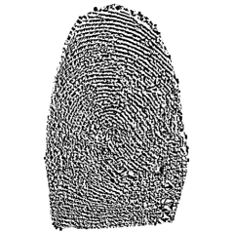

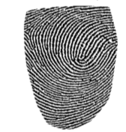
Technology Development
Benchtop Scanner
Acquisition Time: 1/20th Second
True Def Scanner
Acquisition Time: ~1 minute
Closing the signal to noise gap:
Custom feature matching
3D Filtering
Multi-frame stitching
Notes:
This section is typically longer than the others, with more detail. It is best to review presentations from recent projects that are similar to yours in order to gauge how deep to dive into the technology.
You may choose to show the state-of-the-art of related technology, and a technical explanation of what you are proposing to do and what you have already done. (i.e. proof-of-concept, back of the envelope calculations that support your proposal.)
Have you identified the leading technologies?
Can you determine the level of technology differentiation that can be expected from your proposed work?

Slide 7
Technology Roadmap
Consumer
Industrial
Healthcare
Electronics & Energy
Safety & Graphics
Business Groups
SOSD Capture & Share
IPD Next Gen Sterivac
IPD Integrated Cycler Studio
EEESL SmartGrid
TSSD SelfCheck
Selected Potential
Products/Systems
AAD Performance Analysis Tool
Unitek TMP/DSL
HISD Pathways
PSD Active Safety
TSSD Cloud Library
Big Data Reference Platform
Internet of Things
Data Security
SEMS ESL
inteGREAT
Pulse
eSelect
Microsoft Azure
Amazon Web Services
System Security
Enterprise TFS
Microsoft Sharepoint
Dev Process
(Scrum, TSP, etc.)
Platforms, Tools,
& Processes
User Centered Design
Software Project Management
Business Analysis
(Requirements)
Software Development
(Mobile, Web, Desktop)
Quality Assurance
Dev Ops
Capabilities
Data Management
(Database Design & Development)
Data Engineering
(Data Analysis, Quality & Analytics)
Software Architecture
(Cloud, on-Prem, Hybrid, etc.)
Software Outsourcing/
Vendor Management
3M Software Factory
Engineering
Platform
Notes:
A technology roadmap is required for all projects. With this roadmap you will ideally show the potential breadth of the technology. It is best to use this slide to show that your technology has many applications in many divisions and big businesses. This slide will ideally convey that there is low risk in not finding an outlet for the technology. Some logic to the order that you will pursue applications should be given when you review this slide. It is helpful to show the full tech roadmap, then highlight the specific opportunities you are exploring.

Slide 8
Technology Protection Plan – Right to Practice
5 IS’s filed to Date
IS N041111: Multiplexed shape….
IS N041112: A method for ….
IS N041113: A system and method for automated …
External patent selected for evaluation
Assessment and documentation by Division and 3M Legal
IP Tasks for Explore
IP Strategy
Preliminary Right to Practice evaluation
Additional IP filings
Notes:
Use this section to display information on the intellectual property landscape, as well as the plan for providing valuable, defensible intellectual property.
DO NOT MAKE general statements or state your opinions about intellectual property.
Refer to the “Smart Communication” legal training. Contact 3M SEMS Legal Counsel and IP Liaison for more information.

Slide 9
Market Attractiveness
The wearable electronics market:
was $750M in 2012
projected to be ~ $5B–$8B by 2018 (35–50% CAGR)
~ 150M devices expected by 2017
Led by health & wellness sector
Broad interest across verticals Google/Apple/Facebook/Medtronic/Nike/etc.
E.g. supply to Google
If we sold $1/year to 1% of NFC phone users, it would be $20-30M/year sales.
http://www.prweb.com/releases/2014/01/prweb11478994.htm
http://www.marketsandmarkets.com/PressReleases/wearable-electronics.asp
http://go.gigaom.com/rs/gigaom/images/wearable-computing-the-next-big-thing-in-tech.pdf
Notes:
The analysis of Market Attractiveness is different for every project, the content shown is just for reference. Format the slide to appropriately display the information for your project. Please refer to recent presentations given for similar projects. During early phases of the NTI, this section is populated by information that the team collects. There are tools on 3M ATLAS that can help you get some market information. You should list the source of your market information on your slide. Work with division contacts to get more specific market information whenever possible. As an NTI program advances, you should be try to get a financial impact of the technology.

Slide 10
Business Justification
CHIM - Exclusive partner with Home Depot:
General purpose work glove and grip tape combo
Ingredient branded
Anticipated sales up to $30 million
IATD - gripping materials
$300-400 million overall for the gripping program: TMO
TMO for vibration reduction around $30 million
Abrasives systems - power tools
Currently, $30 million in sales per year
Future (20-30% growth per year)
Potential market size: $100 million
Vibration is #1 concern for employers
Notes:
The analysis of Business Justification is different for every project. Please refer to recent presentations given for similar projects.
This section should answer a couple questions: How would this technology ‘fit’ into 3M? Why should 3M develop it? You might want to show existing 3M products and businesses that could be improved by leveraging the technology.

Slide 11
Manufacturing Feasibility / Implementation Plan
Notes:
Provide some comments about how ready a 3M division would be to implement this technology once it is deployed. Could it be implemented with existing manufacturing systems? Produced by current 3M Suppliers or internally? For algorithms or software, how prepared is a division to launch and support the technology?

Slide 12
Project Plan – Proposed Project Schedule
Pre-NTI – May 2015
Objective: Can 3D finger data be compatible with 2D fingerprint images? Can we develop 3D reconstruction algorithms for rapid acquisition of fingers?
Explore – September 2015
Objective: Develop and refine 3D finger capture hardware and algorithms tailored to the lead application requirements.
Qualify – January 2016
Objective: Test performance of hardware and algorithms with varied subjects and conditions. Refine the algorithms and hardware.
Deploy – July 2016
Objective: Finalize technology deployment to division
Notes:
A very high level list of key milestones for the next phase is a necessity in order to show that the team has a plan for how to proceed all the way to deploying the technology.
Include two levels of planning:
Overall plan for the rest of the project.
Plan for activities in the next ~6 months.

Slide 13
Project Timeline
Month 1
Month 2
Month 3
Month 4
Month 5
1
2
3
4
5
6
7
8
9
10
11
12
13
14
15
16
17
18
19
20
Coating opts assessed
Update to SEMS
Quantitative experiments for Δf & f_{var}
Simulation of Δf & Q, m & x
Coatings/etching of resonators
Coupon design experiments
Integrated MMR experiments
Iterate coupon/coating/etch designs
Assess coupon designs in wetpack
InTek
NTI Presentation
IP assess
IP execution (decision to file, breadth of filing, licensing need assessment)
Notes:
Provide a general timeline for the proposed phase of the project. Try to show resolution on a week-by-week level. (It is not required, or even recommended, to use Microsoft Project.) You can draw the timeline in the presentation, or use Excel.

Slide 14
Project Resource Requirements
Team Members
Andrew SEMS 0.4 FTE
Brock SEMS 0.15 FTE
Jake SEMS 0.25 FTE Tech Aid
Consultants
Ron SEMS Expertise
J. J. CRML Materials
Used Resources
Proposed Resources:
Materials $6 K
Components $5 K
0.55 FTE for 3 months + Technical Aid $40 K
Total $51 K
Additional Resources
$4.0 K
$6.0 K
$41 K
$51 K
$1.0 K
$2.0 K
$25.0 K
$28.0 K

Slide 15
Project Contributions
IS’s and patents
InTek Reports
Poster Sessions
Presentations
Notes:
This is not an NTI Deliverable and should be considered option.
For existing projects, provide a list of how the knowledge gained from work on this project has been disseminated throughout 3M.

Slide 16
Presentation Outline
Team Self-Scoring of NTI Deliverables
Technology Development |  | [The eight NTI Deliverables can be presented in any order that is relevant]
Technology Roadmap |  | [Brief statement about why team has scored this deliverable this color]
Technology Protection Plan |  | [A right to practice search/review]
Market Attractiveness |  | [External Perspective to justify the need for this project]
Business Justification |  | [Internal Perspective to justify the need for this project]
EHS&R Requirements |  | [Focus on the “R” – regulatory… Are there regulatory issues need to be considered in this project?]
Preliminary Manufacturing /Implementation Plan |  | [How do you envision rolling this out to the broader company?]
Project Plan
OVERALL |  | [i.e. Ready to advance to Explore phase]
Notes:
You may choose to use the self-scoring of the project as the agenda and show it before each section of the presentation, or you may just show it once at the beginning or the end. But you need to show the team’s self-scoring of the deliverables at least once.

Slide 17
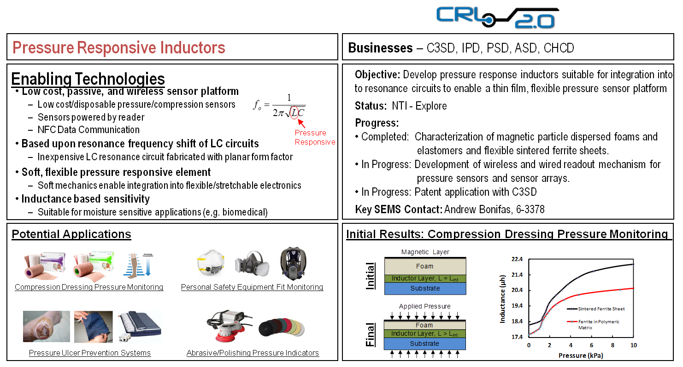
Questions and Comments
Notes:
The end slide of your presentation doesn’t have to be blank or have some goofy clipart. For existing projects only, consider ending with your one-pager or including some summary on your end slide that might enable discussion.

